Slide 1
EEL 3004 Electrical Networks Lecture #22 Introduction to Three-phase Circuits (last Lecture)

Slide 2
Final Exam
Comprehensive online - Final Week
Monday, May 3rd
10:00 AM – 12:00 PM
Between 30-35 Questions
Mostly multiple choice
Seminar on my research area (solar energy) will be recorder and posted during next week.

Slide 3
Lecture Objectives
The lecture today will focus on:
Review of the following topics:
Electrical Quantities
Basic Resistive Circuit Analysis
Advanced Circuit Analysis
RC and RL circuits (DC + Transients)
AC Phasor Analysis Technique
Power Calculations & Power Factor
Introduction to three-phase circuits (Lecture #22)
I Strongly recommend:
Reviewing all lectures carefully, HW’s, and exams.
Go over all examples carefully and understand them.
Work out random examples from the end of chapter problems and ask if you have questions.

Slide 4
Lecture Objectives
Three-Phase Circuits
Objectives:
Why study three-phase circuits?
What is single-phase and three-phase voltages?
Learn about single-phase vs. three-phase configurations
Learn how the three-phase voltage is generated
Know the difference between balanced 3-phase and unbalanced3-phase circuits
Learn about power in a balanced three-phase system

Slide 5
Why study Three-Phase Circuits ?
Between the power generation station (power plant) and the power in buildings and houses, power is transmitted through power transmission line (over- and under-ground) in a form known as three-phase power.
Therefor, in the power grid (refers to all the component responsible for power generation, transmission and distribution) power is primarily transferred in three-phase sinusoidal voltage signals.
Electrical circuits where three-phase voltages are transferred are known as three-phase circuits or three-phase networks.
One major component of three-phase circuits is known as three-phase transformers.
Throughout the power grid, three-phase voltage signals are stepped down, through three-phase transformers, from the point of generation to the point of consumption at the load side (buildings and houses).

Slide 6
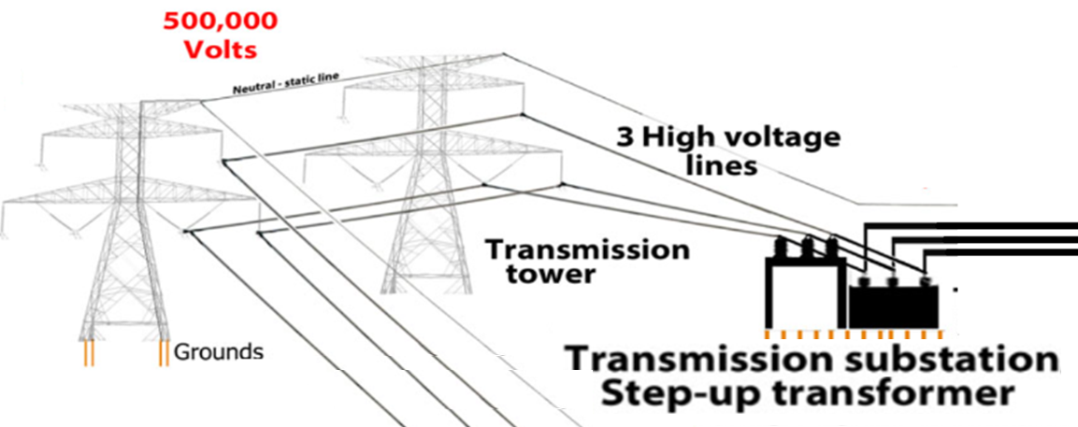
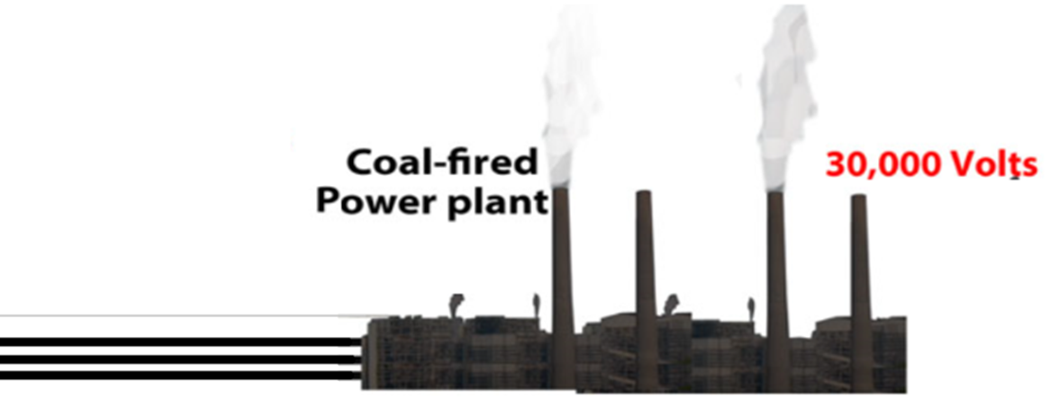
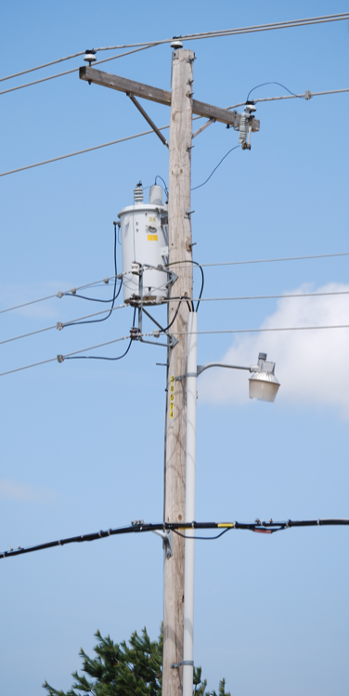
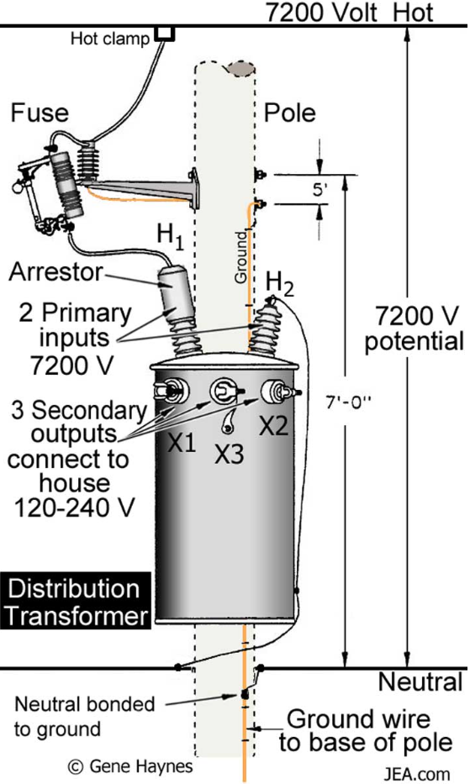
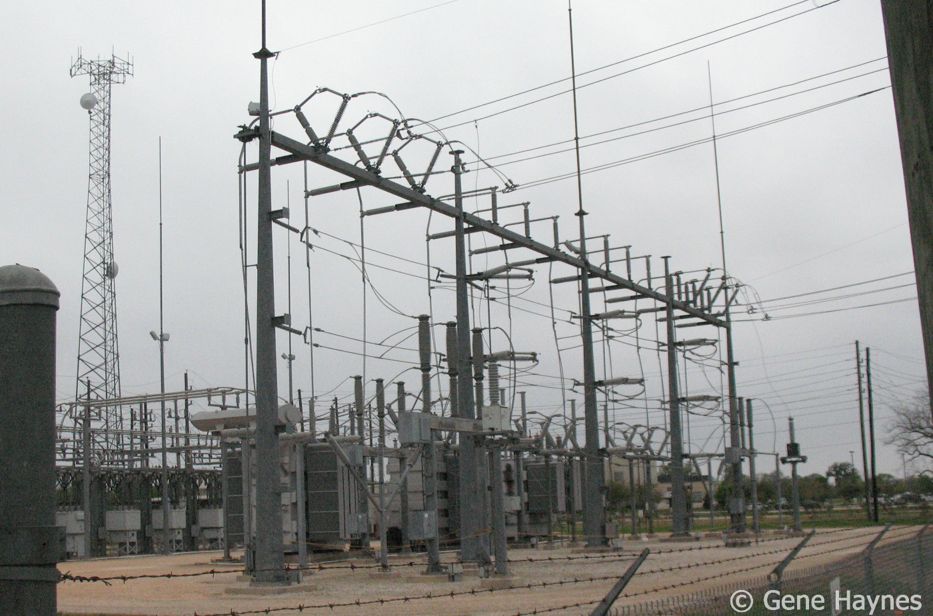
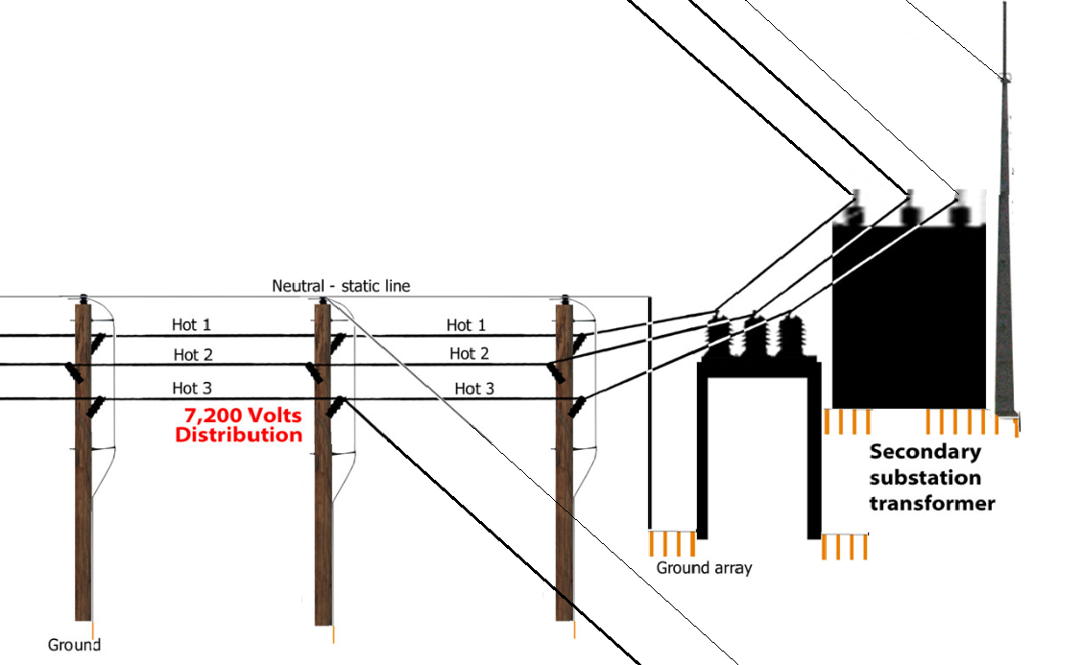
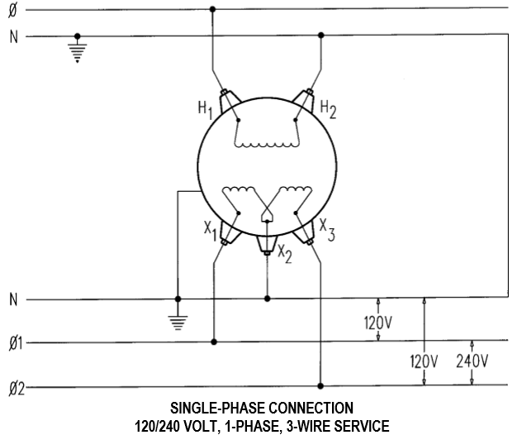
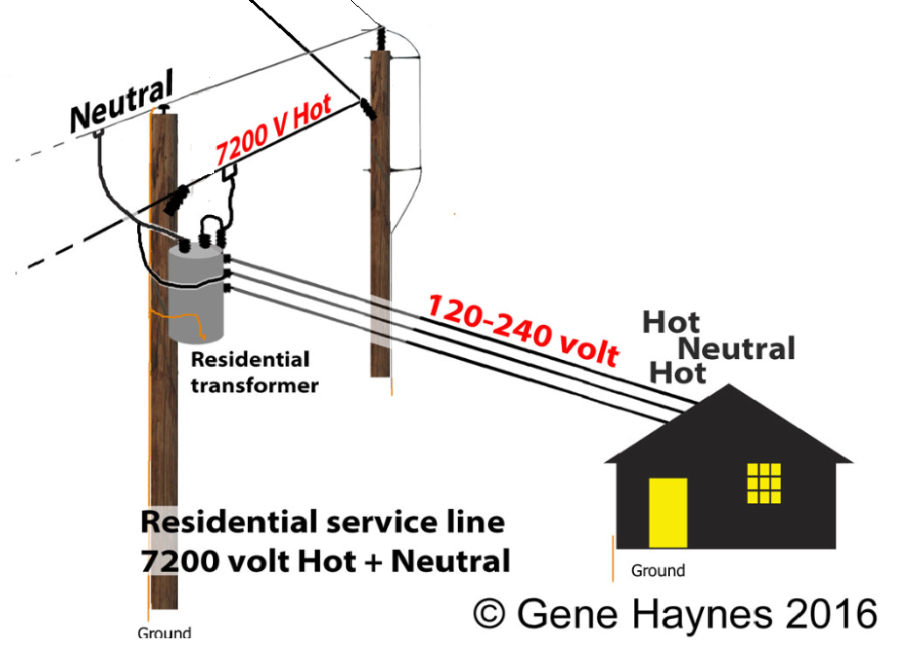
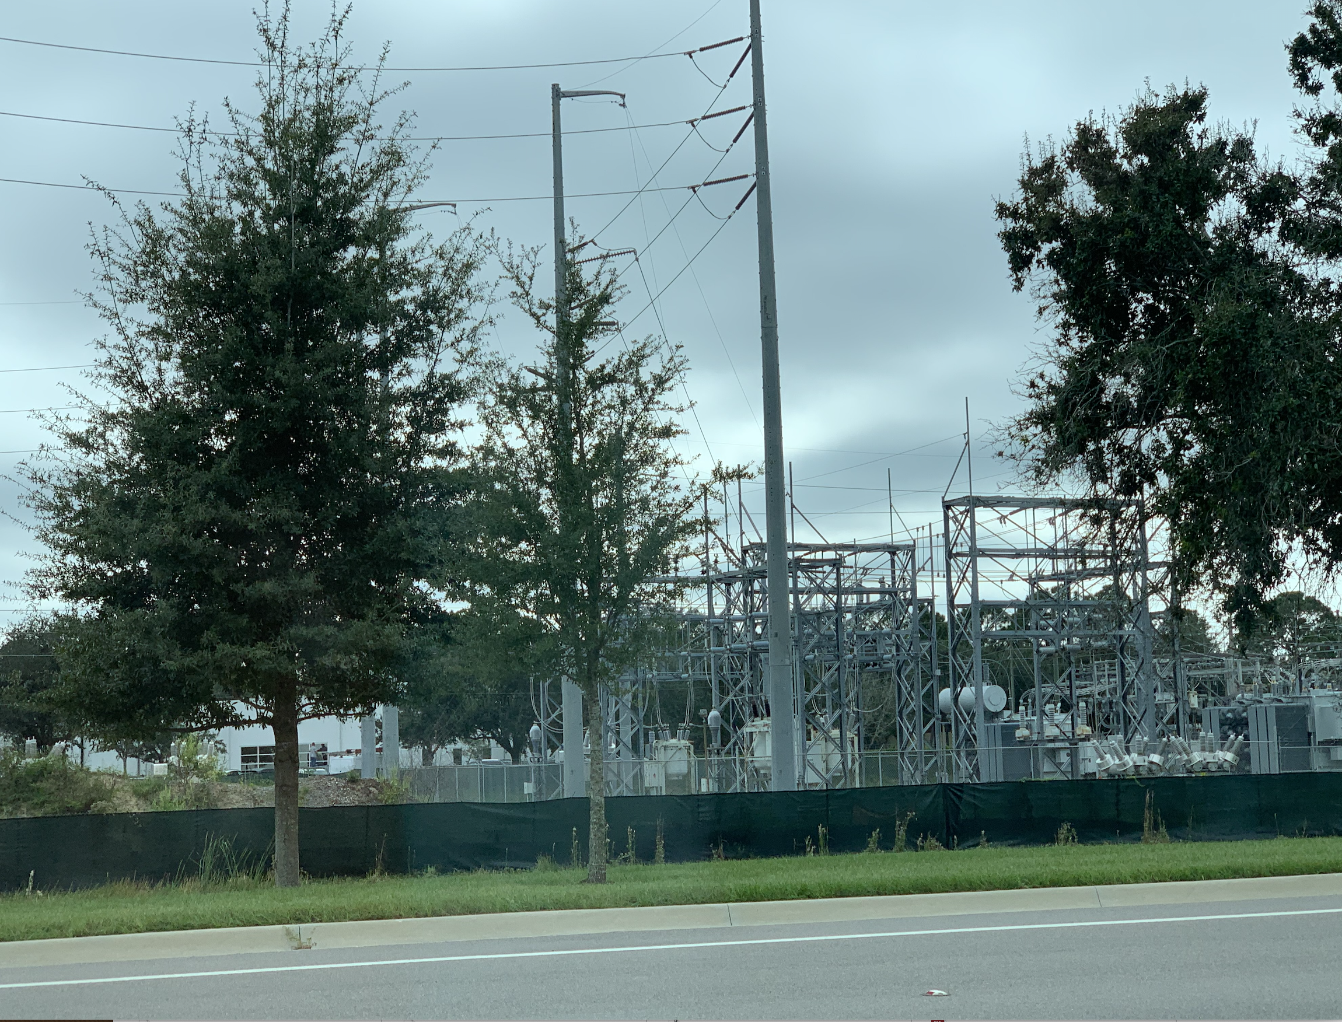
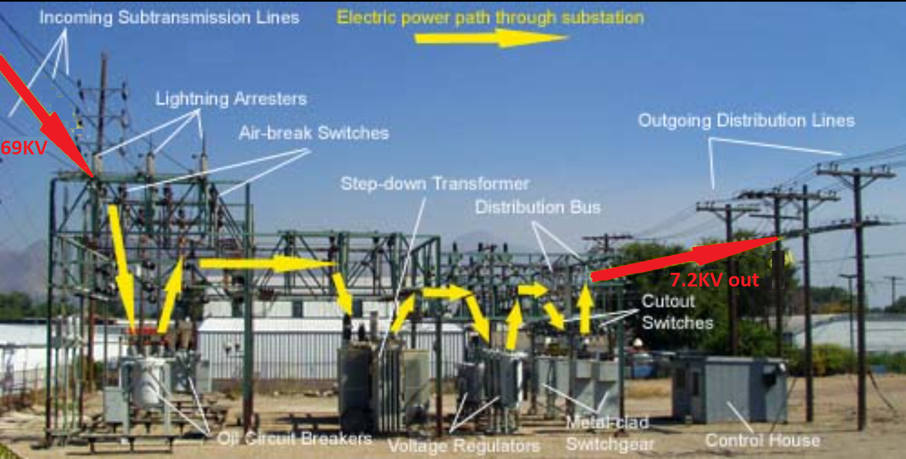
Electricity form Generation to Home
(Gas, Coal, nuclear)
http://waterheatertimer.org/What-is-3-phase-electric.html

Slide 7
Why Using Three-phase for power generation ?
More economical to deliver power in three-phase circuits than in single- or double-phase circuits.
1) You can deliver the same power (KVA) with the same voltage in less conductors, which reduces the amount of copper required.
2)The lighter lines are easier to install, and the supporting structures can be less massive and farther apart.
3) Typically, three-phase generators and motors have preferred design, running and starting characteristics compared to single-phase systems with no need for a special design or additional starting circuitry.

Slide 8
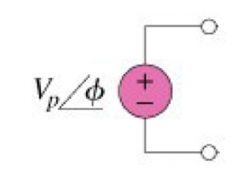
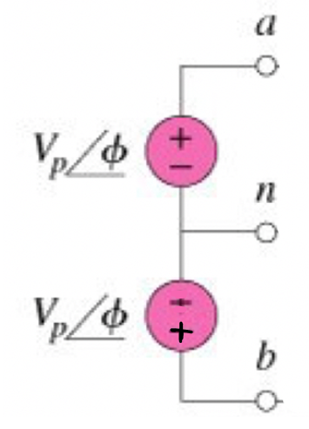
Single-Phase Circuits
I) Single phase systems two-wire type
2) Single phase systems with three-wire type.
Generates the 120 V AC power system
Generates both the 120 V and 240 V AC power system

Slide 9
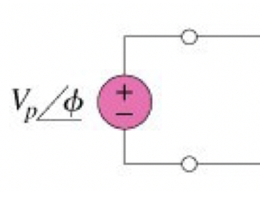
Single-Phase Circuits
3) Three-phase voltages
Each Generates 120 V AC power system as a stand-alone system.
How do we connect the three voltage sources together?
?

Slide 10
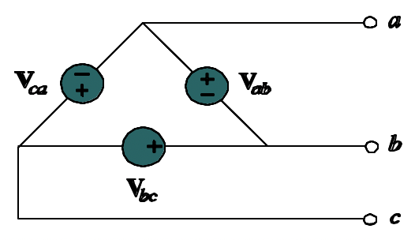
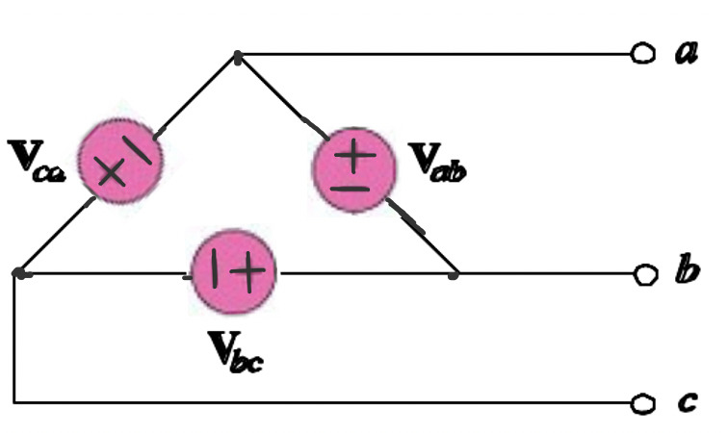
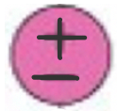
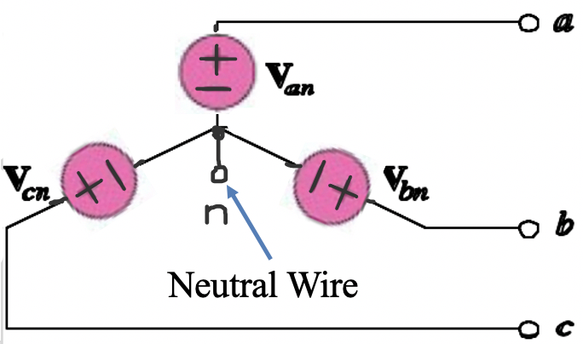
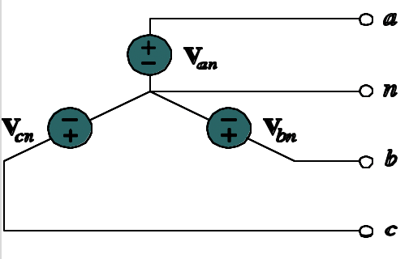
Single-Phase Circuits
3) Three- phase systems are two different types:
i) Three-wire configuration - known as delta configuration
“Delta” three-phase source
ii) Four-wire configuration - known as delta configuration
“Wye” three-phase source
Neutral Wire

Slide 11
Three phase Circuits
When three single-phases are generated at the same time, each phase shifted by 120° from each other, a three-phase system is produced.
A negative phase sequence:
Phasor Domain:
Phase a: $v_{a}\left(t\right)=\text{12}\text{0 }\text{sin}\text{(}ωt+0^{o}) V$
Phase b: $v_{b}\left(t\right)=\text{12}\text{0 }\text{sin}\text{(}ωt+{120}^{o}) V$
Phase c: $v_{c}\left(t\right)=\text{12}\text{0 }\text{sin}\text{(}ωt+{240}^{o}) V$
V_{a} = 120 ∠0°
V_{b} = 120 ∠ 120°
V_{c} = 120∠ 240°
A positive phase sequence:
Phase a: $v_{a}\left(t\right)=\text{12}\text{0 }\text{sin}\text{(}ωt+0^{o}) V$
Phase b: $v_{b}\left(t\right)=\text{12}\text{0 }\text{sin}\text{(}ωt−{120}^{o}) V$
Phase c: $v_{c}\left(t\right)=\text{12}\text{0 }\text{sin}\text{(}ωt−{240}^{o}) V$
V_{a} = 120 ∠0°
V_{b} = 120 ∠ −120°
V_{c} = 120∠ − 240°

Slide 12
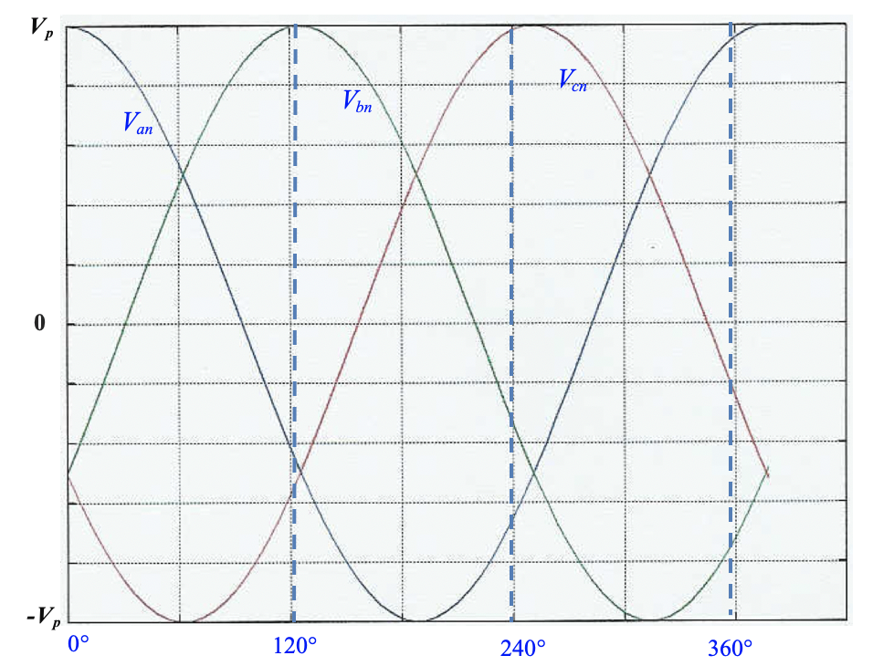
Three phase Voltage Waveforms
$$t$$

Slide 13
Three phase Circuits
Notice the summation of the three phases:
$$v_{a}\left(t\right)+v_{b}\left(t\right)\text{+}v_{c}\left(t\right)=$$
$$=\text{12}\text{0[}\text{sin}\text{(}ωt+0^{o})\text{+}\text{sin}\text{(}ωt+{120}^{o})+\text{sin}\text{(}ωt+{240}^{o})]$$
$=\text{12}\text{0[}\text{sin} ωt cos0^{o}+cosωt sin0^{o}+\text{sin} ωt cos{120}^{o}+cosωt sin{120}^{o}+$ $\text{sin} ωt cos{240}^{o}+cosωt sin{240}^{o}]$
$=\text{12}\text{0[}\text{sin} ωt +\text{sin} ωt cos{120}^{o}+cosωt sin{120}^{o}+$ $\text{sin} ωt cos{240}^{o}+cosωt sin{240}^{o}]$
$=\text{12}\text{0[}\text{sin} ωt −0.5\text{sin} ωt+0.87cosωt−$0.5 $\text{sin} ωt −0.87cosωt]=0$
$$=0$$
Or use the phasor notations:
V_{a} +V_{b} + V_{c} =0
Ref:

Slide 14
How to Generate AC Voltage waveforms?
Single-phase and three-phase AC generators work with the same principle:
A coil is mounted on a stationary metal piece (stator) in the presence of a rotating electromagnet called (rotor). The rotation of the magnet causes AC current to follow in the coil.
Stator: Is a stationary tube where coils are mounted.
Rotor: Is a rotating electromagnet
Coil: Is a conducting stationary coil mounted around a circular tube called a stator.
The spinning of the rotor is done by a turbine or other forces.
As the electromagnet rotates, it induces a sinusoidal voltage of the mounted coil.

Slide 15
Generating Three-phase Voltages
Single-phase AC generator:
An AC generator designed with one induction coil on the stationary ring called stator with a rotating shaft (magnet called rotor) produces a single sinusoidal voltage for each rotation of the rotor.
Polyphase AC generator:
An AC generator designed with a number of coils on the stator to produce a number of voltages (phases) for each rotation of the rotor.
Three-phase AC generator:
The three-phase generator has three induction coils placed 120° apart on the stator.
The three coils have an equal number of turns, the voltage induced across each coil will have the same peak value, shape and frequency.

Slide 16
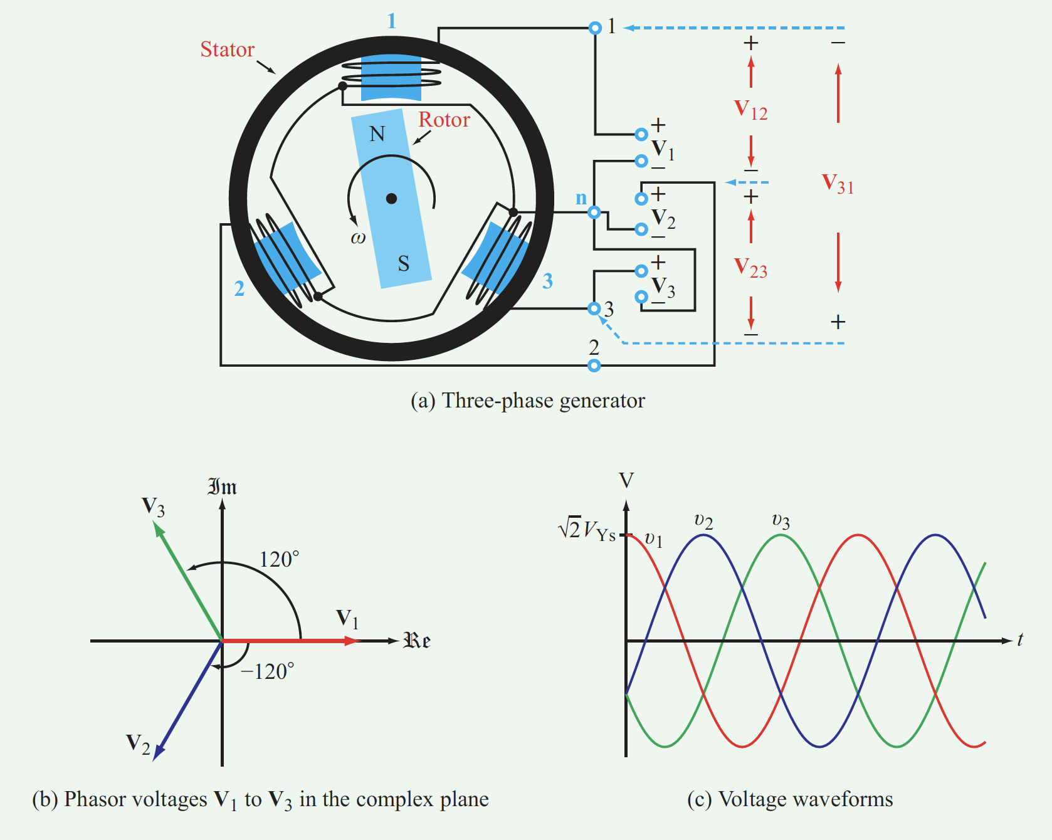

Slide 17
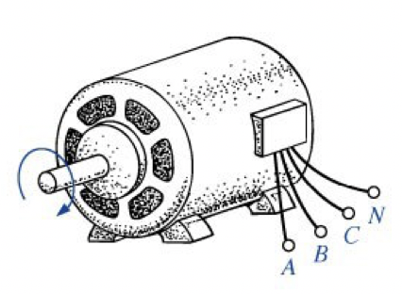
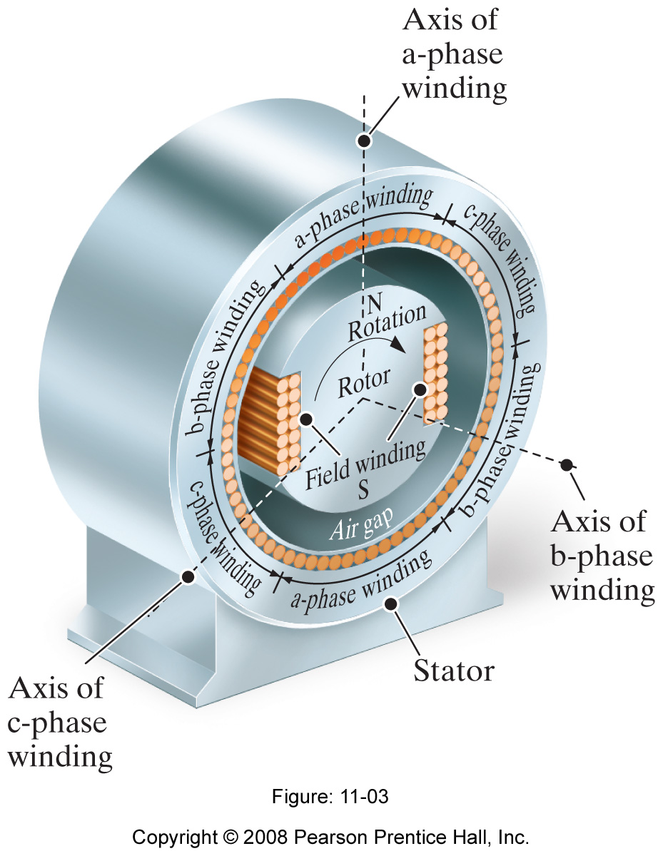
Three-phase Generator
Neutral wire
Rotor-mechanical motion
Three-phase wires – electrical output
Ref. The Engineering Mindset.com
https://www.youtube.com/watch?v=4oRT7PoXSS0

Slide 18
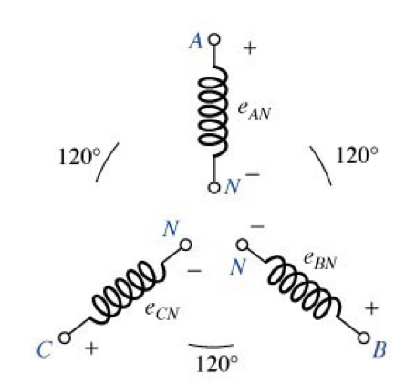
Three-phase Generator
Neutral wire
Rotor-mechanical motion
Three-phase wires – electrical output
https://www.youtube.com/watch?v=4oRT7PoXSS0

Slide 19
Three phase Voltages Configurations
Neutral Wire
Wye Connected Source
Delta Connected Source
V_{an} = V_{p} ∠0°
V_{bn} = V_{p} ∠ −120°
V_{cn} = V_{p}∠ − 240°
V_{an} = V_{p}∠0°
V_{bn} = V_{p} ∠ +120°
V_{cn} = V_{p} ∠ + 240°
V_{an} + V_{bn} + V_{cn} =0

Slide 20
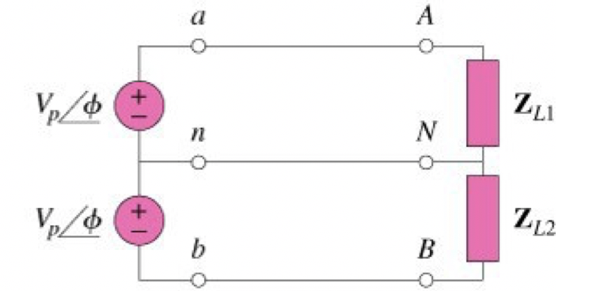
Single-Phase Loads
I) Single phase systems two-wire type
Single-phase voltage across Load
2) Single phase systems with three-wire type.
Adds two-phase voltages across AB Load

Slide 21
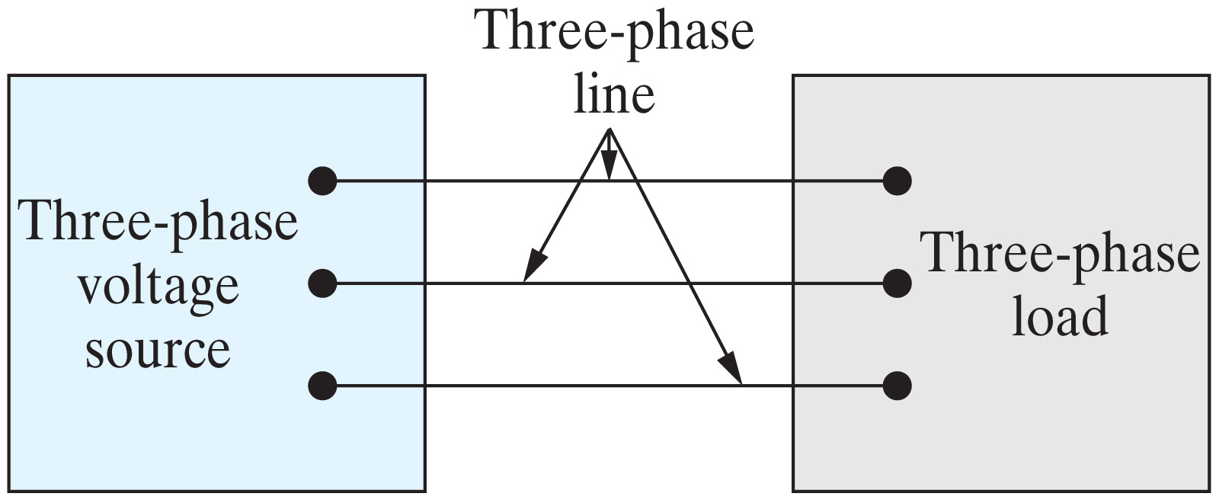
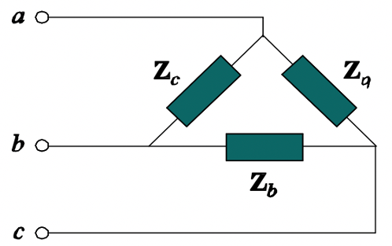
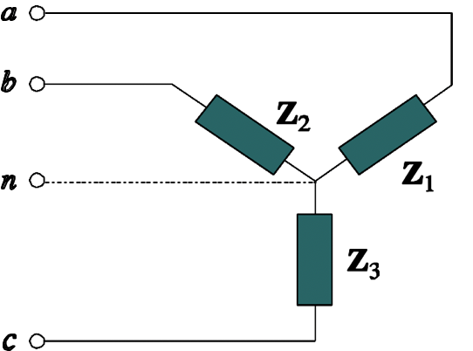
Three-Phase Circuit & Loads
Wye Source
Delta Load
Delta Source
Wye Load

Slide 22
Three phase Load Connections
Both the three-phase source and the three-phase load can be connected either in Wye or Delta configurations.
Therefore, we have 4 possible Source-Load connection types.
Y-Y
Y-Δ
Δ-Δ
Δ-Y

Slide 23
Balanced Three phase Loads
Wye-connected load
Delta-connected load
Unbalanced load three-phase circuit has unequal impedances on all the phases
Balanced load three-phase circuit has equal impedances on all the phases
Balanced Impedance:
Unbalanced Impedance:
Z₁ = Z₂ = Z₃
Z_{a} = Z_{b} = Z_{c}
Z₁ $≠$ Z₂ $≠$ Z₃
Z_{a} $≠$ Z_{b} $≠$ Z_{c}

Slide 24
Balanced Three phase Loads
Wye-connected load
Delta-connected load
Delta-Wye Conversion in Balanced three-phase circuits:
Z_{Y} =Z₁ = Z₂ = Z₃
Z∆ =Z_{a} = Z_{b} = Z_{c}
Z∆ = 3Z_{Y}
Z_{Y} = $\frac{1}{3}$Z ∆

Slide 25
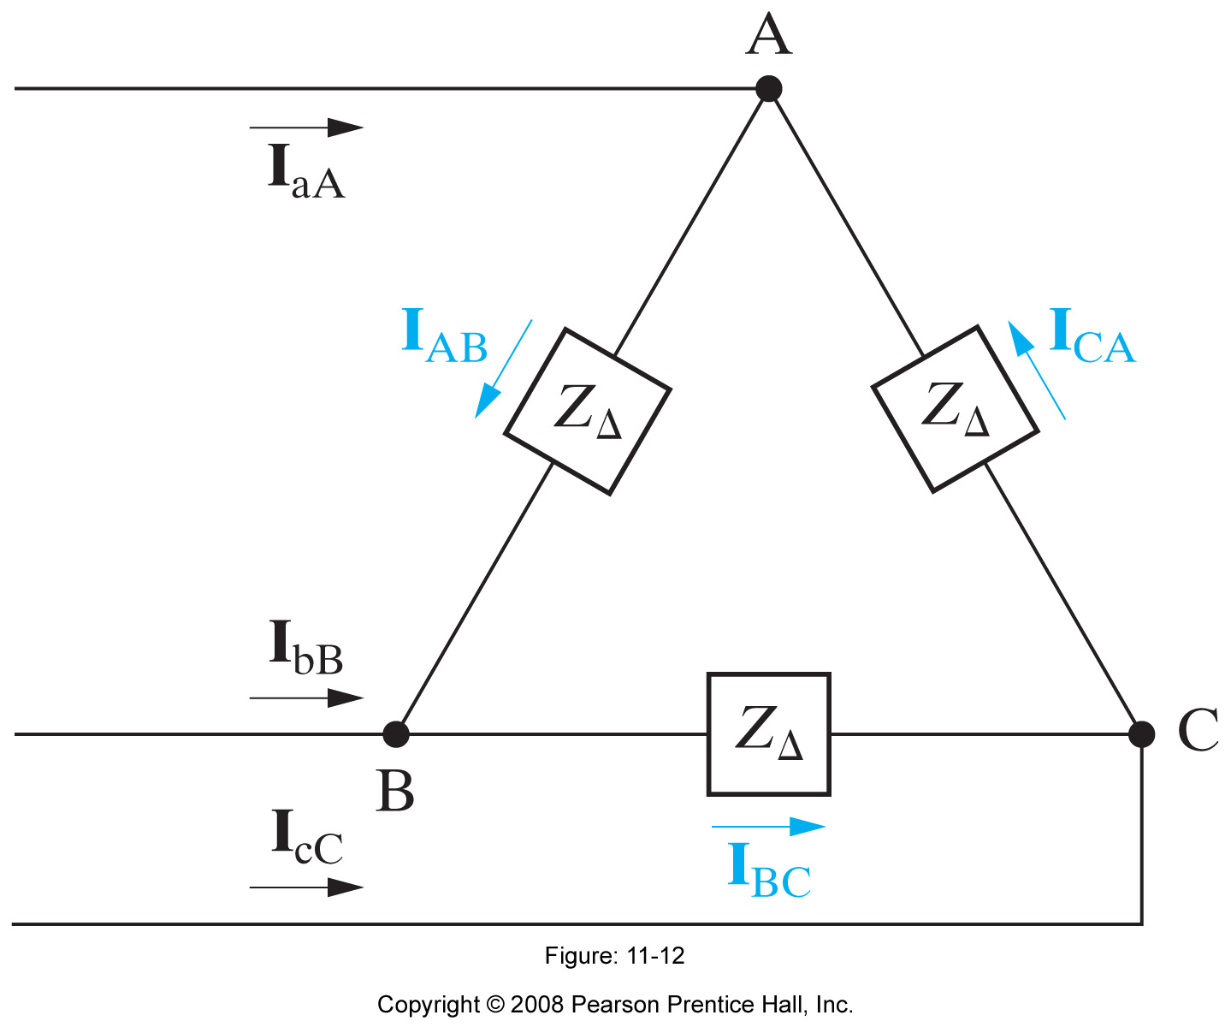
Balanced Three phase Line and Load Currents
Line Currents:
$$I_{aA}, I_{bB}, I_{cC}$$
Load Currents:
$$I_{AB}, I_{CA}, I_{BC}$$
You can show that:
$$I_{aA}+I_{bB}+I_{cC}=0$$
$$I_{AB}+I_{BC}+I_{CA}=0$$

Slide 26
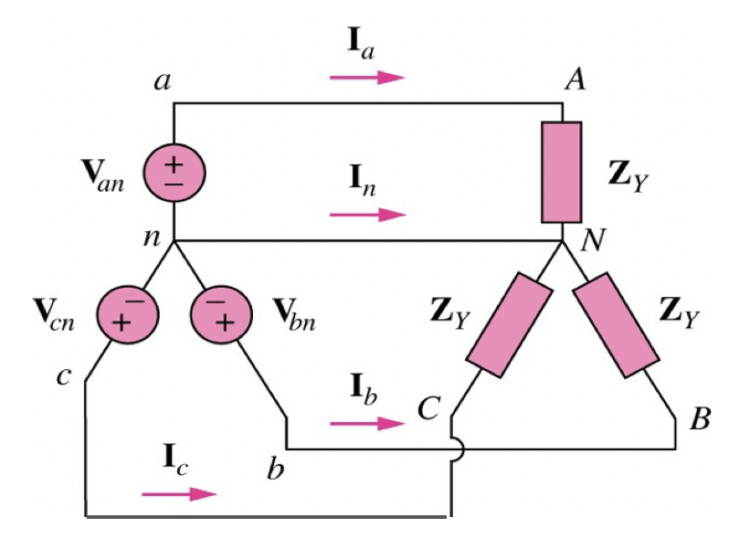
1) Balanced Why-why Connection
Both the source and load are Wye-connected and balanced.
Phase voltages:
$V_{an} , V_{bn}$, $V_{cn}$
Line Currents:
$$I_{a}, I_{b}, I_{c}$$
Load Currents:
$$I_{a}, I_{b}, I_{c}$$
Neutral Current:
$$I_{n}$$
Load voltages:
$$V_{AN},V_{BN},V_{CN}$$
The Phase and Load Currents are given by
You can show that:
$$I_{a}=\frac{V_{AN}}{Z_{Y}}$$
$$I_{b}=\frac{V_{BN}}{Z_{Y}}$$
$$I_{c}=\frac{V_{CN}}{Z_{Y}}$$
$$V_{an} +V_{bn}+V_{cn}=0$$
$$I_{a}+I_{b}+I_{c}=0$$
The Neutral current is given by:
$$V_{AN}+V_{BN}+V_{CN}=0$$
$$I_{n}=−\left(I_{a}+I_{b}+I_{c}\right)=0$$

Slide 27
1) Balanced Why-why Connection
Both the source and load are wye-connected and balanced.
What about the LINE to LINE voltages?
$V_{ac} , V_{ab}$, $V_{bc}$
Recall the phase voltages are given by:
$$V_{an}=V_{p}\text{∠}{ 0}^{o}$$
$$V_{bn}=V_{p}\text{∠}{−120}^{o}$$
$$V_{cn}=V_{p}\text{∠}{−240}^{o}$$
You can show that the line voltages are given by:
$V_{ab}= V_{an}−V_{bn}=\sqrt{3}$ $V_{p}\text{∠}{ 30}^{o}$
$V_{bc}= V_{bn}−V_{cn}=\sqrt{3}$ $V_{p}\text{∠}{ −90}^{o}$
The Line voltages also add up to zero:
$V_{ca}= V_{cn}−V_{an}=\sqrt{3}$ $V_{p}\text{∠}{ −210}^{o}$
$$V_{ab}+V_{bc}+V_{ca}=0$$

Slide 28
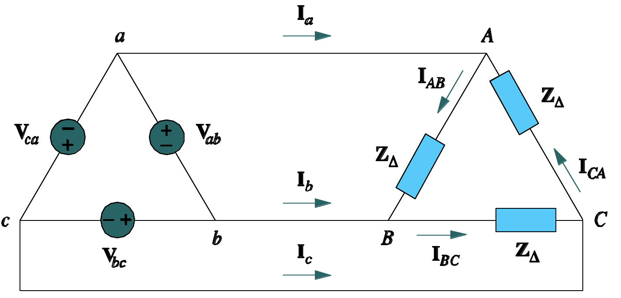
2) Balanced Delta-Delta Connection
Both the source and load are Delta-connected and balanced.
Line Currents: $I_{a}, I_{b}, I_{c}$
Phase Load Currents: $I_{AB}, I_{BC}, I_{CA}$
$$I_{AB}=\frac{V_{AB}}{Z_{∆}}$$
$$I_{BC}=\frac{V_{BC}}{Z_{∆}}$$
$$I_{CA}=\frac{V_{CA}}{Z_{∆}}$$
$$I_{a}= I_{AB}−I_{CA}$$
$$I_{b}= I_{BC}−I_{AB}$$
$$I_{c}= I_{CA}−I_{BC}$$
In balanced three-phase circuits, it can be shown that all line and phase currents add up to zero:
$$I_{a}+I_{b}+I_{c}=0$$
$$I_{AB}+I_{BC}+I_{CA}=0$$

Slide 29
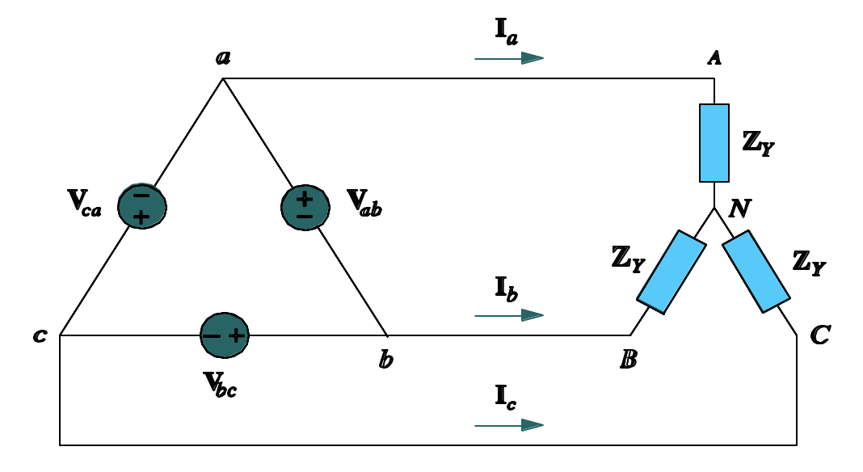
3) Balanced Delta-Wye Connection

Slide 30
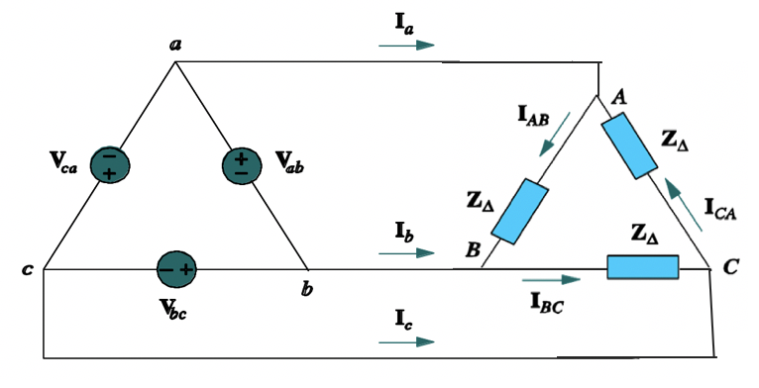
3) Balanced Delta-Wye Connection
Transforming the load from a Wye load to Delta load

Slide 31
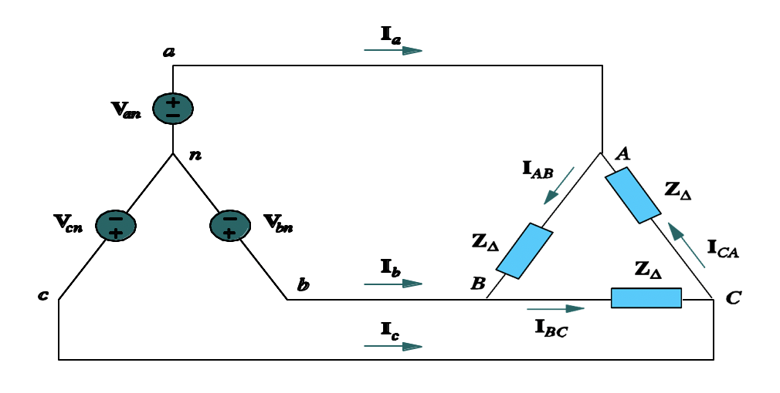
4) Balanced Wye-Delta Connection
There is no neutral connection for the Y-∆ system.

Slide 32
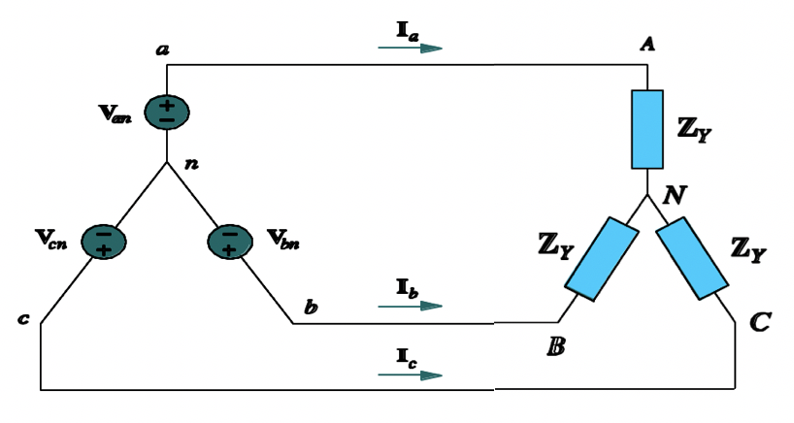
4) Balanced Wye-Delta Connection
There is no neutral connection for the Y-∆ system.
Transforming the load from a Delta load to Wye load

Slide 33
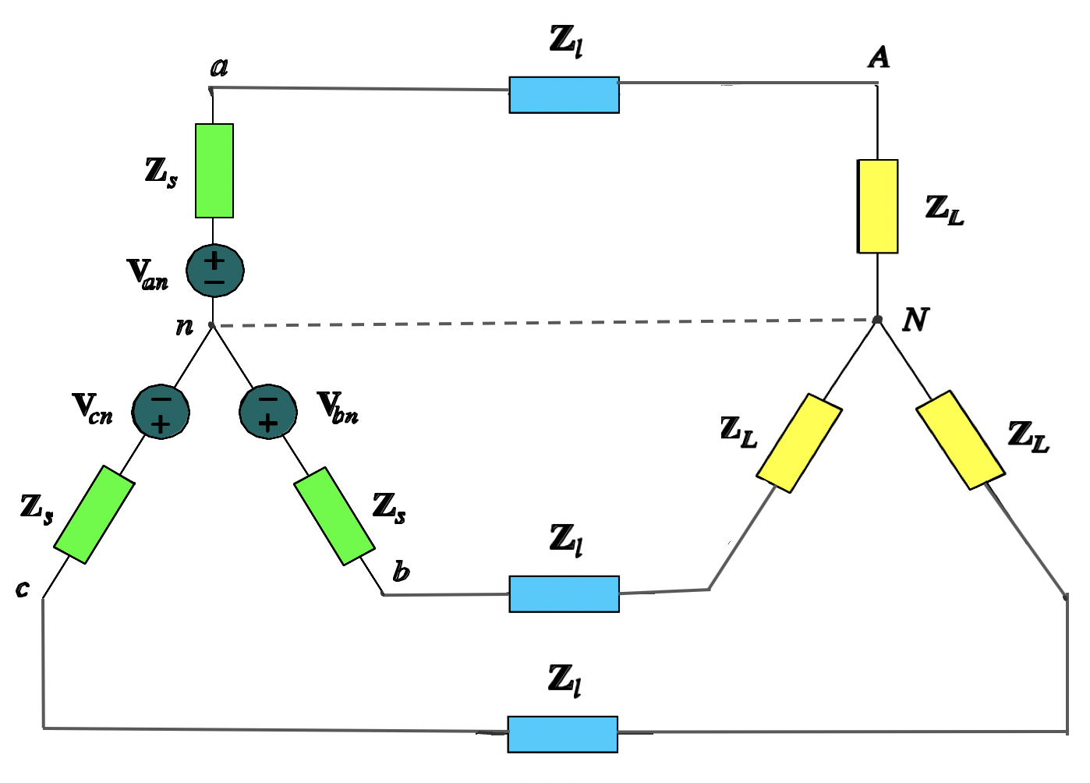
Typical Balanced Wye-Wye Connection
A balanced Y-Y system, showing the source, line and load impedances.
Source Impedance
Line Impedance
Load Impedance

Slide 34
Example of Balanced Y-Y Three-phase Connection:
Consider the following balanced Y-Y three-phase circuit with the given voltage sources and impedances:
$$V_{an}= \text{120}\text{∠}{ 30}^{o} V$$
$$A$$
$$I_{aA}$$
$$V_{bn}= \text{120}\text{∠}{ −90}^{o} V$$
$$V_{cn}= \text{120}\text{∠}{ −210}^{o} V$$
$$Z_{Source}=0.4+j0.3 Ω$$
$$Z_{Line}=0.6+j0.7 Ω$$
$$B$$
$$C$$
$$I_{bB}$$
$$Z_{Load}=24+j19 Ω$$
$$I_{cC}$$
Find line to line voltages: $V_{ab}$, $V_{bc}$, $V_{ca}$
Find line currents: $I_{aA}$, $I_{bB}$, $I_{CC}$

Slide 35
Example of Balanced Y-Y Three-phase Connection:
Solution:
The line to line voltages are given by,
$V_{ab}= V_{an}−V_{bn}=\sqrt{3}$ $V_{p}\text{∠}{ 60}^{o}=\text{207.85}\text{∠}{ 60}^{o} V$
$V_{bc}= V_{bn}−V_{cn}=\sqrt{3}$ $V_{p}\text{∠}{ −60}^{o}=\text{207.85}\text{∠}{ −60}^{o} V$
$V_{ca}= V_{cn}−V_{an}=\sqrt{3}$ $V_{p}\text{∠}{ −180}^{o}=\text{207.85}\text{∠}{ −180}^{o} V$
Check that the phase voltages and the line to line voltages add up to zero!
$$V_{an}+V_{bn}+V_{cn}=0$$
$$V_{ab}+V_{bc}+V_{ca}=0$$
The line currents are given by:
$$I_{aA}=\frac{V_{an}}{Z_{Source}+Z_{Line}+Z_{Load}}=\frac{\text{120}\text{∠}{ 30}^{o} }{\left(0.4+j0.3\right)+(0.6+j0.7)+(24+j19)}$$
$$=\frac{\text{120}\text{∠}{ 30}^{o} }{25+j20}=\frac{\text{120}\text{∠}{ 30}^{o} }{32\text{∠}{ 38.66}^{o}}=3.75\text{∠}{ −8.66}^{o}A$$

Slide 36
Example of Balanced Y-Y Three-phase Connection:
Solution:
The line currents are given by:
$$I_{bB}=\frac{V_{bn}}{Z_{Source}+Z_{Line}+Z_{Load}}=\frac{\text{120}\text{∠}{ −90}^{o} }{\left(0.4+j0.3\right)+(0.6+j0.7)+(24+j19)}$$
$$=\frac{\text{120}\text{∠}{ 30}^{o} }{25+j20}=\frac{\text{120}\text{∠}{ 30}^{o} }{32\text{∠}{ 38.66}^{o}}=3.75\text{∠}{ −128.66}^{o}A$$
$$I_{cC}=\frac{V_{cn}}{Z_{Source}+Z_{Line}+Z_{Load}}=\frac{\text{120}\text{∠}{ −120}^{o} }{\left(0.4+j0.3\right)+(0.6+j0.7)+(24+j19)}$$
$$=\frac{\text{120}\text{∠}{ 30}^{o} }{25+j20}=\frac{\text{120}\text{∠}{ 30}^{o} }{32\text{∠}{ 38.66}^{o}}=3.75\text{∠}{ −248.66}^{o}A$$
Check that the line currents add up to zero!
$$I_{aA}+I_{bB}+I_{cC}=0$$

Slide 37
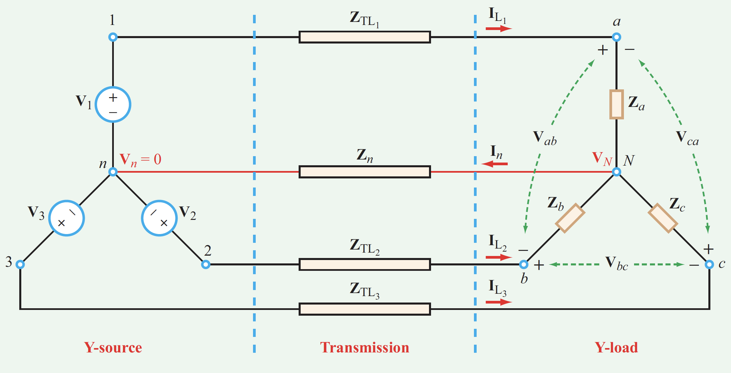
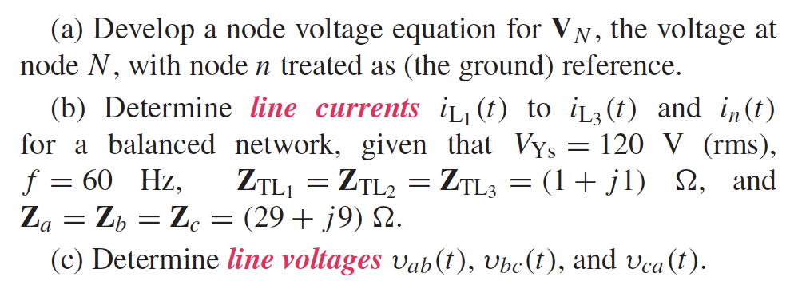
Example - Balanced Y-Y Network
With reference to the network shown
Ref: Circuit Analysis and Design by Ulaby.

Slide 38
Example - Balanced Y-Y Network

Slide 40
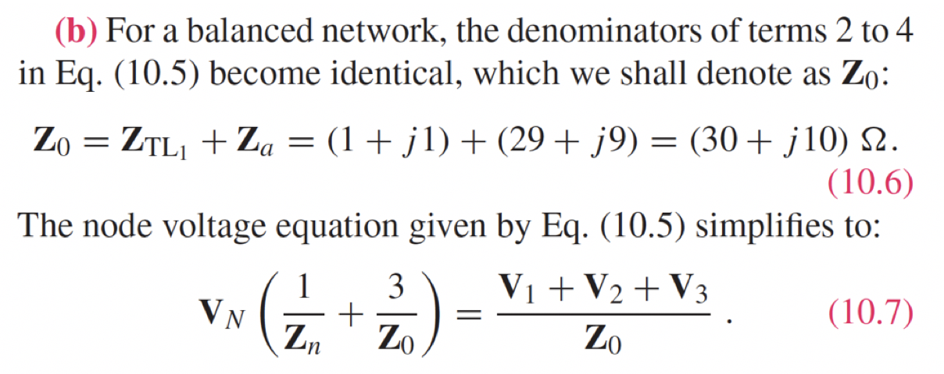
Example - Balanced Y-Y Network
This is because of the following,

Slide 41
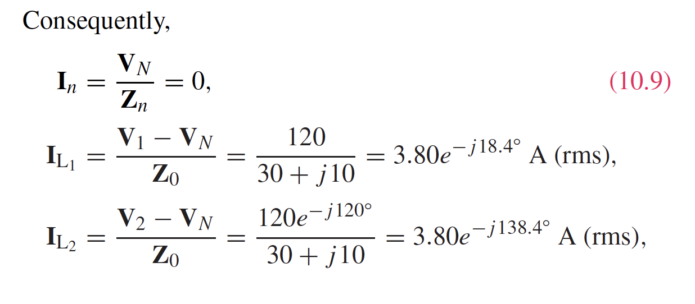

Slide 42
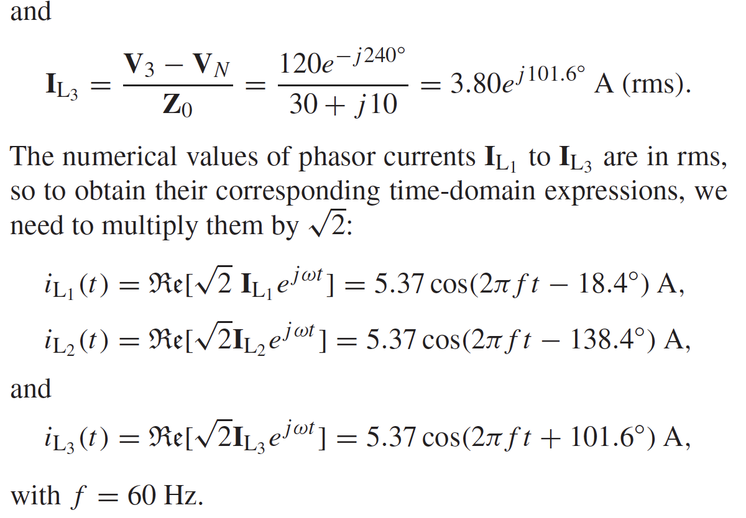

Slide 43
