Slide 1

EEL 3004 Linear Circuits I
Lecture #2
Electrical Quantities & DC power

Slide 2
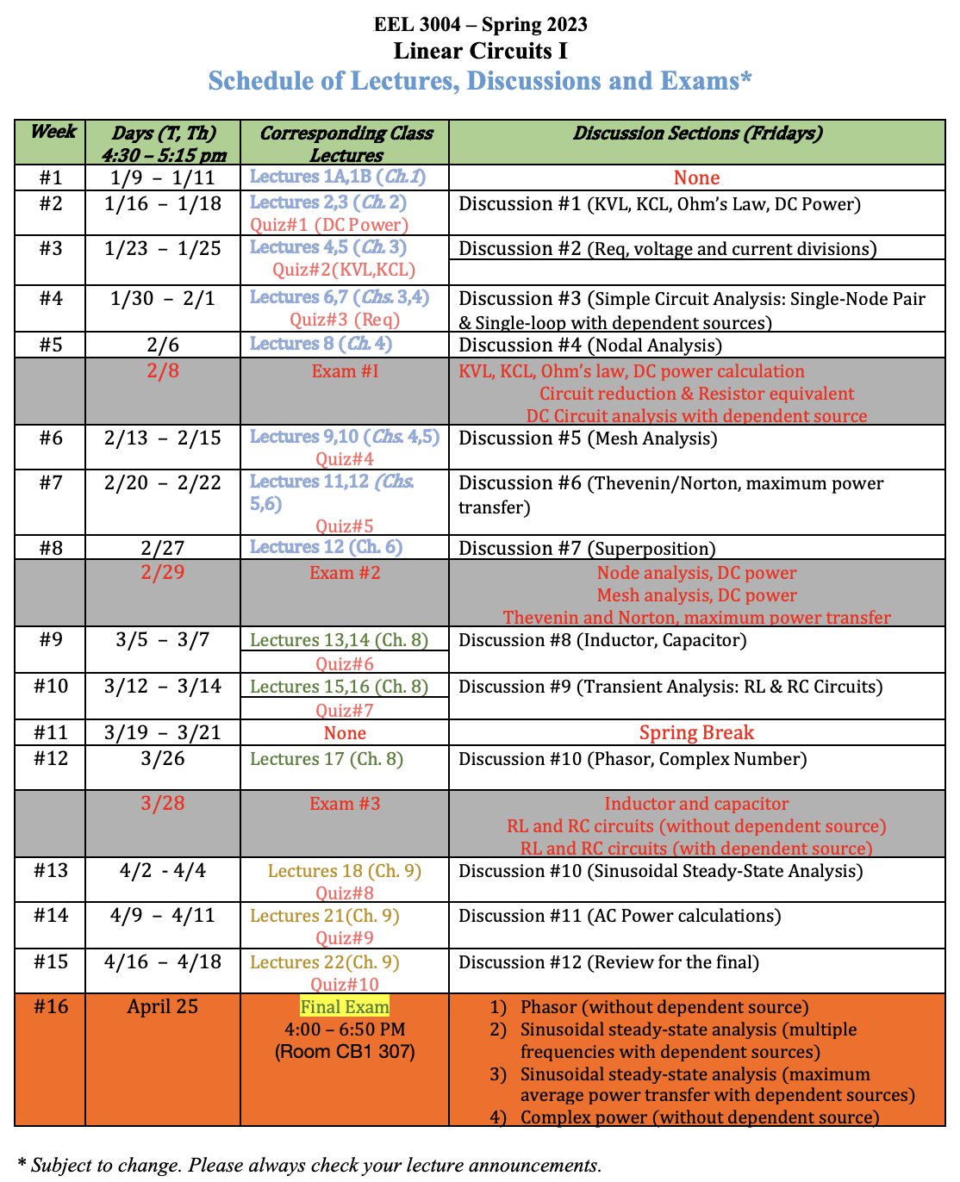

Slide 3
Lecture Objectives
Introduce Electric Quantities
  Charge (q)
  Current (i)
  Voltage (V)
  Energy (W)
  Power (P)
Cover several types of Currents
Power generation and dissipation
Type of depended sources – Examples
Electric Circuit Concepts including: circuit, branch, mesh, node…..

Slide 4
Chapter 2
Fundamentals and Basic Concepts
Electric Quantities: Charge, Current, Voltage, Energy, and Power
Circuit Elements
Electrical Network Concepts
Ohm’s Law
Kirchhoff’s Voltage and Current Laws
Circuit Simplification: Resistors in Series and Parallel
Basic Circuit Analysis
Measuring Current and Voltage
Problems
(Skip)

Slide 5
Electric Quantities
Electric quantities are charge (q), current (i), voltage (v), energy (w), and power (p).
Voltage must have sign polarities – or + be labeled across the element where measurement is taken.
Current must have arrow direction be labeled indicating the current direction in a given wire.
We use the Passive (positive) sign convention. The current assumed positive in the direction of the positive charges.

Slide 6
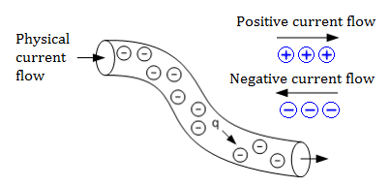

Charge (q)
Charge on an electron, q_{e} = -1.602x10⁻¹⁹ Coulombs (C).
Charge of a proton, q_{p} = 1.602x10⁻¹⁹ Coulombs (C).
When a charge is in motion in a closed path, a current flows and electrical energy is transferred.
The current assumed positive in the direction of the positive charges.
i
Pipeline of charge flow

Slide 7
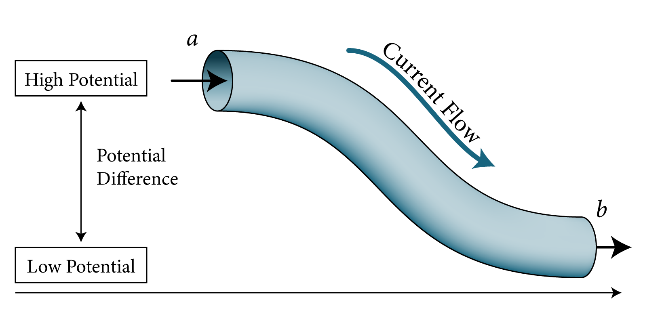
Current (i)
The current, i(t), is the time rate of change of the electrical charge, q, passing through a predetermined area.
Unit for i(t) is coulombs (C) per second (s), which is the Ampere (A).
Current is positive if the direction indicates the flow of positive charge, which is opposite of the flow of negative charge (electrons).
Wire carrying a current

Slide 8

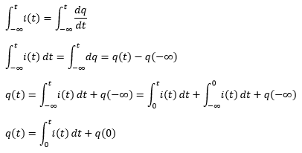
Charge as function of Current
The current is given by,
To find q(t), we integrate both sides from -∞ to t.
q(0): initial value at t=0.

Slide 9
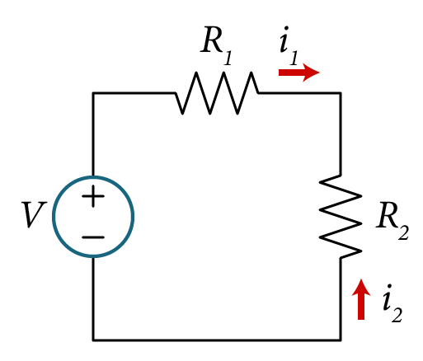
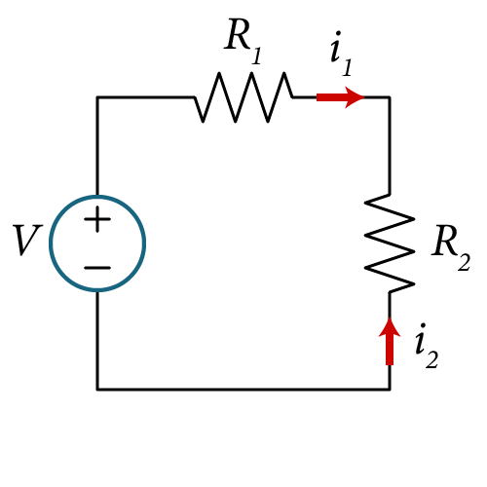
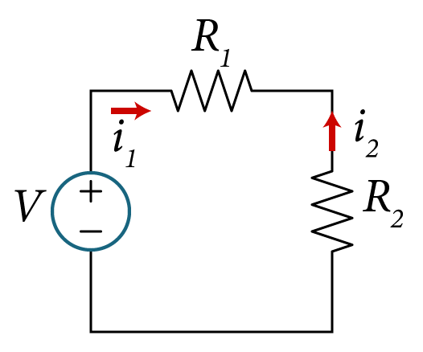
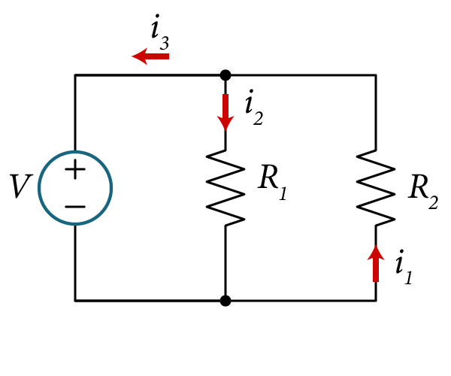



Current Direction
$$i_{1}=−i_{2}$$
or
$$i_{2}=−i_{1}$$
$$i_{1}≠i_{2}≠i_{3}$$

Slide 10
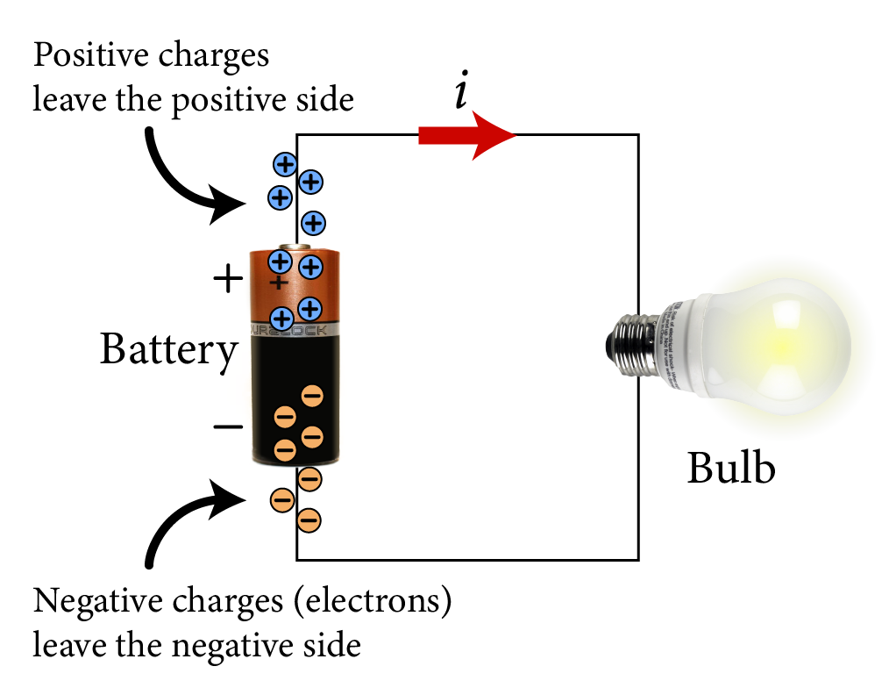
Current Flow in a battery

Slide 11
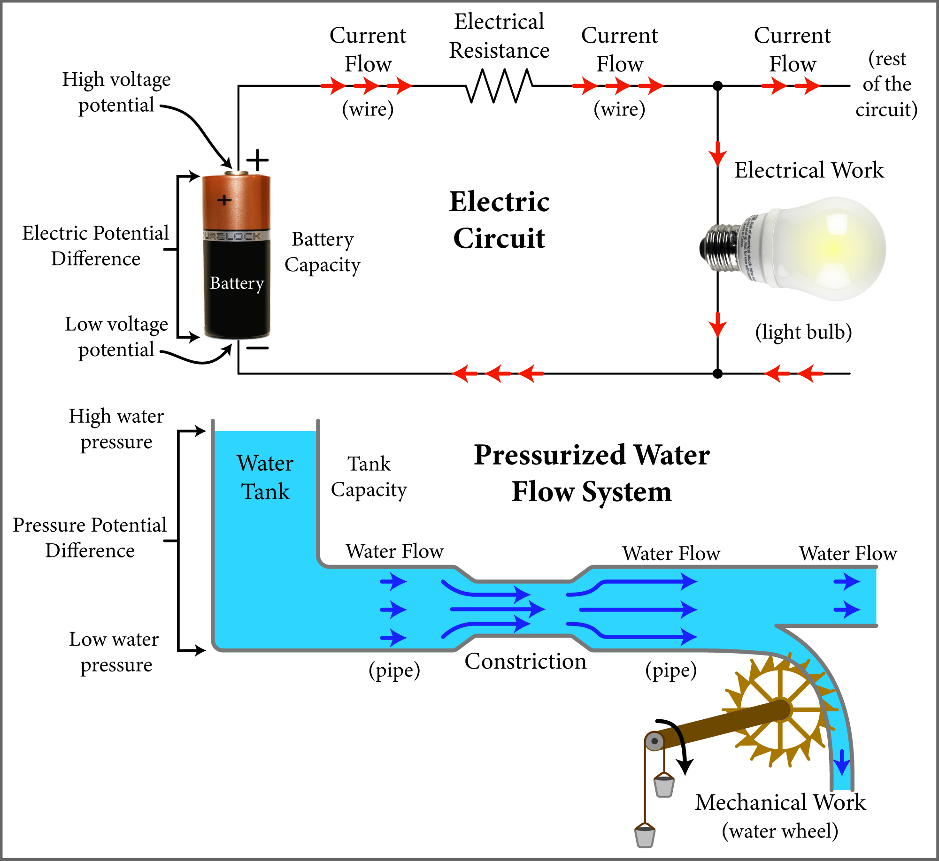
Fig. 2.6 Analogy between current flow in electric circuit and water flow in water tank system

Slide 12
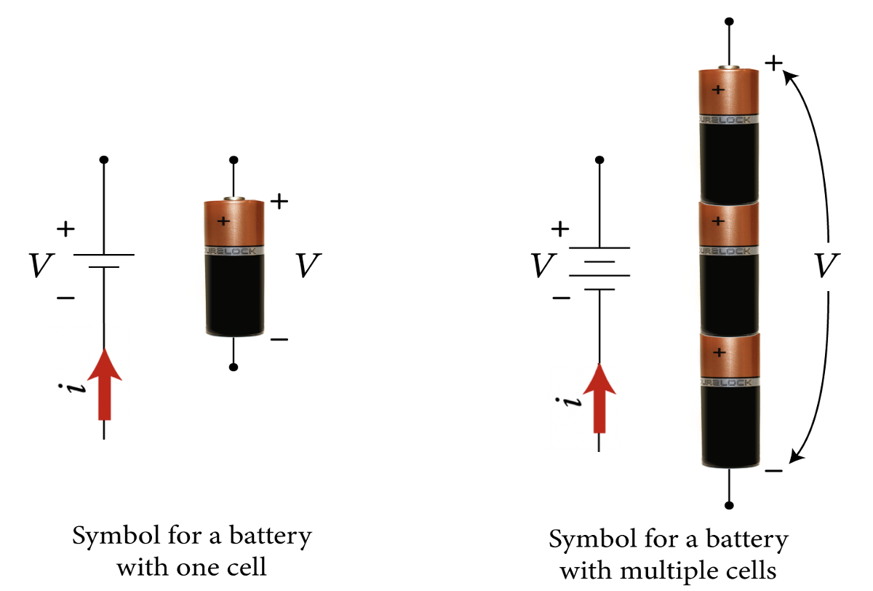
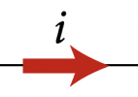

Current Flow in a battery

Slide 13
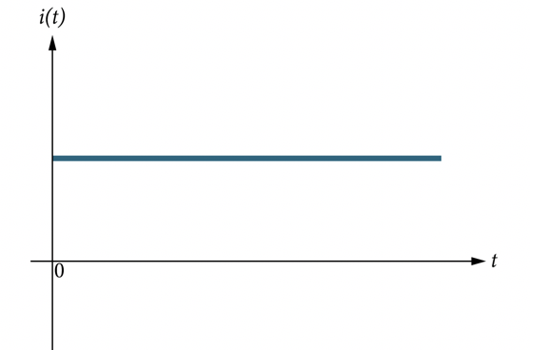
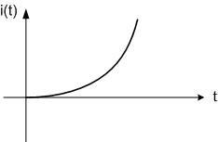
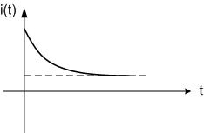
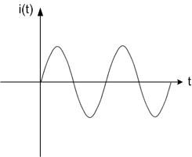
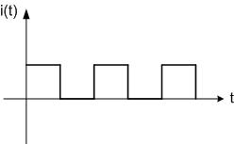
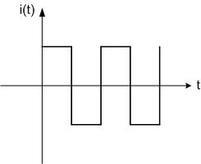
Types of Currents
Direct Current (DC)
Exponential increasing
Exponential decreasing
Alternating Current (AC)
Unipolar square
Bipolar square

Slide 14
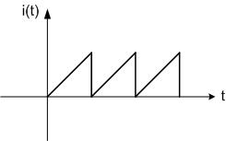
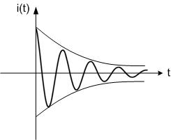
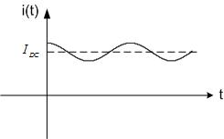
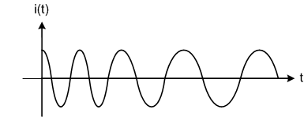
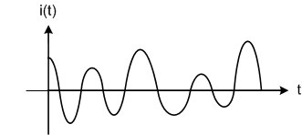
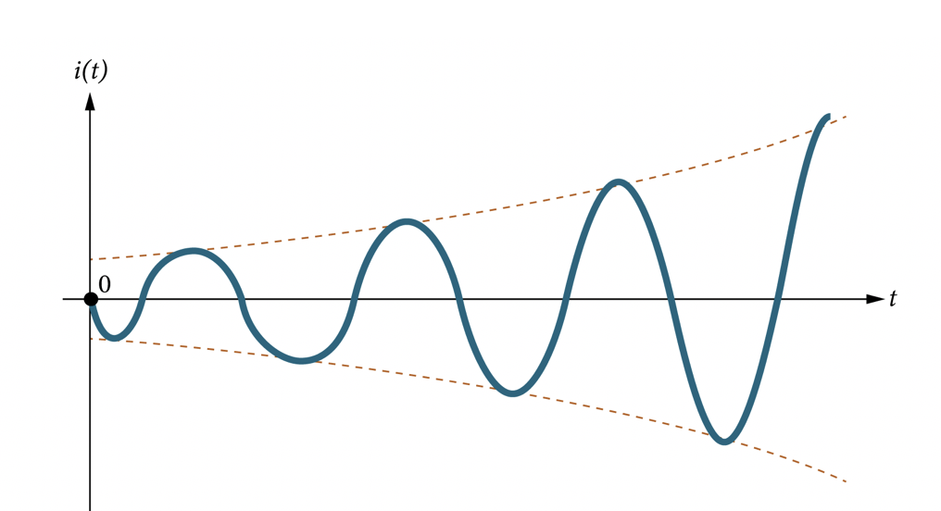
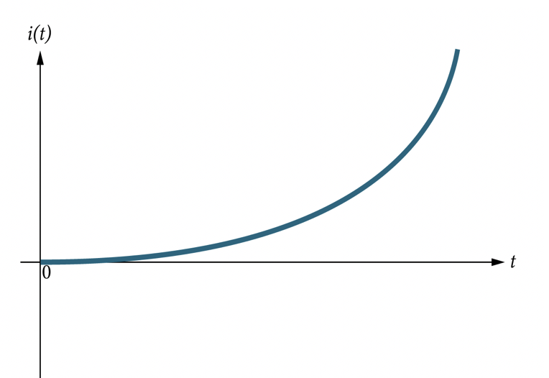
Types of Currents
Sinusoidal
Sinusoidally decaying
Saw Tooth
Non-Linear AC (frequency)
Non-Linear AC (magnitude)
Exponentially growing
Sinusoidally growing

Slide 15
Types of Currents
Chapters 2-5
(all DC circuits)
Chapters 6-7
(RC-LR circuits)
Direct Current (DC)
Exponential increasing
Exponential decreasing
Chapters 9-10
(all AC circuits)
Alternating Current (AC)
Unipolar square
Bipolar square

Slide 16
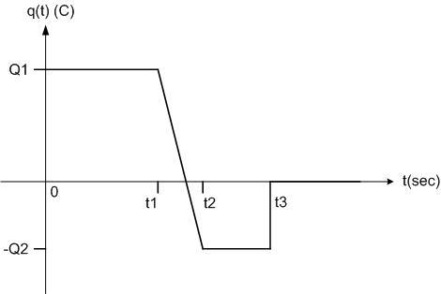
Example – Given Charge Plot
Given the plot of the charge q(t), find the expression for i(t) and sketch it over the time intervals shown.
Charge Plot

Slide 17
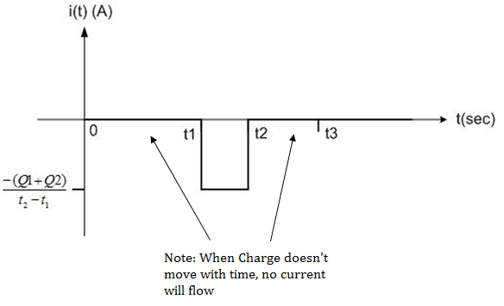
Example – Charge current plots
Solution
Charge plot
Current plot

Slide 18
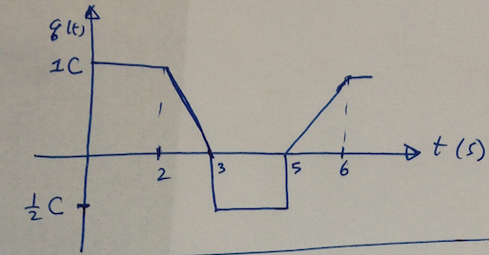
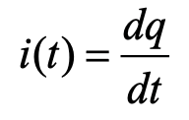
Question
Given the plot of q(t) is drawn below,
Which corresponding plot for i(t) is the correct one?

Slide 19
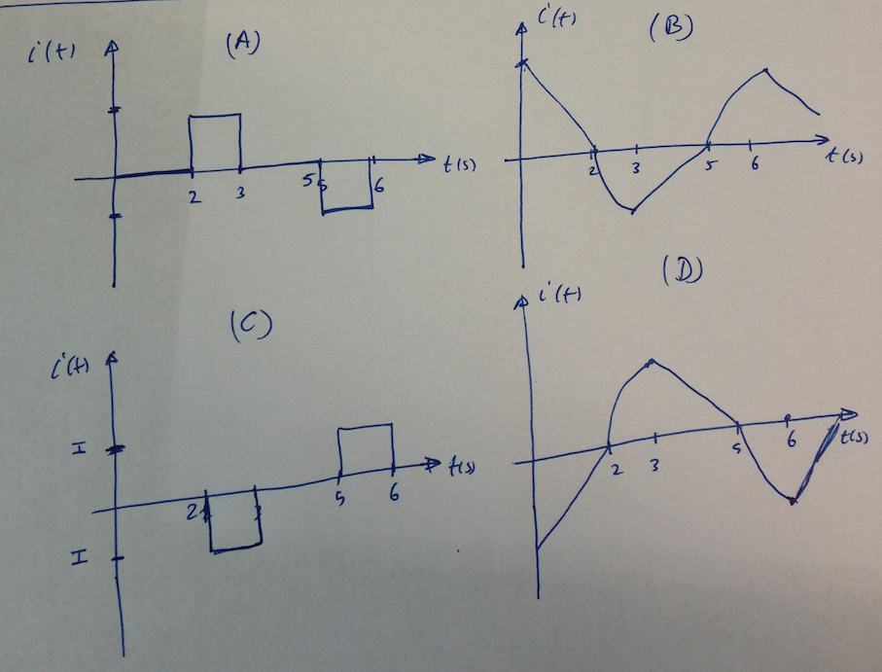
Question
Which plot is the correct i(t)?
q(t)
i(t)

Slide 20

Question
Which plot is the correct i(t)?
q(t)
i(t)

Slide 21

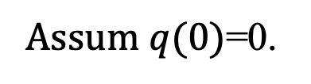
Example – Exponential Expression
Consider the current expression entering a battery terminal is given as follows,
$$i\left(t\right)={I_{o}e}^{−αt}={8e}^{−0.5t}$$
t>0
Find the corresponds expression for the charge $q\left(t\right).$
Assum $q(0)$=0.

Slide 22


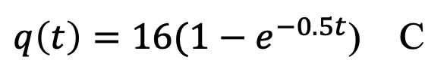
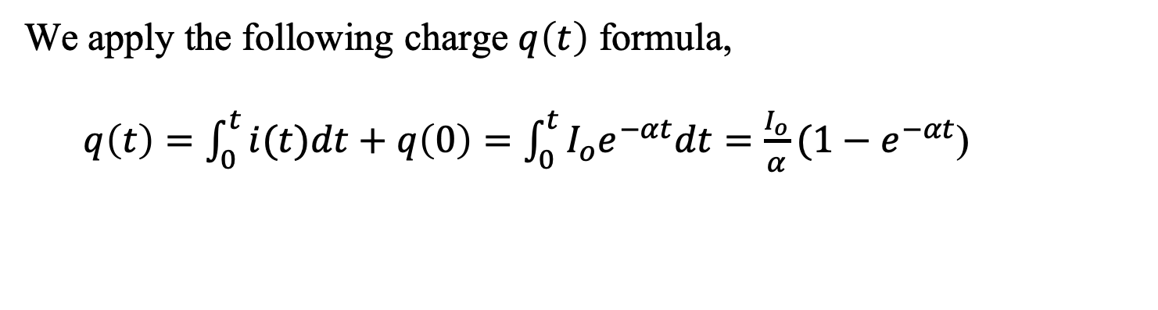
Example – Given Function
Solution:
For given $i\left(t\right) as follows,$
$$i\left(t\right)={I_{o}e}^{−αt}={8e}^{−0.5t}$$
We apply the following charge $q\left(t\right)$ formula,
$q\left(t\right)={\int_{0}^{t}{i(t)dt}+q\left(0\right)=\int_{0}^{t}{{I_{o}e}^{−αt}dt}=\frac{I_{o}}{α}(1−e}^{−αt}$)
$q\left(t\right)=16(1−e^{−0.5t}$) C
Notice at t=0, $q(0)$=0 as expected.

Slide 23
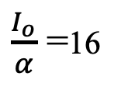



Example – Given Function
$$i\left(t\right)$$
$$q\left(t\right)$$
$$I_{o}$$
$\frac{I_{o}}{α}$ =16

Slide 24
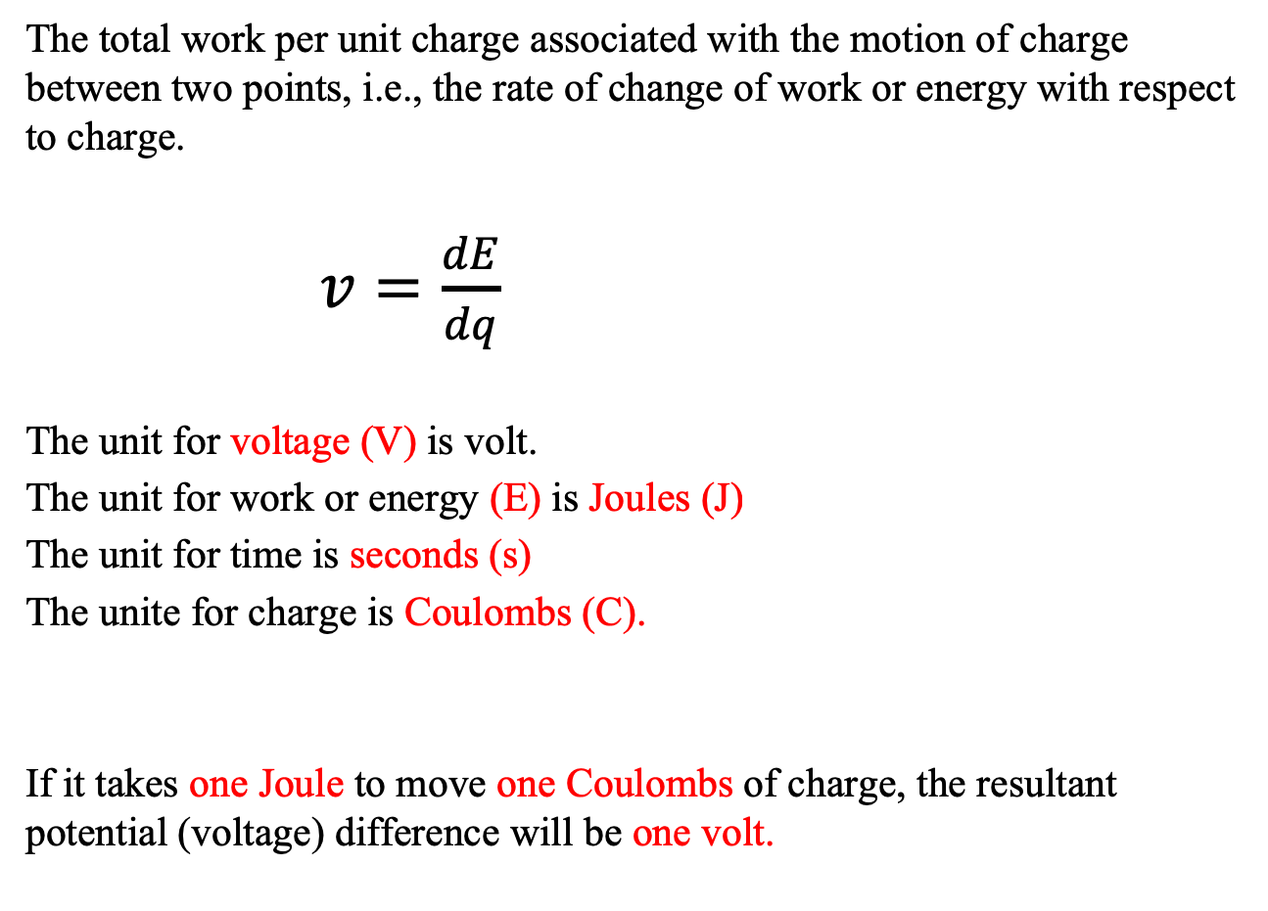
Voltage (v) and Energy (E)
The total work per unit charge associated with the motion of charge between two points, i.e., the rate of change of work or energy with respect to charge.
$v=\frac{dE}{dq}$
The unit for voltage (V) is volt.
The unit for work or energy (E) is Joules (J)
The unit for time is seconds (s)
The unite for charge is Coulombs (C).
If it takes one Joule to move one Coulombs of charge, the resultant potential (voltage) difference will be one volt.

Slide 25
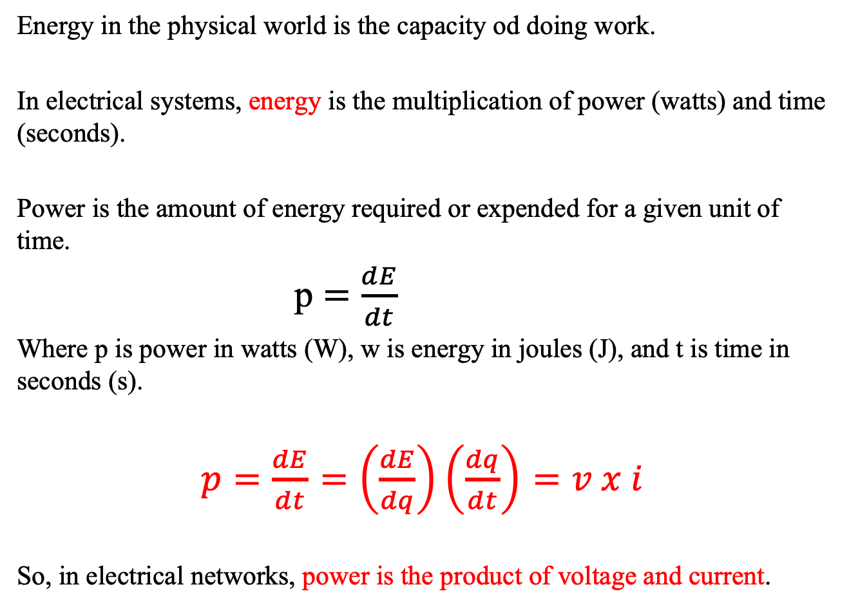
Energy and Power
Energy in the physical world is the capacity od doing work.
In electrical systems, energy is the multiplication of power (watts) and time (seconds).
Power is the amount of energy required or expended for a given unit of time.
            p $=\frac{dE}{dt}$
Where p is power in watts (W), w is energy in joules (J), and t is time in seconds (s).
$p=\frac{dE}{dt}=\left(\frac{dE}{dq}\right)\left(\frac{dq}{dt}\right)=v x i$
So, in electrical networks, power is the product of voltage and current.

Slide 26
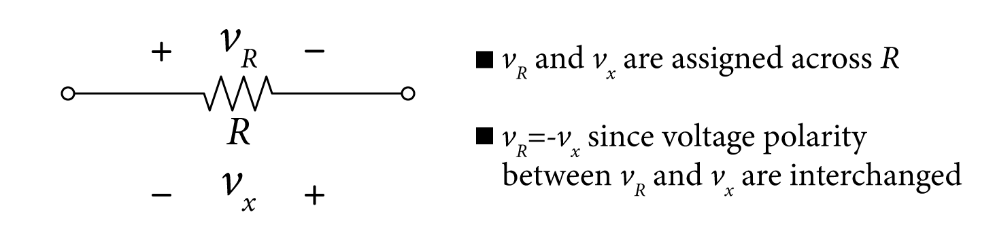
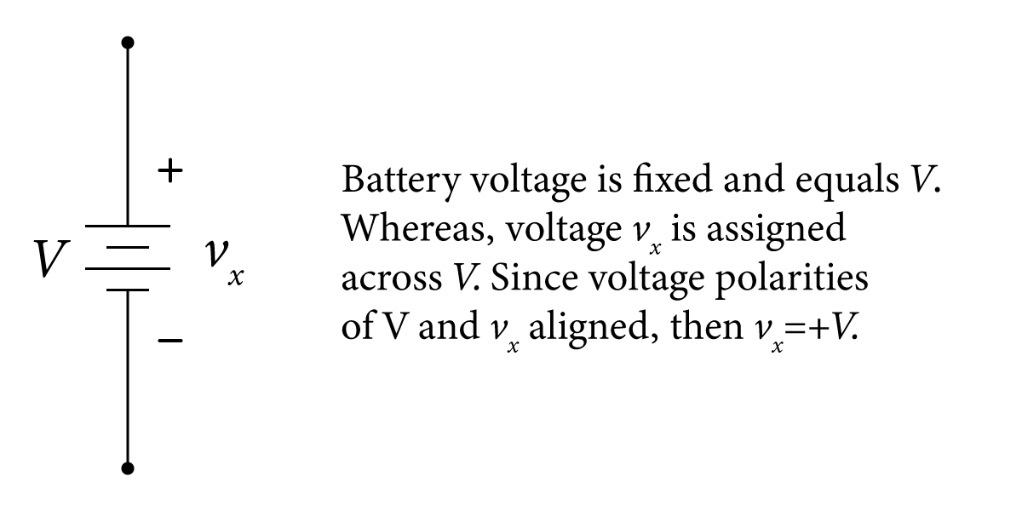
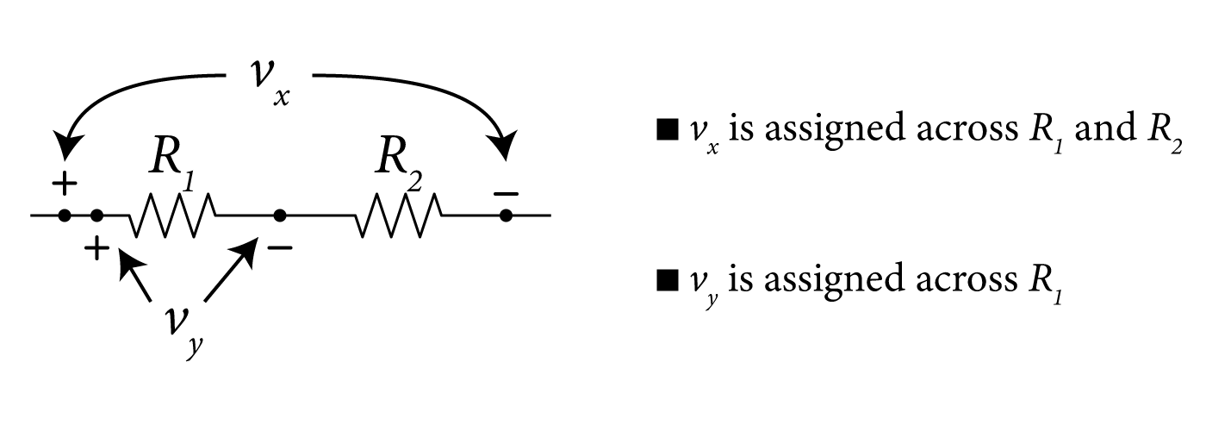
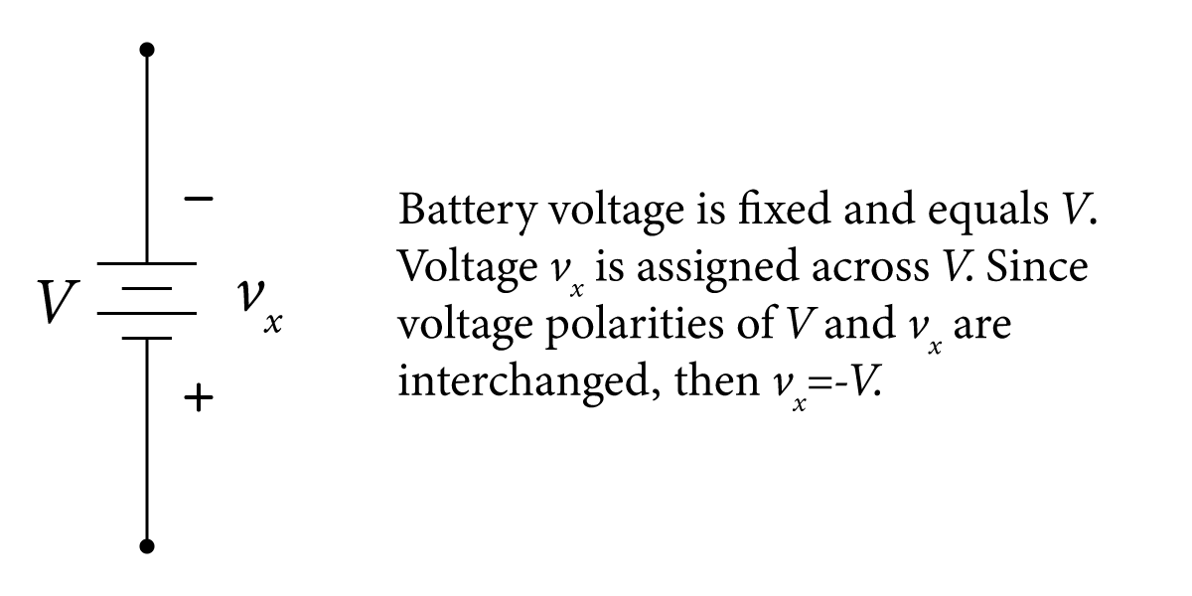
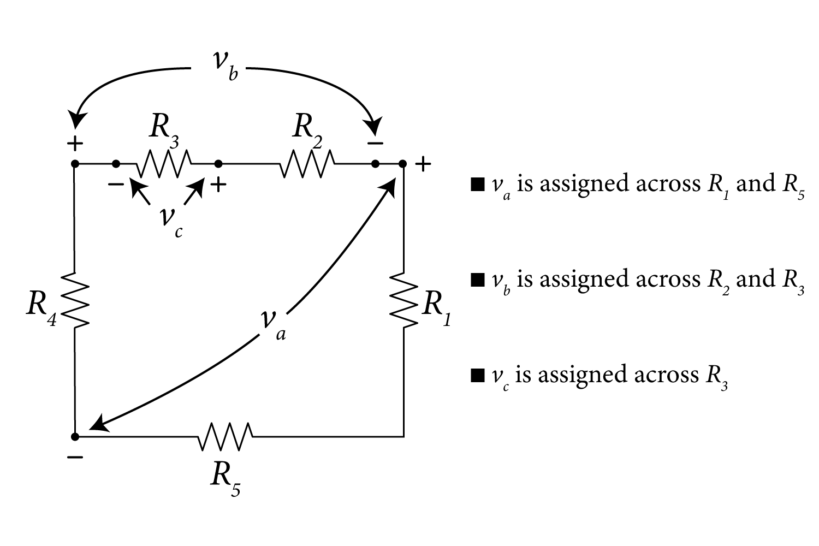
Voltage polarity

Slide 27
Energy and Power - Facts
Power can be positive or negative values (use the positive sign convention)
If p > 0 → power is dissipated or absorbed or lost
If p < 0 → power is generated or delivered or gained
The law of conservation of energy states that the total power generated in a given electrical network must equal the total power dissipated in the same network.
The sum of all absorbed positive power quantities must be equal to all dissipated negative power quantities.
Independent current and voltage sources will always deliver or generate power.
Resistors will always dissipate or waste power.

Slide 28
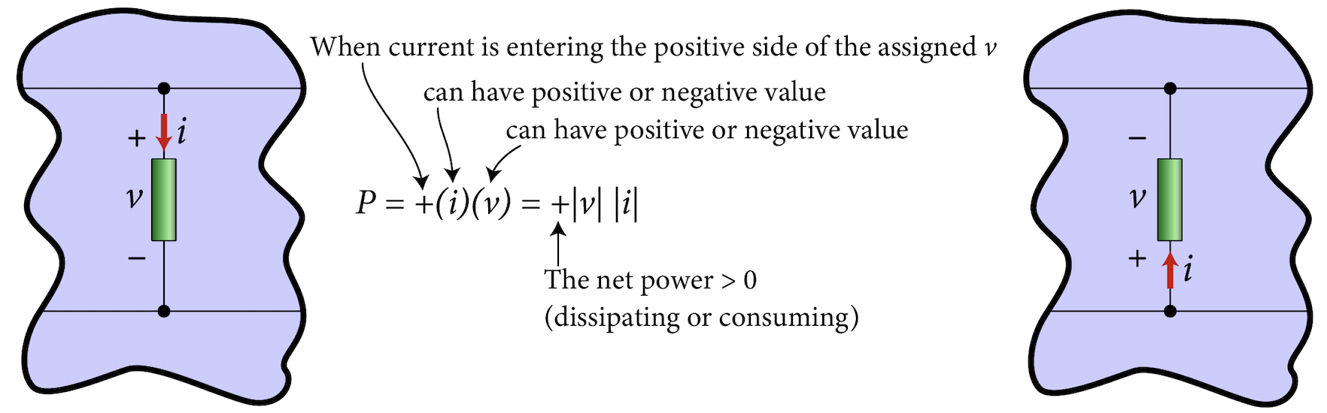
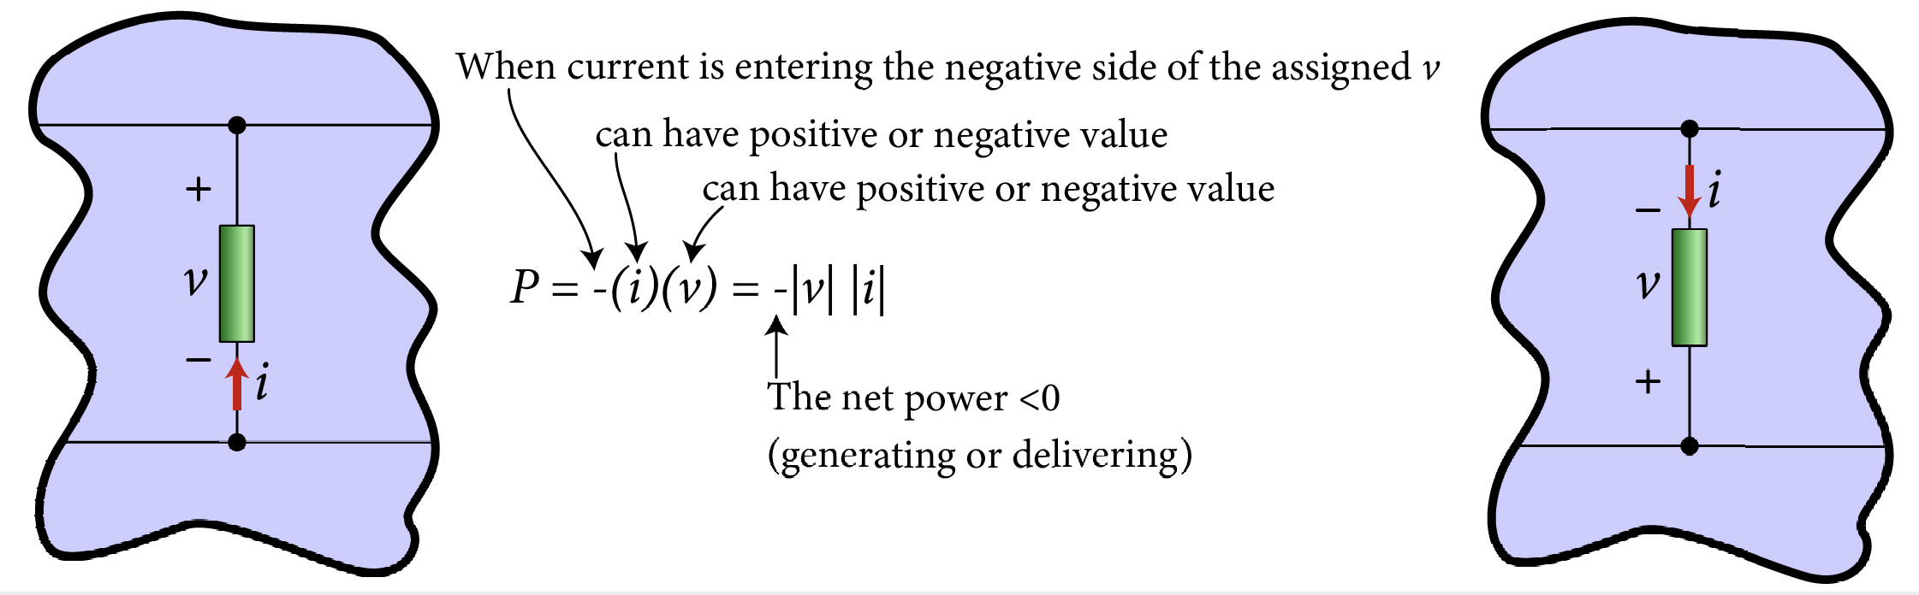
Power Calculations

Slide 29
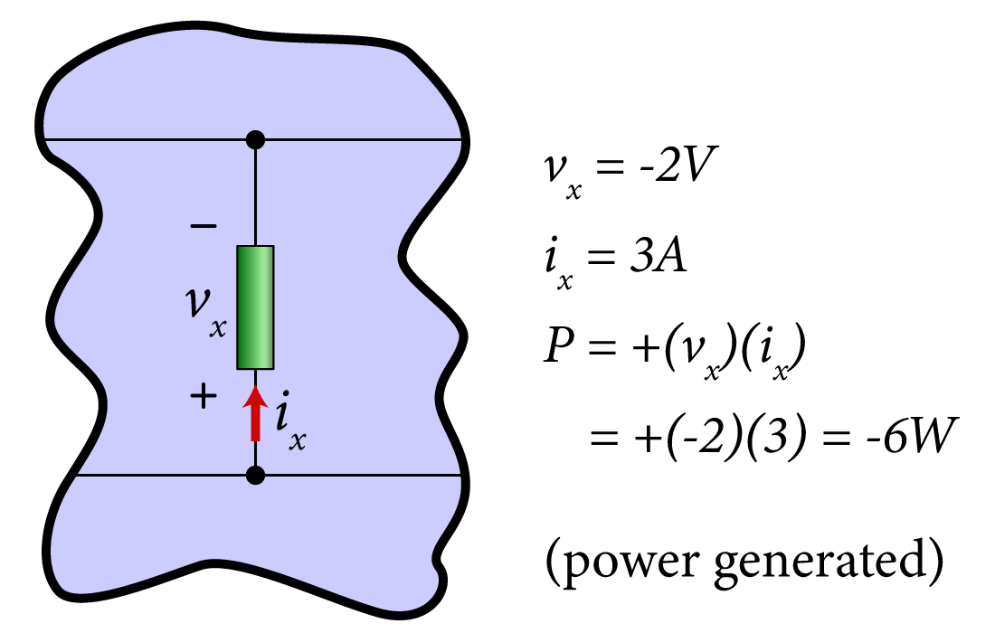
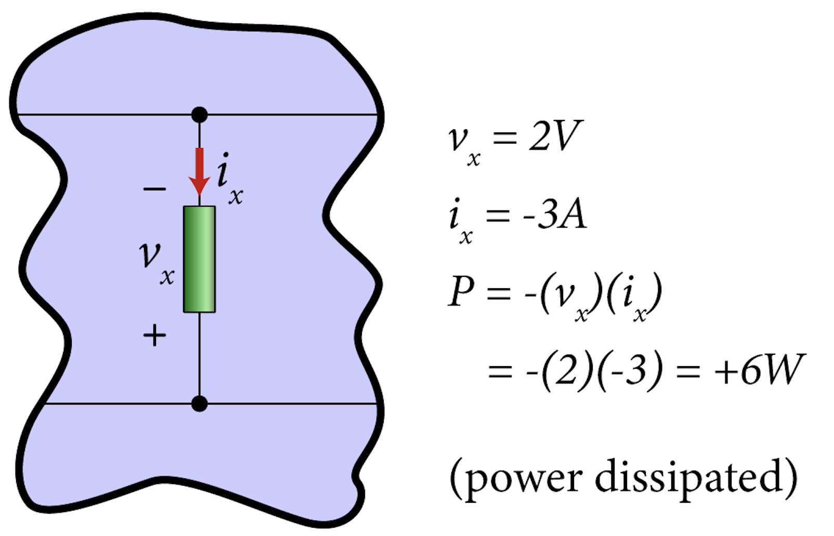

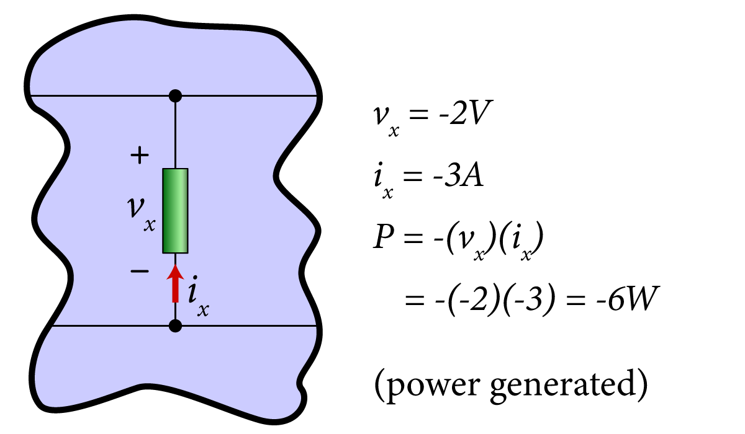
Power Calculations

Slide 30
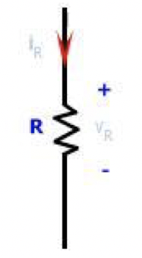
Power in Resistors – Facts
Resistors will always dissipate or waste power
p > 0 → power is dissipated or absorbed
P is always positive in a given resistor
I_{R}
V_{R}
V_{R}
I_{R}
P = +(I_{R} x V_{R})
P = +(I_{R} x V_{R})

Slide 31
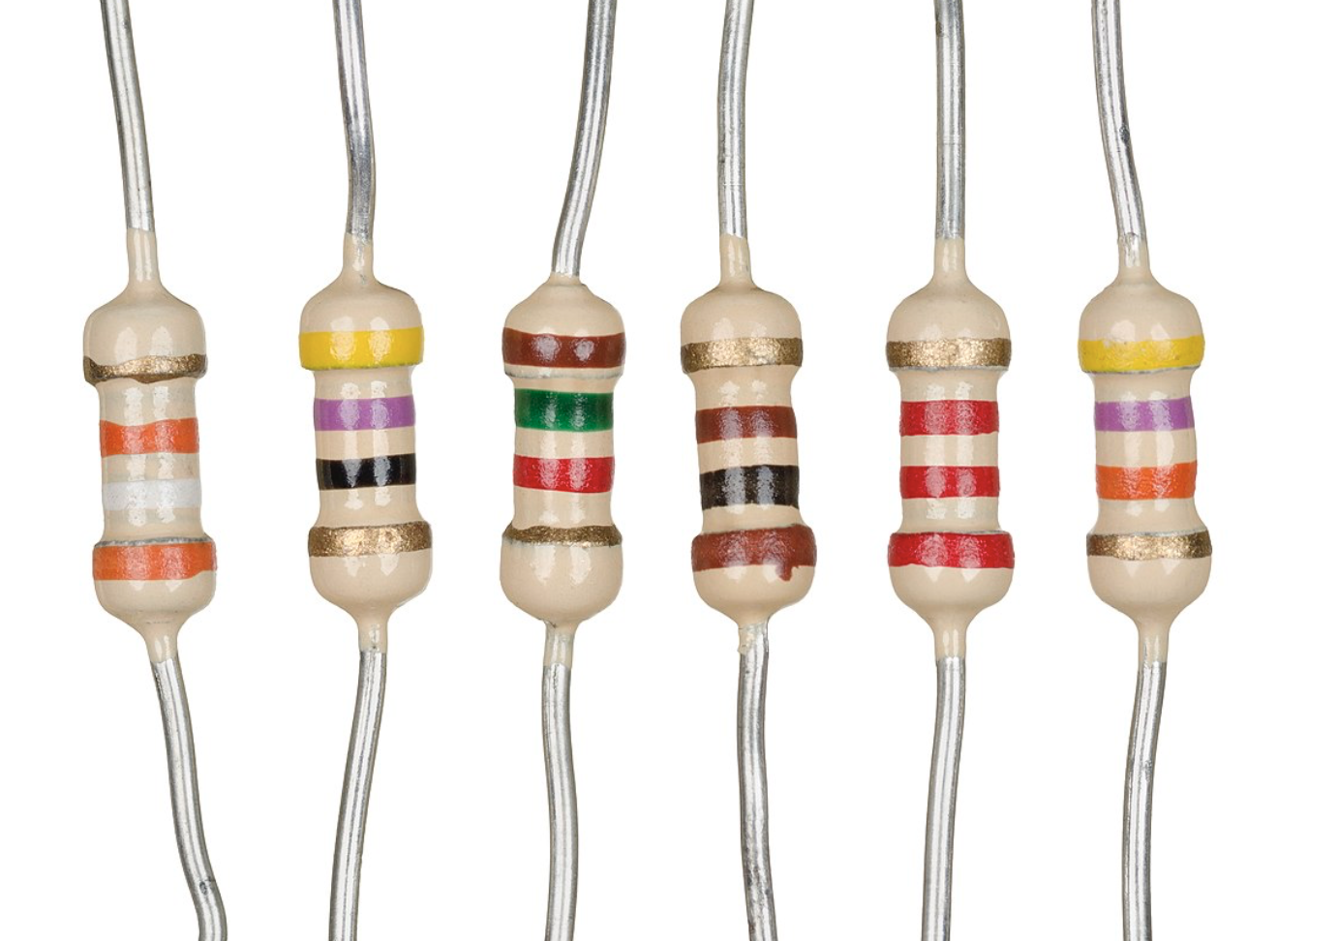
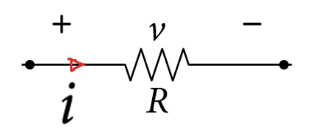
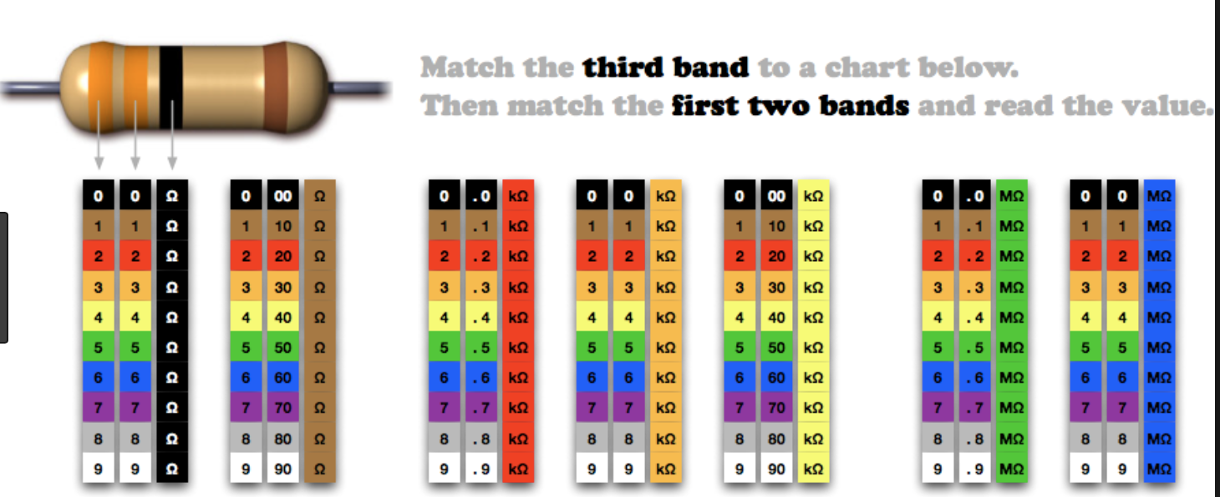

Circuit Elements
The three main circuit elements are listed below:
Resistor: The relationship between the current passing through and the voltage across the element is linearly proportional.
$$v=R i$$
(Ohm’s Law)

Slide 32

Circuit Elements
The Potentiometer:
(a)
(b)
(c)
Fig. 2.31(a) Commercial potentiometer and (b) its two possible equivalent circuit representations

Slide 33




Circuit Elements
Capacitor: The relationship between the current passing through and the voltage across the element is derivative proportional
$$i_{C}(t)=C\frac{dv_{C}(t)}{dt}$$
$$v_{C}\left(t\right)=\frac{1}{C}\int{i_{C}\left(t\right)}dt$$

Slide 34




Circuit Elements
Inductor: The relationship between the current passing through and the voltage across the element is derivative proportional
$$v_{L}=L\frac{di_{L}}{dt}$$
$i_{L}=\frac{1}{L}\int{v_{L}}dt$

Slide 35

Ideal Voltage Sources – Dry Cell batteries

Slide 36


Ideal Sources
voltage sources
Current sources

Slide 37



Combining Sources
Voltages in Series
Currents in Series

Slide 38





Power in voltage Sources – Fact
Voltage sources can produce/deliver power or absorb/dissipate power
p < 0 → power is generated or delivered
p > 0 → power is absorb or dissipate
$$I$$
$$I$$
$$P=−\left(I\right)\left(V\right)=−IV<0$$
$$P=\left(I\right)\left(V\right)=IV>0$$
(Power is absorb or dissipate)
(power is generated or delivered)

Slide 39
Power Calculations in voltage sources
Charging
Charging
Discharging
Discharging

Slide 40
Power Calculations in voltage sources
Charging
Discharging
Charging
Discharging

Slide 41

Power in Current Sources – Fact
Current sources can produce/deliver power or absorb/dissipate power
p < 0 → power is generated or delivered
p > 0 → power is absorb or dissipate
+
V
-
-
V
+
P = - (I) x (V) = - IV < 0
P =+(I)x(V) = + IV > 0
Charging
Discharging

Slide 42
Power Calculations in Current sources
Charging or Discharging

Slide 43
Power Calculations in Resistors
Always dissipating power

Slide 44

Dependent or Controlled Sources
(a) Voltage-controlled Voltage Source
(c) Current-controlled Current Source
(b) Voltage-controlled Current Source
(d) Current-controlled Voltage Source

Slide 45


Examples of Circuit Models with Dependent Sources
The Bipolar Junction Transistor (BJT):
Example of using the BJT as a voltage amplifier known as common-emitter amplifier and its equivalent circuit

Slide 46



Examples of Circuit Models with Dependent Sources
The Metal Oxide Semiconductor Field Effect Transistor (MOSFET):
Example of using the MOSFET as a voltage amplifier known as common-source amplifier and its equivalent circuits

Slide 47

Examples of Circuit Models with Dependent Sources
Insulated Gate Bipolar Transistor (IGBT):

Slide 48

Examples of Circuit Models with Dependent Sources
The Silicon Controlled Rectifier (Thyristor):

Slide 49

Examples of Circuit Models with Dependent Sources
The Operational Amplifier (Op Amp):
Example of using the Op Amp as a non-inverting voltage amplifier

Slide 50







Electrical Network Concepts
Electric elements
Branches
Nodes
Circuit Loops
Grounds

Slide 51


Redrawing Nodes

Slide 52
Electrical Network Concepts – Mesh loops
Mesh is a single loop that contains no other loops within it.
This is a mesh loop

Slide 53


Examples Mesh Loops
Loops 1 and 2 are mesh loops
Loop 3 is NOT a mesh loop
since loops 1 & 2 are inside it.
Loops 1,2,3,4 are mesh loops
Loop 5
Loop 5 is NOT a mesh loop
since loops 1,2 & 4 are inside it.

Slide 54













Example – DC Power
Find the power for elements $A,B and C$ (state whether power is absorbed or delivered )
$$i_{A}=+3 A$$
$$i_{B}=−2 A$$
$$i_{C}=3 A$$
$$v_{A}=+4 V$$
$$v_{B}=5 V$$
$$v_{C}=6 V$$
Solution:
$$P_{A}=\left(+\right)i_{A}v_{A}=+\left(+3\right)\left(+4\right)=+12 W$$
absorbed
$$P_{B}=\left(−\right)i_{B}v_{B}=−\left(−2\right)\left(+5\right)=+10 W$$
absorbed
$$P_{C}=\left(−\right)i_{C}v_{C}=−\left(3\right)\left(6\right)=−18 W$$
delivered

