Slide 1

EEL 3004 Linear Circuits
Lecture #1B
Overview
Course and Introductory Concepts

Slide 2
Syllabus (Update)
Basis for Final Grade
Quiz: Quizzes will be conducted almost weakly in the last 10-15 minutes of the class. A missing a quiz will receive a zero!
Tests: 3 In-person tests worth 15% each will be conducted in person.
Final Exam: The in-person final exam is comprehensive and weights 25%.
Discussion: Students are expected to attend the discussion and based on the level of their participation a 0-5% weight will be assigned. More will be provided by your discussion instructor.
Assignments | Total Percentages
Discussion Session | 5%
Quizzes | 25%
3 Midterm Exams (3x15%) | 45%
Final Exam | 25%
Total | 100%
There will be six Teaching Assistances (TA’s) assigned to the three EEL 3004 Sections.

Slide 3
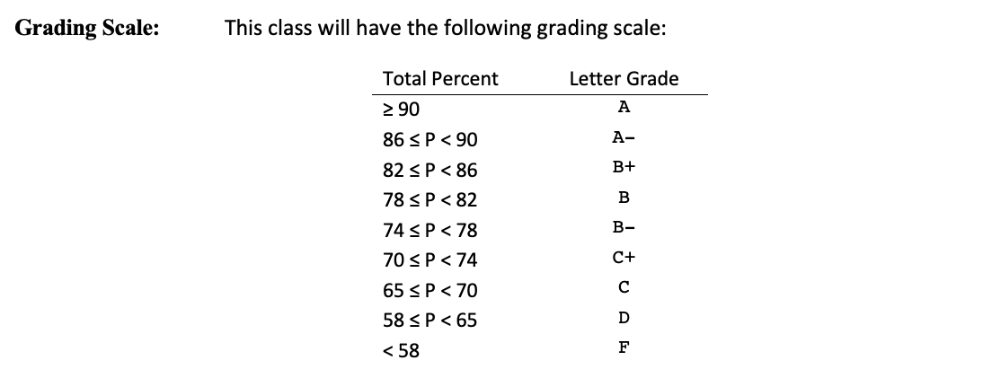
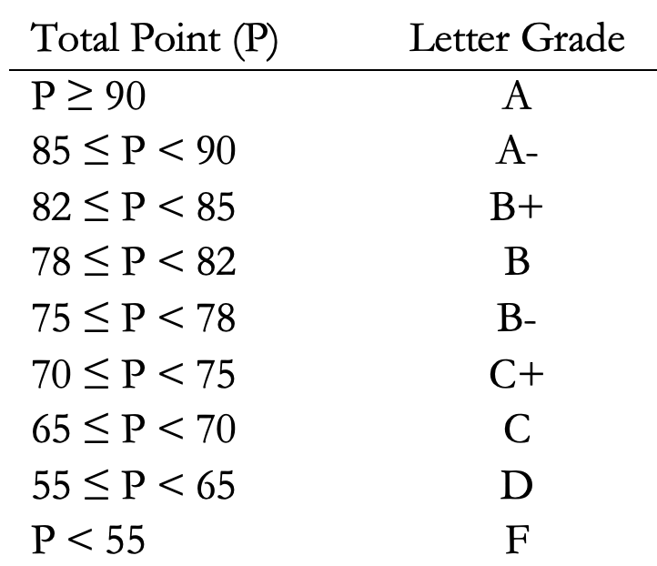
Syllabus (Update)
Grading Scale
Discussion UAL
Two Discussion Periods:
Fridays:
9:00 – 10:50 AM
12:00 – 1:50 PM
Ryan Baumgartner
(954) 415-8252
ryan.baumgartner@ucf.edu

Slide 4
Lecture Objectives
Academic Assignment - Reminder
About Electrical Engineering Profession
Circuit Theory
Lumped Element Method Assumptions
Practical Example – The iPhone

Slide 5
Student Academic Activities
All faculty members are required to document students' academic activity at the beginning of each course. In order to document that you began this course, you must attend the first week and sign the attendance sheet. This academic assignment (signing attendance sheet) must be done no later than the first Friday of the semester. Failure to do so will result in a delay in the disbursement of your financial aid.
For more info, please visit:
http://teach.ucf.edu/support/

Slide 6
Academic Assignment
Read Chapter 1 and History of Electricity & Computing, and answer the following Three Questions:
1) List five different disciplines of Electrical and Computer Engineering.
2) Who discovered the electron and when?
        3) Who defined the notion of bit and when?

Slide 7
What is Electrical Engineering
Layers of the field of Electrical/Computer Engineering:
  The Physical laws
  Components
  Devices
  Circuits or Networks (EEL 3004)
  Systems
  Product development
  Commercialization
Science
Engineering
Business

Slide 8
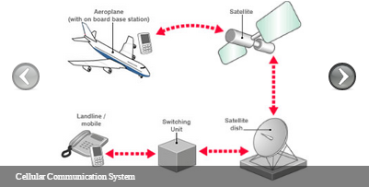





What is Engineering? EE?
Engineering is the purposeful use of science based on proven scientific theorems and concepts that are supported by mathematical formulations.
Electrical engineering is a highly diverse, multidisciplinary profession that covers all types of electrical circuits and systems including communications, power and energy, control, electronics and microelectronics, signal processing, computing, and optics and photonics.
Cellular Communication System

Slide 9


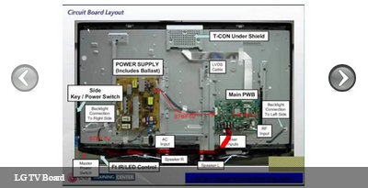
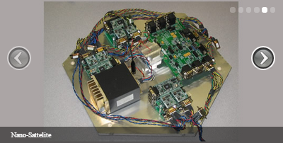
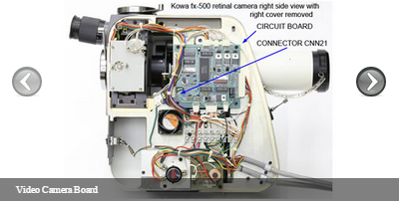


Electrical Circuits and Models
Electric circuits are the building blocks of many of today’s electrical systems, where all communication signals are inputted, processed, stored, and transmitted, and where all power signals are generated, transmitted, and distributed.
Examples of commercial circuit boards

Slide 10
Passive and Active circuits
Analog electric circuits classified as either passive or active:
  Passive electrical circuits: components/circuits/systems - on the average, these circuits always dissipate power
  Active Electrical Circuits: semiconductor devices - on the average they can generate power

Slide 11
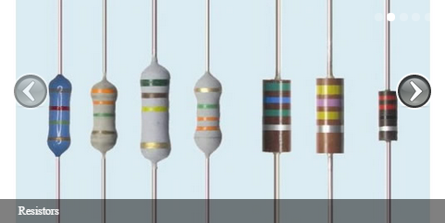
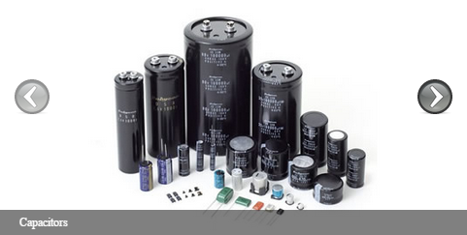
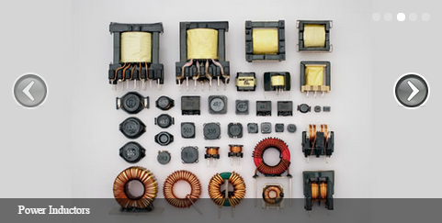
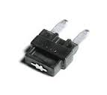
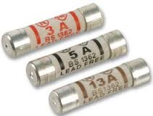
Examples of Passive Elements
  Components:
  Examples: Resistors, capacitors, inductors, transformers, voltage sources, three-phase transformers.
  Passive Devices:
  Diodes fuses

Slide 12
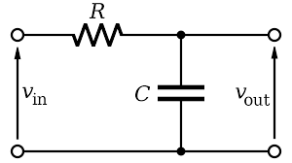
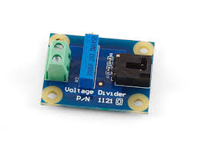


Examples of Passive Elements
  Circuits: Filter circuits, voltage dividers, ladder networks, bridge networks.
  Systems: Heater, toaster, tuner, battery charger, keyboard.

Slide 13
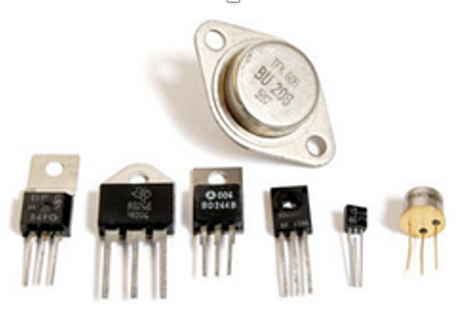
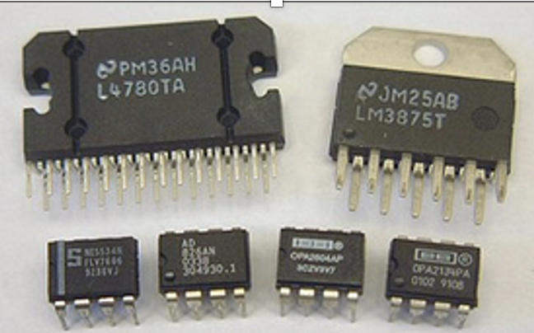
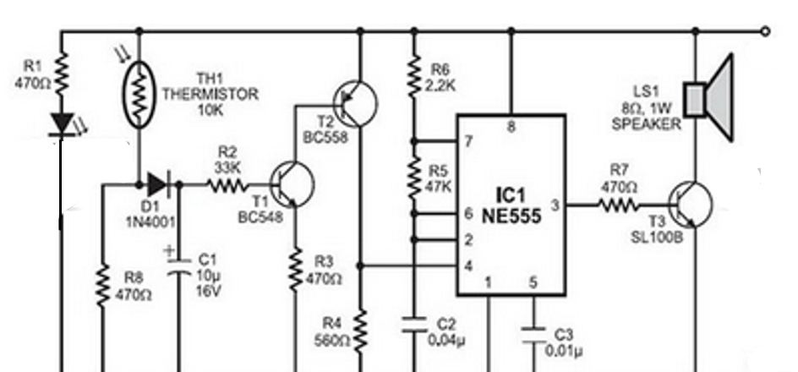
Examples of Active circuits
Devices - transistors
Integrated Circuits (IC)
circuits
These circuits are on average able to deliver power or amplify the current, voltage, or power by changing the voltage and current signals.

Slide 14
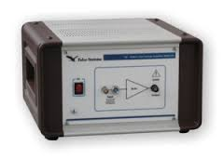
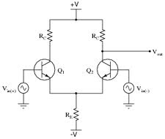
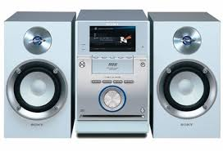

Examples of Active Elements
  Circuits: Voltage amplifiers, differential pairs, integrators, active filters.
  Systems: Stereo systems, power supplies, microphones.

Slide 15
Electrical Circuit Analysis
This course only deals with the analysis and design of passive, linear, and analog circuits that are powered both by direct current (DC) alternating current (AC).
All electrical systems behaviors change as the frequency of the system changes.
Understanding frequency and its impact on circuit analysis, we need to understand the electromagnetic field - The Electromagnetic Frequency Spectrum
We need Maxwell’s equations. They give the fundamental foundation and framework for understanding electrical systems.

Slide 16
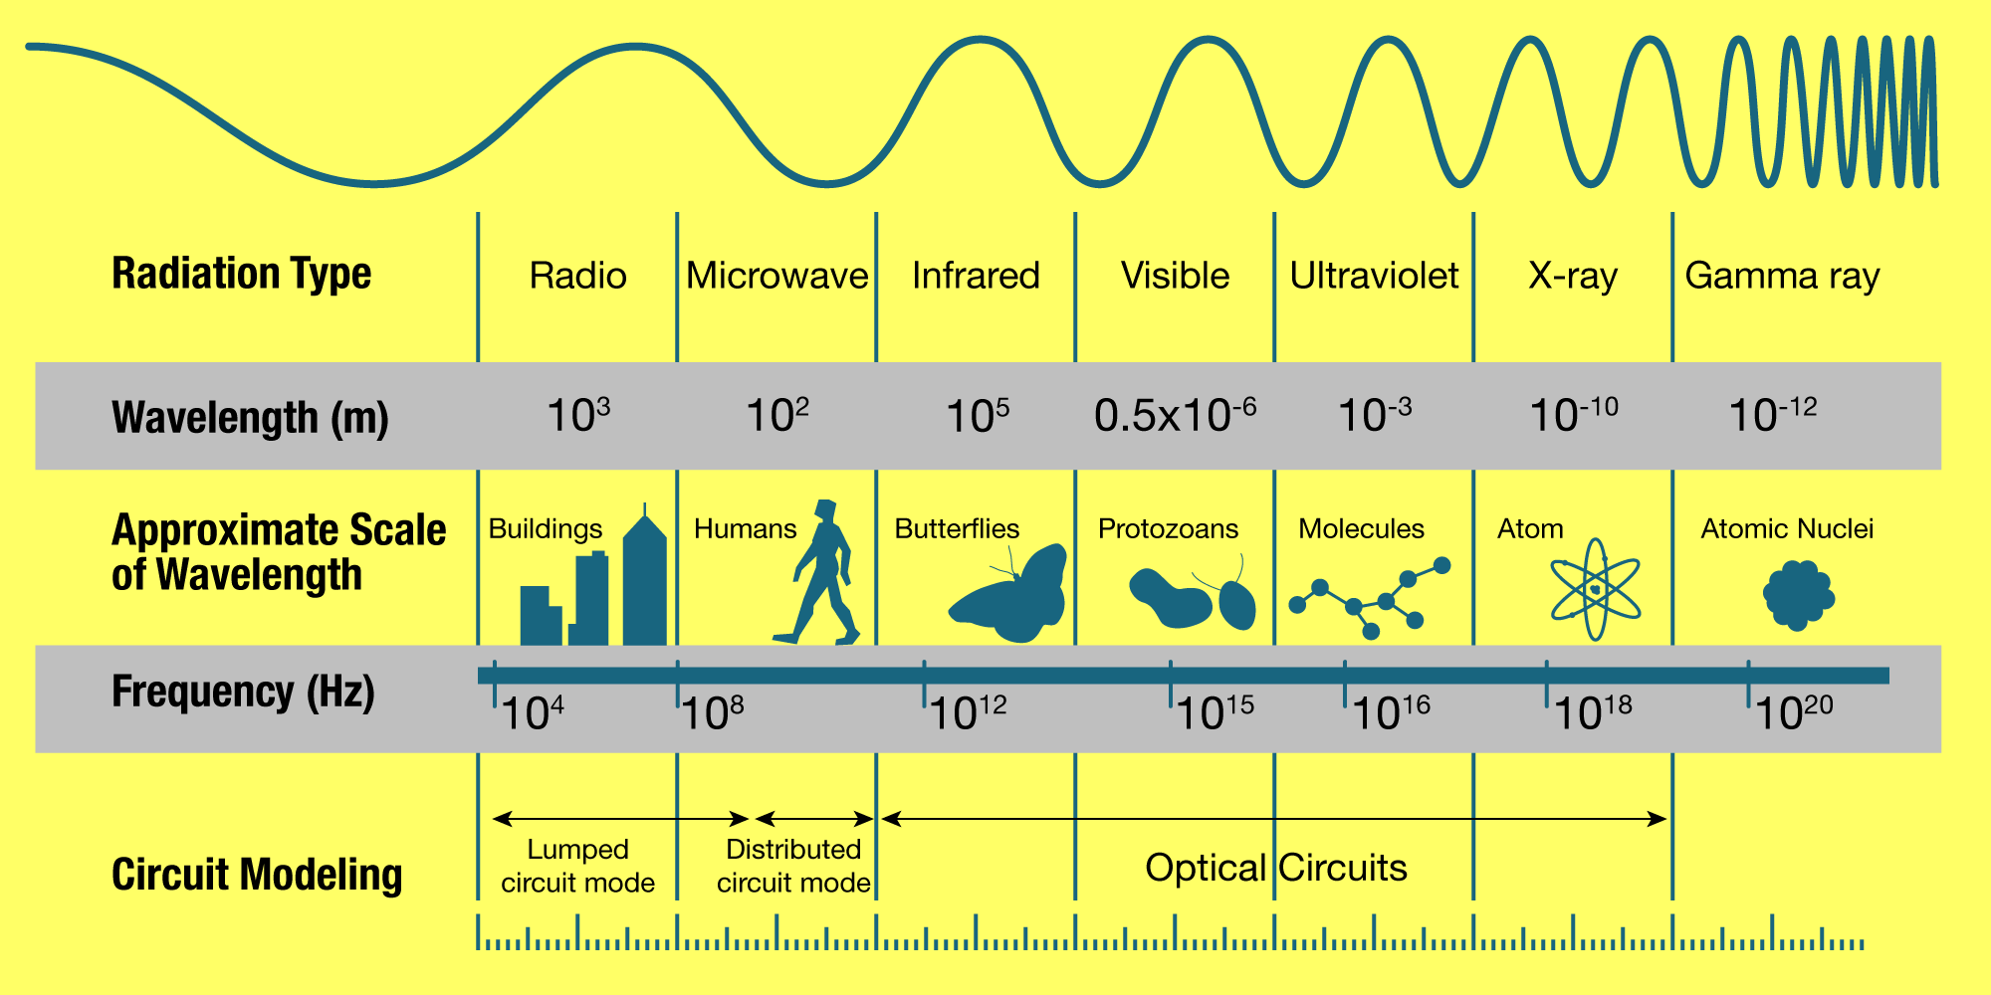
Electromagnetic Frequency spectrum

Slide 17
Electromagnetic frequency spectrum
Then, what are the frequencies of interest?
Our Frequency of interest

Slide 18
Lumped Parameter Approach Assumptions
The application of circuit theory to analyze and design electrical circuits is simplified by the lumped parameter approach of circuit models.
The following three basic assumptions are made so the physical electrical system can be analyzed by using circuit theory instead of electromagnetic field theory:
  Current flow in the circuit will result in zero electric charge variation with respect to time at any given point in the circuit at all times (no electric charge leakages to the air).
  Current flow in the electrical circuit will produce zero variation in the magnetic flux with respect to time in parts of the circuit. (no magnetic field leakages to the air).
  All electric signal frequencies that flow in the circuit are assumed to be much smaller than the electromagnetic wave frequencies (ideal component behavior at low frequency)

Slide 19
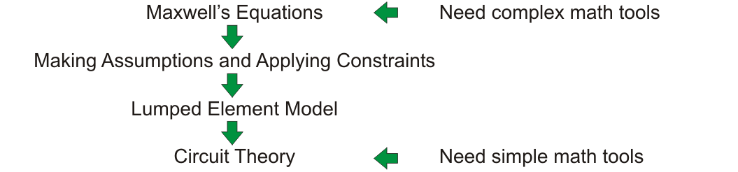
Lumped Parameter Approach Assumptions
Steps of modeling electric systems from applying Maxwell equations to applying simple circuit theory techniques.
Simpler
Approach to Simplified Circuit Theory

Slide 20
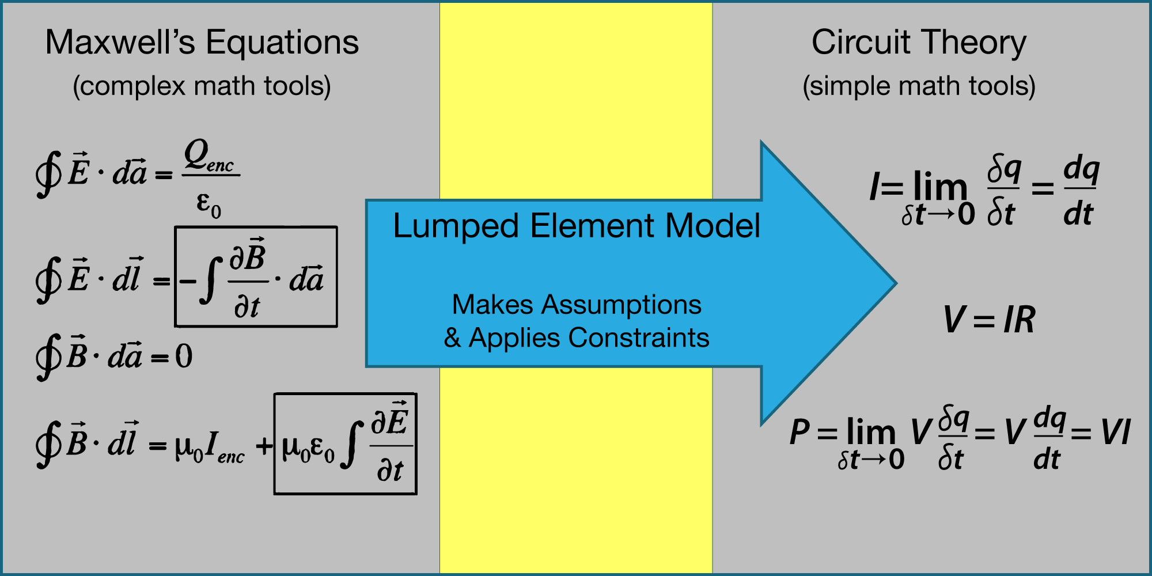
Lumped Parameter Approach: Simplify Circuit Theory
Physics
Engineering

Slide 21
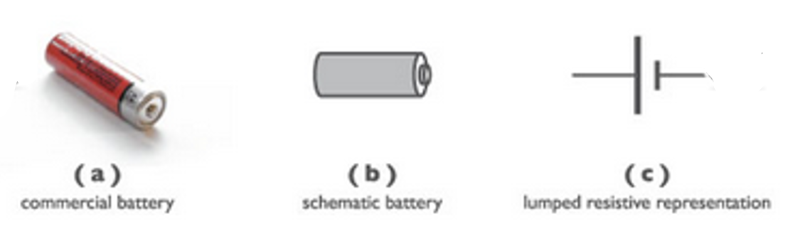
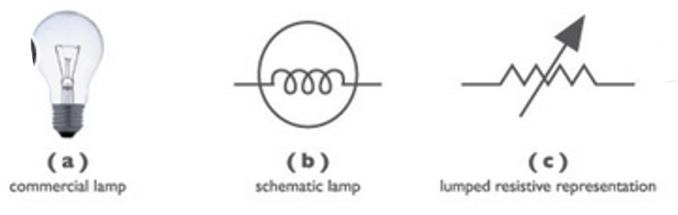
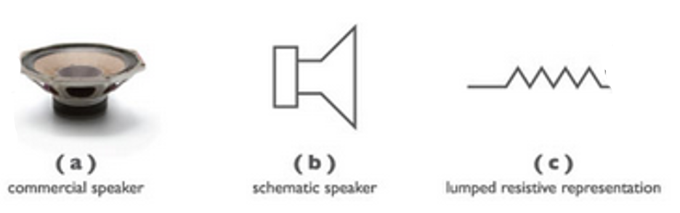
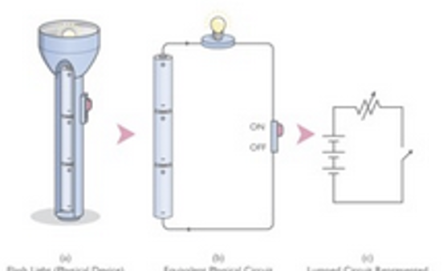






Lumped Parameter Approach Assumptions
A list of physical electrical components, devices, circuits, and systems, and their corresponding idealized lumped element abstraction.
Examples of physical quantities with their equivalent lumped representation

Slide 22

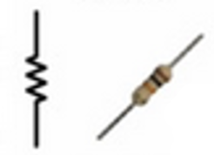
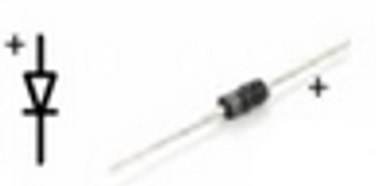
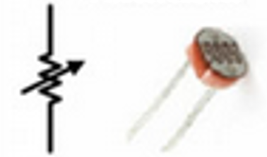
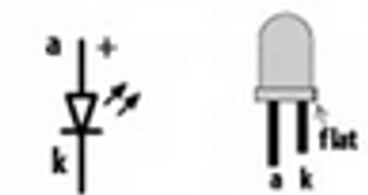
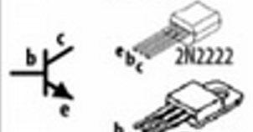

Lumped Parameter Approach Assumptions
Resistor
Capacitor
Diode
Variable Resistor
Transistor
LED
Examples of the most-commonly used lumped representation in circuits

Slide 23
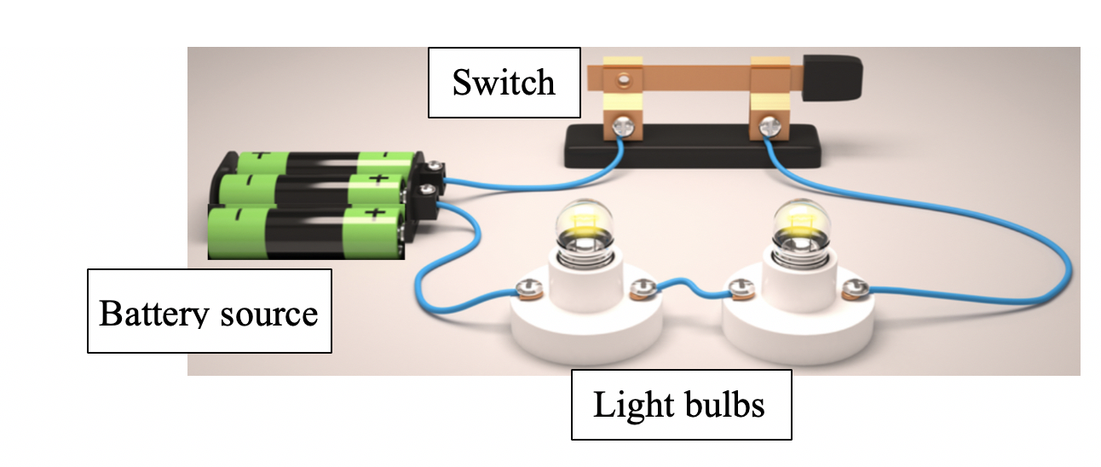
Example of the Lumped Element Method
A simple physical electrical network can be used to illustrate the usefulness of applying the above three assumptions.
Three Batteries – V_{battey} Source
Light bulb #1 – resistor LB1
Light bulb #2 – resistor LB2
Switch – Symbol S shown
Analysis: How much current, voltage and power in each element?
Design: Make another circuit with three
bulbs circuit.

Slide 24
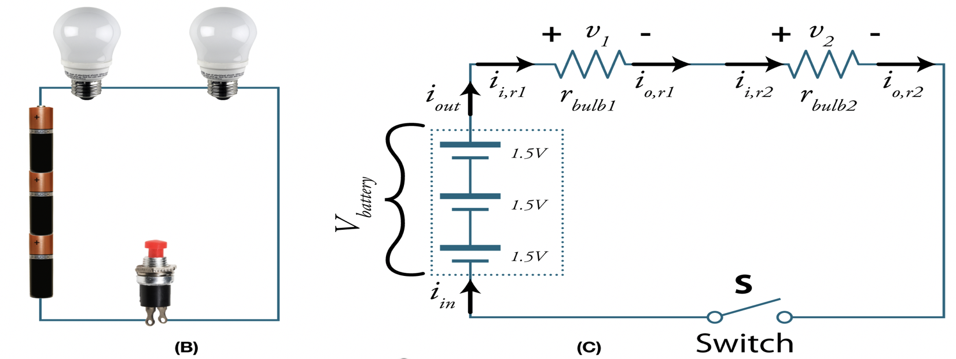
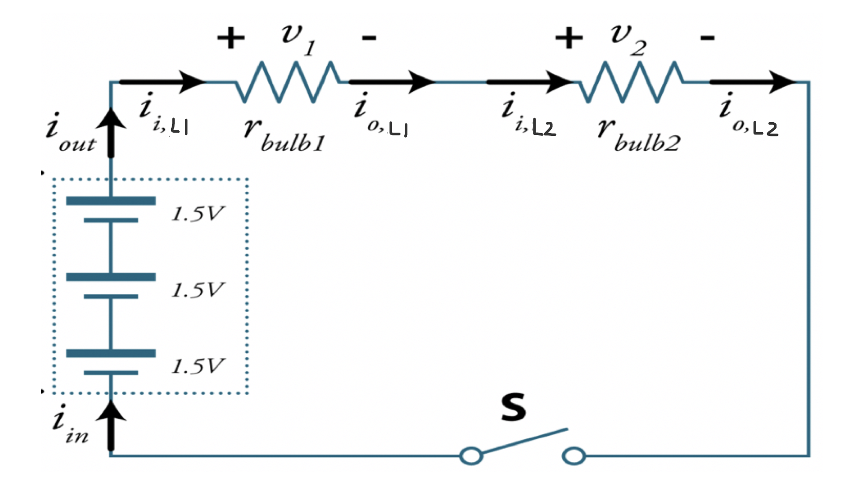
Physical Elements become a Lumped Circuit Element
Having verified that the three assumptions hold, the circuit can be redrawn as a connection with three lumped parameters:

Slide 25
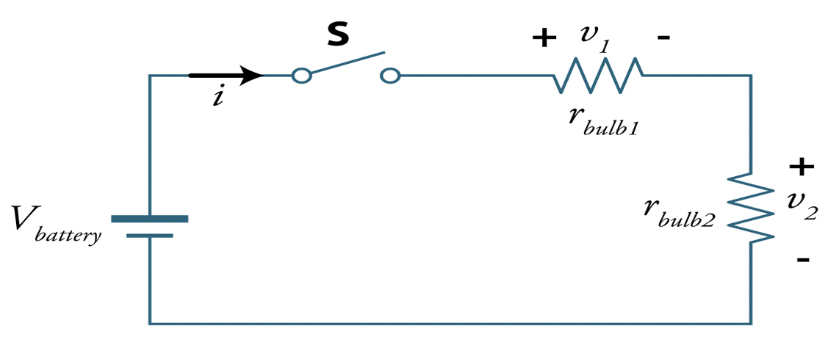
Circuit Analysis
Next we carry t he circuit analysis on the simplified equivalent Lumped Circuit:
Circuit Analysis means to Find:
* Circuit Currents and Voltages: i, v₁ and v₂
* Calculate Power in each component

Slide 26
Example of the Lumped Element Method
Assumption 1: No charge is depleted or accumulated while the current is traveling from the batteries through the lights, the electric switch and back to the batteries.
Assumption 2: the rate change of magnetic fluxes caused by the flow of all currents shown in (a) will be zero.
Assumption 3: The implication of the third assumption is not straightforward because the battery voltage represents a fixed voltage with zero signal frequency (dc).
i_{in} = i_{out}
i_{i,L1} = i_{o,L1}
i_{i,L2} = i_{o, L2}
i_{in} = i_{out} = i_{i,L1} = i_{o,L1} = i_{i,L2} = i_{o, L2} = i

Slide 27
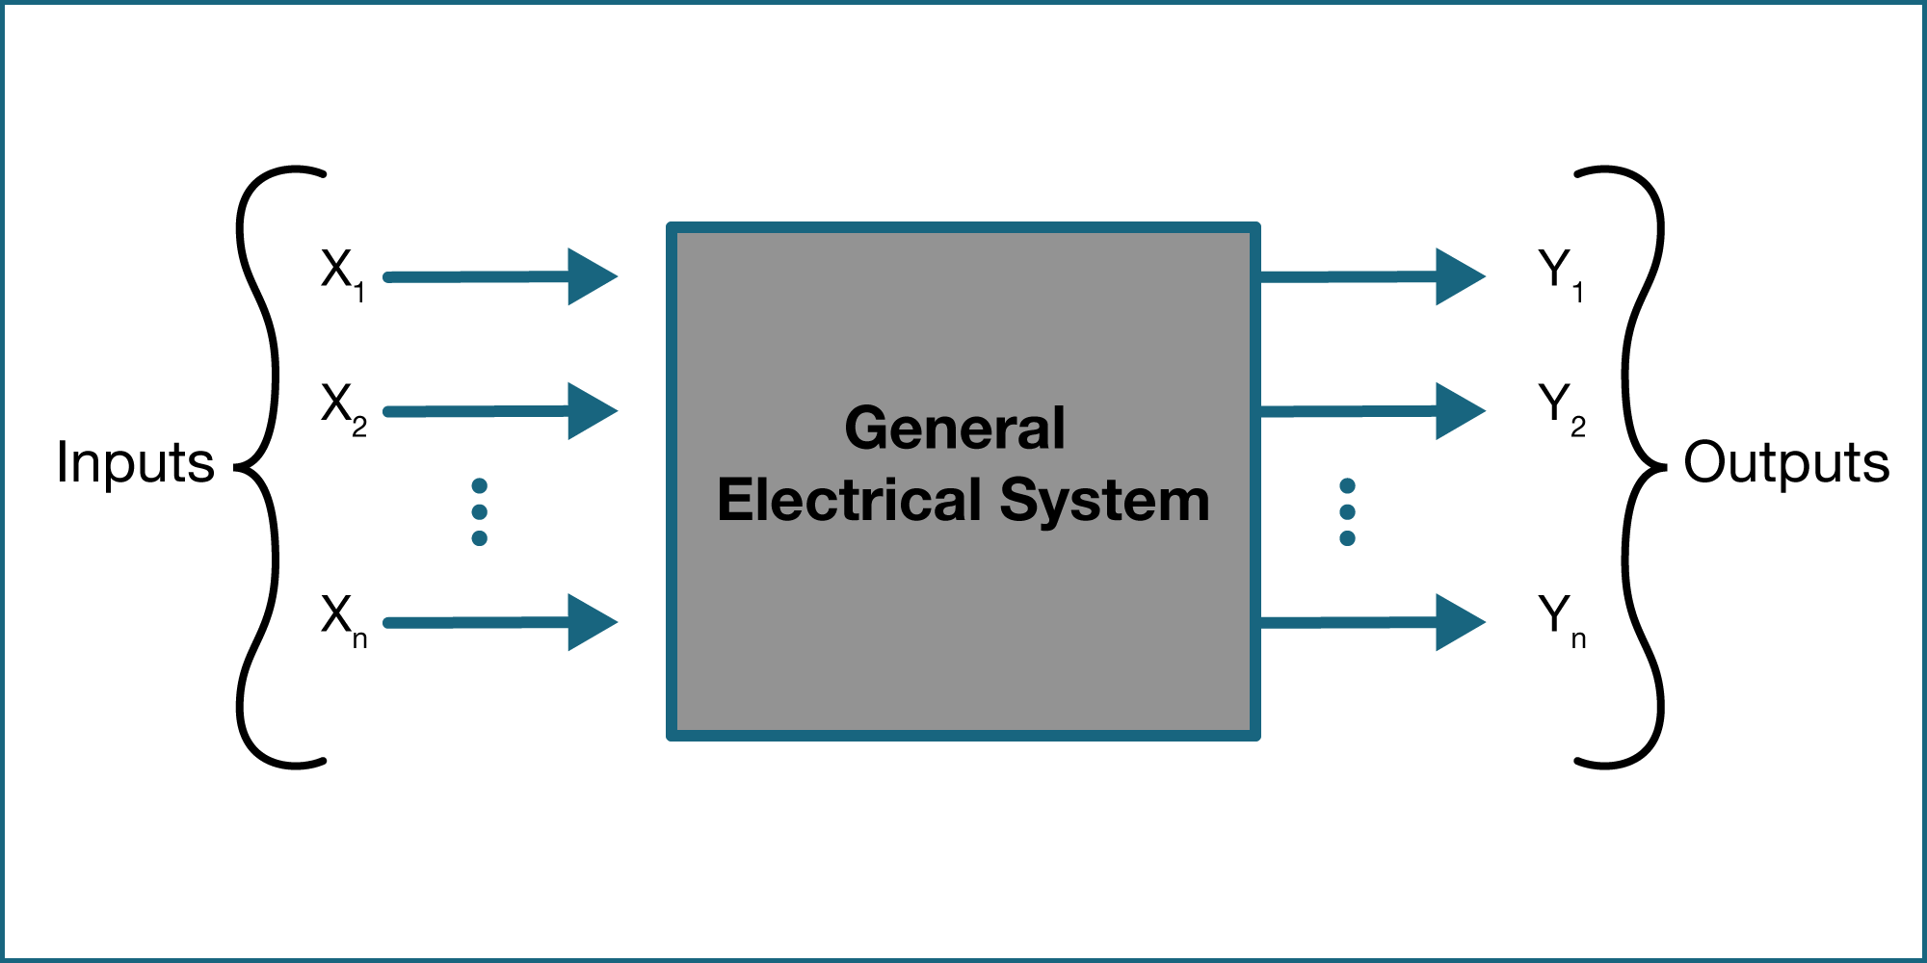
General Electrical Systems
A given system has a built-in process or intelligence that takes in inputs, process the inputs, and produces desired outputs.
  n inputs x₁, x₂, x₃,…… x_{n}
  m output signals y_{1,} y_{2,} y_{3,……..} y_{m}
Electrical Quantities
  Charge (q)
  Current (i)
  Voltage (V)
  Energy (W)
  Power (P)
General block-diagram representation of a typical electrical system

Slide 28
Electrical Signals

Slide 29

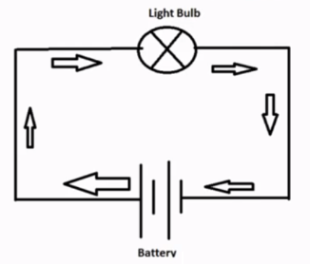
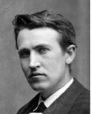
AC vs. DC
Alternating Current (AC)
  Alternates back and forth in the positive and negative values.
  Distribution world-wide electricity: 60Hz or 50 Hz times a second.
Direct Current (DC)
  No Alternation, and current goes in one direction.
  Batteries and Circuits.
Tesla
Direct Current
Edison

Slide 30
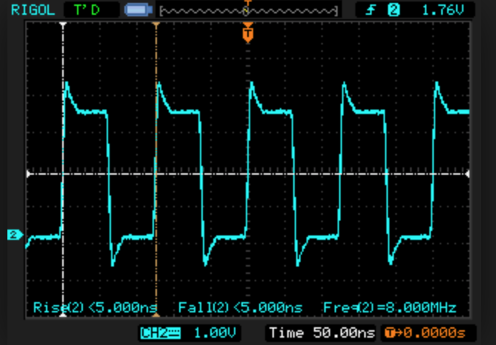
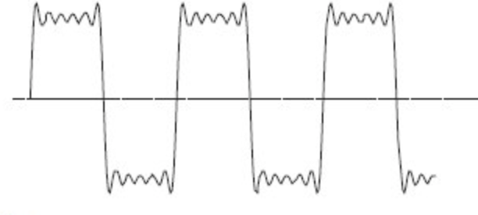
Electrical Signals
Unfortunately, because real-world physical components and devices are non-ideal, practical output signals are normally distorted in terms of shape, frequency, phase, and magnitude, and real components and devices can be lossy and noisy.
The better the electrical system is designed, the less the effect of non-idealities and distortion on the system performance.
Examples of practical (non-ideal or distorted) signals

Slide 31
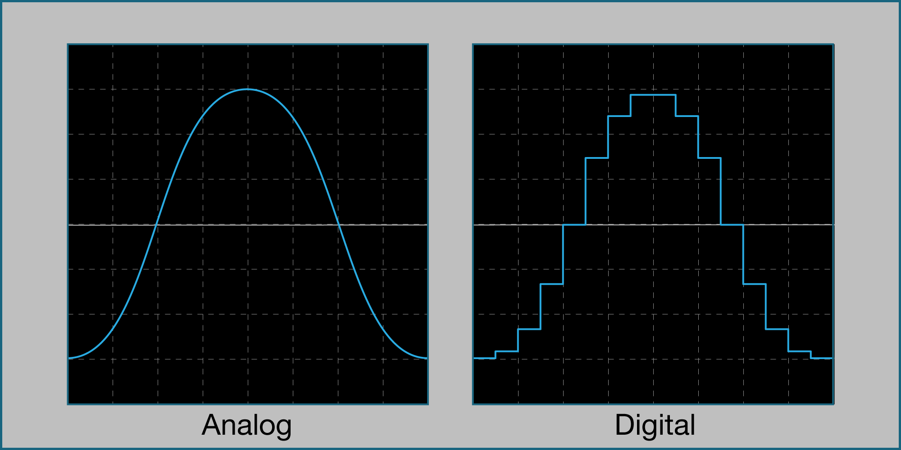
Analog vs. Digital
Analog describes a system whose values change continuously. Analog electrical current and voltage signals are continuous in time and can take on various magnitudes at different times.
Digital systems, on the other hand, do not change values continuously. Digital or discrete signals can take on discrete values at different quantized time intervals.
Analog vs. digital

Slide 32
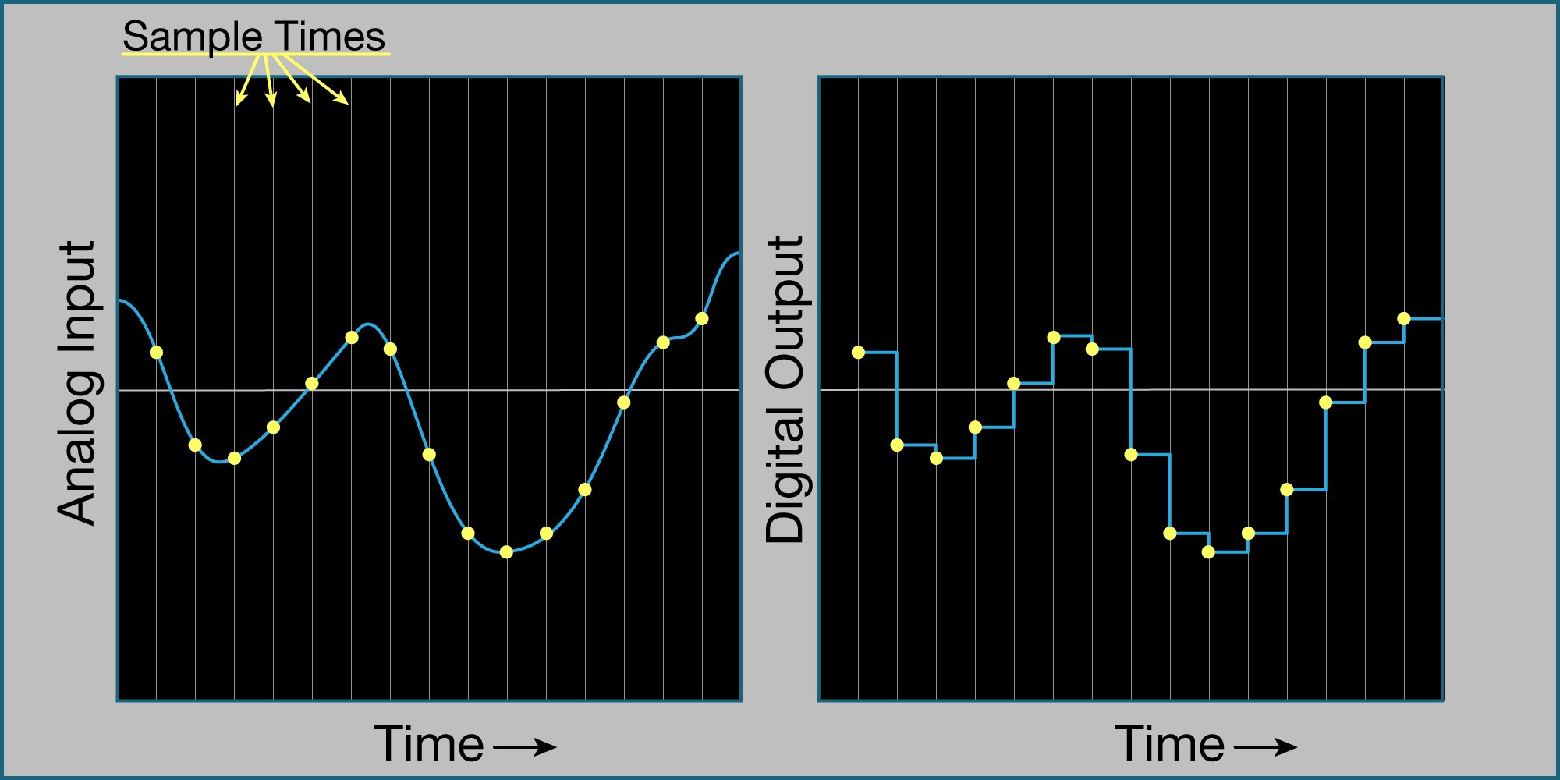
Analog vs. Digital
Significant improvements have been made in the process of converting analog signals to digital signals:
  discretization process: A process through which a single value is assigned to a range of values for a given parameter of interest. These sample electrical quantities are then called digital signals.
Analog vs. digital

Slide 33
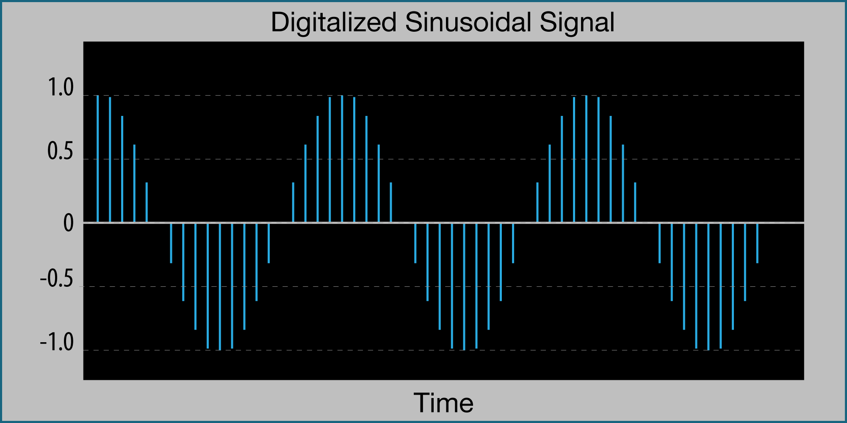
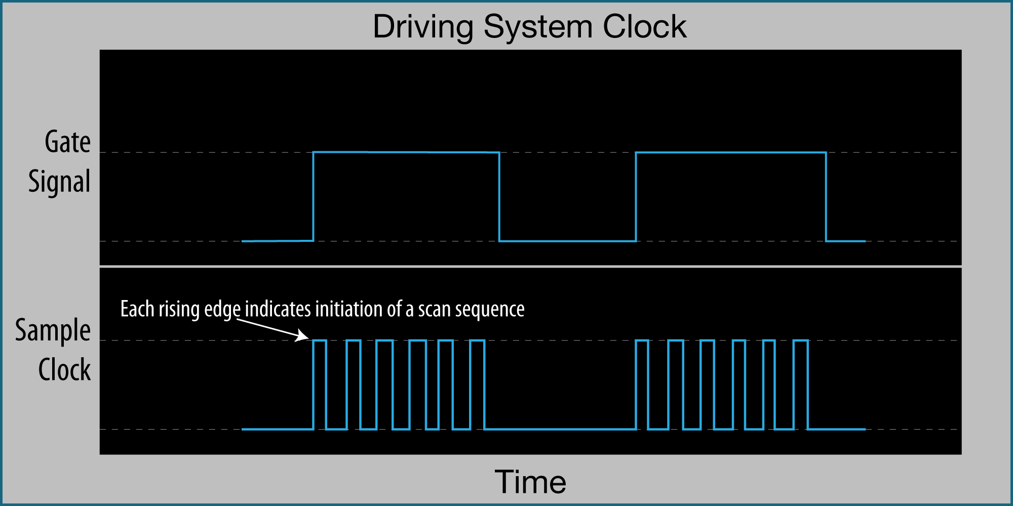
Analog vs. Digital
Significant improvements have been made in the process of converting analog signals to digital signals:
  discretization process: A process through which a single value is assigned to a range of values for a given parameter of interest. These sample electrical quantities are then called digital signals.
discretization process:

Slide 34
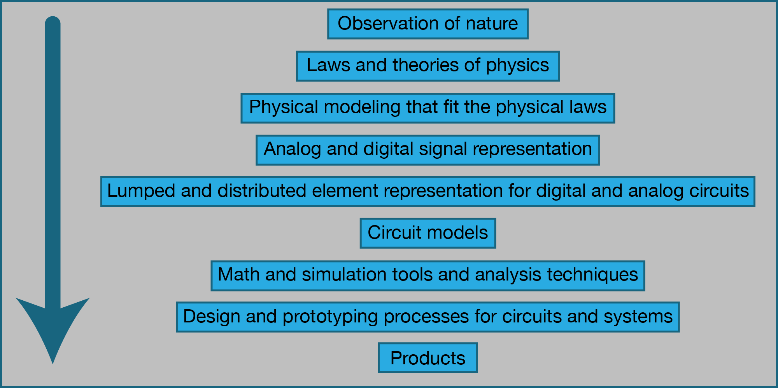
Circuit Analysis and Design
Electrical engineers have developed a well-defined methodology for analyzing and designing electrical circuits and systems.
Science and engineering joint journey of product development

Slide 35
Circuit Analysis and Design
Problem Solving:
  As a practicing engineer, you will spend most of your time solving problems (challenges) by designing and building products according to customer specifications, providing various engineering solutions, and working within a team.
Circuit Analysis:
The process of analysis begins with fully understanding the scope of the stated problem, then formulating the necessary assumptions and constraints, and then using mathematical tools and circuit theory to compute the desired parameters.

Slide 36
Circuit Analysis and Design
Circuit Design:
The process of design is more challenging and depends on the clarity of the statement and specifications of what is to be designed.
Broadly speaking, today’s engineering design process follows five simple steps:
  State the problem to be solved or design objective to be met.
  Identify any assumptions or constraints of the problem statement.
  Propose a possible design solution and find that solution.
  Check the viability of the solution and select the most appropriate solution to meet the objective in step1.
  Build and test the design. If the design objectives are not satisfactorily met, repeat the above steps.

Slide 37
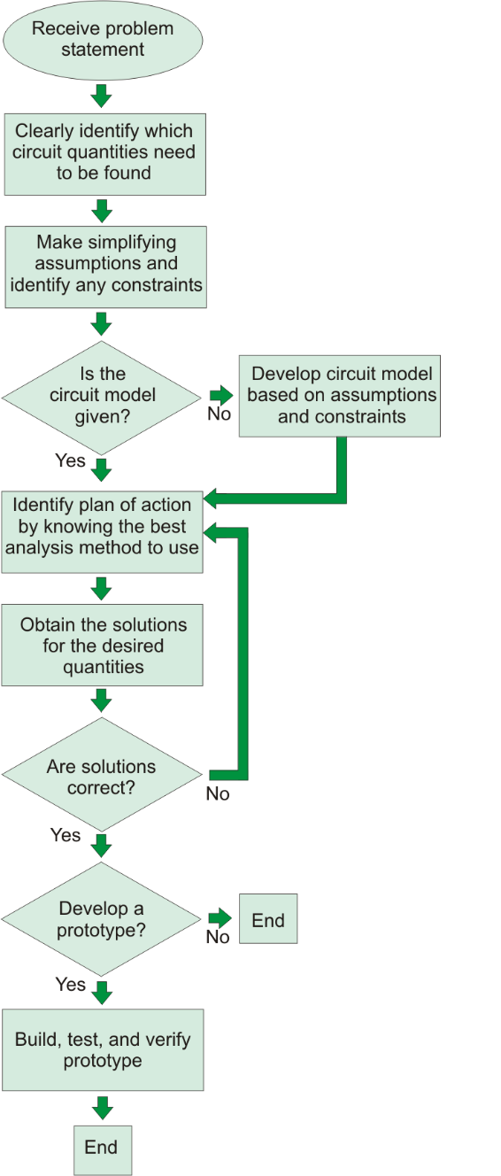
Circuit Analysis and Design
Conceptual diagram of circuit analysis

Slide 38
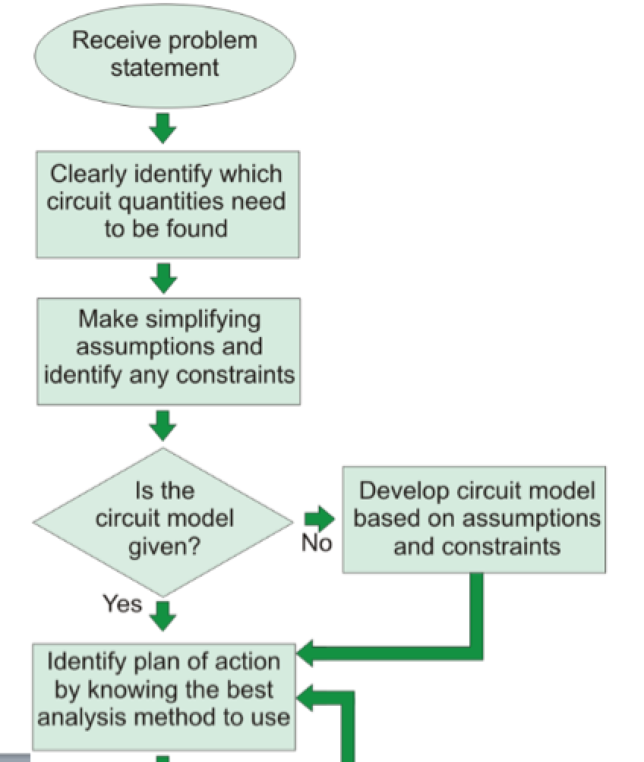
Circuit Analysis and Design

Slide 39
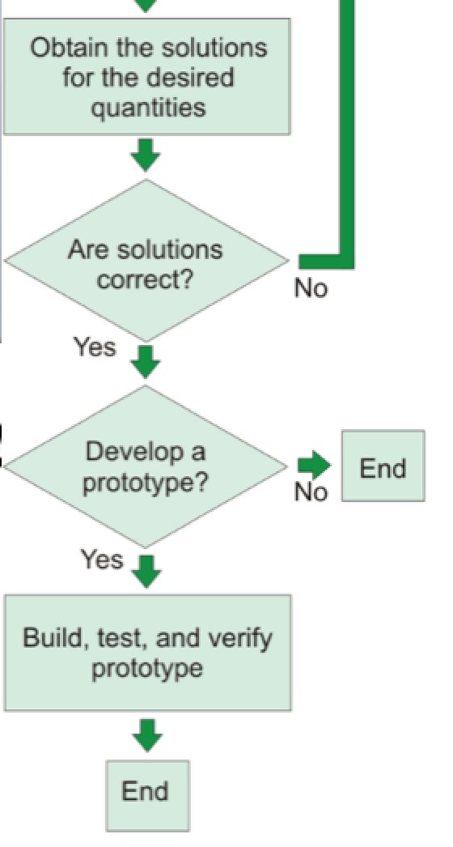
Circuit Analysis and Design

Slide 40
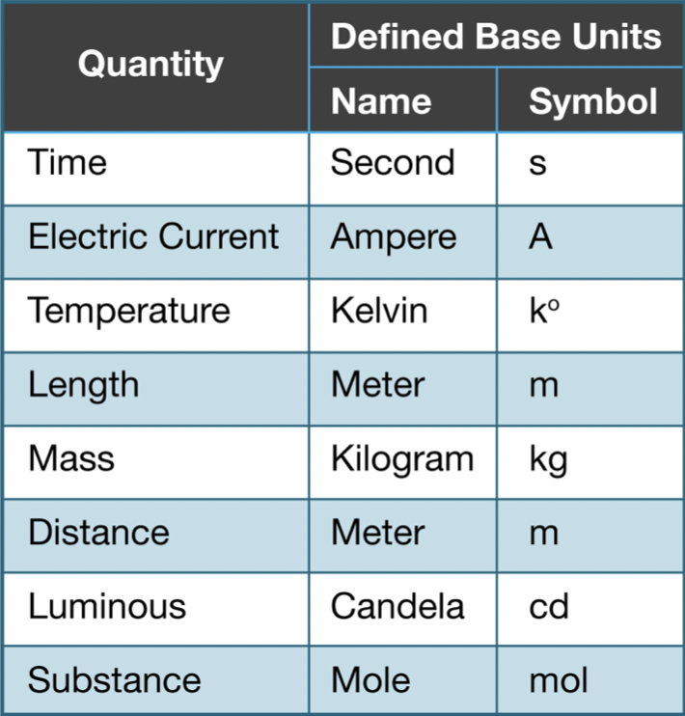
System of Units for Engineers
Used International System (SI) Units and their symbols

Slide 41
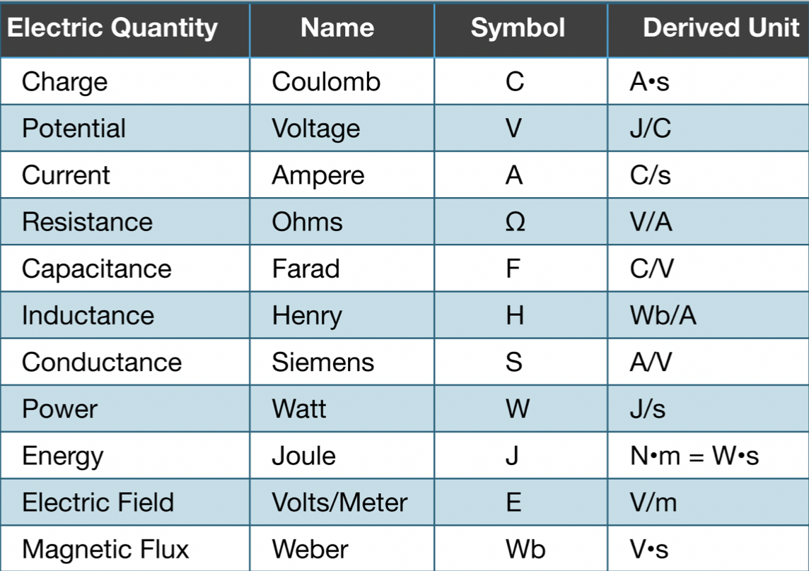
System of Units for Engineers
Derived units based on the defined base SI units

Slide 42

System of Units for Engineers
Common engineering standardized prefix multipliers and their symbols
Standardized prefix multipliers

Slide 43
System of Units for Engineers
Common engineering standardized prefix multipliers and their symbols
Used in this
course
Standardized prefix multipliers

Slide 44

Practical Example
Apple iPhone
Mesh Analysis – Voltage Amplifier
Voltage Amplifiers are electronic circuits that are used to amplify (enlarge) a weak input signal (voltage or current) and produce a stronger output signal (voltage or current).
Consumer Electronics: Radios, T.Vs., Cell phones, satellites, VCRs and DVD.

Slide 45

Practical Example
Apple iPhone
Voltage/Power Amplifier
http://maltiel-consulting.com/iPhone_Components_maltiel_semiconductor-Update.htm#Inside_Apple_iPhone_3G

Slide 46
Practical Example
Smart iPhone
Voltage/Power Amplifier
http://maltiel-consulting.com/iPhone_Components_maltiel_semiconductor-Update.htm#Inside_Apple_iPhone_3G

Slide 47




Commercial Product
Printer Circuit Board
Power Amplifier IC
Voltage Amplifier block Diagram
Av: Stands for Voltage Gain
Mathematical Representation

Slide 48

Practical Voltage amplifier

Slide 49

Practical Voltage amplifier – 400 W Audio Amplifier
http://electronics.stackexchange.com/questions/123879/amplifying-analogue-audio-from-an-iphone-docking-station

Slide 50
Practical Voltage amplifier – 400 W Audio Amplifier
Resistor
DC Source
Diode
Capacitor
Transistors
Op Amp
Ground
http://electronics.stackexchange.com/questions/123879/amplifying-analogue-audio-from-an-iphone-docking-station

Slide 51






Highly Simplified Equivalent Circuit: MOSFET Voltage Amplifier
DC Source
Output Signal
Input Signal
Simplified Common source amplifier with MOSFET Transistor

Slide 52


Highly Simplified Equivalent Circuit: MOSFET Voltage Amplifier
Active device
Transistor
DC Source
Output Signal
Drain (D)
Input Signal
Gate (G)
Source (S)
Simplified Common source amplifier with MOSFET Transistor

Slide 53


Highly Simplified Equivalent Circuit: MOSFET Voltage Amplifier
D
G
S
Equivalent Small Signal model for a MOSFET Transistor

Slide 54



Highly Simplified Equivalent Circuit: MOSFET Voltage Amplifier
Simplified Equivalent common source amplifier with MOSFET Transistor

Slide 55



Highly Simplified Equivalent Circuit: MOSFET Voltage Amplifier
Simplified Equivalent common source amplifier with MOSFET Transistor
Using Circuit Analysis method in this course, we can solve for Av.

Slide 56
ELECTRIC CIRCUITS
Technical Electronic Book
(New Textbook under print by Pearson)
by
Issa Batarseh
University of Central Florida
Please send corrections or comments to Dr. Issa Batarseh
issa.batarseh@ucf.edu

Slide 57
Thank You !

