Slide 1
EEL 3004 Linear Circuits Lecture #1A Overview Course and Introductory Concepts

Slide 2
Lecture Objectives
Academic Assignment
Course Outline and Policy
About Electrical Engineering Profession
Types of Engineering and EE Concentrations
Brief History of EE
Introduction to my textbook in print by Pearson (Technical eBook)

Slide 3
Student Academic Activities
All faculty members are required to document students' academic activity at the beginning of each course. In order to document that you began this course, you must attend the first week and sign the attendance sheet. This academic assignment (signing attendance sheet) must be done no later than the first Friday of the semester. Failure to do so will result in a delay in the disbursement of your financial aid.
For more info, please visit:
http://teach.ucf.edu/support/

Slide 4
Academic Assignment
Read Chapter 1 and History of Electricity & Computing, and answer the following Three Questions:
1) List five different disciplines of Electrical and Computer Engineering.
2) Who discovered the electron and when?
3) Who defined the notion of bit and when?

Slide 5
EEL 3004 - Linear Circuits Syllabus
Instructor: Dr. Issa Batarseh
Instructor’s Office: Harris Engineering Center (HEC 204)
Office Hours: 12:00 – 1:30 T,Th
Phone Numbers: ♦ Work: 407-823-0185 ♦ Cell: 407-962-8630
Email: issa.batarseh@ucf.edu
Class Hours: T, Th 4:30 – 5:45 AM
Class Room: Class Room Building 1 (CB1) – 0307
Catalog Description: Analysis and design of linear circuits, transients, ac analysis, power calculations
and three-phase circuits.
Course Objectives: The course objectives are to familiarize students with the basic theorems, concepts and laws of electric circuits. By the end of this course, students should be able to apply fundamentals of electric circuit theory to analyze and design electrical networks.
Prerequisites: MAC 2311C , MAC 2312 , MAC 2313 , PHY 2048C , PHY 2049C all with a grade of “C” (2.0)
or better grade. Corequisite(s): MAP 2302
Course Content: Engineering Design: 1 credit hours
Engineering Science: 2 credit hours

Slide 6
EEL 3004 - Linear Circuits Syllabus
Recommended Textbook:
Electric Circuits, J. W. Nilsson and S. A. Riedel, Pearson. ISBN: 978-0133760033
Electric Circuits*, Issa Batarseh – My draft Textbook under preparation, Pearson (please don’t distribute)
*To be used for reading and other assignments

Slide 7
Syllabus
Covered Topics:
Fundamental Concepts
Electrical Definitions of quantities, elements, network concepts, units.
Review of complex numbers, solving determinants- Kramer’s rule, and solving first order differential equations.
Analysis Techniques of Resistive Circuits:
Ohm’s Law
Kirchhoff’s Laws
Advanced Resistive Circuit Analysis:
Node Analysis Mesh Analysis
Superposition Thevenin and Norton Theorems
Maximum Power Transfer

Slide 8
Syllabus
Covered Topics:
Energy Storage Elements: Inductors and Capacitors
Capacitors, Inductors, Series and Parallel Connections of Capacitors
First Order Transient Response of RL and RC Circuits
The First Order RC and RL Circuits, Natural and Step Responses
Sinusoidal Steady State Analysis
Sinusoidal Signals, Response in phasors.
AC Steady-State Power Calculations
Instantaneous, Real, Reactive, Apparent and Complex Powers
Power Factor and Power factor corrections

Slide 9
Syllabus
Basis for Final Grade
Quiz: 10 quizzes will be conducted. A missing a quiz will receive a zero!
Tests: 2 In-person tests worth 20% each will be conducted in person.
Final Exam: The in-person final exam is comprehensive and weights 30%.
Discussion: Students are expected to attend the discussion and based on the level of their participation a 0-5% weight will be assigned. More will be provided by your discussion instructor.
Assignments | Total Percentages
Discussion Session | 5%
Quizzes (10x2.5%) | 25%
Midterm Exams I&II (2x20%) | 40%
Final Exam | 30%
Total | 100%
There will be six Teaching Assistances (TA’s) assigned to the three EEL 3004 Sections.

Slide 10
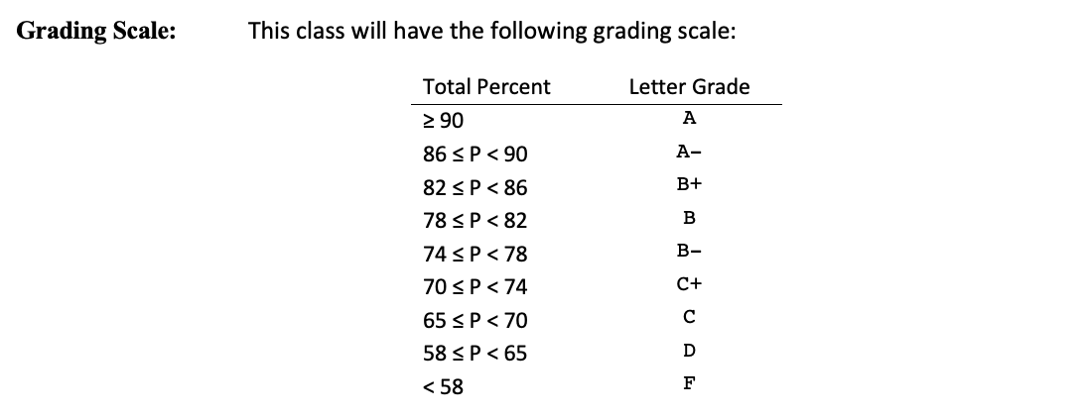
Syllabus
Grading Scale
Grading scale will only include: A, A-, B+, B, B-, C, D, F

Slide 11
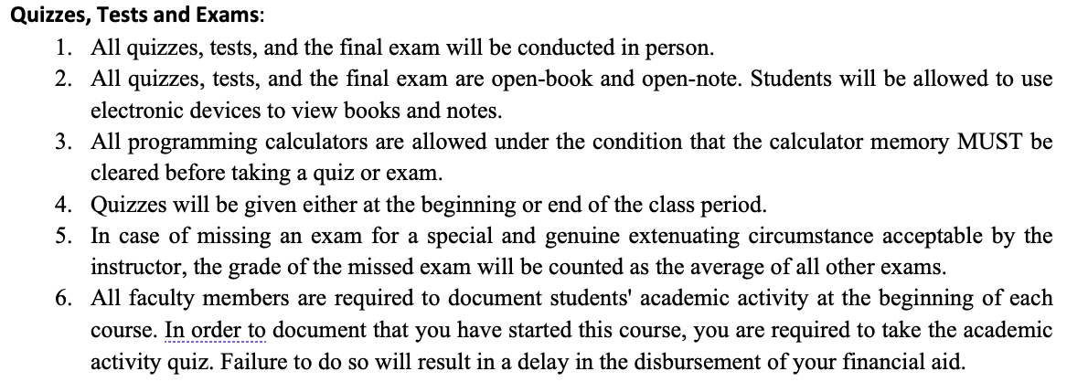
Syllabus - Course Policies

Slide 12
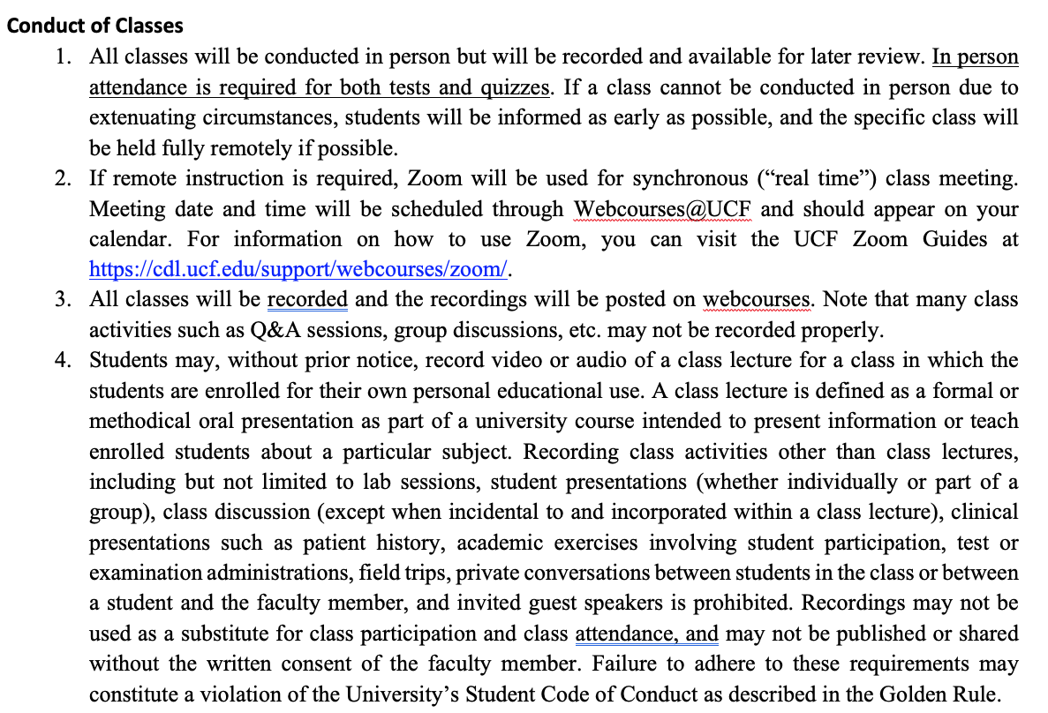
Syllabus - Course Policies

Slide 13
Syllabus - Course Policies
Class Attendance
All students are encouraged to attend all lectures in person at the regular class meeting time.
Discussion Sessions
The discussion sessions will begin in the 2nd week of classes. All discussion sessions are conducted in person by your teaching assistant (TA).
You will earn up to 5% point depending on your attending and participating in the discussion sessions. Please see the Discussion instructor for the attendance requirements. Failure to meet the attendance requirement will earn you zero point.
To meet the attendance requirement for each discussion session, you are required to attempt a the selected problems.

Slide 14
Syllabus - Course Policies
Student Academic Activities:
All faculty members are required to document students' academic activity at the beginning of each course. In order to document that you began this course, you must attend the first week and sign the attendance sheet. This academic assignment (signing attendance sheet) must be done no later than the first Friday of the semester. Failure to do so will result in a delay in the disbursement of your financial aid.
For more info, please visit:
http://teach.ucf.edu/support/

Slide 15
Important Dates and Deadlines:

Slide 16
What is the field of Engineering?
Engineering is a profession that use science, technology and math to solve problems.

Slide 17
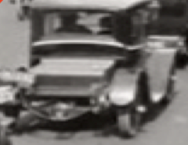
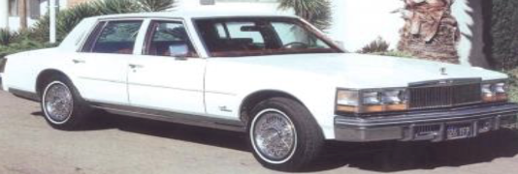
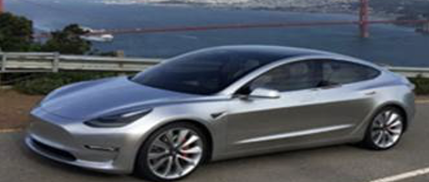
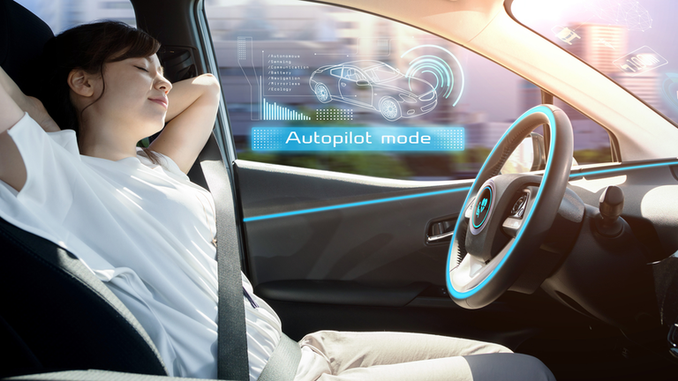
Transportation Problem
People needed to move between different places fast
Possible Solutions:
Imagining☺
Walking
Running
Horses
Boats
Trains
Cars
Busses
Planes
Rockets

Slide 18
What is Electrical Engineering
Layers of the field of Electrical/Computer Engineering:
The Physical laws
Components
Devices
Circuits or Networks (EEL 3004)
Systems
Product development
Commercialization
Science
Engineering
Business

Slide 19
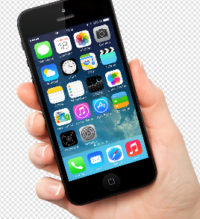
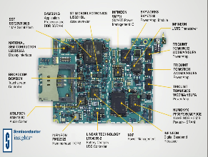
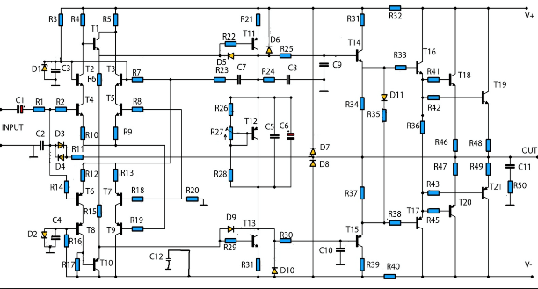
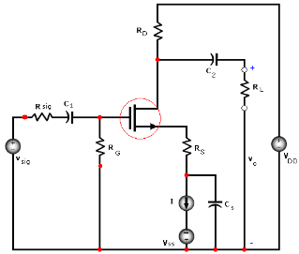
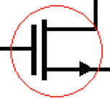
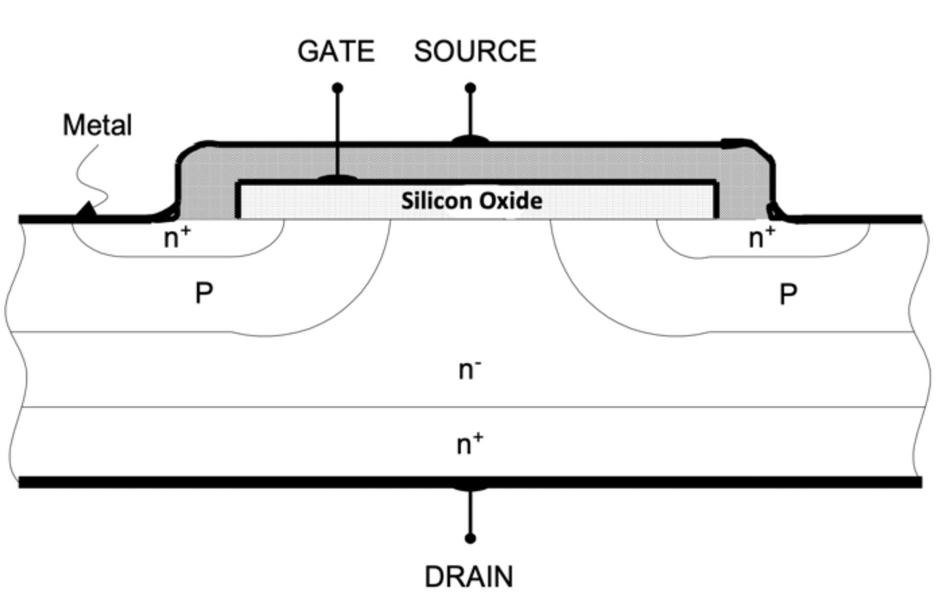
Engineering Design, Product Development, Commercialization
Product Commercialization
and Sales
$
All: Product development
$
EE/CpE/Business:
Initial Product Design concepts
$
EE: System Design & Testing
$
EE: Circuit analysis/ testing
Physics
$

Slide 20
Engineering Programs in CECS
Dept. of ECE
Electrical Engineering
Computer Engineering
Civil Engineering
Environmental Engineering
Construction Engineering
Industrial Engineering
Aerospace Engineering
Mechanical Engineering
Computer Science
Information Technology

Slide 21
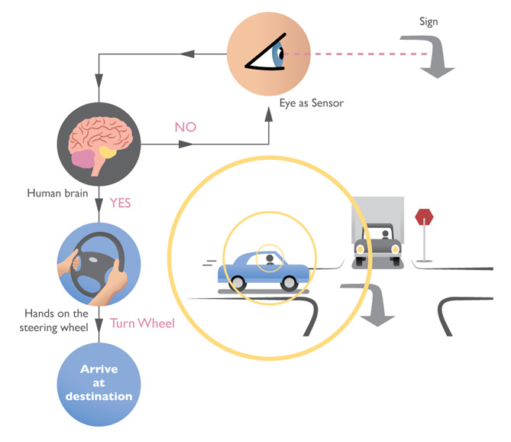
Concentrations in Electrical Engineering
Control Engineering: Control engineering focuses on the modeling of a diverse range of dynamic systems and the design of controllers that will cause these systems to behave in the desired manner.
Schematic representation for a typical control system

Slide 22
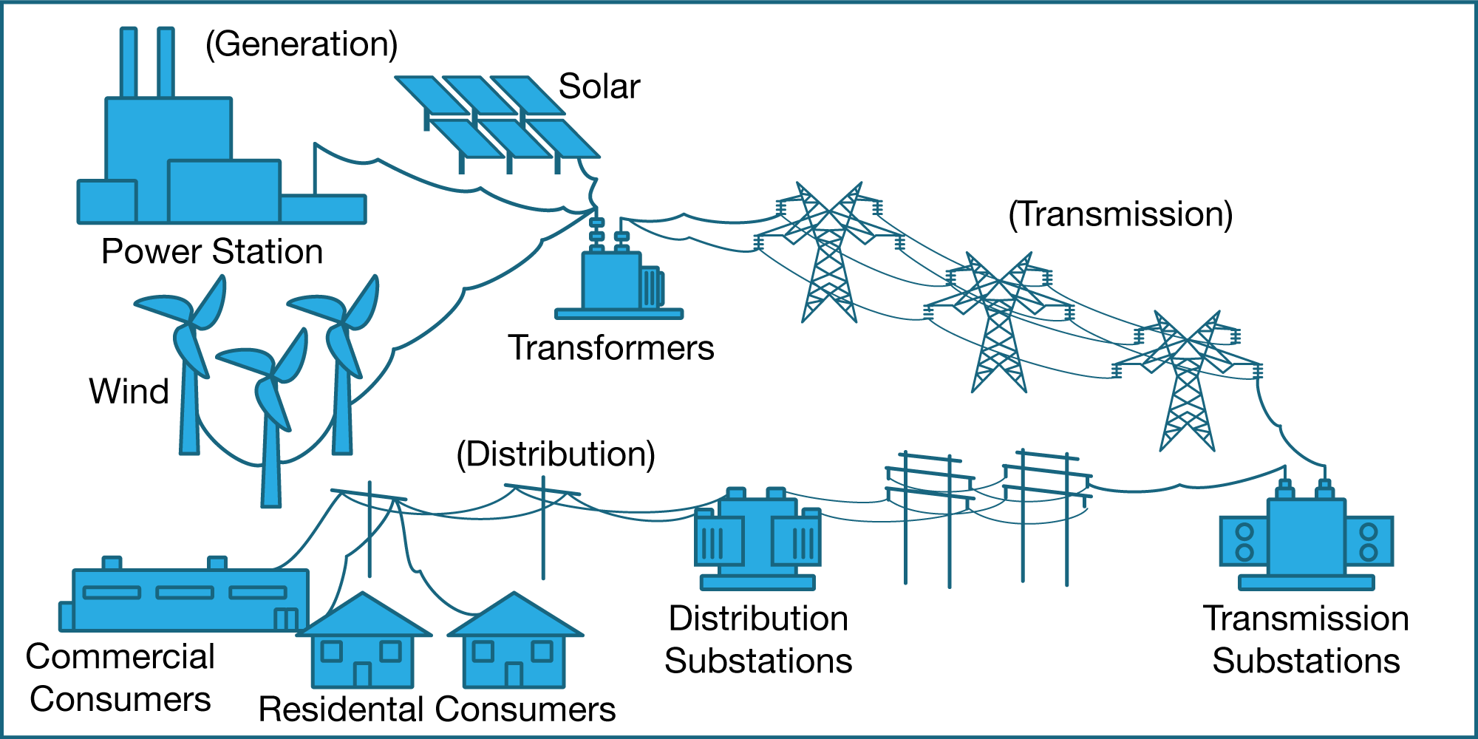
Concentrations in Electrical Engineering
Power and Energy Engineering: Deals with the generation, transmission, and distribution of electricity from various types of sources.
Figure 1.20 Typical power infrastructure with power generation, transmission and distributions, and residential

Slide 23
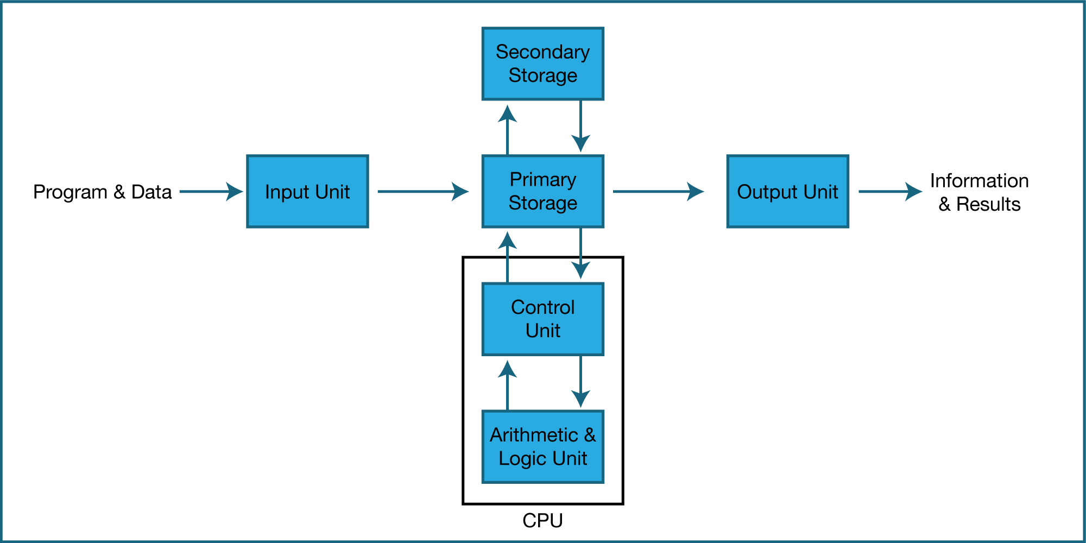
Concentrations in Electrical Engineering
Computer Engineering: deals with the design of computers and computer systems. This work ranges from the design of new hardware, such as RAM, to the use of computers to control an industrial plant.
Major components of computer architecture

Slide 24
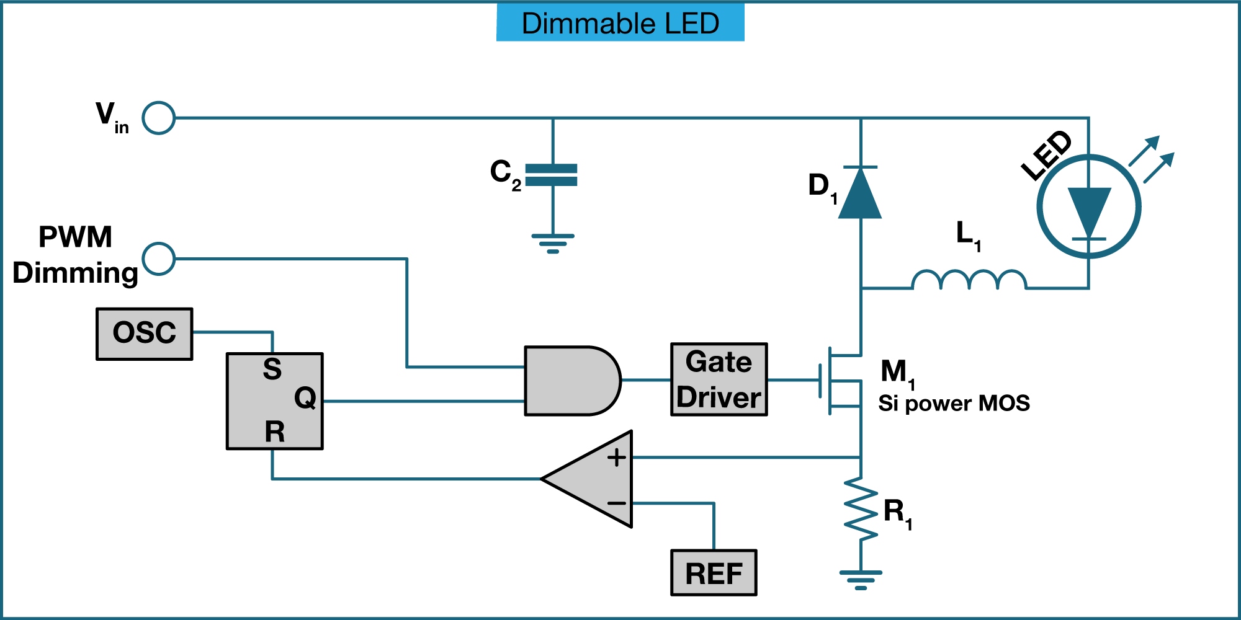
Concentrations in Electrical Engineering
Electronics/Microelectronics Engineering: Involves the design of electronic circuits that use the properties of electronic components such as resistors, capacitors, inductors, diodes, transistors, Integrated Circuits (ICs), and operational amplifiers to achieve a particular goal.
Simplified schematic circuit representation for a typical electronics circuit to drive a dimmable Light Emitting Diode (LED)

Slide 25
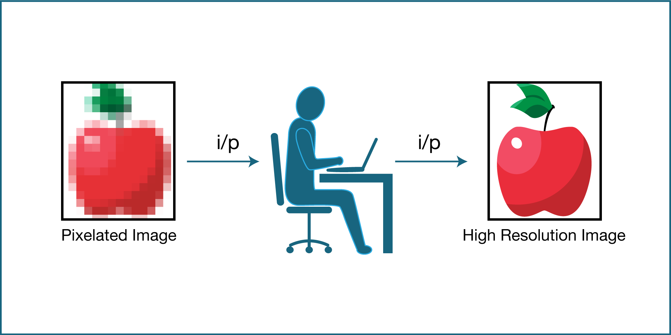
Concentrations in Electrical Engineering
Digital Signal Processing: Signal processing deals with the analysis and manipulation of signals.
Schematic representation of a Digital Signal Processing (DSP) circuit for filtering a noisy image

Slide 26
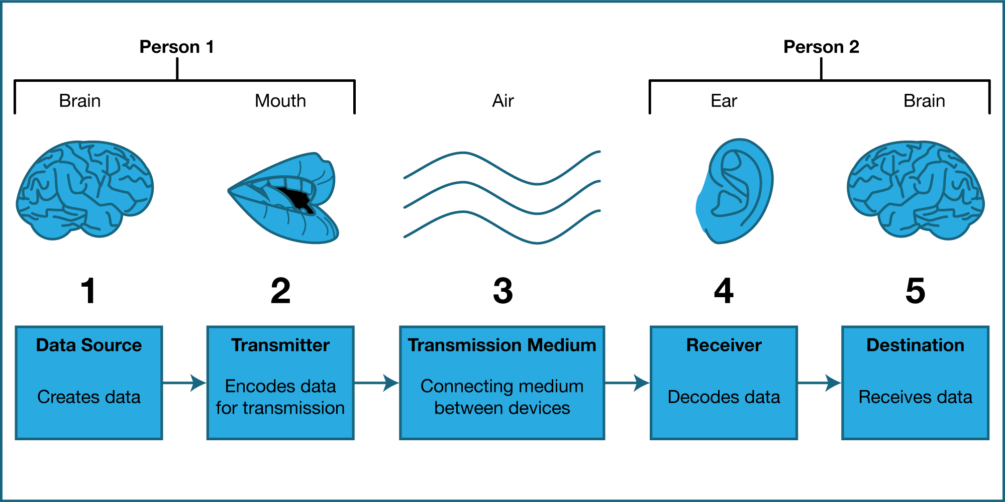
Concentrations in Electrical Engineering
Communication Engineering: Communication engineering focuses on the transmission of information across a channel such as a coaxial cable, optical fiber, or free space.
Basic components of a typical communication system

Slide 27
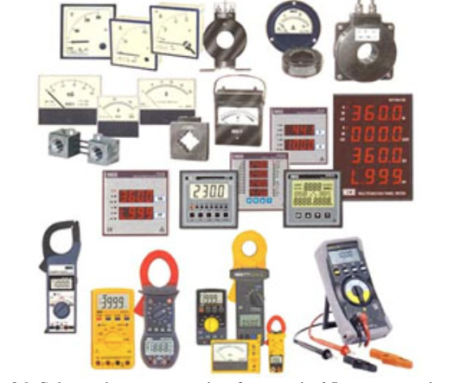
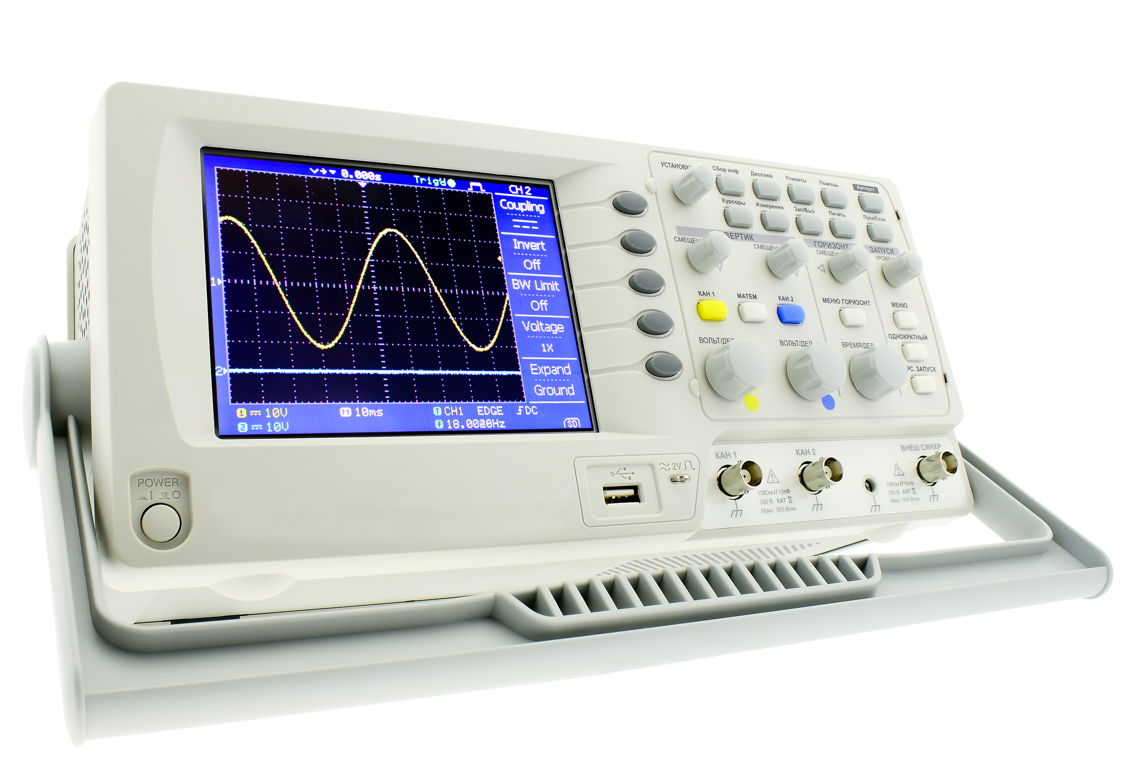
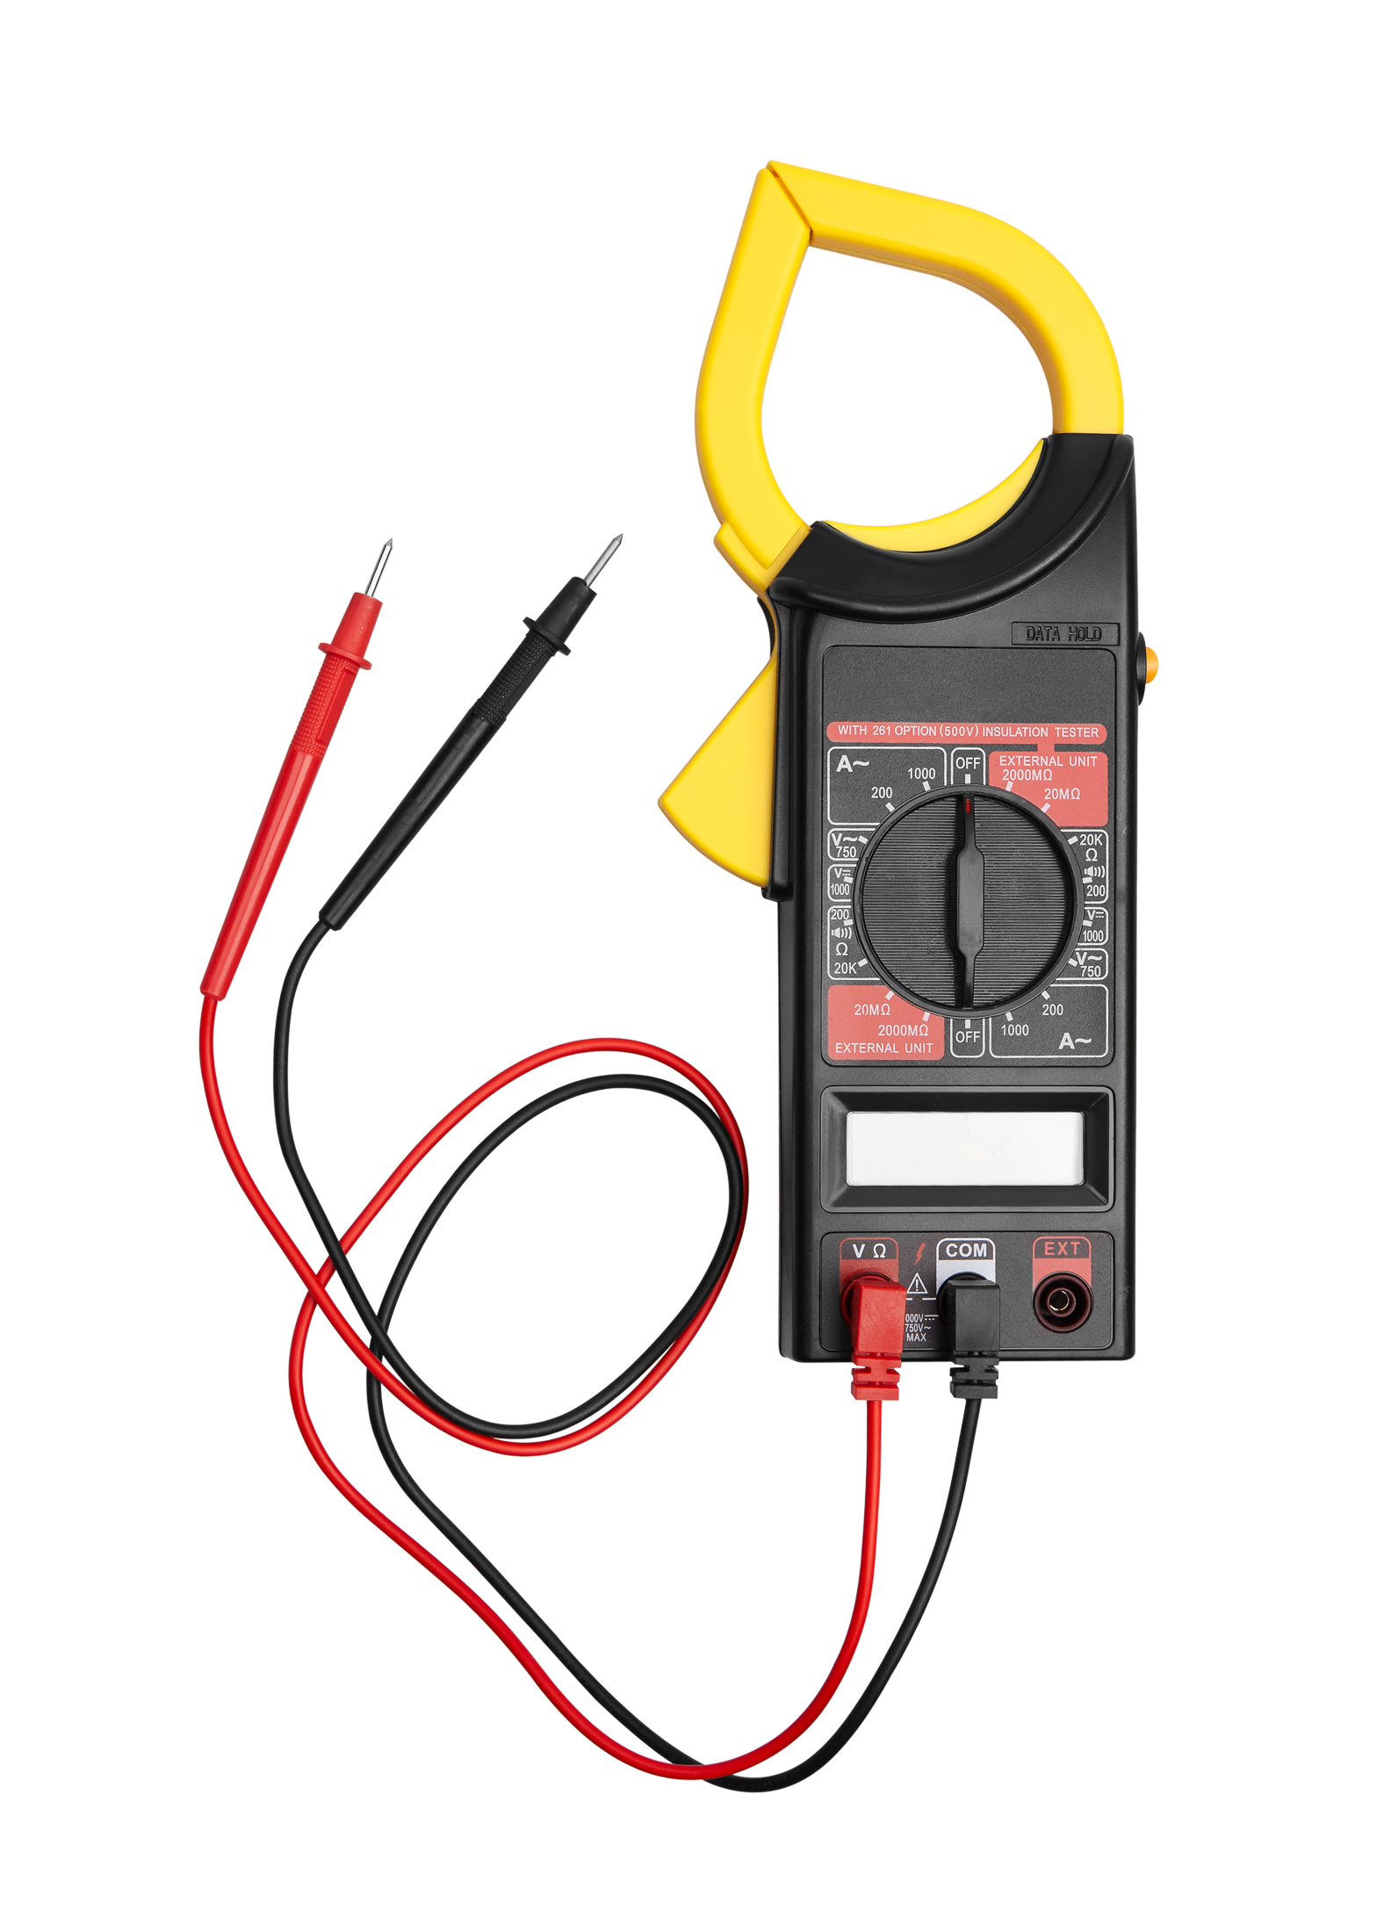
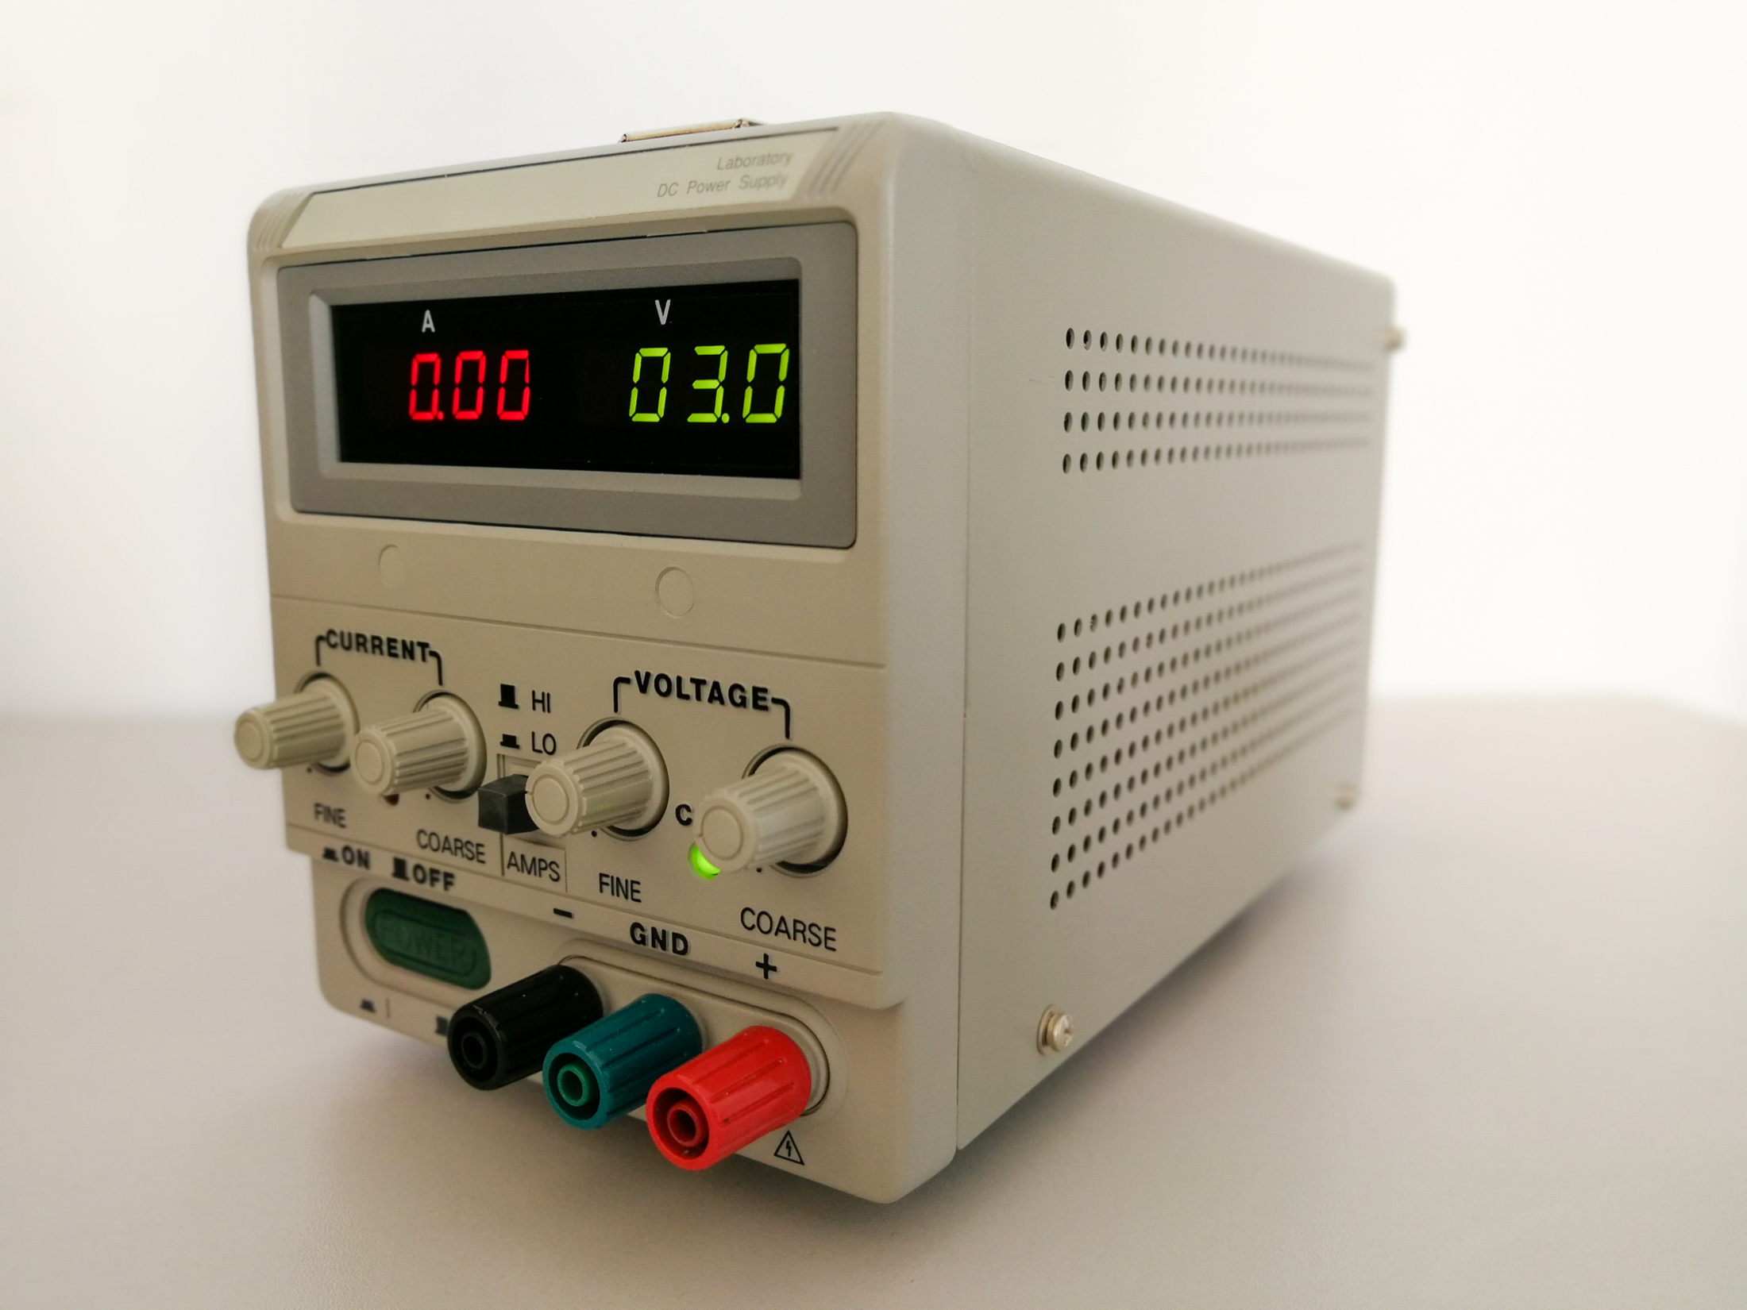
Concentrations in Electrical Engineering
Instrumentation Engineering: Deals with the design of devices to measure physical quantities such as pressure, flow, and temperature.
Examples of real world products that could be designed by an instrumentation engineer.
Others such biomedical Engineering, Mechatronics, CS, Bioinfromatics:

Slide 28
History of Electricity and Computing
See the presentation posted under “Files/Lectures” folders of your
course.

Slide 29
The Electron & Bit Discovery
The seeds for today’s Digital Revolution were planted by the discovery of the electromagnetic force (electron) and the development of the notion of binary system (bit).

Slide 30
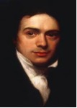
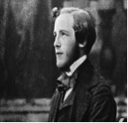
The Electron Discovery
Michael Faraday built the first electric motor based on magnetic induction, the first generator and transformer. The words ion, electrode, cathode, and anode were coined by Faraday.
James Maxwell presented the unified theory of electromagnetism, mathematically unifying Faraday’s and Ampere’s Laws. He concluded that electric and magnetic energy travel in transverse waves which propagate at a speed equal to that of light. He is best known for his famous ‘Maxwell Equations’.

Slide 31
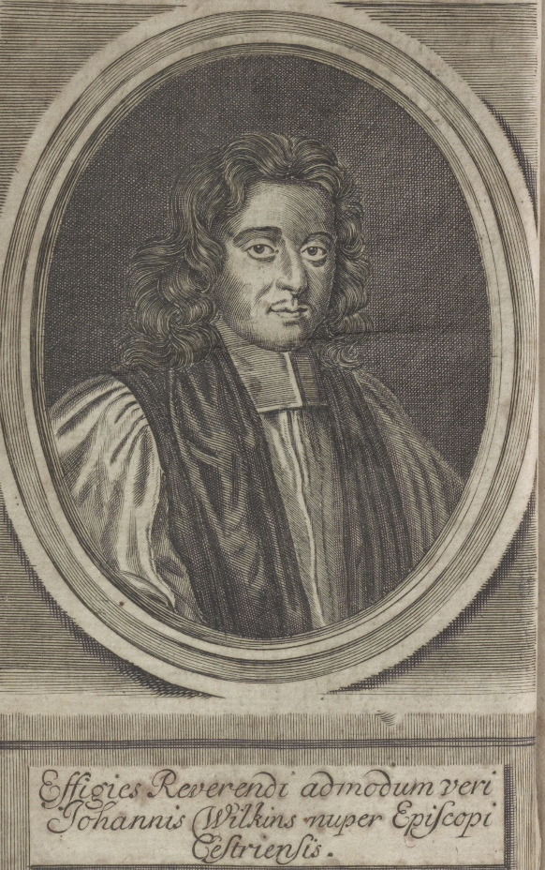
Inventing the Binary System
In 1641, John Wilkins published a book entitled:
Mercury; or, The secret and swift messenger. Shewing, how a man may with privacy and speed communicate his thoughts to a friend at any distance
Only with 2 letters of Alphabets “a” and “b” you can write any message and no one will know how to read it!
John Wilkins (1614-1672)
https://www.loc.gov/item/11019070/

Slide 32
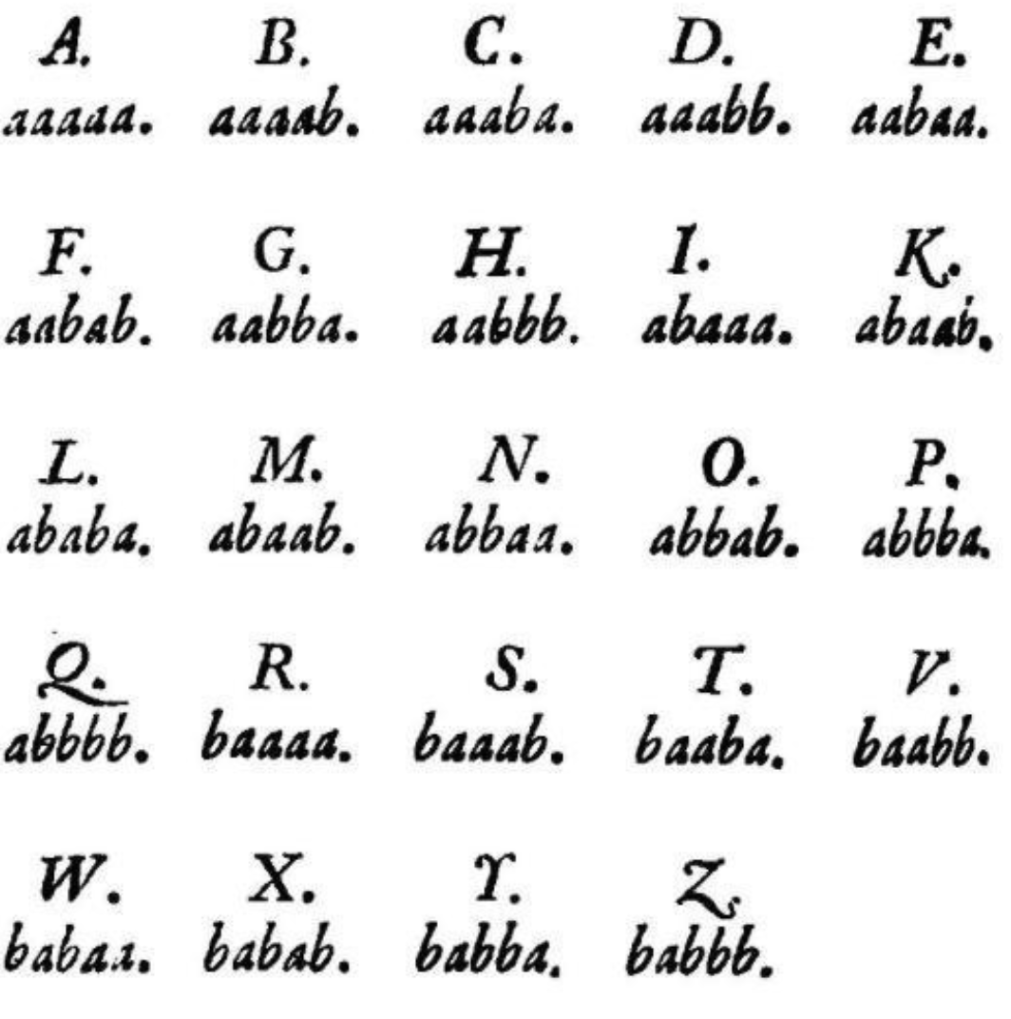
Inventing the Binary System
The statement “FLY AWAY” is written as:
abaaabaaabbaaabaaaaa aaaabaaaaabaabaaaaabaaaabaaabaabaaaabbb
I s s a b a t a r s e h

Slide 33
Inventing the Binary System
This is simply a binary system that was invented nearly 400 years ago!
200 years later, George Boole replaced a=1 and b=0 !
100 years later, Claude Shannon said let us denote 0=switch off and 1= switch on.
25 years later, the switch became a transistor, and the transistor gave us digital gates, then Integrated Circuits, the microprocessors, the computer, the internet, WWW, and Facebook..etc.🙂
When mankind inventing the notion that we only need two DIFFERENT symbols to represent and communicate information.

Slide 34
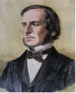
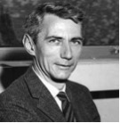
The Bit Discovery
George Boole developed a form of symbolic logic called Boolean Algebra which formed the basis for digital circuit design and led to modern-day digital computers and digital electronics.
Claude E. Shannon made brilliant contributions to digital communications and information theory and is best known for the Shannon Sampling Theorem. Proposing the groundbreaking idea of converting any kind of data, whether pictures, text, or sound, into zeros and ones for error-free communication.

Slide 35
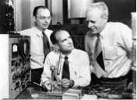
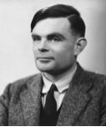
The Digital Revolution The Merger of the Electron and the bit
Shockley, Bardeen, and Brattain have changed the world with their invention of the semiconductor transistor, ushering in the age of technology. Their groundbreaking work led to the invention of the electric transistor in 1947.
Alan Turing introduced the idea of a universal machine, known as the ‘Turing Machine’, capable of computing anything that could be computed. The Turing machine was a precursor of the modern computer.

Slide 36
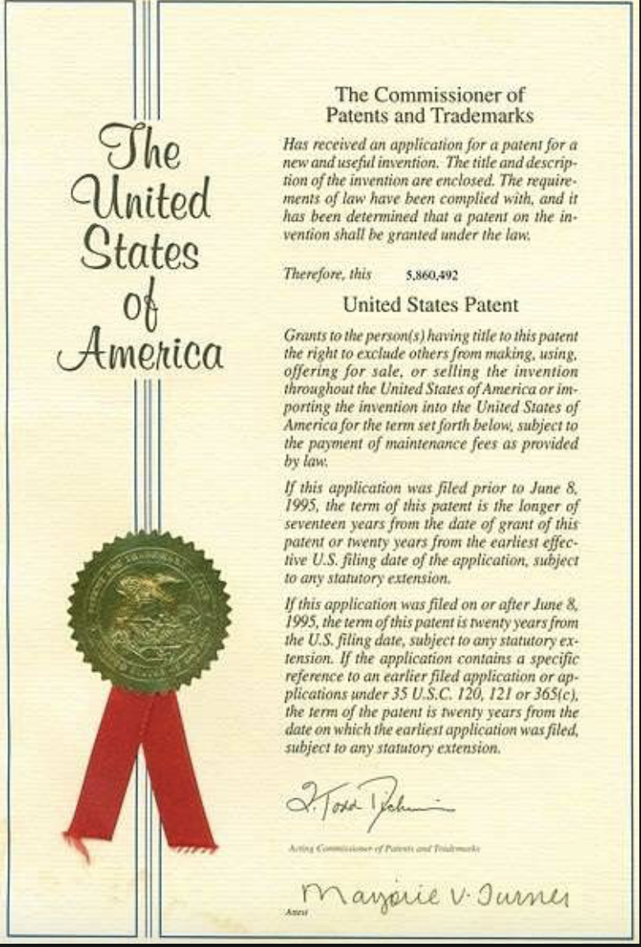
US Patent Law
On January 8, 1790, during his first State of the Union, President George Washington called on Congress to establish a system: “The advancement of Agriculture, commerce and Manufactures, by all proper means, will not, I trust, need recommendation.”
On April 10, 1790, President Washington signed the bill that laid the foundation of the modern American patent system. This date marks the first time in American history that the law gave inventors rights to their creations.
The first patent was issued on July 31, 1790.
On July 31, 1790 Samuel Hopkins was issued the first patent for a process of making potash, an ingredient used in fertilizer. The patent was signed by President George Washington.
In summer 2019, the total US issued patents exceeded 10,000,000!

Slide 37
Professional Organizations
Institute of Electrical and Electronics Engineering (IEEE)
Accreditation Board for Engineering and Technology, Inc. (ABET)
American Society of Engineering Education (ASEE)
National Academy of Engineering (NAE)
American Association for the Advancement of Science (AAAS)
National Academy of Inventors (NAI)

Slide 38
ELECTRIC CIRCUITS
Technical Electronic Book
(New Textbook under print by Pearson)
by
Issa Batarseh
University of Central Florida
Please send corrections or comments to Dr. Issa Batarseh
issa.batarseh@ucf.edu
This is a copyrighted materials

Slide 39
Thank You !

