Slide 1
EEL 3004 Electrical Networks Lecture #18 Examples and Advanced Phasor Circuit Analysis

Slide 2
Lecture Objectives
The lecture today will focus on:
Example phasor circuits – single-node pair
Example using total impedance
Introducing the admittance notation
Mesh analysis in the frequency domain.
Delta-Wye transformations in phasor approach and examples.
The Thevenin and Norton techniques in phasor analysis.

Slide 3
Exam II
WednesdayApril 7 | Exam II: 10:30 – 11:45 AM | Lectures 11-18 (Chs. 4,5,6,8)

Slide 4
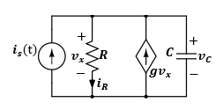
Example
Given the RC circuit with the dependent source, the current input is given by,
Determine the expression for v_{C}(t) and i_{R}(t) by using phasor method.
I_{m}
Variable | Default | Unit
I_{m} | 6 | A
ω | 3000 | rad/s
θ | π/3 | rad
R | 18 | Ω
C | 0.8 | mF
g | 4

Slide 5
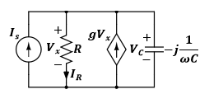
1) First we transform the time-domain circuit into the phasor-domain,
time-domain circuit
Phasor-domain circuit
2) Second solve for phasor currents and voltages as complex
numbers by using any analysis method
3) Transform the phasor domain values to time domain.

Slide 6
Applying KCL at the upper node yields,
It can be seen that V_{x} = V_{C},
Now applying KVL around the loop including the resistor and capacitor yields,

Slide 7
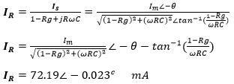
Solving these two equations for I_{R},
Transforming the current IR back to the time-domain yields,

Slide 8
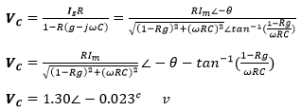
Solving these two equations for V_{C},
Transforming the voltage VC back to the time-domain yields,

Slide 9
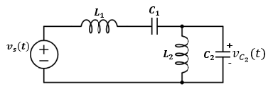
Example:
For the time-domain circuit given in the voltage source, $v_{s}(t)$ is given by
$v_{s}\left(t\right)=V_{m}\cos{ωt}$
Determine the total impedance in phase-domain seen by the source
Find the expression for the total current $i_{s}\left(t\right)$ drawn by the source
Find the expression for the capacitor voltage$v_{C2}(t)$.
Where $V_{m}=5V,ω={10}^{5}\frac{rad}{s},θ={45}^{°}, L_{1}=10mH, L_{2}=6mH,C_{1}=20μF and C_{2}=180μF$
$$i_{s}\left(t\right)$$

Slide 10
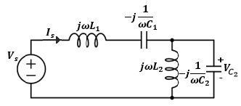
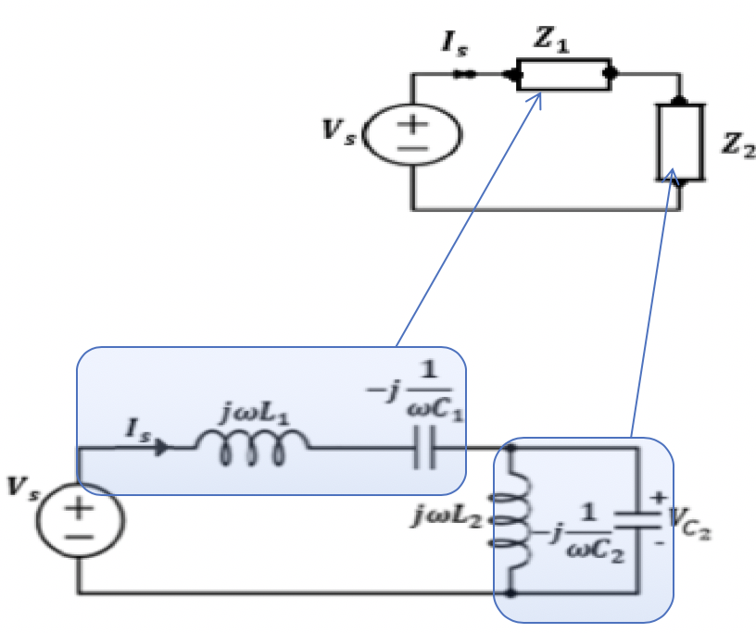
Solution:
The first step is to transfer the circuit from time-domain to frequency-domain as shown
Combining impedance of single elements connected in series,$Z_{1}$, and connected in parallel,${ Z}_{2}.$

Slide 11
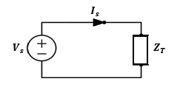
Where,
$$Z_{1}=jωL_{1}+\left(−j\frac{1}{ωC_{1}}\right)$$
$Z_{2}=(jω{L_{2})}/{/(}−j\frac{1}{ωC_{2}}$)
The total impedance is given by,
$$Z_{T}=Z_{1}+Z_{2}$$
Then, the total current drawn by the source is obtained from
$$I_{s}=\frac{V_{s}}{Z_{T}}$$
Next, we fins the complex numbers for $Z_{1} and Z_{2}$

Slide 12
First Calculate $Z_{1}$:
$$Z_{1}=jωL_{1}+\left(−j\frac{1}{ωC_{1}}\right)=j(ωL_{1}−\frac{1}{ωC_{1}})$$
$$=j({10}^{5}x10x{10}^{−3}−\frac{1}{{10 }^{5}x 20x{10}^{−6}}$$
$=j\left({10}^{3}−\frac{1}{20x{10}^{−1}}\right) Ω$
$$Z_{1}=j 999.5Ω$$

Slide 13
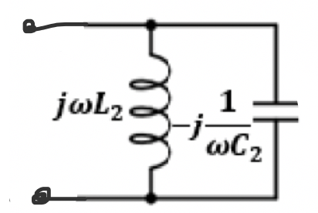
Second Calculate $Z_{2}$:
$Z_{2}=(jω{L_{2})}/{/(}−j\frac{1}{ωC_{2}}$)
$$Z_{2}$$
$$=\frac{(jωL_{2})(−j\frac{1}{ωC_{2}})}{\left(jωL_{2}\right)+(−j\frac{1}{ωC_{2}})}=\frac{ −j^{2}\frac{L_{2}}{C_{2}}}{j(ωL_{2}−\frac{1}{ωC_{2}})}$$
$$=\frac{ −(−1)\frac{L_{2}}{C_{2}}}{j(ωL_{2}−\frac{1}{ωC_{2}})}=\frac{ \frac{L_{2}}{C_{2}}}{j(ωL_{2}−\frac{1}{ωC_{2}})}=−j\frac{ \frac{L_{2}}{C_{2}}}{ωL_{2}−\frac{1}{ωC_{2}}}=j\frac{L_{2}ω}{1−ω^{2}L_{2}C_{2}}$$
$$=−j\frac{ \frac{6x{10}^{−3}}{180x{10}^{−6}}}{{10}^{5}x 6x{10}^{−3}−\frac{1}{{10}^{5} x180x{10}^{−6}}}=−j\frac{0.0333x{10}^{3}}{6x{10}^{2}−\frac{1}{180x{10}^{−1}}}$$
$$=−j\frac{33.33}{600−0.056}=−j\frac{33.33}{599.94}=−j\text{0.06}Ω$$
$$Z_{2}=−j\text{0.0}6 Ω$$

Slide 14
The total impedance $Z_{T}$:
The total impedance is given by,
$$Z_{T}=Z_{1}+Z_{2}$$
$$Z_{T}=j 999.5−j\text{0.0}6 Ω$$
$$Z_{T}=j\text{999.44 } Ω$$
$$Z_{T}$$
$$=999.4∠{90}^{o}$$

Slide 15
(b) First expressing the voltage source as a cosine function,
$$v_{s}\left(t\right)=V_{m}\sin{(ωt+θ)}= V_{m}\cos{(ωt+θ−90°)}$$
$$v_{s}\left(t\right)=5\cos\left(100000t−45°\right) V$$
The total current drawn by the source is obtained from
$$I_{s}=\frac{V_{s}}{Z_{T}}=\frac{\left.V_{m}∠(θ−90°\right)}{|Z_{T}|∠θ_{Z_{T}}}=|I_{s}|∠θ_{Is}$$
$I_{s}={|I}_{s}|∠θ_{Is}=5∠−{135}^{o}$ mA
Where,
$${|I}_{s}|=\frac{V_{m}}{\left|Z_{T}\right|}=\frac{5 V}{999.44 Ω}=5 mA$$
$$θ_{Is}=θ−{90}^{o}−θ_{Z_{T}}={45}^{°}−{90}^{o}−{90}^{o}=−{135}^{o}$$

Slide 16
So, the phasor current I_{s} may be expressed by,
$$I_{s}={|I}_{s}|∠θ_{Is}$$
$$=5∠{−135}^{o}$$
mA
Polar Form in degrees
$$=5∠−3π/4$$
mA
Polar Form in radians
$$=5e^{−j3π/4}$$
mA
In Euler’s Formula
$$=−3.54−J3.54$$
mA
Rectangular Form
Therefore, in time-domain the corresponding source current is given by,
$$i_{s}\left(t\right)={|I}_{s}\left|\cos{(ωt+}θ_{Is}\right)$$
$$= 5\cos\left({10}^{5}t−{135}^{o}\right) mA$$

Slide 17
(c) The phasor capacitor voltage is equal to the voltage across $L_{2}$, hence $V_{C_{2}}$ is given by
$$V_{C_{2}}=Z_{2}I_{s}=\left|Z_{2}\right|\left|I_{s}\right|∠{(θ}_{Z_{2}}+θ_{I_{S}})$$
$$=−19.65+j19.65 mV$$
$$=27.8∠135° mV$$
Where,
$$\left|Z_{2}\right|=\frac{L_{2}ω}{1−ω^{2}L_{2}C_{2}}=−j\text{0.0}6 Ω$$
$$θ_{Z_{2}}=−90°$$
Therefore, in time-domain the corresponding voltage $v_{C2}\left(t\right)$ is given by
$$v_{C2}\left(t\right)=27.8\cos\left({10}^{5}t+{135}^{o}\right) μV$$

Slide 18
Admittance
Like in time-domain where the reciprocal of resistance ‘R ’ is defined as the conductance ‘G ’, in phasor domain reciprocal of impedance is also defined and known as admittance.
The admittance, ‘Y’, is defined as the ratio of phasor current to phasor voltage.
In rectangular format, where ‘Z’ is expressed Z = R + jX, ‘Y’, is expressed as,
Where ‘G ’ is known as the conductance and ‘B ’ is the susceptance and both are measured in Siemens (S).

Slide 19
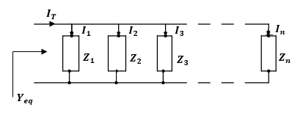
Admittance
The use of admittance is clearly seen when we algebraically sum the admittances of a network consisting of parallel connected impedances.
Where,
And the phasor current flowing through any of these individual impedance ‘I_{i} is given by,

Slide 20
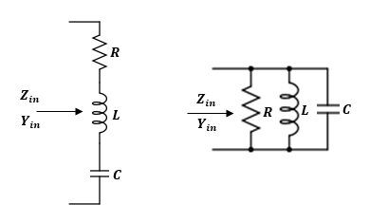
Example
Determine the input impedance and admittance for each of the following circuits:
Variable | Values | Unit
ω | 10⁵ | rad/s
R | 1 | kΩ
L | 100 | μH
C | 5 | μF

Slide 21
First we transform the circuit into the phasor-domain,
For the first circuit, the input impedance is given by,
$$Z_{in1}=R+j(ωL−\frac{1}{ωC})$$
$$=1000+j8 Ω$$
While the input admittance is given by,
$$Y_{in1}=\frac{1}{Z_{in1}}=a_{1}+jb_{1}$$
Where,
$$a_{1}=\frac{Rω^{2}C^{2}}{R^{2}ω^{2}C^{2}+{(ω^{2}LC−1)}^{2}}=1.00x{10}^{−3}$$
$$b_{1}=−\frac{ωC(ω^{2}LC−1)}{R^{2}ω^{2}C^{2}+{(ω^{2}LC−1)}^{2}}=−8.00∗{10}^{−6}$$

Slide 22
For the second circuit, the input impedance is given by,
$$Z_{in2}=\left(R//jωL//−j\frac{1}{ωC}\right)=a_{2}+b_{2}$$
$$=0.0063−j2.5 Ω$$
Where,
$$a_{2}=\frac{ω^{2}L^{2}R}{R^{2}{(1−ω^{2}LC)}^{2}+ω^{2}L^{2}}=0.0063$$
$$b_{2}=\frac{ωLR^{2}(1−ω^{2}LC)}{R^{2}{(1−ω^{2}LC)}^{2}+ω^{2}L^{2}} =−2.5$$
While the input admittance is given by,
$$Y_{in2}=\frac{1}{R}+j(ωC−\frac{1}{ωL})$$
$$=0.001+j0.4 S$$

Slide 23
Check if this equation is valid:
$$Y_{in2}=\frac{1}{Z_{in2}} ?$$
Recall, we found $Y_{in2}$through the long method
$$Y_{in2}=0.001+j0.4 S$$
We can find $Y_{in2}$directly by using $\frac{1}{Z_{in2}}$, where we got $Z_{in2}$ through the long method,
$$Y_{in2}=\frac{1}{Z_{in2}}=\frac{1}{0.0063−j2.5}$$
$$=\frac{1∠0^{o}}{2.5∠−{98.86}^{o}}=\frac{1}{2.5}∠{98.86}^{o}=0.4∠{98.86}^{o}$$
$$=0.4 cos{98.86}^{o}+j0.4sin98.86=0.001+j0.4$$
$Y_{in2}=0.001+j0.4$ as before!

Slide 24
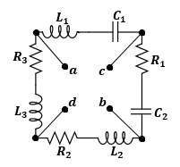
Example
Determine the equivalent impedance, seen between the terminals “ab”, “cd”, and “cb” of the circuit shown,
Variable | Values | Unit
ω | 1000 | rad/s
R₁ | 10 | kΩ
R₂ | 6 | kΩ
R₃ | 8 | kΩ
L₁ | 20 | mH
L₂ | 20 | mH
L₃ | 20 | mH
C₁ | 180 | μF
C₂ | 180 | μF

Slide 25
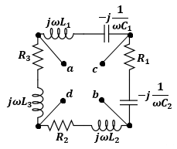
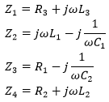
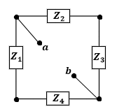
First we transfer the circuit to the phasor domain,
Let,
The equivalent impedance Z_{ab} is equal to,

Slide 26
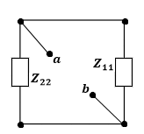
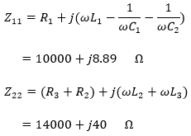
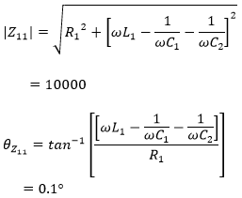
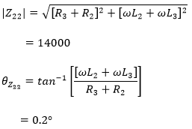
Where,
Such that,

Slide 27
Thus,

Slide 28
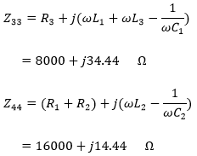
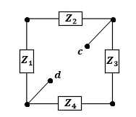
In the same manner, the equivalent impedance Z_{cd} is equal to,
Where,

Slide 29
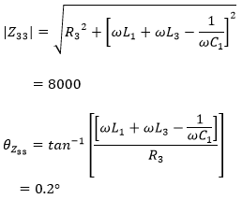
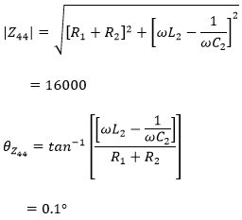
Such that,
Therefore,

Slide 30
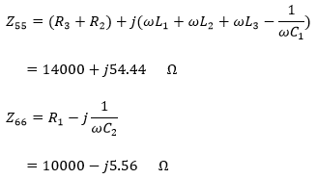
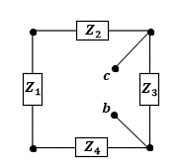
In the same manner, the equivalent impedance Z_{cb} is equal to,
Where,

Slide 31
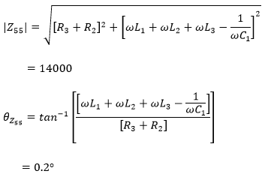
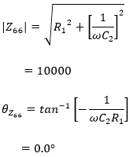
Such that,
Therefore,

Slide 32
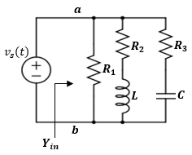
Practice Example: Consider the following time-domain circuit:
1) Convert the time-domain circuit to phasor domain circuit.
2) Determine the input admittance, Y_{in}, seen between terminals “ab” in rectangular and polar form for the network.
3) Determine the input impedance seen between terminals “ab” in rectangular and polar form for the network.
4) Determine the time-domain current in L.
5) Determine the expression for the power supplied by the voltage source.
Variable | Values | Unit
V_{m} | 5 | v
ω | 1000 | rad/s
R₁ | 700 | Ω
R₂ | 700 | Ω
R₃ | 700 | Ω
L | 25 | mH
C | 92 | μF

Slide 33
The mesh analysis method in the frequency domain.
Recall, as stated earlier, the phasor analysis approach applies to mesh current analysis method as well.
We assign mesh phasor currents and then apply KVL as before

Slide 34
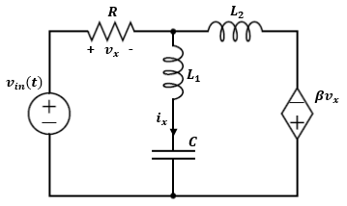
Example
For the given circuit, the voltage input is given by:
Determine the time-domain expressions for i_{x}(t) and v_{x}(t).
Variable | Default | Unit
V_{m} | 10 | V
ω | 3000 | rad/s
θ | π/3 | rad
R₁ | 5 | Ω
L₁ | 0.2 | mH
L₂ | 0.2 | mH
C | 0.8 | mF
β | 8

Slide 35
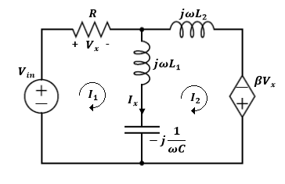
Solution:
First we transform the circuit into the phasor-domain,
It can be seen that the current I_{x} equals I₁ – I₂, and that,
Now applying KVL around both loops yields,
(1)
(2)
Plug values for the impedances and solve Eq. (1) and (2) for I₁ and I_{2.}

Slide 36
Solution:
Solving both equations for I₁,
Solving both equations for I₂,
Calculating the voltage V_{x},
Calculating the voltage I_{x},

Slide 37
Solution:
Transforming the voltage V_{x} back to the time-domain yields,
Transforming the voltage I_{x} back to the time-domain yields,

Slide 38
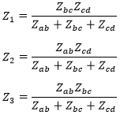
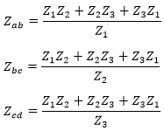
Delta-Wye Transformation
The same ∆-to-Y and Y-to-∆ transformation principles in resistive circuits apply to impedances.

Slide 39
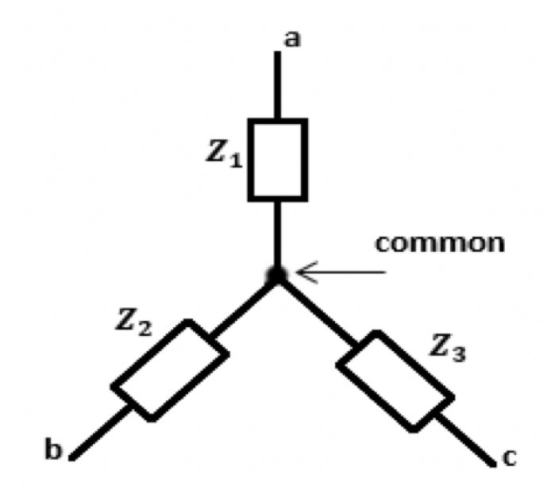
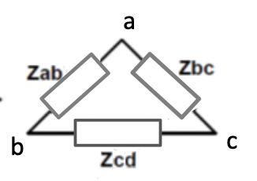
Delta-Wye Transformation
If the impedances are equal in a given configuration, then the circuit is known as a balanced circuit.

Slide 40
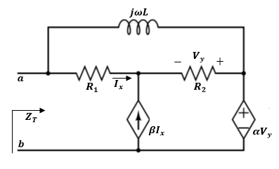
Example
For the given circuit, determine the total input impedance Z_{T}, seen by terminals “ab”.
Variable | Default | Unit
ω | 3000 | rad/s
R₁ | 10 | Ω
R₂ | 8 | Ω
L | 0.2 | mH
α | 4
β | 4

Slide 41
Solution:
Let us use the ∆-to-Y conversion of the delta configuration made by R₁, R₂ and L,
since the controlling current I_{x} will be destroyed in the Y configuration, we replace it by V_{x} such that,

Slide 42
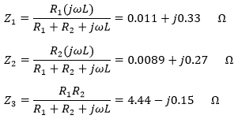
Solution:
Let us use the ∆-to-Y conversion of the delta configuration made by R₁, R₂ and L,
since the controlling current I_{x} will be destroyed in the Y configuration, we replace it by V_{x} such that,
Where,

Slide 43
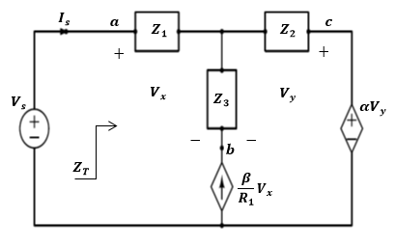
We notice the ∆-to-Y transformation results in simplifying the three-loop circuit into two-loop circuit
To find Z_{T}, We apply external voltage sources V_{S} as shown.
Where,
After assigning phasor mesh currents I₁ and I₂, it can be shown the following relations hold:

Slide 44
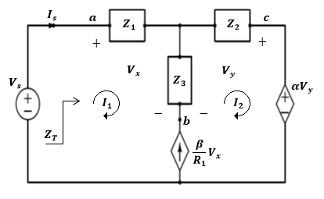
Applying KVL to the two loops yields,

Slide 45
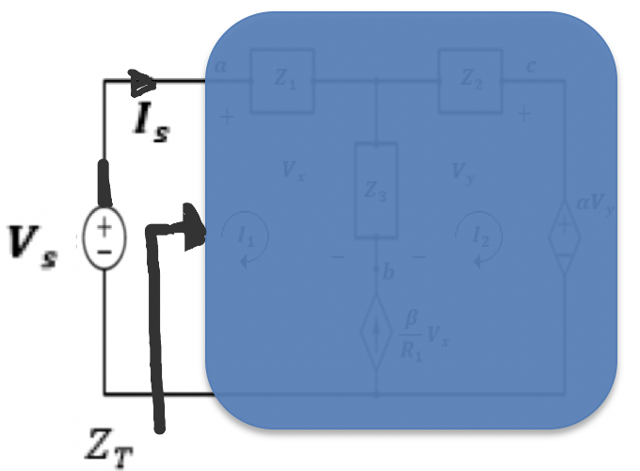
Writing an equation in terms of I₁ and V_{S} yields,
Now we can find Z_{T} as,

Slide 46
Thévenin-Norton Equivalent Phasor Circuits
The circuit analysis technique using Thévenin’s, and Norton’s theorems apply and follow the same analysis steps in phasor circuits like in the resistive circuits,

Slide 47
Thévenin-Norton Equivalent Phasor Circuits
Calculation of Z_{Th} when there is no dependent sources:
All independent voltage sources are converted to a short-circuit, and all independent current sources are converted to an open-circuit

Slide 48
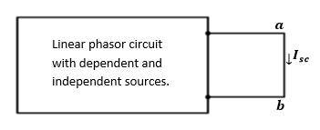
Thévenin-Norton Equivalent Phasor Circuits
Calculation of Z_{Th} when there is dependent sources:
The terminal “ab” is shorted and the short circuit current I_{SC} through it is measured. Then the equivalent impedance is given by:

Slide 49
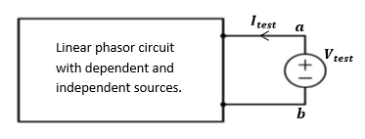
Thévenin-Norton Equivalent Phasor Circuits
Calculation of Z_{Th} when there is dependent sources:
An alternative approach is to apply external test voltage, V_{test}, and the resulting current, I_{test}, drawn from it is used to calculate the equivalent impedance:
We should note that once the Thévenin’s equivalent V_{Th} and Z_{Th} are obtained, then it is always possible to transform it to a Norton equivalent circuit, or vice versa using source transformation.

Slide 50
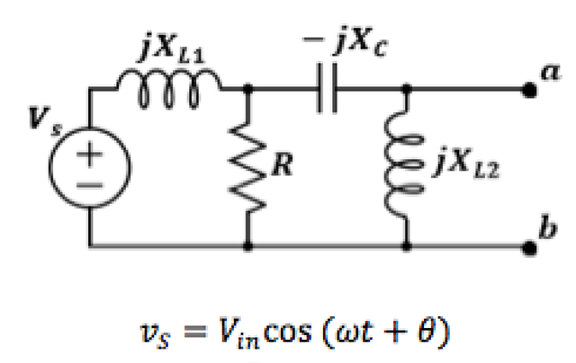
Example – Thevenin’s Equivalent
Consider the following phasor circuit. Determine the equivalent Thevenin’s circuit seen between terminals “a” and “b”.
Determine the load current when a resistive-inductive load is added between terminals “a” and “b”.

Slide 51
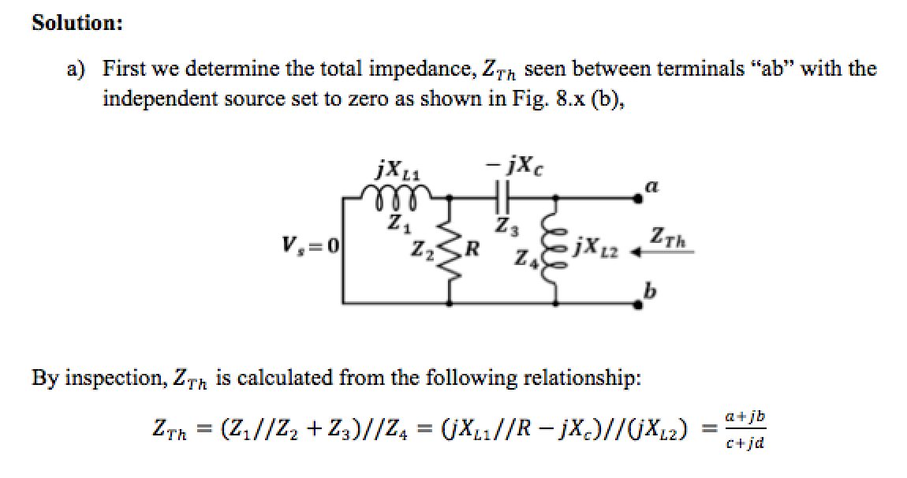

Slide 52
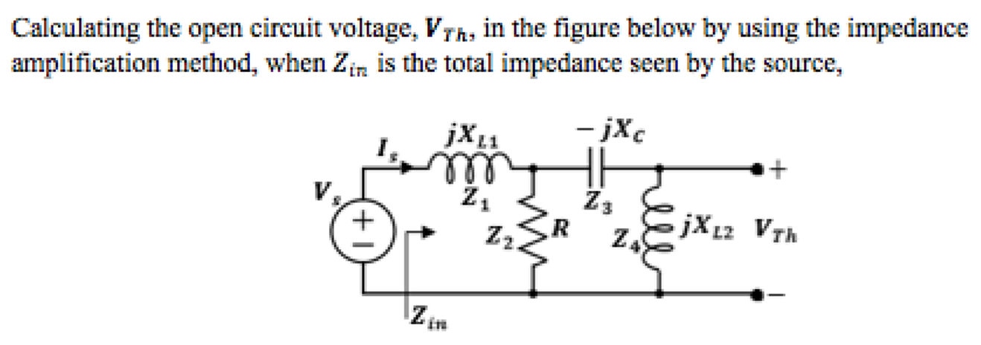
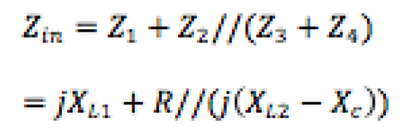

Slide 53
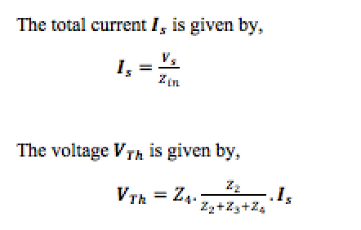
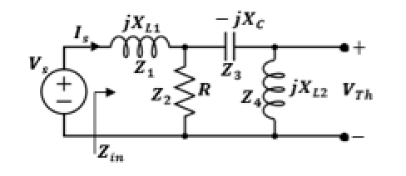
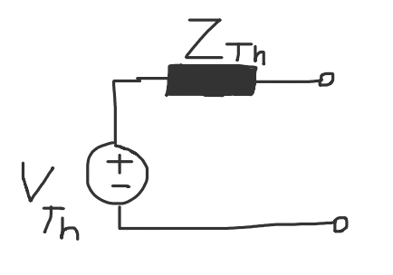

Slide 54
b) Determine the load current when a resistive-inductive load
$$Z_{L1}=R_{Load1}+jX_{L,Load1}$$
$$I_{L1}=\frac{V_{Th}}{R_{Load1}+jX_{L,Load1}+Z_{Th}}$$

Slide 55
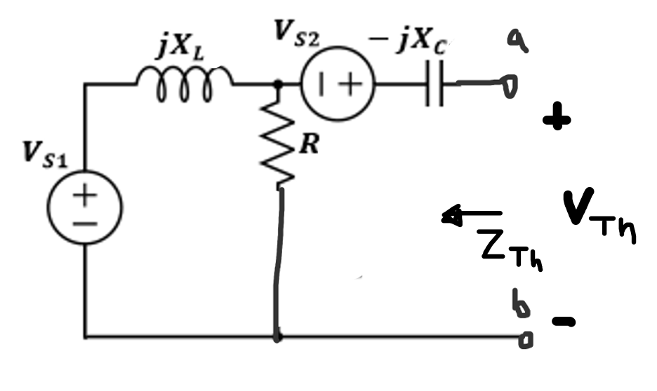
Example:
For the given circuit shown. Determine the equivalent Thevenin phasor circuit seen between terminals “ab” by finding $V_{Th}$ and $Z_{Th}$. Assume $X_{L}=0.8 Ω,R=10 Ω, X_{C}=1.5 Ω$and $V_{s1}=24∠0^{0}$ V and $V_{s2}=12∠{30}^{0}$ V.

Slide 56
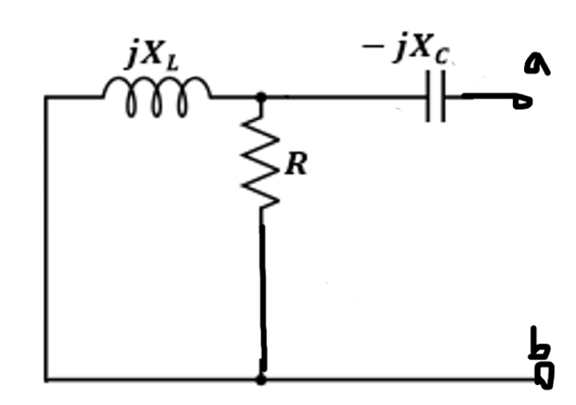
Solution:
First, we determine the total impedance,$Z_{Th}$ seen between terminals “ab” with the independent source set to zero as shown:
By inspection,$Z_{Th}$ is calculated from the following relationship:
$$Z_{Th}=R//jX_{L} −jX_{C}=\frac{jRX_{L}}{R+jX_{L}}−jX_{C}=\frac{j8}{10+j0.8}−j1.5=\frac{j8}{10+j0.8}\frac{10−j0.5}{10−j0.5}−j1.5$$
$$=\frac{j80+4}{100.64}−j1.5=0.04+j0.7$$
$Z_{Th}=7.79∠{87.1}^{o} Ω$

Slide 57
Solution:
The Thevenin’s open circuit voltage,$V_{Th}$, is given by applying voltage divider in series with to $V_{s2}$ yield,
$$V_{Th}=\frac{R}{R+jX_{L}}V_{s1}+V_{s2}=\frac{10x24∠{60}^{o}}{10+j0.8}+12∠{30}^{0}=\frac{124∠{60}^{o}}{100.64∠{4.6}^{o}}+10.4+j6$$
$$V_{Th}=1.23∠{55.4}^{o}+10.4+j6 =0.7+j+10.4+j6=11.1+j7$$
$$=13∠{32}^{o} V$$

Slide 58
Solution:
The equivalent Thevenin’s phasor circuit seen between terminals “a” and “b” is shown

Slide 59
Example:
Determine the equivalent Thevenin phasor circuit seen between terminals “ab”.
The impedance,$Z_{Th}$ is given by:

Slide 60
The impedance,$Z_{Th}$ is given by:
$$−j3$$
$$j5$$
By inspection,$Z_{Th}$ is calculated from the following relationship:
$Z_{Th}=−j3+j5=j2 Ω=2∠{90}^{o} Ω$

Slide 61
By inspection, the Thevenin’s open circuit voltage,$V_{Th}$, is given by,
i=$0$
$$V_{Th}=(4∠{45}^{0})\left(2∠{90}^{o}\right)=8∠{135}^{o} V$$

