Slide 1
EEL 3004 Electrical Networks Lecture #17 Phasor (Frequency-Domain) Circuits Analysis

Slide 2
Lecture Objectives
The lecture today will focus on:
Important notes about the frequency-domain or Phasor analysis
Using different analysis techniques in the frequency-domain, such as source transformation, mesh and nodal analysis.

Slide 3
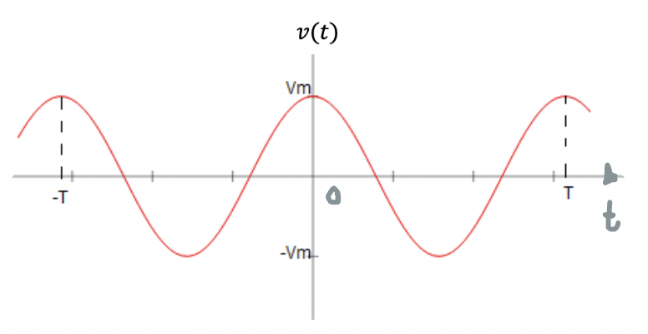
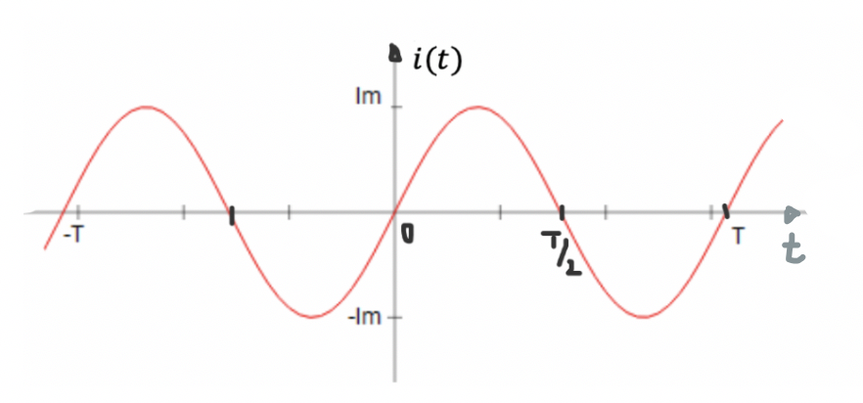
Sinusoidal Functions
$$\left.v\left(t\right)=V_{m}\cos{(}ωt\right)$$
$$\left.i\left(t\right)=I_{m}\sin{(}ωt\right)$$

Slide 4
Sinusoidal Function Values
Given sinusoidal functions:
$$\left.v\left(t\right)=V_{m}cos⁡(\frac{2π}{T}t\right)$$
Frequency values:
$ω= \frac{360°}{T}=360° f degrees/second$
$$\left.i\left(t\right)=I_{m}sin⁡(ωt\right)$$
$$ω=\frac{2π}{T}$$
Amplitude or peak value:
$V_{m}$ or $I_{m}$
$f= \frac{number of cycles}{seconds}= \frac{1}{T} Hz$
Average or DC value:
Amplitude or rms value:
$$V_{DC}= \frac{1}{T}\int_{t_{0}}^{T+t_{0}}{v\left(t\right) dt}=\frac{1}{T}\int_{t_{0}}^{T+t_{0}}{V_{m}\cos{\frac{2π}{T}\left(t−t_{o}\right)}dt}=0$$
$V_{rms}=\sqrt{ \frac{1}{T}\int_{0}^{T}{{(V_{m}\cos{\frac{2π}{T}\left(t\right))}}^{2}dt}}$
$$= \frac{V_{m}}{\sqrt{2}}$$

Slide 5
Sinusoidal Functions
Example:
For a given sinusoidal current expressed by $i\left(t\right)=I_{m}\sin{(ωt+θ)}$, where $ω=\frac{π}{3} rad/s,$ $θ=\frac{π}{6} rad,$and $I_{m}=4A$.
Determine the:
a) Period.
b) Frequency.
c) The magnitude of$i\left(t\right)$ at$\frac{T}{4},\frac{T}{3},\frac{T}{2},T$
d) The DC value.
e) The rms value.

Slide 6
Sinusoidal Functions
Solution:
To calculate the period, we use the following formula,
$$T=\frac{2π}{ω} =\frac{2π}{\frac{π}{3}}=6 s$$
b) To calculate the frequency, we use the following formula,
$$f=\frac{ω}{2π}=\frac{1}{T}=\frac{1}{6}=0.17 Hz$$
c) To calculate the magnitude of$i\left(t\right)$, we simply substitute values,
$$i\left(\frac{T}{4}\right)=I_{m}\sin{(ω\frac{T}{4}+θ)}=4\sin{(\frac{2π}{T}\frac{T}{4}+\frac{π}{6})}=4\sin{(\frac{π}{2}+\frac{π}{6})}=4\sin{(\frac{4π}{6})}=3.46 A$$
$$i\left(\frac{T}{3}\right)=I_{m}\sin{(ω\frac{T}{3}+θ)}=4\sin{(\frac{2π}{T}\frac{T}{3}+\frac{π}{6})}=4\sin{(\frac{2π}{3}+\frac{π}{6})}=4sin{(\frac{5π}{6})}=2.00 A$$
$$i\left(\frac{T}{2}\right)=I_{m}\sin{(ω\frac{T}{2}+θ)}=4\sin{(\frac{2π}{T}\frac{T}{2}+\frac{π}{6})}=4\sin{(π+\frac{π}{6})}=4\sin{(\frac{7π}{6})}=−2.00 A$$
$$i\left(T\right)=I_{m}\sin{(ωT+θ)}=4\sin{(\frac{2π}{T}T+\frac{π}{6})}=4\sin{(2π+\frac{π}{6})}=4\sin{(\frac{13π}{6})}=2.00 A$$

Slide 7
Sinusoidal Functions
d) To calculate the DC value, we can either use the formula, or since we are dealing with a sinusoidal function we know it’s zero,
$I_{DC}=\frac{1}{T}\int_{t_{0}}^{T+t_{0}}{i\left(t\right) dt}$
$=\frac{1}{T}\int_{t_{0}}^{T+t_{0}}{I_{m}\sin{(ωt+θ)} dt=\frac{1}{6}\int_{0}^{6}{4\sin\left(\frac{π}{3}t+\frac{π}{6}\right)dt}}$
Recall,
$$\int{\sin{x dx}=−\cos{x+c}}$$
$I_{DC}=\frac{4}{6}[−cos\left(\frac{π}{3}t+\frac{π}{6}\right)|_{0}^{6}=$ $\frac{4}{6}[−cos\left(\frac{π}{3}6+\frac{π}{6}\right)+\cos\left(\frac{π}{3}0+\frac{π}{6}\right)]$
$=$ $\frac{4}{6}[−cos\left(2π+\frac{π}{6}\right)+\cos\left(\frac{π}{6}\right)]=\frac{4}{6}[−cos\left(\frac{π}{6}\right)+\cos\left(\frac{π}{6}\right)]$
$$I_{DC}=0$$

Slide 8
Sinusoidal Functions
e) To calculate the rms value, we use the formula,
$$I_{rms}=\sqrt{\frac{1}{T}\int_{0}^{T}{i^{2}\left(t\right)}dt}=\sqrt{\frac{1}{T}\int_{0}^{T}{{I_{m}}^{2}\sin^{2}\left(ωt+θ\right)dt}}$$
Recall,
$$\sin{x^{2}}=\frac{1}{2}(1−\cos\left(2x\right))$$
$$I_{rms}=\sqrt{\frac{1}{T}\int_{0}^{T}{{I_{m}}^{2}\frac{1}{2}(1−2cos\left(ωt+θ\right))dt}}$$

Slide 9
Sinusoidal Functions
$$I_{rms}=\sqrt{\frac{{I_{m}}^{2}}{2}+\frac{{I_{m}}^{2}}{4T\frac{2π}{T}}(−\sin\left(2\frac{2π}{T}T+2θ\right)+\sin{(2θ))}}$$
$$=\sqrt{\frac{{I_{m}}^{2}}{2}−\frac{{I_{m}}^{2}}{8π}(−sin\left(2θ\right)+\sin\left(2θ\right))}$$
$=\frac{I_{m}}{\sqrt{2}} =\frac{4}{\sqrt{2}}=2.83 Amps in rms$

Slide 10
Sinusoidal Functions
Example:
Express the following sinusoidal sine function as one term cosine function where $I_{1}=2A, I_{2}=4A, ω=\frac{π}{3} rad/s.$
$$i\left(t\right)=−I_{1}\sin\left(ωt\right)+I_{2}\cos{(ωt)})$$
Recall,
$$+A_{1}\cos\left(ωt\right)∓A_{2}\sin\left(ωt\right) =A cos(ωt−θ)$$ Where $A=\sqrt{{A_{1}}^{2}+{A_{2}}^{2}}$ & $θ= ∓\tan^{−1}\frac{A_{2}}{A_{1}}$ A₁ > 0 and A₂ > 0
$$−A_{1}\cos\left(ωt\right)∓A_{2}\sin\left(ωt\right) =A cos(ωt−θ)$$ Where $A=\sqrt{{A_{1}}^{2}+{A_{2}}^{2}}$ & $θ= π±\tan^{−1}\frac{A_{2}}{A_{1}}$ A₁ > 0 and A₂ > 0

Slide 11
Sinusoidal Functions
Example:
Express the following sinusoidal sine function as one term cosine function where $I_{1}=2A, I_{2}=4A, ω=\frac{π}{3} rad/s.$
$$i\left(t\right)=−I_{1}\sin\left(ωt\right)+I_{2}\cos{(ωt)}$$
Solution:
This sinusoidal sine function can be expressed as follows,
$$i\left(t\right)=I_{x}\cos{(ωt−θ_{x})}$$
Where,
$$I_{x}=\sqrt{I_{1}^{2}+I_{2}^{2}} θ_{x}=−\tan^{−1}{(\frac{I_{1}}{I_{2}})}$$
Thus,
$$i\left(t\right)=\sqrt{I_{1}^{2}+I_{2}^{2}}\cos{(ωt+\tan^{−1}{(\frac{I_{1}}{I_{2}})})}$$
$$=4.47\cos\left(\frac{π}{3}t+{0.46}^{c}\right) A$$

Slide 12
Steady-state phasor analysis

Slide 13
Review - Analysis of Phasor Circuits
Phasor circuits allow for the use of powerful analysis techniques such as nodal and mesh analysis to obtain steady state voltages and currents in AC circuits.
Given the time-domain circuits – time domain analysis used (Chapter 2-6) – complex with R,L, C circuits
Given the phasor-domain (frequency-domain) equivalent circuits, then we used phasor-analysis to find all voltages, currents and powers everywhere in the circuit – Simpler with R,L, C circuits

Slide 14
Important Notes
phasors refer only to complex numbers that are associated with coefficient peak of the sinusoidal voltage or current and the associated phase-shift.
The impedance is a complex number, but not a phasor since it has no association to time-domain cosine function.
It is mathematically incorrect to mix the two domains of the equivalent circuit schematic.

Slide 15
Phasor Analysis Approach
The process of applying the phasor concept:
0) Adopt the cosine function as a reference.
1) Transform sources and elements form time domain to frequency domain.
Time Domain | Phasor Domain
R | R
L | Z_{L} = jωL
C | Z_{C} = 1/jωC
$$i\left(t\right)=I_{m}cos⁡(ωt+θ)$$ | $$I=I_{m}∠θ$$
v$\left(t\right)=V_{m}cos⁡(ωt+θ)$ | V$=V_{m}∠θ$
Notice that voltage and current sources should be in cosine reference.
2) establish the relationship between the phasor current, I, and phasor voltage, V, for each passive circuit elements R, L and C.

Slide 16
Phasor Analysis Approach (cont’d)
3) Develop the corresponding phasor circuit with all its voltage and current sources, and element impedances expressed in phasor.
4) Now the circuit is known as a phasor circuit and we are in the phasor or frequency-domain.
5) The circuit analysis process is carried out completely in the complex notations establishing KVL, KCL and ohm’s Law equations in phasor-domain.
6) Last step, transfer all phasor solutions to time domain values.

Slide 17
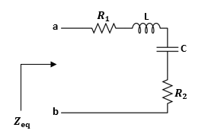
Impedance Calculations
Example:
Determine the equivalent impedance$Z_{eq}$, seen between the terminals “ab”
Draw the equivalent simplified circuit consisting of single R, L or C connected in series.
Where $ω=1000 rad/s, R_{1}=10 KΩ, R_{2}=6 KΩ, L=20 mH, C=180 μF.$

Slide 18
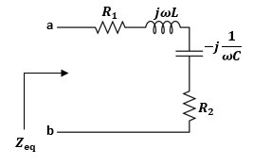
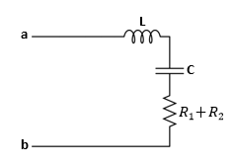
Impedance Calculations
Phasor Circuit
The equivalent simplified circuit
The equivalent impedance $Z_{eq}$ is equal to,
$$Z_{eq}=R_{1}+R_{2}+jωL−j\frac{1}{ωC}=\left(R_{1}+R_{2}\right)+j(ωL−\frac{1}{ωC})$$
$$=16000+j14.44 Ω$$

Slide 19
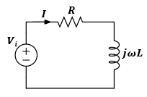
Example of a Simple Circuits
For the given RL circuit, the voltage input is given by:
$$v_{i}\left(t\right)=V_{m}\sin{(ωt−θ)}$$
$$R=5Ω, L=0.2 mH, V_{m}=10V, ω=3000 rad/s, θ=π/3rad$$
Determine the expression for the current$i\left(t\right)$.
$$i\left(t\right)$$
$$v_{i}\left(t\right)$$
Time-domain circuit

Slide 20
Simple Circuits
First, we covert the voltage source$v_{i}\left(t\right)$ to a cosine form,
$v_{i}\left(t\right)=V_{m}\cos\left(ωt−θ−\frac{π}{2}\right)=10\cos\left(3000t−(π/3+π/2)\right)$
$=10\cos\left(3000t−\frac{5π}{6}\right) V$
Next, we transform the circuit into the phasor-domain:
The phasor voltage,
$$V_{i}=V_{m}∠−(θ+\frac{π}{2})=10∠−\frac{5π}{6}$$

Slide 21
Simple Circuits
One way to calculate the phasor current, $I ,$ we calculate the total impedance
$$Z_{T}$$
$Z_{T}=R+jωL$
$=5+j0.6 Ω$
In polar form, $Z_{T}$is given by,
|$Z_{T}|=\sqrt[2]{5^{2}+{0.6}^{2}}=5.04 Ω$
$$Z_{T}=5.04{∠6.84}^{o}$$
$$∠Z_{T}=\tan^{−1}\left(\frac{ωL}{R}\right)=\tan^{−1}\left(\frac{0.6}{5}\right)={6.84}^{o}$$

Slide 22
Simple Circuits
Then using Ohm’s Law we calculate the current$I$,
$I=\frac{V_{i}}{Z_{T}}=\frac{10∠−\frac{5π}{6}}{5.04{∠6.84}^{o}}=\frac{10{∠−150}^{o}}{5.04{∠6.84}^{o}}=\frac{10}{5.04}∠−({150}^{o}+{6.84}^{o})$
$=1.98∠−{156.84}^{o} A$
Transforming the current$I$ back to the time-domain yields,
$i\left(t\right)=1.98\cos\left(3000t−{156.84}^{o}\right) A$

Slide 23
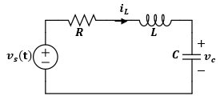
Example:
For the given RLC circuit shown below. The voltage input is given by
$v_{s}(t)=V_{m}\sin{(ωt+θ)}$.
Determine the expression for$i_{L}\left(t\right) \& v_{C}(t)$.
Solution:
Express the voltage source in cosine function,
$v_{s}(t)=V_{m}\cos{(ωt+θ−\frac{π}{2})}$.

Slide 24
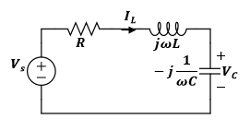
Solution (cont’d):
Next, we transform the circuit into the phasor-domain as shown,
Let us represent the circuit by the impedances Z₁, Z₂ and Z₃ as shown,
Z₁ =R Z₂ = j$ω$L Z₃= $j(−\frac{j}{ωC }$ )
Z₁
Z₂
Z₃=
Applying KVL around the circuit yields,
$V_{s}=RI_{L}+{jωLI}_{L}−j\frac{I_{L}}{ωC}$
Where, $V_{s}=V_{m}$ $∠θ\text{− }\frac{π}{2}$
Solving for$I_{L}$ yields,
$I_{L}=\frac{V_{s}}{R+j(ωL−\frac{1}{ωC})}=\frac{V_{m}∠θ−\frac{π}{2}}{\sqrt{R^{2}+{\left(ωL−\frac{1}{ωC}\right)}^{2}}∠\tan^{−1}\left(\frac{ωL−\frac{1}{ωC}}{R}\right)}=|I_{L}|∠θ_{IL}$
Where,
$$\left|I_{L}\right|=\frac{V_{m}}{\sqrt{R^{2}+{\left(ωL−\frac{1}{ωC}\right)}^{2}}}$$
$$θ_{IL}=∠[θ−\frac{π}{2}−\tan^{−1}\left(\frac{ωL−\frac{1}{ωC}}{R}\right)]$$

Slide 25
Now applying Ohm’s Law for the capacitor yields,
$V_{C}=−j\frac{1}{ωC}I_{L}$
$V_{C}=\frac{\frac{V_{s}}{ωC}}{\left.R+j(ωL−\frac{1}{ωC}\right)}$ $∠π$ = $\frac{V_{m}}{ωC\sqrt{R^{2}+{(ωL−\frac{1}{ωC})}^{2}}}∠θ−π−\tan^{−1}(\frac{ωL−\frac{1}{ωC}}{R})$
Where,
$$−j=∠−π/2$$
In time domain,
$$\left.i_{L}(t)=\frac{V_{m}}{\sqrt{R^{2}+{\left(ωL−\frac{1}{ωC}\right)}^{2}}}cos{(}ωt+θ−\frac{π}{2}−\tan^{−1}(\frac{ωL−\frac{1}{ωC}}{R})\right)$$
$$\left.v_{C}(t)=\frac{V_{m}}{ωC\sqrt{R^{2}+{\left(ωL−\frac{1}{ωC}\right)}^{2}}}cos{(}ωt+θ−π−\tan^{−1}(\frac{ωL−\frac{1}{ωC}}{R})\right)$$

Slide 26
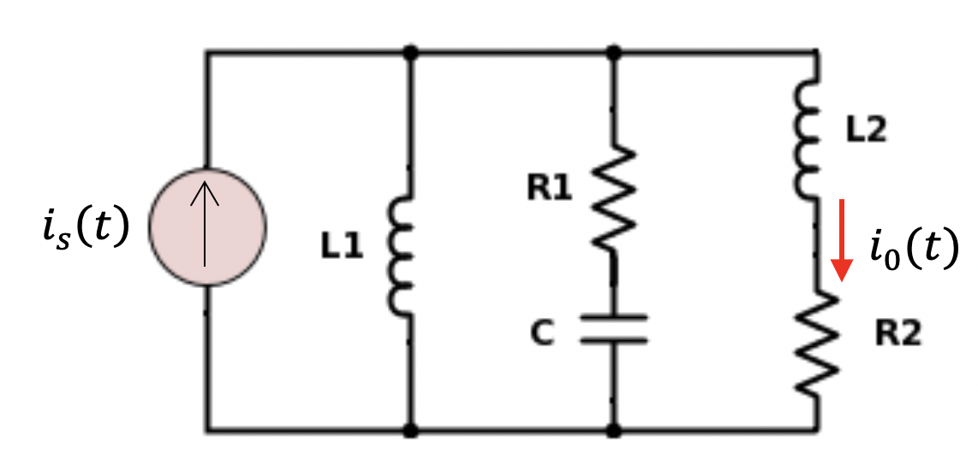
Example:
Find the steady-state response for $i_{x}\left(t\right)$ and $i_{o}\left(t\right)$ in the circuit shown assuming the source current is given by $i_{s}\left(t\right)=I_{m}\cos\left(ωt\right) A.$
$$i_{x}\left(t\right)$$

Slide 27
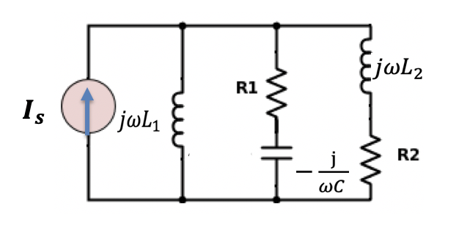
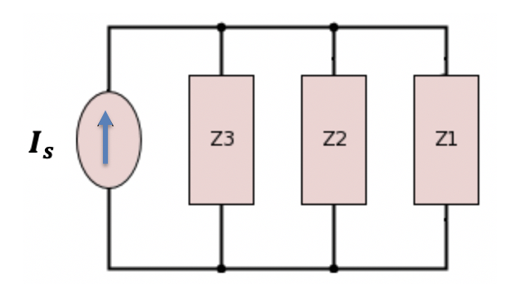
Solution:
The phasor circuit is shown
Let us represent the circuit by the impedances Z₁, Z₂ and Z₃ as shown,
Where,
$$Z_{1}=R_{2}+j{ωL}_{2}$$
$Z_{2}=R_{1}+j(−\frac{1}{ωC }$ )
$$Z_{3}=j{ωL}_{1}$$
Taking Z₁ and Z₂ in parallel, we obtain
Where, $I_{s}=I_{m}$ $∠0$
$$Z_{12}={Z_{1}}//Z_{2} =\frac{Z_{1}Z_{2}}{Z_{1}+Z_{2} }$$
$$=|Z_{12}|∠θ_{12}$$

Slide 28
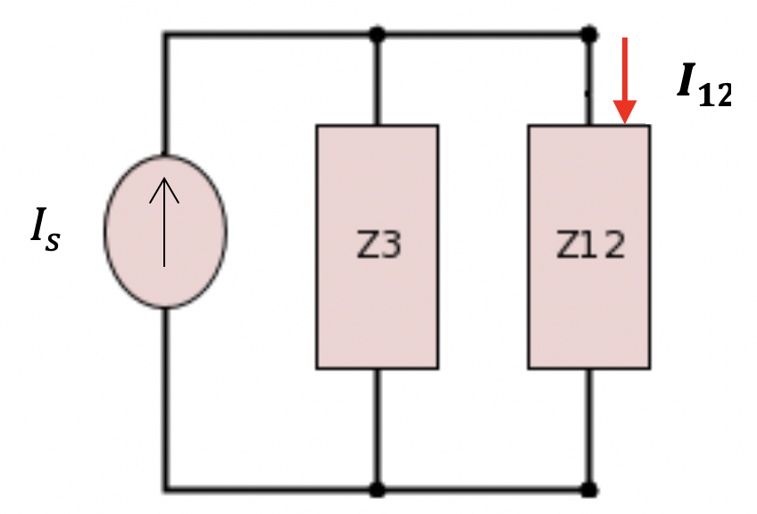
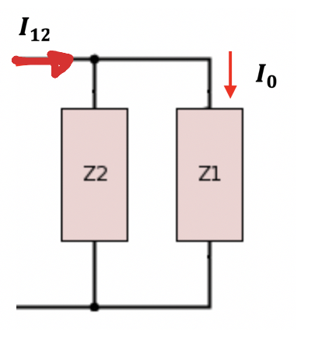
$$I_{x}$$
Solution:
Applying current division, we obtain I₁₂
$$I_{x}=\frac{Z_{3}}{Z_{3}+Z_{12}}I_{s}$$
$$=\left|I_{12}\right|∠θ_{12}$$
In time-domain,
$i_{x}\left(t\right)=\left|I_{x}\right|\cos\left(ωt+θ_{12}\right)$
$$I_{x}$$
Using Current division again,
$$I_{0}=\frac{Z_{2}}{Z_{2}+Z_{1}}I_{x}$$
$$=\left|I_{0}\right|∠θ_{0}$$
Hence, in time domain,
$$i_{0}\left(t\right)=\left|I_{0}\right|\cos\left(ωt+θ_{0}\right)$$

Slide 29
Problem:
Given, the following phasor circuit. What is expression for the total impedance $Z_{in}$ seen by the voltage sources?
Solution:
Let us represent the circuit by the impedances Z₁, Z₂ and Z₃ as shown,
Z₁ =R Z₂ = j$ω$L Z₃= $j(−\frac{j}{ωC }$ )
The total impedance is given by,
$Z_{in}=R+jωL−j\frac{1}{ωC}$
$$Z_{in}=R+j(ωL−\frac{1}{ωC})$$
$Z_{in}=R−j\left(ωL−\frac{1}{ωC}\right)$
$Z_{in}=R+j(ωL+\frac{1}{ωC})$
$Z_{in}=R+j(ωL−\frac{1}{ωC})$
$Z_{in}=R+jωL−\frac{1}{jωC}$
None of the above

Slide 30
Given, the following phasor circuit. What is correct expression for $ω$that will make the total impedance $Z_{in}$ be REAL part only?
Solution:
Let us represent the circuit by the impedances Z₁, Z₂ and Z₃ as shown,
Z₁ =R Z₂ = j$ω$L Z₃= $j(−\frac{j}{ωC }$ )
The total impedance is given by,
$Z_{in}=R+jωL−j\frac{1}{ωC}$
$$Z_{in}=R+j(ωL−\frac{1}{ωC})$$
For $Z_{in}$ to be real part, we must have,
$ω=\sqrt{LC}$
$ω=−R$
$ω=\frac{1}{\sqrt{LC}}$
$ω={(LC)}^{2}$
None of the above
$ωL−\frac{1}{ωC}$=0
Solving for $ω$,
$ω^{2}L−\frac{1}{C}$=0
$$ω=\frac{1}{\sqrt{LC}}$$
$$ω^{2}LC=1$$

Slide 31
Impedance Source Transformation Analysis
The same concept of source transformations in resistive circuits applies to the phasor-domain.
Where,
The two circuits are equivalent

Slide 32
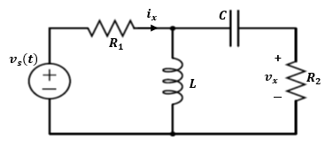
Example
For the given circuit, the voltage input is given by:
Determine the expressions i_{x}(t) and v_{x}(t).
Variable | Values | Unit
V_{m} | 10 | V
ω | 3000 | rad/s
θ | π/3 | rad
R₁ | 5 | Ω
R₂ | 18 | Ω
L | 0.2 | mH
C | 0.8 | mF

Slide 33
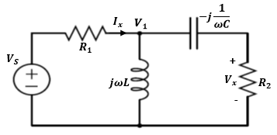
Solution:
1) First we transform the time-domain circuit into the phasor-domain,
$$V_{s}=V_{m}∠θ$$
2) Second solve for phasor currents and voltages as complex
numbers by using any analysis method.
The goal is to slove for all phasor values: $I_{x} and V_{x}$
3) Transform the phasor domain values to time domain.

Slide 34
Let us use the nodal method by assigning a phasor nodal voltage V₁
Where phasor $V_{s}$ is given by,
$$V_{s}=V_{m}∠θ$$

Slide 35
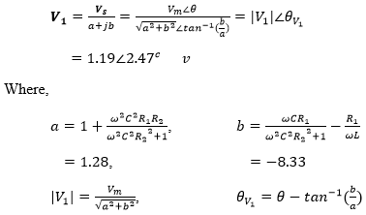
Applying KCL at the node V₁ yields,
Solving for V₁

Slide 36
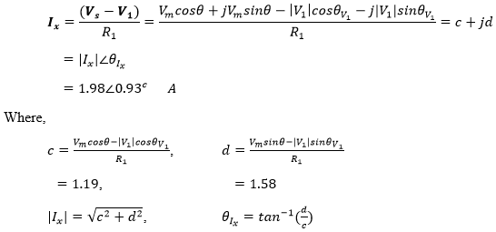
Calculating the current I_{x},

Slide 37
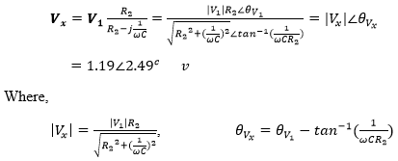
Calculating the voltage V_{x} using voltage division,

Slide 38
Transforming back the voltage V_{x} back to the time-domain,
Transforming the current I_{x} back to the time-domain,

