Slide 1
EEL 3004 ELECTRICAL NETWORKS -Lecture 16 Step (Forced response) Response

Slide 2
Lecture Objectives
The lecture today will focus on:
Step response of RC circuits, for solving capacitor voltage and current.
Examples with dependent and independent sources

Slide 3
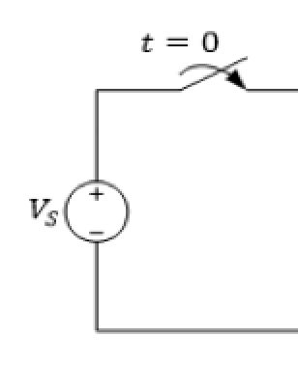
Step Response of RC circuits
In the circuit, a constant voltage source V_{S} is connected to the RC circuit at t = 0, by closing the switch.
Assume that the initial voltage on the capacitor at t = 0⁻ is denoted by v_{C}(0⁻).
After certain action (switching):
R’s and C’s
Applied External source

Slide 4
Step Response of RL circuits
In the circuit, a constant voltage source V_{S} is connected to the RL circuit at t = 0, by closing the switch.
Assume that the initial voltage on the capacitor at t = 0⁻ is denoted by i_{L}(0⁻).
After certain action (switching):
R’s and L’s
Applied External source

Slide 5
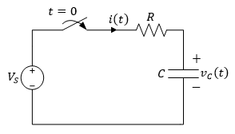
Step Response of RC circuits
After the switch is closed, applying KVL around the loop,
Since the voltage across the capacitor cannot change instantaneously,

Slide 6
Step Response of RC circuits
Same solution as in the natural RC response circuit, except for an additional constant term due to the presence of the DC external source,
Where K₁, K₂ and s are constants to be determined,
Substitute the above assumed general solution of v_{c}(t) into the circuit equation,
The characteristic equation becomes,

Slide 7
Step Response of RC circuits
For equality, the coefficient of e^{st} must be zero,
Also,
Substituting these values yields,

Slide 8
Step Response of RC circuits
Using the initial voltage condition across the capacitor,
Which yields,
Substituting, the final solution is,
Where,

Slide 9
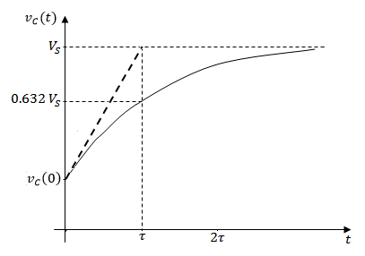
Step Response of RC circuits
As in the natural response, the second term on the right is called the transient response, which eventually decays to zero as t → ∞.
The first term on the right is the steady state response or forced response, which remains after the transient has decayed.

Slide 10
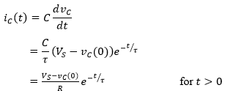
Step Response of RC circuits
The current through the capacitor is obtained as,
We notice that the capacitor current just before the switch was closed, is zero.
The capacitor current just after the switch was closed is given by,

Slide 11
Step Response of RC circuits
In general, we can write the following solution for any RC circuit,
Where v(∞) and v(0) are the final and initial voltage on the capacitor, respectively, at t = ∞ and t = 0,

Slide 12
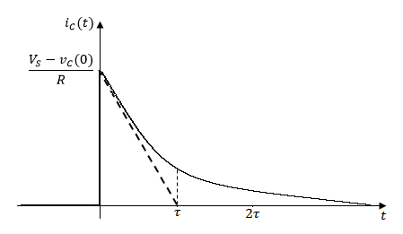
Step Response of RC circuits
We notice that the capacitor current just before the switch was closed, is zero.
The capacitor current just after the switch was closed is given by,

Slide 13
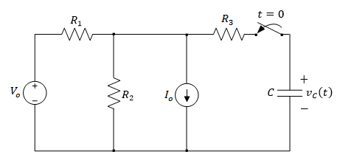
Example
In the circuit, at t = 0 the switch is closed. It is desired to derive an expression for the voltage v_{C}(t) for t > 0. Assume
Variable | Default | Unit
V_{o} | 8.6 | V
I_{o} | 2 | mA
R₁ | 2.4 | kΩ
R₂ | 1.2 | kΩ
R₃ | 3.8 | kΩ
C | 2.1 | μF

Slide 14
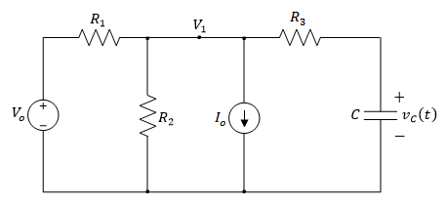
For t > 0,
Applying KCL to the top node yields,
It can also be seen that,
Combining both equations yields,
Rearranging terms yields,

Slide 15
Integrating both sides,
Using substitution,

Slide 16
Raising both sides of the equation to the power of e,
Evaluating the equation at t = 0,
Which yields,

Slide 17
Hence the final solution is given by,
Where,
And,

Slide 18
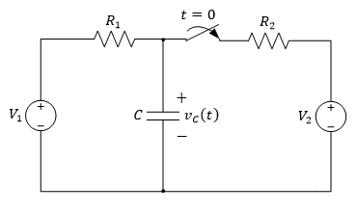
Example
In the circuit, at t = 0 the switch is closed. It is desired to derive an expression for the voltage v_{C}(t) for t > 0.
Variable | Default | Unit
V₁ | 8.6 | V
V₂ | 4.2 | V
R₁ | 2.4 | kΩ
R₂ | 1.2 | kΩ
C | 2.1 | μF

Slide 19
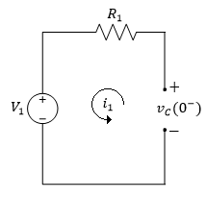
For t < 0 the switch has been open for a long time, allowing the capacitor to act like an open circuit,
Since the voltage across the capacitor doesn’t change instantaneously,

Slide 20
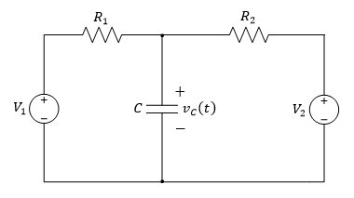
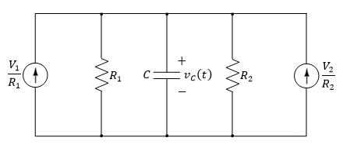
For t > 0,
Using the source transformation method, by transforming both voltage sources to current sources,
The circuit can now be simplified as follows,

Slide 21
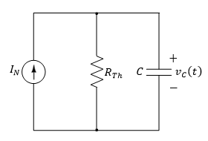
For t > 0,
Where I_{N} is given by,
And the Thevenin resistance by,

Slide 22
For t > 0,
Therefore the time constant is given by,
As t → ∞, the capacitor acts as an open circuit,
The general solution for the forced response of v_{C}(t) is given by,

Slide 23
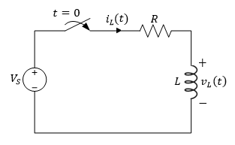
Step Response of RL circuits
In the circuit, at t = 0, the switch is closed.
Assume that the initial current passing through the inductor at t = 0⁻ is denoted by i_{L}(0⁻).

Slide 24
Step Response of RL circuits
Applying KVL around the loop,
Substitute for v_{L} in terms of i_{L} yields,
Since the current passing through the inductor cannot change instantaneously,

Slide 25
Step Response of RL circuits
The solution will be the same as in the case of the natural RL response circuit, except for an additional constant term K₁,
In which K₁, K₂ and s are constants to be found,
we arrive at the characteristic equation,

Slide 26
Step Response of RL circuits
Rewriting the equation yields,
For equality, the coefficient of e^{st} must be zero,
From the equation we also get,

Slide 27
Step Response of RL circuits
Substituting these values yields,
Using the initial current condition through the inductor,
Which yields,

Slide 28
Step Response of RL circuits
Substituting we get the solution,
Where,

Slide 29
Step Response of RL circuits
As before in the natural response, the second term on the right is called the transient response, which will eventually decay to zero as t → ∞.
The first term on the right is the steady state response or forced response, which remains after the transient has decayed.

Slide 30
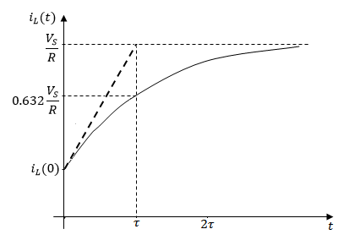
Step Response of RL circuits
i_{L}(t) starts from its initial value at i_{L}(0), and finally reaches a steady state value of V_{S}/R asymptotically.
After one time constant it reaches 0.632 of V_{S}/R. After about five time constants it reaches its final value V_{S}/R.

Slide 31
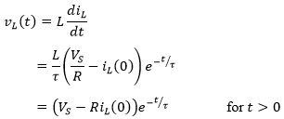
Step Response of RL circuits
The voltage across the inductor is obtained as,

Slide 32
Step Response of RL circuits
In general we can write the following solution for any RL circuit,
Where iL(∞) and iL(0) are the final and initial current passing through the inductor at t = ∞, and t = 0, respectively.

Slide 33
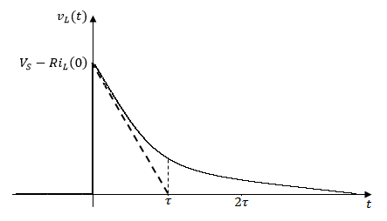
Step Response of RL circuits
The voltage across the inductor was zero before the instant the switch was closed.
As expected, the inductor voltage can change values instantaneously, but not the inductor current as discussed.

Slide 34
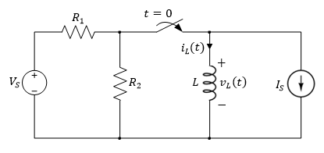
Example
In the circuit, at t = 0 the switch is closed. It is desired to derive an expression for the current i_{L}(t) for t > 0.
Variable | Default | Unit
V_{S} | 8.6 | V
I_{S} | 200 | mA
R₁ | 20 | Ω
R₂ | 24 | Ω
L | 12 | mH

Slide 35
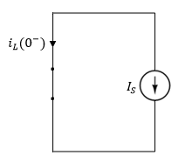
For t < 0 the switch has been open for a long time, so the inductor acts like a short circuit,
Since the current through the inductor doesn’t change instantaneously,

Slide 36
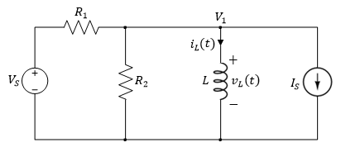
For t > 0,
Applying KCL to the top node,
Noting that V₁ = v_{L},
Since,
We rewrite the equation as,

Slide 37
Rearranging terms,
Integrating both sides,
Using integration by substitution,

Slide 38
Substituting yields,
Raising both sides of the equation to the power of e,

Slide 39
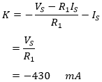
Evaluating the above equation at t = 0,
Which yields,

Slide 40
Evaluating the above equation at t = 0,
Which yields,
Thus giving an expression for i_{L}(t) of,

Slide 41
Or use the general solution as given by,
Where,
And,

Slide 42
Example
In the circuit, at t = 0 the switch closes. Find the current response i_{L}(t) for t > 0.
Variable | Default | Unit
V_{S} | 8.6 | V
I_{S1} | 200 | mA
I_{S2} | 130 | mA
R₁ | 20 | Ω
R₂ | 24 | Ω
R₃ | 34 | Ω
R₄ | 28 | Ω
L | 12 | mH

Slide 43
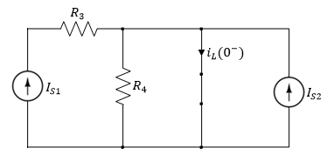
For t < 0 the switch has been open for a long time allowing the inductor to act like a short circuit,
Since R₄ is shorted, the current passing through the inductor,
Since the current through the inductor doesn’t change instantaneously,

Slide 44
For t > 0, the switch is closed, resulting in a forced RL circuit,
Transforming the voltage source to a current source,

Slide 45
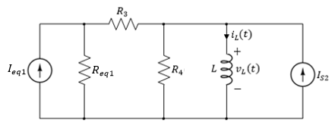
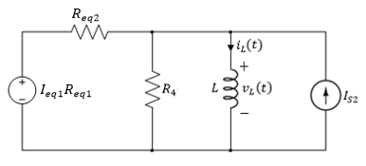
Where,
And,
Where,

Slide 46
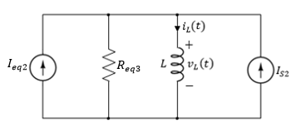
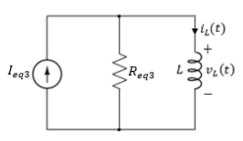
Again transforming the voltage source to a current source,
Where,
And,
Where,

Slide 47
As t → ∞, the inductor acts like a short circuit, with current passing through it given by,

Slide 48
The general solution for the forced response of i_{L}(t) is given by,

Slide 49
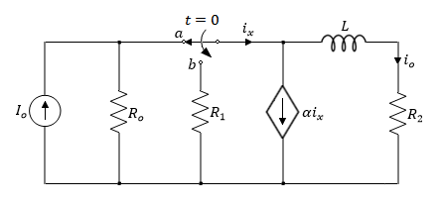
Example
The switch in the circuit has been in position ‘a’ for a long time. At t = 0, the switch is moved to position ‘b’. Determine:
The current i_{o}(t) for t > 0,
The initial energy stored in L.
Variable | Default | Unit
I_{o} | 25 | mA
R_{o} | 100 | Ω
R₁ | 200 | Ω
R₂ | 150 | Ω
L | 10 | mH
α | 3 | -

Slide 50
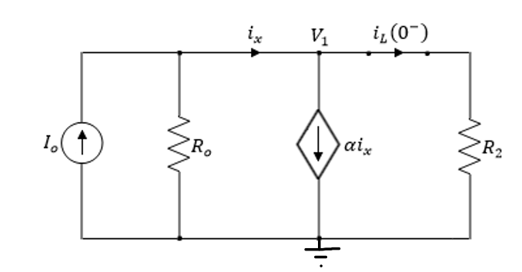
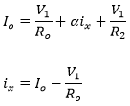
1) For t < 0 the switch has been open for a long time allowing the inductor to act like a short circuit,
Applying KCL at the top node,
Solving for V₁,
$$V_{1}=\frac{(α−1)R_{o}R_{2}I_{o}}{\left(α−1\right)R_{2}−R_{o}}=\frac{\left(3−1\right)100x150x.025}{\left(3−1\right)150−100}$$
$$V_{1}=\frac{750}{200}=3.75 V$$

Slide 51
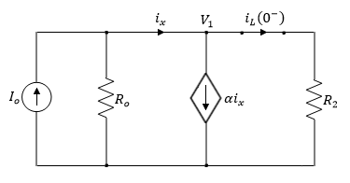
Therefore, the current $i_{L}\left(0^{−}\right)$ can be obtained as follows,
$$i_{L}\left(0^{−}\right)=\frac{V_{1}}{R_{2}}=\frac{3.75}{150}=25 mA$$
Since the current through the inductor doesn’t change instantaneously,
$$i_{L}\left(0^{−}\right)=i_{L}\left(0^{+}\right)=25 mA$$

Slide 52
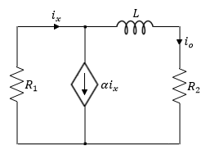
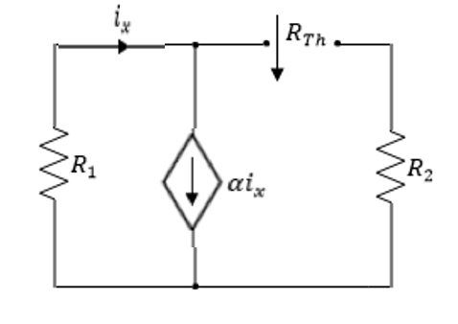
For t > 0, the switch closes resulting in a forced RL circuit,
2) To find the time constant, we need to find R_{Th},
R_{Th} seen by the inductor,
$$v_{t}$$
$$i_{t}$$
$$R_{Th}=\frac{v_{t}}{i_{t}}=\frac{{i_{t}R_{2}+i}_{x}R_{1}}{i_{t}}$$
$${v_{t}=i_{t}R_{2}−i}_{x}R_{1}$$
$i_{t}$= $i_{x}−αi_{x}=(1−α)i_{x}$
$$R_{Th}=\frac{v_{t}}{i_{t}}=\frac{i_{t}R_{2}+\frac{R_{1}}{(1−α)}i_{t}}{i_{t}}=R_{2}+\frac{R_{1}}{(1−α)}$$

Slide 53
Thus, the time constant is given by,
$$τ=\frac{L}{R_{Th}}=\frac{L}{R_{2}+\frac{R_{1}}{(1−α)}}=\frac{10 mH}{150+\frac{200}{(1−3)}}=0.2 ms$$

Slide 54
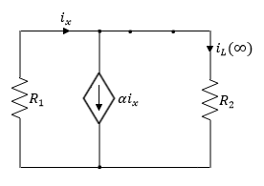
3) Next, we find, the inductor current at t → ∞
As t → ∞ the following circuit is obtained,
Since the circuit doesn’t contain any independent dc sources, there is no current flow, hence,
$$i_{x}=0$$
$$i_{L}(∞)=0$$

Slide 55
3) Next, we find, the inductor current at t → ∞
As t → ∞ the following circuit is obtained,
From KCL,
Since the circuit doesn’t contain any independent dc sources, there is no current flow, hence,
$$i_{x}−αi_{x}=i_{L}(∞)$$
From KVL,
$$i_{L}(∞)=0$$
$$−i_{x}R_{1}=i_{L}\left(∞\right)R_{2}=(1−α)i_{x}R_{2}$$
Therefore,
$$−i_{x}R_{1}= (1−α)i_{x}R_{2}$$
$$i_{x}=0$$

Slide 56
Summary:
$$i_{L}\left(0^{+}\right)=25 mA$$
$$τ=0.2 ms$$
$$i_{L}(∞)=0$$
Therefor, the general solutions:
$$i_{L}\left(t\right)=i_{L}\left(∞\right)+(i_{L}\left(0^{+}\right)−i_{L}(∞))e^{−t/τ}$$
$$i_{L}\left(t\right)=0+(25−0)e^{−t/0.2}={25e}^{−\frac{t}{0.2}} mA$$
Notce the initial and final values of the inductor current are the same as above

Slide 57
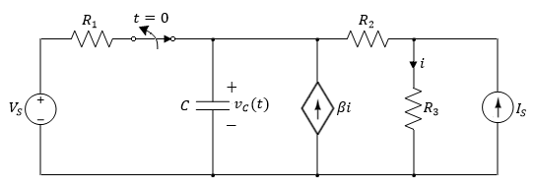
Example
In the circuit, the switch opens at t = 0. Assume zero initial voltage across the capacitor. Find the voltage response v_{C}(t) for t > 0.
Variable | Default | Unit
V_{S} | 8.6 | V
I_{S} | 2 | mA
R₁ | 2.4 | kΩ
R₂ | 1.2 | kΩ
R₃ | 0.8 | kΩ
C | 2.1 | μF
β | 0.8 | -

Slide 58
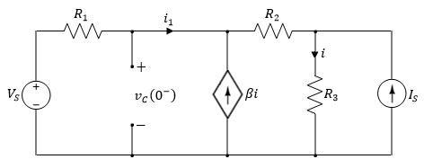
1) For t < 0 the switch has been closed for a long time allowing the capacitor to act like an open circuit, where,
And,

Slide 59
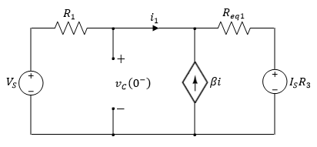
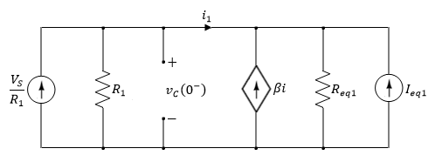
Applying source transformation, first by transforming the current source to a voltage source, where,
Again applying source transformations for both voltage sources, where,

Slide 60
Applying KCL at the top node,

Slide 61
Solve for i₁
Substituting to find v(0⁻),
This yields,

Slide 62
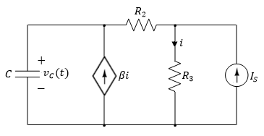
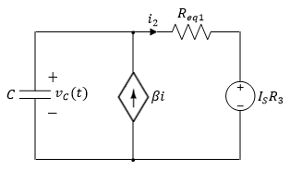
2) For t > 0, the switch is opened resulting in a forced RC circuit,
Transforming the current source to a voltage source
Where,
And,
Next find the time constant

Slide 63
3) For t → ∞ , the switch is opened resulting in a forced RC circuit,
Transforming the current source to a voltage source

Slide 64
Hence the final solution is given by,
Find the expression for i
The best is to use nodal method

Slide 65
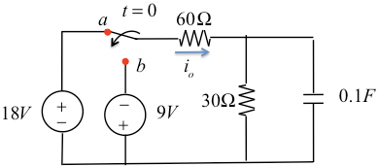
Example:
For the shown circuit the switch was at (a) for long time. The switch is moved to (b) at t = 0

Slide 66
Solution:
For t<0:
For t>0:

Slide 67
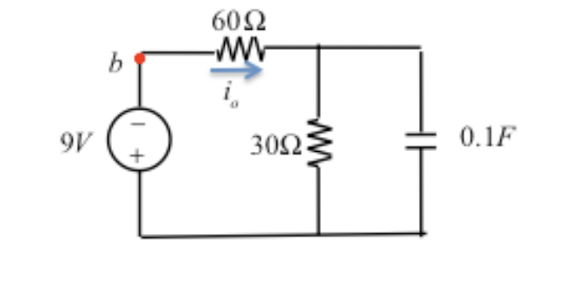
Solution:
For t= ∞ :

Slide 68
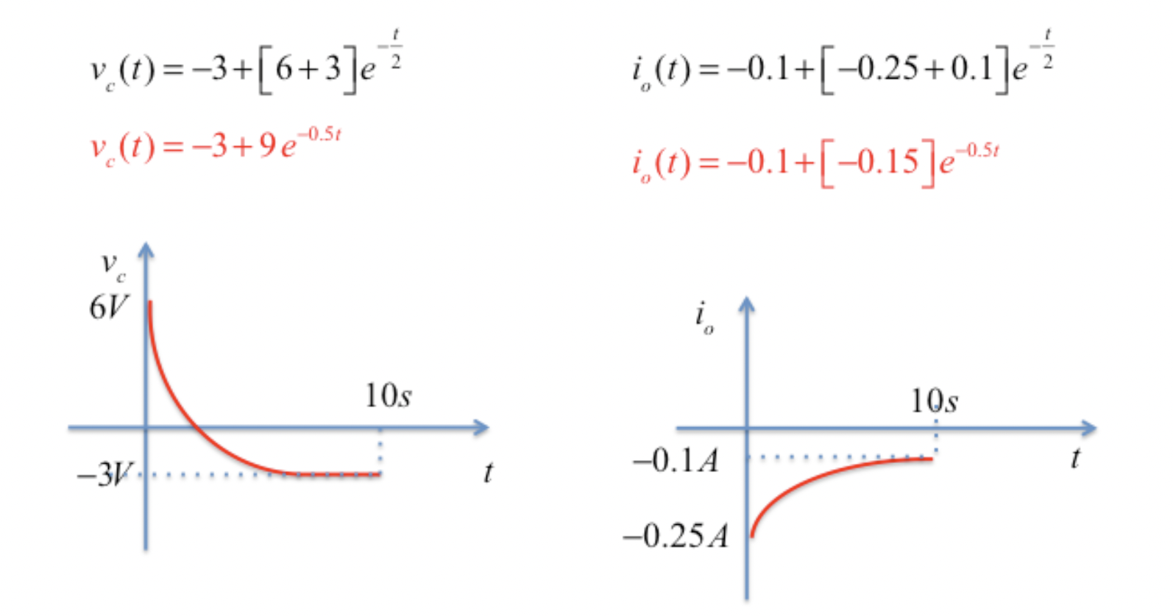
Solution:
General Solution

