Slide 1
EEL 3004 ELECTRICAL NETWORKS -Lecture 17- Step Response

Slide 2
Lecture Objectives
The lecture today will focus on:
Step response of RC circuits, for solving capacitor voltage and current.
Examples with dependent and independent sources

Slide 3
Natural Response of RC and RL circuits
The natural response for an RC and RL circuits are obtained when the external independent source is set to zero.
For the natural responses to exist it is required that the capacitor and inductor have energy stored in it at the moment of switching and the parallel RC and RL circuits are obtained.
After certain action (switching):
R’s and C’s
R’s and L’s
No External source
No External source

Slide 4
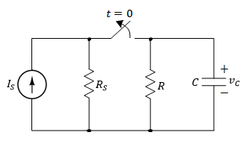
Natural Response of RC circuits
Assume the switch was closed for a long time.
Switch that is opened at t=0 to remove the applied current source.
Find the natural response after the switch has been opened.

Slide 5
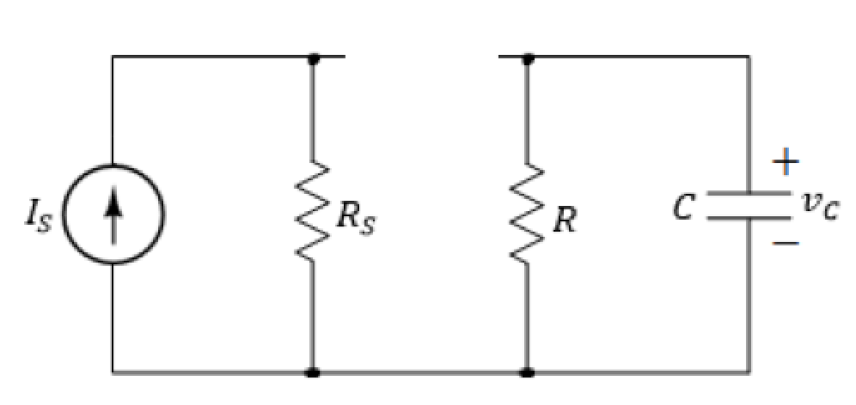
Natural Response of RC circuits
Assume the switch was closed for a long time.
Switch that is opened at t=0 to remove the applied current source.
Find the natural response (voltage v_{c}) after the switch has been opened.
t > 0
No voltage or current sources

Slide 6
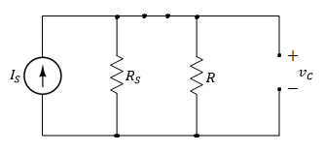
Natural Response of RC circuits
I) Find vc for t < 0 (Long time when the switch was closed):
Since we have DC current, therefore, the capacitor behaves like an open circuit prior to opening the switch.
Since the voltage on the capacitor cannot change instantaneously,

Slide 7
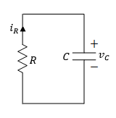
Natural Response of RC circuits
II) Find vc for t > 0 (The time after the switch is opened):
The equivalent circuit for t > 0.
Applying KVL around the loop.
An ordinary first-order differential equation with constant coefficients

Slide 8
Natural Response of RC circuits
Solve first order DEQ:

Slide 9
Natural Response of RC circuits
The final expression is given by,
Where,
Capacitor initial value
Time constant

Slide 10
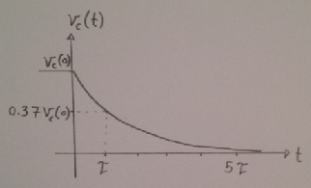
Natural Response of RC circuits
The final expression is given by,
At t=5τ the capacitor voltage becomes practically zero.

Slide 11
Natural Response of RC circuits
The induced current in the resistor, is the same as the induced current in the capacitor,

Slide 12
Natural Response of RC circuits
Instantaneous power in the resistor,
Instantaneous energy dissipated in the resistor,

Slide 13
Natural Response of RC circuits
At t=0, the energy dissipated in the resistor starts at zero value, and as t→∞ it reaches,
Which is the amount of energy that was initially stored in the capacitor at t=0.

Slide 14
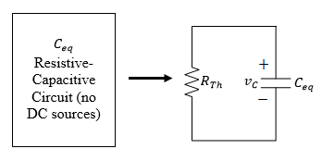
General Natural Response of RC circuits
Any given resistive-capacitive circuit without external independent DC sources that can be reduced to a parallel equivalent R_{Th}C_{eq} circuit.
The general solution for v_{C}(t) is given,

Slide 15
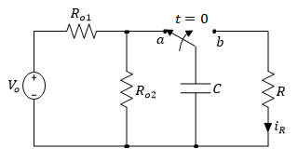
Example
For the following RC circuit with a DC voltage source. Initially the switch has been connected to position ‘a’ for a long time. At t=0, the switch moved to position ‘b’. Determine:
The voltage response for v_{C}(t), for t≥0,
The current i_{R}(t) for t>0,
The total energy dissipated in R at t=τ, 5τ, and ∞.
Variable | Default | Unit
V_{o} | 8.6 | V
R | 4.5 | kΩ
R_{o1} | 8 | kΩ
R_{o2} | 16 | kΩ
C | 2.1 | mF

Slide 16
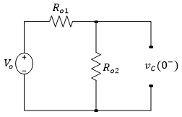
For t < 0 the capacitor is fully charged. Hence at t=0⁻ we have,

Slide 17
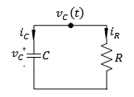
For t > 0,
Applying KCL to the top node yields,
Substituting for i_{C} and i_{R} in terms of v_{C}(t),

Slide 18
Solving the first order differential equation,

Slide 19
Solving the first order differential equation,
Solving for v_{C}(t),
K

Slide 20
Evaluating the above equation at t=0,

Slide 21
Evaluating the above equation at t=0,
Hence, the general solution for v_{C}(t) is given by,

Slide 22
The current across the resistor can be calculated as,

Slide 23
The current across the resistor can be calculated as,
The total energy dissipated in R is given by,

Slide 24
Calculating τ,

Slide 25
Calculating τ,
Energy dissipated at different times can be found as,

Slide 26
Calculating τ,
Energy dissipated at different times can be found as,
All the initial energy that was stored in C is released to R as t → ∞

Slide 27
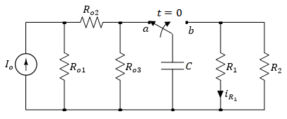
Example
For the following RC circuit with a DC voltage source. Initially the switch has been connected to position ‘a’ for a long time. At t=0, the switch moved to position ‘b’. Determine:
The voltage response for v_{C}(t), for t≥0,
The current i_{R1}(t) for t>0,
The total energy dissipated in R₁ at t=τ, 5τ, and ∞.
Variable | Default | Unit
I_{o} | 2 | mA
R₁ | 4.5 | kΩ
R₂ | 2.4 | kΩ
R_{o1} | 8 | kΩ
R_{o2} | 16 | kΩ
R_{o3} | 24 | kΩ
C | 2.1 | mF

Slide 28
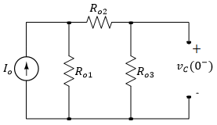
For t < 0 the capacitor is fully charged. Hence at t=0⁻ we have,

Slide 29
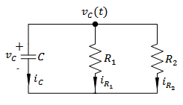
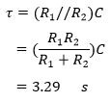
For t > 0,
Calculating τ,

Slide 30
For t > 0,
Calculating τ,
Substituting these values in the default expression,

Slide 31
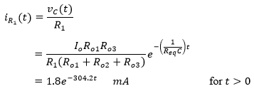
The current across the resistor can be calculated as,

Slide 32
The current across the resistor can be calculated as,
The total energy dissipated in R₁ is given by,

Slide 33
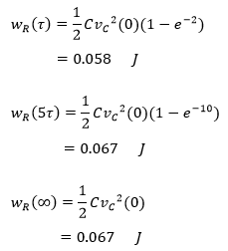
Energy dissipated at different times can be found as,

Slide 34
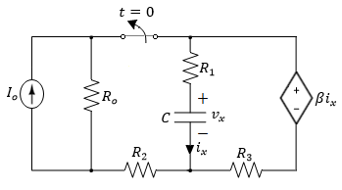
Example
In the circuit, the switch has been closed for a long time and opened at t=0. Determine:
The voltage v_{x}(t), and current i_{x}(t) for t ≥ 0,
Energy stored in the capacitor for t = 0,
Energy dissipated in R₃ at t = ∞.
Variable | Default | Unit
I_{o} | 4 | A
R_{o} | 5 | Ω
R₁ | 8 | Ω
R₂ | 5 | Ω
R₃ | 4 | Ω
C | 1.5 | μF
β | 5 | -

Slide 35
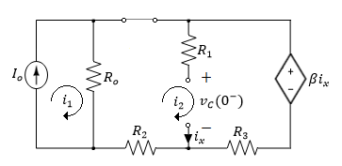
For t < 0 the capacitor is fully charged. Hence at t = 0⁻ we have,
Applying KVL around the loops,
Where,
Solving for i₂ yields,

Slide 36
Solving for i₂ yields,
The initial capacitor voltage is given by,

Slide 37
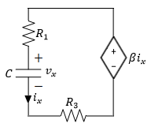
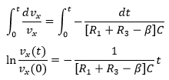
After the switch is opened for t > 0,
Applying KVL around the loop,
Substituting i_{x}, the equation becomes,

Slide 38
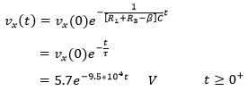
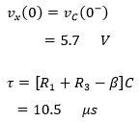
Solving for v_{x}(t),
Where,

Slide 39
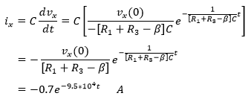
The current i_{x}(t) is calculated as follows,

Slide 40
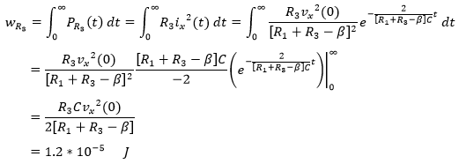
The initial energy stored in the capacitor,
The total energy dissipated in R₃ is given by,

Slide 41
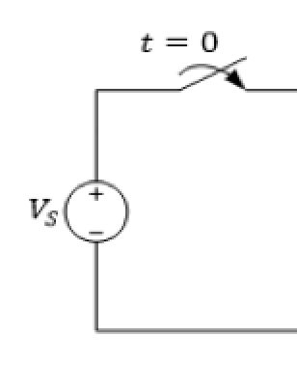
Step Response of RC circuits
In the circuit, a constant voltage source V_{S} is connected to the RC circuit at t = 0, by closing the switch.
Assume that the initial voltage on the capacitor at t = 0⁻ is denoted by v_{C}(0⁻).
After certain action (switching):
R’s and C’s
Applied External source

Slide 42
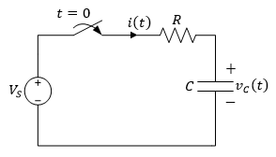
Step Response of RC circuits
After the switch is closed, applying KVL around the loop,
Since the voltage across the capacitor cannot change instantaneously,

Slide 43
Step Response of RC circuits
Same solution as in the natural RC response circuit, except for an additional constant term due to the presence of the DC external source,
Where K₁, K₂ and s are constants to be determined,
The characteristic equation becomes,

Slide 44
Step Response of RC circuits
For equality, the coefficient of e^{st} must be zero,
Also,
Substituting these values yields,

Slide 45
Step Response of RC circuits
Using the initial voltage condition across the capacitor,
Which yields,
Substituting, the final solution is,
Where,

Slide 46
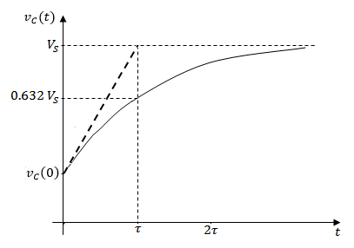
Step Response of RC circuits
As in the natural response, the second term on the right is called the transient response, which eventually decays to zero as t → ∞.
The first term on the right is the steady state response or forced response, which remains after the transient has decayed.

Slide 47
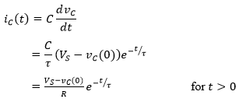
Step Response of RC circuits
The current through the capacitor is obtained as,

Slide 48
Step Response of RC circuits
In general, we can write the following solution for any RC circuit,
Where v(∞) and v(0) are the final and initial voltage on the capacitor, respectively, at t = ∞ and t = 0,
We notice that the capacitor current just before the switch was closed, is zero.
The capacitor current just after the switch was closed is given by,

Slide 49
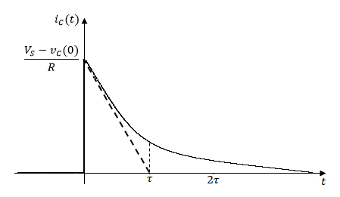
Step Response of RC circuits
We notice that the capacitor current just before the switch was closed, is zero.
The capacitor current just after the switch was closed is given by,

Slide 50
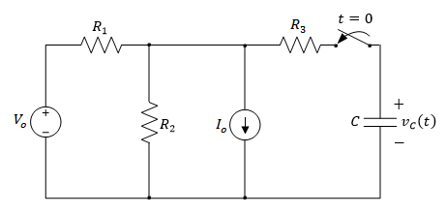
Example
In the circuit, at t = 0 the switch is closed. It is desired to derive an expression for the voltage v_{C}(t) for t > 0.
Variable | Default | Unit
V_{o} | 8.6 | V
I_{o} | 2 | mA
R₁ | 2.4 | kΩ
R₂ | 1.2 | kΩ
R₃ | 3.8 | kΩ
C | 2.1 | μF

Slide 51
For t < 0 the switch has been open for a long time, and the capacitor is not connected to the circuit,

Slide 52
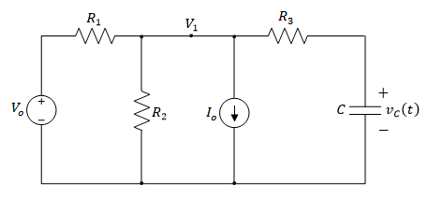
For t > 0,
Applying KCL to the top node yields,
It can also be seen that,
Combining both equations yields,
Rearranging terms yields,

Slide 53
Integrating both sides,
Using substitution,

Slide 54
Raising both sides of the equation to the power of e,
Evaluating the equation at t = 0,
Which yields,

Slide 55
Hence the final solution is given by,
Where,
And,

Slide 56
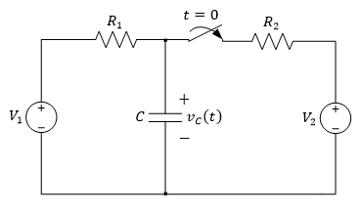
Example
In the circuit, at t = 0 the switch is closed. It is desired to derive an expression for the voltage v_{C}(t) for t > 0.
Variable | Default | Unit
V₁ | 8.6 | V
V₂ | 4.2 | V
R₁ | 2.4 | kΩ
R₂ | 1.2 | kΩ
C | 2.1 | μF

Slide 57
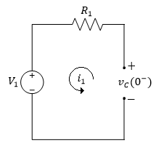
For t < 0 the switch has been open for a long time, allowing the capacitor to act like an open circuit,
Since the voltage across the capacitor doesn’t change instantaneously,

Slide 58
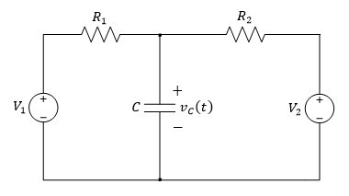
For t > 0,
Using the source transformation method, by transforming both voltage sources to current sources,

Slide 59
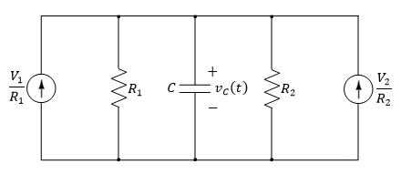
For t > 0,
The circuit can now be simplified as follows,

Slide 60
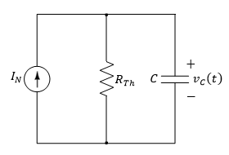
For t > 0,
Where I_{N} is given by,
And the Thevenin resistance by,

Slide 61
For t > 0,
Therefore the time constant is given by,
As t → ∞, the capacitor acts as an open circuit,
The general solution for the forced response of v_{C}(t) is given by,

Slide 62
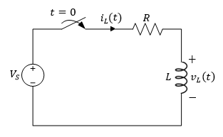
Step Response of RL circuits
In the circuit, at t = 0, the switch is closed.
Assume that the initial current passing through the inductor at t = 0⁻ is denoted by i_{L}(0⁻).

Slide 63
Step Response of RL circuits
Applying KVL around the loop,
Substitute for v_{L} in terms of i_{L} yields,
Since the current passing through the inductor cannot change instantaneously,

Slide 64
Step Response of RL circuits
The solution will be the same as in the case of the natural RL response circuit, except for an additional constant term K₁,
In which K₁, K₂ and s are constants to be found,
we arrive at the characteristic equation,

Slide 65
Step Response of RL circuits
Rewriting the equation yields,
For equality, the coefficient of e^{st} must be zero,
From the equation we also get,

Slide 66
Step Response of RL circuits
Substituting these values yields,
Using the initial current condition through the inductor,
Which yields,

Slide 67
Step Response of RL circuits
Substituting we get the solution,
Where,

Slide 68
Step Response of RL circuits
As before in the natural response, the second term on the right is called the transient response, which will eventually decay to zero as t → ∞.
The first term on the right is the steady state response or forced response, which remains after the transient has decayed.

Slide 69
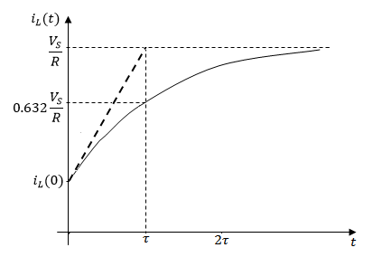
Step Response of RL circuits
i_{L}(t) starts from its initial value at i_{L}(0), and finally reaches a steady state value of V_{S}/R asymptotically.
After one time constant it reaches 0.632 of V_{S}/R. After about five time constants it reaches its final value V_{S}/R.

Slide 70
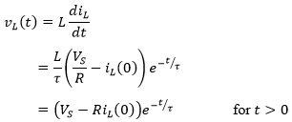
Step Response of RL circuits
The voltage across the inductor is obtained as,

Slide 71
Step Response of RL circuits
In general we can write the following solution for any RL circuit,
Where iL(∞) and iL(0) are the final and initial current passing through the inductor at t = ∞, and t = 0, respectively.

Slide 72
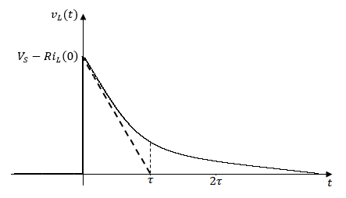
Step Response of RL circuits
The voltage across the inductor was zero before the instant the switch was closed.
As expected, the inductor voltage can change values instantaneously, but not the inductor current as discussed.

Slide 73
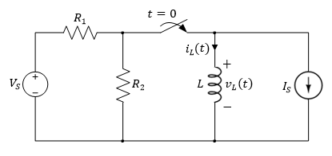
Example
In the circuit, at t = 0 the switch is closed. It is desired to derive an expression for the current i_{L}(t) for t > 0.
Variable | Default | Unit
V_{S} | 8.6 | V
I_{S} | 200 | mA
R₁ | 20 | Ω
R₂ | 24 | Ω
L | 12 | mH

Slide 74
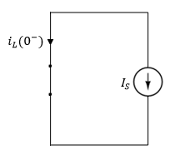
For t < 0 the switch has been open for a long time, so the inductor acts like a short circuit,
Since the current through the inductor doesn’t change instantaneously,

Slide 75
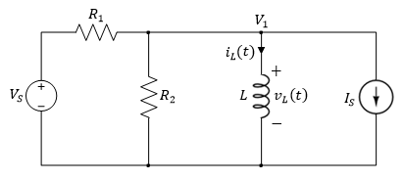
For t > 0,
Applying KCL to the top node,

Slide 76
For t > 0,
Applying KCL to the top node,
Noting that V₁ = v_{L},

Slide 77
For t > 0,
Applying KCL to the top node,
Noting that V₁ = v_{L},
Since,
We rewrite the equation as,

Slide 78
Rearranging terms,

Slide 79
Rearranging terms,
Integrating both sides,

Slide 80
Rearranging terms,
Integrating both sides,
Using integration by substitution,

Slide 81
Substituting yields,

Slide 82
Substituting yields,
Raising both sides of the equation to the power of e,

Slide 83
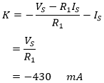
Evaluating the above equation at t = 0,
Which yields,

Slide 84
Evaluating the above equation at t = 0,
Which yields,
Thus giving an expression for i_{L}(t) of,

Slide 85
Or use the general solution as given by,
Where,
And,

Slide 86
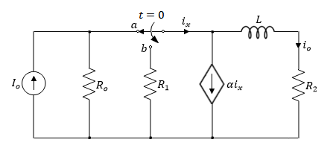
Example
The switch in the circuit has been in position ‘a’ for a long time. At t = 0, the switch is moved to position ‘b’. Determine:
The current i_{o}(t) for t > 0,
The initial energy stored in L.
Variable | Default | Unit
I_{o} | 25 | mA
R_{o} | 100 | Ω
R₁ | 200 | Ω
R₂ | 150 | Ω
L | 10 | mH
α | 3 | -

Slide 87
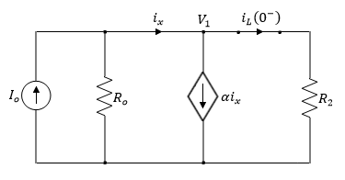
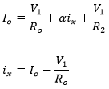
For t < 0 the switch has been open for a long time allowing the inductor to act like a short circuit,
Applying KCL at the top node,

Slide 88
For t < 0 the switch has been open for a long time allowing the inductor to act like a short circuit,
Applying KCL at the top node,

Slide 89
For t < 0 the switch has been open for a long time allowing the inductor to act like a short circuit,
Applying KCL at the top node,
Solving for V₁,

Slide 90
For t < 0 the switch has been open for a long time allowing the inductor to act like a short circuit,
Therefore the current iL(0⁻) is,
Since the current through the inductor doesn’t change instantaneously,

Slide 91
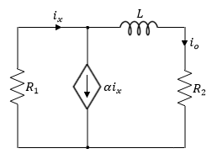
For t > 0, the switch closes resulting in a forced RL circuit,

Slide 92
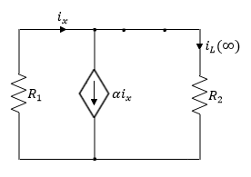
For t > 0, the switch closes resulting in a forced RL circuit,
As t → ∞ the following circuit is obtained,

Slide 93
For t > 0, the switch closes resulting in a forced RL circuit,
As t → ∞ the following circuit is obtained,
Since the circuit doesn’t contain any independent dc sources then it has a transient response,

Slide 94
To find the time constant, we need to find R_{Th},

Slide 95
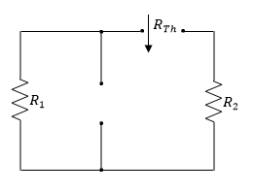
To find the time constant, we need to find R_{Th},
R_{Th} seen by the inductor,

Slide 96
To find the time constant, we need to find R_{Th},
Thus the time constant,
R_{Th} seen by the inductor,

Slide 97
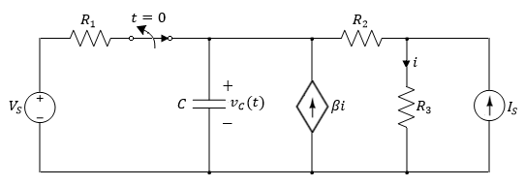
Example
In the circuit, the switch opens at t = 0. Assume zero initial voltage across the capacitor. Find the voltage response v_{C}(t) for t > 0.
Variable | Default | Unit
V_{S} | 8.6 | V
I_{S} | 2 | mA
R₁ | 2.4 | kΩ
R₂ | 1.2 | kΩ
R₃ | 0.8 | kΩ
C | 2.1 | μF
β | 0.8 | -

Slide 98
For t < 0 the switch has been closed for a long time allowing the capacitor to act like an open circuit, where,
And,

Slide 99
Applying source transformation, first by transforming the current source to a voltage source, where,

Slide 100
Again applying source transformations for both voltage sources, where,

Slide 101
Again applying source transformations for both voltage sources, where,
Applying KCL at the top node,

Slide 102
Making i₁ the subject of the formula,
Substituting to find v(0⁻),

Slide 103
This yields,

Slide 104
For t > 0, the switch is opened resulting in a forced RC circuit,
Transforming the current source to a voltage source

Slide 105
Where,
And,

Slide 106
Where,
And,
Applying KCL at the top node,

Slide 107
Combining all three equations yields,
Rearranging the terms yields,

Slide 108
Integrating both sides,
Using the substitution method of integration,

Slide 109
Substituting yields,

Slide 110
Raising both sides of the equation to the power of e,

Slide 111
Hence the final solution is given by,
Where,
And,

Slide 112
Example
In the circuit, at t = 0 the switch closes. Find the current response i_{L}(t) for t > 0.
Variable | Default | Unit
V_{S} | 8.6 | V
I_{S1} | 200 | mA
I_{S2} | 130 | mA
R₁ | 20 | Ω
R₂ | 24 | Ω
R₃ | 34 | Ω
R₄ | 28 | Ω
L | 12 | mH

Slide 113
For t < 0 the switch has been open for a long time allowing the inductor to act like a short circuit,
Since R₄ is shorted, the current passing through the inductor,
Since the current through the inductor doesn’t change instantaneously,

Slide 114
For t > 0, the switch is closed, resulting in a forced RL circuit,
Transforming the voltage source to a current source,

Slide 115
For t > 0, the switch is closed, resulting in a forced RL circuit,
Simplifying the circuit yields,

Slide 116
Where,
And,

Slide 117
Where,
And,
Transforming the current source to a voltage source,

Slide 118
Where,

Slide 119
Where,
Again transforming the voltage source to a current source,

Slide 120
Where,
And,

Slide 121
Where,
And,
Simplifying the circuit yields,

Slide 122
Where,
And the time constant,

Slide 123
Where,
And the time constant,
As t → ∞, the inductor acts like a short circuit, with current passing through it given by,

Slide 124
The general solution for the forced response of i_{L}(t) is given by,

