Slide 1
EEL 3004 ELECTRICAL NETWORKS -Lecture 16 Examples of Natural Response

Slide 2
Lecture Objectives
The lecture today will focus on:
Examples of Natural Response of RC circuits, for solving capacitor voltage and current.

Slide 3
Natural Response of RC and RL circuits
The natural response for an RC and RL circuits are obtained when the external independent source is set to zero.
For the natural responses to exist it is required that the capacitor and inductor have energy stored in it at the moment of switching and the parallel RC and RL circuits are obtained.
After certain action (switching):
R’s and C’s
R’s and L’s
Natural Response when no External
source after t<0
Natural Response when no External
source after t<0

Slide 4
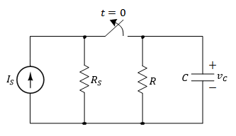
Natural Response of RC circuits
Assume the switch was closed for a long time.
Switch that is opened at t=0 to remove the applied current source.
Find the natural response after the switch has been opened.

Slide 5
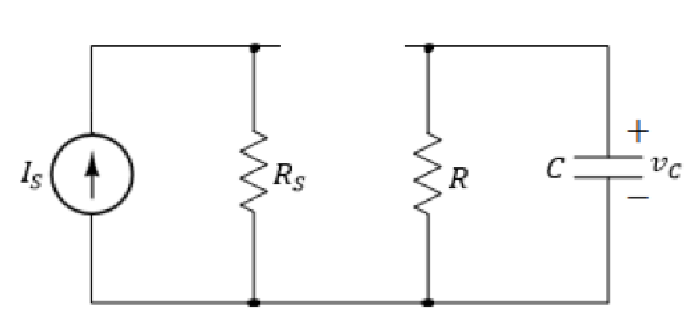
Natural Response of RC circuits
Assume the switch was closed for a long time.
Switch that is opened at t=0 to remove the applied current source.
Find the natural response (voltage v_{c}) after the switch has been opened.
t > 0
No voltage or current sources

Slide 6
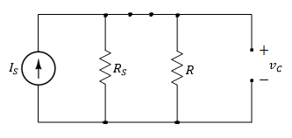
Natural Response of RC circuits
I) Find vc for t < 0 (Long time when the switch was closed):
Since we have DC current, therefore, the capacitor behaves like an open circuit prior to opening the switch.
Since the voltage on the capacitor cannot change instantaneously,

Slide 7
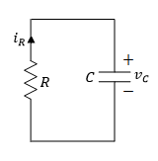
Natural Response of RC circuits
II) Find vc for t > 0 (The time after the switch is opened):
The equivalent circuit for t > 0.
Applying KVL around the loop.
An ordinary first-order differential equation with constant coefficients

Slide 8
Natural Response of RC circuits
Solve first order DEQ:

Slide 9
Natural Response of RC circuits
The final expression is given by,
Where,
Capacitor initial value
Time constant

Slide 10
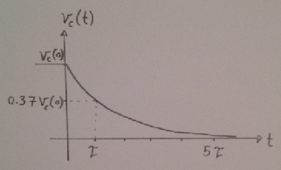
Natural Response of RC circuits
The final expression is given by,
At t=5τ the capacitor voltage becomes practically zero.

Slide 11
Natural Response of RC circuits
The induced current in the resistor, is the same as the induced current in the capacitor,

Slide 12
Natural Response of RC circuits
Instantaneous power in the resistor,
Instantaneous energy dissipated in the resistor,

Slide 13
Natural Response of RC circuits
At t=0, the energy dissipated in the resistor starts at zero value, and as t→∞ it reaches,
Which is the amount of energy that was initially stored in the capacitor at t=0.

Slide 14
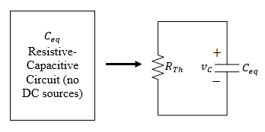
General Natural Response of RC circuits
Any given resistive-capacitive circuit without external independent DC sources that can be reduced to a parallel equivalent R_{Th}C_{eq} circuit.
The general solution for v_{C}(t) is given,

Slide 15
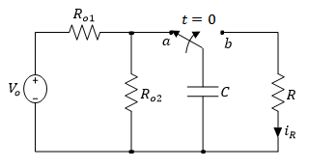
Example
For the following RC circuit with a DC voltage source. Initially the switch has been connected to position ‘a’ for a long time. At t=0, the switch moved to position ‘b’. Determine:
The voltage response for v_{C}(t), for t≥0,
The current i_{R}(t) for t>0,
The total energy dissipated in R at t=τ, 5τ, and ∞.
Variable | Default | Unit
V_{o} | 8.6 | V
R | 4.5 | kΩ
R_{o1} | 8 | kΩ
R_{o2} | 16 | kΩ
C | 2.1 | mF

Slide 16
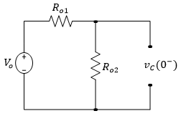
For t < 0 the capacitor is fully charged. Hence at t=0⁻ we have,

Slide 17
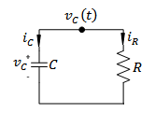
For t > 0,
Applying KCL to the top node yields,
Substituting for i_{C} and i_{R} in terms of v_{C}(t),

Slide 18
Solving the first order differential equation,

Slide 19
Solving the first order differential equation,
Solving for v_{C}(t),
K

Slide 20
Evaluating the above equation at t=0,
Hence, the general solution for v_{C}(t) is given by,

Slide 21
The current across the resistor can be calculated as,
The total energy dissipated in R is given by,

Slide 22
Calculating τ,
Energy dissipated at different times can be found as,
All the initial energy that was stored in C is released to R as t → ∞

