Slide 1
EEL 3004 Linear Circuits I Lecture #15 First Order LR Circuits - Natural responses without DC sources

Slide 2
Lecture Objectives
The lecture today will focus on:
Introduction to switching RL circuits
Natural response of RL Circuits without DC sources
Examples

Slide 3
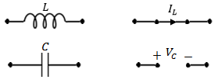
RLC circuits with DC sources and NO Switching
(Steady-state)
If the circuit consists only of direct current and voltage sources (dc), and the switch has been closed or opened for long time, then the capacitor behaves as an open circuit, and the inductor behaves as a short circuit.
Under DC conditions – the circuit has been undisturbed for a long time

Slide 4
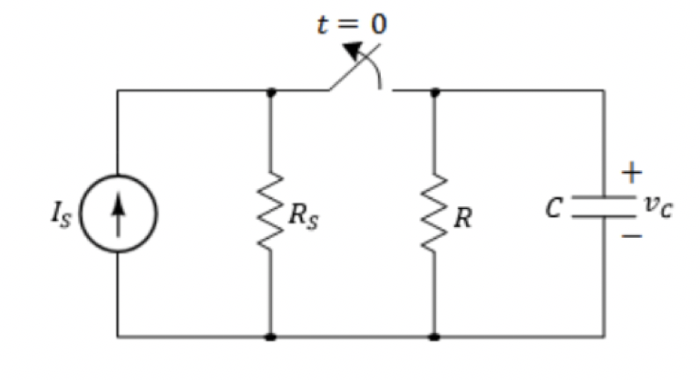
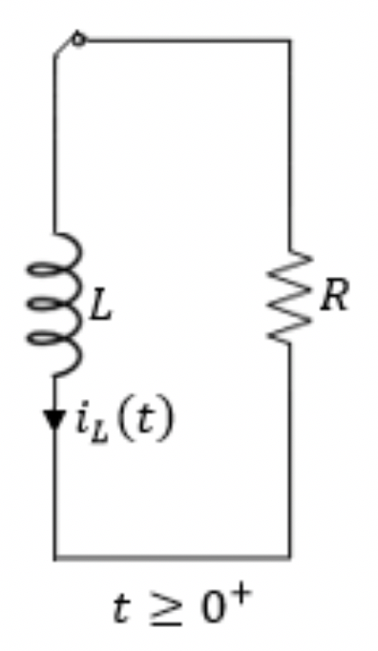
Natural Response RL circuits
The natural response for an RL circuits are obtained when the external independent source is set to zero or removed as shown below.
For the natural responses to exist it is required that the inductor have energy stored in it at the moment of switching and the equivalent RL circuits are obtained.
After certain action (switching):
This circuit will responds naturally due to its L &R equivalent values.
We call it natural response or transient response.
R’s and L’s Only
No External source
Our goal to find the voltages, currents and power after t > 0.

Slide 5
Natural Response of LR circuits
IMPORTANT DEFINITIONS
$$We define:$$
For t < 0, we let
$$i_{L}\left(0^{−}\right)=inductor current just before t=0$$
For t > 0, we let
$$i_{L}\left(0^{+}\right)=inductor current just after t=0$$
Therefore, for the inductor has these conditions met all the time:
$i_{L}\left(0^{+}\right)$= $i_{L}\left(0^{−}\right)=i_{L}\left(0\right)$

Slide 6
General Natural Response of LR circuits
Any given resistive-capacitive circuit without external independent DC sources that can be reduced to a series equivalent L/R circuit.
The general solution for i_{L}(t) is given,
$i_{L}\left(t\right)=i_{L}(0)e^{−t/τ}$
$τ=\frac{L}{R}$ is the circuit time constant
$i_{L}(0)$= $i_{L}(0^{−})$ is the initial inductor value across in L.

Slide 7
General Natural Response of LR circuits
Any given resistive-capacitive circuit without external independent DC sources that can be reduced to a series equivalent L/R circuit.
The general solution for i_{L}(t) is given,
$i_{L}\left(t\right)=i_{L}(0)e^{−t/τ}$
$τ=\frac{L}{R}$ is the circuit time constant
R: The total resistance seen by the inductor
$i_{L}(0)$= $i_{L}\left(0^{−}\right)=i_{L}\left(0^{+}\right)$ is the initial inductor value
across in L.
Simplified circuit

Slide 8
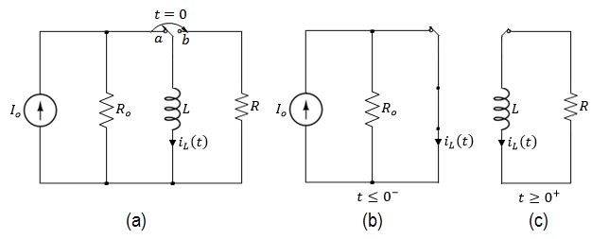
Natural Response of RL circuits
The natural response for an RL circuit is analogous to the natural response of an RC circuit
Consider the circuit where the switch moves from position ‘a’ to ‘b’.
=?

Slide 9
Natural Response of RL circuits
The natural response for an RL circuit is analogous to the natural response of an RC circuit
Consider the circuit where the switch moves from position ‘a’ to ‘b’.

Slide 10
Natural Response of RL circuits
The initial inductor current for t = 0⁻ right before the switch is moved from ‘a’ to ‘b’, is given by,
Applying KVL around the parallel RL circuit,
Since the inductor current doesn’t change its value instantaneously
An ordinary first-order differential equation with constant coefficients

Slide 11
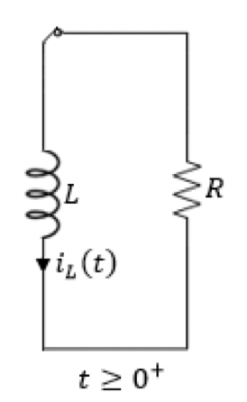
Natural Response of RL circuits
It can be easily shown that the general natural response of i_{L}(t) is given by,
Where i_{L}(0) = I_{o} is the initial inductor current, and the time constant,

Slide 12
Natural Response of RL circuits
The voltage across the resistor is given by,
The instantaneous power delivered to R,
And the energy dissipated in R,

Slide 13
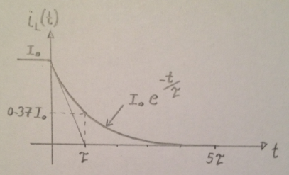
Natural Response of RL circuits
The plot for the natural response of an RL circuit,

Slide 14
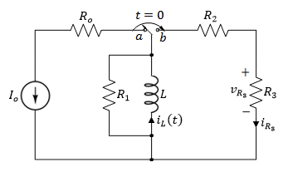
Example
Initially the switch has been in position ‘a’ for a long time. At t = 0, the switch is moved to position ‘b’. Determine for t > 0:
The currents i_{L}(t) and i_{R3}(t) and voltage v_{R3},
The power dissipated in R₃,
The initial energy stored in L,
The total energy delivered to R₃,
The percentage of energy dissipated in R₃.
Variable | Values | Unit
I_{o} | 2 | A
R_{o} | 2 | Ω
R₁ | 8 | Ω
R₂ | 5 | Ω
R₃ | 4 | Ω
L | 0.5 | H

Slide 15
The solution approach:
The key is to find the for $i_{L}\left(t\right)$ after the switch is closed, i.e. for $For t≥0$.
Once we solve for $i_{L}\left(t\right)$ then all the currents, voltages, power and energy can be expressed in terms of $i_{L}\left(t\right)$.
The inductor current $i_{L}\left(t\right)$ is known as state variable
Let us use two possible solution methods:
Solution A – Use the General Formula – short cut
Solution B – Use differential Equation (DEQ) approach directly – finding the integral

Slide 16
Solution A – Use the General Formula
The general solution (natural response) for i_{L}(t):
$$i_{L}\left(t\right)=i_{L}\left(0^{+}\right)e^{−\frac{t}{τ}} For t≥0$$
$$R_{Th}$$
Where,
$i_{L}\left(0\right)$is the initial inductor current
$τ \text{is} \text{the} \text{time} \text{constant}$ given by
$$τ=\frac{L}{R_{Th}}$$
$R_{Th}$ is the equivalent resistance seen by the inductor

Slide 17
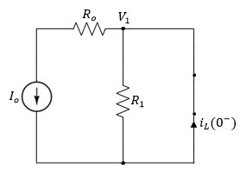
Solution A – Use the General Formula
(1) Need to find $i_{L}(0^{+})$
For t < 0 the inductor acts like a short circuit,
Applying KCL at the top node yields,
$$V_{1}=0 Since it is shorted to the ground$$
Hence,
Since the current in the inductance doesn’t change instantaneously,

Slide 18
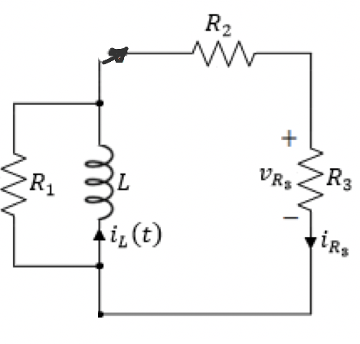
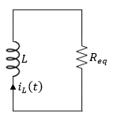
(2) Need to find $τ$
For t > 0, the equivalent circuit is shown below
Simplified equivalent circuit, where
So, by inspection the time constant is:
$$τ=\frac{L}{R_{eq}}=\frac{0.5}{4.2}=0.12 s$$

Slide 19
Solution B – Use differential Equation approach directly applied to the DEQ below,
Recall for t>0, we have this DEQ,
Integrating both sides,
Raising both sides of the equation to the power of e,
$$τ=\frac{L}{R_{eq}}$$
Notice this is equal to $1/τ$
Need to find K !!

Slide 20
Evaluating the above equation at t = 0,
Yes
$$\frac{1}{τ}=\frac{R_{eq}}{L}$$
$$τ=\frac{L}{R_{eq}}$$
Yes
The natural response is given by,

Slide 21
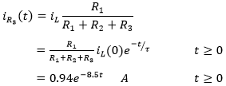
The current in R₃ can be found by current division,
And the voltage across R₃ is given by,

Slide 22
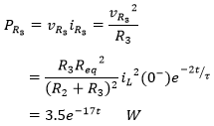
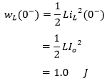
The power dissipated in R₃ is given by,
The initial energy stored in the inductor is,

Slide 23
The total energy delivered to R₃ is,
The percentage of energy dissipated in R₃ is,

Slide 24
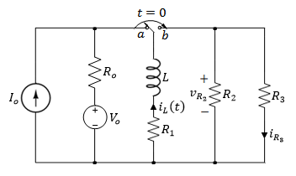
Example
Initially the switch has been in position ‘a’ for a long time. At t = 0, the switch is moved to position ‘b’. Determine for t > 0:
The currents i_{L}(t) and i_{R3}(t) and voltage v_{R3},
The power dissipated in R₃,
The initial energy stored in L,
The total energy delivered to R₃,
The percentage of energy dissipated in R₃.
Variable | Values | Unit
V_{o} | 24 | V
I_{o} | 6 | A
R_{o} | 2 | Ω
R₁ | 8 | Ω
R₂ | 5 | Ω
R₃ | 4 | Ω
L | 0.5 | H

Slide 25
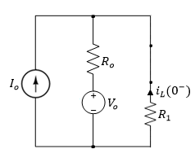
Solution – Use the General Formula
For t < 0, we use the circuit to find $i_{L}\left(0^{−}\right)$
Use any analysis method to solve for$i_{L}\left(0^{−}\right)$
For t<0.

Slide 26
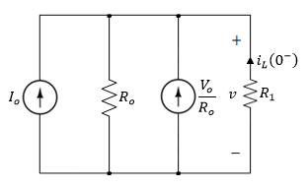
Solution – Use the General Formula
For t < 0 the inductor acts like a short circuit,
Applying source transformation,

Slide 27
Assign v across all parallel branches
Applying KCL to the single-node circuit yields,
It can be seen that,
Solving for i_{L}(0) yields,
$$i_{L}\left(0^{−}\right)=−\frac{2x6+24}{2+8}=−3.6 A$$
Since the current in the inductance doesn’t change instantaneously,
$$i_{L}\left(0^{+}\right)=i_{L}\left(0^{−}\right)=−3.6 A$$

Slide 28
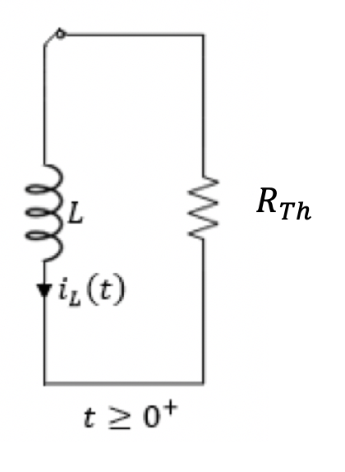
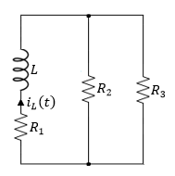
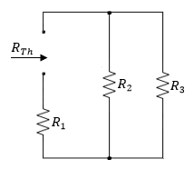
For t > 0, we use the circuit to find $τ$:
R_{Th} is given by,
$$τ=\frac{L}{R_{eq}}$$
finding the Thevenin total resistance seen by the inductor,

Slide 29
And the time constant,
The solution for i_{L}(t) is given by,

Slide 30
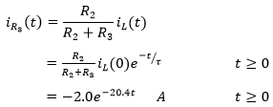
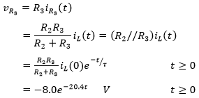
The current in R₃ is given by,
+
-
$$v_{R3}$$
The voltage across R₃ is given by,

Slide 31
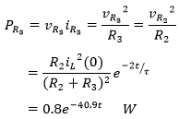
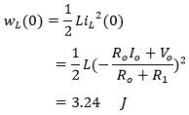
The power dissipated in R₃ is given by,
The initial energy stored in the inductor is,

Slide 32
The total energy delivered to R₃ is given by,
Where,
The percentage of energy dissipated in R₃ is,

Slide 33
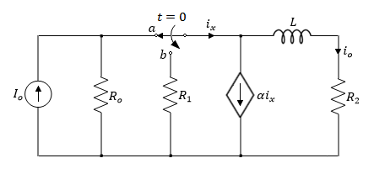
Example
The switch in the circuit has been in position ‘a’ for a long time. At t = 0, the switch is moved to position ‘b’. Find the current i_{o}(t) for t > 0,
Variable | Default | Unit
I_{o} | 25 | mA
R_{o} | 100 | Ω
R₁ | 200 | Ω
R₂ | 150 | Ω
L | 10 | mH
α | 3 | -

Slide 34
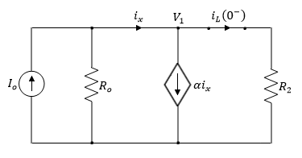
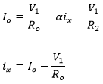
For t < 0 the switch has been open for a long time allowing the inductor to act like a short circuit,
Applying KCL at the top node,

Slide 35
For t < 0 the switch has been open for a long time allowing the inductor to act like a short circuit,
Applying KCL at the top node,

Slide 36
For t < 0 the switch has been open for a long time allowing the inductor to act like a short circuit,
Applying KCL at the top node,
Solving for V₁,

Slide 37
For t < 0 the switch has been open for a long time allowing the inductor to act like a short circuit,
Therefore the current i_{L}(0⁻) is,
$$i_{L}\left(0^{−}\right)= \frac{V_{1}}{R_{2}}=\frac{3.8}{150}=25.33 mA$$
Since the current through the inductor doesn’t change instantaneously,
$$i_{L}\left(0^{+}\right){=i}_{L}\left(0^{−}\right)= 25.33 mA$$

Slide 38
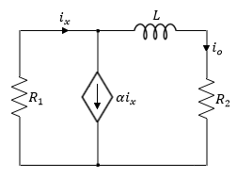
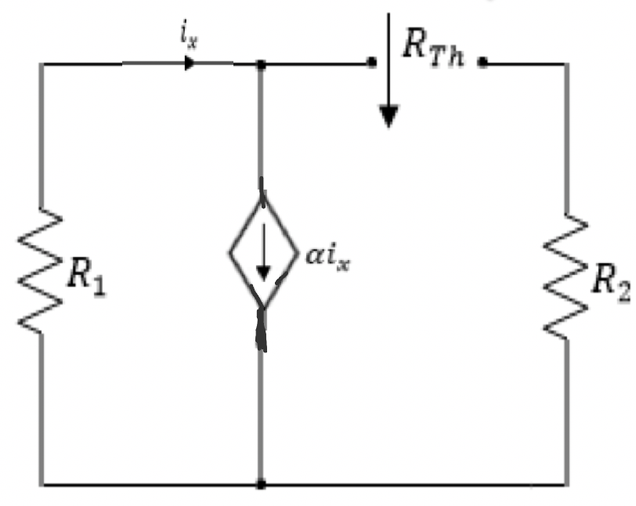
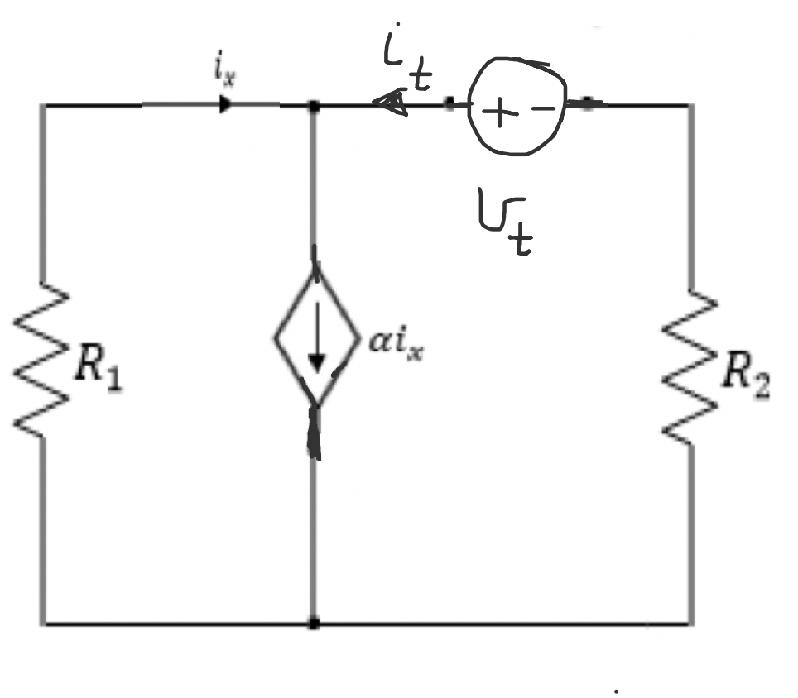
To find the time constant, we need to find R_{Th.}
R_{Th} seen by the inductor,
Using the test voltage method, we have
$$\frac{v_{t}}{i_{t}}=R_{Th}$$

Slide 39
Apply KVL:
$$R_{2}i_{t}−v_{t}−i_{x}R_{1}=0$$
Apply KVL:
$$i_{t}+i_{x}={αi}_{x}$$
$$i_{t}=({α−1)i}_{x}$$
From the above two equations, we have
$\frac{v_{t}}{i_{t}}=R_{Th}=R_{2}+\frac{R_{1}}{1−α}=$ $150+\frac{200}{1−3}=50 Ω$
Thus the time constant,
$$τ=\frac{L}{R_{Th}}=\frac{10 mH}{50 Ω}=2 ms$$

Slide 40
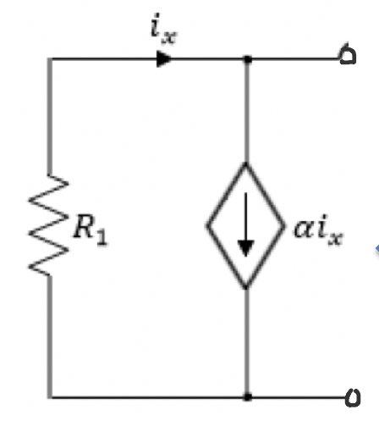
Another way to find R_{Th}
$${R′}_{Th}$$
Using the test voltage method, we have
$$R_{Th}=R_{2}+{R′}_{Th}$$
$${R′}_{Th}=\frac{R_{1}}{1−α}$$
Therefor, $R_{Th}$is given by,
$$R_{Th}=R_{2}+\frac{R_{1}}{1−α}$$

Slide 41
Recall we have,
$$i_{L}\left(0^{+}\right)= \frac{V_{1}}{R_{2}}=\frac{3.8}{150}=25.33 mA$$
The general solutions is given by,
$$i_{L}\left(t\right)=i_{L}\left(0^{+}\right)e^{−\frac{t}{τ}}=25.33e^{−\frac{t}{2}} mA$$
Note that the output current is given by,
$$i_{o}\left(t\right)=i_{L}\left(t\right)$$
$$i_{o}\left(t\right)=25.33 e^{−\frac{t}{2}} mA$$

