Slide 1
EEL 3004 Linear Circuits I Lecture #14 First Order RC Circuits - Natural responses

Slide 2
Reading Materials
Chapter 6 – Transient Response for RL and RC Circuits
Only the following sections:
6.1 The First Order Circuits
6.3 Natural Response of RC Circuits
6.4 Natural Response of RL Circuits

Slide 3
Lecture Objectives
This lecture will focus on:
Review of RC circuits with DC sources under switching (natural response).
Natural response in RC Circuits with DC sources
Examples

Slide 4
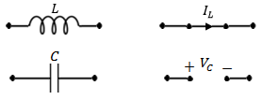
RLC circuits with DC sources and NO Switching
(Steady-state)
If the circuit consists only of direct current and voltage sources (dc), and the switch has been closed or opened for long time, then the capacitor behaves as an open circuit, and the inductor behaves as a short circuit.
Under DC conditions – the circuit has been undisturbed for a long time

Slide 5
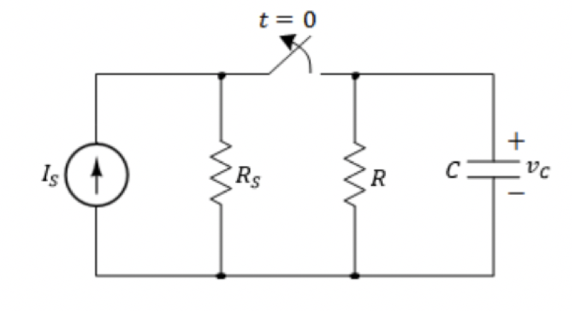
RC circuits with DC sources under switching
(Transient-state)
Assume the switch has been closed for long time, then
At time t=0, the switch is opened.
What happens to the capacitor voltage after the current source
has been removed?
This circuit will respond naturally due to its circuit values and the way they are arranged.
We call it natural response or transient response.
Our goal to find the voltages, currents and power after t > 0.

Slide 6
RC circuits with DC sources under switching
(Transient-state)
R’s and L’s In Series
This circuit will respond naturally due to its circuit values and the way they are arranged.
We call it natural response or transient response.
Our goal to find the voltages, currents and power after t > 0.

Slide 7
Natural Response of RC circuits
The natural response for an RC circuits are obtained when the external independent source is set to zero (removed).
For the natural responses to exist it is required that the capacitor has energy stored in it at the moment of switching.
R’s and C’s
After certain action (switching)
Determine the currents and voltages (natural responses)
No External source

Slide 8
Natural Response of RC circuits
IMPORTANT DEFINITIONS
$$We define:$$
For t < 0, we let
$$v_{c}\left(0^{−}\right)=capacitor voltage just before t=0$$
For t > 0, we let
$$v_{c}\left(0^{+}\right)=capacitor voltage just after t=0$$
Therefore, for the capacitor:
$v_{c}\left(0^{+}\right)$= $v_{c}\left(0^{−}\right)=v_{c}\left(0\right)$

Slide 9
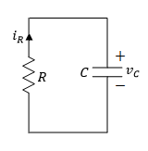
Finding the Natural Response of RC circuits
We follow two-step process:
Find $v_{c}\left(t\right)$ for t < 0 (Before the switching action took place)
But, since we have dc sources and no switching action for long time, the capacitor voltage is constant and is equal to,
$v_{c}\left(t\right)$= $v_{c}\left(0^{−}\right)$
For all time t < 0
II) Find $v_{c}\left(t\right)$ for t > 0 (After the switching action took place)
An ordinary 1st order DEQ with constant coefficients
General solution
$v_{c}\left(t\right)=$ $v_{c}(0^{+})e^{− \frac{t}{τ} }$
$τ=RC$ is the overall time constant
$v_{c}(0^{+}){=v}_{c}(0^{−})$ is the initial capacitor value across $C$
The new circuit

Slide 10
Finding the Natural Response of RC circuits
Notice the following:
1) When $t=τ,$
$v_{c}\left(t\right)=$ $v_{c}(0^{+})e^{− \frac{τ}{τ} }$= $v_{c}(0^{+})e^{− 1 }$= 0.37 $v_{c}(0^{+})$
This means after one time constant ($τ$) the capacitor voltage drops to 37% of its initial value of $v_{c}(0^{+})$
The capacitor voltage drops by 63% from its original value
2) When $t=5τ,$
$v_{c}\left(t\right)=$ $v_{c}(0^{+})e^{− \frac{5τ}{τ} }$= $v_{c}(0^{+})e^{− 5 }$= 0.0067 $v_{c}(0^{+})$
This means after five time constant ($5τ$) the capacitor voltage drops to 0.67% of its initial value of $v_{c}(0^{+})$
The capacitor voltage drops by 99.33% from its original value

Slide 11
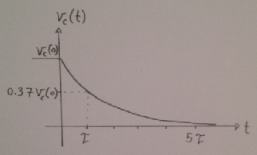
Typical Sketch for Natural Response of RC circuits
$v_{c}\left(t\right)=$ $v_{c}(0^{+})e^{− \frac{t}{τ} }$
$v_{c}\left(τ\right)=$0.37 $v_{c}(0^{+})$
$v_{c}\left(5τ\right)=$0.01 $v_{c}(0^{+})$

Slide 12
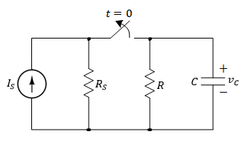
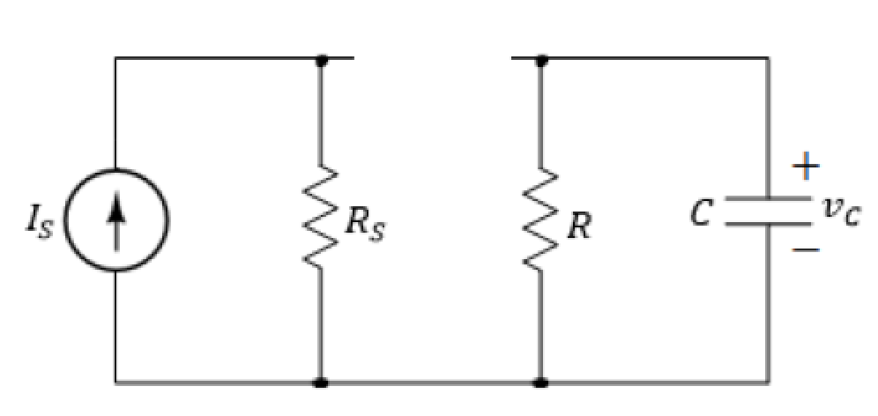
Natural Response of RC circuits
Assume the switch was closed for a long time.
Switch that is opened at t=0 to remove the applied current source.
Find the natural response (voltage v_{c}) after the switch has been opened.
t > 0
No voltage or current sources

Slide 13
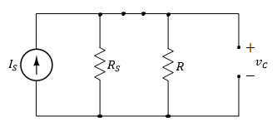
Finding the Natural Response of RC circuits
I) Find for t < 0 (Long time when the switch was closed):
Since we have DC current, therefore, the capacitor behaves like an open circuit prior to opening the switch.
Since the voltage on the capacitor cannot change instantaneously,

Slide 14
Natural Response of RC circuits
II) Find v_{C}(t) for t > 0 (The time after the switch is opened):
The equivalent circuit for t > 0.
Applying KVL around the loop.
An ordinary first-order differential equation (DEQ) with constant coefficients

Slide 15
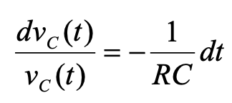
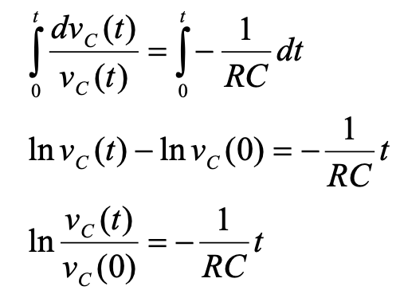
Natural Response of RC circuits
Solve first order DEQ:
Re-arrange the above equation,
Integrate the above equation from t=0 to t:

Slide 16
Natural Response of RC circuits
The final expression is given by,
Where,
Capacitor initial value
Time constant

Slide 17
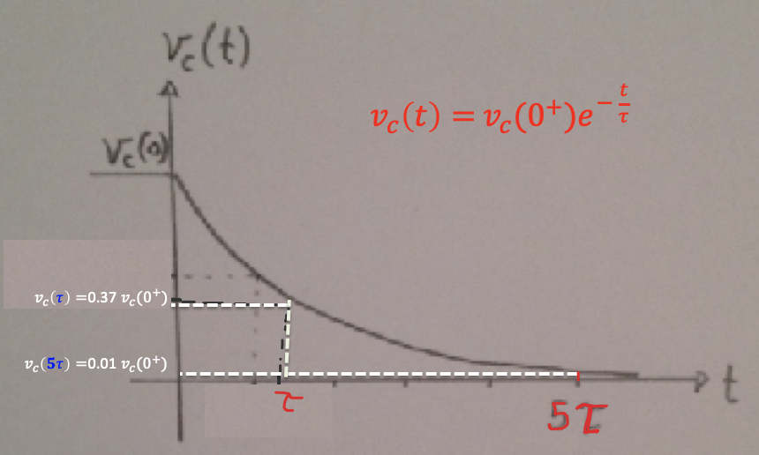
Natural Response of RC circuits
The final expression is given by,
At t=5τ the capacitor voltage becomes practically zero.

Slide 18
Natural Response of RC circuits
The induced current in the resistor, is the same as the induced current in the capacitor,

Slide 19
Natural Response of RC circuits
Instantaneous power in the resistor,
Instantaneous energy dissipated in the resistor,

Slide 20
Natural Response of RC circuits
At t=0, the energy dissipated in the resistor starts at zero value, and as t→∞ it reaches,
Which is the amount of energy that was initially stored in the capacitor at t=0.

Slide 21
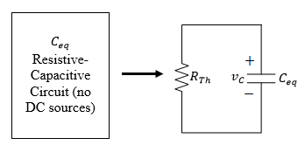
General Natural Response of RC circuits
Any given resistive-capacitive circuit without external independent DC sources that can be reduced to a parallel equivalent R_{Th}C_{eq} circuit.
The general solution for v_{C}(t) is given,
${τ=R}_{Th}C_{eq}$ is the overall time constant
$v_{c}(0^{+})$ is the initial capacitor value across $C_{eq}.$

Slide 22
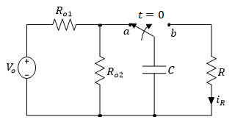
Example
For the following RC circuit with a DC voltage source. Initially the switch has been connected to position ‘a’ for a long time. At t=0, the switch moved to position ‘b’.
Determine the voltage response for v_{C}(t), for t≥0,
Variable | Values | Unit
V_{o} | 8.6 | V
R | 4.5 | kΩ
R_{o1} | 8 | kΩ
R_{o2} | 16 | kΩ
C | 2.1 | mF

Slide 23
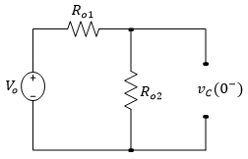
Step 1: Find vc for t < 0 (Long time when the switch was in position a):
For t < 0 the capacitor is fully charged. Hence at t=0⁻ we have,
Therefor,
$v_{c}\left(0^{+}\right)$= $v_{c}\left(0^{−}\right)=v_{c}\left(0\right)$=5.7 V

Slide 24
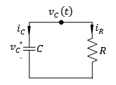
Step 2: Find vc for t > 0 (after the switch is moved to position b):
For t > 0,
The general solution for v_{C}(t) is given by,
$v_{c}\left(t\right)=$ $v_{c}(0^{+})e^{− \frac{t}{τ} }$
$v_{c}\left(0^{+}\right)$= $v_{c}\left(0^{−}\right)=v_{c}\left(0\right)$=5.7 V
$τ=RC=4.5x{10}^{3}Ω x$ $2.1x{10}^{−3}$F = 9.5 seconds
Note:
When R in Ohms and C in Farads gives time in seconds
$v_{c}\left(t\right)=$ $5.7e^{− \frac{t}{9.5} }=5.7e^{− 0.11 t}$Volts

Slide 25
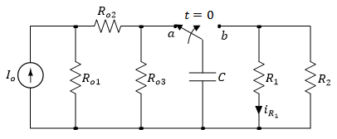
Example
For the following RC circuit with a DC voltage source. Initially the switch has been connected to position ‘a’ for a long time. At t=0, the switch moved to position ‘b’. Determine:
The voltage response for v_{C}(t), for t≥0,
The current i_{R1}(t) for t>0,
What is the voltage across the capacitor at t=3 s, 15 s and 30s.
Variable | Values | Unit
I_{o} | 2 | mA
R₁ | 4.5 | kΩ
R₂ | 2.4 | kΩ
R_{o1} | 8 | kΩ
R_{o2} | 16 | kΩ
R_{o3} | 24 | kΩ
C | 2.1 | mF

Slide 26
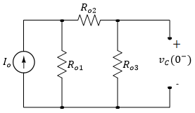
For t < 0 the capacitor is fully charged and acts like an open circuit.
Hence at t=0⁻ we have,
$i_{o3}=$ $\frac{R_{o1}}{R_{o1}+R_{o2}+R_{o3}}I_{o}=\frac{8}{8+16+24}2=3.333 mA$
$v_{c}\left(0^{−}\right)=$ $i_{o3}{xR}_{o3}=$ $3.333x24=8 V$
$$i_{o3}$$
Therefor,
$v_{c}\left(0^{+}\right)$= $v_{c}\left(0^{−}\right)=v_{c}\left(0\right)$= 8 V

Slide 27
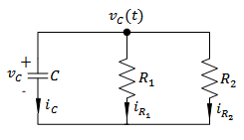
For t > 0,
Calculating τ,
$R=R_{1}//R_{2}$=
$τ=RC=1.57x{10}^{3}x$ $2.1x{10}^{−3}$
= 3.29 seconds
=$\frac{4.5x2.4}{4.5+2.4}=1.57 kΩ$
(a) Substituting these values in the general expression for $v_{c}\left(t\right)$ for t>0,
$v_{c}\left(t\right)=$ $v_{c}\left(0^{+}\right)e^{− \frac{t}{τ} }=8e^{− \frac{t}{3.29} }=8e^{− 0.3 t}$
Volts

Slide 28
(b) The current across the resistor can be calculated as,
$v_{c}\left(t\right)=$ $8e^{− 0.3 t}$
$i_{R1}\left(t\right)=$ $\frac{v_{c}(t)}{R_{1}}=\frac{8e^{− 0.3 t} V}{4.5 kΩ}$
$=1.77e^{− 0.3 t}$ mA
Similarly,
$i_{R2}\left(t\right)=$ $\frac{v_{c}(t)}{R_{2}}=\frac{8e^{− 0.3 t} V}{2.4 kΩ}$
$=3.3e^{− 0.3 t}$ mA

Slide 29
The current across the resistor can be calculated as,
$v_{c}\left(t\right)=$ $8e^{− 0.3 t}$
$i_{R1}\left(t\right)=$ $\frac{v_{c}(t)}{R_{1}}=\frac{8e^{− 0.3 t} V}{4.5 kΩ}$
$=1.77e^{− 0.3 t}$ mA
Check:
$i_{c}\left(t\right)=−\left(i_{R1}\left(t\right)+i_{R2}\left(t\right)\right)=5.07e^{− 0.3 t}$ mA
But
Similarly,
$i_{c}\left(t\right)=$ C$\frac{dv_{c}(t)}{dt}=Cx(−8x0.3e^{− 0.3 t}$)
= $2.1x{10}^{−3}x$( $−8x0.3e^{− 0.3 t})$
=5.04 $e^{− 0.3 t}$ mA
$i_{R2}\left(t\right)=$ $\frac{v_{c}(t)}{R_{2}}=\frac{8e^{− 0.3 t} V}{2.4 kΩ}$
$=3.3e^{− 0.3 t}$ mA

Slide 30
c) What is the voltage across the capacitor at t=1 s, 3.3 s, 15 s and 30s.
At t=1 s
$v_{c}\left(t\right)=$ $8e^{− 0.3 t}=8e^{− 0.3x1}=$5.93 V
At t=3.3 s ($t≈τ)$
$v_{c}\left(t\right)=$ $8e^{− 0.3 t}=8e^{− 0.3x3.3}=8x0.37=2.97$ V
At t=15 s ($t≈5τ)$
$v_{c}\left(t\right)=$ $8e^{− 0.3 t}=8e^{− 0.3x15}=8x0.011=0.088$ V
At t=30 s
$v_{c}\left(t\right)=$ $8e^{− 0.3 t}=8e^{− 0.3x30}=8x0.0001=0.0008$ V

Slide 31
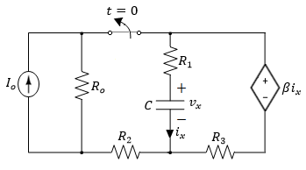
Example
In the circuit, the switch has been closed for a long time and opened at t=0. Determine:
The voltage v_{x}(t), and current i_{x}(t) for t ≥ 0,
Energy stored in the capacitor for t = 0,
Energy dissipated in R₃ at t = ∞.
Variable | Default | Unit
I_{o} | 4 | A
R_{o} | 5 | Ω
R₁ | 8 | Ω
R₂ | 5 | Ω
R₃ | 4 | Ω
C | 1.5 | μF
β | 5 | Ω

Slide 32
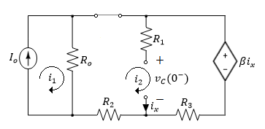
For t < 0 the capacitor is fully charged. Hence at t = 0⁻ we have,
Applying KVL around the loops,
Where,
Solving for i₂ yields,

Slide 33
Solving for i₂ yields,
The initial capacitor voltage is given by,

Slide 34
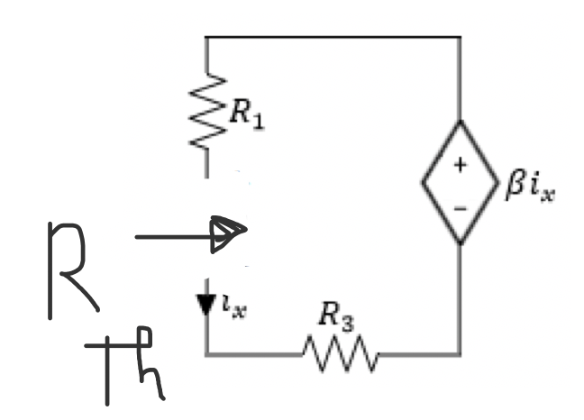
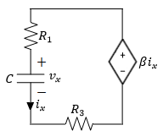
After the switch is opened for t > 0,
Next we find R_{Th}

Slide 35
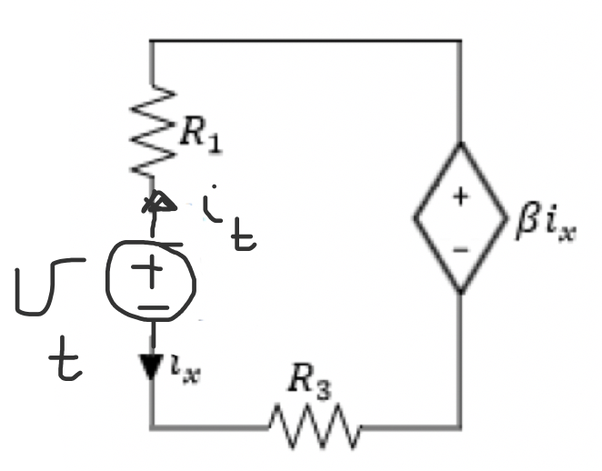
After the switch is opened for t > 0,
Apply KVL:
${−v}_{t}$+ $R_{1}$ $i_{t}$+ ${βi}_{x}$ + $R_{3}$ $i_{t}=0$
But we have
$i_{x}$=$−i_{t}$
$$\frac{v_{t}}{i_{t}}=R_{1}−β \text{+ }R_{3}$$
$$R_{Th}=R_{1}−β \text{+ }R_{3}=8−5+4=7 Ω$$
$τ=R_{Th}C=$7x1.5=10. ms

Slide 36
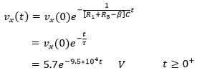
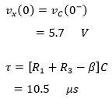
Solving for v_{x}(t),
Where,

Slide 37
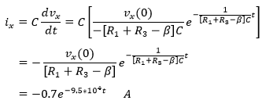
The current i_{x}(t) is calculated as follows,

Slide 38
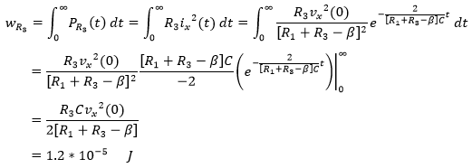
The initial energy stored in the capacitor,
The total energy dissipated in R₃ is given by,

Slide 39
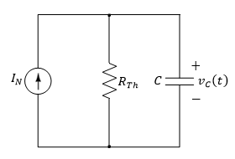
For t > 0,
Therefore the time constant is given by,
As t → ∞, the capacitor acts as an open circuit,
The general solution for the forced response of v_{C}(t) is given by,

Slide 40
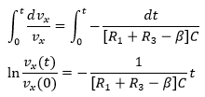
What about using the differential Equation (DEQ) approach directly – finding the integral?
After the switch is opened for t > 0,
Applying KVL around the loop,
Substituting i_{x}, the equation becomes,
$$τ={{(R}_{1}−β \text{+ }R_{3})C=R}_{Th}C$$

