Slide 1
EEL 3004 Linear Circuits I Lecture #14 First Order RC Circuits - Natural responses

Slide 2
Reading Materials
Chapter 6 – Transient Response for RL and RC Circuits
Only the following sections:
6.1 The First Order Circuits
6.3 Natural Response of RC Circuits
6.4 Natural Response of RL Circuits

Slide 3
Lecture Objectives
This lecture will focus on:
Review of RC circuits with DC sources under switching (natural response).
Natural response in RC Circuits with DC sources
Examples

Slide 4
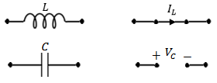
RLC circuits with DC sources and NO Switching
(Steady-state)
If the circuit consists only of direct current and voltage sources (dc), and the switch has been closed or opened for long time, then the capacitor behaves as an open circuit, and the inductor behaves as a short circuit.
Under DC conditions – the circuit has been undisturbed for a long time

Slide 5
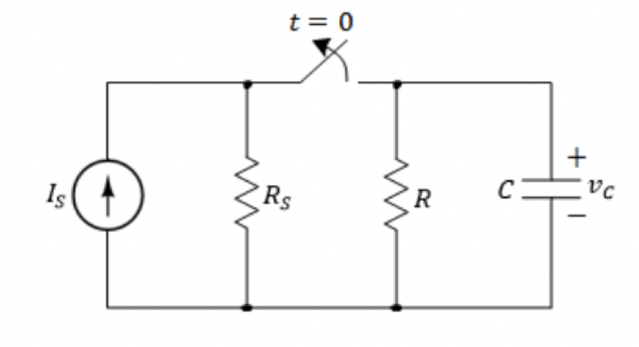
RC circuits with DC sources under switching
(Transient-state)
Assume the switch has been closed for long time, then
At time t=0, the switch is opened.
What happens to the capacitor voltage after the current source
has been removed?
This circuit will respond naturally due to its circuit values and the way they are arranged.
We call it natural response or transient response.
Our goal to find the voltages, currents and power after t > 0.

Slide 6
RC circuits with DC sources under switching
(Transient-state)
R’s and L’s In Series
This circuit will respond naturally due to its circuit values and the way they are arranged.
We call it natural response or transient response.
Our goal to find the voltages, currents and power after t > 0.

Slide 7
Natural Response of RC circuits
The natural response for an RC circuits are obtained when the external independent source is set to zero (removed).
For the natural responses to exist it is required that the capacitor has energy stored in it at the moment of switching.
R’s and C’s
After certain action (switching)
Determine the currents and voltages (natural responses)
No External source

Slide 8
Natural Response of RC circuits
IMPORTANT DEFINITIONS
$$We define:$$
For t < 0, we let
$$v_{c}\left(0^{−}\right)=capacitor voltage just before t=0$$
For t > 0, we let
$$v_{c}\left(0^{+}\right)=capacitor voltage just after t=0$$
Therefore, for the capacitor:
$v_{c}\left(0^{+}\right)$= $v_{c}\left(0^{−}\right)=v_{c}\left(0\right)$

Slide 9
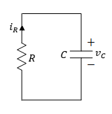
Finding the Natural Response of RC circuits
We follow two-step process:
Find $v_{c}\left(t\right)$ for t < 0 (Before the switching action took place)
But, since we have dc sources and no switching action for long time, the capacitor voltage is constant and is equal to,
$v_{c}\left(t\right)$= $v_{c}\left(0^{−}\right)$
For all time t < 0
II) Find $v_{c}\left(t\right)$ for t > 0 (After the switching action took place)
An ordinary 1st order DEQ with constant coefficients
General solution
$v_{c}\left(t\right)=$ $v_{c}(0^{+})e^{− \frac{t}{τ} }$
$τ=RC$ is the overall time constant
$v_{c}(0^{+}){=v}_{c}(0^{−})$ is the initial capacitor value across $C$
The new circuit

Slide 10
Finding the Natural Response of RC circuits
Notice the following:
1) When $t=τ,$
$v_{c}\left(t\right)=$ $v_{c}(0^{+})e^{− \frac{τ}{τ} }$= $v_{c}(0^{+})e^{− 1 }$= 0.37 $v_{c}(0^{+})$
This means after one time constant ($τ$) the capacitor voltage drops to 37% of its initial value of $v_{c}(0^{+})$
The capacitor voltage drops by 63% from its original value
2) When $t=5τ,$
$v_{c}\left(t\right)=$ $v_{c}(0^{+})e^{− \frac{5τ}{τ} }$= $v_{c}(0^{+})e^{− 5 }$= 0.0067 $v_{c}(0^{+})$
This means after five time constant ($5τ$) the capacitor voltage drops to 0.67% of its initial value of $v_{c}(0^{+})$
The capacitor voltage drops by 99.33% from its original value

Slide 11
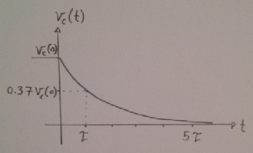
Typical Sketch for Natural Response of RC circuits
$v_{c}\left(t\right)=$ $v_{c}(0^{+})e^{− \frac{t}{τ} }$
$v_{c}\left(τ\right)=$0.37 $v_{c}(0^{+})$
$v_{c}\left(5τ\right)=$0.01 $v_{c}(0^{+})$

Slide 12
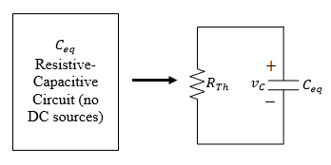
General Natural Response of RC circuits
Any given resistive-capacitive circuit without external independent DC sources that can be reduced to a parallel equivalent R_{Th}C_{eq} circuit.
The general solution for v_{C}(t) is given,
${τ=R}_{Th}C_{eq}$ is the overall time constant
$v_{c}(0^{+})$ is the initial capacitor value across $C_{eq}.$

Slide 13
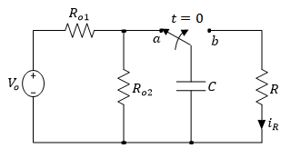
Example
For the following RC circuit with a DC voltage source. Initially the switch has been connected to position ‘a’ for a long time. At t=0, the switch moved to position ‘b’.
Determine the voltage response for v_{C}(t), for t≥0,
Variable | Values | Unit
V_{o} | 8.6 | V
R | 4.5 | kΩ
R_{o1} | 8 | kΩ
R_{o2} | 16 | kΩ
C | 2.1 | mF

Slide 14
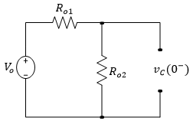
Step 1: Find vc for t < 0 (Long time when the switch was in position a):
For t < 0 the capacitor is fully charged. Hence at t=0⁻ we have,
Therefor,
$v_{c}\left(0^{+}\right)$= $v_{c}\left(0^{−}\right)=v_{c}\left(0\right)$=5.7 V

Slide 15
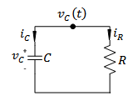
Step 2: Find vc for t > 0 (after the switch is moved to position b):
For t > 0,
The general solution for v_{C}(t) is given by,
$v_{c}\left(t\right)=$ $v_{c}(0^{+})e^{− \frac{t}{τ} }$
$v_{c}\left(0^{+}\right)$= $v_{c}\left(0^{−}\right)=v_{c}\left(0\right)$=5.7 V
$τ=RC=4.5x{10}^{3}Ω x$ $2.1x{10}^{−3}$F = 9.5 seconds
Note:
When R in Ohms and C in Farads gives time in seconds
$v_{c}\left(t\right)=$ $5.7e^{− \frac{t}{9.5} }=5.7e^{− 0.11 t}$Volts

Slide 16
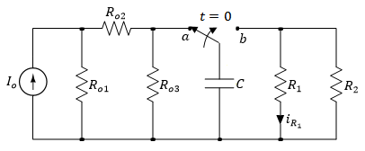
Example
For the following RC circuit with a DC voltage source. Initially the switch has been connected to position ‘a’ for a long time. At t=0, the switch moved to position ‘b’. Determine:
The voltage response for v_{C}(t), for t≥0,
The current i_{R1}(t) for t>0,
What is the voltage across the capacitor at t=3 s, 15 s and 30s.
Variable | Values | Unit
I_{o} | 2 | mA
R₁ | 4.5 | kΩ
R₂ | 2.4 | kΩ
R_{o1} | 8 | kΩ
R_{o2} | 16 | kΩ
R_{o3} | 24 | kΩ
C | 2.1 | mF

Slide 17
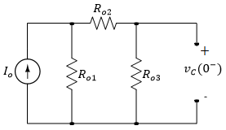
For t < 0 the capacitor is fully charged and acts like an open circuit.
Hence at t=0⁻ we have,
$i_{o3}=$ $\frac{R_{o1}}{R_{o1}+R_{o2}+R_{o3}}I_{o}=\frac{8}{8+16+24}2=3.333 mA$
$v_{c}\left(0^{−}\right)=$ $i_{o3}{xR}_{o3}=$ $3.333x24=8 V$
$$i_{o3}$$
Therefor,
$v_{c}\left(0^{+}\right)$= $v_{c}\left(0^{−}\right)=v_{c}\left(0\right)$= 8 V

Slide 18
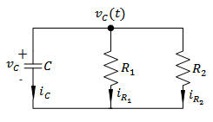
For t > 0,
Calculating τ,
$R=R_{1}//R_{2}$=
$τ=RC=1.57x{10}^{3}x$ $2.1x{10}^{−3}$
= 3.29 seconds
=$\frac{4.5x2.4}{4.5+2.4}=1.57 kΩ$
(a) Substituting these values in the general expression for $v_{c}\left(t\right)$ for t>0,
$v_{c}\left(t\right)=$ $v_{c}\left(0^{+}\right)e^{− \frac{t}{τ} }=8e^{− \frac{t}{3.29} }=8e^{− 0.3 t}$
Volts

Slide 19
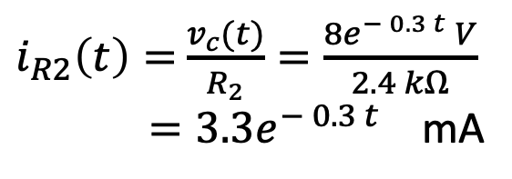
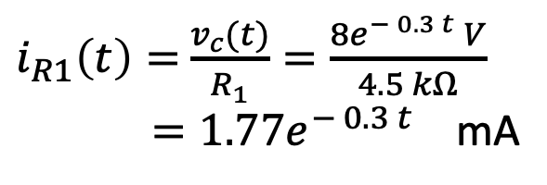
(b) The current across the resistor can be calculated as,
$v_{c}\left(t\right)=$ $8e^{− 0.3 t}$
$i_{R1}\left(t\right)=$ $\frac{v_{c}(t)}{R_{1}}=\frac{8e^{− 0.3 t} V}{4.5 kΩ}$
$=1.77e^{− 0.3 t}$ mA
Similarly,
$i_{R2}\left(t\right)=$ $\frac{v_{c}(t)}{R_{2}}=\frac{8e^{− 0.3 t} V}{2.4 kΩ}$
$=3.3e^{− 0.3 t}$ mA

Slide 20
The current across the resistor can be calculated as,
$v_{c}\left(t\right)=$ $8e^{− 0.3 t}$
$i_{R1}\left(t\right)=$ $\frac{v_{c}(t)}{R_{1}}=\frac{8e^{− 0.3 t} V}{4.5 kΩ}$
$=1.77e^{− 0.3 t}$ mA
Check:
$i_{c}\left(t\right)=−\left(i_{R1}\left(t\right)+i_{R2}\left(t\right)\right)=5.07e^{− 0.3 t}$ mA
But
Similarly,
$i_{c}\left(t\right)=$ C$\frac{dv_{c}(t)}{dt}=Cx(−8x0.3e^{− 0.3 t}$)
= $2.1x{10}^{−3}x$( $−8x0.3e^{− 0.3 t})$
=5.04 $e^{− 0.3 t}$ mA
$i_{R2}\left(t\right)=$ $\frac{v_{c}(t)}{R_{2}}=\frac{8e^{− 0.3 t} V}{2.4 kΩ}$
$=3.3e^{− 0.3 t}$ mA

Slide 21
c) What is the voltage across the capacitor at t=1 s, 3.3 s, 15 s and 30s.
At t=1 s
$v_{c}\left(t\right)=$ $8e^{− 0.3 t}=8e^{− 0.3x1}=$5.93 V
At t=3.3 s ($t≈τ)$
$v_{c}\left(t\right)=$ $8e^{− 0.3 t}=8e^{− 0.3x3.3}=8x0.37=2.97$ V
At t=15 s ($t≈5τ)$
$v_{c}\left(t\right)=$ $8e^{− 0.3 t}=8e^{− 0.3x15}=8x0.011=0.088$ V
At t=30 s
$v_{c}\left(t\right)=$ $8e^{− 0.3 t}=8e^{− 0.3x30}=8x0.0001=0.0008$ V

