Slide 1
EEL 3004 Linear Circuits I Lecture #12 Energy Storage Elements: Capacitors & Inductors

Slide 2
Lecture Objectives
The lecture today will focus on:
Energy storage elements: Capacitors and Inductors
Capacitor structure, capacitor types, principle of operation, current-voltage relationship, power and energy.
Inductor structure, capacitor types, principle of operation, current-voltage relationship, power and energy.
Capacitors series and parallel combinations.
Inductors series and parallel combinations.

Slide 3
Reading Materials
Chapter 5 – Energy Storage Elements
Only the following sections:
5.4 Series and Parallel Connections of Capacitors
5.5 Series and Parallel Connections of Inductors
5.6 RLC Circuits with DC Sources
Chapter 6 – Transient Response for RL and RC Circuits
Only the following sections:
6.1 The First Order Circuits
6.3 Natural Response of RC Circuits
6.4 Natural Response of RL Circuits

Slide 4
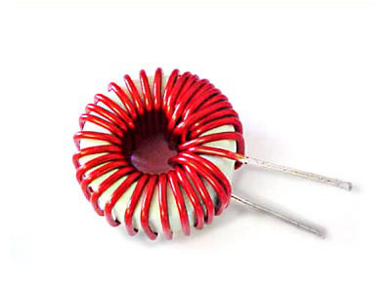
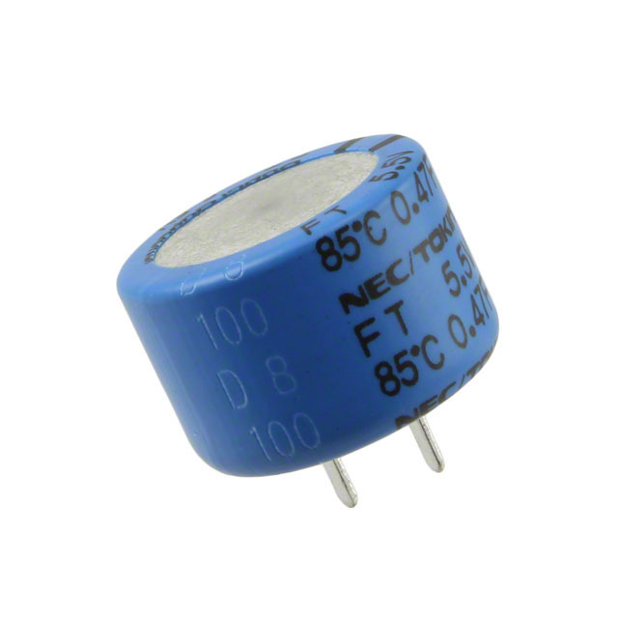
Energy Storage Elements
Two new types of two-terminal passive elements; capacitors and inductors.
Capacitors
Inductors
The circuit no longer has infinitely fast responses.
Current and voltage terminal behavior is not algebraic like Ohm’s law, but rather in a differential integral way.

Slide 5
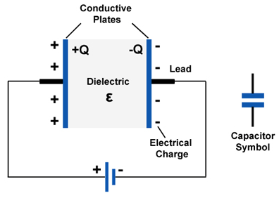
Capacitors
Two conducting surfaces (plates) separated by dielectric material allowing charge to be accumulated at the two conducting plates, creating in the process an electric field.
Plates are connected externally by leads
When a voltage is applied, positive charges are transferred to the one plate and negative charges are transferred to the opposite plate.

Slide 6
Capacitors
Two conducting surfaces (plates) separated by dielectric material allowing charge to be accumulated at the two conducting plates, creating in the process an electric field.
Plates are connected externally by leads
When a voltage is applied, positive charges are transferred to the one plate and negative charges are transferred to the opposite plate.
The ability to store charge is measured by the capacitance of the device:
The dielectric is an insulating material, electric charge does not get transported; current does not flow through the dielectric.

Slide 7
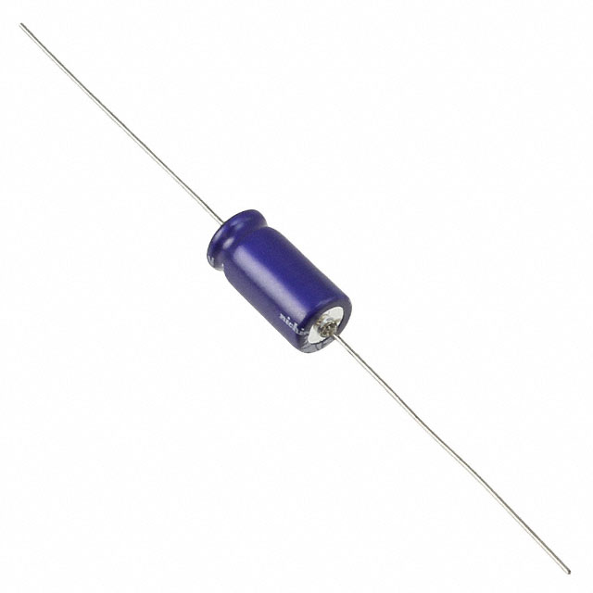
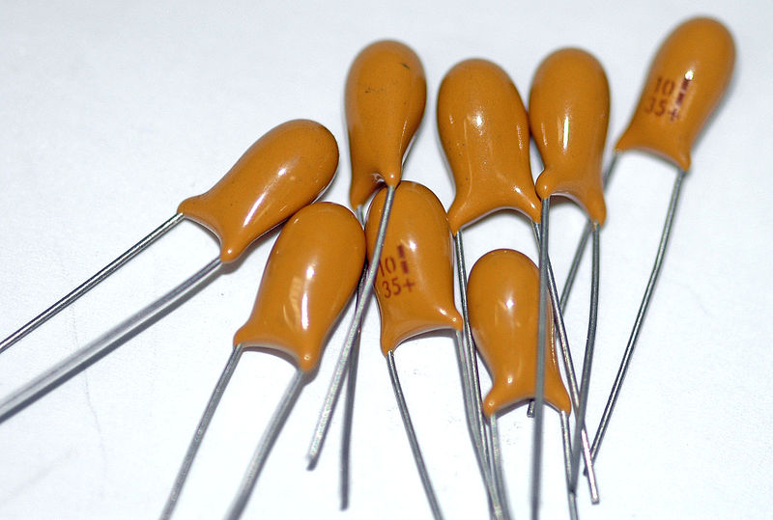
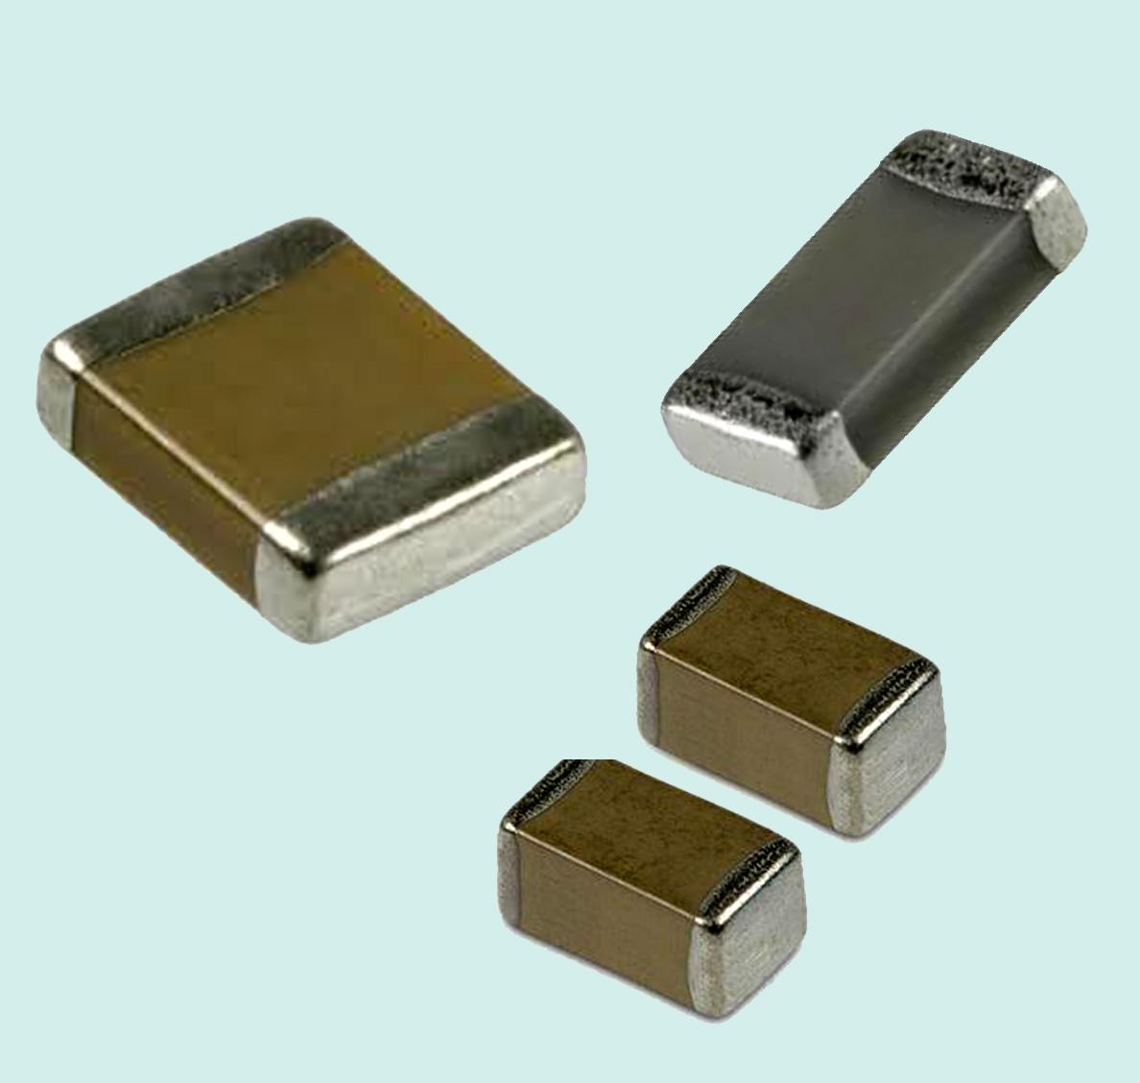
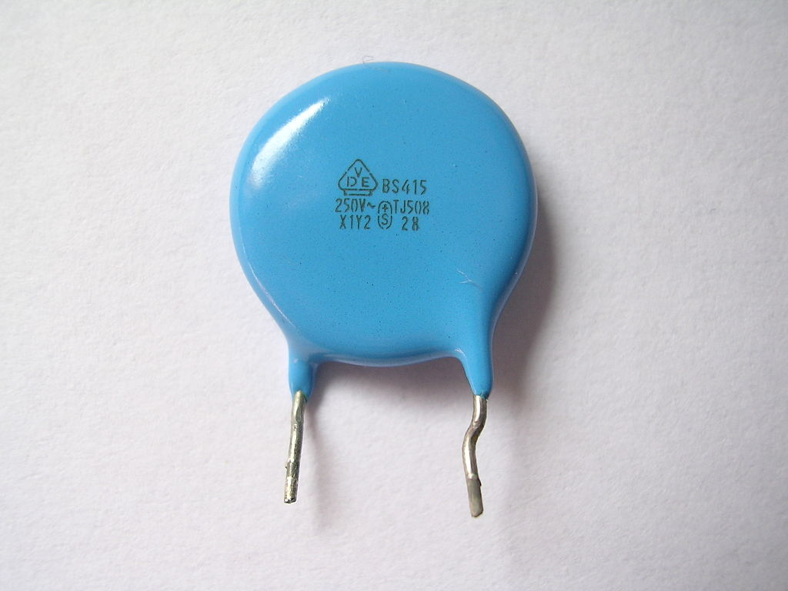
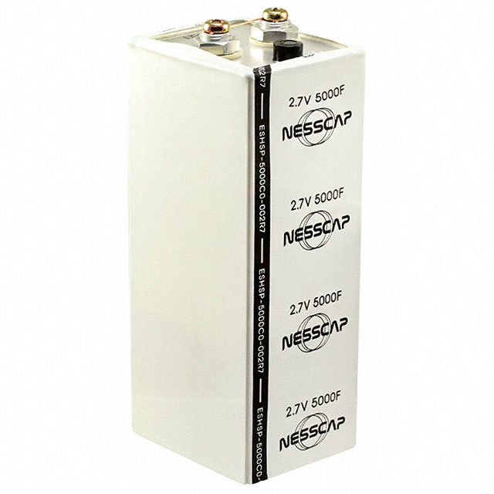
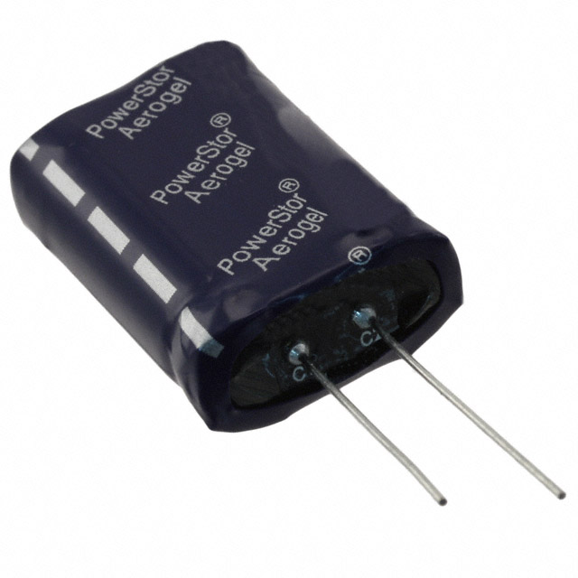
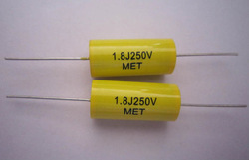
Examples of Discrete Commercial Capacitors
Electrolytic Capacitors
Ceramic Capacitors
Film Capacitors
Supercapacitors

Slide 8
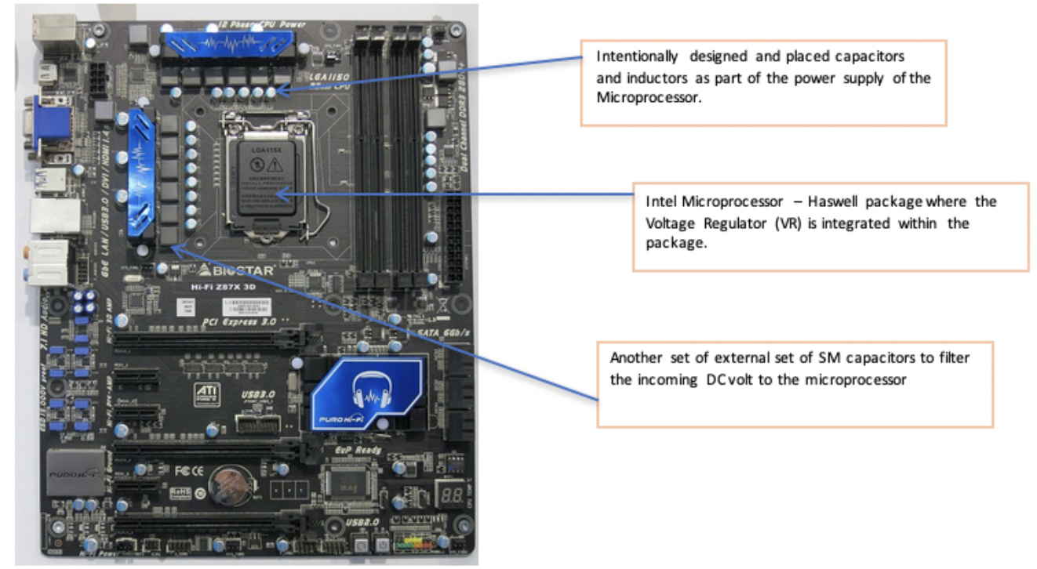
Examples of Commercial Capacitors – IC Motherboard
Power System Capacitors

Slide 9
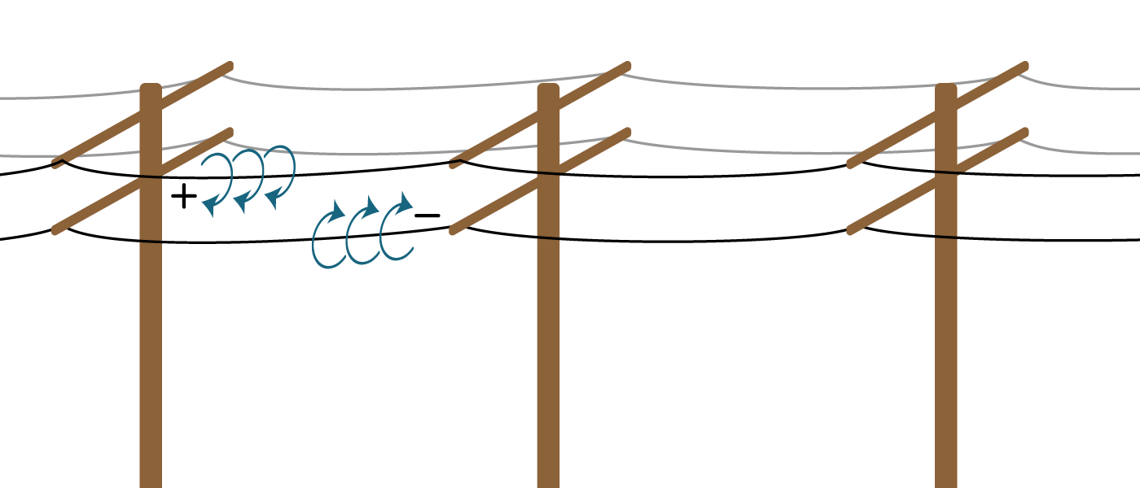
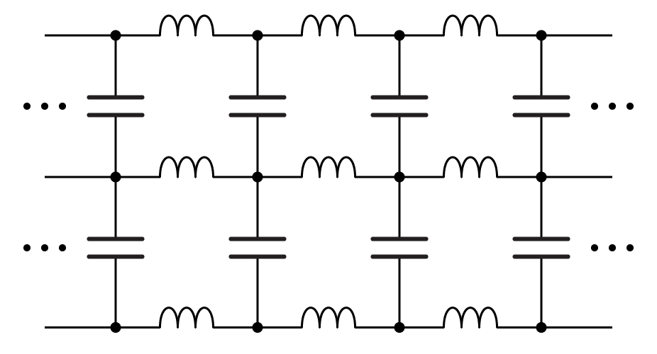
Examples of Parasitic Capacitors – Distributed and undesired
Power System Capacitors

Slide 10
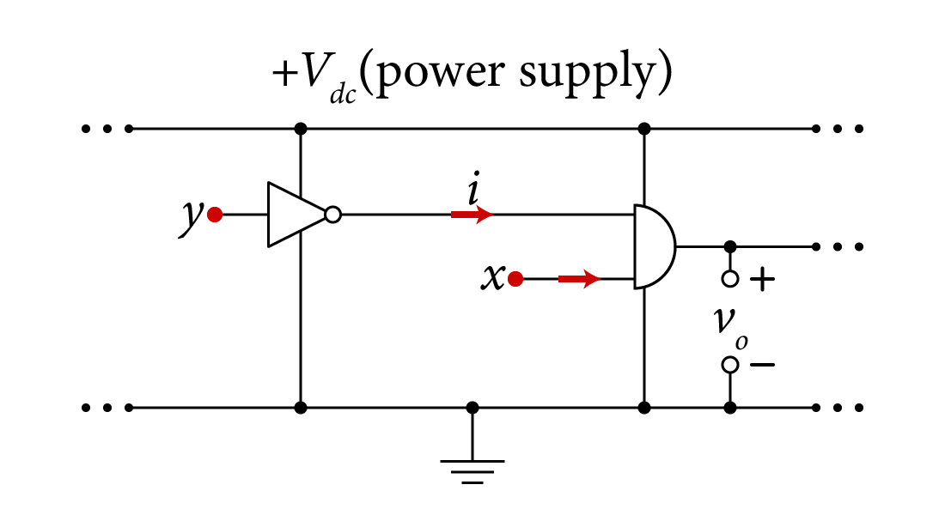
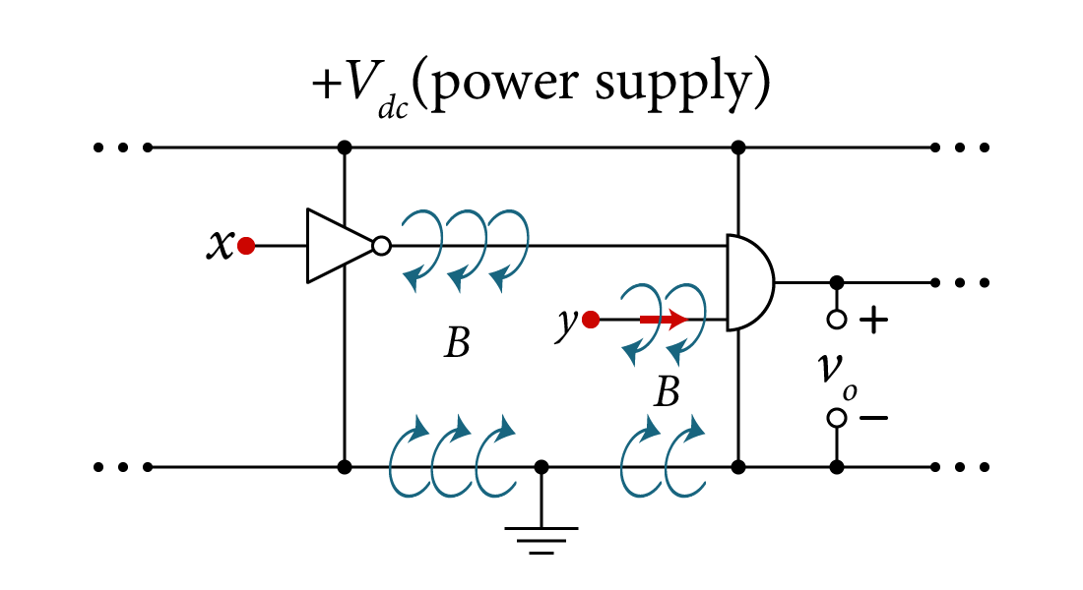
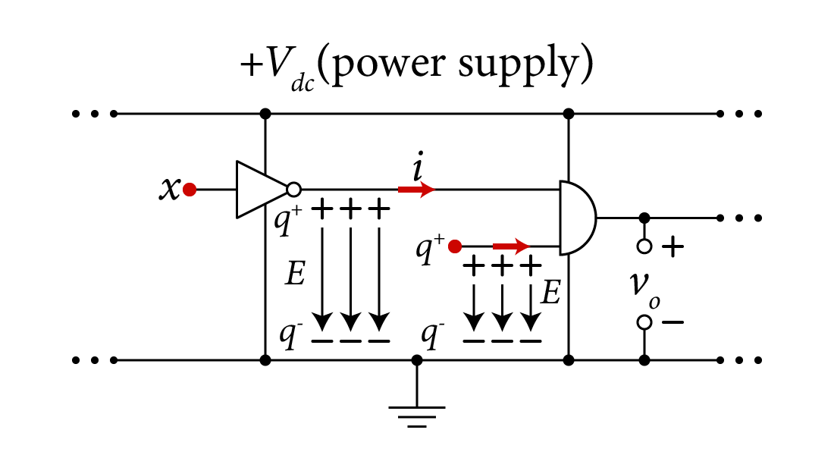
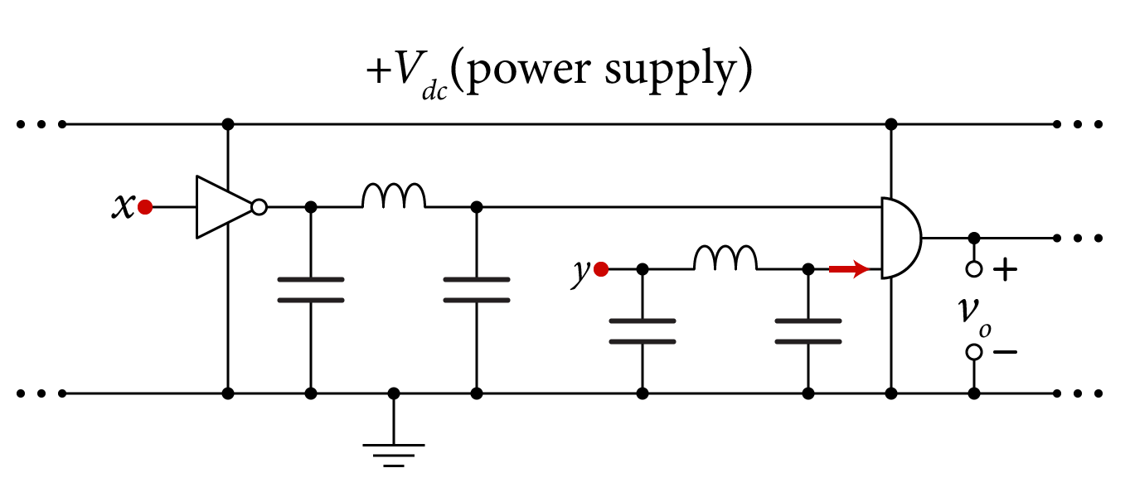
Examples of Parasitic Capacitors – Distributed and undesired
Digital Logic Circuits

Slide 11
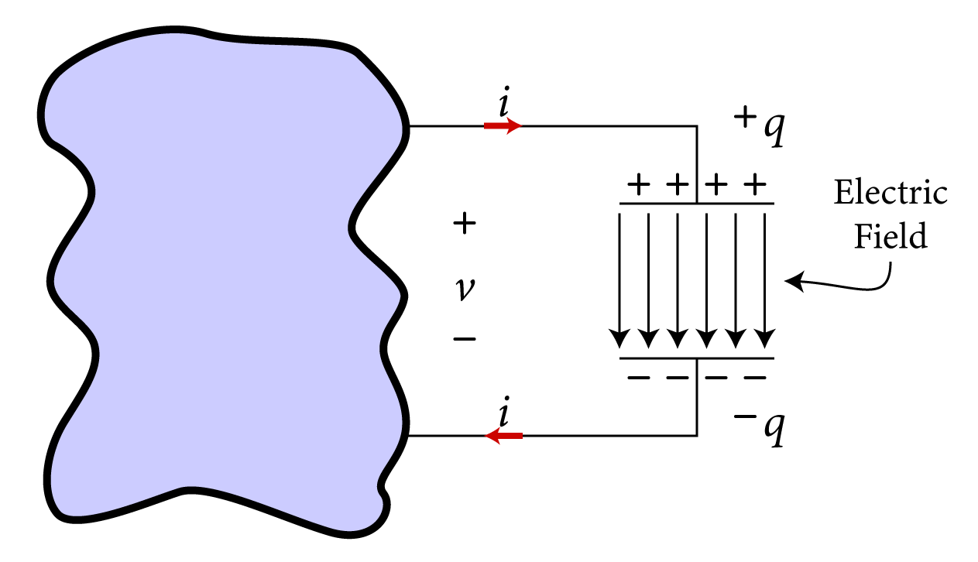
Capacitor’s Principle of Operation
Once the capacitor is connected, positive charge is transported onto the plate of the positive side of the terminal.
Through the formed electric field, an equivalent negative and equal charge q⁻ is formed on the lower conducting plate.
Current i, starts leaving this negative terminal.
An electric field is formed across the dielectric.
the amount of the net charge variation is zero. Hence, the charge accumulated on one side of the plates is equal to the charge accumulated on the other side of the plates.

Slide 12
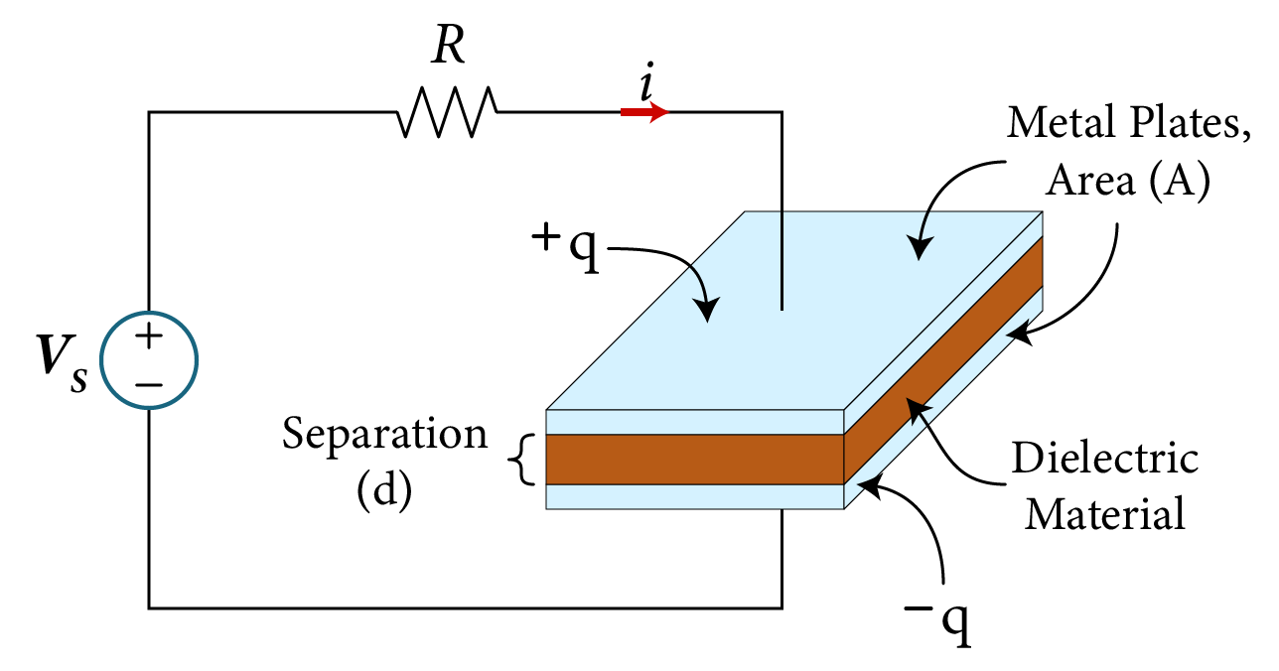
Capacitors
If the dimensions of the parallel plate capacitor are known, then the capacitance value can be found,
A is the area of the parallel plate
d is the separation of the parallel plates
ε is the capacitance permittivity
ε_{o} is the relative permittivity of free space (8.85x10⁻¹² F/m)
ε_{r} is the dielectric constant of the insulating material

Slide 13
Capacitors
The charge on the capacitor is proportional to the voltage applied,
q is charge in units of Coulombs
v is the applied voltage across the capacitor in volts
C is the constant of proportionality, called Capacitance
The unit for the capacitance is Farad =Coulombs/Volts.

Slide 14
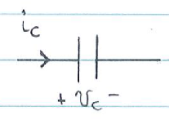
Capacitor’s Current-Voltage Relationship
i_{C}(t) and v_{C}(t) are now functions of time,
The capacitor’s current is given by,
Therefore,
The capacitor’s voltage is given by,
$$C$$
q(t) is the total charge stored in the capacitor
$$i_{C}(t)=C \frac{{dv}_{C}(t)}{dt}$$
v(t_{o}) is the initial capacitor voltage; the capacitor voltage at t=t_{o}

Slide 15
Power and Energy in the Capacitor
the capacitor’s ability to hold charge from past current variations translates to the ability of the capacitor to store energy,
The power delivered to the capacitor,
w_{C}(t) is the energy stored in the capacitor

Slide 16
Example
A capacitor is made with two parallel conducting plates separated by air, and each plate has an area A = 1 cm², and thickness d = 100 μm. Find the capacitance, C.
The relative dielectric constant of air is,
The capacitance C, is given by,

Slide 17
Capacitor Observations
Like the resistor, the capacitor exhibits an algebraic relationship between its branch voltage and the stored charge on its plate.
Time varying voltage applied across the capacitor will induce current flow in the capacitor caused by charge variations through the charging process.
Constant voltage (DC) applied across the capacitor will result in zero capacitor current.
If the voltage across the capacitor changes its value instantly i.e. dt=0, then an infinite current is required. hence,
the capacitor voltage cannot change its value in zero time (instantaneously)
$$i_{C}(t)=C \frac{{dv}_{C}(t)}{dt}$$

Slide 18
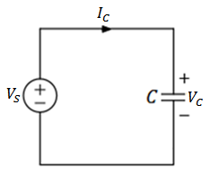
Example
Given the voltage source,
Sketch the voltage v_{C}(t) and the current i_{C}(t)
Variable | values | Unit
V_{o} | 8 | V
α | 5 | s⁻¹
C | 2.4 | μF

Slide 19
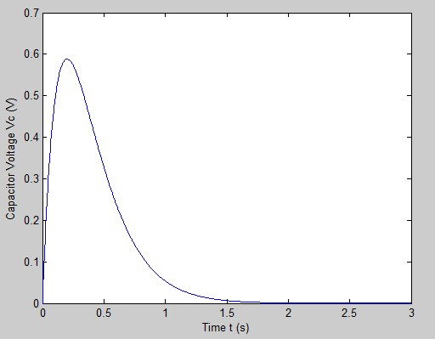
the capacitor voltage is given by,

Slide 20
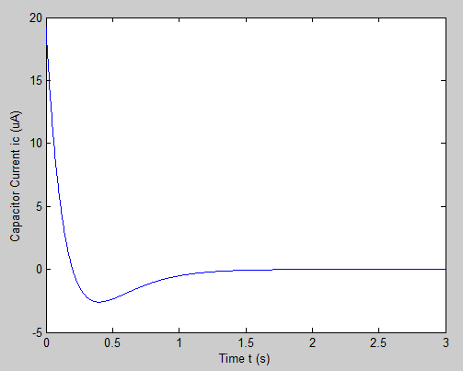
the capacitor current is given by,

Slide 22
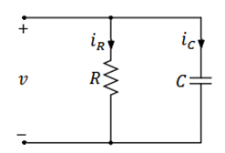
Example
For the parallel RC circuit with applied voltage,
Find:
the currents i_{C}(t) and i_{R}(t),
The expressions for the power dissipated in R and the energy stored in C,
Maximum power dissipation in R, when does it occur in the first cycle,
Maximum energy stored in C, what time does it occur in the first cycle.
Variable | Default | Unit
V_{m} | 160 | V
ω | 120π | rad/s
R | 16 | kΩ
θ | 15 | °
C | 0.1 | μF

Slide 23
The current passing through the capacitor is given by,
The current passing through the resistor is given by Ohm’s Law,

Slide 24
The power dissipated in the resistor is given by,
The energy stored in the capacitor is given by,

Slide 25
The maximum power dissipation in the resistor is given when the sine function is at its maximum,
During the first cycle this happens at,
Solving for t yields,
The maximum energy stored in the capacitor is given when the sine function is at its maximum,

Slide 26
Inductors
A conducting wire when wrapped in the shape of a coil forms an inductor, L, measured in an inductance value in Henry(H).
A magnetic field is produced from current excitation in a wire wound into a coil. This is how energy is stored in an inductor.

Slide 27
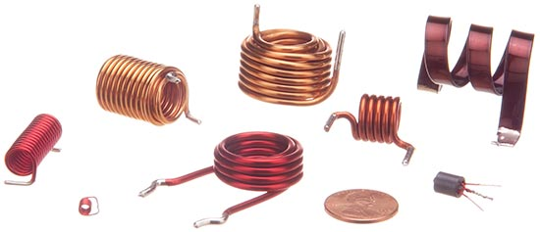
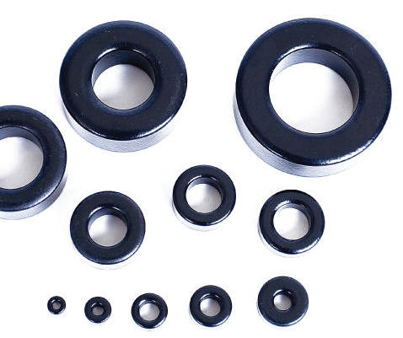
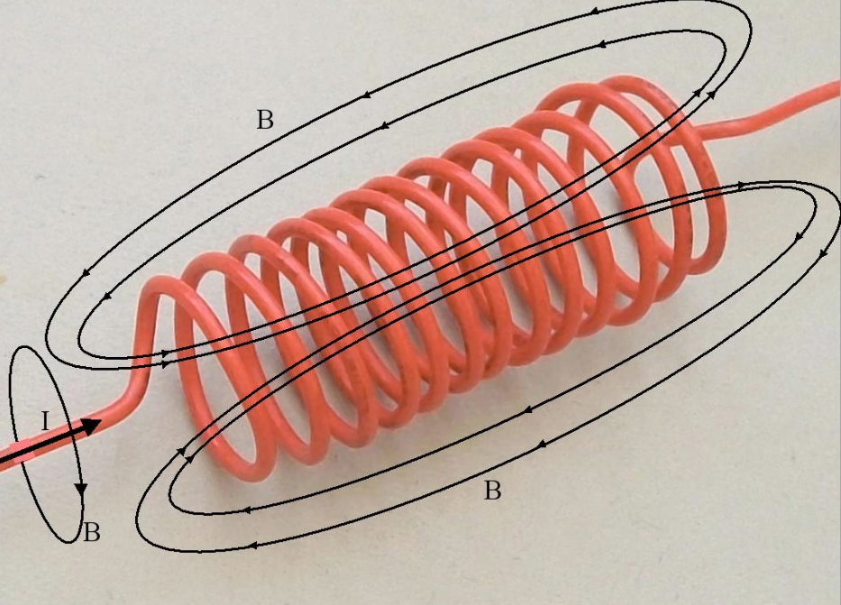
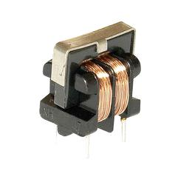
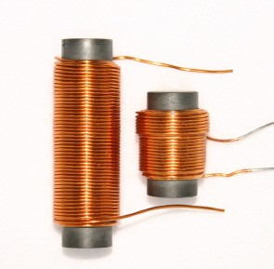
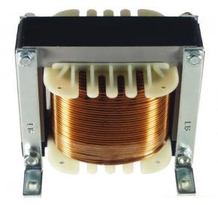
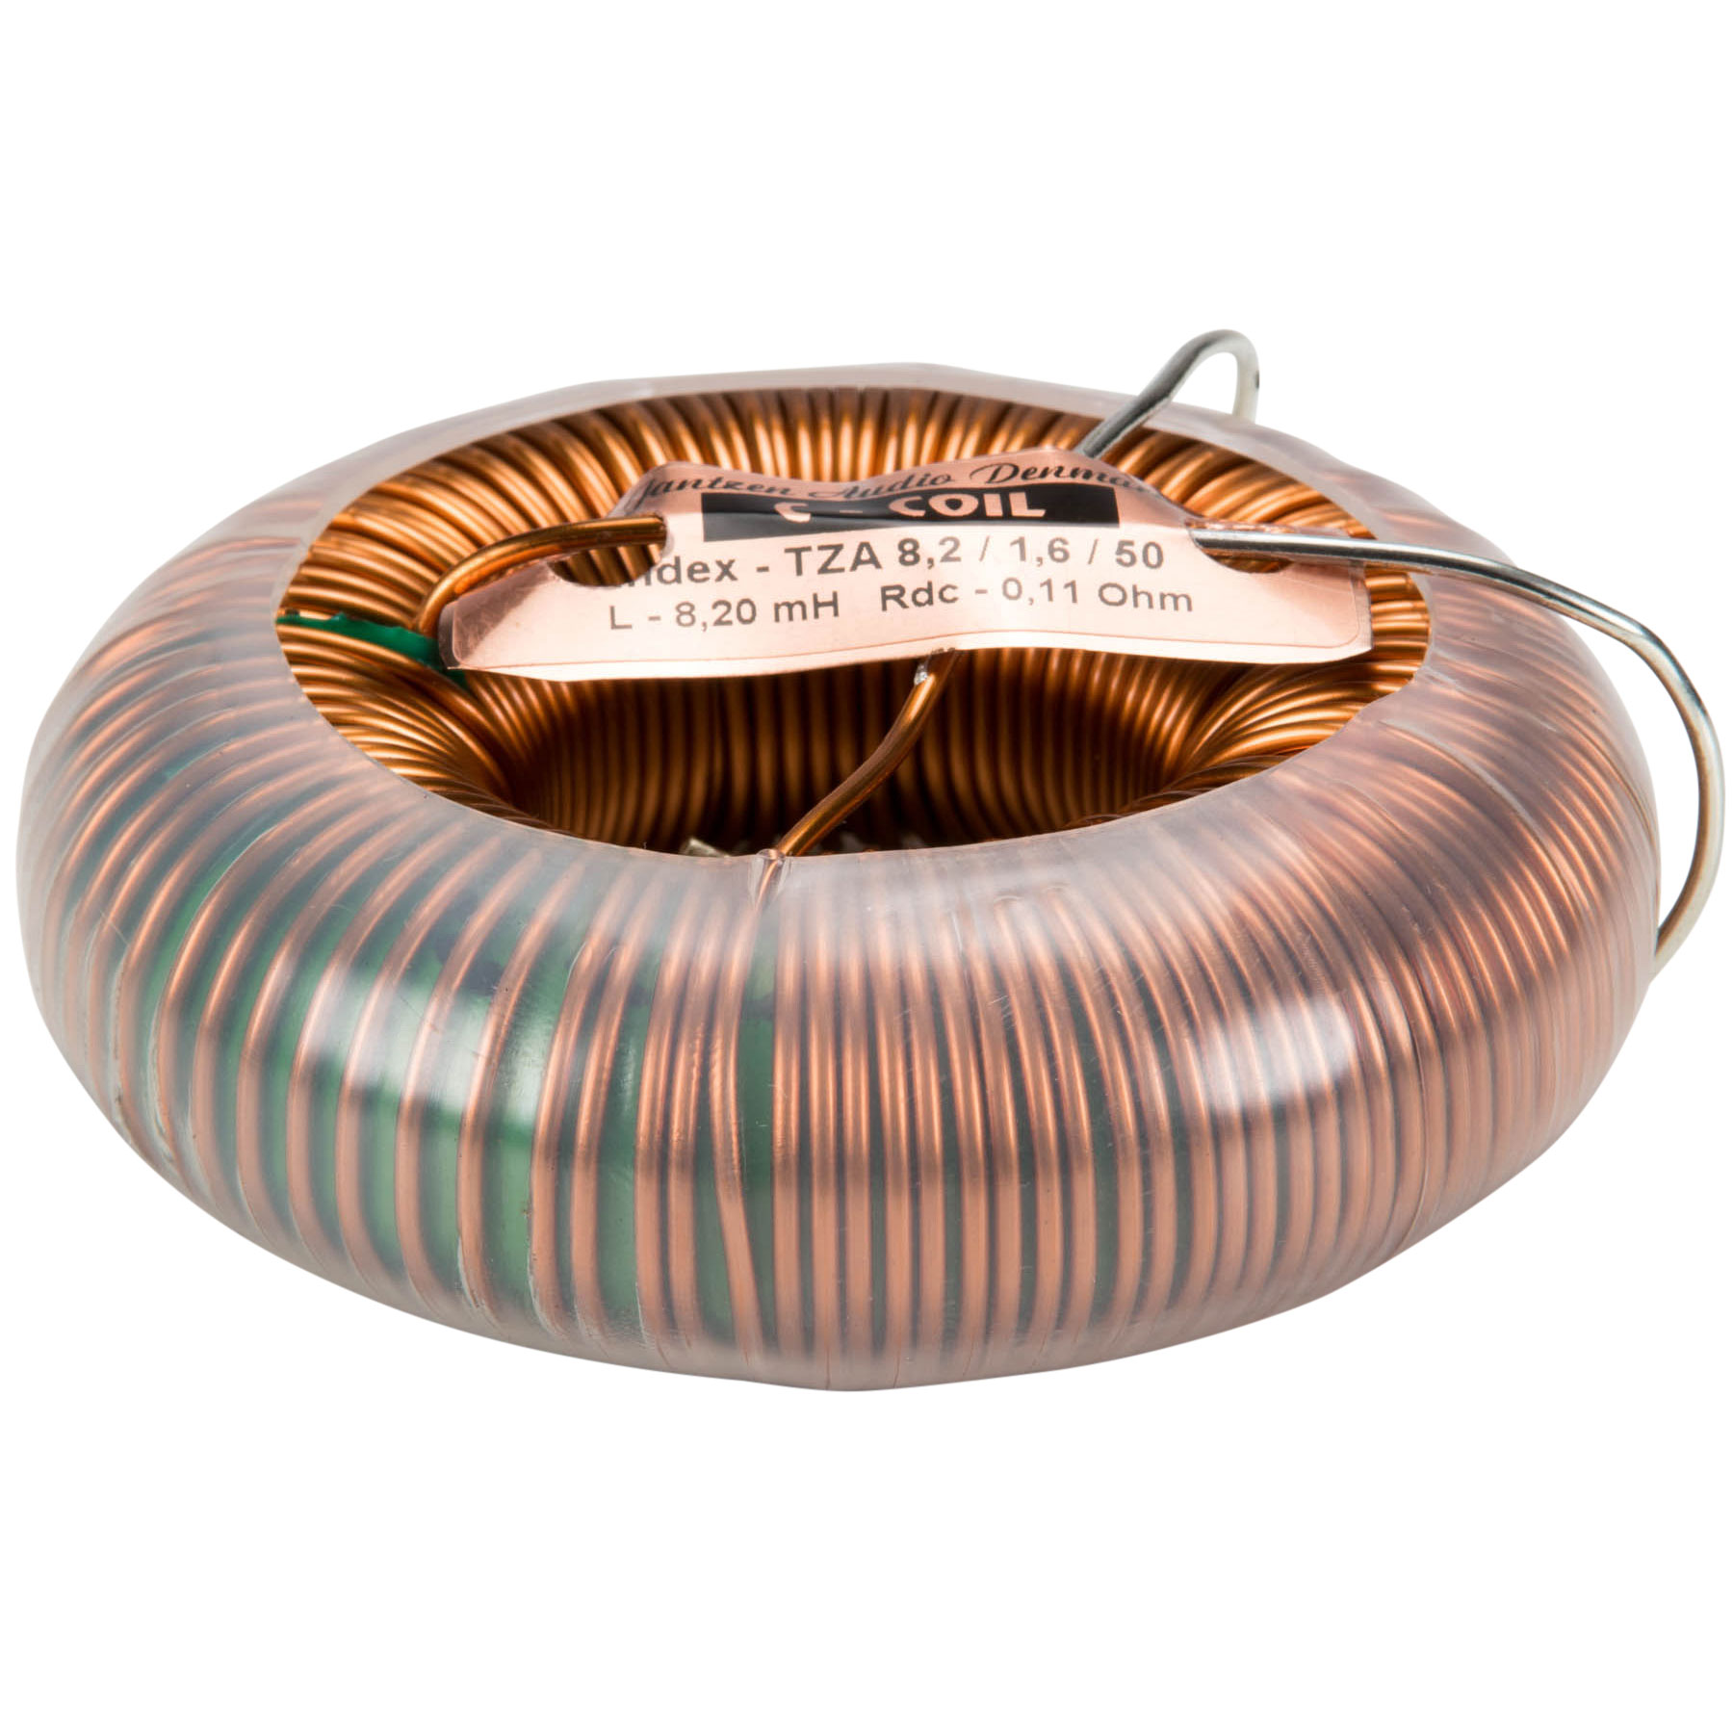
Examples of Inductors
Air core inductors
Powdered Core Inductors
Ferrite Core Inductors
Silicon Steel Core Inductors

Slide 28
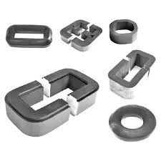
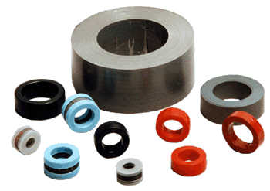
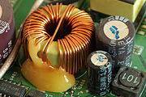
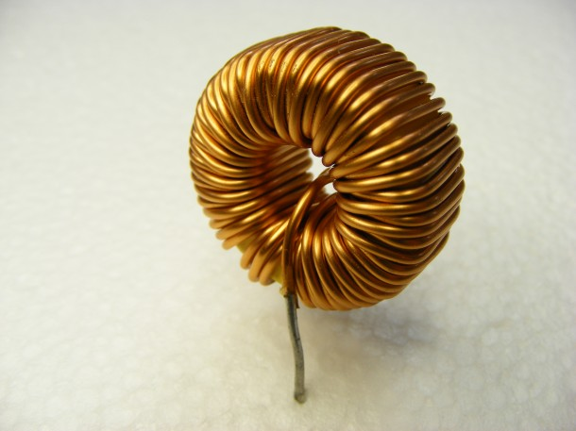
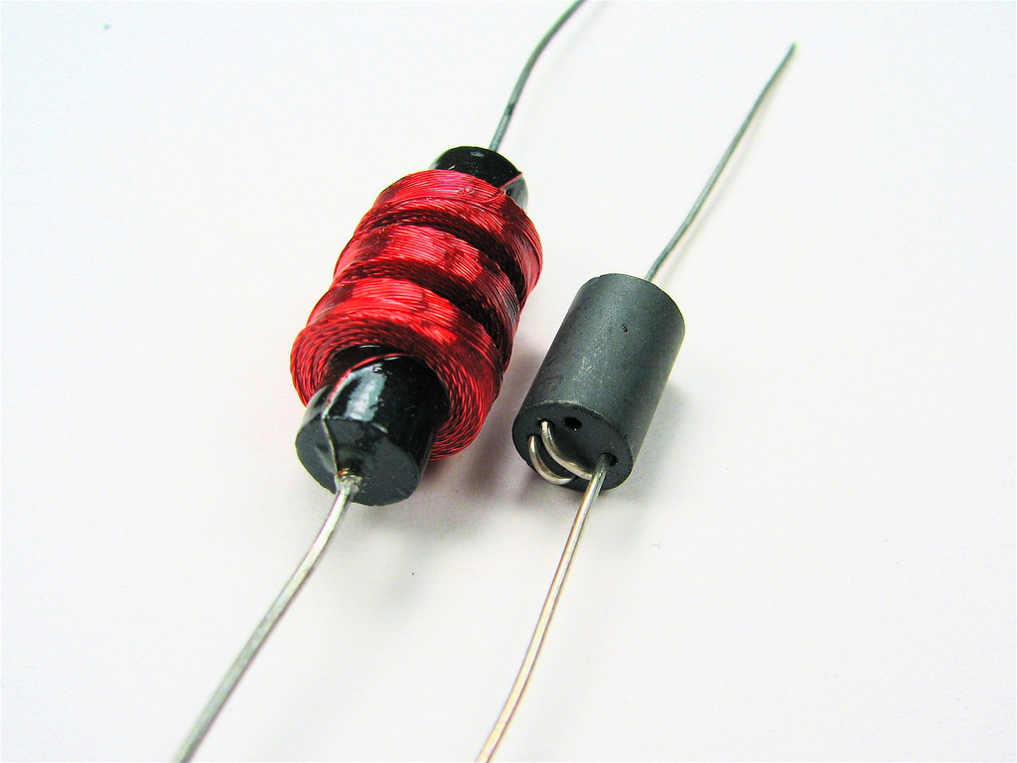
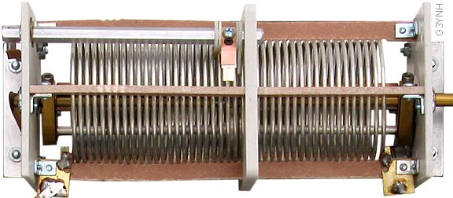
Examples of Inductors
Tape Wound Core Inductors
Toroidal core inductor
Choke Inductors
Variable Inductors

Slide 29
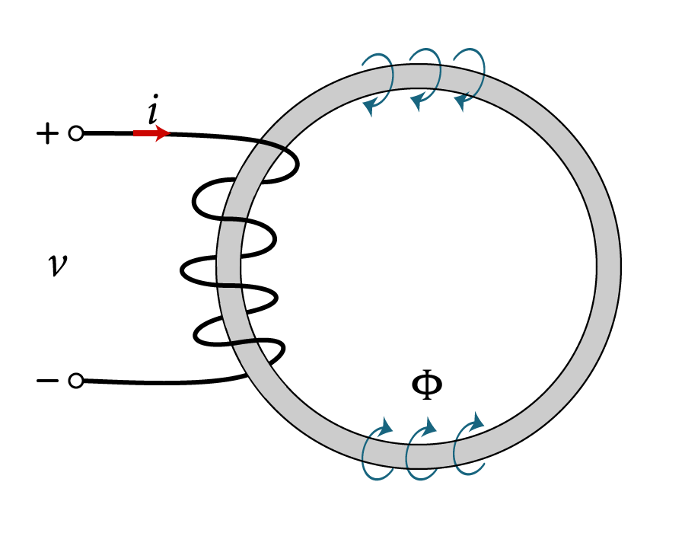
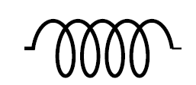
Inductor’s Principle of Operation
Once a current is applied to one side of the inductor winding, magnetic fields get generated in the windings.
As the current starts varying in time, it produces an induced voltage across the winding.
Inductor Symbol

Slide 30
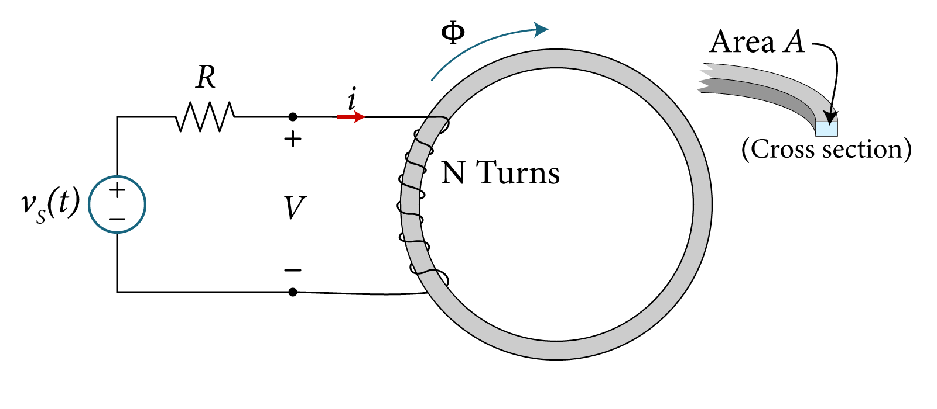
Inductor’s Principle of Operation
Typically the wire has N number of turns of wounded coil around a toroidal core.
The core is made of an insulator material that allows magnetic flux to flow through it with permeability μ, and a cross sectional area A.
The applied voltage causes the current i to flow through the coil, producing a magnetic flux Φ(t), around the coil.

Slide 31
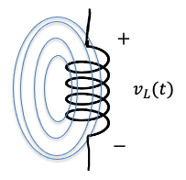
Inductor’s Principle of Operation
The induced voltage due to the rate change of magnetic flux linkage in a wire is governed by the equation derived from Maxwell’s equation as follows:
With N turns in the coil, $v_{L}(t)$ is expressed as:
$$N turns$$
$$v_{L}(t)= \frac{d∅(t)}{dt}$$
$$flux ∅(t)$$
$$i_{L}(t)$$
$$v_{L}(t)=N\frac{d∅(t)}{dt}$$

Slide 32
Inductor’s Principle of Operation
Merging the following two equations:
Yields,
$$v_{L}(t)=N\frac{d∅(t)}{dt}$$
$$∅(t)=N\frac{μA}{i}i_{L}(t)$$
$$v_{L}(t)=L \frac{{di}_{L}(t)}{dt}$$
The inductance L is given by,
The unit of inductance L is Webers/Ampere (Wb/A) or Henry (H)

Slide 34
Inductor’s Current-Voltage Relationship
i_{C}(t) and v_{C}(t) are now functions of time,
The inductor’s voltage is given by,
The inductor’s current is given by,
i(t_{o}) is the initial inductor current; the inductor current at t=t_{o}

Slide 35
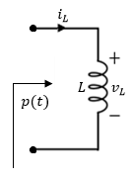
Power and Energy in the Inductor
The rate change of energy w(t), in an element is equal to the power p(t),
The power delivered to the inductor,
Therefore the energy stored in an inductor,

Slide 36
Inductor Observations
Like the resistor, the inductor exhibits an algebraic relationship between its terminal current and the induced magnetic flux in the core.
When time varying current is applied across the inductor, it induces voltage across the inductor winding caused by magnetic field variation.
When the inductor current is a fixed DC value, there is no voltage induced across it.
If the inductor current changes its value instantly i.e. dt=0, then the resultant induced voltage will be infinity. hence,
the inductor current does not change instantaneously

Slide 37
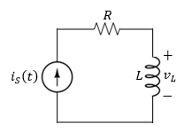
Example
Given the applied current,
find:
An expression for v_{L}(t),
The time t_{p} when the inductor current reaches its peak value,
The time t_{o} when the inductor voltage reaches its zero value,
The expressions for inductor power p_{L}, and energy w_{L}.
Sketch the waveforms i_{S}, v_{L}, p_{L}, and w_{L}.
Variable | Values | Unit
a | 20 | A/s
L | 25 | mH
R | 1 | Ω
t_{o} | 0.5 | ms

Slide 38
The voltage v_{L} is found by applying the formula,
It can be seen from the current expression that theoretically, the peak current occurs at infinity with a theoretical infinite current,
Therefore,

Slide 39
It can be seen from the voltage expression that there is no zero voltage, therefore${ t}_{0}$ does not exist,
To find the energy stored in the inductor, we apply the following formula,
To find the power of the inductor, we apply the following formula,

Slide 40
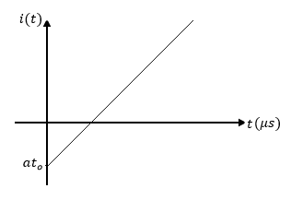
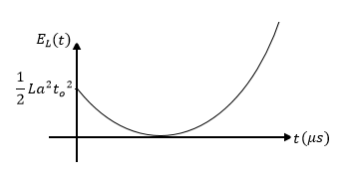
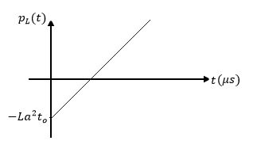
The current i_{L}(t)
The voltage v_{L}(t)
The energy w_{L}(t)
The power p_{L}(t)

Slide 41
The current i_{L}(t)
The voltage v_{L}(t)
$\frac{dE_{L}}{dt}$ > 0
$\frac{dE_{L}}{dt}$ < 0
The energy w_{L}(t)
The power p_{L}(t)

Slide 42
Capacitor connections
Capacitors series and parallel combinations.
Inductors series and parallel combinations.

Slide 43
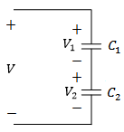
Capacitors in Series
When capacitors are in series, what is the relationship between q₁ and q₂ ?

Slide 44
Capacitors in Series
When capacitors are in series, what is the relationship between q₁ and q₂ ?
Why?

Slide 45
Capacitors in Series
Recall, that currents are given by
∴
∴

Slide 46
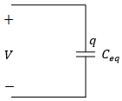
Capacitors in Series
$V=V_{1}+$ $V_{2}$
∴
$$\frac{1}{C_{eq}}=\frac{1}{C_{1}}+\frac{1}{C_{2}}$$
$$V=\frac{q_{1}}{C_{1}}+\frac{q_{1}}{C_{1}}=q\left(\frac{1}{C_{1}}+\frac{1}{C_{2}}\right)=q\frac{1}{C_{eq}}$$

Slide 47
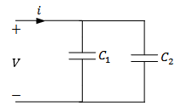
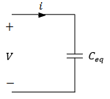
Capacitors in Parallel
When capacitors are in parallel, what is the relationship between q_{1,} q₂ and q_{T}?

Slide 48
Capacitors in Parallel
When capacitors are in parallel, what is the relationship between q_{1,} q₂ and q_{T}?

Slide 49
Capacitors in Parallel
Why?
$$i=\frac{dq_{T}}{dt}$$
$$q_{T}= q_{1}+q_{2}$$

Slide 50
Capacitors in Parallel
Therefor, we have
and

Slide 51
Three Capacitors in Series
It is clear that the capacitors in series combine like resistors in parallel

Slide 52
Three Capacitors in Parallel
It is clear that the capacitors in parallel combine like resistors in series

Slide 53
Example
Find the equivalent capacitance of the given circuit,
Variable | Values | Unit
C₁ | 1 | mF
C₂ | 2 | mF
C₃ | 2 | mF
C₄ | 1 | mF

Slide 54
Finding the equivalent capacitance of the two capacitors in parallel,

Slide 55
Series and Parallel Combinations of Inductors
Inductors in Series:
It is clear that the inductors in series combine like resistors in series

Slide 56
Series and Parallel Combinations of Inductors
Inductors in Parallel:
It is clear that the inductors in parallel combine like resistors in parallel

Slide 57
Example
Find the equivalent inductance of the given circuit,
Variable | Default | Unit
L₁ | 5.6 | mH
L₂ | 3.4 | mH
L₃ | 2.7 | mH
L₄ | 3.1 | mH

Slide 58
Finding the equivalent inductance of the two inductors in parallel,

Slide 59
Example
Determine the total capacitance seen across terminals “ab”.
Variable | Values | Unit
C₁ | 1 | mF
C₂ | 2 | mF
C₃ | 2 | mF
C₄ | 1 | mF

Slide 60
The equivalent capacitance for the four capacitors is given by:

Slide 61
The equivalent capacitance for the four capacitors is given by:

Slide 62
The equivalent capacitance for the four capacitors is given by:

Slide 63
The equivalent capacitance for the four capacitors is given by:

