Slide 1
EEL 3004 Linear Circuits I Lecture #10 Superposition Principle

Slide 2
Lecture Objectives
The lecture today will focus on:
Introducing the Superposition Principle, its benefit and procedure.
Analysis Examples using Superposition.

Slide 3
Superposition Principle
The Current and Voltage responses obtained when several independent voltage and current sources applied simultaneously is equal to the algebraic sum of each current and voltage response obtained from the contribution of each independent source acting alone. The other sources are set to zero!
The key advantage is to reduce the circuit complexity.

Slide 4
Superposition Principle
Important Points to Remember:
This circuit analysis method only applies to linear circuits.
2. Dependent voltage and current sources are kept in their places in the circuit with their corresponding controlling parameters also in place.
3. Since power and energy formulas are not linear, the principle of superposition doesn’t apply to power and energy calculations in linear circuits.
4. Setting sources to zero means:
Voltage sources are short-circuited
Current sources are open-circuited.

Slide 5
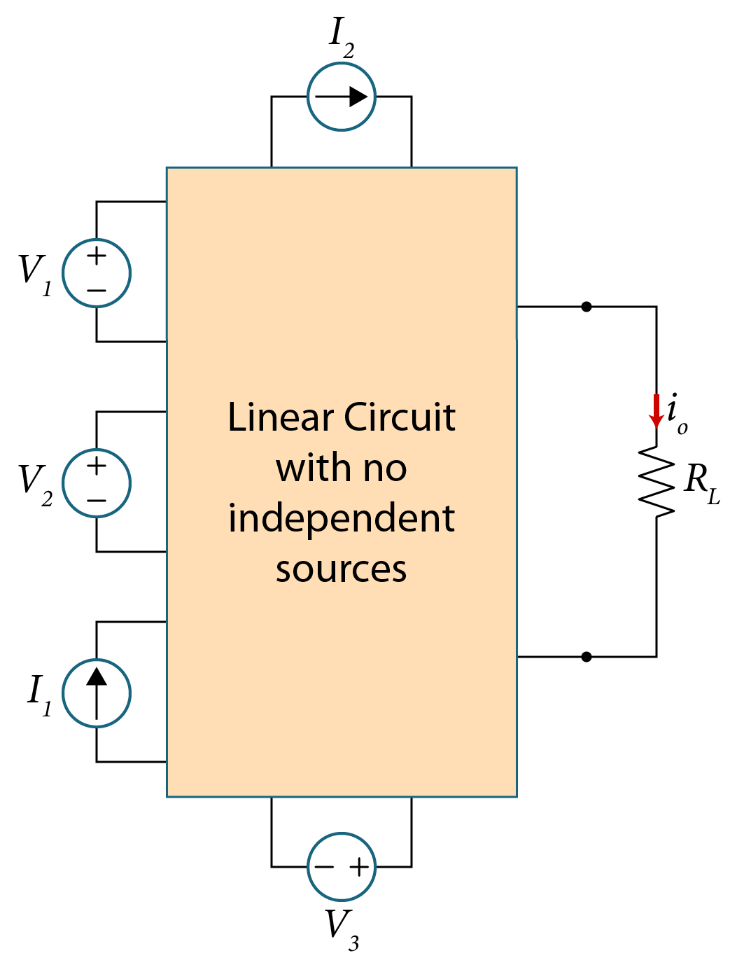
The Superposition Principle
Consider a circuit consisting of :
Three voltage sources: V1, V2, V3
Two current sources: I1, I2
We are required to find i_{o} in the load resistor RL

Slide 6
The Superposition Principle- Steps
The circuit can be simplified by doing the following:
Apply V1 and set all other sources to zero, i.e.:
V2 and V3 are short circuited.
I1 and I 2 are open circuited.
Analyze the circuit and find i_{o1}
2) Apply V2 and set all other sources to zero, i.e.:
V1 and V3 are short circuited.
I1 and I 2 are open circuited.
Analyze the circuit and find i_{o2}
3) Apply V3 and set all other sources to zero, i.e.:
V1 and V2 are short circuited.
I1 and I 2 are open circuited.
Analyze the circuit and find i_{o3}
4) Apply I1 and set all other sources to zero, i.e.:
V1, V2 and V3 are short circuited.
I2 is open circuited.
Analyze the circuit and find i_{o4}
5) Apply I2 and set all other sources to zero, i.e.:
V1, V2 and V3 are short circuited.
I1 is open circuited.
Analyze the circuit and find i_{o5}

Slide 7
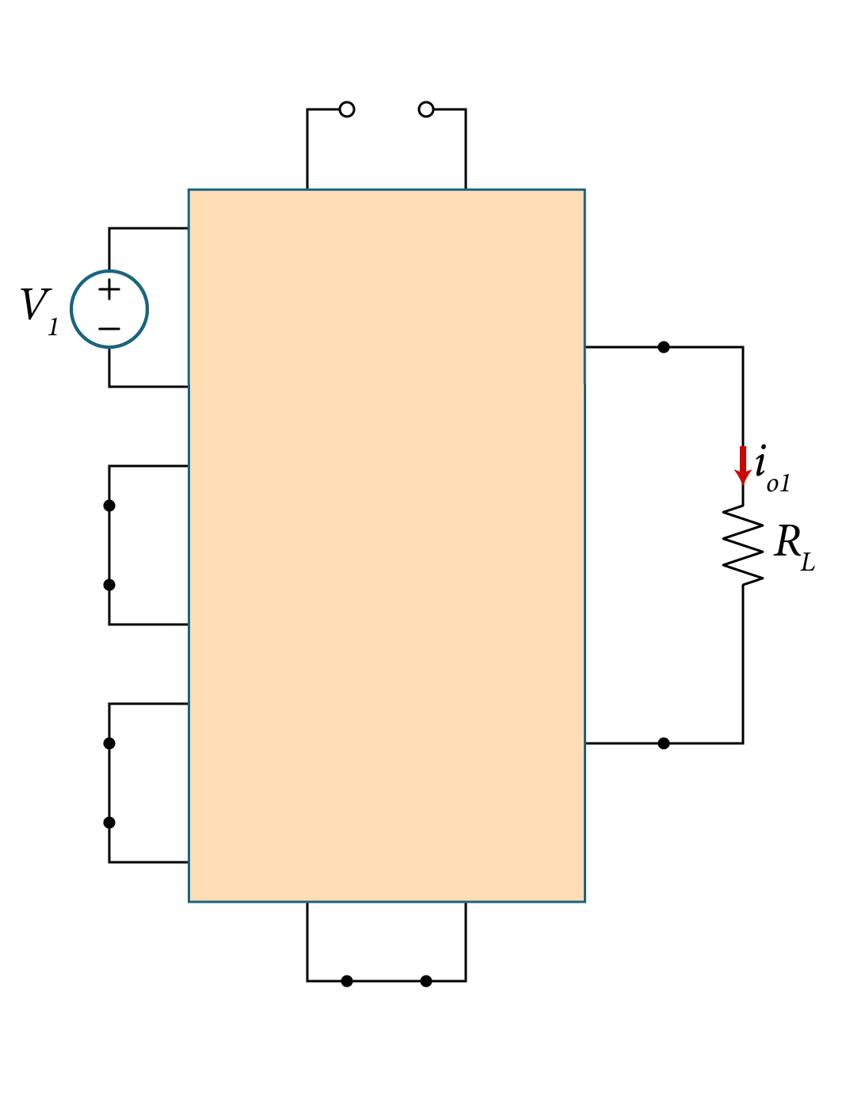
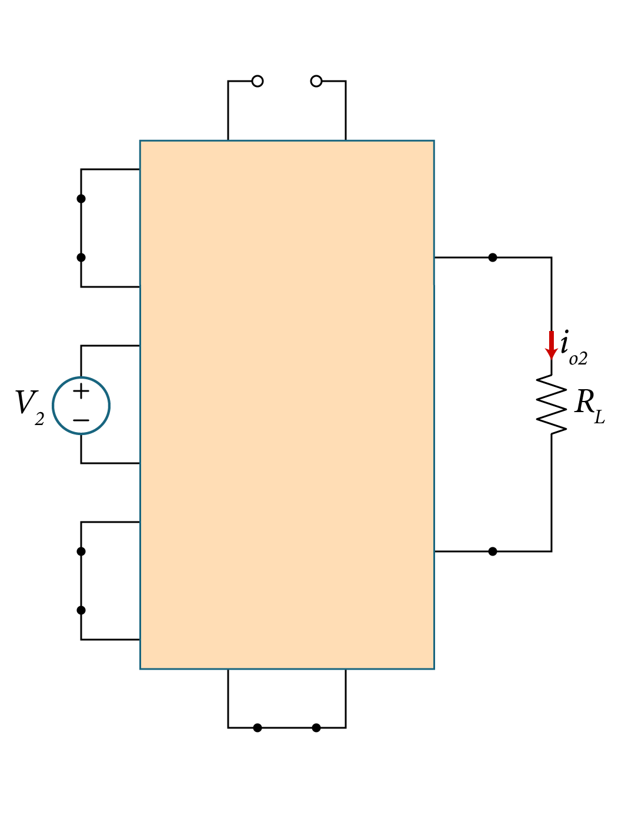
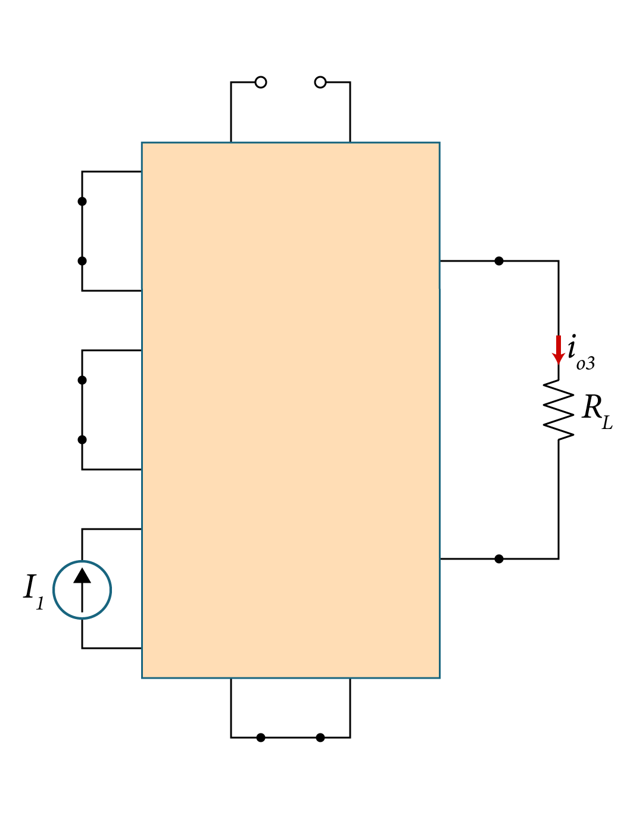
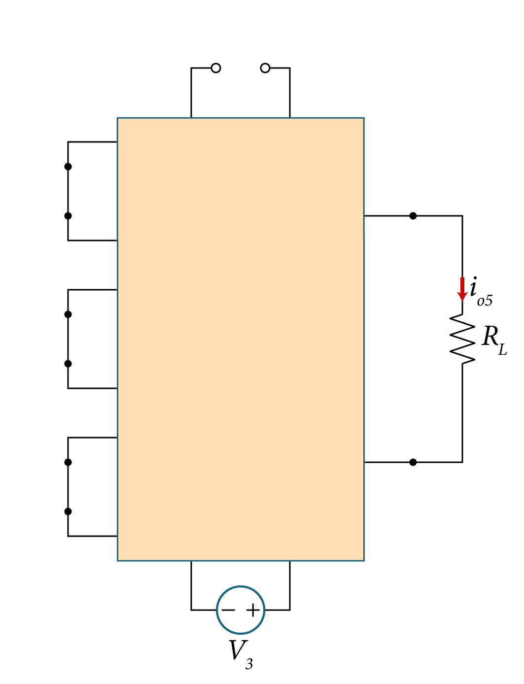
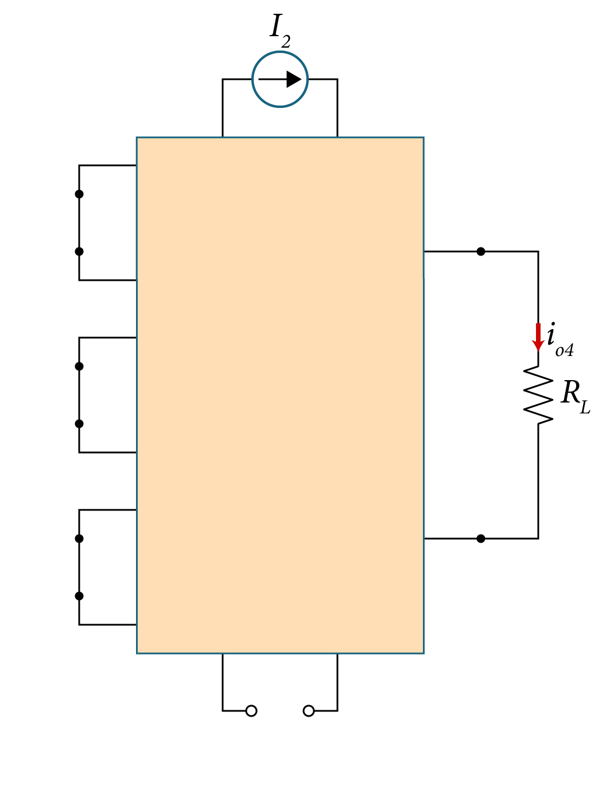
Applying the Superposition Principle
Find i_{o1} when only V₁ applied
Find i_{o2} when only V₂ applied
Find i_{o3} when only I₁ applied
Find i_{o4} when only I₂ applied
Find i_{o5} when only V₃ applied
The total Current
i_{o} = i_{o1} + i_{o2} + i_{o3}+ i_{o4} + i_{o5}

Slide 8
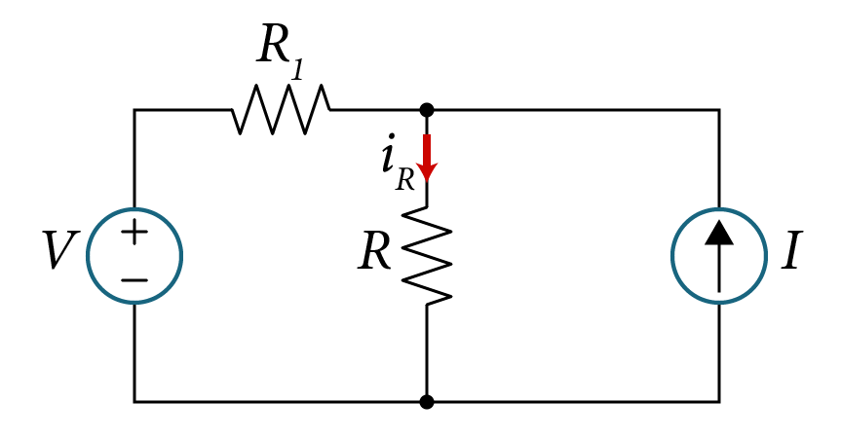
Example
Solve for the current flowing in the resistance R by applying the Principle of Superposition.
Variable | Default | Unit
V | 16 | V
I | 10 | A
R | 8 | Ω
R₁ | 6 | Ω

Slide 9
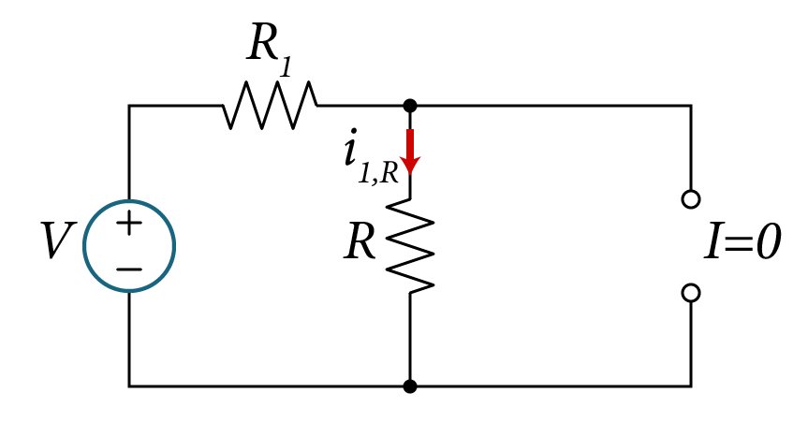
There are two sources: Voltage V and Current I:
1) Applying voltage V and set the current source I to zero (open circuit)
Applying voltage division,

Slide 10
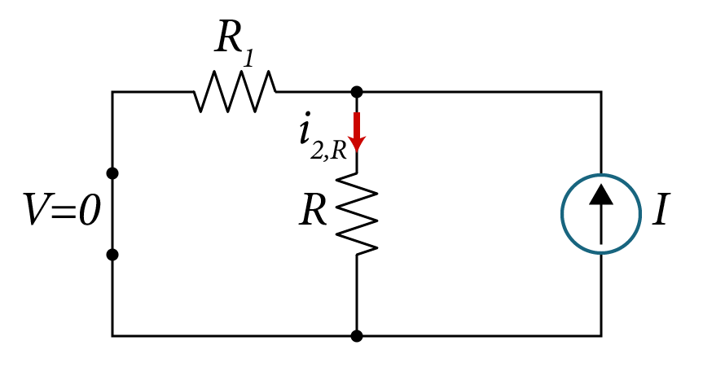
2) Applying the current source I and set the voltage source V to zero (short-circuit)
Applying current division,

Slide 11
Summary.
Applying voltage V and open circuit the current source I:
Applying the current source I and short-circuit V:
Applying voltage division,
Applying current division,

Slide 12
By applying superposition principle:
+

Slide 13
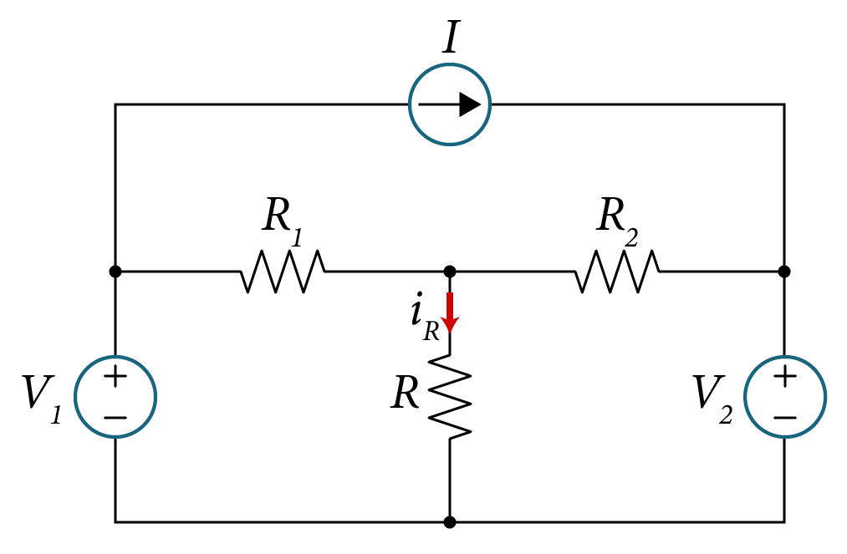
Example
Solve for the current flowing in the resistance R by applying the Principle of Superposition.
Variable | Values | Unit
V₁ | 8 | V
V₂ | 4 | V
I | 12 | A
R | 10 | Ω
R₁ | 14 | Ω
R₂ | 18 | Ω

Slide 14
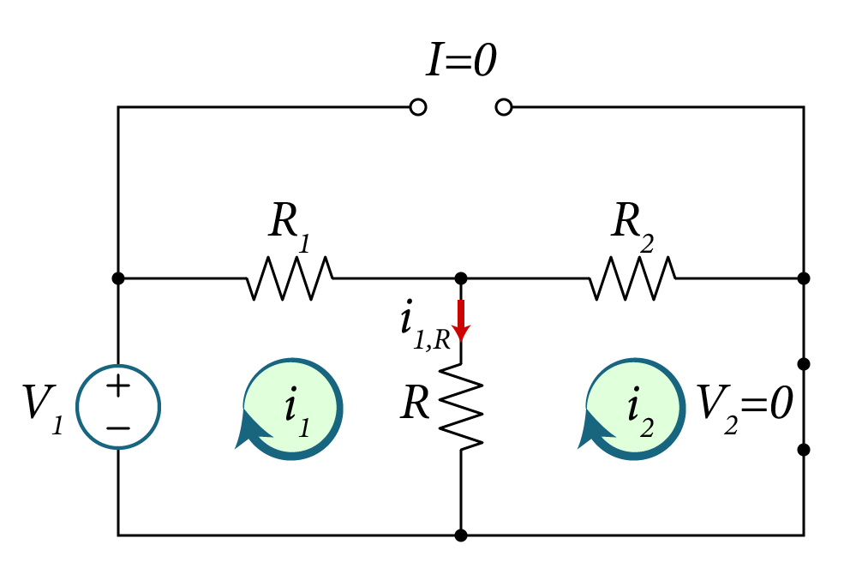
Solution:
There are three sources: Voltage V₁, V₂ and Current I:
1) Applying voltage V₁ and setting the voltage source V₂ and current source I to zero (short and open circuit respectively)
Apply KVL to the two mesh loops yields,
$$−V_{1}+R_{1}i_{1}+R\left(i_{1}−i_{2}\right)=0$$
$$R\left(i_{2}−i_{1}\right)+R_{2}i_{2}=0$$
Solving for $i_{1}$ and $i_{2}$currents,
$$i_{1}=\frac{\left(R+R_{2}\right)V_{1}}{RR_{1}+RR_{2}+R_{1}R_{2}}=\frac{\left(10+18\right)8}{10x14+10x18+14x18}=0.4 A$$
$$i_{2}=\frac{RV_{1}}{RR_{1}+RR_{2}+R_{1}R_{2}}=\frac{10x8}{10x14+10x18+14x18}=0.1 A$$
Solving for$i_{1,R}$, we obtain,
$$i_{1,R}=i_{1}−i_{2} =0.4−0.1=0.3 A$$

Slide 15
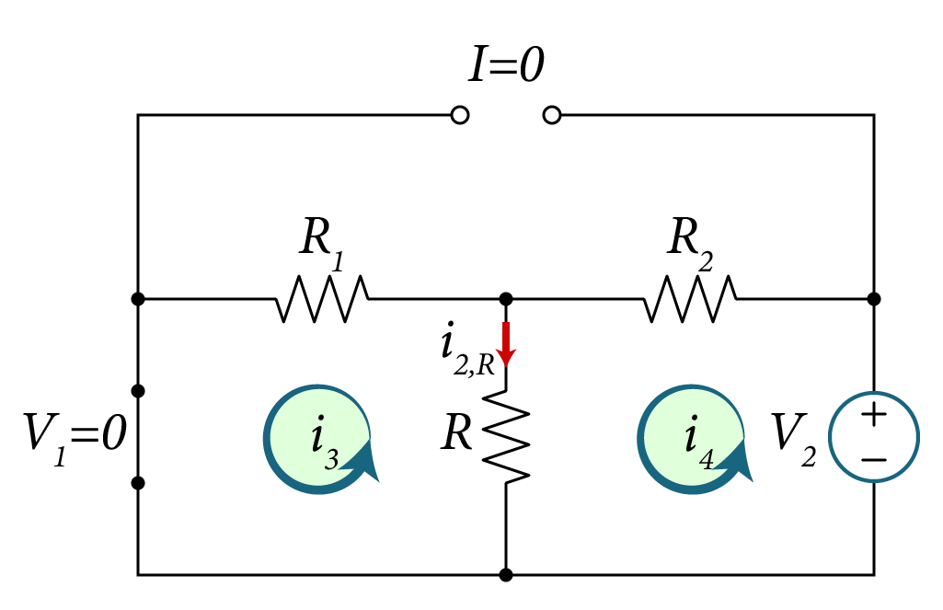
Solution B:
2) Applying voltage V₂ and setting the voltage source V₁ and current source I to zero (short and open circuit respectively)
Applying KVL for both loops yields,
$$R_{1}i_{3}+R\left(i_{3}−i_{4}\right)=0$$
$$−V_{2}+R_{2}i_{4}+R\left(i_{4}−i_{3}\right)=0$$
Solving for both currents,
$$i_{3}=\frac{RV_{2}}{RR_{1}+RR_{2}+R_{1}R_{2}}=\frac{10x4}{10x14+10x18+14x18}=0.1 A$$
$$i_{4}=\frac{\left(R+R_{1}\right)V_{2}}{RR_{1}+RR_{2}+R_{1}R_{2}} =\frac{\left(10+14\right)4}{10x14+10x18+14x18}=0.2 A$$
Then,
$$i_{2,R}=i_{4}−i_{3} =0.2−0.1=0.1 A$$

Slide 16
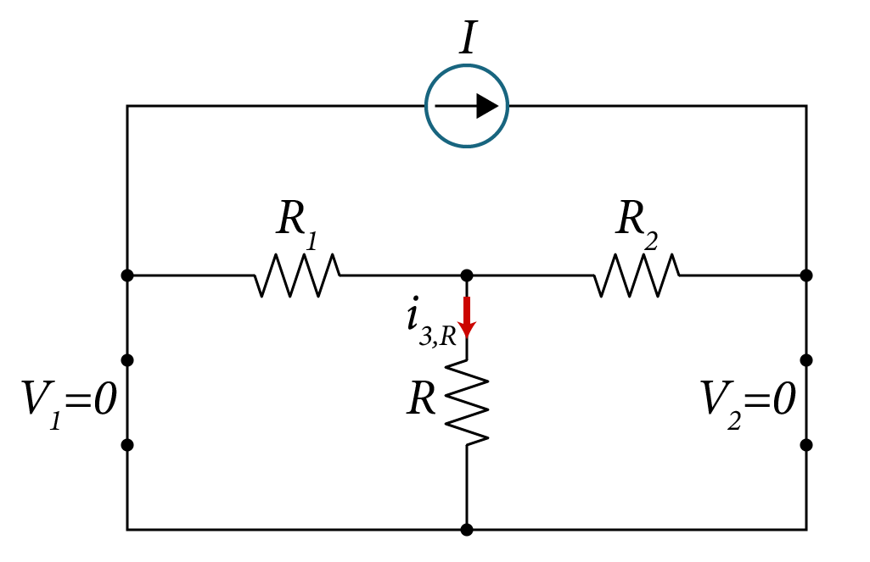
Solution:
3) Applying current I and setting the voltage source V₁ and voltage source V₂ to zero (short circuit)

Slide 17
Solution:
3) Applying current I and setting the voltage source V₁ and voltage source V₂ to zero (short circuit)
It is obvious that the equivalent resistance seen by the current source is equal to zero since all resistors are shorted,
$$i_{3,R}=0 A$$

Slide 18
Solution:
3) Applying current I and setting the voltage source V₁ and voltage source V₂ to zero (short circuit)
Short circuit
It is obvious that the equivalent resistance seen by the current source is equal to zero since all resistors are shorted,
$$i_{3,R}=0 A$$

Slide 19
Solution:
Summary.
Applying only voltage V₁,
Applying only voltage V₂,
Applying only current source I,
$$i_{R}=i_{1,R}+i_{2,R}+i_{3,R}=0.3+0.1+0=0.4 A$$

Slide 20
Example
Solve for power dissipation in the resistance R_{L} using superposition.
Assume $V_{1}=26 V, V_{2}=22 V, R_{1}=10 Ω, R_{2}=12 Ω, R_{3}=14 Ω, R_{4}=12, R_{L}=16 Ω, β=2$.

Slide 21
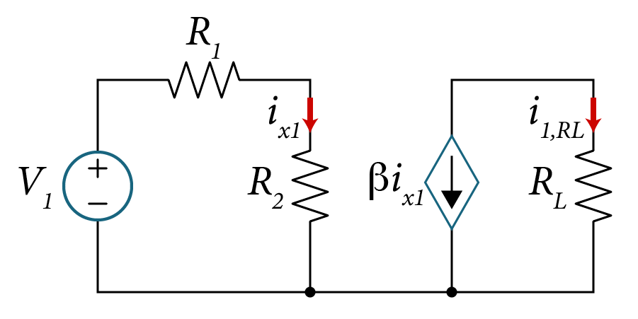
Applying voltage source V₁ and short circuit the voltage source V₂:
V₂=0
Since i_{x2} is equal to zero, then the circuit is reduced as follows:
From Ohm’s law, we find,
$$i_{x_{1}}=\frac{V_{1}}{R_{1}+R_{2}}$$
$$=\frac{26}{10+12}=1.2 A$$
By inspection we obtain,
$$i_{1,RL}=−βi_{x_{1}}$$
$$=−2x1.2=−2.4 A$$

Slide 22
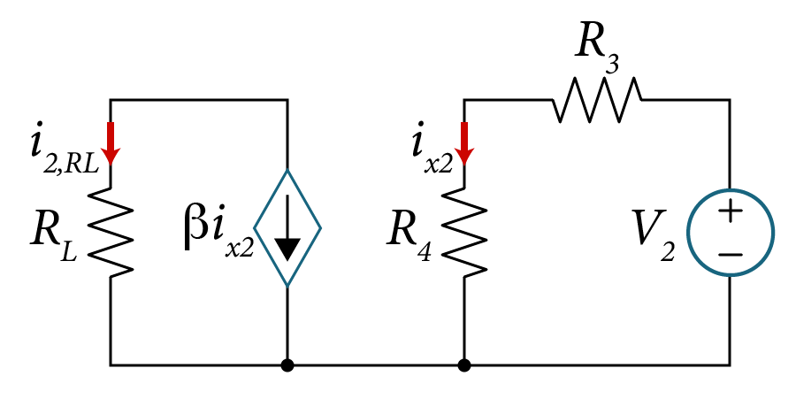
Applying voltage source V₂ and short circuit the voltage source V₁:
V₁=0
Since i_{x1} is equal to zero, then the circuit is reduced as follows:
From Ohm’s law, we find,
$$i_{x_{2}}=\frac{V_{2}}{R_{3}+R_{4}}=\frac{22}{14+12}=0.8 A$$
By inspection we obtain,
$$i_{2,RL}=−βi_{x_{2}} =−2x0.8=−1.6 A$$

Slide 23
According to the superposition principle,
$$i_{R_{L}}=i_{1,RL}+i_{2,RL}$$
$$=−2.4−1.6=−4.0 A$$
The power dissipated in the load resistor is given by,
$$p_{R_{L}}=R_{L}{i_{R_{L}}}^{2}=16{\left(−4.0\right)}^{2}=256 W$$

Slide 24
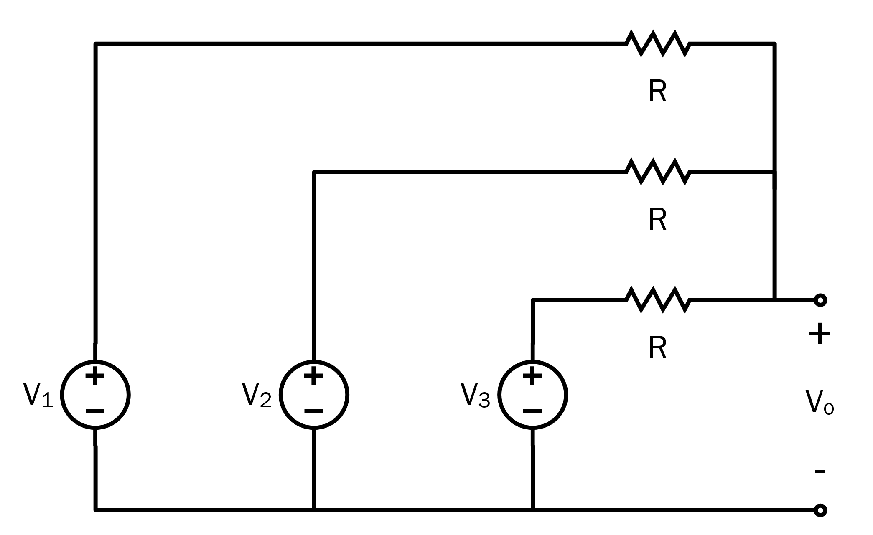
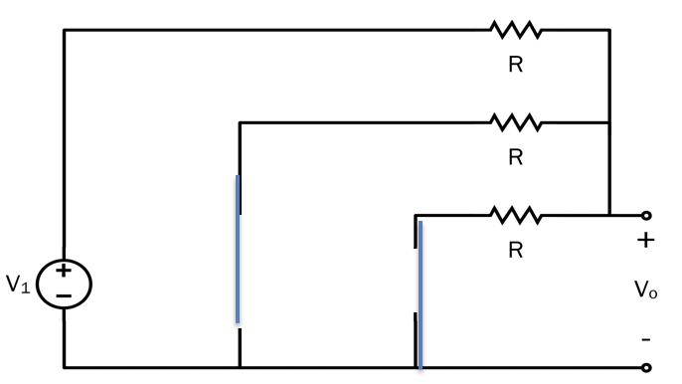
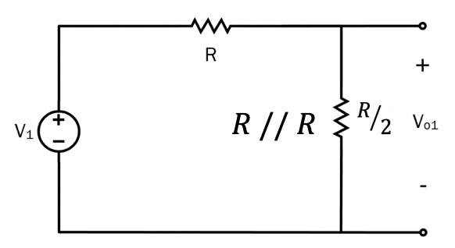
Example:
Derive the expression for the output voltage, v_{o}.
$$v_{o1}= \frac{R/2}{R+R/2}∙V_{1}$$
$$= \frac{1}{2+1}V_{1}= \frac{1}{3} V_{1}$$
Solution:
Use superposition:
V₁ is applied, V₂ and V₃ are set to 0V.
Similarly, $v_{o2}= \frac{1}{3}V_{2}$ and $v_{o3}= \frac{1}{3}V_{3}$.
$v_{o}= v_{o1}+ v_{o2}+ v_{o3}$
$v_{o}= \frac{1}{3} ( V_{1}+ V_{2}+ V_{3} )$

