Slide 1
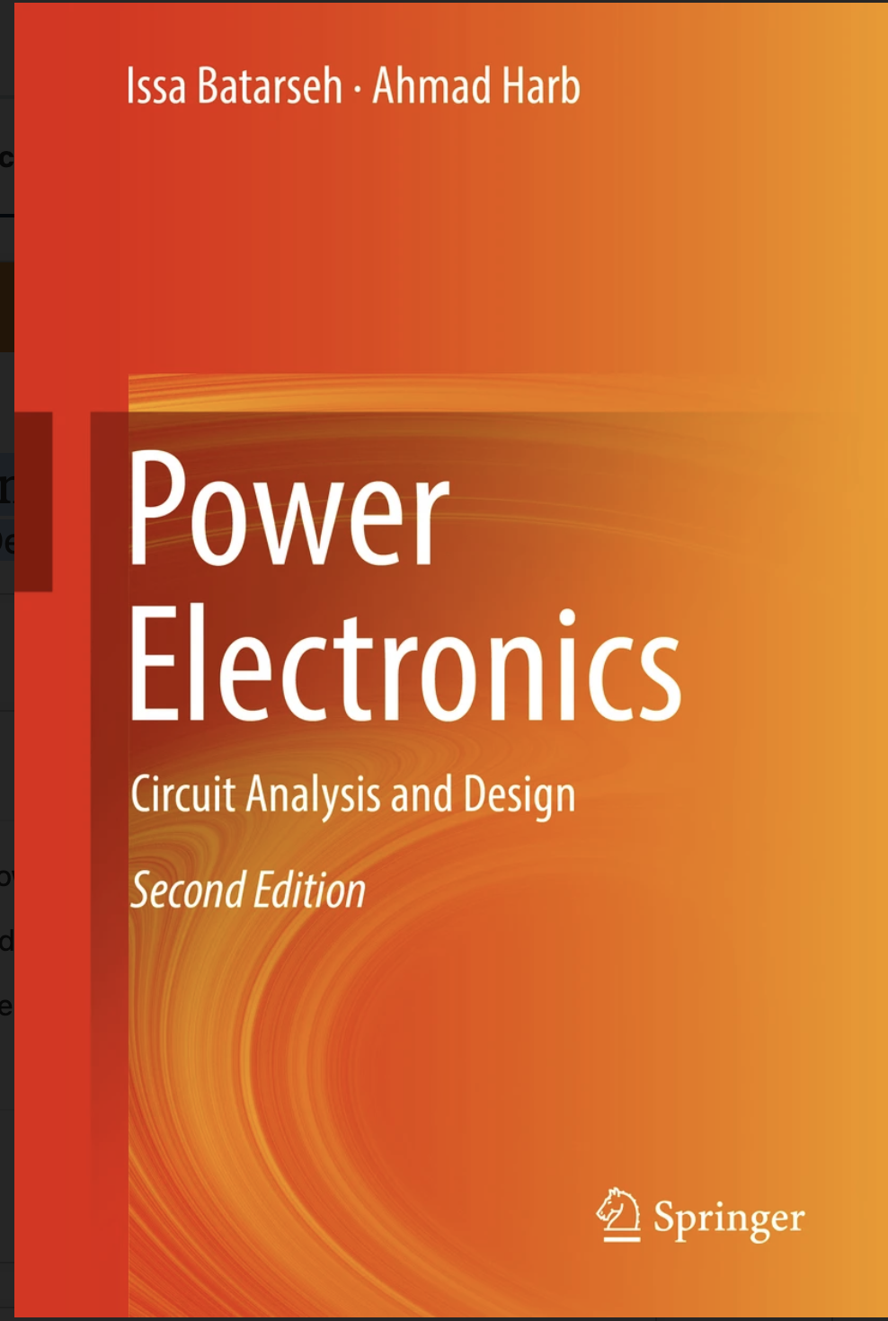
Power Electronics
Circuit Analysis and Design
https://link.springer.com/book/10.1007/978-3-319-68366-9
About this book
This fully updated textbook provides complete coverage of electrical circuits and introduces students to the field of energy conversion technologies, analysis and design. Chapters are designed to equip students with necessary background material in such topics as devices, switching circuit analysis techniques, converter types, and methods of conversion. The book contains a large number of examples, exercises, and problems to help enforce the material presented in each chapter. A detailed discussion of resonant and softswitching dc-to-dc converters is included along with the addition of new chapters covering digital control, non-linear control, and micro-inverters for power electronics applications. Designed for senior undergraduate and graduate electrical engineering students, this book provides students with the ability to analyze and design power electronic circuits used in various industrial applications.

