Slide 1
Which is the fact(s) about the three-phase system?
(a) Power is primarily transferred in a form of balanced three-phase power
(b) Most of exiting three-phase circuits in industry are of the balanced type.
(c) Three-phase transformers are used to step-up and step-down thee-phase voltages.
(d) More economical to deliver power in three-phase circuits than in single- or double-phase circuits.
(e) All of the above

Slide 2
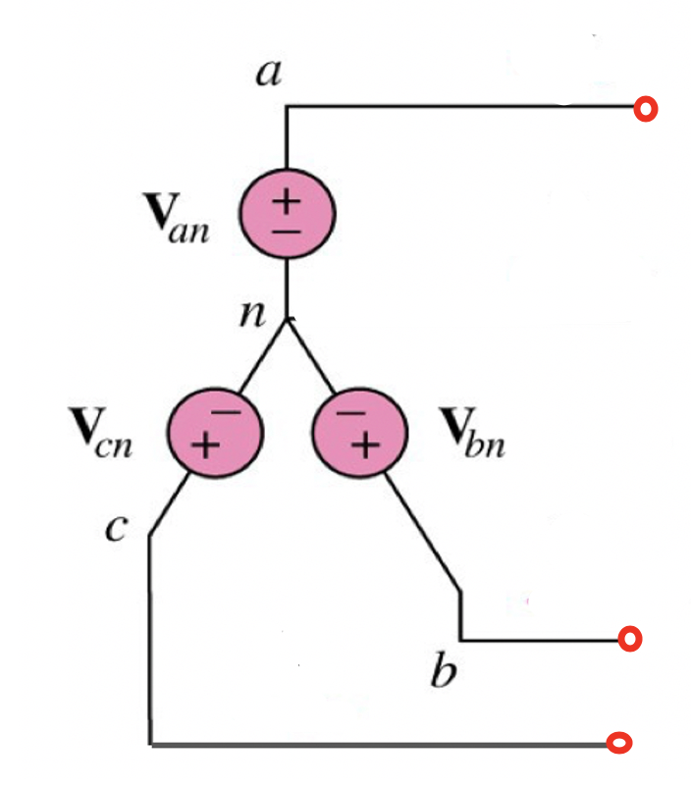
Consider the following balanced three-phase circuit with one of the phase-voltage is given by,
$$v_{bn}\left(t\right)=\text{1}\text{0}\text{0 }\text{sin}\text{(}ωt+0^{o}) V$$
Which of the following completes the remaining voltages for the three-phase Y-source voltage.
(a)
$$v_{an}\left(t\right)=\text{1}\text{0}\text{0 }\text{sin}\text{(}ωt−{120}^{o}) V$$
$$v_{cn}\left(t\right)=\text{1}\text{0}\text{0 }\text{sin}\text{(}ωt−{240}^{o}) V$$
(b)
$$v_{an}\left(t\right)=\text{1}\text{0}\text{0 }\text{sin}\text{(}ωt+0^{o}) V$$
$$v_{cn}\left(t\right)=\text{1}\text{0}\text{0 }\text{sin}\text{(}ωt+{120}^{o}) V$$
(c)
$$v_{an}\left(t\right)=\text{1}\text{0}\text{0}\sqrt{3} \text{sin}\text{(}ωt+{120}^{o}) V$$
$$v_{cn}\left(t\right)=\text{1}\text{0}\text{0 }\sqrt{3}\text{sin}\text{(}ωt+{240}^{o}) V$$
(d)
$$v_{an}\left(t\right)=\text{1}\text{0}\text{0}\sqrt{3}\text{sin}\text{(}ωt+{120}^{o}) V$$
$$v_{cn}\left(t\right)=\text{1}\text{0}\text{0}\sqrt{3}\text{sin}\text{(}ωt+{240}^{o}) V$$
(e)
$$v_{bn}\left(t\right)=\text{1}\text{0}\text{0 }\text{sin}\text{(}ωt+{120}^{o}) V$$
$$v_{cn}\left(t\right)=\text{1}\text{0}\text{0 }\text{sin}\text{(}ωt−{240}^{o}) V$$

Slide 3
Consider the following balanced three-phase circuit with one of the phase-voltage is given by,
$$v_{an}\left(t\right)=\text{1}\text{0}\text{0 }\text{sin}\text{(}ωt+0^{o}) V$$
Which of the following completes the remaining voltages for the three-phase Y-source voltage.
(a)
$$v_{bn}\left(t\right)=\text{1}\text{0}\text{0 }\text{sin}\text{(}ωt−{120}^{o}) V$$
$$v_{cn}\left(t\right)=\text{1}\text{0}\text{0 }\text{sin}\text{(}ωt+{240}^{o}) V$$
(b)
$$v_{bn}\left(t\right)=\text{1}\text{0}\text{0 }\text{sin}\text{(}ωt+0^{o}) V$$
$$v_{cn}\left(t\right)=\text{1}\text{0}\text{0 }\text{sin}\text{(}ωt+{120}^{o}) V$$
(c)
$$v_{bn}\left(t\right)=\text{1}\text{0}\text{0}\sqrt{3} \text{sin}\text{(}ωt+{120}^{o}) V$$
$$v_{cn}\left(t\right)=\text{1}\text{0}\text{0 }\sqrt{3}\text{sin}\text{(}ωt+{240}^{o}) V$$
(d)
$$v_{bn}\left(t\right)=\text{1}\text{0}\text{0 }\text{sin}\text{(}ωt+{120}^{o}) V$$
$$v_{cn}\left(t\right)=\text{1}\text{0}\text{0 }\text{sin}\text{(}ωt+{240}^{o}) V$$
(e)
$$v_{bn}\left(t\right)=\text{1}\text{0}\text{0 }\text{sin}\text{(}ωt+{120}^{o}) V$$
$$v_{cn}\left(t\right)=\text{1}\text{0}\text{0 }\text{sin}\text{(}ωt−{240}^{o}) V$$

Slide 4
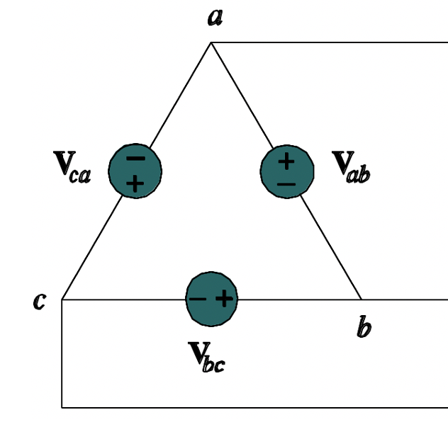
Consider the following balanced three-phase circuit with one of the phase-voltage is given by,
$$v_{ca}\left(t\right)=\text{1}\text{0}\text{0 }\text{sin}\text{(}ωt+{120}^{o}) V$$
Which of the following completes the remaining voltages for the three-phase delta-source voltage.
(a)
$$v_{bc}\left(t\right)=\text{1}\text{0}\text{0 }\text{sin}\text{(}ωt−0^{o}) V$$
$$v_{ab}\left(t\right)=\text{1}\text{0}\text{0 }\text{sin}\text{(}ωt−{120}^{o}) V$$
(b)
$$v_{bc}\left(t\right)=\text{1}\text{0}\text{0 }\text{sin}\text{(}ωt−0^{o}) V$$
$$v_{ab}\left(t\right)=\text{1}\text{0}\text{0 }\text{sin}\text{(}ωt+{120}^{o}) V$$
(c)
$$v_{bc}\left(t\right)=\text{1}\text{0}\text{0}\sqrt{3} \text{sin}\text{(}ωt+{120}^{o}) V$$
$$v_{ab}\left(t\right)=\text{1}\text{0}\text{0 }\sqrt{3}\text{sin}\text{(}ωt+{240}^{o}) V$$
(d)
$$v_{bc}\left(t\right)=\text{1}\text{0}\text{0 }\text{sin}\text{(}ωt+{240}^{o}) V$$
$$v_{ab}\left(t\right)=\text{1}\text{0}\text{0 }\text{sin}\text{(}ωt−{120}^{o}) V$$
(e)
$$v_{bc}\left(t\right)=\text{1}\text{0}\text{0 }\text{sin}\text{(}ωt−0^{o}) V$$
$$v_{ab}\left(t\right)=\text{1}\text{0}\text{0 }\text{sin}\text{(}ωt+0^{o}) V$$

Slide 5
Consider the following balanced three-phase circuit with one of the phase-voltage is given by,
$$v_{ab}\left(t\right)=\text{1}\text{0}\text{0 }\text{sin}\text{(}ωt+{30}^{o}) V$$
Which of the following completes the remaining voltages for the three-phase delta-source voltage.
(a)
$$v_{bc}\left(t\right)=\text{1}\text{00 }\text{sin}\text{(}ωt−0^{o}) V$$
$$v_{ca}\left(t\right)=\text{1}\text{00 }\text{sin}\text{(}ωt−{120}^{o}) V$$
(b)
$$v_{bc}\left(t\right)=\text{1}\text{0}\text{0 }\text{sin}\text{(}ωt−0^{o}) V$$
$$v_{ca}\left(t\right)=\text{1}\text{0}\text{0 }\text{sin}\text{(}ωt+{120}^{o}) V$$
(c)
$$v_{bc}\left(t\right)=\text{1}\text{0}\text{0}\sqrt{3} \text{sin}\text{(}ωt+{120}^{o}) V$$
$$v_{ca}\left(t\right)=\text{1}\text{0}\text{0 }\sqrt{3}\text{sin}\text{(}ωt+{240}^{o}) V$$
(d)
$$v_{bc}\left(t\right)=\text{1}\text{00 }\text{sin}\text{(}ωt+{240}^{o}) V$$
$$v_{cab}\left(t\right)=\text{1}\text{0}\text{0 }\text{sin}\text{(}ωt−{120}^{o}) V$$
(e)
$$v_{bc}\left(t\right)=\text{1}\text{0}\text{0 }\text{sin}\text{(}ωt−90^{o}) V$$
$$v_{ca}\left(t\right)=\text{1}\text{0}\text{0 }\text{sin}\text{(}ωt+{150}^{o}) V$$

Slide 6
Consider the following balanced Y-source three-phase circuit with the phase-voltages are given by,
$$v_{bn}\left(t\right)=\text{1}\text{0}\text{0 }\text{sin}\text{(}ωt+0^{o}) V$$
$$v_{an}\left(t\right)=\text{1}\text{0}\text{0 }\text{sin}\text{(}ωt−{120}^{o}) V$$
$$v_{cn}\left(t\right)=\text{1}\text{0}\text{0 }\text{sin}\text{(}ωt−{240}^{o}) V$$
Which of the following is a correct expression for the equivalent Delta-source three-phase voltage,
(a)
$$v_{cn}\left(t\right)=\text{1}\text{00}\sqrt{3} \text{sin}\text{(}ωt+{150}^{o}) V$$
(b)
$$v_{cn}\left(t\right)=\text{1}\text{0}\text{0}\sqrt{3}\text{sin}\text{(}ωt−{150}^{o}) V$$
(c)
$$v_{cn}\left(t\right)=\frac{100}{\sqrt{3}}\text{sin}\text{(}ωt+{150}^{o}) V$$
(d)
$$v_{cn}\left(t\right)=\frac{100}{\sqrt{3}}\text{sin}\text{(}ωt−{150}^{o}) V$$
(e) none of the above

Slide 7
Consider the following balanced Y-source three-phase circuit with the phase-voltages are given by,
$$v_{bn}\left(t\right)=\text{1}\text{0}\text{0 }\text{sin}\text{(}ωt+0^{o}) V$$
$$v_{an}\left(t\right)=\text{1}\text{0}\text{0 }\text{sin}\text{(}ωt−{120}^{o}) V$$
$$v_{cn}\left(t\right)=\text{1}\text{0}\text{0 }\text{sin}\text{(}ωt−{240}^{o}) V$$
Which of the following is a correct expression for the equivalent Y-source three-phase voltage,
(a)
$$v_{ab}\left(t\right)=\text{1}\text{00}\sqrt{3} \text{sin}\text{(}ωt+{30}^{o}) V$$
(b)
$$v_{ab}\left(t\right)=\text{1}\text{0}\text{0}\sqrt{3}\text{sin}\text{(}ωt−{30}^{o}) V$$
(c)
$$v_{ab}\left(t\right)=\frac{100}{\sqrt{3}}\text{sin}\text{(}ωt−{30}^{o}) V$$
(d)
$$v_{ab}\left(t\right)=\frac{100}{\sqrt{3}}\text{sin}\text{(}ωt+{30}^{o}) V$$
(e) none of the above

Slide 8
Consider the following balanced Y-source three-phase circuit with the phase-voltages are given by,
$$v_{bn}\left(t\right)=\text{1}\text{0}\text{0 }\text{sin}\text{(}ωt+0^{o}) V$$
$$v_{an}\left(t\right)=\text{1}\text{0}\text{0 }\text{sin}\text{(}ωt−{120}^{o}) V$$
$$v_{cn}\left(t\right)=\text{1}\text{0}\text{0 }\text{sin}\text{(}ωt−{240}^{o}) V$$
Which of the following is a correct expression for the equivalent Y-source three-phase voltage,
(a)
$$v_{bc}\left(t\right)=\text{1}\text{00}\sqrt{3} \text{sin}\text{(}ωt+{30}^{o}) V$$
(b)
$$v_{bc}\left(t\right)=\text{1}\text{0}\text{0}\sqrt{3}\text{sin}\text{(}ωt−{90}^{o}) V$$
(c)
$$v_{bc}\left(t\right)=\frac{100}{\sqrt{3}}\text{sin}\text{(}ωt−{90}^{o}) V$$
(d)
$$v_{bc}\left(t\right)=\frac{100}{\sqrt{3}}\text{sin}\text{(}ωt+{30}^{o}) V$$
(e) none of the above

Slide 9
Consider the following balanced Delta-source three-phase circuit with the phase-voltages are given by,
$$v_{bn}\left(t\right)=\text{1}\text{0}\text{0 }\text{sin}\text{(}ωt+0^{o}) V$$
$$v_{an}\left(t\right)=\text{1}\text{0}\text{0 }\text{sin}\text{(}ωt−{120}^{o}) V$$
$$v_{cn}\left(t\right)=\text{1}\text{0}\text{0 }\text{sin}\text{(}ωt−{240}^{o}) V$$
Which of the following is a correct expression for the equivalent Y-source three-phase voltage,
(a)
$$v_{cn}\left(t\right)=\text{1}\text{00}\sqrt{3} \text{sin}\text{(}ωt+{150}^{o}) V$$
(b)
$$v_{cn}\left(t\right)=\text{1}\text{0}\text{0}\sqrt{3}\text{sin}\text{(}ωt−{150}^{o}) V$$
(c)
$$v_{cn}\left(t\right)=\frac{100}{\sqrt{3}}\text{sin}\text{(}ωt+{150}^{o}) V$$
(d)
$$v_{cn}\left(t\right)=\frac{100}{\sqrt{3}}\text{sin}\text{(}ωt−{150}^{o}) V$$
(e) none of the above

Slide 10
Consider the following balanced Delta-source three-phase circuit with the phase-voltages are given by,
$$v_{bn}\left(t\right)=\text{1}\text{0}\text{0 }\text{sin}\text{(}ωt+0^{o}) V$$
$$v_{an}\left(t\right)=\text{1}\text{0}\text{0 }\text{sin}\text{(}ωt−{120}^{o}) V$$
$$v_{cn}\left(t\right)=\text{1}\text{0}\text{0 }\text{sin}\text{(}ωt−{240}^{o}) V$$
Which of the following is a correct expression for the equivalent Y-source three-phase voltage,
(a)
$$v_{ab}\left(t\right)=\text{1}\text{00}\sqrt{3} \text{sin}\text{(}ωt+{30}^{o}) V$$
(b)
$$v_{ab}\left(t\right)=\text{1}\text{0}\text{0}\sqrt{3}\text{sin}\text{(}ωt−{30}^{o}) V$$
(c)
$$v_{ab}\left(t\right)=\frac{100}{\sqrt{3}}\text{sin}\text{(}ωt−{30}^{o}) V$$
(d)
$$v_{ab}\left(t\right)=\frac{100}{\sqrt{3}}\text{sin}\text{(}ωt+{30}^{o}) V$$
(e) none of the above

Slide 11
Consider the following balanced Delta-source three-phase circuit with the phase-voltages are given by,
$$v_{bn}\left(t\right)=\text{1}\text{0}\text{0 }\text{sin}\text{(}ωt+0^{o}) V$$
$$v_{an}\left(t\right)=\text{1}\text{0}\text{0 }\text{sin}\text{(}ωt−{120}^{o}) V$$
$$v_{cn}\left(t\right)=\text{1}\text{0}\text{0 }\text{sin}\text{(}ωt−{240}^{o}) V$$
Which of the following is a correct expression for the equivalent Y-source three-phase voltage,
(a)
$$v_{bc}\left(t\right)=\text{1}\text{00}\sqrt{3} \text{sin}\text{(}ωt+{30}^{o}) V$$
(b)
$$v_{bc}\left(t\right)=\text{1}\text{0}\text{0}\sqrt{3}\text{sin}\text{(}ωt−{90}^{o}) V$$
(c)
$$v_{bc}\left(t\right)=\frac{100}{\sqrt{3}}\text{sin}\text{(}ωt−{90}^{o}) V$$
(d)
$$v_{bc}\left(t\right)=\frac{100}{\sqrt{3}}\text{sin}\text{(}ωt+{30}^{o}) V$$
(e) none of the above

Slide 12
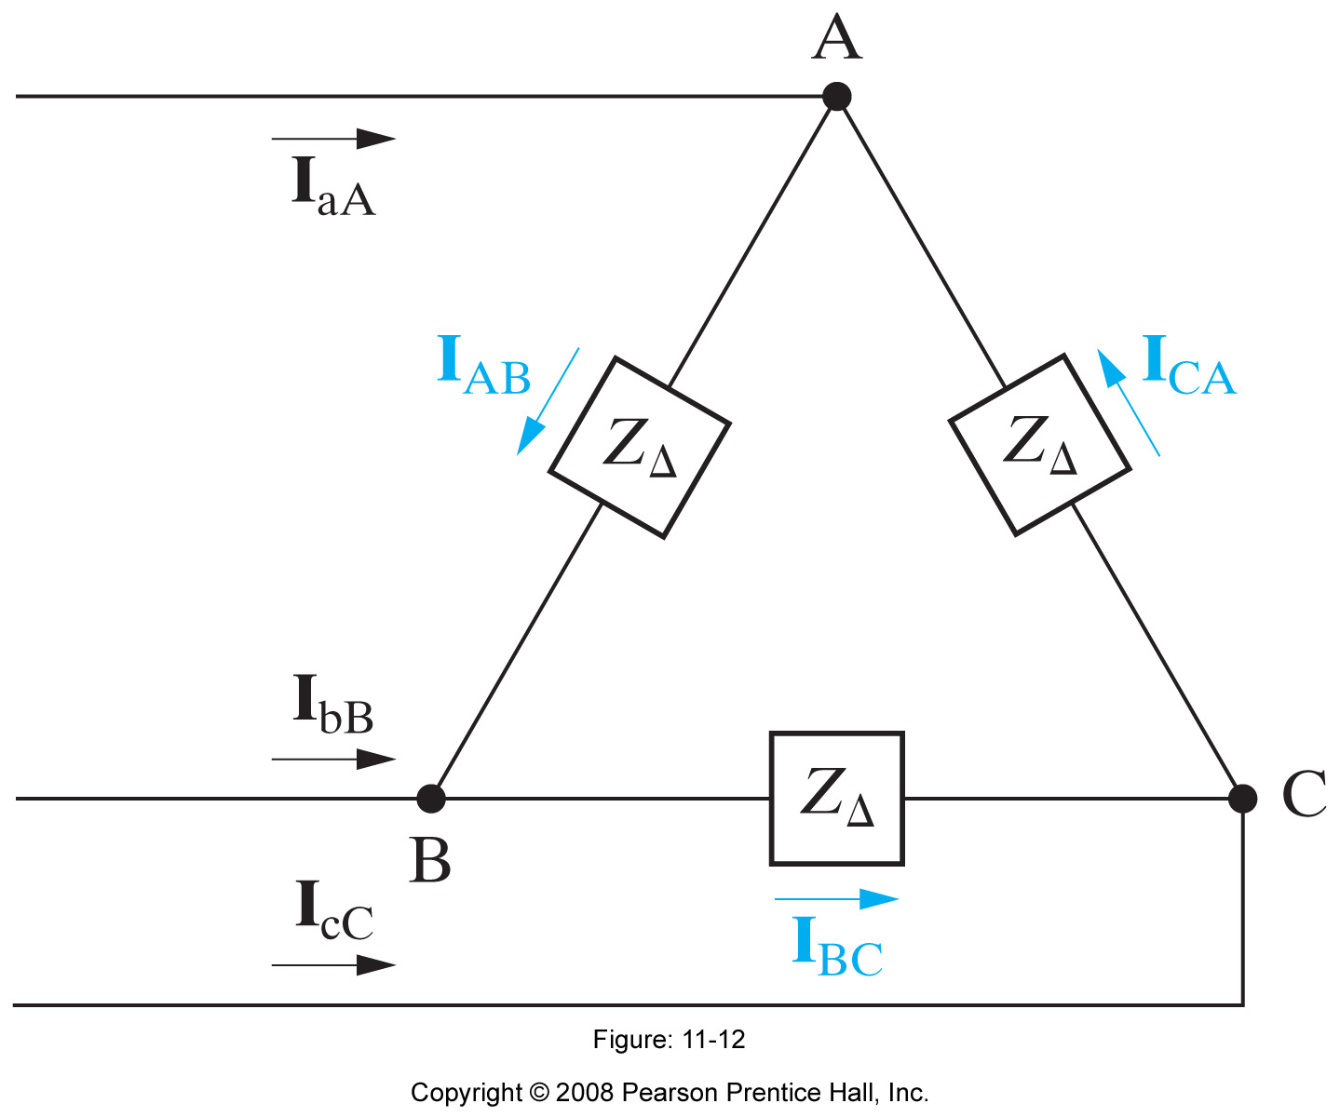
Three phase Circuits
Which of the following expressions apply to the three-phase circuit shown below,
$$v_{a}\left(t\right)+v_{b}\left(t\right)\text{+}v_{c}\left(t\right)=0$$
Or use the phasor notations:
V_{a} +V_{b} + V_{c} =0
Ref:

Slide 13
Three phase Circuits
Which of the following expressions apply to the three-phase circuit shown below,
$$v_{a}\left(t\right)+v_{b}\left(t\right)\text{+}v_{c}\left(t\right)=0$$
Or use the phasor notations:
V_{a} +V_{b} + V_{c} =0
Ref:

Slide 14
Which of the following expression(s) that apply to the three-phase circuit shown below,
(a)
$$I_{aA}=I_{AB}−I_{CA}$$
(b)
$$I_{bB}−I_{BC}+I_{AB}$$
(c)
$$I_{aA}+I_{bB}+I_{cC}=0$$
(d)
$$I_{AB}+I_{BC}+I_{CA}=0$$
(e) All of the above

Slide 15
Which of the following expression(s) that apply to the three-phase circuit shown below,
(a)
$$I_{aA}=I_{AB}+I_{CA}$$
(b)
$$v_{a}\left(t\right)+v_{b}\left(t\right)\text{+}v_{c}\left(t\right)=0$$
(c)
$$I_{aA}+I_{bB}+I_{BC}=0$$
(d)
$$I_{AB}+I_{BC}+I_{CA}=0$$
(e) All of the above

Slide 16
Which of the following expression(s) that apply to the three-phase circuit shown below,
(a)
$$I_{aA}=I_{AB}+I_{CA}$$
(b)
$$v_{a}\left(t\right)+v_{b}\left(t\right)\text{+}v_{c}\left(t\right)=0$$
(c)
$$I_{aA}+I_{bB}+I_{BC}=0$$
(d)
$$I_{AB}+I_{cC}+I_{aA}=0$$
(e) None of the above

Slide 17
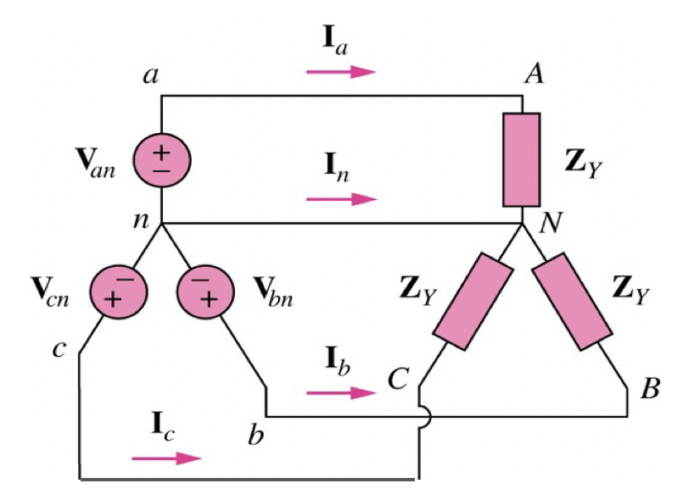
1) Balanced Why-why Connection
Which of the following expression(s) that apply to the three-phase circuit shown below,
$$V_{an} +V_{bn}+V_{cn}=0$$
$$I_{a}+I_{b}=I_{c}$$
$$V_{AN}+V_{BN}=V_{CN}$$
$$I_{a}=I_{b}=\frac{V_{AN}}{Z_{Y}}$$
None of the above

Slide 18
Which of the following expression(s) that apply to the three-phase circuit shown below,
$$V_{an} +V_{bn}+V_{cn}=0$$
$$I_{a}+I_{b}+I_{c}=0$$
$$V_{AN}+V_{BN}+V_{CN}=0$$
$$I_{a}=\frac{V_{AN}}{Z_{Y}}$$
All of the above

Slide 19
Which of the following expression(s) that apply to the three-phase circuit shown below,
$$V_{an} +V_{bn}−V_{cn}=0$$
$$I_{a}+I_{b}+I_{c}=0$$
$$V_{AN}−V_{BN}−V_{CN}=0$$
$$I_{c}=\frac{V_{CN}}{Z_{Y}}$$
All of the above

Slide 20
Which of the following expression(s) that apply to the three-phase circuit shown below,
$$I_{n}=0$$
$${−I}_{a}−I_{b}−I_{c}=0$$
$$I_{n}=−\left(I_{a}+I_{b}+I_{c}\right)$$
$$I_{a}=I_{b}=\frac{V_{AN}}{Z_{Y}}$$
All of the above

Slide 21
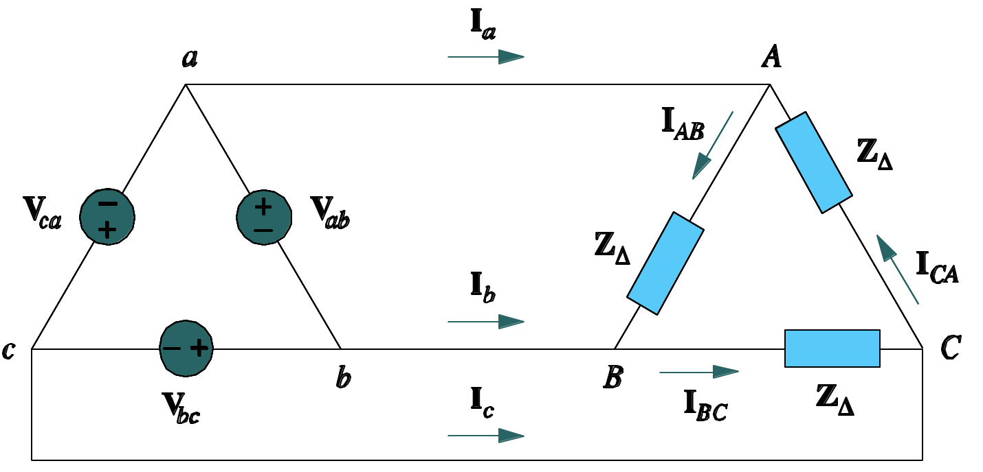
Which of the following expression(s) that apply to the three-phase circuit shown below,
$$I_{a}=\frac{V_{CA}}{Z_{∆}}$$
$$I_{AB}=−\frac{V_{AB}}{Z_{∆}}$$
$$I_{b}=\frac{V_{BC}}{Z_{∆}}$$
$$I_{a}= I_{AB}+I_{CA}$$
$$I_{b}= I_{BC}−I_{AB}$$
$$I_{c}= I_{CA}−I_{BC}$$
None of the above
$$I_{a}+I_{b}+I_{c}=0$$
$$I_{AB}+I_{BC}+I_{CA}=0$$

Slide 22
Which of the following expression(s) that apply to the three-phase circuit shown below,
$$I_{CA}=\frac{V_{CA}}{Z_{∆}}$$
$$I_{AB}=\frac{V_{AB}}{Z_{∆}}$$
$$I_{BC}=\frac{V_{BC}}{Z_{∆}}$$
$$I_{b}= I_{BC}−I_{AB}$$
$$I_{c}= I_{CA}−I_{BC}$$
All of the above
$$I_{a}+I_{b}+I_{c}=0$$
$$I_{AB}+I_{BC}+I_{CA}=0$$

Slide 23
Which of the following expression(s) that apply to the three-phase circuit shown below,
$$I_{CA}=−\frac{V_{CA}}{Z_{∆}}$$
$$I_{AB}=−\frac{V_{AB}}{Z_{∆}}$$
$$I_{c}= I_{CA}−I_{BC}$$
$$I_{b}= I_{BC}+I_{AB}$$
All of the above

Slide 24
Which of the following expression(s) that apply to the three-phase circuit shown below,
$$I_{a}=\frac{V_{CA}}{Z_{∆}}$$
$$I_{AB}=−\frac{V_{AB}}{Z_{∆}}$$
None of the above
All of the above
$$I_{a}+I_{b}+I_{c}=0$$

