Slide 1
Zero-Voltage Switching (ZVS)
Buck Converter

Slide 2
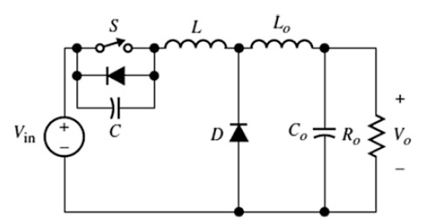
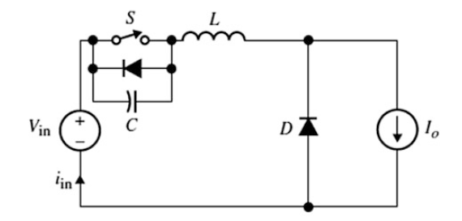
Quasi resonant buck converter
with M-type switch
Simplified equivalent circuit

Slide 3
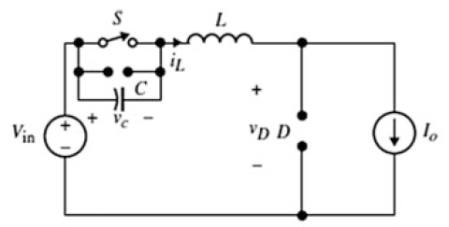
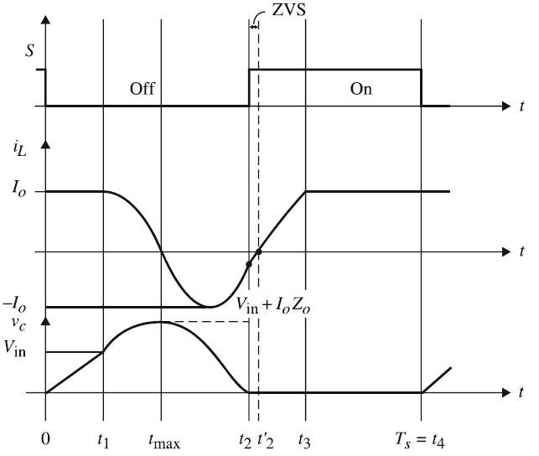
Mode 1 (0 ≤ t < t₁)
S: OFF
Initial Conditions:
Interval Equations:

Slide 4
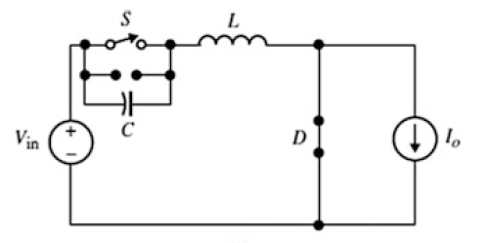
Mode 2 (t₁ ≤ t < t₂)
S: OFF
Initial Conditions:
D: ON
circuit enters the resonant stage
Interval Equations:
inductor current is zero when the capacitor voltage reaches the peak
capacitor starts discharging while the inductor current is a negative
inductor current reaches the peak when the capacitor drops to the input voltage

Slide 5
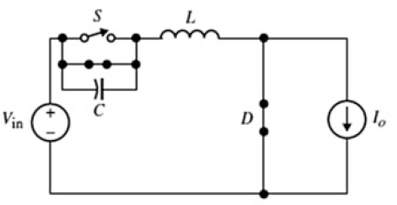
Mode 3 (t₂ ≤ t < t₃)
S: ON
After t₂ and before t₂'
Initial Conditions:
Interval Equations:
At t=t₃, the inductor current reaches the output current it forces the diode to turn off.

Slide 6
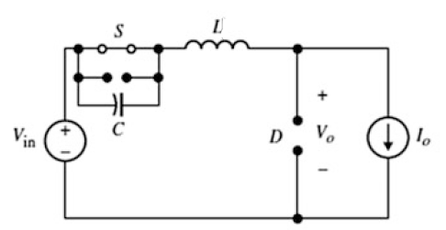
Mode 4 (t₃ ≤ t < t₄)
S: ON
Initial Conditions:
Interval Equations:
Mode 4 will continue as long as the switch remains ON
At t=t₄=Ts, the switching cycle repeats

Slide 7
Zero-Voltage Switching (ZVS)
Boost Converter

Slide 8
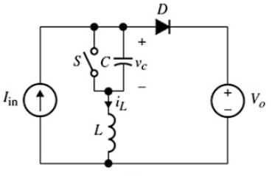
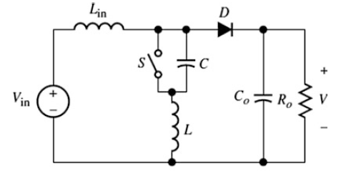
Quasi resonant boost converter
with M-type switch
Simplified equivalent circuit

Slide 9
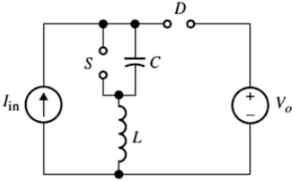
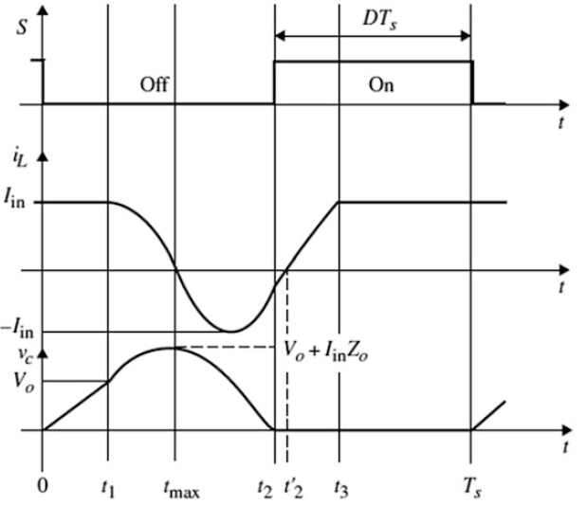
Mode 1 (0 ≤ t < t₁)
S: OFF
Initial Conditions:
Interval Equations:

Slide 10
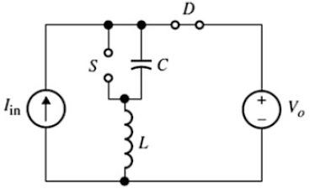
Mode 2 (t₁ ≤ t < t₂)
S: OFF
Initial Conditions:
D: ON
Circuit enters the resonant stage
Interval Equations:

Slide 11
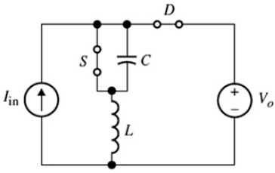
ZVS
Mode 3 (t₂ ≤ t < t₃)
S: ON
After t₂ and before t₂'
Initial Conditions:
Interval Equations:

Slide 12
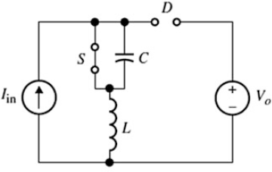
Mode 4 (t₃ ≤ t < t₄)
S: ON
Initial Conditions:
Interval Equations:

Slide 13
Zero-Voltage Switching (ZVS)
Buck-Boost Converter

Slide 14
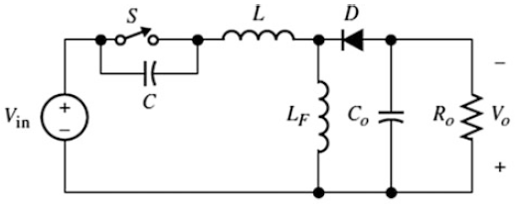
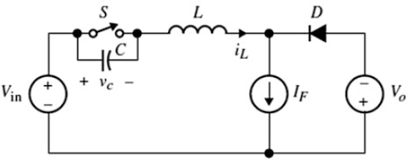
Quasi resonant Buck-Boost converter
with M-type switch
Simplified equivalent circuit

Slide 15
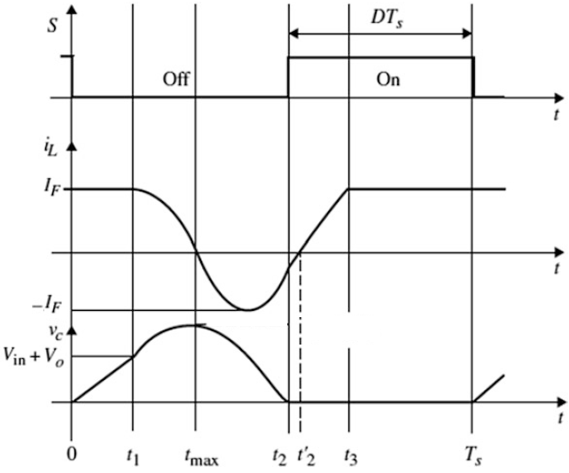
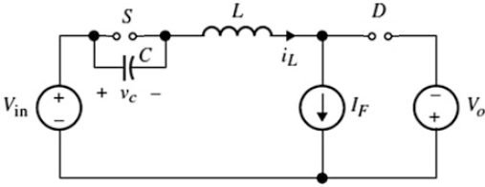
Mode 1 (0 ≤ t < t₁)
S: OFF
Initial Conditions:
Interval Equations:

Slide 16
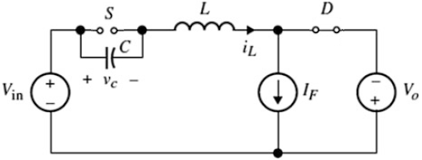
Mode 2 (t₁ ≤ t < t₂)
S: OFF
Initial Conditions:
D: ON
Circuit enters the resonant stage
Interval Equations:

Slide 17
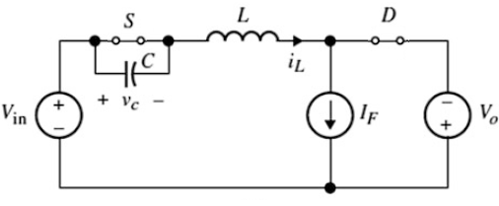
ZVS
Mode 3 (t₂ ≤ t < t₃)
S: ON
After t₂ and before t₂'
Initial Conditions:
Interval Equations:

Slide 18
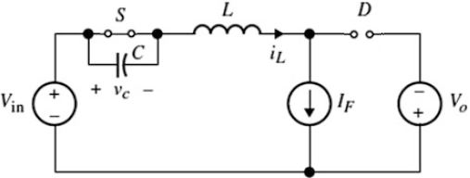
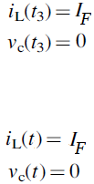
Mode 4 (t₃ ≤ t < t₄)
S: ON
Initial Conditions:
Interval Equations:

