Slide 1
EEL 646 POWER ELECTRONICS II Zero-Voltage Trasition (ZVT): Buck and Buck-Boost
Lecture 8

Slide 2
Agenda
Example of Steady-State Analysis of Zero-Voltage Transition (ZVT) of buck and buck-boost
Application of Zero-Voltage Transition (ZVT): Bidirectional Buck-Boost Converter

Slide 3
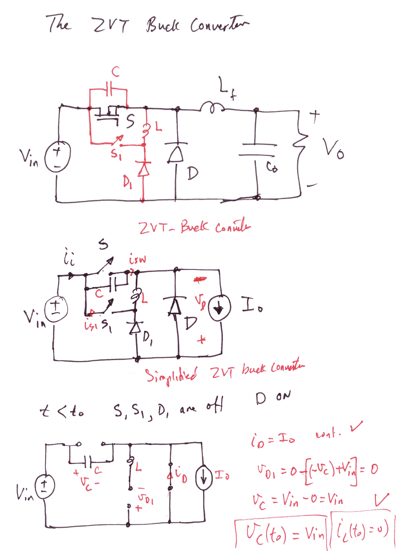

Slide 4
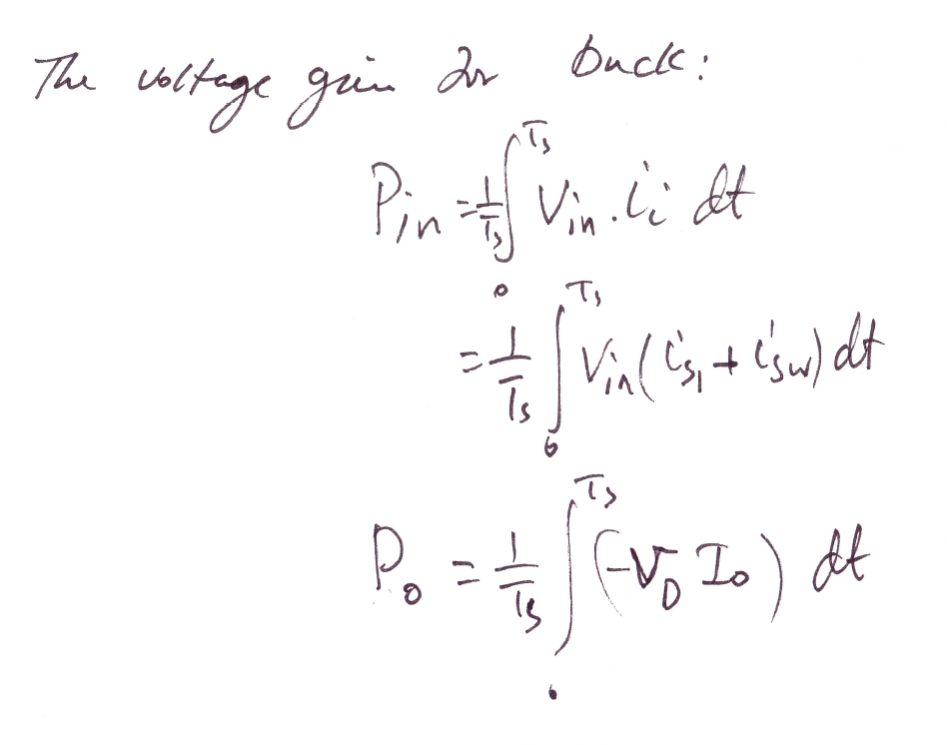

Slide 5
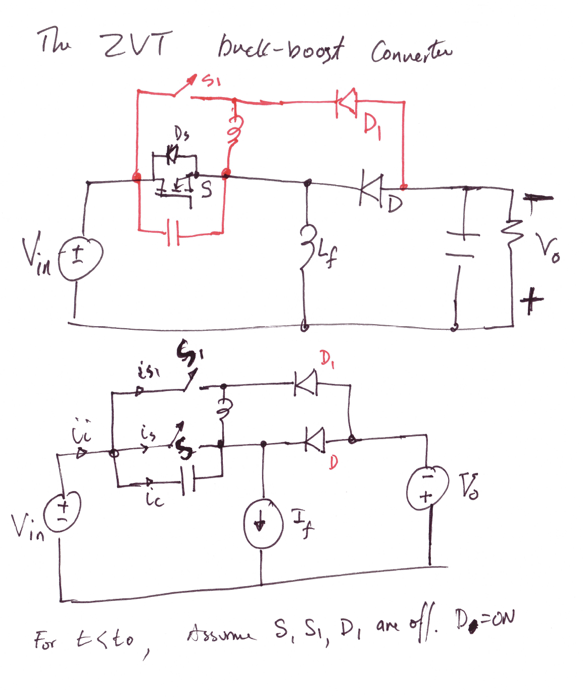

Slide 6
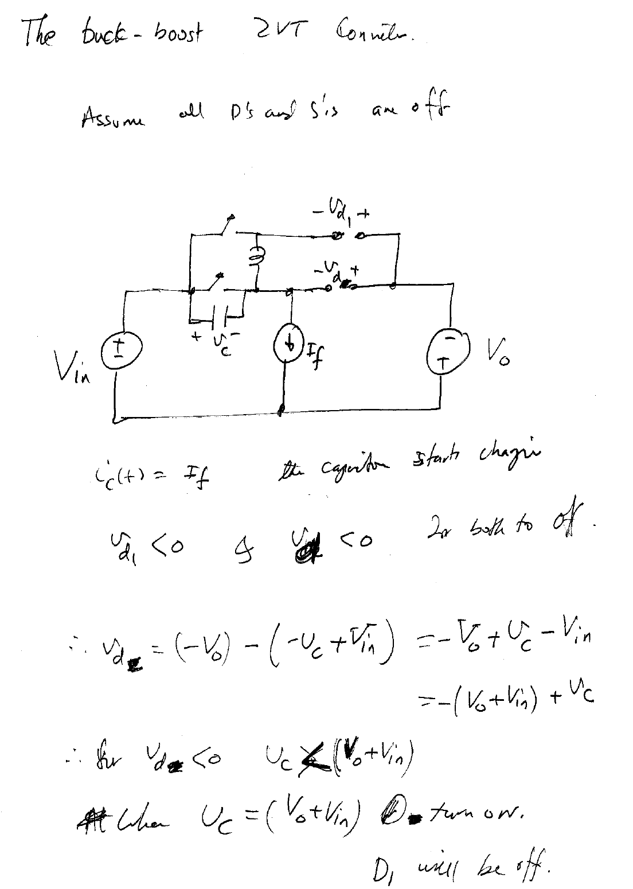

Slide 7
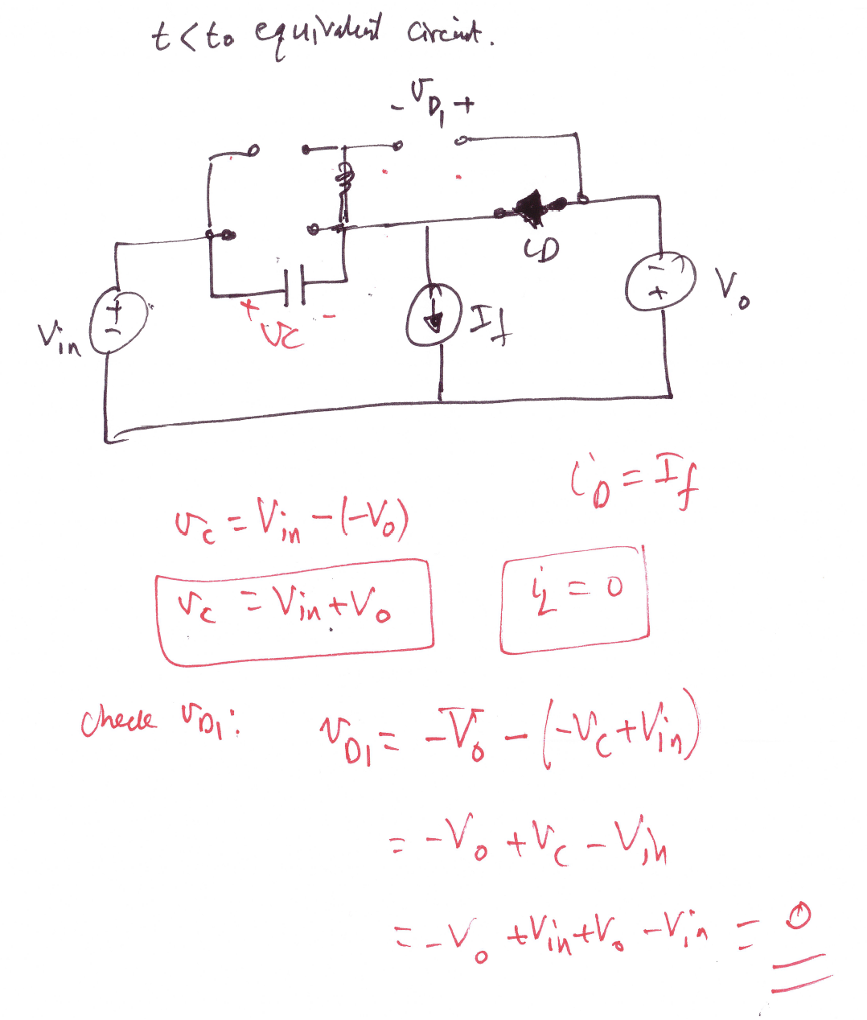

Slide 8
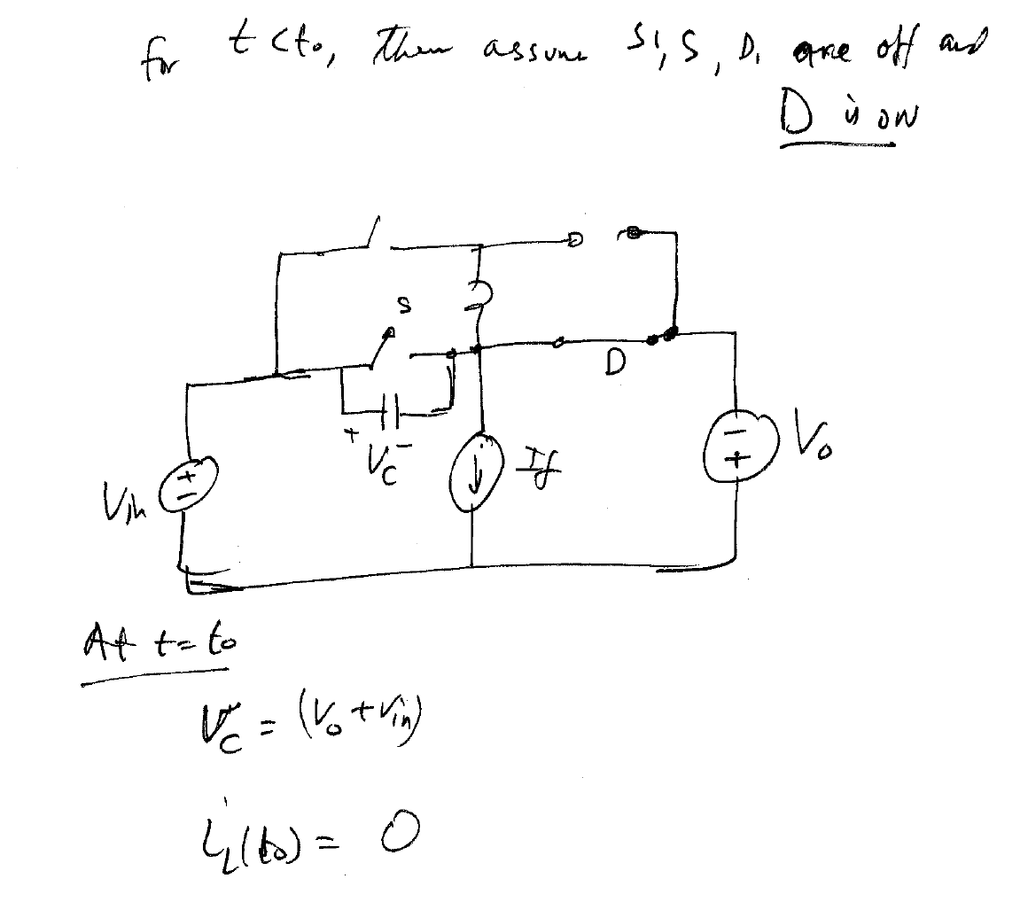

Slide 9
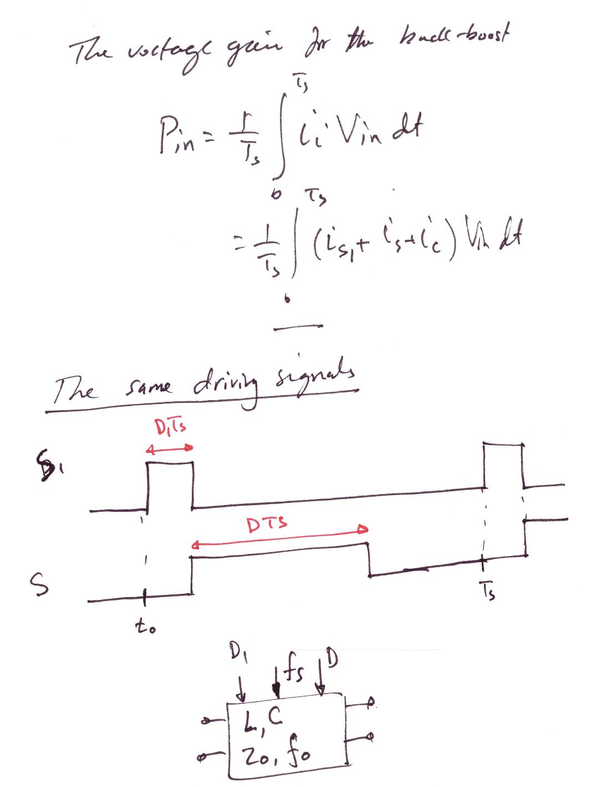

Slide 10
Applications of ZVT

Slide 11
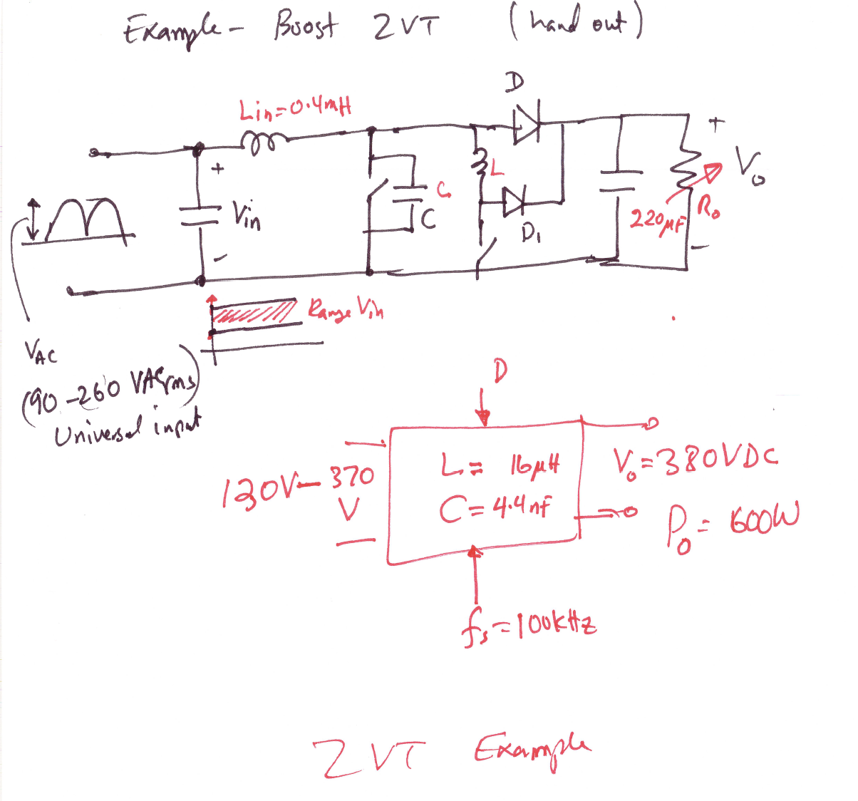

Slide 12
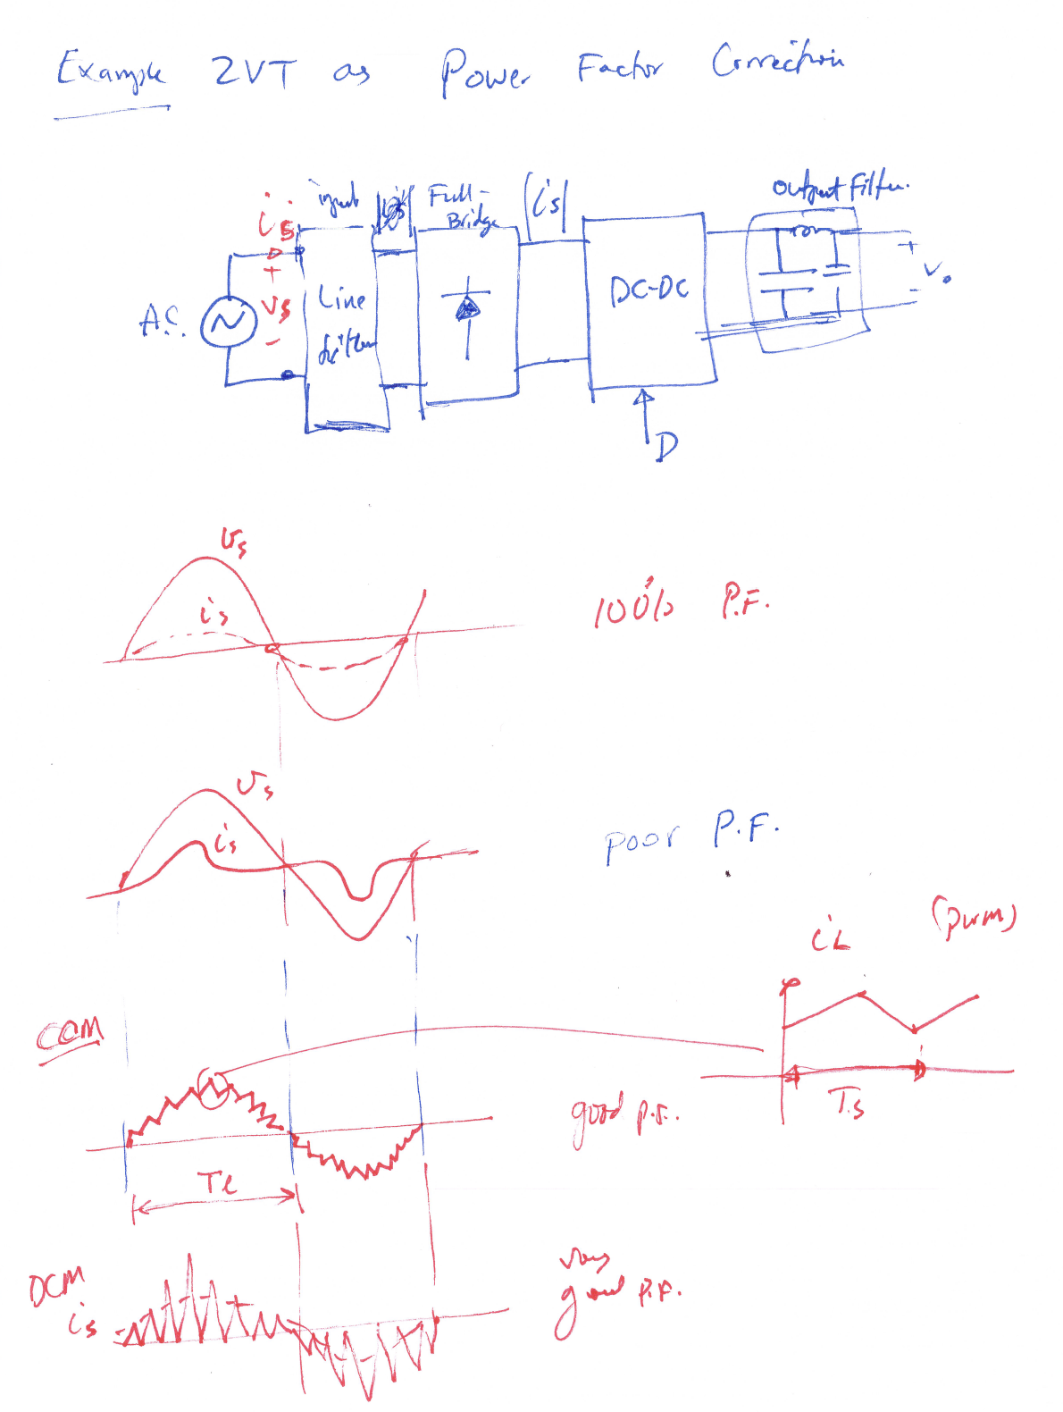

Slide 13
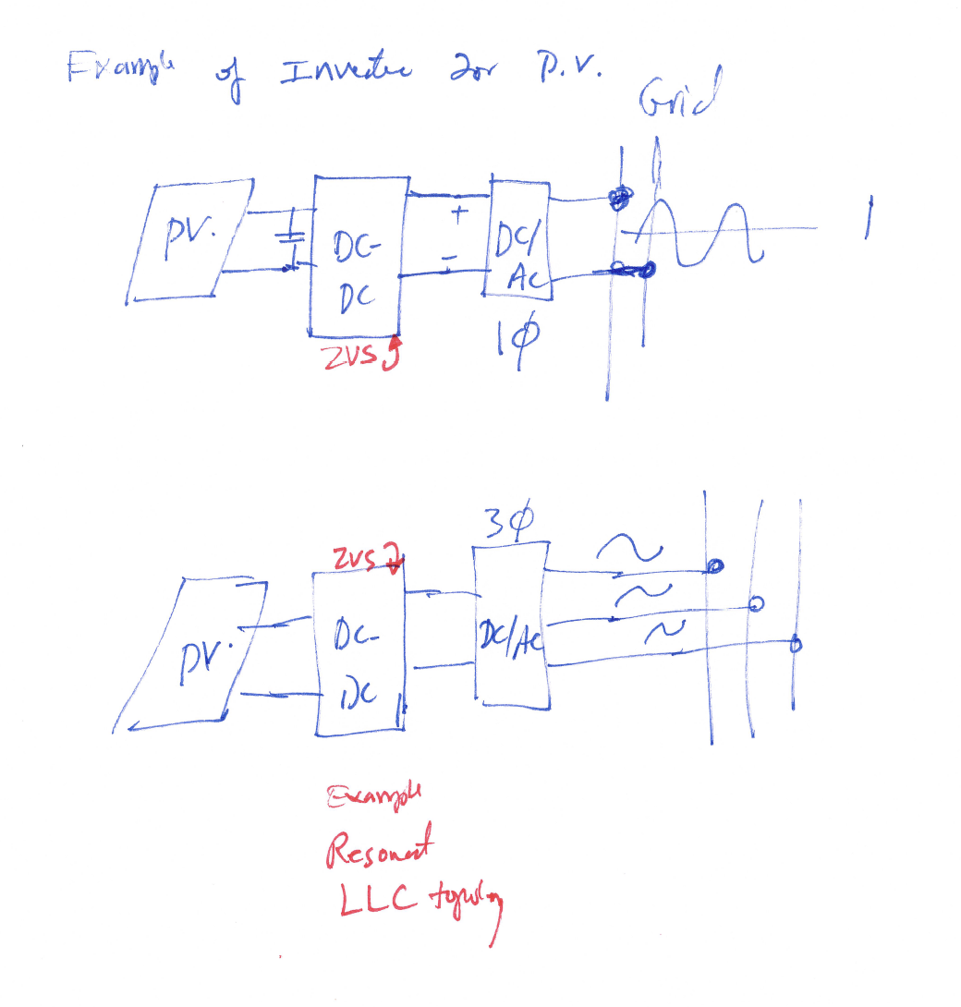

Slide 14
Application of ZVT
Bidirectional Buck-Boost Converter

Slide 15
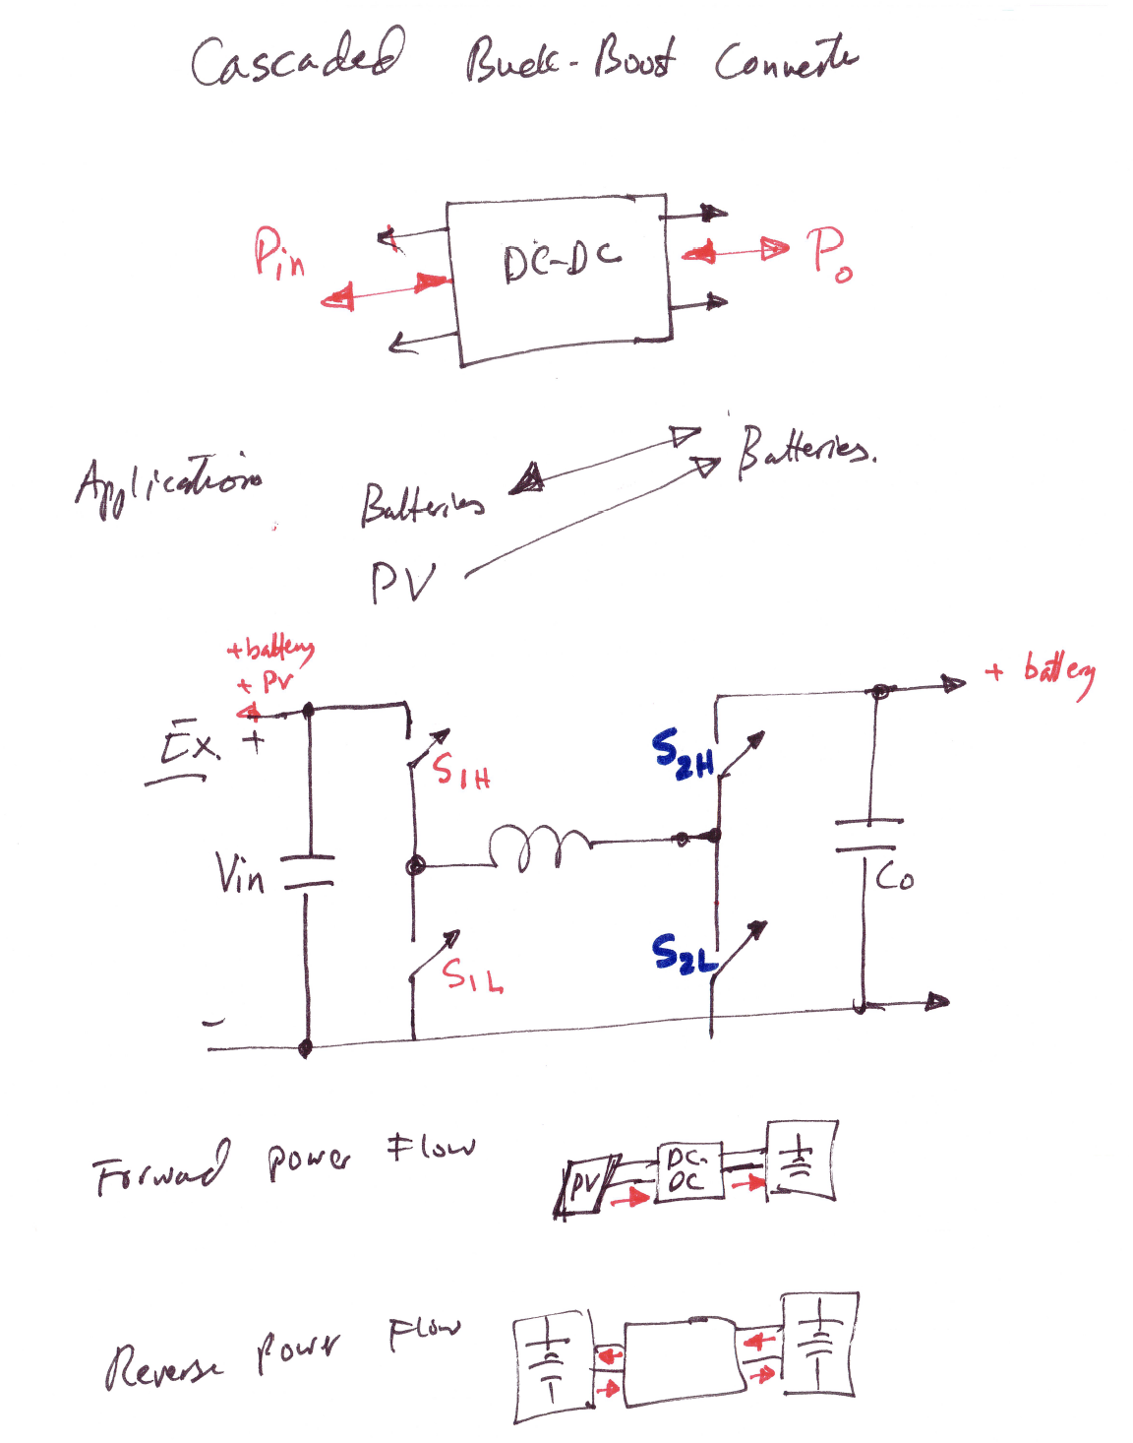

Slide 16
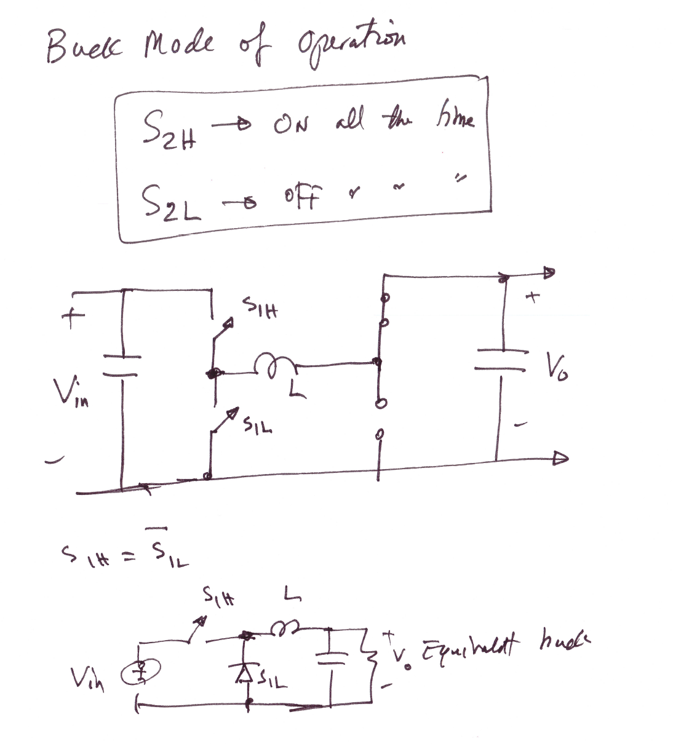

Slide 17
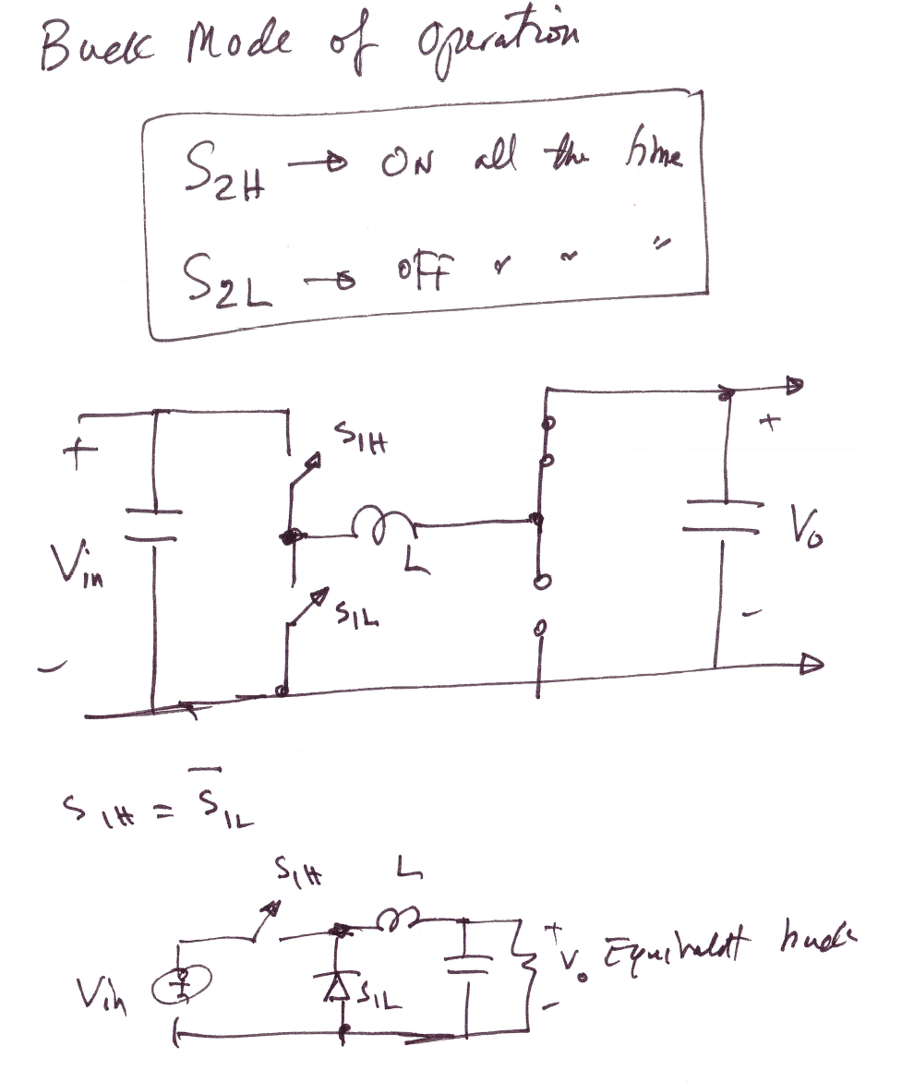

Slide 18
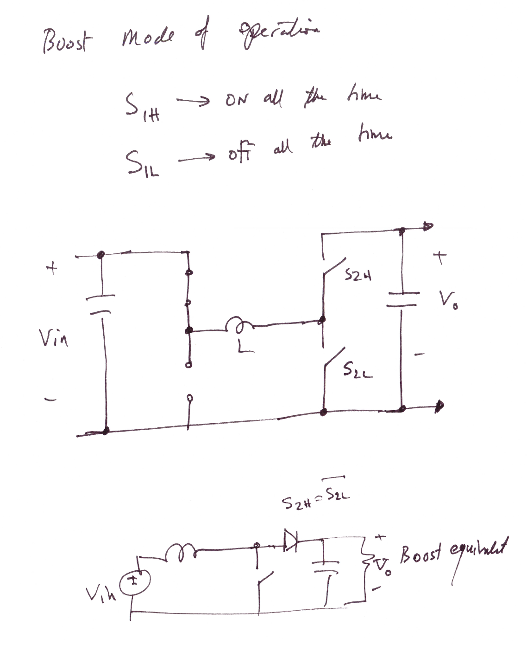

Slide 19
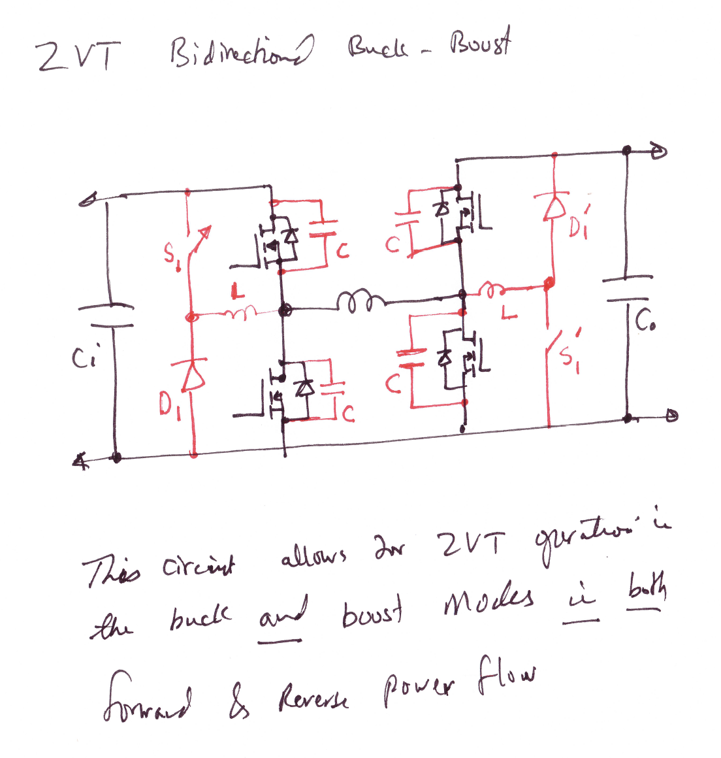

Slide 20
