Slide 1
EEL 3004 Electrical Networks Lecture #6 Simple Circuit Analysis Voltage and Current Division Formulas & Delta and Wye Connection

Slide 2
Simple Circuit Analysis Techniques
Chapter Three
Chapter Outline
Introduction
3.1 Analysis of Single-Loop Circuits
3.2 Analysis of Single-Node-Pair Circuits
3.3 Voltage and Current Division
3.4 Intuitive Analysis Method: Circuit Reduction
3.5 Voltage and Current Source Transformation

Slide 3
Lecture Objectives
The lecture today will focus on Sections 3.3 and 3.4:
* Present two simple, but important, formulas:
Voltage Division
Current Division
* Two simple practical analysis methods:
Intuitive Method: Circuit Reduction
Delta and Wye Connection

Slide 4
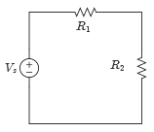
Voltage Division
When do we apply voltage division?
Two conditions must be met:
All the resistors being used in the formula have the same currents.
AND
The voltage being divided is applied across all the resistors used in the division formula.
Simple circuit with two resistors in series

Slide 5
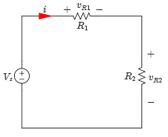
Voltage Division
When do we apply voltage division?
Two conditions must be met:
All the resistors being used in the formula have the same currents.
AND
The voltage being divided is applied across all the resistors used in the division formula.
The voltage across a given resistor is equal to that resistor divided by the total of series-connected resistors multiplied by the applied voltage.
Simple circuit with two resistors in series

Slide 6
Voltage Division
Assuming the following current direction and voltage polarities,
Applying KVL to the circuit below,
Apply Ohm’s law:
Simple circuit with two resistors in series

Slide 7
Voltage Division
Solving for i yields,
Therefore, v_{R1} and v_{R2} are given by,
Simple circuit with two resistors in series

Slide 8
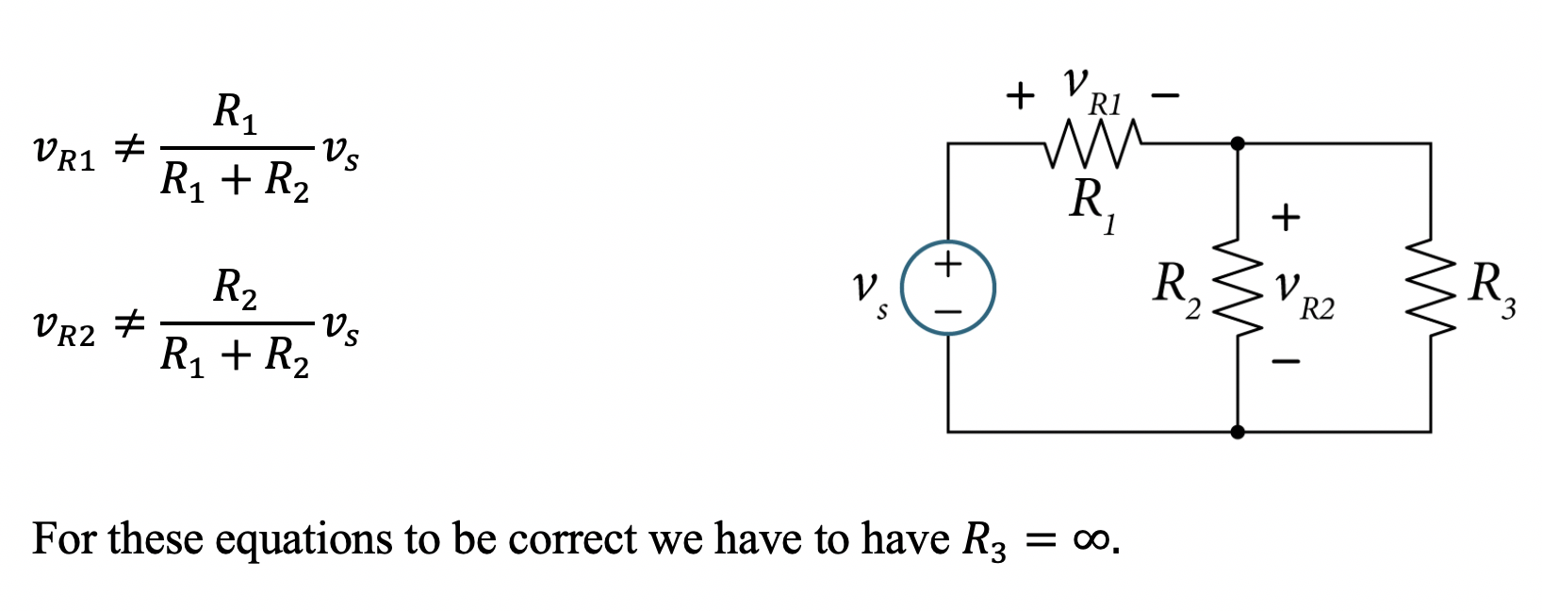
Invalid Examples of Voltage Division

Slide 9
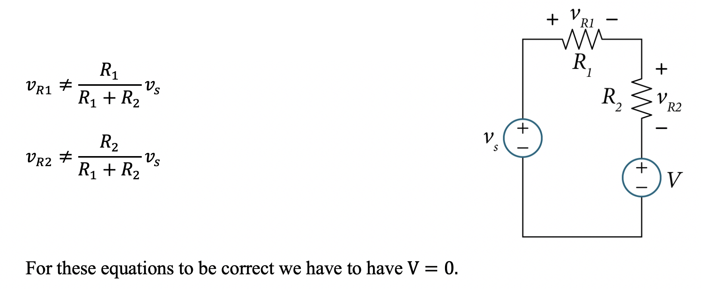
Invalid Examples of Voltage Division

Slide 10
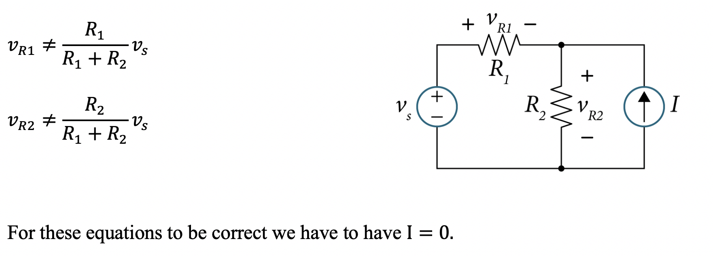
Invalid Examples of Voltage Division

Slide 11
Voltage Division Formula
In series-connected resistors, the voltage across a given resistor is equal to that resistor divided by the total of series-connected resistors multiplied by the total voltage across the total of series-connected resistors.
Simple circuit with two resistors in series

Slide 12
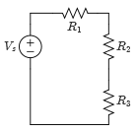
Example
For the circuit given, find the voltages across the resistors by using the voltage division formula.
Values:
Circuit with three resistors in series
Variable | Default | Unit
V_{s} | 18 | V
R₁ | 5 | Ω
R₂ | 10 | Ω
R₃ | 15 | Ω

Slide 13
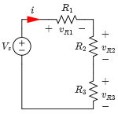
Example
Standard Solution – Using KVL in a Single-Loop
Assume the direction of the current and voltage polarities shown, because the current in each resistor is the same then,
Applying KVL to the loop yields,
Solving for i yields,
Assigning current direction and voltage polarities

Slide 14
Example
Therefore, the voltages across the resistors are given by,
Assigning current direction and voltage polarities

Slide 15
Example
Short Cut Solution – Direct application of voltage division formula:
Check:

Slide 16
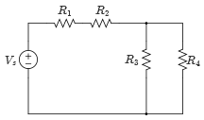
Example
Use voltage division to find the voltage across each resistor in the circuit.
Values:
Single-Loop circuit
Variable | Default | Unit
V_{s} | 18 | V
R₁ | 25 | kΩ
R₂ | 5 | kΩ
R₃ | 10 | kΩ
R₄ | 10 | kΩ

Slide 17
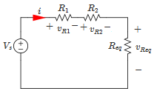
Example
Solution:
The circuit can be redrawn as an equivalent circuit with three series resistors,
Applying the voltage division formula,
Equivalent circuit with assigned current and voltages

Slide 18
Example
Because R₃ and R₄ are in parallel,
Equivalent circuit with assigned current and voltages

Slide 19
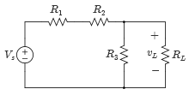
Design Example
Consider the circuit given, select a value for the load resistor, R_{L}, so that its voltage, v_{L}, becomes 0.5V_{S} =0.5x10=5V.
Values:
Circuit with load resistance
Variable | Default | Unit
V_{S} | 10 | V
R₁ | 5 | Ω
R₂ | 10 | Ω
R₃ | 20 | Ω

Slide 20
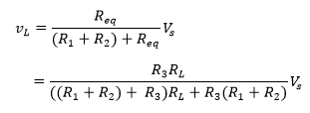
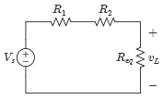
Example
Solution:
To solve for v_{L}, resistors R₃ and R_{L} are combined in parallel,
Apply the voltage division formula as follows, and substitute R_{eq},
Equivalent circuit

Slide 21
Example
Solution:
Set v_{L} = 0.5V_{S}, and solve for R_{L},
Equivalent circuit

Slide 22
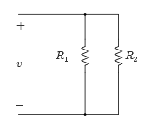
Current Division
To apply current division make sure that the resistors being used all have the same voltage across.
Current division gives you a simple method to find the current in single node-pair circuits.
Two resistors in parallel

Slide 23
Current Division
Current division is not as simple as voltage division, to make the equations for current division simpler, resistance is expressed in terms of its conductance values.
Consider the circuit below,
i_{s}
i_{R1}
i_{R2}
Two resistors in parallel
What fraction of i_{s} flows in each resistor?

Slide 24
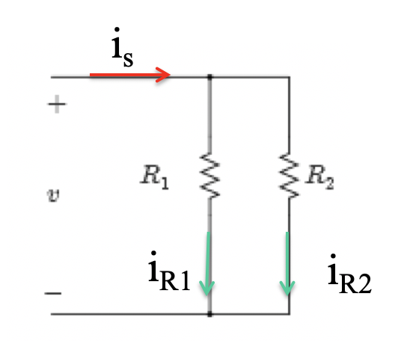
Current Division
Current division is not as simple as voltage division, to make the equations for current division simpler, resistance is expressed in terms of its conductance values.
Consider the circuit below,
Check: i_{s}=i_{R1}+i_{R2}
Two resistors in parallel
What fraction of i_{s} flows in each resistor?

Slide 25
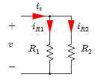
Current Division
We assign current directions as shown, because the voltage across each resistor in the parallel-connected resistors is v,
Applying KCL at the upper node connects all the resistors to yield
Current directions assigned

Slide 26
Current Division
Substitute for v, and solve for i_{R1} and i_{R2}, respectively,
Current directions assigned

Slide 27
Current Division
Direct application of current division formula:
Check: i_{s}=i_{R1}+i_{R2}

Slide 28
Current Division
The equations of i_{R1} and i_{R2} consist of dividing the reciprocals of resistors.
Therefore, some test tools use the conductance, G, to express the current division formulas as shown,
Where,
Current directions assigned

Slide 29
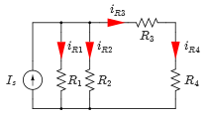
Example
Use the current division method to find the current in each resistor in the circuit given.
Values:
Circuit with load resistance
Variable | Default | Unit
I_{S} | 12 | A
R₁ | 10 | Ω
R₂ | 20 | Ω
R₃ | 14 | Ω
R₄ | 16 | Ω

Slide 30
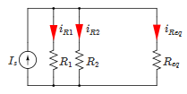
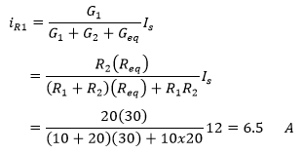
Example
Solution:
First, combine R₃ and R₄ in series,
Applying the current division formula,
Equivalent circuit

Slide 31
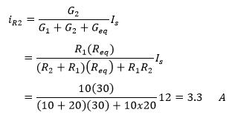
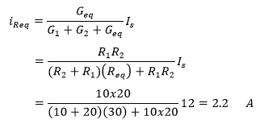
Example
Equivalent circuit
?
Check: 6.5+3.3+2.2= 12 A = Is

Slide 32
Example
Where,
The currents in R₃ and R₄ are equal to the current passing through the resistor R_{eq} as follows,
Equivalent circuit

Slide 33
Design Example
Consider the circuit given, select the value for the load resistor, R_{L}, so that its current, i_{L}, becomes I_{S} =0.5I_{S} (the load current is at 50% of Is).
Values:
Circuit with load resistance
Variable | Default | Unit
I_{S} | 12 | A
R₁ | 20 | kΩ
R₂ | 20 | kΩ
R₃ | 8 | kΩ

Slide 34
Example
Solution:
First, combine R₁ and R₂ in parallel as shown,
Equivalent circuit

Slide 35
Example
Solution:
Also combine the resistors R₃ and R_{L} in series as shown below, now we can apply the current division rule as follows,
Set i_{L} = 0.5I_{S}, and solve for R_{L}
Equivalent circuit

Slide 36
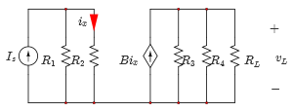
Example
Find the voltage across the load resistor v_{L} for the circuit using current division.
Values:
Variable | Default | Unit
I_{S} | 4 | A
R₁ | 5 | Ω
R₂ | 10 | Ω
R₃ | 10 | Ω
R₄ | 20 | Ω
R_{L} | 10 | Ω
β | 2 | -
Circuit with load resistance

Slide 37
Example
Find the voltage across the load resistor v_{L} for the circuit using current division.
Values:
Variable | Default | Unit
I_{S} | 4 | A
R₁ | 5 | Ω
R₂ | 10 | Ω
R₃ | 10 | Ω
R₄ | 20 | Ω
R_{L} | 10 | Ω
β | 2 | -
i=?
Circuit with load resistance

Slide 38
Example
Find the voltage across the load resistor v_{L} for the circuit using current division.
Values:
Variable | Default | Unit
I_{S} | 4 | A
R₁ | 5 | Ω
R₂ | 10 | Ω
R₃ | 10 | Ω
R₄ | 20 | Ω
R_{L} | 10 | Ω
β | 2 | -
i=?
Circuit with load resistance

Slide 39
Example
Solution:
The current passing through resistor R₂,
Using the current division formula,
the voltage across the load resistor, v_{L},
Circuit with load resistance

Slide 40
1752
Benjamin Franklin conducts famous ‘kite experiment’ to study electricity
Benjamin Franklin – American Scientist and Inventor
(1706 - 1790)
Benjamin Franklin, one of the founding fathers, won great fame for his study of electricity. He developed the theory of ‘positive’ and ‘negative’ electricity, showed the effect of pointed bodies in drawing off electricity, studied the identity of lightning and electricity, and recognized the potential of using iron rods to protect buildings. His famous kite and key experiment drew down electricity from the clouds and charged a Leyden jar.

Slide 41
Intuitive Method: Circuit Reduction
Reduce the number of components to an equivalent simplified circuit.
The final number of nodes and loops are significantly reduced.
Elements with currents and voltages of interest are left alone as given in the original circuit.
Does not follow a specific procedure, but rather depends on experience.

Slide 42
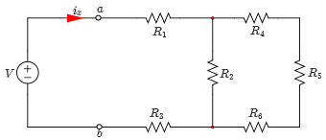
Example
Use the circuit reduction method to find the current i_{x} shown in the circuit.
Values:
Resistive circuit
Variable | Default | Unit
V | 18 | V
R₁ | 5 | kΩ
R₂ | 3 | kΩ
R₃ | 8 | kΩ
R₄ | 4 | kΩ
R₅ | 7 | kΩ
R₆ | 11 | kΩ

Slide 43
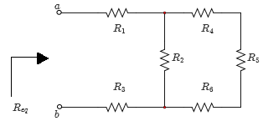
Example
Solution:
To find the current i_{x}, find the equivalent resistance as seen from terminals “a” and “b” as shown,
Circuit with load resistance

Slide 44
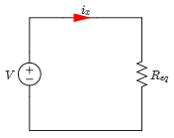
Solution (con’d)
The circuit below shows the equivalent circuit after replacing all the resistors with one resistor R_{eq},
Thus,
Circuit with load resistance

Slide 45
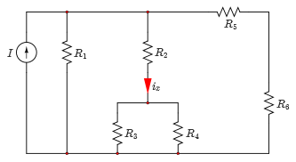
Example
Use the circuit reduction method to find the current i_{x} shown in the circuit.
Values:
Resistive circuit
Variable | Default | Unit
I | 8 | A
R₁ | 10 | Ω
R₂ | 10 | Ω
R₃ | 20 | Ω
R₄ | 20 | Ω
R₅ | 15 | Ω
R₆ | 25 | Ω

Slide 46
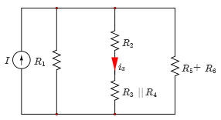
Example
Solution:
Because the current of interest is in the middle of the circuit, you combine the resistors in such a way that the R₂ branch always remains by itself in the reduced circuit.
By combining R₃ and R₄ in parallel and R₅ and R₆ in series,
Reducing the circuit

Slide 47
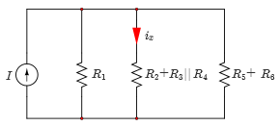
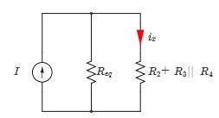
Example (Solution-cont’d)
Then you combine R₂ in series with (R₃//R₄).
Then, R₁ is combined in parallel with (R₅+R₆) as shown
Reducing the circuit
Reducing the circuit

Slide 48
Example (Solution-cont’d)
Now you apply current division to solve for i_{x} to yield,
Reducing the circuit

Slide 49
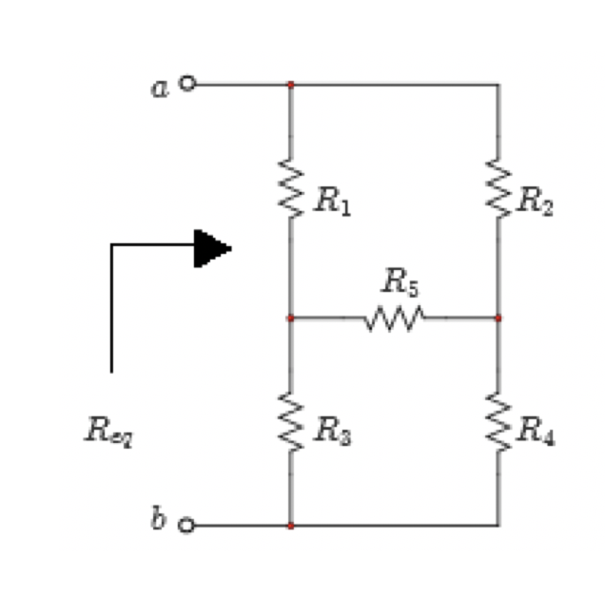
Example - Combining Resistors
What is the equivalent resistance seen between terminals “a” and “b?
Req ?

Slide 50
Example - Combining Resistors
What is the equivalent resistance seen between terminals “a” and “b?
Req ?
None of the resistors are in series or in parallel !!!

Slide 51
Example - Combining Resistors
One way to find the resistance between “a” and “b” is to set-up an experiment in the lab and apply a battery across terminals “a” and “b”:
Step 1: Measure I
Step 2: Since you know V, then carry out Ohm’s Law
$$R_{eq}=\frac{V}{i}$$
None of the resistors are in series or in parallel !!!

Slide 52
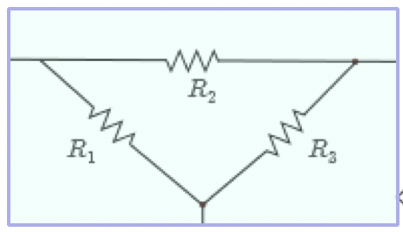
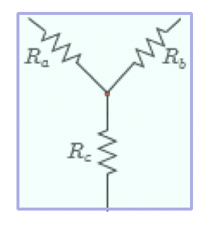
Delta and Wye Connections
In some resistor circuits, none of the resistors can be combined either in series or in parallel.
Wye and delta circuit interconnections are the most common configurations where resistors cannot be simplified by simple series or parallel.
Delta (△)
Wye (Y)

Slide 53
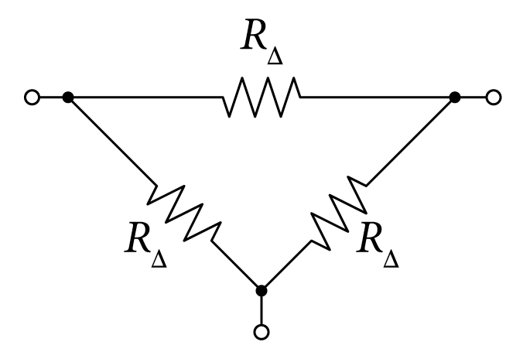
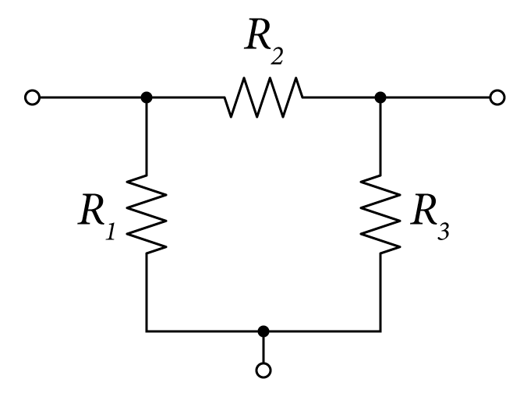
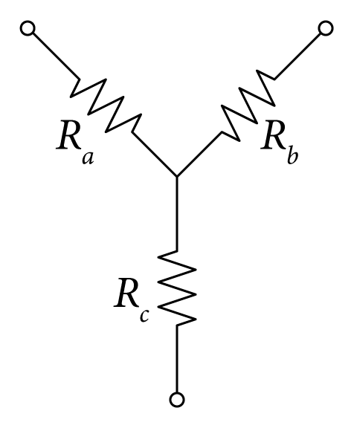
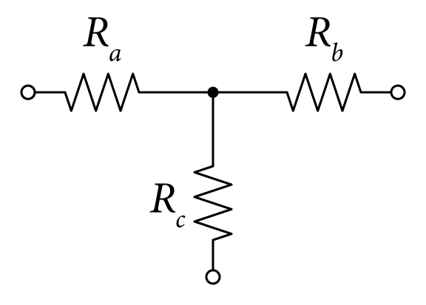
Delta and Wye Connections
Other configuration of Wye and delta circuit interconnections:
Delta (△)
Wye (Y)

Slide 54
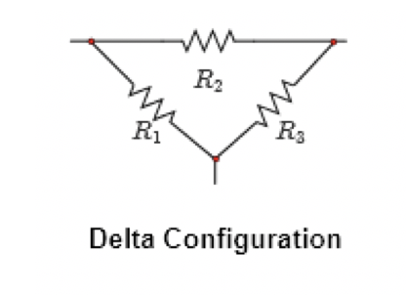
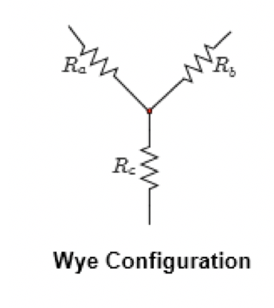
Delta and Wye Connection
In these two cases, we use a method known as the delta-to-wye (∆ Y) and wye-to-delta (Y ∆) transformations.
Circuit Transformation

Slide 55
Delta and Wye Transformation
Wye and delta circuit interconnections can be transformed from one configuration to the other by properly adjusting their resistor values.
To transform the ∆ configuration to Y configuration, you use the following relations:
∆→Y and Y→∆ transformation

Slide 56
Delta and Wye Connection
If all resistors in a given structure are equal as shown, then the transformation equations are simplified as follows:
∆→Y and Y→∆ transformation

Slide 57
The most Common Connection – The Bridge Circuit
For example, for the circuit shown, we are interested in finding the total equivalent resistance R_{eq} between terminals a and b.
No possible combination of resistors is allowed

Slide 58
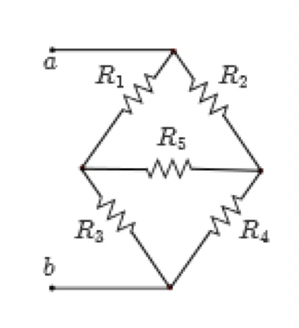
Delta Connection
Notice that there are two possible ways to from Delta connections as shown.
1) Delta 1: Resistors R1, R2, and R5
2) Delta 2: Resistors R3, R4, and R5

Slide 59
Delta Connection
Notice that there are two possible ways to from Wye connections as shown.
1) Wye 1: Resistors R2, R4, and R5
2) Wye 2: Resistors R1, R3, and R5

Slide 60
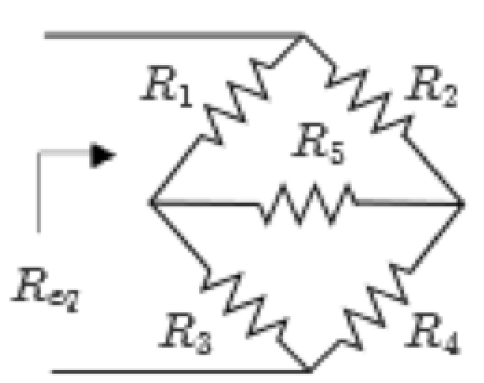
Example
Consider the problem of finding R_{eq} for the circuit shown:

Slide 61
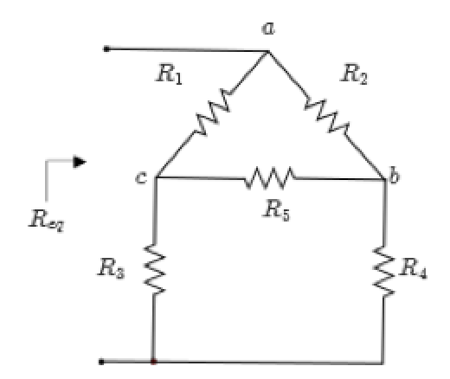
Example (solution)
Solution (A) – Use the upper ∆ to Y transformation):
Consider transforming the ∆ configuration formed by resistors R₁, R₂, and R₅ as shown:
Resistive circuit

Slide 62
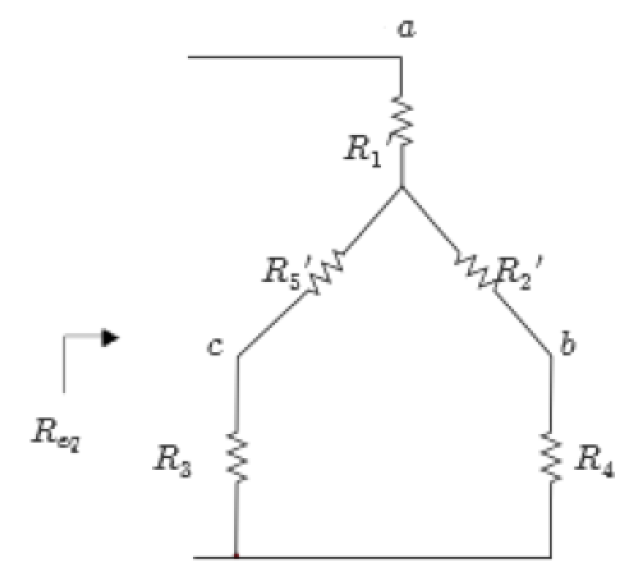
Example (solution-cont’d)
From the ∆-to-Y transformation equations come the following equations:

Slide 63
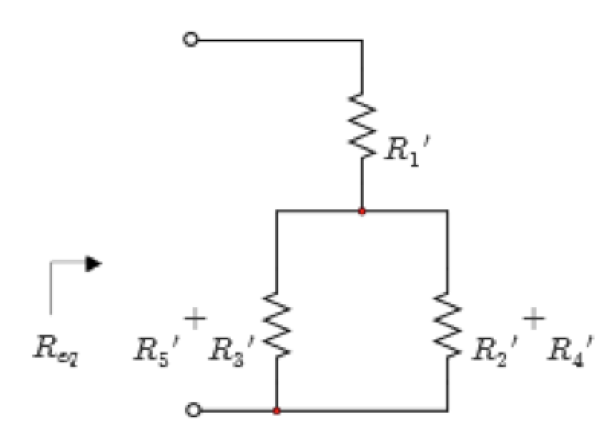
Example (solution-cont’d)
From the ∆-to-Y transformation equations come the following equations:

Slide 64
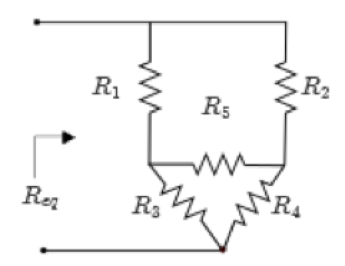
Example (solution-cont’d)
Solution (B) Use the lower ∆ to Y transformation):
Consider transforming the ∆ configuration formed by resistors R₃, R₄, and R₅ as shown;
Resistive circuit

Slide 65
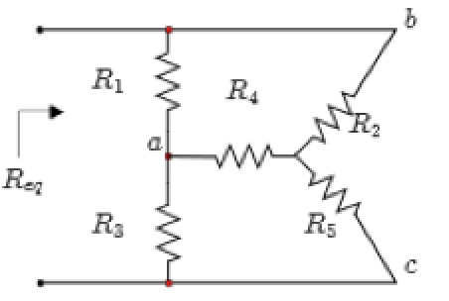
Example 3 (solution-cont’d)
Solution (C) - Use the right Y to ∆ transformation):
Consider transforming the Y configuration formed by resistors R₂, R₄, and R₅ as shown:
Resistive circuit

Slide 66
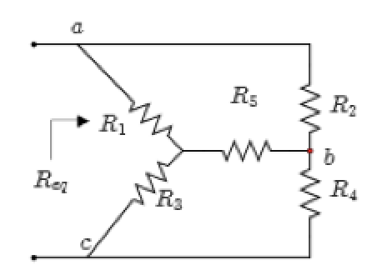
Example (solution-cont’d)
Solution (D) – Use the left Y to ∆ transformation):
Consider transforming the Y configuration formed by resistors R₁, R₃, and R₅ as shown:
Resistive circuit

Slide 68
$$i$$
In another words find i first then find $P_{s}$
$$P_{s}=\frac{V_{s}}{i}$$

Slide 69
$$i$$
In another words find i first then find $P_{s}$
$$P_{s}=\frac{V_{s}}{i}$$
Dr. Batarseh’s Pearson eText – Copy Rights Protected

Slide 70
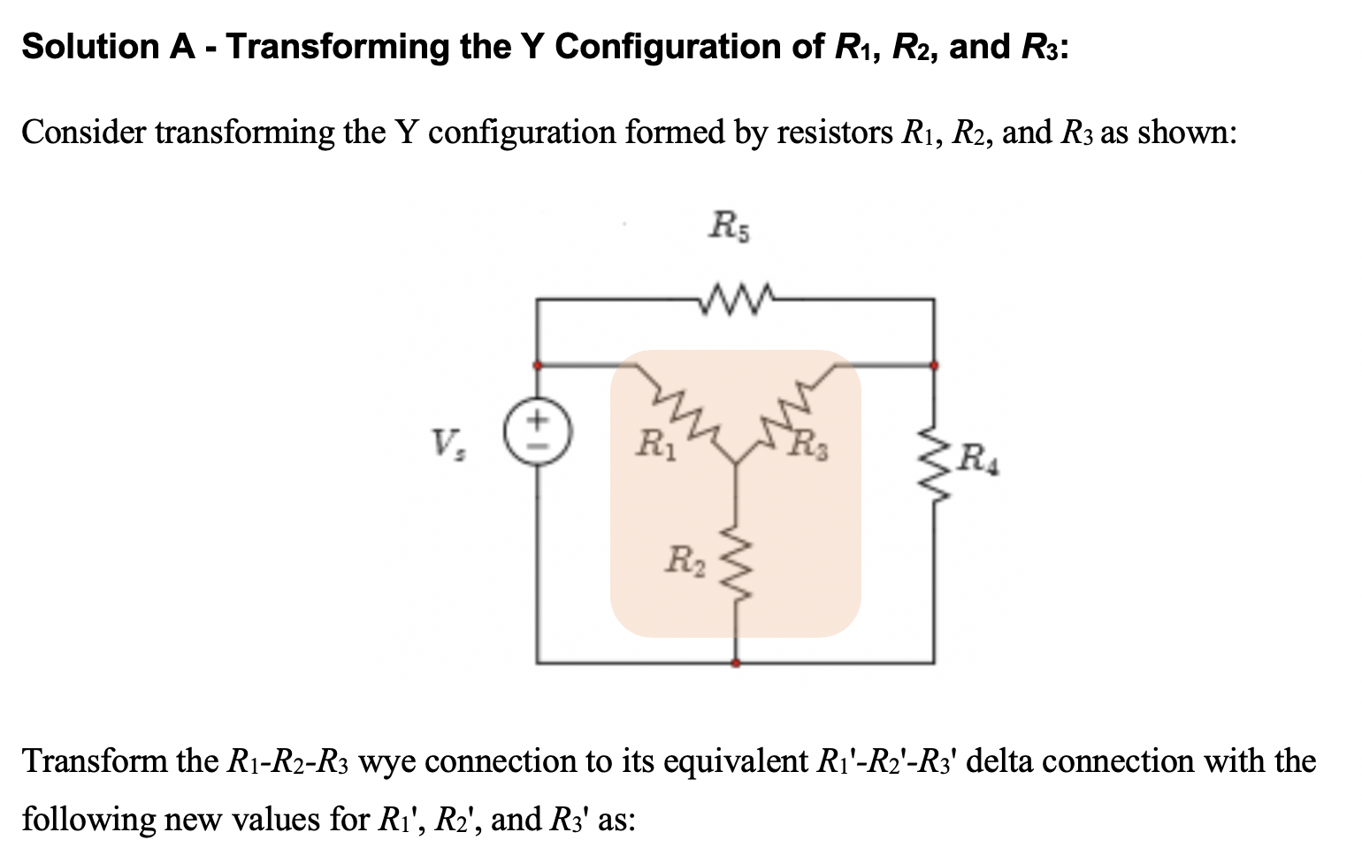
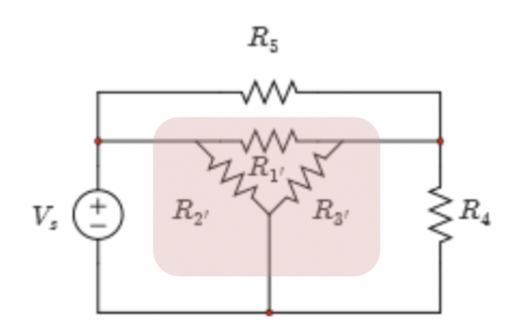

Slide 71
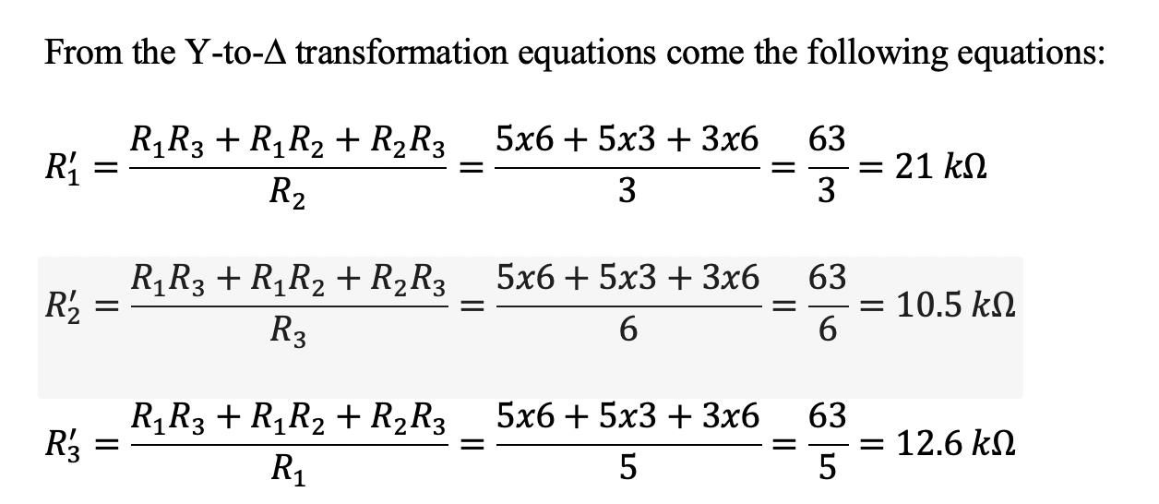
Redrawn as follows:

Slide 72
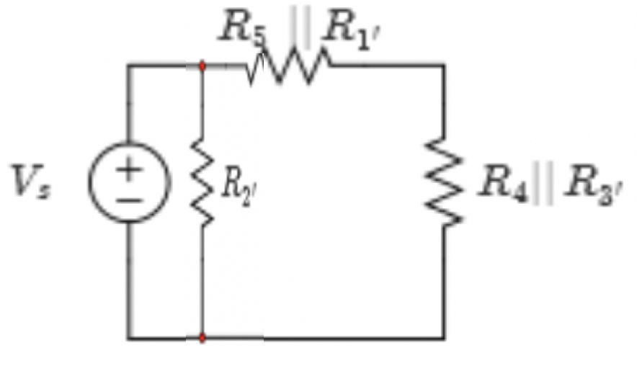
Next, combine R₁' and R₅ in parallel and R₃' and R₄ also in parallel as shown:
Finally, $R_{eq}$ is obtained by combining the two resistors of Figure 3.58(d) in series to yield
$$R_{eq}={(R}_{1}^{′}//R_{5}+R_{3}^{′}//R_{4})//R_{2}^{′}=(21//10+12.6//4)//10.5.$$
$$=(6.774+3.036)//10.5=9.81//10.5=5.1 kΩ$$

Slide 73
The total power defined by the voltage source v_{s} is given by,
$$P_{total}=\frac{V_{s}^{2}}{R_{eq}}= \frac{{10}^{2}}{5.1}=19.61 mW$$

Slide 74
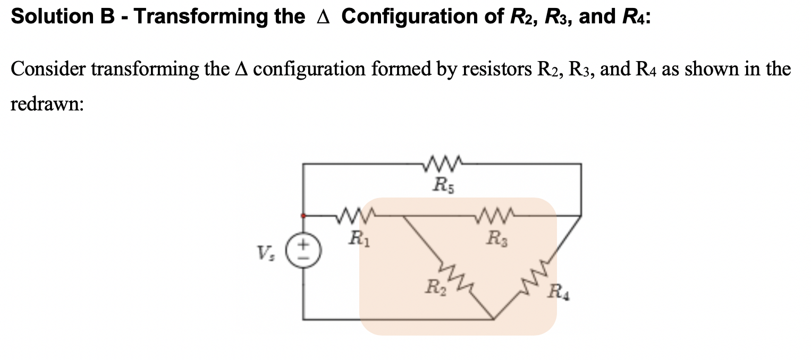

Slide 75
From the ∆-to-Y transformation equations come the following equations:
$$R_{2}^{′}=\frac{R_{2}R_{3}}{R_{2}+R_{3}+R_{4}}=\frac{3x6}{3+6+4}=\frac{18}{13}=1.385 kΩ$$
$$R_{3}^{′}=\frac{R_{3}R_{4}}{R_{2}+R_{3}+R_{4}}=\frac{6x4}{3+6+4}=\frac{24}{13}=1.846 kΩ$$
$$R_{4}^{′}=\frac{R_{2}R_{4}}{R_{2}+R_{3}+R_{4}}=\frac{3x4}{3+6+4}=\frac{12}{13}=0.923 kΩ$$

Slide 77
Finally, R_{eq} is obtained by combining the two resistors in series to yield,
$$R_{eq}=R_{4}^{′}+[(R_{1}{+R}_{2}^{′})//(R_{5}{+R}_{3}^{′})=0.923+(5+1.38)//(10+1.846)=9.23+6.38//11.846=0.923+\frac{75.577}{18.226}=0.923+4.147=5.1 kΩ$$
The total power defined by the voltage source v_{s} is given by,
$$P_{total}=\frac{V_{s}^{2}}{R_{eq}}= \frac{{10}^{2}}{5.1}=19.61 mW$$

Slide 80
Example
Find the equivalent resistance, R_{eq}, seen between terminals “a” and “b”.
Variable | Values | Unit
R₁ | 7.5 | kΩ
R₂ | 4 | kΩ
R₃ | 2 | kΩ
R₄ | 6 | kΩ
R₅ | 2 | kΩ
R₆ | 1 | kΩ
R₇ | 3 | kΩ
Combination of resistors

Slide 81
Example (Solution)
Solution:
The circuit can be simplified as shown, where,
Parallel combination

Slide 82
Example
The circuit can be simplified as shown, where,
The circuit can be simplified as shown, where,
Series combination
Parallel combination

Slide 83
Example
The circuit can be simplified as shown, where,
The circuit can be simplified as shown, where,
Series combination
Parallel combination

Slide 84
Example
The circuit can be simplified as shown, where,
Series combination

Slide 85
Example 6
For the circuit, given the values of V_{o} and all resistors, find:
The equivalent resistance, R_{eq}, seen between terminals “a” and “b”.
The current leaving the voltage source, i.
Variable | Values | Unit
V_{o} | 10 | V
R₁ | 4 | kΩ
R₂ | 1 | kΩ
R₃ | 3 | kΩ
R₄ | 4 | kΩ
R₅ | 6 | kΩ
R₆ | 6 | kΩ
R₇ | 3 | kΩ
R₈ | 5 | kΩ
R₉ | 4 | kΩ
Resistive circuit

Slide 86
Example
For the circuit, given the values of V_{o} and all resistors, find:
The equivalent resistance R_{eq} seen between terminals “a” and “b”.
The current leaving the voltage source, i.
Variable | Values | Unit
V_{o} | 10 | V
R₁ | 4 | kΩ
R₂ | 1 | kΩ
R₃ | 3 | kΩ
R₄ | 4 | kΩ
R₅ | 6 | kΩ
R₆ | 6 | kΩ
R₇ | 3 | kΩ
R₈ | 5 | kΩ
R₉ | 4 | kΩ
R_{eq}
Resistive circuit

Slide 87
Example (Solution)
Solution:
a) By inspection, R₇, R₈ and R₉ are in series as well as R₅ and R₆ and R₂ and R₃. The circuit in Figure P 2.5(a) can be simplified to the one shown,
Equivalent circuit

Slide 88
Example 6 (Solution)
Moreover, the circuit can be simplified to the one shown,
Equivalent circuit

Slide 89
Example (Solution)
Moreover, the circuit can be simplified to the one shown,
b) Using Ohm’s law, we obtain,
Equivalent circuit
The total resistance seen by the voltage source Vo is 5.5 kΩ

Slide 90
Example
Consider the circuit with all the parameters are given. Find the current i.
Variable | Values | Unit
V_{o} | 10 | V
R₁ | 8 | Ω
R₂ | 4 | Ω
R₃ | 9 | Ω
R₄ | 4 | Ω
R₅ | 10 | Ω
R₆ | 3 | Ω
R₇ | 7 | Ω
Resistive circuit

Slide 91
Example (Solution)
Solution:
We start by reducing the circuit as seen,
Apply Ohm’s law,
Equivalent circuit – Single Loop

Slide 92
Example (Solution)
What if we ask for voltages $v^{′} and v$?
$$v$$
$$v^{′}$$
$v^{′}=−i{ R}_{eq1 }$=-0.61x4.5= -2.8 V
$$v^{′}$$

Slide 93
Example (Solution)
What if we ask for voltage v?
$${ R}_{eqx}={ R}_{5}//({ R}_{6}+{ R}_{7})=10//(3+7)=5$$
Apply voltage division:
$v=\frac{R_{eqx}}{R_{eqx}+R_{4}}v^{′}$= $\frac{5}{5+4}\left(−2.8\right)=−1.56 V$

Slide 94
Check your answer
$$i^{′′}$$
$$v^{′′}$$
Let us assign $v^{′′}$as shown above. Then we must have ${−v^{′}+v}^{′′}+v=0 !$
Notce, the current $i^{′′}$is given by,
$$i^{′′}=\frac{v}{R_{5}//(R_{6}+R_{7})}=\frac{−1.56}{10//(3+7)}=\frac{−1.56}{5}=−0. 31 A$$
So, we have $v^{′′}=R_{4}i^{′′}=4x\left(−0.31\right)=−1.25 V$
Now let us check your answer
$${−v^{′}+v}^{′′}+v=0 ?$$
$$−\left(−2.8\right)+\left(−1.25\right)+\left(−1.56\right)=−0.01$$

Slide 95
Example (Solution)
What if we ask for voltage v?
$${ R}_{eqx}={ R}_{5}//({ R}_{6}+{ R}_{7})=10//(3+7)=5$$
Apply voltage division:
$v=\frac{R_{eqx}}{R_{eqx}+R_{4}}v^{′}$= $\frac{5}{5+4}\left(−2.8\right)=−1.56 V$

