Slide 1

EEL 3004 Linear Circuits I
Lecture #4
KVL and KCL Laws

Slide 2
Lecture Objectives
To understand and apply the following laws:
  Kirchhoff's Voltage Law (KVL)
  Kirchhoff's Current Law (KL)
Be able to combine resistors that are in:
  Resistors in Series
  Resistors in Parallel

Slide 3
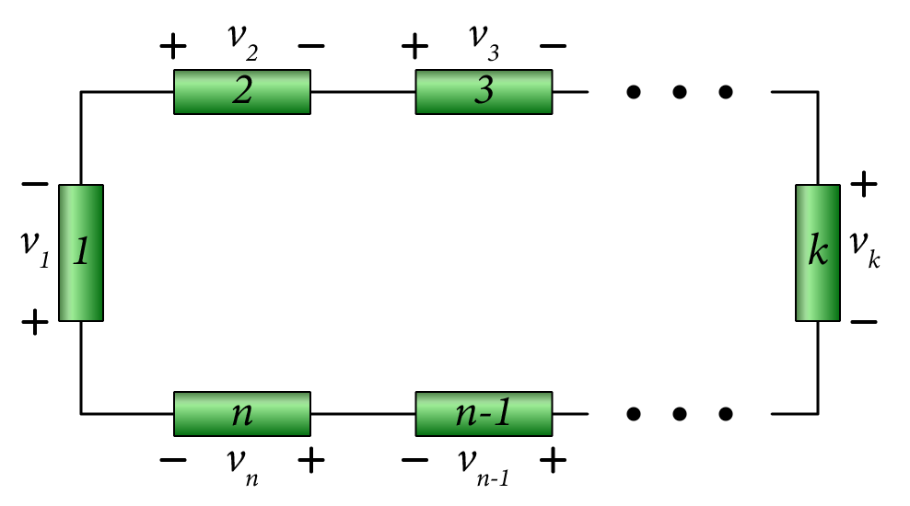

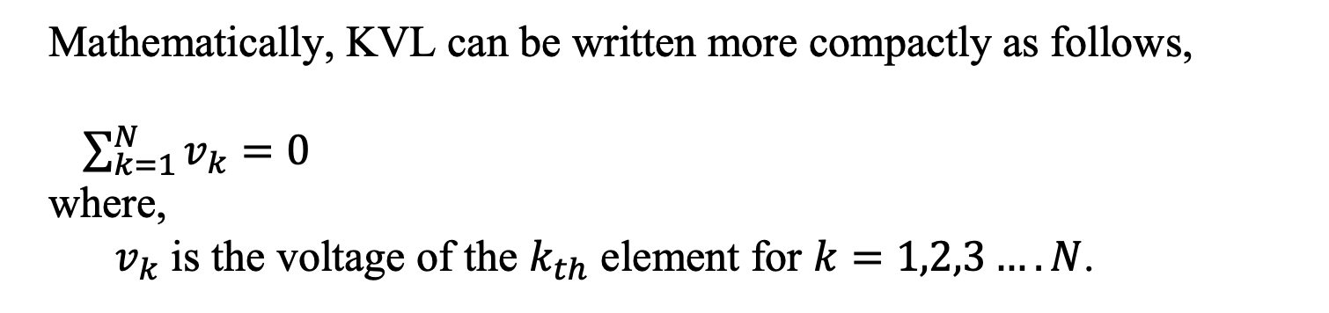
Kirchoff’s Voltage Law
The algebraic sum of all voltages in a closed circuit is equal to zero.
(KVL is a law of conservation of energy (zero net change in energy).
Where: Vn is the voltage across branch n.
Closed circuit - Loop
Apply KVL around the loop:
$$v_{1}+v_{2}+v_{3}+ …+v_{n}=0$$
Mathematically, KVL can be written more compactly as follows,
$\sum_{k=1}^{N}{v_{k}=0}$
where,
$v_{k}$ is the voltage of the $k_{th}$ element for $k=1,2,3….N$.

Slide 4
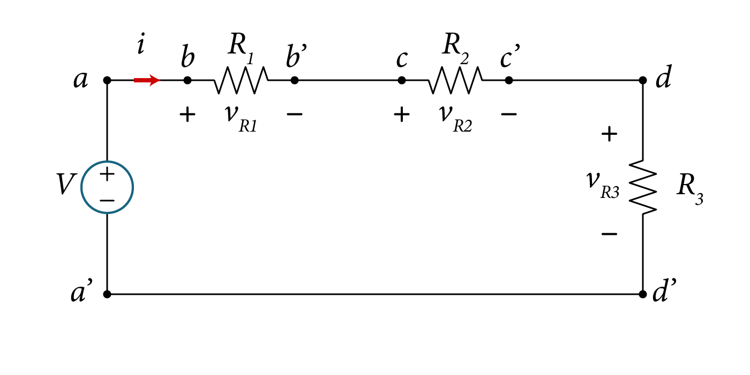

Kirchoff’s Voltage Law
Example of four elements
In terms of voltages assigned across the elements:
Voltage source (Excitation) - between nodes a and a’
Resistance R₁ between nodes b and b'
Resistance R₂ between nodes c and c'
KVL:
$−V+v_{R1}+v_{R2}+v_{R3}=0$

Slide 5

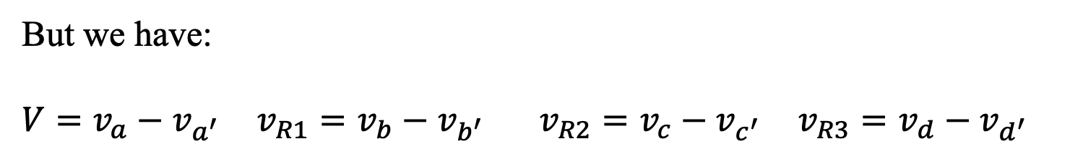
Kirchoff’s Voltage Law
Example of four elements
What about if we apply KVL by looking at the node voltages?
$${−v}_{a^{′}}+v_{a}+v_{b}−v_{b^{′}}+v_{c}−v_{c^{′}}+v_{d}−v_{d^{′}}=0$$
But we have:
$V=v_{a}−v_{a^{′}}$ $v_{R1}=v_{b}−v_{b^{′}}$ $v_{R2}=v_{c}−v_{c^{′}}$ $v_{R3}=v_{d}−v_{d^{′}}$
$−V+v_{R1}+v_{R2}+v_{R3}=0$

Slide 6
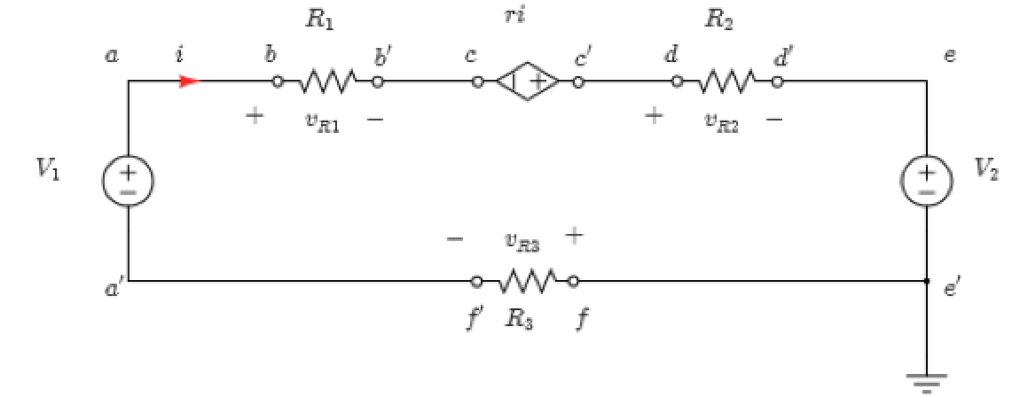
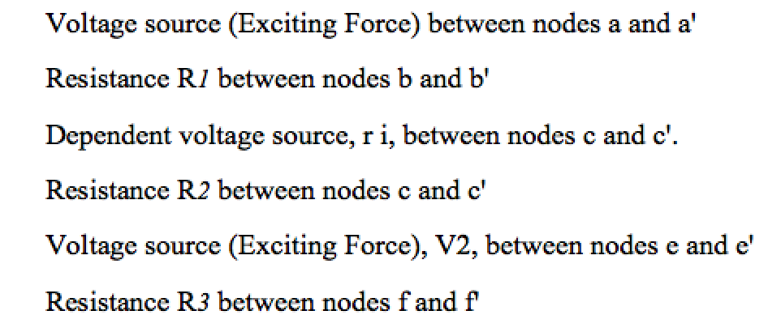


Kirchoff’s Voltage Law - Example
Example of
six elements
KVL:

Slide 7
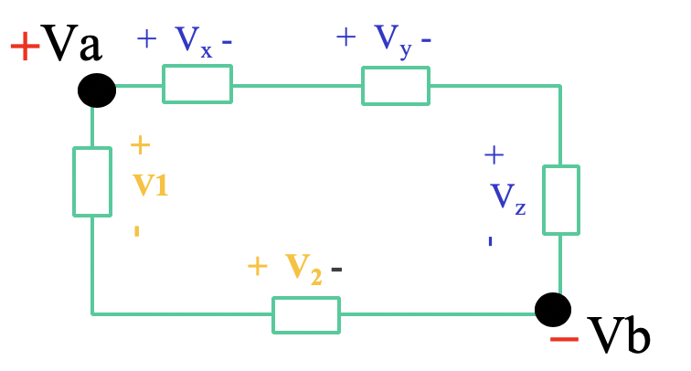

Kirchoff’s Voltage Law
Element Voltages:
The voltage across elements like V_{x ,}V_{y},V_{z} V_{1,}V₂
Apply KVL
-V₁+V_{x}+V_{y}+V_{z} -V₂=0
Closed loop

Slide 8

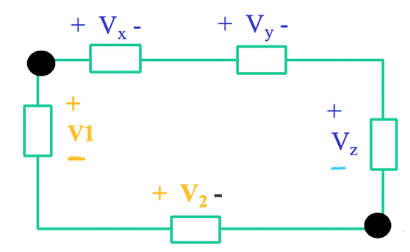
Kirchoff’s Voltage Law
Element Voltages:
The voltage across elements like V_{x ,}V_{y},V_{z} V_{1,}V₂
Apply KVL
-V₁+V_{x}+V_{y}+V_{z} -V₂=0
What about the voltage at V_{a} ?
What about the voltage at V_{b} ?
Closed loop
Undetermined! Unknown! Invalid Question!

Slide 9

Kirchoff’s Voltage Law
Node Voltages:
The voltage at V_{a} or at V_{b} must be in measured with respect to another node voltage or to the ground?
Let us find the voltage between nodes V_{a} or at V_{b}
Closed loop

Slide 10
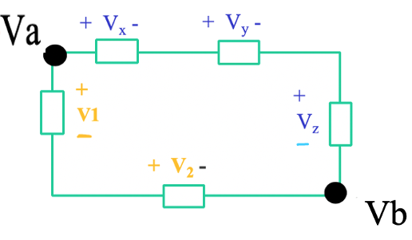


Kirchoff’s Voltage Law
Node Voltages:
The voltage at V_{a} or at V_{b} must be in measured with respect to another node voltage or to the ground?
Let us find the voltage between nodes V_{a} or at V_{b}
Two options:
Go around to the clockwise direction
Go around in the counter clockwise
direction
Closed loop

Slide 11
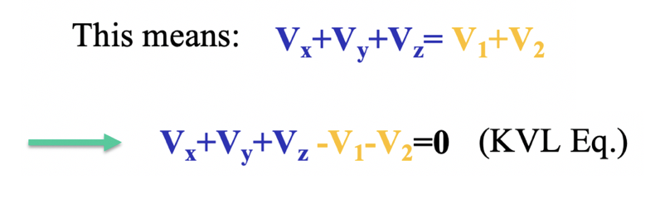
Kirchoff’s Voltage Law
Node Voltages: The voltage between two nodes can be obtained by adding all voltages along the path that connects the two nodes.
V_{a}-V_{b} = V_{x}+V_{y}+V_{z}
OR
V_{a}-V_{b} = V₁+V₂
Closed loop

Slide 12
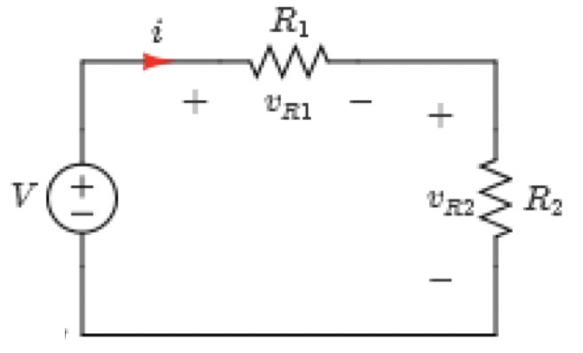
Example
Given the circuit, apply KVL to find the current i.
Simple electric circuit
Variable | Values | Unit
V | 14 | V
R₁ | 15 | Ω
R₂ | 20 | Ω

Slide 13


Example
Solution:
First assign voltage polarities:
From KVL,
Starting from node
Simple electric circuit
Solving for current i by using Ohm’s Law,

Slide 14
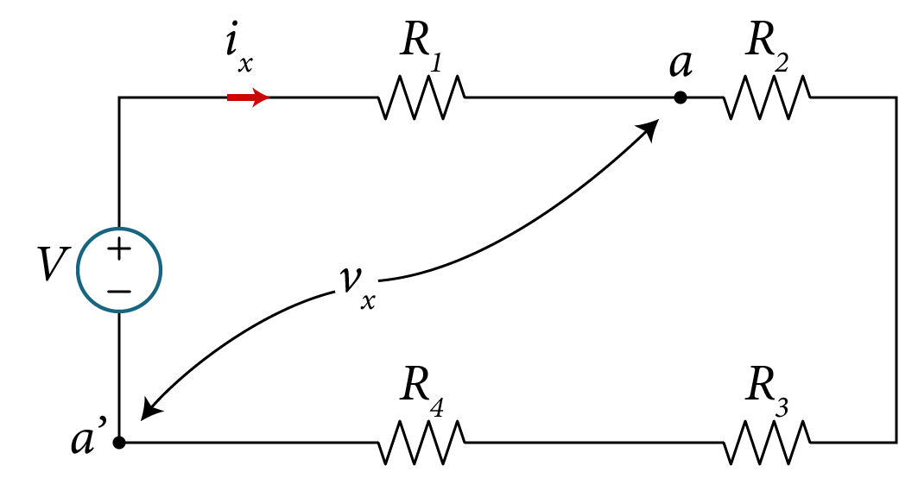

Example
Given the circuit shown, apply KVL to find:
The current $i_{x}$
The voltage $v_{x}$.
 | Default
Variables | Values | Unit
R₁ | 15 | Ω
R₂ | 5 | Ω
R₃ | 8 | Ω
R₄ | 4 | Ω
V | 25 | V

Slide 15
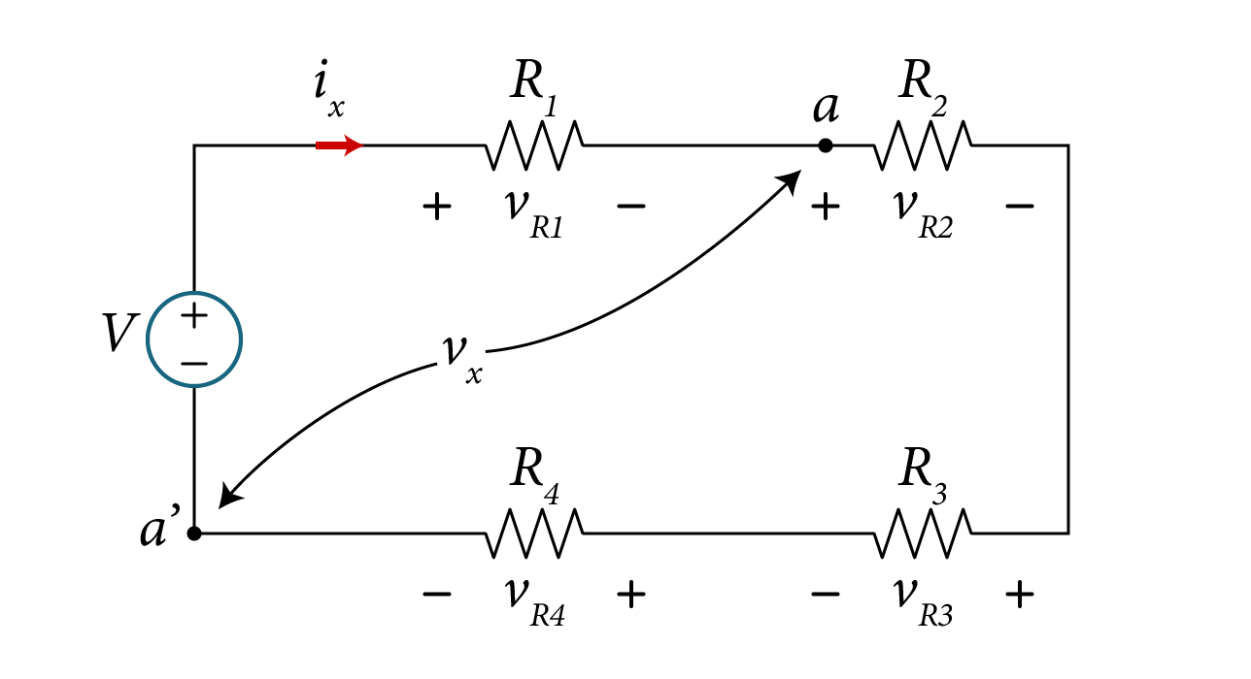
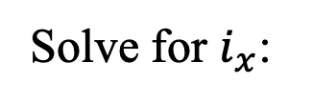

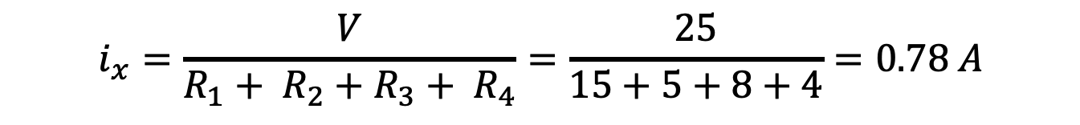
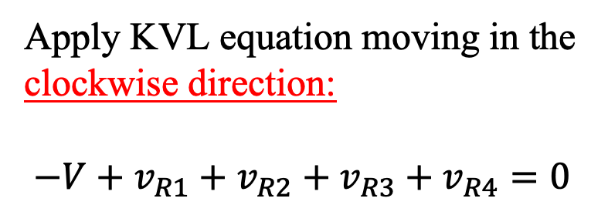

Solution A - clockwise direction:
First we need to find $i_{x} .$
Assign voltage $v_{R1}, v_{R2}, v_{R3}, and v_{R4}$ as shown
Apply KVL equation moving in the clockwise direction:
$$−V+v_{R1}+v_{R2}+v_{R3}+v_{R4}=0$$
From Ohm’s law
$$−V+i_{x} R_{1}+i_{x} R_{2}+i_{x} R_{3}+i_{x} R_{4}=0$$
Solve for $i_{x}$:
$$i_{x}=\frac{V}{R_{1}+ R_{2}+R_{3}+ R_{4}}=\frac{25}{15+5+8+4}=0.78 A$$

Slide 16
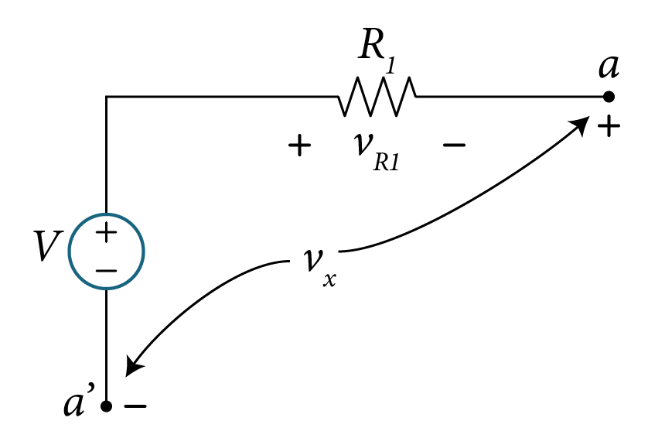
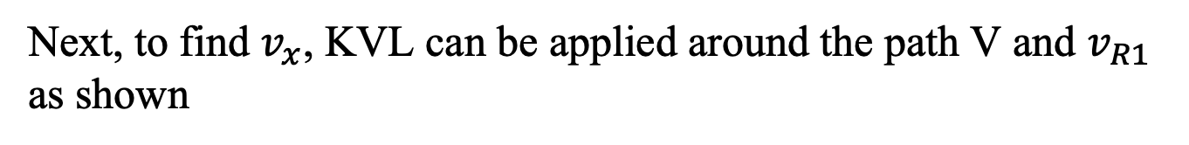
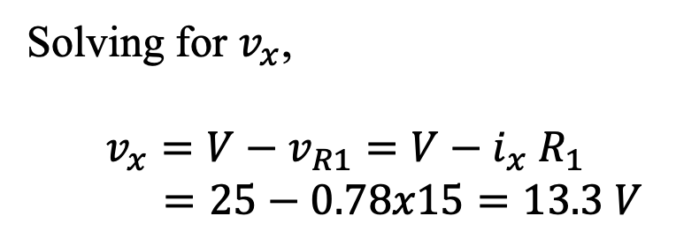

Solution A - clockwise direction:
Next, to find $v_{x}$, KVL can be applied around the path V and $v_{R1}$ as shown
Apply KVL equation:
$$−V+v_{R1}+v_{x}=0$$
Solving for $v_{x}$,
$$v_{x}=V−v_{R1}=V−i_{x} R_{1}$$
$$=25−0.78x15=13.3 V$$

Slide 17
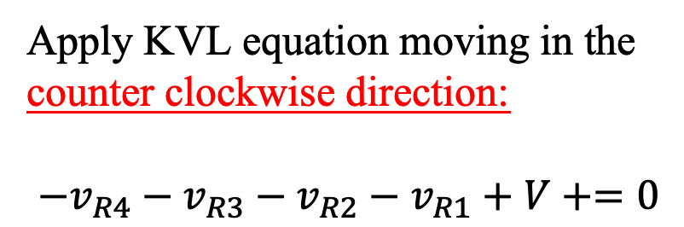
Solution B – counter clockwise direction:
First we assign voltage $v_{R1}, v_{R2}, v_{R3}, and v_{R4}$ as shown
Apply KVL equation moving in the counter clockwise direction:
$$−v_{R4}−v_{R3}−v_{R2}−v_{R1}+V+=0$$
From Ohm’s law
$$−i_{x} R_{4}−i_{x} R_{3}−i_{x} R_{2}−i_{x} R_{1}+V=0$$
Solve for $i_{x}$:
$$i_{x}=\frac{V}{R_{1}+ R_{2}+R_{3}+ R_{4}}=\frac{25}{15+5+8+4}=0.78 A$$

Slide 18
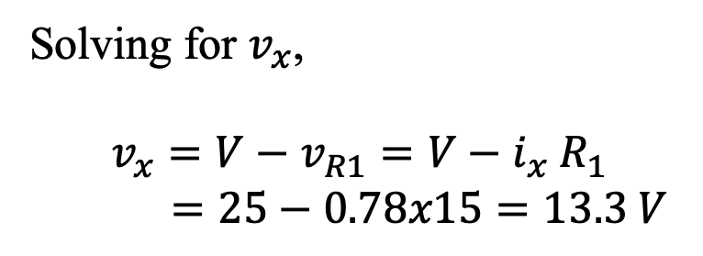

Solution B – counter clockwise direction:
Next, to find $v_{x}$, KVL can be applied around the path V and $v_{R1}$ as shown
Apply KVL equation moving counter clockwise direction:
$$+V−v_{x}{−v}_{R1}=0$$
Solving for $v_{x}$,
$$v_{x}=V−v_{R1}=V−i_{x} R_{1}$$
$$=25−0.78x15=13.3 V$$

Slide 19
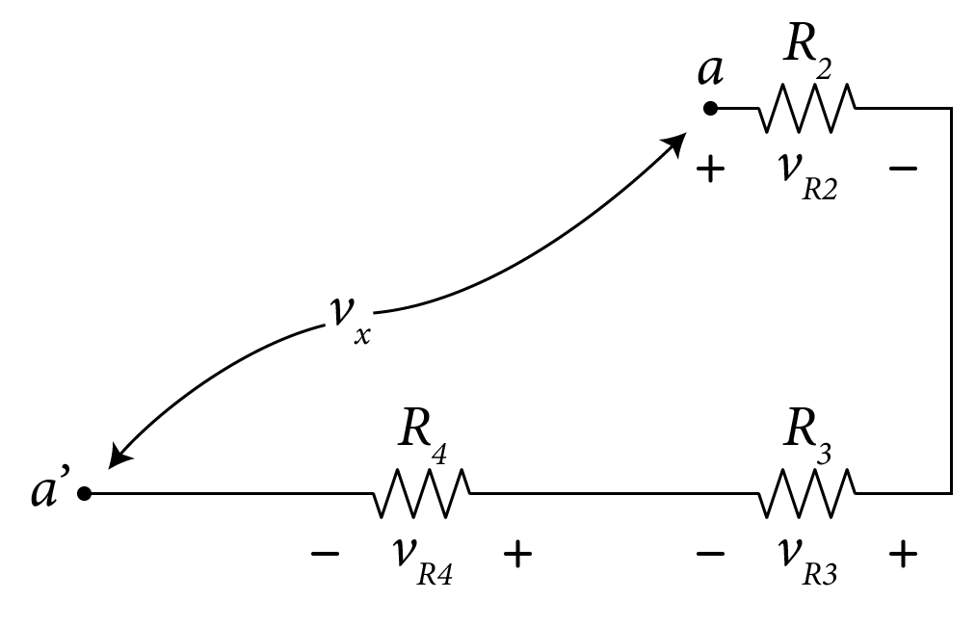
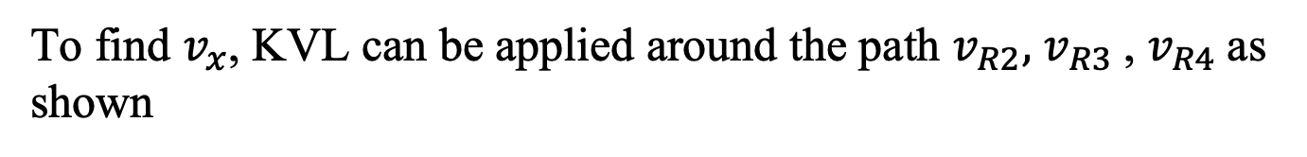


Solution C – Different portion of the circuit:
To find $v_{x}$, KVL can be applied around the path $v_{R2},$ $v_{R3}$, $v_{R4}$as shown
Apply KVL equation:
$$−v_{x}+v_{R2}+v_{R3}+v_{R4}=0$$
$$v_{x}=v_{R2}+v_{R3}+v_{R4}=i_{x} (R_{2}+R_{3}+R_{4})$$
$$=0.78x(5+8+4)=13.3 V$$

Slide 20



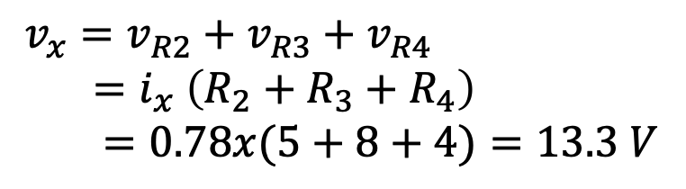




Solution C – Different portion of the circuit:
To find $v_{x}$, KVL can be applied around the path $v_{R2},$ $v_{R3}$, $v_{R4}$as shown
Apply KVL equation:
$$+V−v_{x}{−v}_{R1}=0$$
$$v_{x}=V−v_{R1}=V−i_{x} R_{1}$$
$$−v_{x}+v_{R2}+v_{R3}+v_{R4}=0$$
$$=25−0.78x15$$
$$v_{x}=v_{R2}+v_{R3}+v_{R4}$$
$$=i_{x} \left(R_{2}+R_{3}+R_{4}\right)$$
$$=0.78x(5+8+4)=13.3 V$$
$$=13.3 V$$

Slide 21
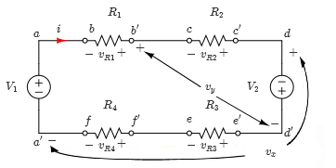

Example
Example
Given the circuit, apply KVL to find the voltages v_{x} and v_{y}.
Circuit with voltages $v_{x}$ and $v_{y}$
Variable | Values | Unit
V₁ | 28 | V
V₂ | 14 | V
R₁ | 18 | Ω
R₂ | 13 | Ω
R₃ | 15 | Ω
R₄ | 12 | Ω

Slide 22
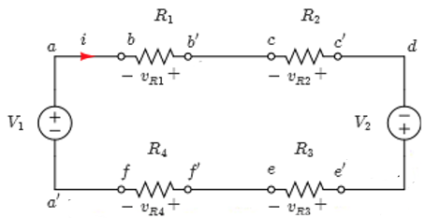
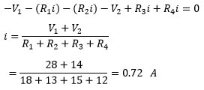




Example
Solution:
First we need to calculate the current i using KVL,
Using Ohm’s Law and solving for i,
Circuit with voltages $v_{x}$ and $v_{y}$

Slide 23

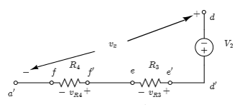

Example
Solving for v_{x}:
Applying KVL around the path d-d', e-e', f-f', and f'-a' as shown,
Using Ohm’s Law and solving for v_{x},
Solving for voltage vx

Slide 24


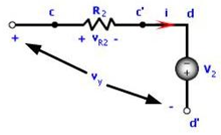


Example
Solving for v_{y} :
Applying KVL around the path c-c', d-d', and d'-c as shown
Using Ohm’s Law and solving for v_{y},
Solving for voltage vy

Slide 25
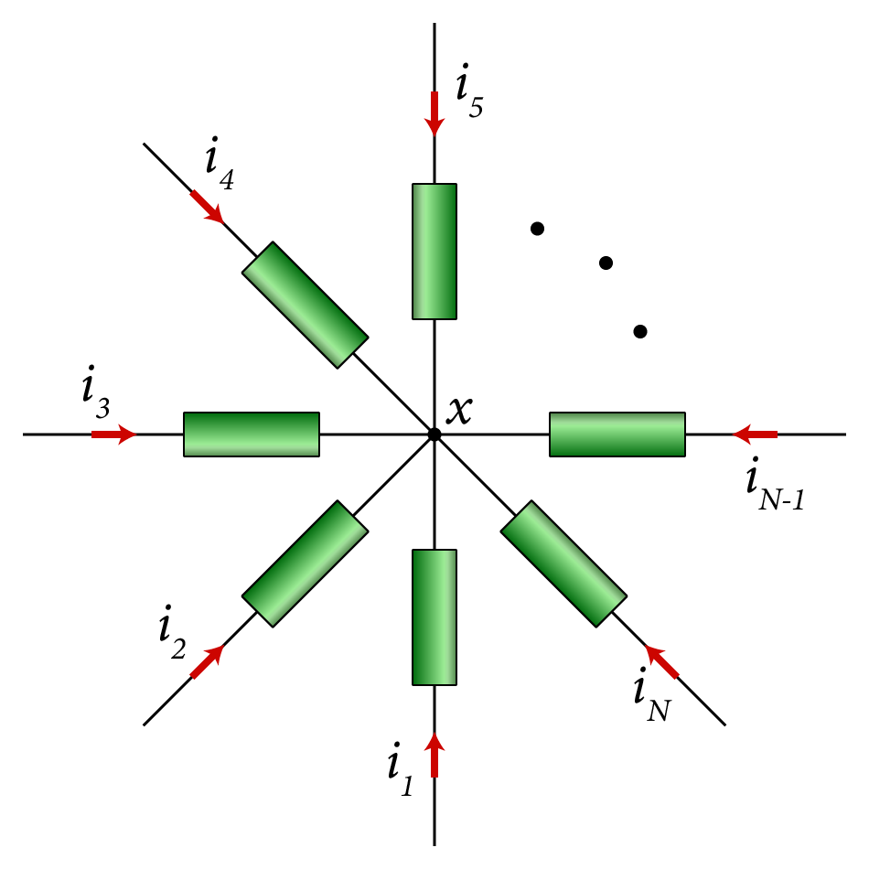
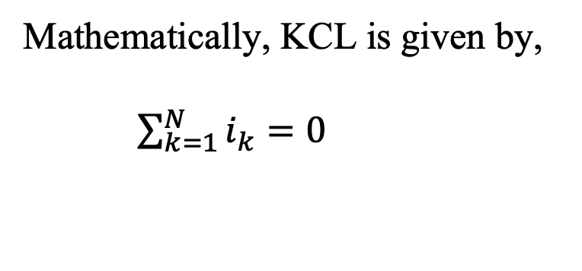
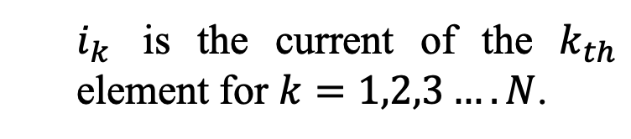
Kirchhoff's Current Law
The sum of all currents i₁, i₂, …i_{n} at any node is equal to 0.
Mathematically, KCL is given by,
$\sum_{k=1}^{N}{i_{k}=0}$
$i_{k}$ is the current of the $k_{th}$ element for $k=1,2,3….N$.

Slide 26
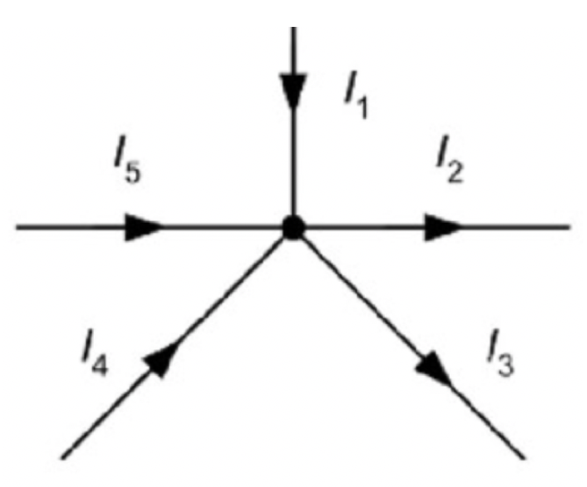
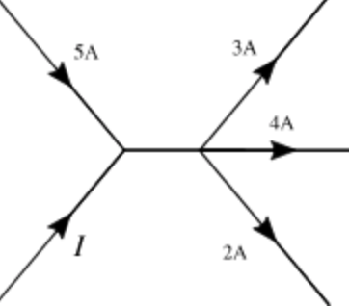
Kirchhoff’s Current Law
OR
The total currents flowing in = total currents flowing out.
OR
I₁+I₄+I₅=I₂+I₃
I+5=3+4+2
_{I= 4 A}

Slide 27
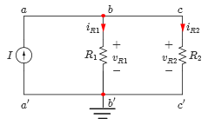
Kirchoff’s Current Law
Upper node
Example:
Lower node
The three branches:
Current source (Exciting Force) between nodes a and a’
Resistance R1 between nodes b and b’
Resistance R2 between nodes c and c'
KCL @ upper node: I=i_{R1} + i_{R2} or I- i_{R1} - i_{R2} =0
KCL @ lower node: I=i_{R1} + i_{R2} or -I+ i_{R1} + i_{R2} =0

Slide 28
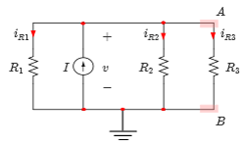

Example
Example
Given the circuit, apply KCL to find the current i_{R2}.
Simple electric circuit
Variable | Values | Unit
I | 1 | mA
R₁ | 5 | kΩ
R₂ | 3 | kΩ
R₃ | 4 | kΩ

Slide 29
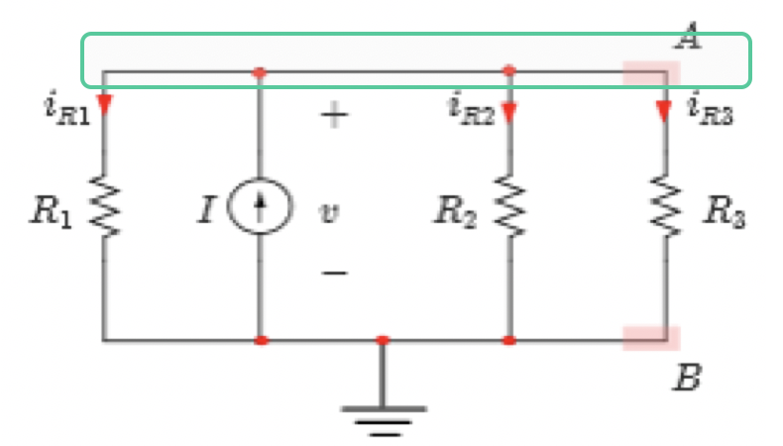


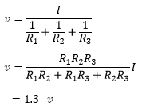

Example
Solution:
Assign currents and voltages.
Applying KCL at node “A”,
Voltage across all resistors is equal,
Simple electric circuit
Solving for voltage v,
Solving for current i_{R2} using Ohm’s Law,

Slide 30
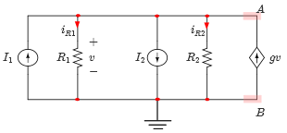
Example
Example
Given the circuit, apply KCL to find the voltage v.
Resistive circuit
Variable | Values | Unit
I₁ | 1 | mA
I₂ | 2 | mA
R₁ | 1 | kΩ
R₂ | 2 | kΩ
g | 0.8 | 1/kΩ

Slide 31
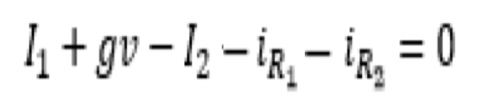


Example
Solution:
It can be seen by Ohm’s Law that
Applying KCL at node ‘A’,
Resistive circuit
From Ohm’s Law we deduct,

Slide 32
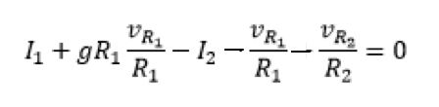
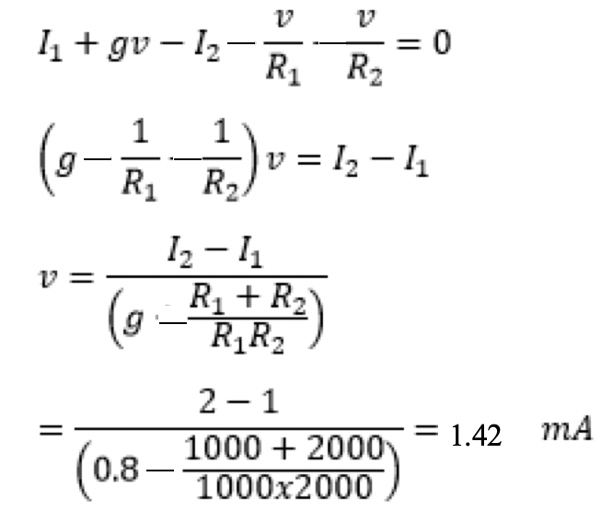
Example (Con’d)
Substituting in the KCL equation,
Solving for v,
Resistive circuit
- 1.43V

Slide 33
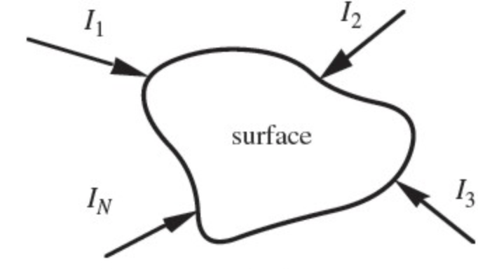
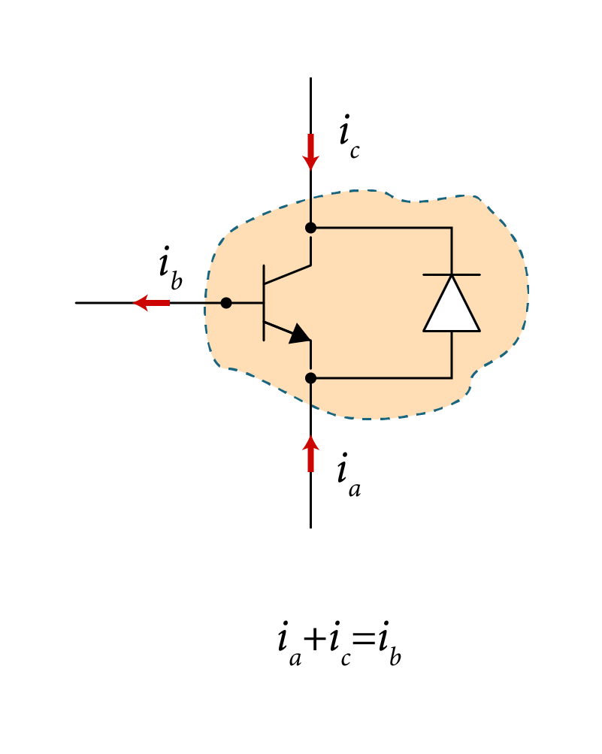
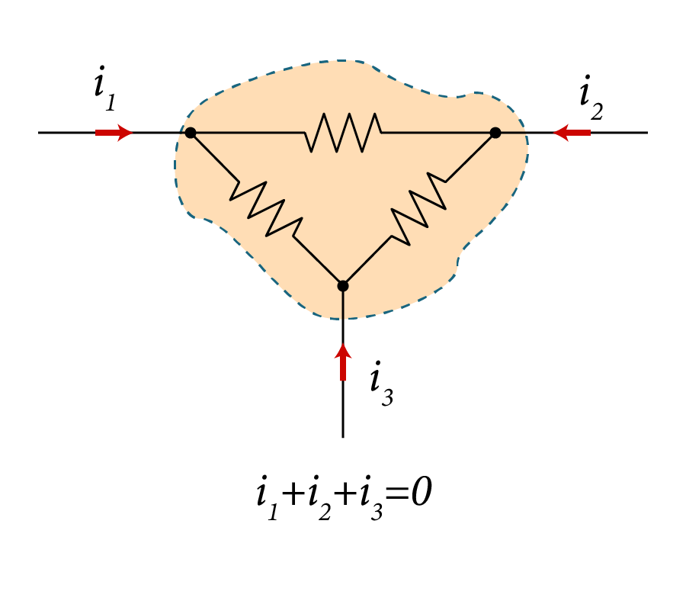
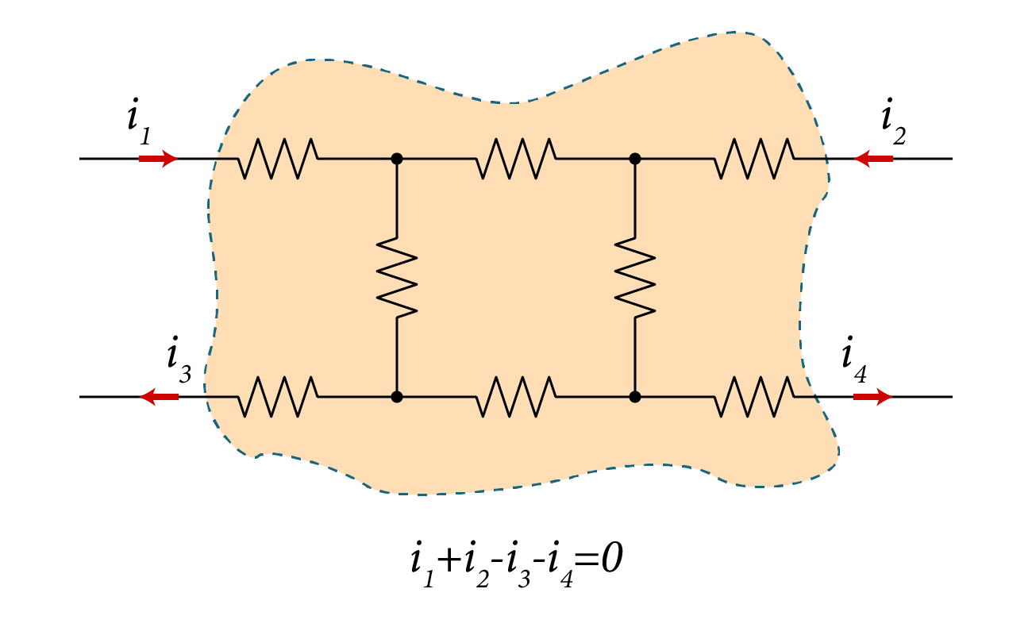
Kirchoff’s Current Law
KCL also extends to surfaces of planar circuits.
KCL is a statement of conversation of charge, i.e., no charge is being generated or destroyed as a result of current flow.

Slide 34
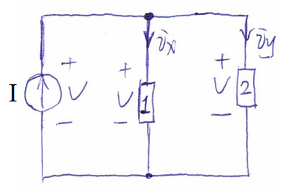
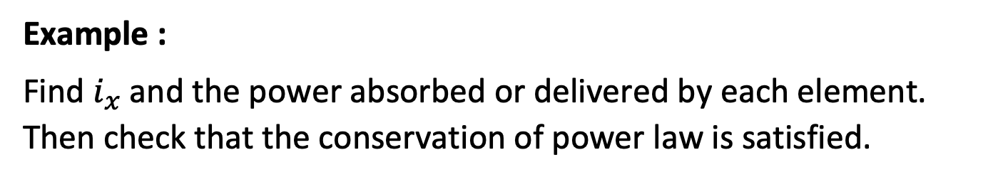
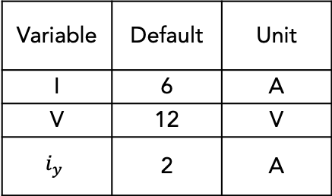
Example :
Find $i_{x}$ and the power absorbed or delivered by each element. Then check that the conservation of power law is satisfied.
Variable | Default | Unit
I | 6 | A
V | 12 | V
$$i_{y}$$ | 2 | A

Slide 35
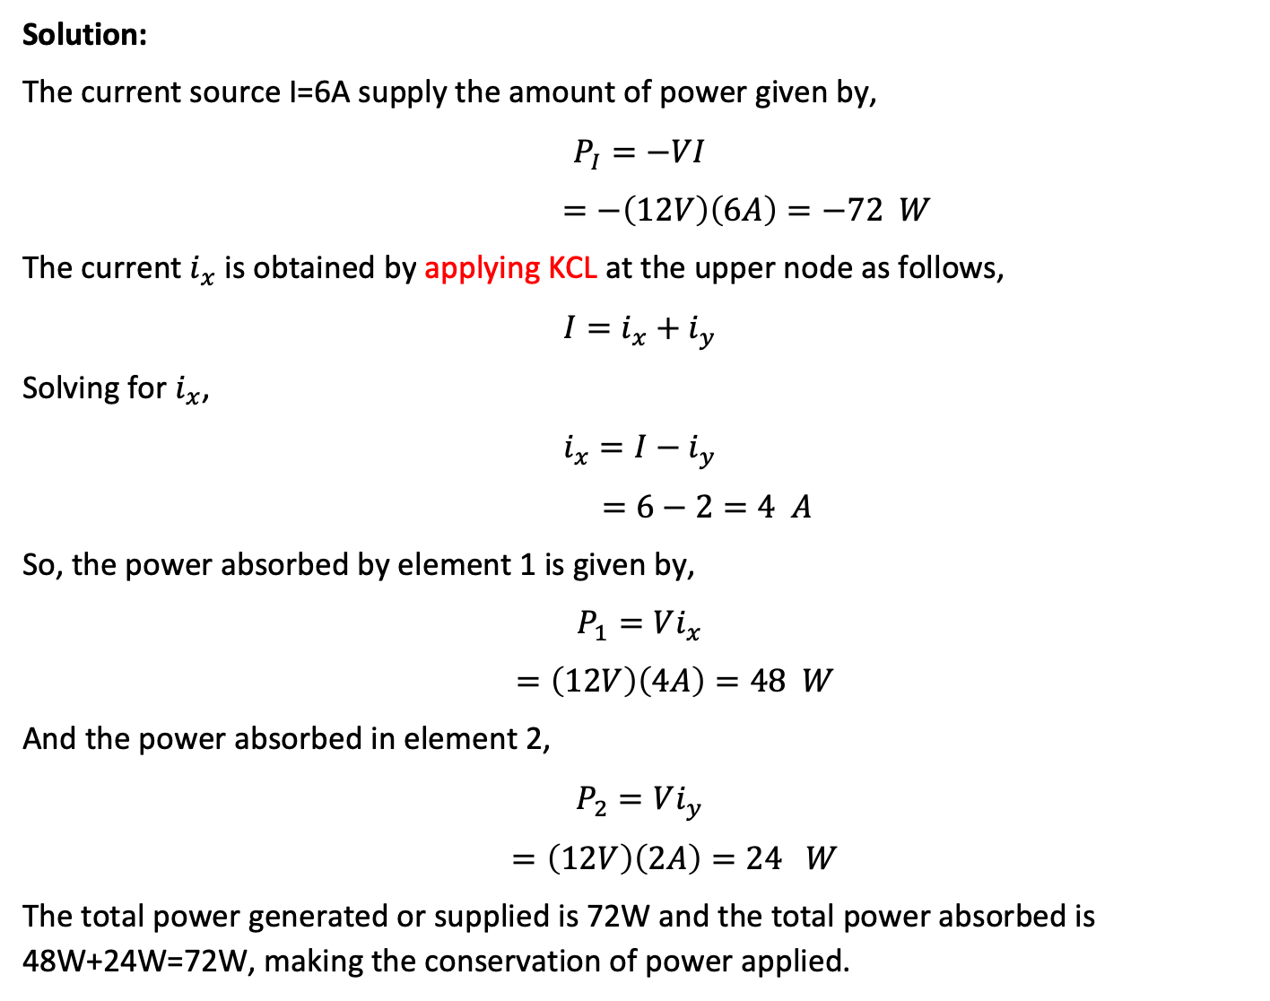
Solution:
The current source I=6A supply the amount of power given by,
$$P_{I}=−VI$$
$$=−\left(12V\right)\left(6A\right)=−72 W$$
The current $i_{x}$ is obtained by applying KCL at the upper node as follows,
$$I=i_{x}+i_{y}$$
Solving for $i_{x}$,
$$i_{x}=I−i_{y}$$
$$=6−2=4 A$$
So, the power absorbed by element 1 is given by,
$$P_{1}=Vi_{x}$$
$$=\left(12V\right)\left(4A\right)=48 W$$
And the power absorbed in element 2,
$$P_{2}=Vi_{y}$$
$$=\left(12V\right)\left(2A\right)=24 W$$
The total power generated or supplied is 72W and the total power absorbed is 48W+24W=72W, making the conservation of power applied.

Slide 36



Example:
Find $i_{x}$ and the power absorbed or delivered by each element. Then check that the conservation of power is satisfied.
Variable | Value | Unit
I | 6 | A
V1 | 12 | V
V2 | 12 | V
V3 | 3 | V
Vi | 9 | V
$$i_{y}$$ | 2 | A

Slide 37

Solution:
The current source I=6A supplies the amount of power given by,
$$P_{I}=−V_{i}I$$
$$=−\left(9V\right)\left(6A\right)=−54 W$$
The element 3 supplies the amount of power given by,
$$P_{3}=−V_{3}I$$
$$=−\left(3V\right)\left(6A\right)=−18 W$$
The current $i_{x}$ is obtained by applying KCL at the upper node as follows,
$$I=i_{x}+i_{y}$$
Solving for $i_{x}$,
$$i_{x}=I−i_{y}$$
$$=6−2=4 A$$
So, the power absorbed by element 1 is given by,
$$P_{1}=V_{1}i_{x}$$
$$=\left(12V\right)\left(4A\right)=48 W$$
And the power absorbed in element 2,
$$P_{2}=V_{2}i_{y}$$
$$=\left(12V\right)\left(2A\right)=24 W$$
The total power generated or supplied is 54W+18W=72W and the total power absorbed is 48W+24W=72W, satisfying the conservation of power requirement.

Slide 38


Example:
Find $i_{x}$ and the power absorbed or delivered by each element. Then check that the conservation of power is satisfied.
Variable | Default | Unit
I | 6 | A
V1 | 9 | V
Vi | 12 | V
V3 | 3 | V
V2 | 12 | V
i_{y} | 2 | A

Slide 39

Solution:
The current source I=6A supplies the amount of power given by,
$$P_{I}=−Vi I$$
$$=−\left(12V\right)\left(6A\right)=−72 W$$
The current $i_{x}$ is obtained by applying KCL at the upper node as follows,
$$I=i_{x}+i_{y}$$
Solving for $i_{x}$,
$$i_{x}=I−i_{y}$$
$$=6−2=4 A$$
So, the power absorbed by element 1 is given by,
$$P_{1}=V_{1}i_{x}$$
$$=\left(9V\right)\left(4A\right)=36 W$$
And the power absorbed in element 2,
$$P_{2}=V_{2}i_{y}$$
$$=\left(12V\right)\left(2A\right)=24 W$$
The element 3 absorbs the amount of power given by,
$$P_{3}=V_{3}i_{x}$$
$$=\left(3V\right)\left(4A\right)=12 W$$
The total power generated or supplied is 72W and the total power absorbed is 36W+24W+12W=72W, satisfying the conservation of power requirement.

Slide 40


Example:
Find $i_{x}$ and the power absorbed or delivered by each element. Then check that the conservation of power is satisfied.
Variable | Default | Unit
I | 6 | A
V1 | 9 | V
V2 | 9 | V
V3 | 3 | V
V4 | 3 | V
Vi | 12 | V
iy | 2 | A

Slide 41

Solution:
The current source I=6A supplies the amount of power given by,
$$P_{I}=−Vi I$$
$$=−\left(12V\right)\left(6A\right)=−72 W$$
The current $i_{x}$ is obtained by applying KCL at the upper node as follows,
$$I=i_{x}+i_{y}$$
Solving for $i_{x}$,
$$i_{x}=I−i_{y}$$
$$=6−2=4 A$$
So, the power absorbed by element 1 is given by,
$$P_{1}={V_{1}i}_{x}$$
$$=\left(9V\right)\left(4A\right)=36 W$$
And the power absorbed in element 2,
$$P_{2}=V_{2}i_{y}$$
$$=\left(9V\right)\left(2A\right)=18 W$$
The element 3 absorbs the amount of power given by,
$$P_{3}=V_{3}i_{x}$$
$$=\left(3V\right)\left(4A\right)=12 W$$
The element 4 absorbs the amount of power given by,
$$P_{4}=V_{4}i_{y}$$
$$=\left(3V\right)\left(2A\right)=6 W$$
The total power generated or supplied is 72W and the total power absorbed is 36W+18W+12W+6W=72W, satisfying the conservation of power requirement.

Slide 42

Resistors in Series
Resistors in Series:
Each of the two elements are connected to the same node without any additional elements connected to that node.
The current entering the first element equals the current entering the second element.
Resistors in Series

Slide 43

Example
Consider the circuit shown, apply Ohm’s and Kirchoff’s voltage laws to find the equivalent resistor seen by the voltage source.
Resistors in Series
Variable | Values | Unit
V | 15 | V
R₁ | 1 | kΩ
R₂ | 2 | kΩ

Slide 44



Example
Solution:
From Ohm’s Law,
Applying KVL around the loop,
Substituting for the resistor voltage,
Resistors in Series
Therefore,
The total resistance seen by the voltage source V

Slide 45

Example
Consider the circuit shown, apply Ohm’s and Kirchoff’s voltage laws to find an expression for the equivalent resistor seen by the voltage source.
Solution:
From Ohm’s Law,
Applying KVL around the loop,
Resistors in Series

Slide 46


Example
From Ohm’s Law,
Rearranging the equation gives,
Therefore,
The total resistance seen by the voltage source V

Slide 47

Resistors in Parallel
Resistors in Parallel:
  Both ends of one element are connected to both ends of the other element.
  The voltage across the first element equals the voltage across the second element.
Resistors in Parallel

Slide 48

Example
Consider the circuit shown, find the total resistance seen by the current source by applying Ohm’s and Kirchhoff's voltage laws.
Values:
Resistors in Parallel
Variable | Default | Unit
I | 10 | mA
R₁ | 2.5 | kΩ
R₂ | 2.5 | kΩ
R₃ | 1.25 | kΩ

Slide 49

Example
Consider the circuit shown, find the total resistance seen by the current source by applying Ohm’s and Kirchhoff's voltage laws.
Values:
Resistors in Parallel
Variable | Default | Unit
I | 10 | mA
R₁ | 2.5 | kΩ
R₂ | 2.5 | kΩ
R₃ | 1.25 | kΩ

Slide 50


Example
Solution:
From Ohm’s Law,
Since the resistors are in parallel,
Applying KCL at the top node,
Resistors in Parallel

Slide 51



Example
Substituting for the resistors currents from the above equations,
Therefore,
Resistors in Parallel
The total resistance seen by the current source I

Slide 52


Example
Consider the circuit shown, apply Ohm’s and Kirchoff’s voltage laws to find an expression for the equivalent resistor seen by the current source.
Solution:
From Ohm’s Law,
Resistors in Parallel

Slide 53


Example
Since all elements are connected in parallel,
Applying KCL at node v,
Applying Ohm’s Law to the equation yields,

Slide 54


Example
Rearranging the equation yields,
Therefore,

Slide 55




Resistors in Series and Parallel
Resistor connections that cannot be combined
Not all resistors in a circuit can be connected in series or parallel

Slide 56

Example
Consider the circuit shown, find the main current i being supplied by the voltage source.
Values:
Simple resistive circuit
Variable | Default | Unit
V | 15 | v
R₁ | 1 | Ω
R₂ | 4 | Ω
R₃ | 4 | Ω

Slide 57


Example
Solution:
The equivalent resistance as seen from terminals “ab” is shown,
Equivalent resistance

Slide 58


Example
The circuit shows the equivalent circuit after replacing the three resistors R1, R2 and R3 with one resistor Req,
Apply Ohm’s law and solving for the current gives,
Equivalent Resistance

Slide 59








Example
Equivalent Resistance
Consider the circuit shown, find the main current i being supplied by the voltage source.
$$R_{eq1}$$
$$R_{eq1}= R_{6}+R_{5}//(R_{4}+R_{7})=R_{6}+\frac{R_{5}{(R}_{4}+R_{7})}{R_{4}+R_{5}+R_{7}}$$
$=6+\frac{25(7+18)}{25+7+18}=18.5 Ω$
$R_{eq}= R_{1}+[R_{2}//R_{3}//R_{eq1}$]
$R_{eq}= R_{1}+\frac{R_{2}R_{3}R_{eq1}}{{R_{2}R_{3}+R_{3}R}_{eq1}+R_{2}R_{eq1}}$ =$10+\frac{7.5x15x18.5}{7.5x15+15x18.5+7.5x18.5}= 13.94 Ω$

Slide 60

Example
Equivalent Resistance
Consider the circuit shown, find the main current i being supplied by the voltage source.
Solving for the current to give,
$i=\frac{V}{R_{eq}}=\frac{53}{13.94}=3.8 A$

Slide 61



Example
In the circuit shown, the independent source delivers input power $P_{in}=15 W$ to the circuit. Assume $V_{0}=5 V$, $β=0.9$ , and $R_{2}=10 Ω$ .
Determine:
The total power dissipated in the resistors
Determine $R_{1}$
The total power supplied or dissipated in the dependent source
Verify the conservation of power concept

Slide 62


Example
Solution:
The input power supplied by the independent voltage source $V_{o}$ is given by,
$$P_{in}=V_{o}i=V_{o}i_{x}$$
Solving for $i_{x}$
$$i_{x}=\frac{P_{in}}{V_{o}}=\frac{15W}{5V}=3A$$
The Network

Slide 63






Solution
The current in $R_{2}$ as labeled is obtained by applying KCL at the node connecting the three resistors as follows,
$i_{R2}=i_{x}−βi_{x}=\left(1−β\right)i_{x}$
$=\left(1−0.9\right)\left(3A\right)=0.3A$
The voltage across $R_{2}$ is given by,
$$v_{R2}=i_{R2}R_{2}$$
$$=\left(0.3\right)\left(10\right)=3V$$
The power absorbed in $R_{2}$ is given by,
$$P_{R2}=v_{R2}i_{R2}$$
$$=\left(3\right)\left(0.3\right)=0.9 W$$

Slide 64






Solution
The voltage across $R_{1}$ is obtained from KVL when applied to the left loop,
$v_{R1}=V_{0}−v_{R2}=5−3=2 V$
The power absorbed in $R_{1}$ of the left loop is given,
$$P_{R1}=v_{R1}i_{R1}=v_{R1}i_{x}$$
$$P_{R1}=v_{R1}i_{R1}=v_{R1}i_{x}$$
$$=2x3=6 W$$
(b) Therefor, the resistor value of $R_{1 }$is given by,
$$R_{1}=\frac{P_{R1}}{{i_{R1}}^{2}}=\frac{6}{3^{2}}=0.67 Ω$$

Slide 65




Solution
The power absorbed in $R_{1}$ of the right loop is given by,
$$P_{R1}=v_{R1}^{′}\left(βi_{x}\right)$$
Where $v_{R1}^{′}$ is given by,
$$v_{R1}^{′}=R_{1}(βi_{x})$$
So, the power absorbed in $R_{1}$ of the right loop is given by,
$$P_{R1}=R_{1}(βi_{x})(βi_{x})$$
$$=0.67x\left(0.9\right)\left(3\right)\left(0.9x3\right)=4.88 W$$
The total power dissipated in the three resistors is,
$$P_{R}=P_{R1}+P_{R1′}+P_{R2}$$
$$=6+4.88+0.9=11.78 W$$

Slide 66





Solution
(b) The power delivered to the dependent limit source is given by,
$$P_{depen}=vxβi_{x}$$
Where,
$${v=v}_{R2}−v_{R1}^{′}=v_{R2}−R_{1}\left(βi_{x}\right) =3−0.67x\left(0.9\right)\left(3\right)=3−1.81=+1.19 V$$
Therefore, power delivered to the dependent limit source is given by,
$$\left.P_{depen}=v(βi_{x}\right)=+1.19x\left(0.9\right)\left(3\right)=3.21 W$$
(d) The conservation of power is given by,
$$P_{in}+P_{R}+P_{dep}=0$$
$$−15+11.78+3.21=0$$
As expected!

Slide 67
Example - Power and Energy
If in a certain residential application, a 36 V battery can supply 7 kW power continuously for one hour at 2.5 A. This means the battery capacity is 7 kWh.
(a) What is the battery capacity rating in Ampere-Hours (Ah)?
(b) If battery is fully charged, how long will the house continued to be powered by the battery?
(c) How much energy in joules did the house consume when using fully charge battery?

Slide 68



Example - Power and Energy
Solution:
The energy capacity in $kWh$ can be expressed as,
1 $kWh= \frac{Watts x hours}{1000 }= \frac{ampare x voltage x hour}{1000 }$
$$=\frac{A x voltage x h}{1000}=\frac{Ah x voltage }{1000}$$
Therefore, the expression for $Ah$ is given by,
$$Ah=\frac{1000x kWh}{ voltag}$$

Slide 69

Example - Power and Energy
Solution:
In this problem we have states that battery can supply 7 kW power continuously for one hour : so → 7kW-hour = 7kWh
and voltage=36 V, hence
$$Ah=\frac{1000xkWh}{ voltag}=\frac{1000x7}{36}=194.44 Ah$$

Slide 70



Example - Power and Energy
Solution:
(b) We have Ampere-hour rating (Ah) and since the average current I supplied to the load from battery, therefore,
$$Hour of continues use \left(h\right)=\frac{Ah}{I}=\frac{194.44 Ah}{2.5A}$$
$$=77.80 hours$$
$$=77 Hours and 48 min$$

Slide 71

Example - Power and Energy
Solution:
(c) Fully charge battery has rated capacity of 7 kWh
1 kWh = 3600000 joules =3.6 Mjoules
Therefore, for 7 kWh battery joules consumed by house will be,
$$7 x 3.6 Mjoules=25.2 Mjoules$$

