Slide 1

EEL 3004 Electrical Networks
Lecture #25
Course Review Topics

Slide 2
Final Exam
Comprehensive online - Final Week
April 21, 2020
(1 PM – 4PM)
Between 25-30 Questions
Mostly multiple choice

Slide 3
Lecture Objectives
The lecture today will focus on:
Review of the following topics:
Electrical Quantities
Basic Resistive Circuit Analysis
Advanced Circuit Analysis
RC and RL circuits (DC + Transients)
AC Phasor Analysis Technique
Power Calculations & Power Factor
Introduction to three-phase circuits (Lecture #24)

Slide 4
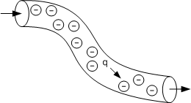


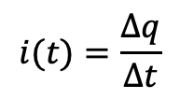
Electrical Quantities
Charge on an electron, q_{e} = -1.602x10-19 coulombs.
The current, i(t), is the time rate of change of the electrical charge, q, passing through a predetermined area,
Current must have arrow direction be labeled indicating the current direction in a given wire.
$$i(t)=\frac{∆q}{∆t}$$
$$i(t)=\frac{dq\left(t\right)}{dt)}$$

Slide 5
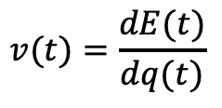
Electrical Quantities
Voltage is the total work per unit charge associated with the motion of charge between two points, i.e., the rate of change of work or energy with respect to charge.
Voltage must have sign polarities – or + be labeled across the element where measurement is taken.
$$v(t)=\frac{dE(t)}{dq(t)}$$

Slide 6

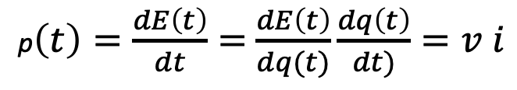
Electrical Quantities
Energy is the multiplication of power (watts) and time (seconds).
Power is the amount of energy required or expended for a given unit of time.
Where p is power in watts (W), w is energy in joules (J), and t is time in seconds (s).
The law of conservation of energy states that the total power generated in a given electrical network must equal the total power dissipated in the same network
p$(t)=\frac{dE(t)}{dt}$
p$\left(t\right)=\frac{dE\left(t\right)}{dt}=$ $\frac{dE\left(t\right)}{dq(t)}\frac{dq\left(t\right)}{dt)}=v i$

Slide 7
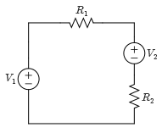
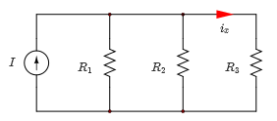
Basic Resistive Circuit Analysis
Single loop circuits are circuits where all elements of the circuits are connected in series, usually one KVL equation needed around the loop.
Single-node-pair circuits are circuits where all the circuit elements are connected across the same pair of nodes, usually one KCL equation needed to be written at one of the nodes.

Slide 8
Basic Resistive Circuit Analysis
The Intuitive Method of circuit reduction reduces the number of components to an equivalent simplified circuit, where the final number of nodes and loops are significantly reduced.
Elements with currents and voltages of interest are left alone as given in the original circuit.
Does not follow a specific procedure, but rather depends on experience.

Slide 9
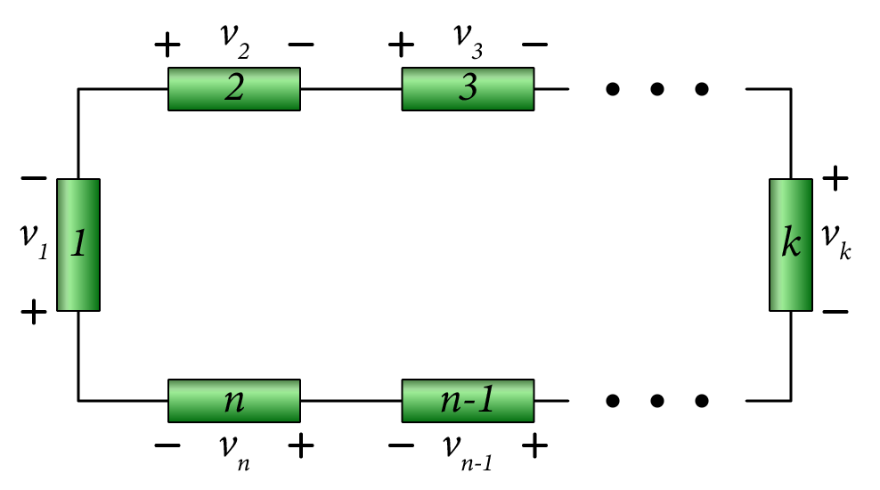

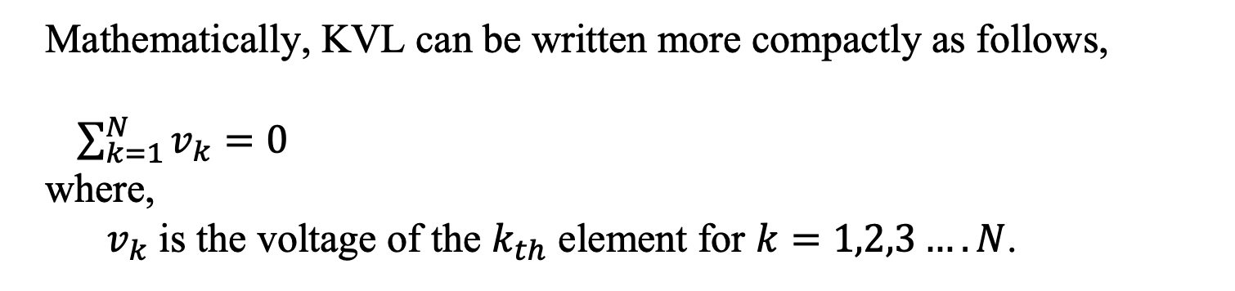
Kirchoff’s Voltage Law
The algebraic sum of all voltages in a closed circuit is equal to zero.
(KVL is a law of conservation of energy (zero net change in energy).
Where: Vn is the voltage across branch n.
Closed circuit - Loop
Apply KVL around the loop:
$$v_{1}+v_{2}+v_{3}+ …+v_{n}=0$$
Mathematically, KVL can be written more compactly as follows,
$\sum_{k=1}^{N}{v_{k}=0}$
where,
$v_{k}$ is the voltage of the $k_{th}$ element for $k=1,2,3….N$.

Slide 10
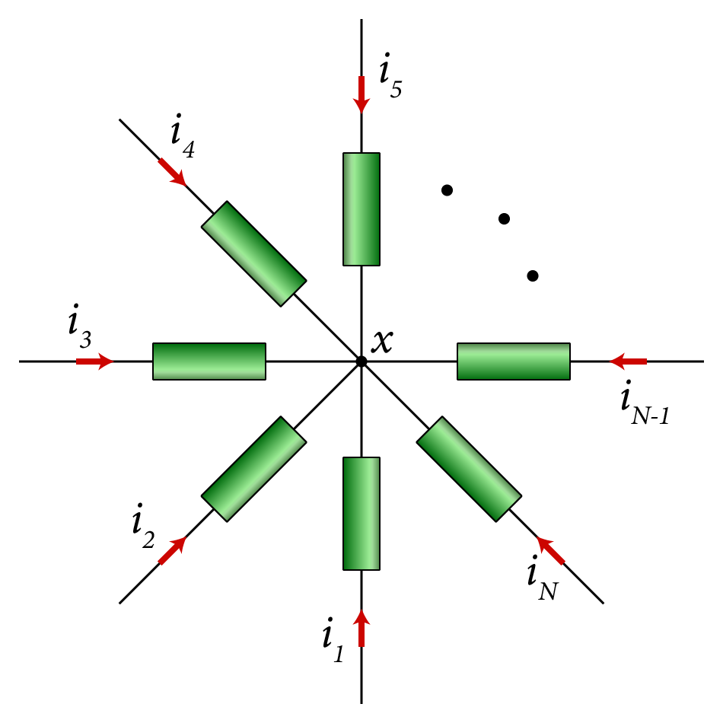
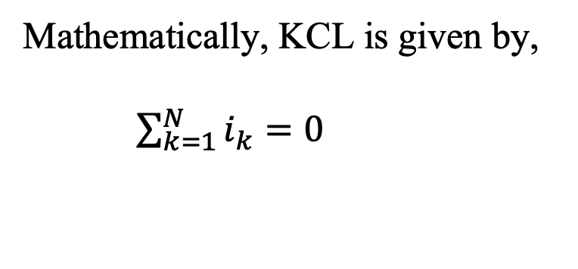
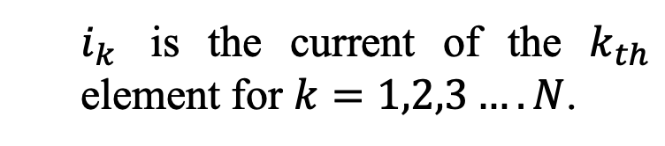
Kirchhoff's Current Law
The sum of all currents i₁, i₂, …i_{n} at any node is equal to 0.
Mathematically, KCL is given by,
$\sum_{k=1}^{N}{i_{k}=0}$
$i_{k}$ is the current of the $k_{th}$ element for $k=1,2,3….N$.

Slide 11
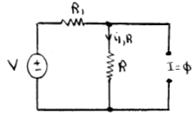
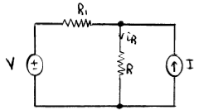
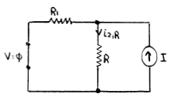
Advanced Circuit Analysis
Branch current, nodal-voltage and advanced theorems based analysis by applying Ohm’s and Kirchhoff's laws.
Superposition Principle states that the branch current and voltage responses obtained, is equal to the algebraic sum of each current and voltage response obtained from the contribution of each independent source acting alone.
This circuit analysis method only applies to linear circuits.

Slide 12
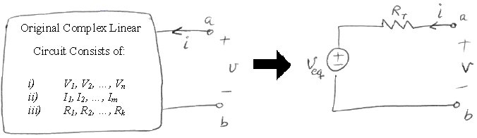
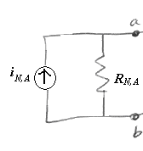
Advanced Circuit Analysis
Thevenin’s theorem states that a linear one port network consisting of independent and dependent sources and resistors can be replaced by a series connection of Thevenin’s resistance, R_{Th}, and independent Thevenin’s voltage source, v_{Th}.
Norton’s theorem states that a linear one port network can be replaced by equivalent circuits consist of the parallel combination of a current source, i_{N} , and equivalent resistance, R_{N}.

Slide 13
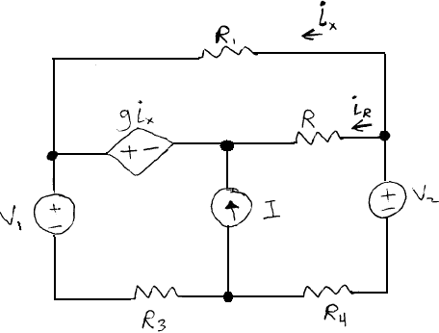
Example
Solve for the current flowing in the resistance R by applying the Principle of Superposition.
Variable | Default | Unit
V₁ | 16 | V
V₂ | 14 | V
I | 8 | A
R | 10 | Ω
R₁ | 8 | Ω
R₃ | 6 | Ω
R₄ | 4 | Ω
g | 2 | Ω

Slide 14
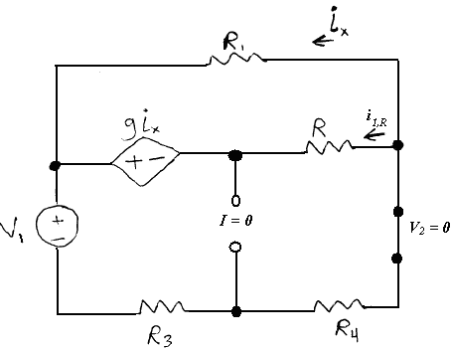

There are three sources: Voltage V₁, Voltage V₂ and Current I:
1) Applying voltage V₁ and set the voltage source V₂ and current source I to zero (short and open circuit respectively)
Assigning Mesh currents to find $i_{1,R}$

Slide 15

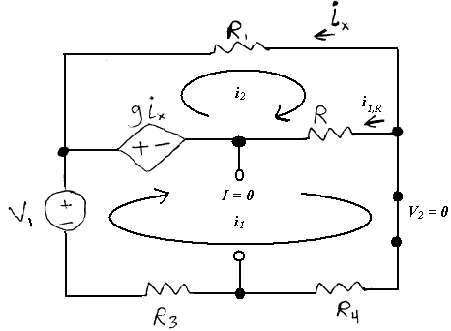
Applying KVL to the loops,
By inspection,
Solving for i₁ and i₂,
Solving for i_{1,R},

Slide 16
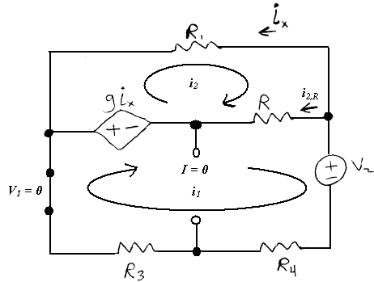

2) Applying voltage V₂ and set the voltage source V₁ and current source I to zero (short and open circuit respectively)
Applying KVL to the loops,
By inspection,

Slide 17
2) Applying voltage V₂ and set the voltage source V₁ and current source I to zero (short and open circuit respectively)
Solving for i₁ and i₂,
Solving for i_{2,R},

Slide 18
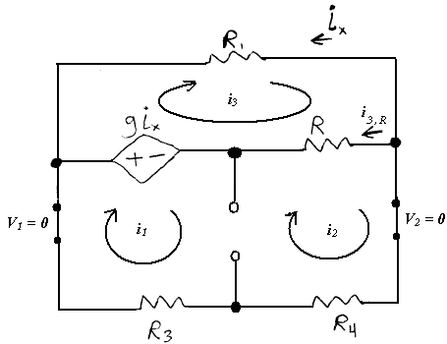

3) Applying current I and set the voltage sources V₁ and V₂ to zero (short circuits)
Applying KVL to the loop,
The equation of the current source,
Super Mesh
By inspection,

Slide 19
3) Applying current I and set the voltage sources V₁ and V₂ to zero (short circuits)
Solving for i₁, i₂ and i₃,
Solving for i_{3,R},

Slide 20
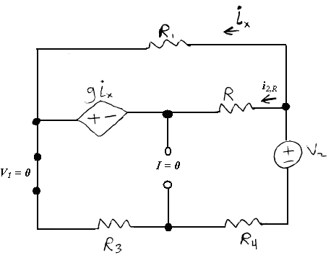
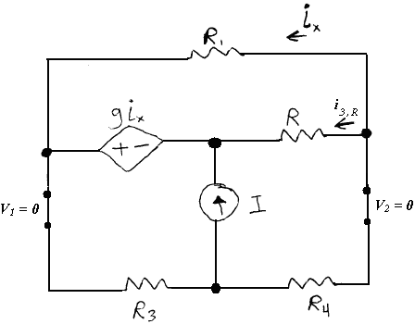
By applying superposition principle:

Slide 21
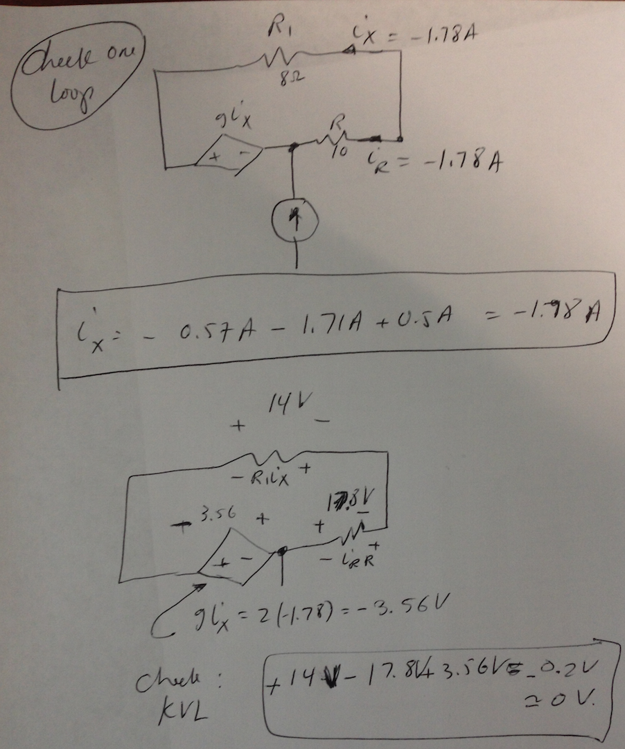

Slide 22
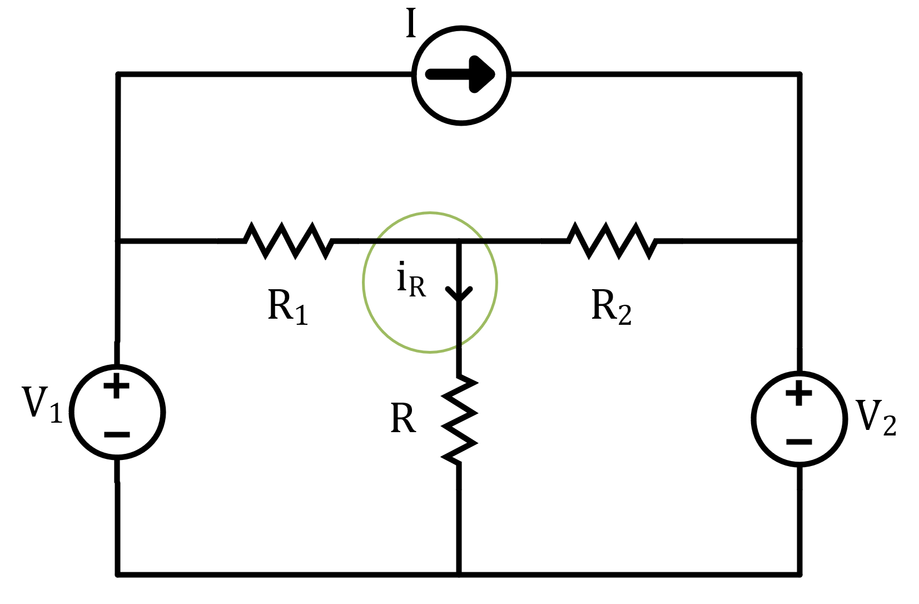
Variable | Values | Unit
V₁ | 24 | V
V₂ | 20 | V
I | 12 | A
R | 18 | Ω
R₁ | 18 | Ω
R₂ | 14 | Ω
Example
Solve for the current flowing in the resistance R.

Slide 23
Let us consider four solution methods:
Solution A: Use the Superposition concept
Solution B: Use the Nodal Analysis method
Solution C: Use the Nodal Analysis method with different ground location than Solution B.
Solution D: Use Y-Δ transformation
Solution E: Use Thevenin Theorem

Slide 24
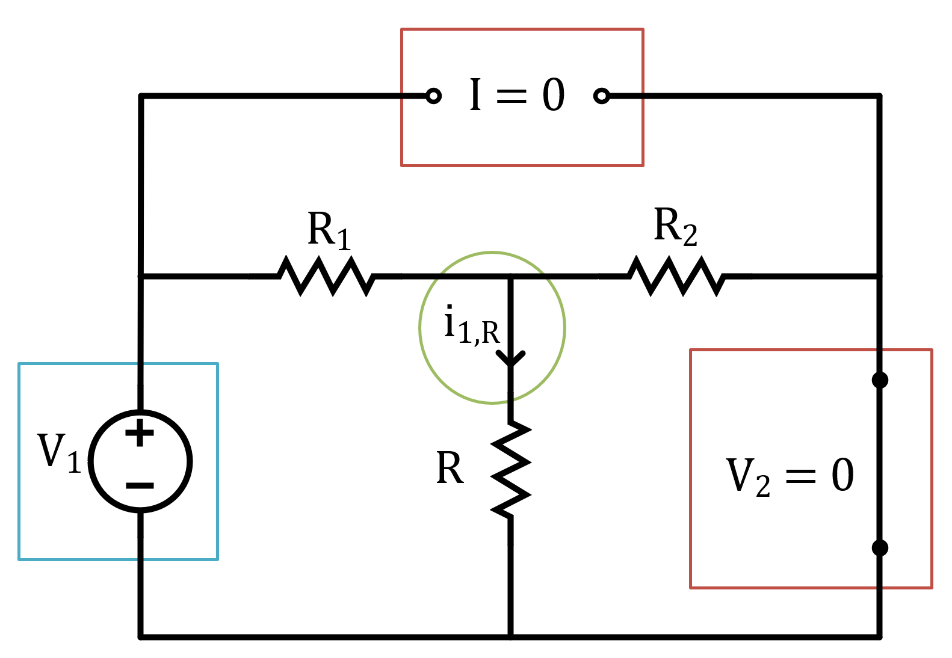
Solution A:
There are three sources: Voltage V₁, V₂ and Current I:
Applying voltage V₁ and setting the voltage source V₂ and current source I to zero (short and open circuit respectively)
Simplifying the circuit,

Slide 25
Solution A:
The resistance R_{eq} is given by,
Combine R and R₂ into R_{eq} and solve for the current going through the loop.
The current i is given by,

Slide 26
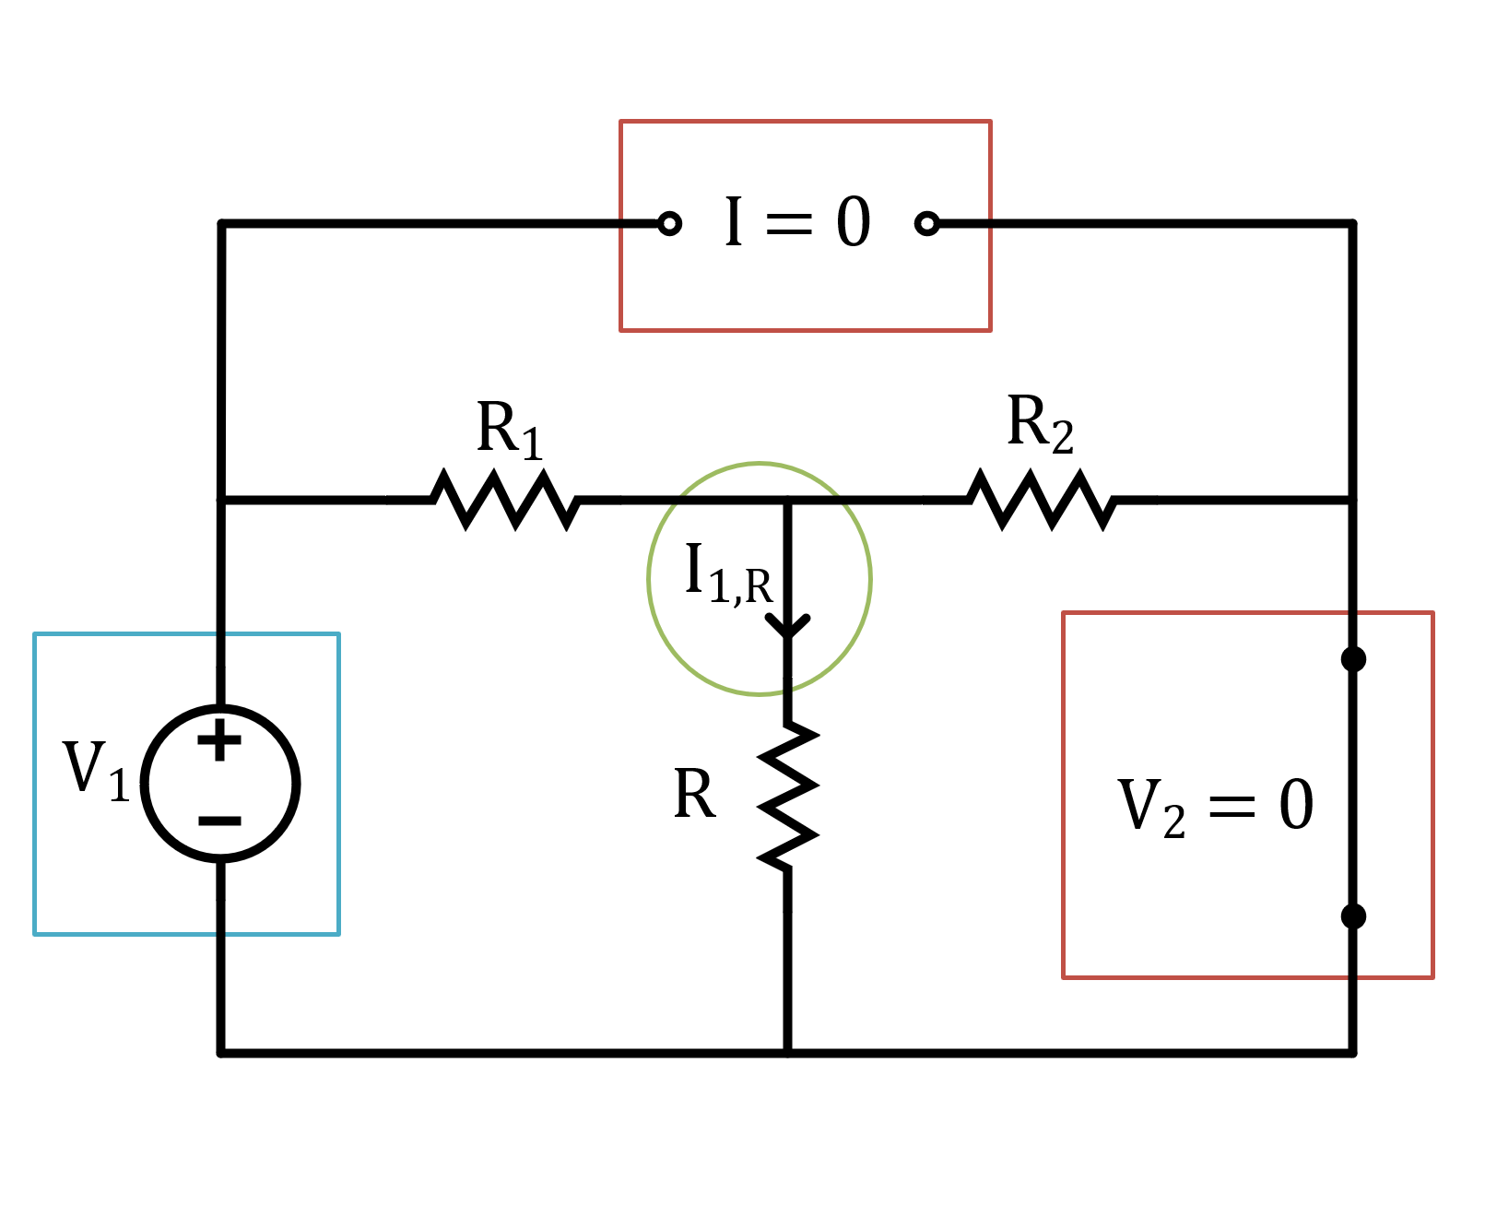
Solution A (cont’d):
The current i_{1,R} can be found using current divider on the branch

Slide 27
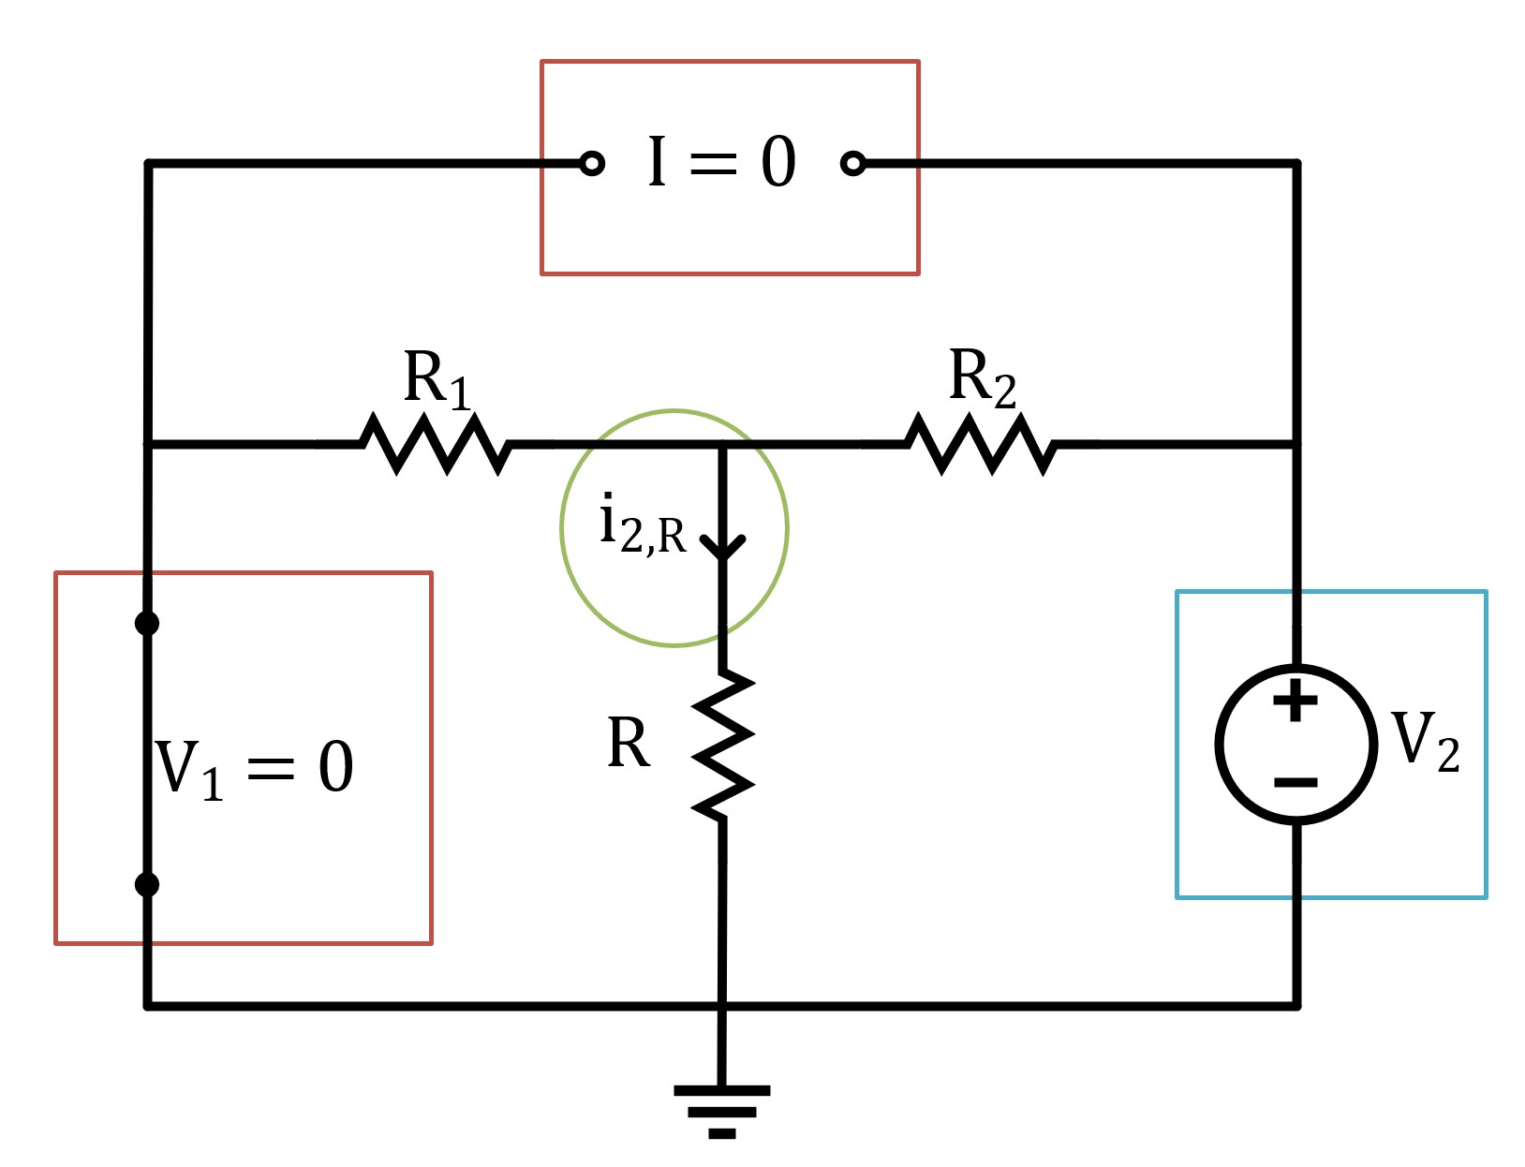
Solution A (cont’d):
Applying voltage V₁ and setting the voltage source V₂ and current source I to zero (short and open circuit respectively)
Simplifying the circuit,

Slide 28
Solution A (cont’d):
The resistance R_{eq} is given by,
Combine R and R₁ into R_{eq} and solve for the current going through the loop.
The current i is given by,

Slide 29
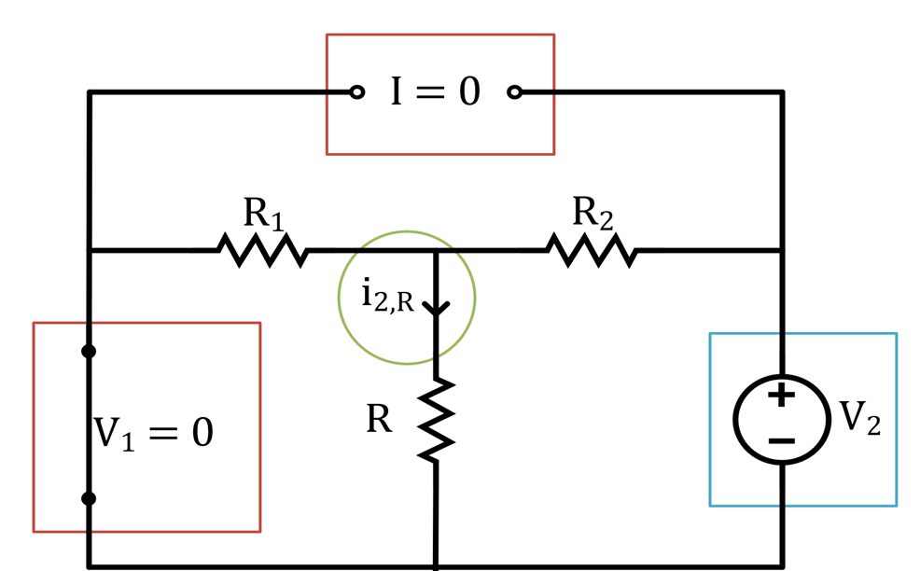
Solution A (cont’d):
The current i_{2,R} can be found using current divider on the branch

Slide 30
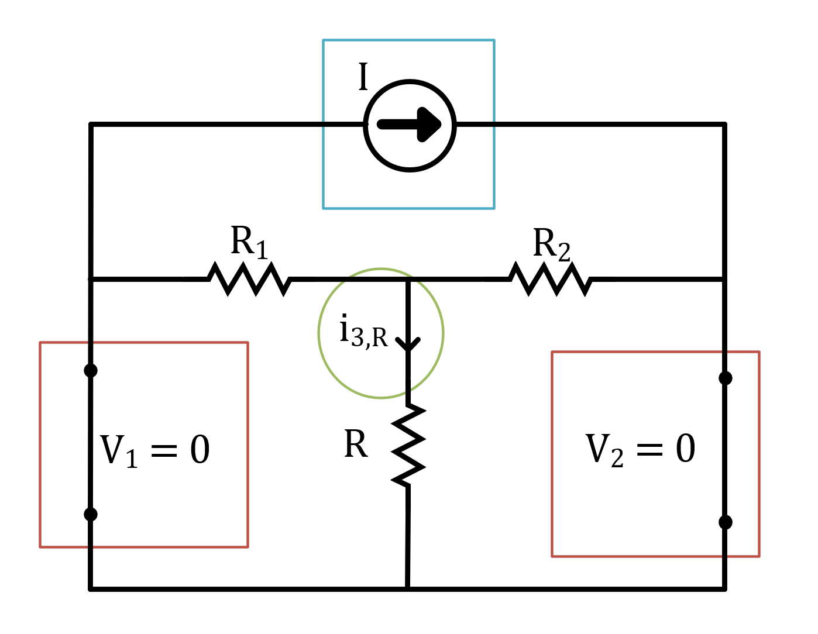
Solution A (cont’d):
Applying current I and setting the voltage source V₁ and voltage source V₂ to zero (short circuits)
It can be seen that the equivalent resistance seen by the current source is equal to zero since all resistors are shorted.
Therefore,

Slide 31

Solution A (cont’d):
Applying current I and setting the voltage source V₁ and voltage source V₂ to zero (short circuits)
It can be seen that the equivalent resistance seen by the current source is equal to zero since all resistors are shorted.
Therefore,

Slide 32
Summary of Solution A
Applying only voltage V₁,
Applying only voltage V₂,
Applying only current source I,
By applying the superposition principle:

Slide 33
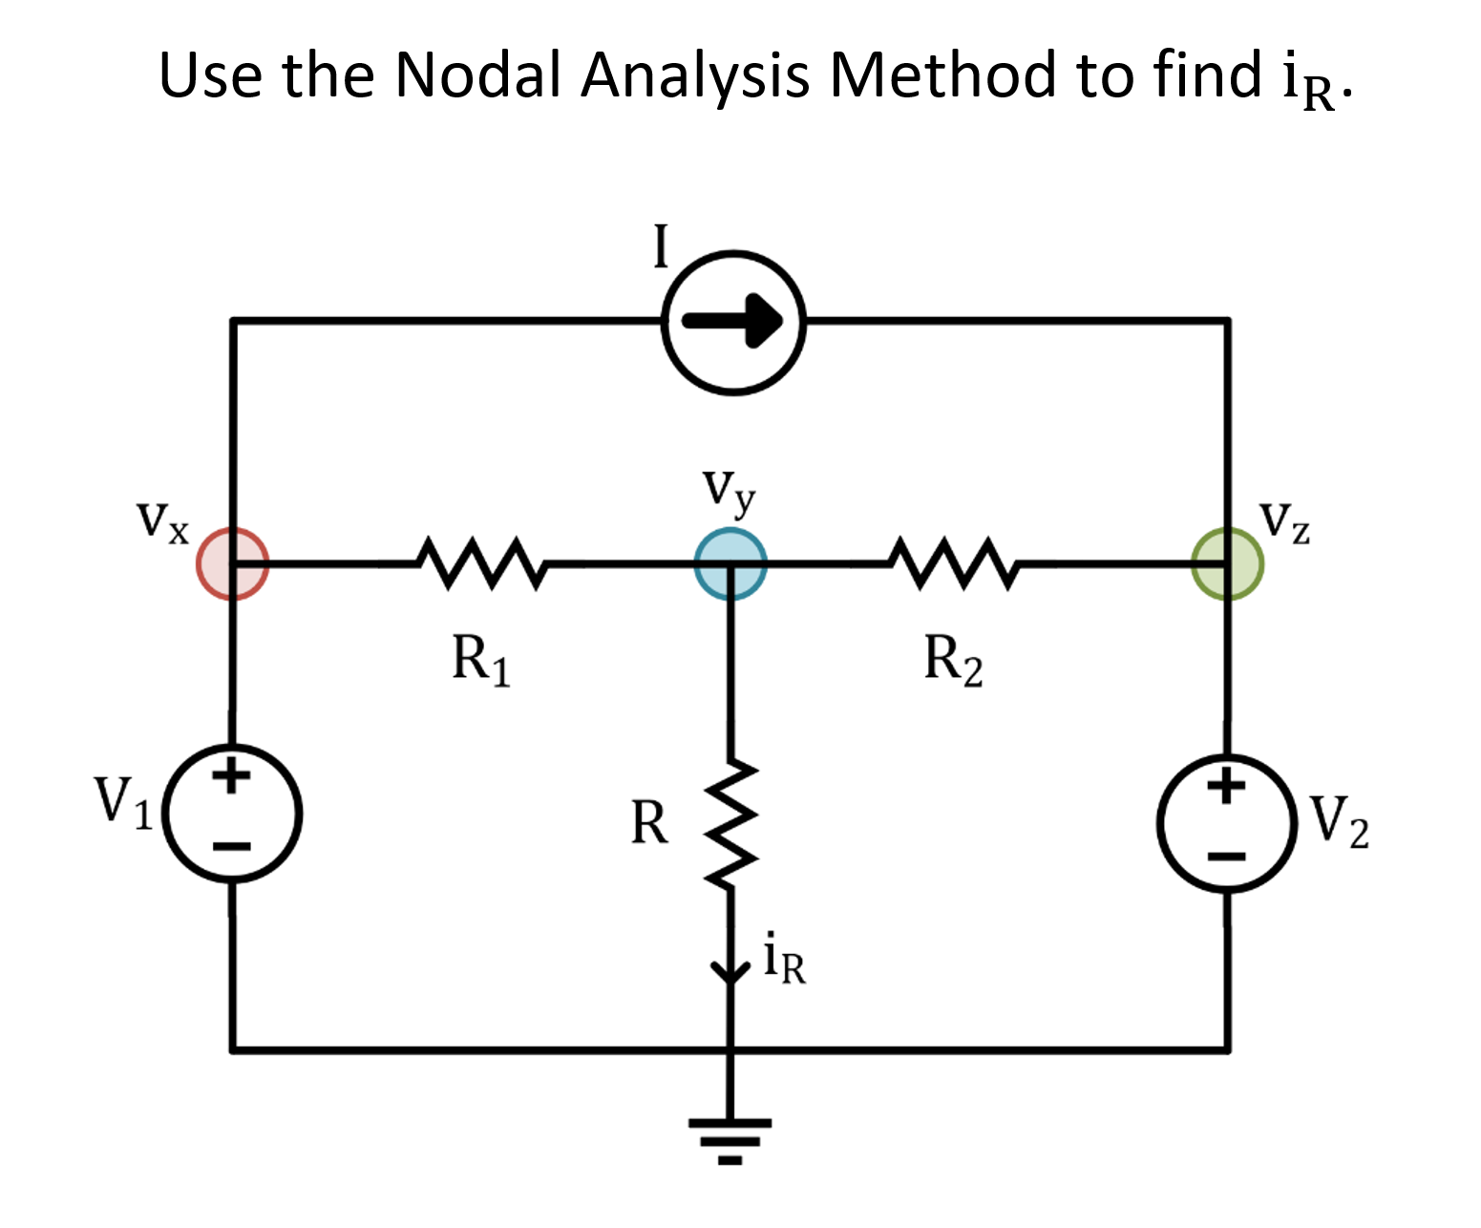
Solution B

Slide 34
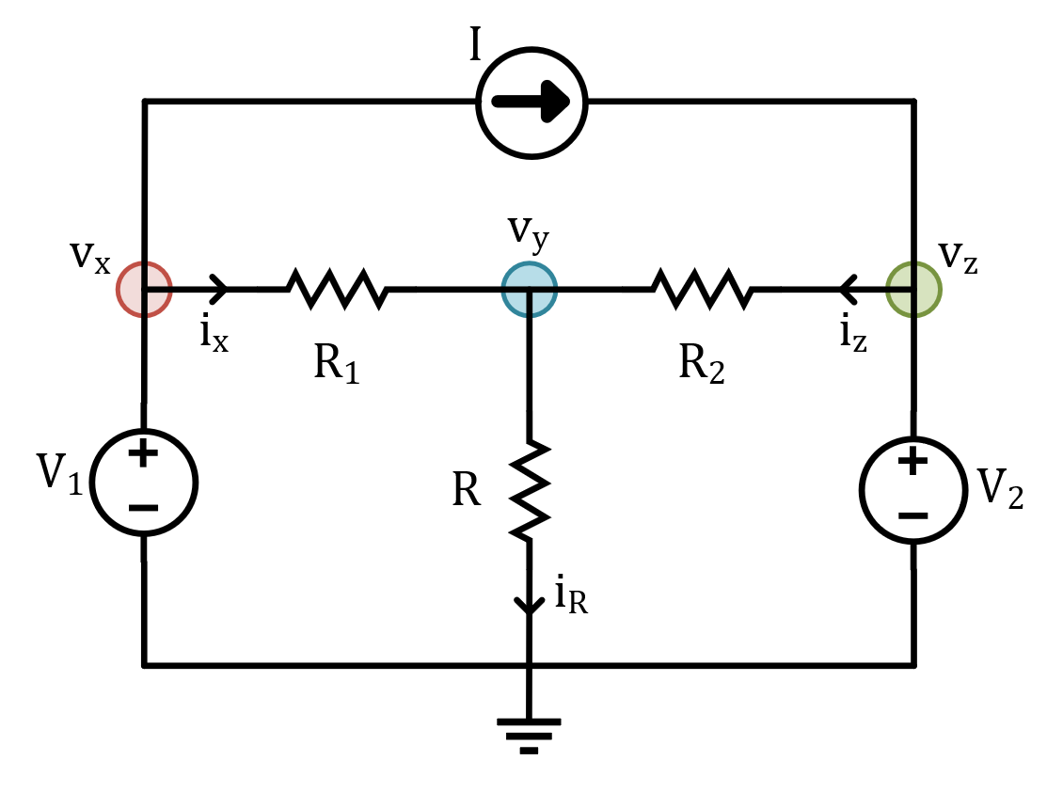
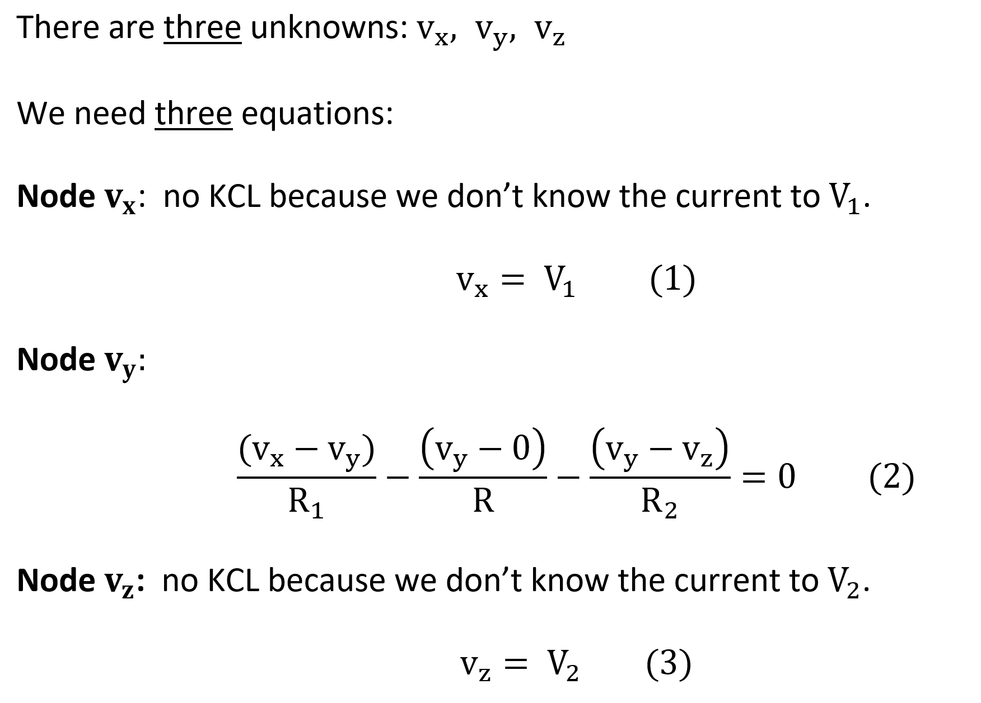
Solution B

Slide 35
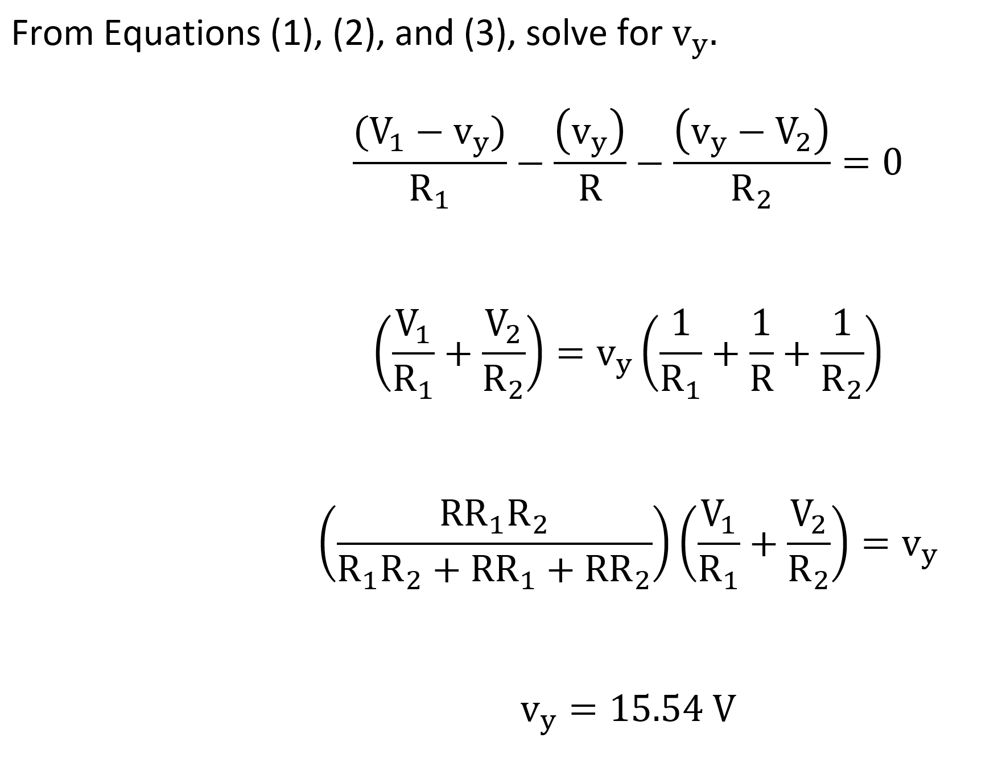
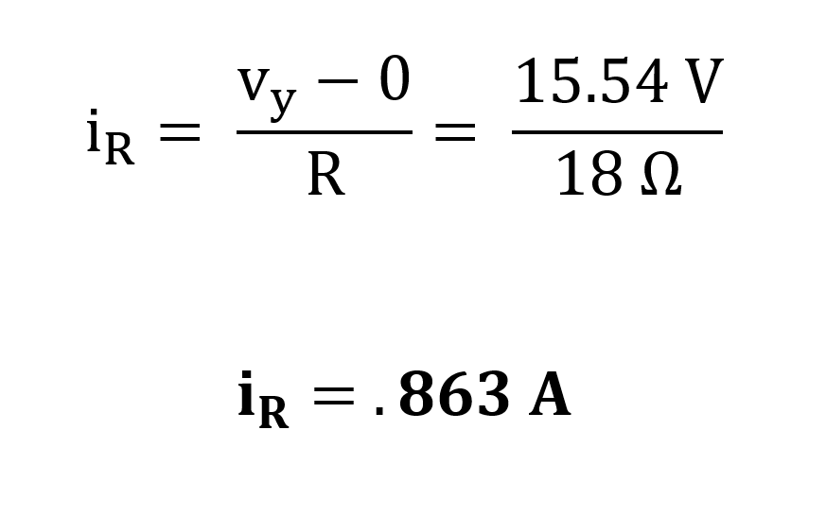
Solution B

Slide 36
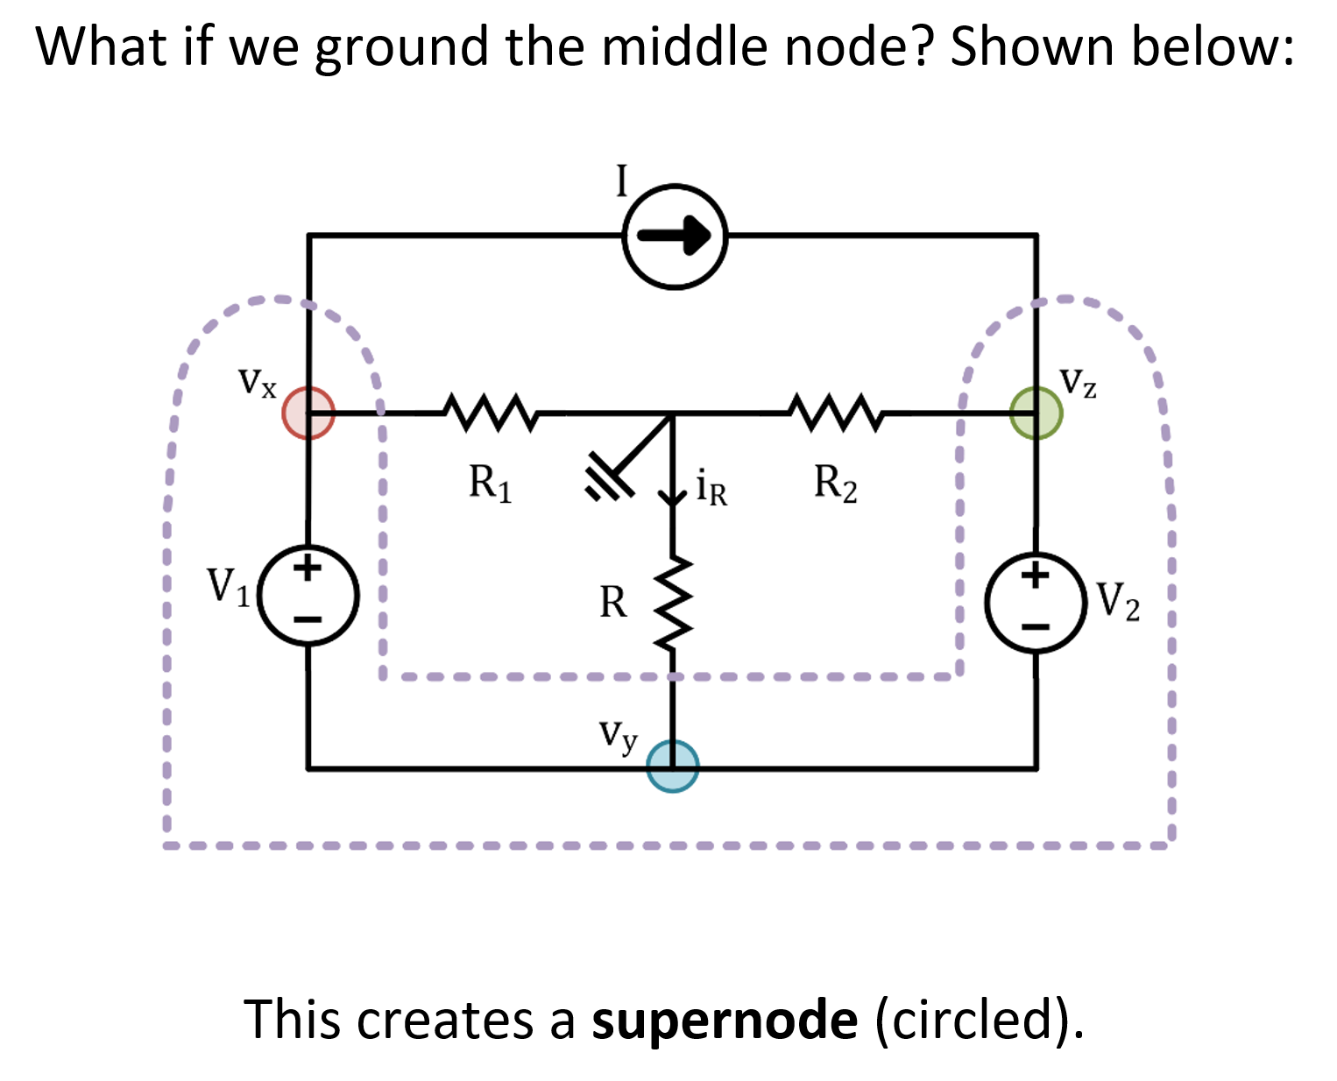
Solution C

Slide 37
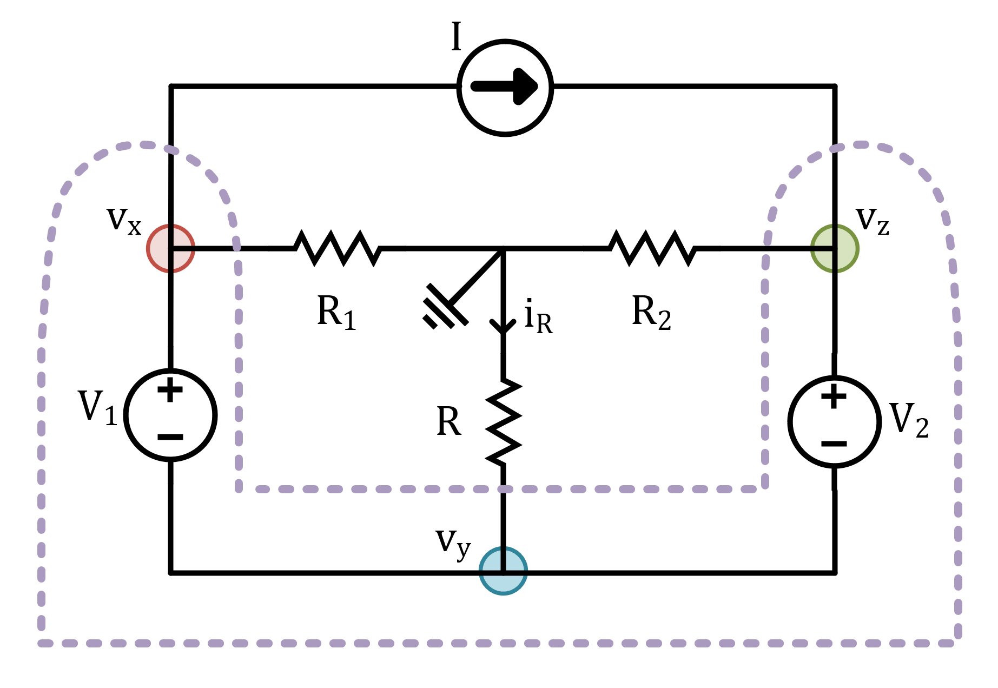
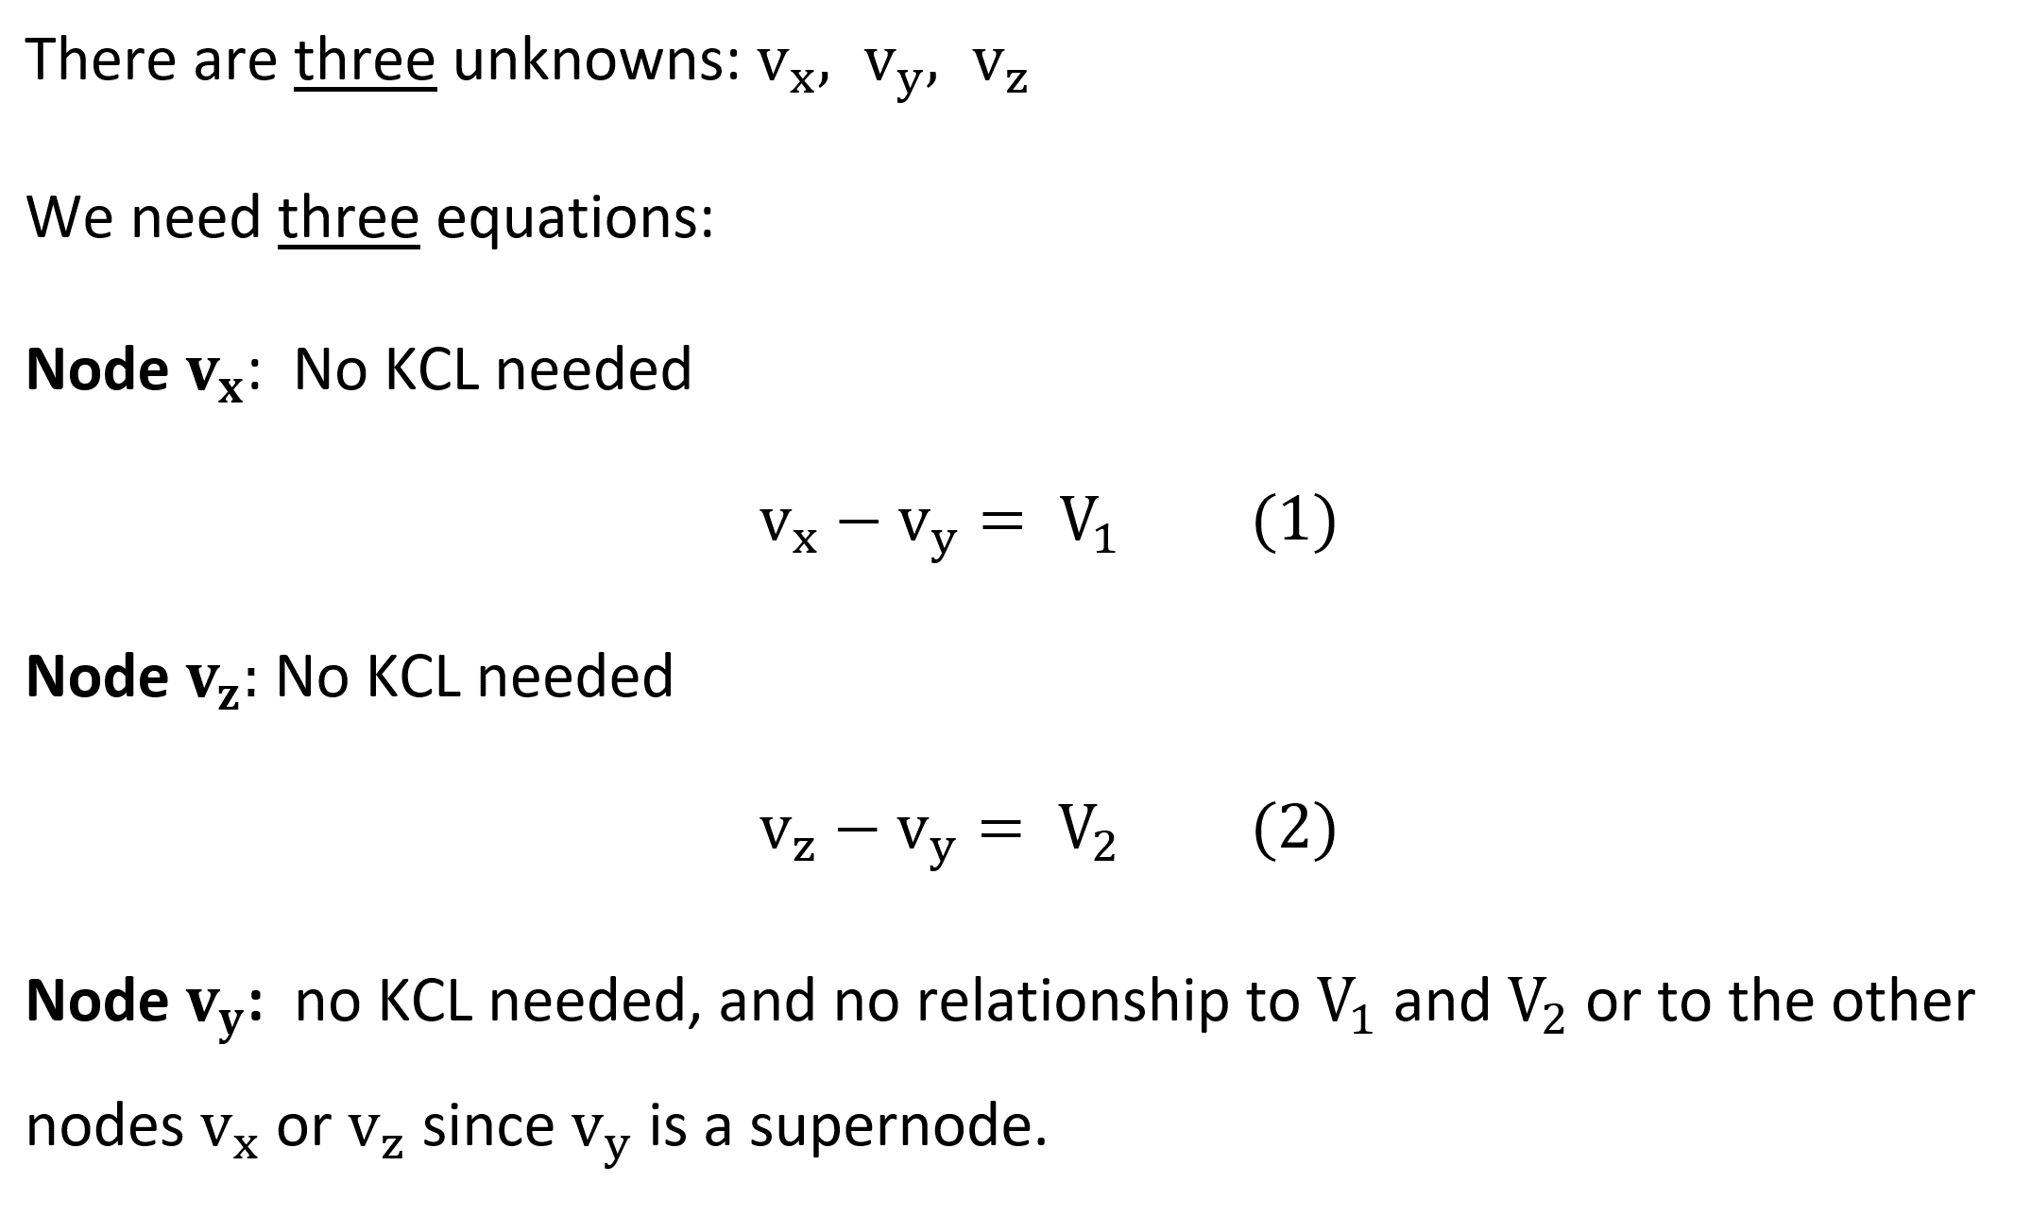
Solution C

Slide 38
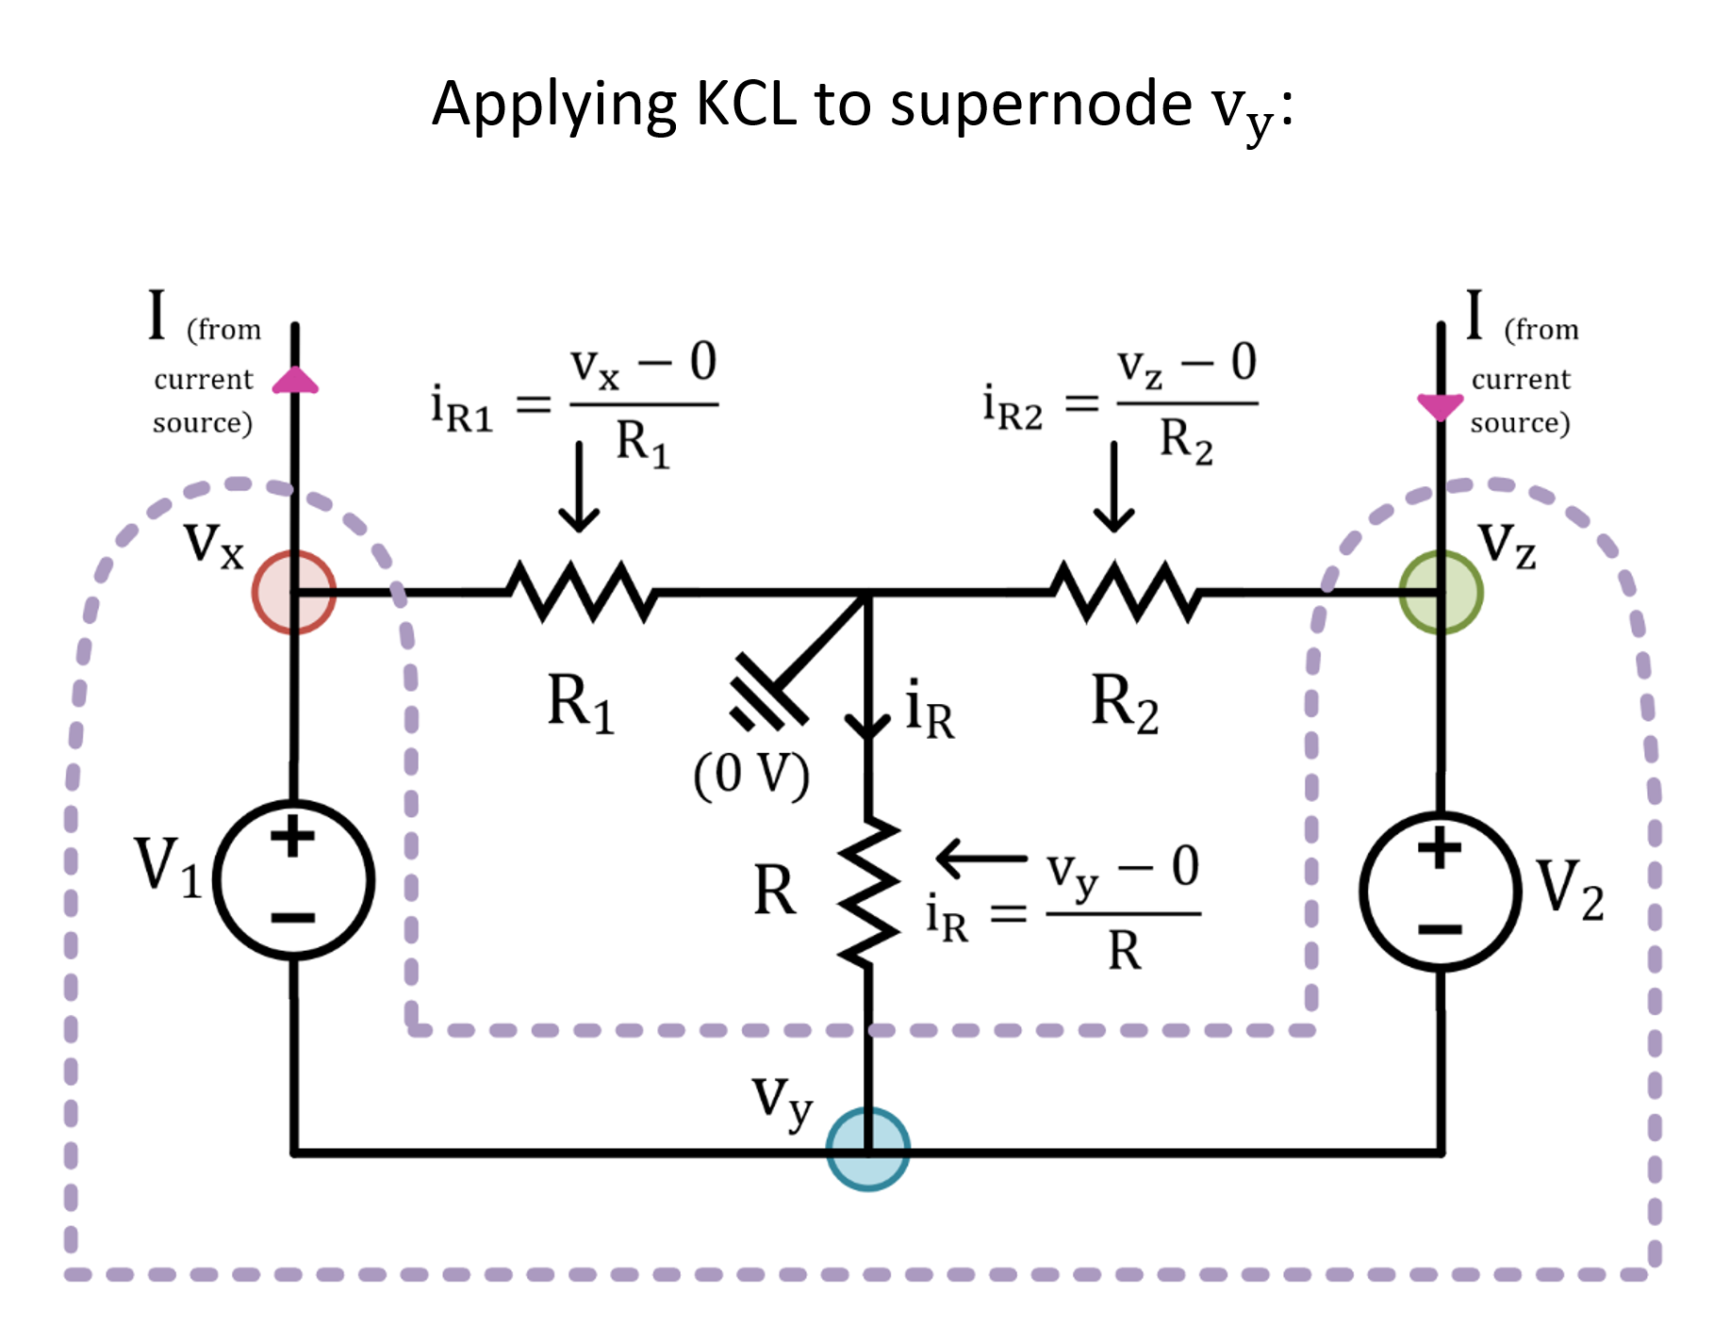
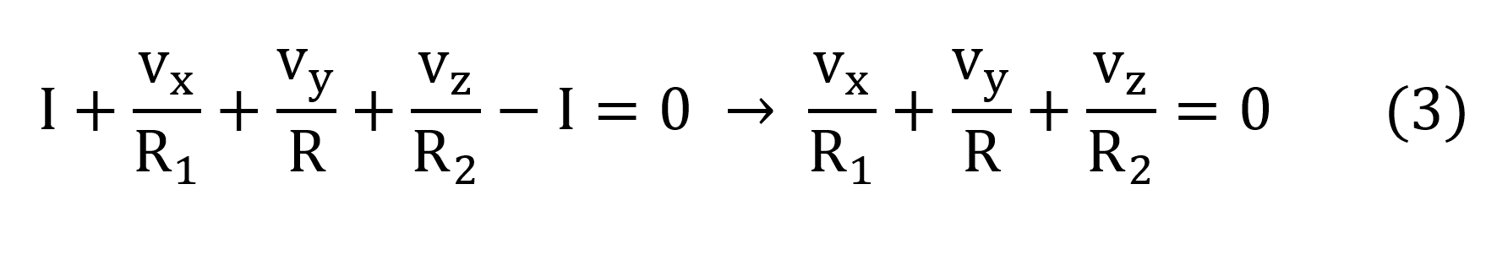
Solution C

Slide 39
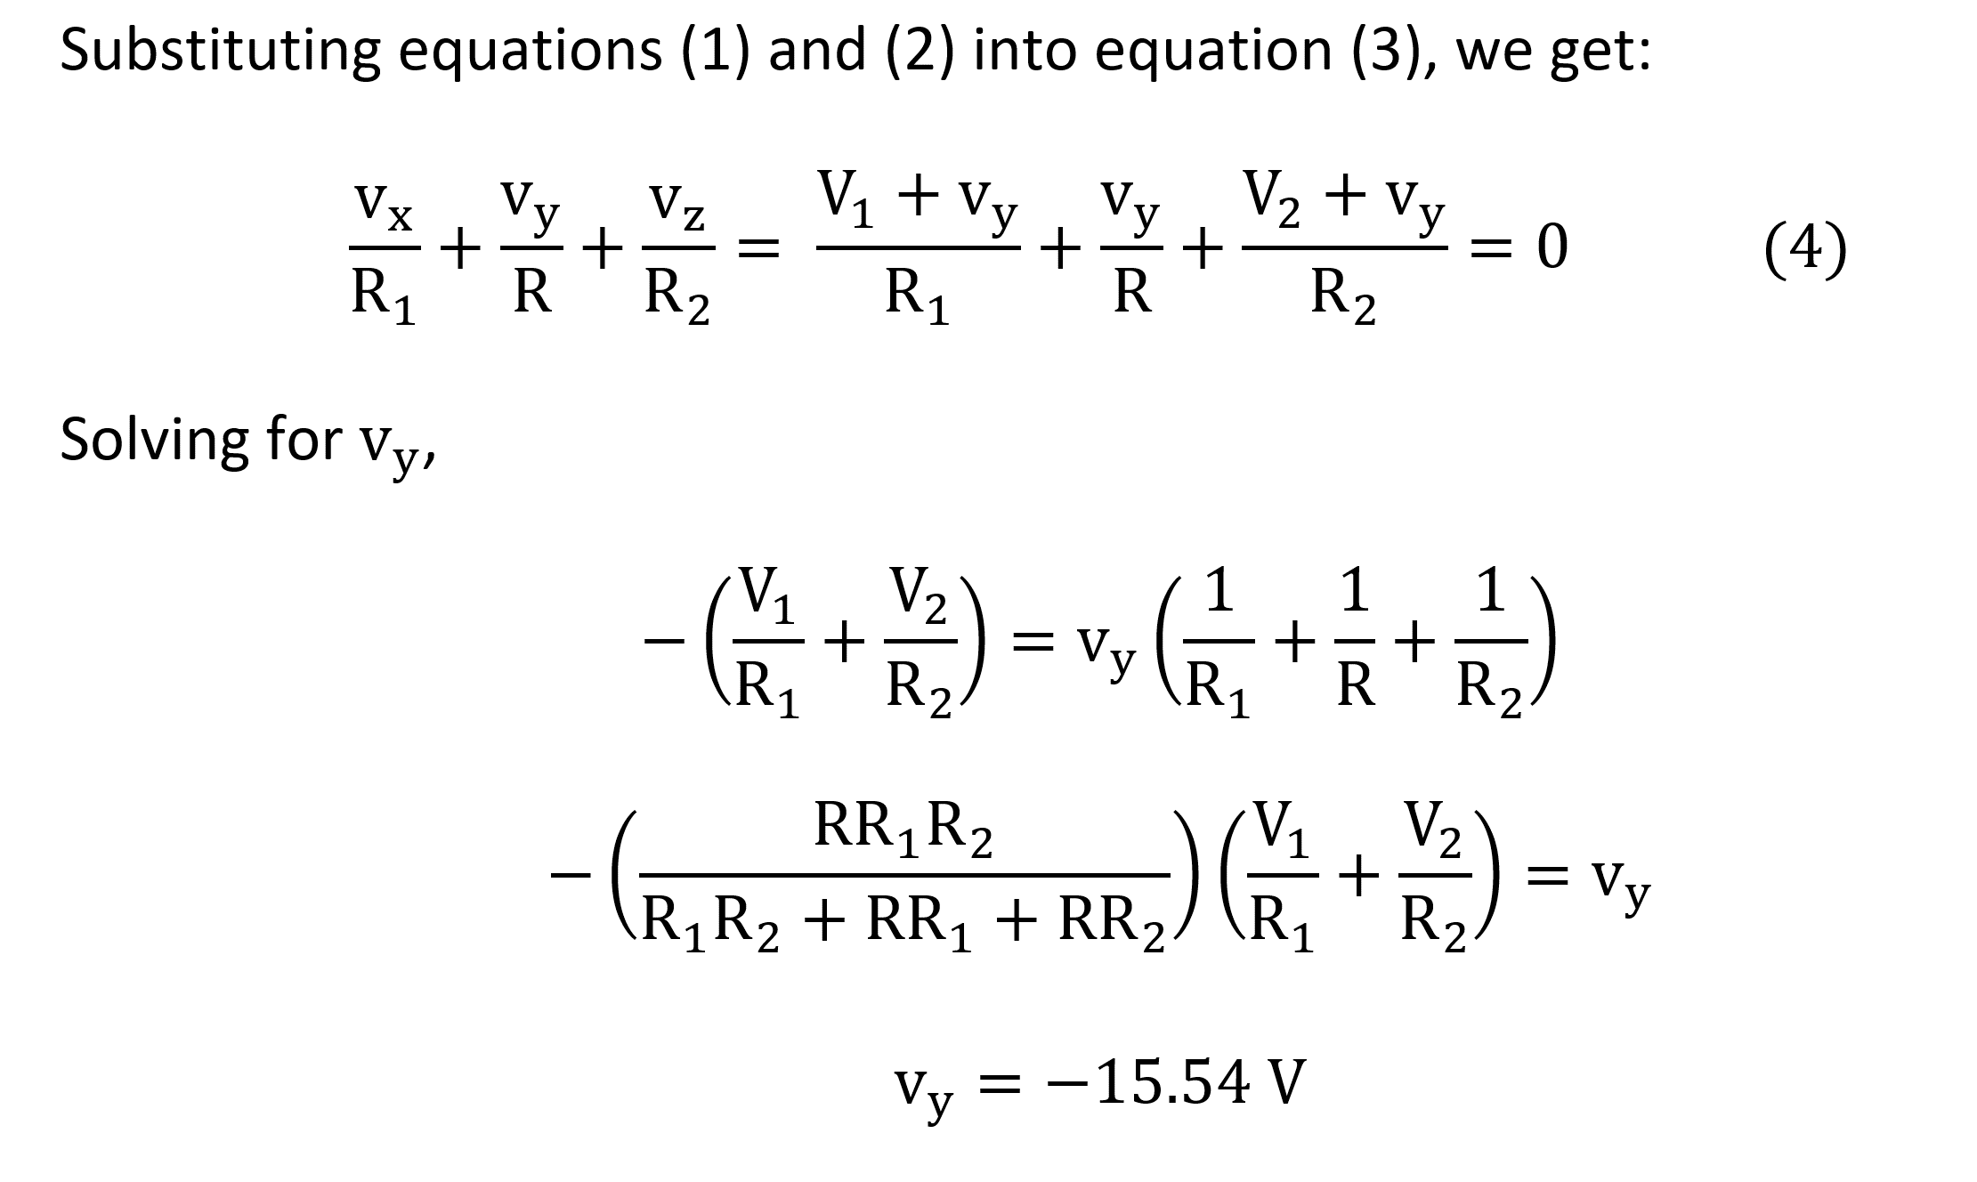
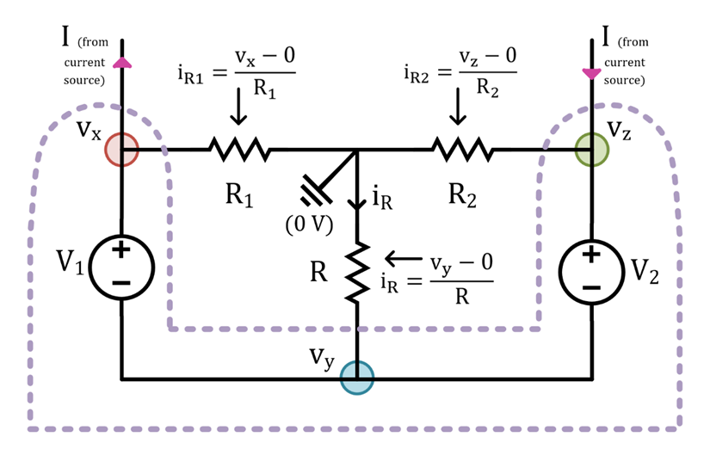
Solution C

Slide 40
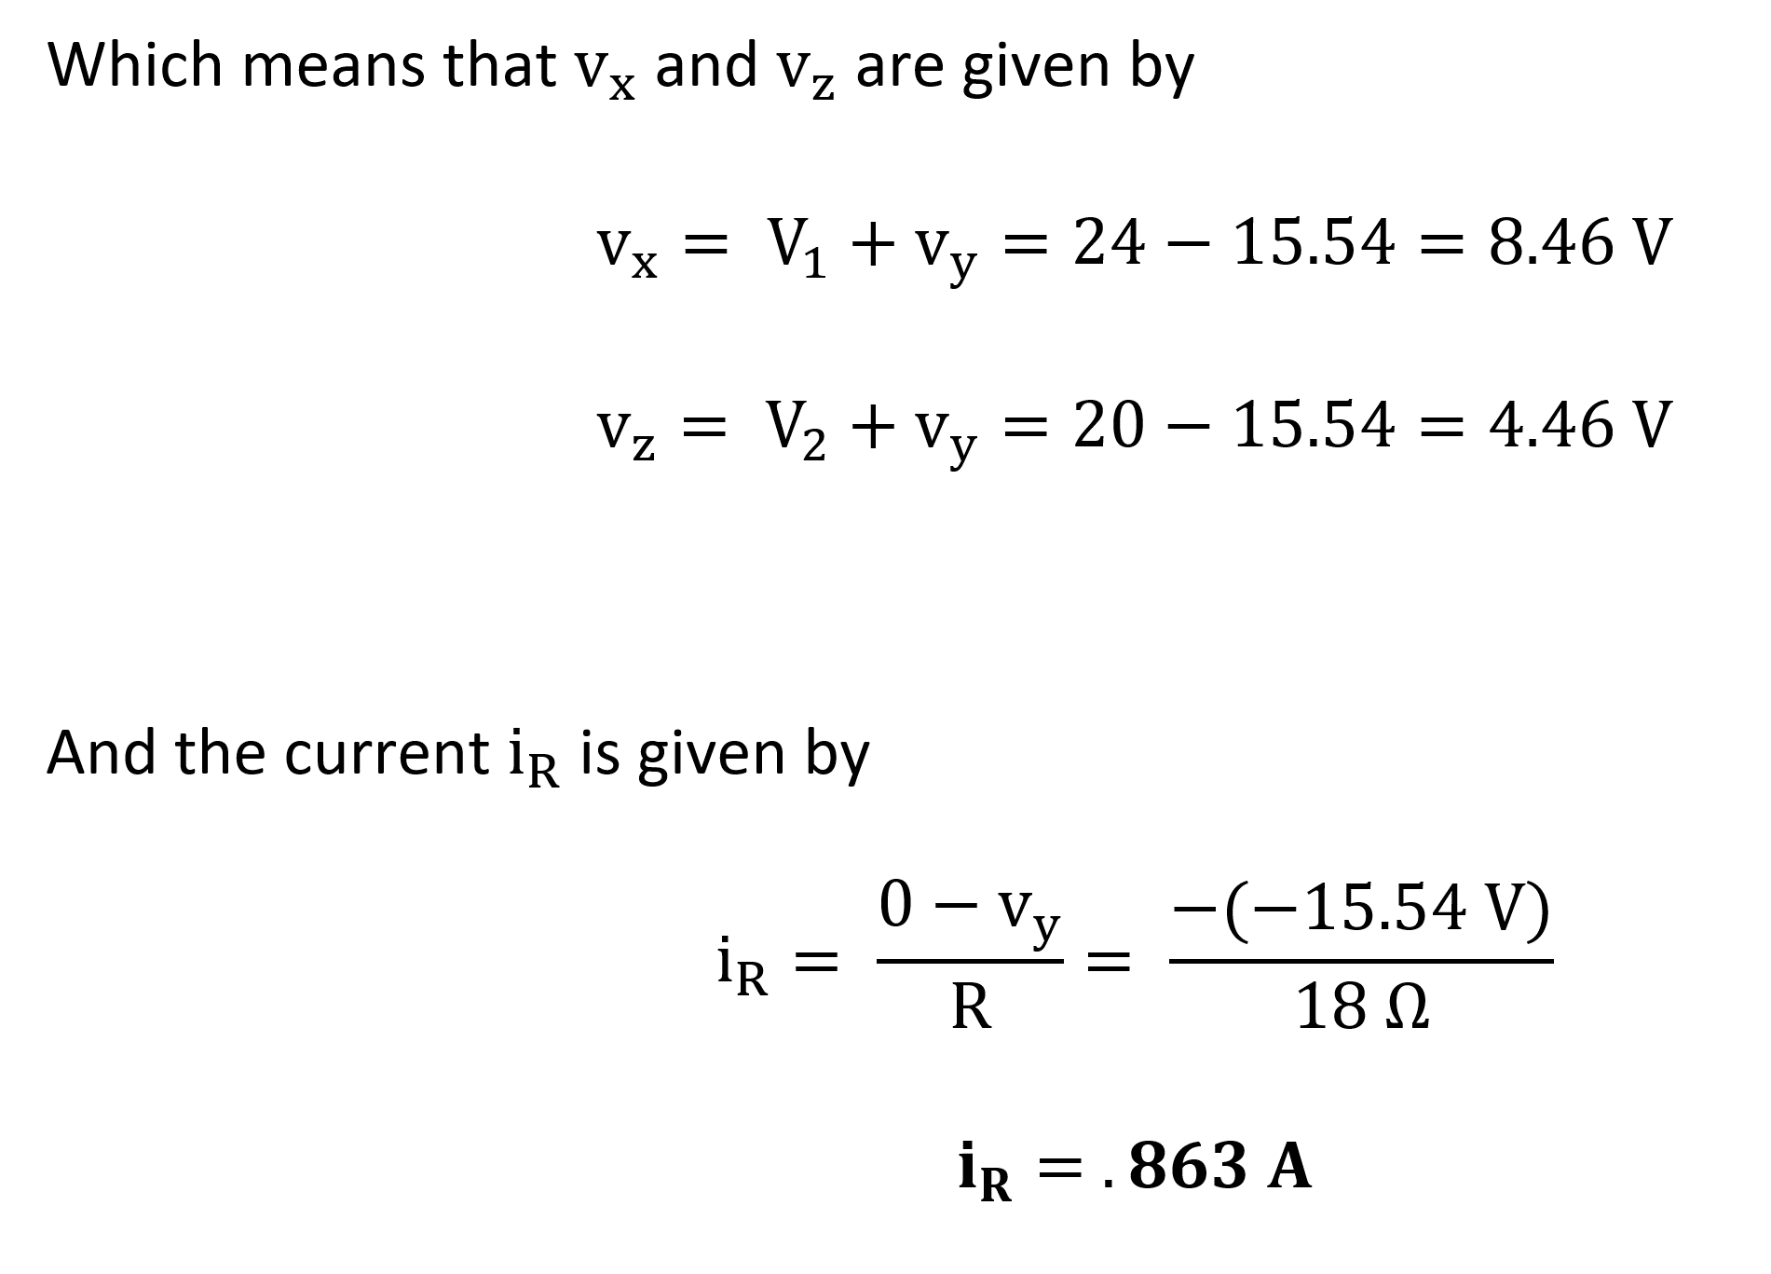
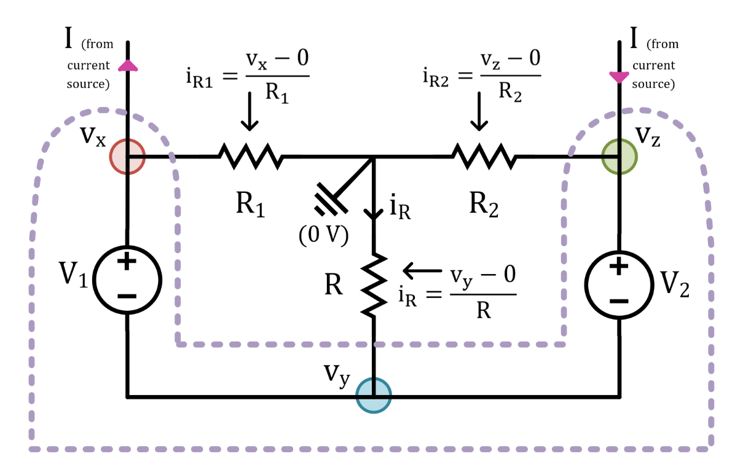
Solution C

Slide 41
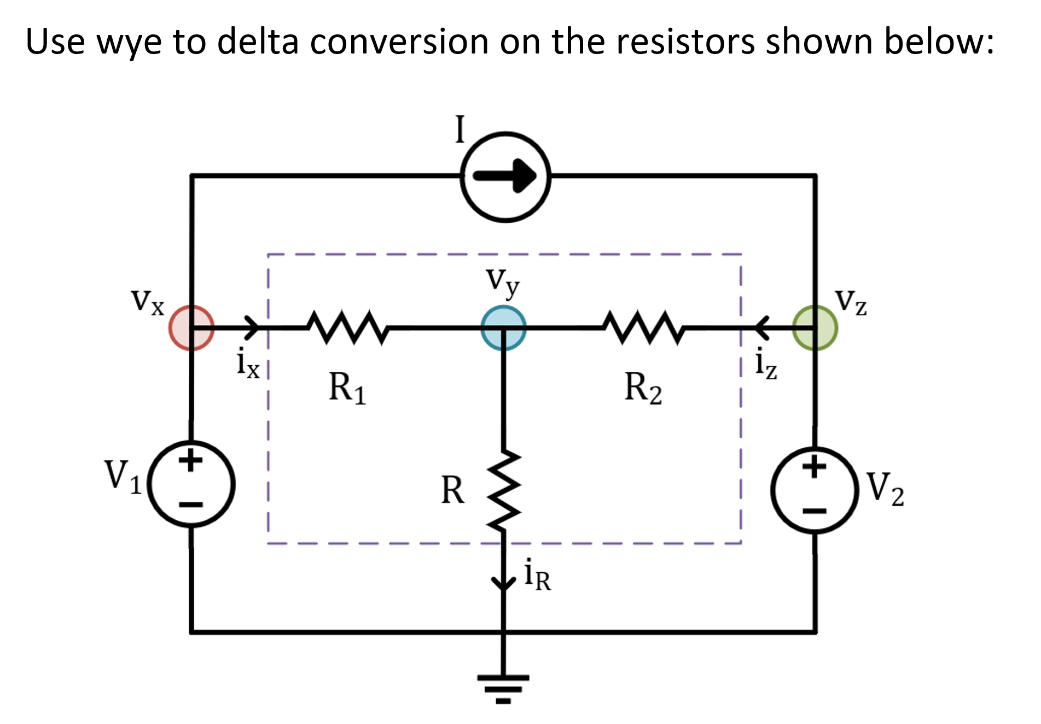
Solution D

Slide 42
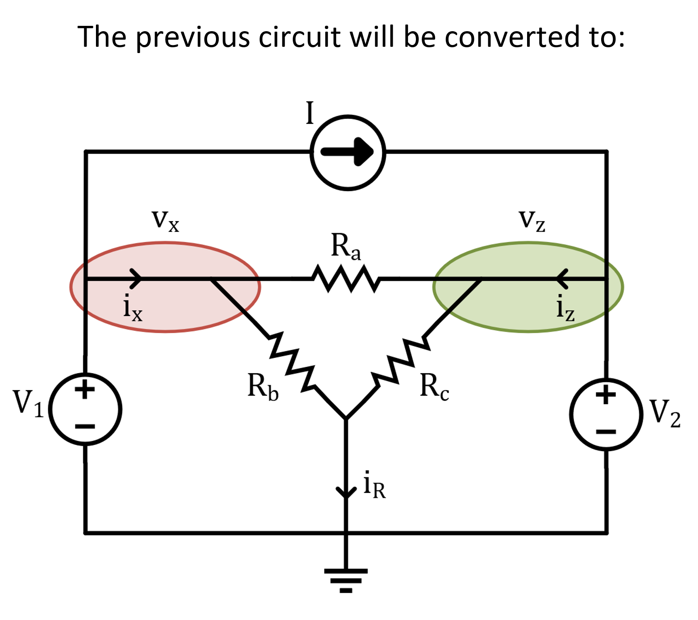
Solution D

Slide 43
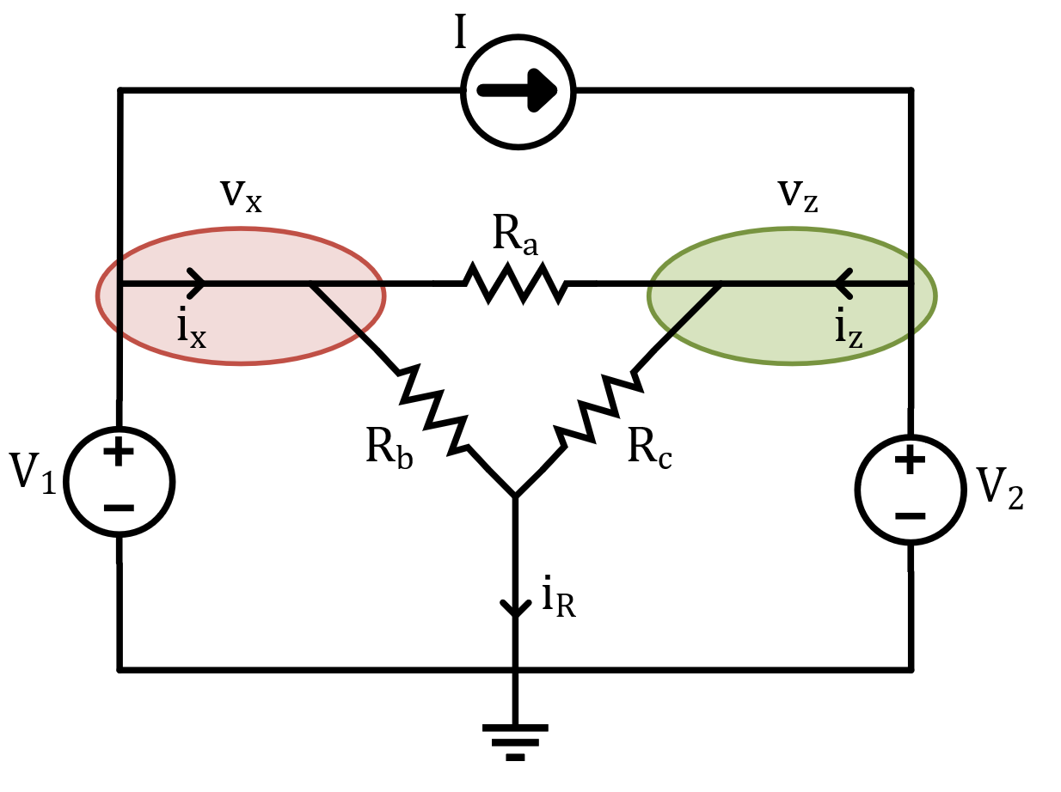
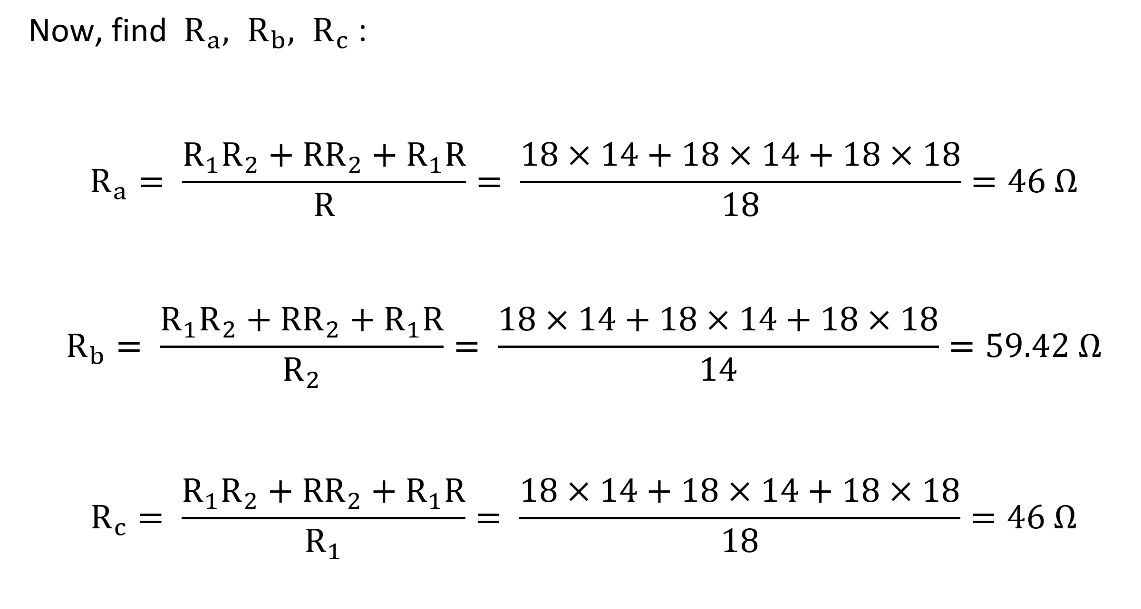
Solution D

Slide 44

Solution D

Slide 45


Solution D

Slide 46

Solution D

Slide 47


Solution D

Slide 48

E) Solution E: Use Thevenin Theorem

Slide 49

i) Find R_{Th} by setting V₁=V₂=0 and I=0 as follows

Slide 50

ii) Find V_{Th} which is the open circuit voltage as follows

Slide 51


Slide 52


Slide 53


Maximum Power Transfer
Consider the Linear Resistive Circuit.
Replace the entire circuit to the left by its Thevenin equivalent.

Slide 54
Maximum Power Transfer
Replace the load current, i_{L}, by the circuit parameters as follows,
Substitute for i_{L},

Slide 55

Maximum Power Transfer
Sketch a plot of p_{Load} vs. R_{Load} for given values of v_{Th} and R_{Th},
?

Slide 56

Maximum Power Transfer
For a given circuit, we recognize that its parameters are fixed, i.e., v_{Th} and R_{Th}, and the goal is to set the adjustable value of R_{Load} so that p_{Load} is maximum.
Set R_{Load} value so that the p_{Load} vs. R_{Load} plot is at its maximum value.

Slide 57
Maximum Power Transfer
Differentiate p_{Load} with respect to R_{Load},
Setting to zero will result in maximum power,
It is clear that is equal to zero when,
This results in the following important relation,

Slide 58
Capacitor Observations
Like the resistor, the capacitor exhibits an algebraic relationship between its branch voltage and the stored charge on its plate.
Time varying voltage applied across the capacitor will induce current flow in the capacitor caused by charge variations through the charging process.
Constant voltage (DC) applied across the capacitor will result in zero capacitor current.
If the voltage across the capacitor changes its value instantly i.e. dt=0, then an infinite current is required. hence,

Slide 59



RECALL
Inductor Observations
Like the resistor, the inductor exhibits an algebraic relationship between its terminal current and the induced magnetic flux in the core.
When time varying current is applied across the inductor, it induces voltage across the inductor winding caused by magnetic field variation.
When the inductor current is a fixed DC value, there is no voltage induced across it.
If the inductor current changes its value instantly i.e. dt=0, then the resultant induced voltage will be infinity. hence,

Slide 60

RLC circuits with DC sources and NO Switching
(Steady-state)
If the circuit consists only of direct current and voltage sources (dc), then the capacitor behaves as an open circuit, and the inductor behaves as a short circuit.
Under DC conditions – the circuit has been undisturbed for a long time

Slide 61
Natural Response of RC circuits
IMPORTANT DEFINITIONS
$$We define:$$
For t < 0, we let
$$v_{c}\left(0^{−}\right)=capacitor voltage just before t=0$$
For t > 0, we let
$$v_{c}\left(0^{+}\right)=capacitor voltage just after t=0$$
Therefore, for the capacitor:
$v_{c}\left(0^{+}\right)$= $v_{c}\left(0^{−}\right)=v_{c}\left(0\right)$

Slide 62

Finding the Natural Response of RC circuits
We follow two-step process:
Find $v_{c}\left(t\right)$ for t < 0 (Before the switching action took place)
But, since we have dc sources and no switching action for long time, the capacitor voltage is constant and is equal to,
$v_{c}\left(t\right)$= $v_{c}\left(0^{−}\right)$
For all time t < 0
II) Find $v_{c}\left(t\right)$ for t > 0 (After the switching action took place)
An ordinary 1st order DEQ with constant coefficients
General solution
$v_{c}\left(t\right)=$ $v_{c}(0^{+})e^{− \frac{t}{τ} }$
$τ=RC$ is the overall time constant
$v_{c}(0^{+}){=v}_{c}(0^{−})$ is the initial capacitor value across $C$
The new circuit

Slide 63
Finding the Natural Response of RC circuits
Notice the following:
1) When $t=τ,$
$v_{c}\left(t\right)=$ $v_{c}(0^{+})e^{− \frac{τ}{τ} }$= $v_{c}(0^{+})e^{− 1 }$= 0.37 $v_{c}(0^{+})$
This means after one time constant ($τ$) the capacitor voltage drops to 37% of its initial value of $v_{c}(0^{+})$
The capacitor voltage drops by 63% from its original value
2) When $t=5τ,$
$v_{c}\left(t\right)=$ $v_{c}(0^{+})e^{− \frac{5τ}{τ} }$= $v_{c}(0^{+})e^{− 5 }$= 0.0067 $v_{c}(0^{+})$
This means after five time constant ($5τ$) the capacitor voltage drops to 0.67% of its initial value of $v_{c}(0^{+})$
The capacitor voltage drops by 99.33% from its original value

Slide 64


Natural Response RL circuits
The natural response for an RL circuits are obtained when the external independent source is set to zero or removed as shown below.
For the natural responses to exist it is required that the inductor have energy stored in it at the moment of switching and the equivalent RL circuits are obtained.
After certain action (switching):
This circuit will responds naturally due to its L &R equivalent values.
We call it natural response or transient response.
R’s and L’s Only
No External source
Our goal to find the voltages, currents and power after t > 0.

Slide 65
Natural Response of LR circuits
IMPORTANT DEFINITIONS
$$We define:$$
For t < 0, we let
$$i_{L}\left(0^{−}\right)=inductor current just before t=0$$
For t > 0, we let
$$i_{L}\left(0^{+}\right)=inductor current just after t=0$$
Therefore, for the inductor has these conditions met all the time:
$i_{L}\left(0^{+}\right)$= $i_{L}\left(0^{−}\right)=i_{L}\left(0\right)$

Slide 66
General Natural Response of LR circuits
Any given resistive-capacitive circuit without external independent DC sources that can be reduced to a series equivalent L/R circuit.
The general solution for i_{L}(t) is given,
$i_{L}\left(t\right)=i_{L}(0)e^{−t/τ}$
$τ=\frac{L}{R}$ is the circuit time constant
R: The total resistance seen by the inductor
$i_{L}(0)$= $i_{L}\left(0^{−}\right)=i_{L}\left(0^{+}\right)$ is the initial inductor value
across in L.
Simplified circuit

Slide 67

Example
For the following RC circuit with a DC voltage source. Initially the switch has been connected to position ‘a’ for a long time. At t=0, the switch moved to position ‘b’. Determine:
The voltage response for v_{C}(t), for t≥0,
The current i_{R1}(t) for t>0,
The total energy dissipated in R₁ at t=τ, 5τ, and ∞.
Variable | Values | Unit
I_{o} | 2 | mA
R₁ | 4.5 | kΩ
R₂ | 2.4 | kΩ
R_{o1} | 8 | kΩ
R_{o2} | 16 | kΩ
R_{o3} | 24 | kΩ
C | 2.1 | mF

Slide 68


For t < 0 the capacitor is fully charged. Hence at t=0⁻ we have,

Slide 69


For t > 0,
Calculating τ,

Slide 70

For t > 0,
Calculating τ,
Substituting these values in the default expression,

Slide 71

The current across the resistor can be calculated as,

Slide 72

The current across the resistor can be calculated as,
The total energy dissipated in R₁ is given by,

Slide 73

Energy dissipated at different times can be found as,

Slide 74

Example
In the circuit, the switch has been closed for a long time and opened at t=0. Determine:
The voltage v_{x}(t), and current i_{x}(t) for t ≥ 0,
Energy stored in the capacitor for t = 0,
Energy dissipated in R₃ at t = ∞.
Variable | Default | Unit
I_{o} | 4 | A
R_{o} | 5 | Ω
R₁ | 8 | Ω
R₂ | 5 | Ω
R₃ | 4 | Ω
C | 1.5 | μF
β | 5 | -

Slide 75

For t < 0 the capacitor is fully charged. Hence at t = 0⁻ we have,

Slide 76

For t < 0 the capacitor is fully charged. Hence at t = 0⁻ we have,
Applying KVL around the loops,
Where,

Slide 77

For t < 0 the capacitor is fully charged. Hence at t = 0⁻ we have,
Applying KVL around the loops,
Where,
Solving for i₂ yields,

Slide 78

Solving for i₂ yields,
The initial capacitor voltage is given by,

Slide 79

After the switch is opened for t > 0,

Slide 80
After the switch is opened for t > 0,
Applying KVL around the loop,

Slide 81



After the switch is opened for t > 0,
Applying KVL around the loop,
Substituting i_{x}, the equation becomes,

Slide 82


Solving for v_{x}(t),
Where,

Slide 83

The current i_{x}(t) is calculated as follows,

Slide 84


The initial energy stored in the capacitor,
The total energy dissipated in R₃ is given by,

Slide 85




For t > 0,
Therefore the time constant is given by,
As t → ∞, the capacitor acts as an open circuit,
The general solution for the forced response of v_{C}(t) is given by,

Slide 86

Example
The switch in the circuit has been in position ‘a’ for a long time. At t = 0, the switch is moved to position ‘b’. Determine:
The current i_{o}(t) for t > 0,
The initial energy stored in L.
Variable | Default | Unit
I_{o} | 25 | mA
R_{o} | 100 | Ω
R₁ | 200 | Ω
R₂ | 150 | Ω
L | 10 | mH
α | 3 | -

Slide 87



For t < 0 the switch has been open for a long time allowing the inductor to act like a short circuit,
Applying KCL at the top node,
Solving for V₁,

Slide 88

For t < 0 the switch has been open for a long time allowing the inductor to act like a short circuit,
Therefore the current iL(0⁻) is,
Since the current through the inductor doesn’t change instantaneously,

Slide 89






For t > 0, the switch closes resulting in a forced RL circuit,
To find the time constant, we need to find R_{Th},
Thus the time constant,
R_{Th} seen by the inductor,

Slide 90

AC Phasor Analysis Technique
Phasor technique obtains the steady-state, which significantly reduces mathematical complexity. Unlike the differential equation solution approach that leads to both responses.
All voltage and current responses due to sinusoidal excitation will also be sinusoidal at the same frequency of the excitation signal.
Only their maximum amplitudes and phase shift will be different than the excitation signal.
The phasor impedance refers to the phasor equivalence in complex numbers of the single elements R, L and C expressed as impedance,
The phasor I-V relationship for the three elements is given by,

Slide 91

AC Phasor Analysis Technique
Powerful analysis techniques such as nodal and mesh analysis can be used in phasor circuits to obtain steady state voltages and currents in AC circuits.
When analyzing phasor circuits, voltage and current sources should be in cosine reference, then we transfer the circuit elements from time-domain to phasor-domain equivalent,

Slide 92

Example
For the given circuit, the voltage input is given by:
Determine the expressions i_{x}(t) and v_{x}(t).
Variable | Default | Unit
V_{m} | 10 | V
ω | 3000 | rad/s
θ | π/3 | rad
R₁ | 5 | Ω
L₁ | 0.2 | mH
L₂ | 0.2 | mH
C | 0.8 | mF
β | 8

Slide 93


First we transform the circuit into the phasor-domain,
It can be seen that the current I_{x} equals I₁ – I₂, and that,
Now applying KVL around both loops yields,

Slide 94


Solving both equations for I₁,
Solving both equations for I₂,

Slide 95


Calculating the voltage V_{x},
Calculating the voltage I_{x},

Slide 96


Transforming the voltage V_{x} back to the time-domain yields,
Transforming the voltage I_{x} back to the time-domain yields,

Slide 97
Power Calculations
Instantaneous power for transient dc RLC circuits and steady state ac circuits.
Average power for purely resistive, purely capacitive, purely inductive, and resistive reactive RLC networks.
Reactive Power
Complex power, apparent power, and the power factor.
Power factor Pf under more details and for different types of load impedance.

Slide 98

Power Calculations
Instantaneous power, P(t), is measured as the product of the instantaneous current, i(t), and the instantaneous voltage, v(t).
Average Power is the average rate by which energy is being absorbed by a circuit element, it is defined as the average of the instantaneous power, p(t),
Reactive power is power that gets exchanged back and forth in reactive elements; inductors and capacitors, denoted by Q.

Slide 99

Instantaneous Power
The instantaneous power, P(t), is measured as the product of the instantaneous currant, i(t), and the instantaneous voltage, v(t).
The unit of instantaneous power, P(t), is watts (W).

Slide 100

Power Calculations
For general RLC circuits,
Where p(t) is the instantaneous power, P_{av} is the average power being delivered to the network, and Q is the reactive power being stored is the reactive elements.

Slide 101


The Average Power
For a general linear RLC circuits with a purely sinusoidal voltage source excitation, , corresponding supplied source current, , the instantaneous power supplied by the source is given by,
The resulting average power supplied by the source,
The integral of the second term is zero over one cycle, therefore,

Slide 102


Reactive Power
To distinguish the average power and the reactive power, we use watts (W) for instantaneous and average (real) power
Watts (W)
Where as Q is given as the product of volt (V) and amp (I) for reactive power (R) for reactive power – (VAR)
VAR
When Q is positive then the circuit is inductive and when Q is negative then the circuit is capacitive

Slide 103

Reactive Power
Having defined Q, the instantaneous power expressions P_{av} for capacitors and inductors can be expressed in terms of Q,
So the measure of the power associated with an inductor and capacitor is the reactive power Q.
Q represents the average amount of power that gets exchanged between the source and the rest of the circuit.
P_{av} represents the measure of the power associated with a resistor.

Slide 104


Reactive power In the inductor
Recall that the reactive power in any circuit with is given by,
$Q=\frac{\left|V\right||I|}{2}sin⁡(θ_{v}−θ_{i}$)
$Q=\frac{V_{m}I_{m}}{2}sin⁡(θ_{v}−θ_{i}$)
For the inductor,
$V_{L}=\left(jωL\right)I_{L}$= ${ωL I}_{L}∠{90}^{o}$
Then the Reactive Power in the inductor,
$$Q_{L}=\frac{\left|V_{L}\right||I_{L}|}{2}sin{90}^{o}$$
Since we have,
$$Q_{L}=ωL\frac{{{|I}_{L}|}^{2}}{2}$$
$${|V}_{L}|={ωL|I}_{L}|$$
$$Q_{L}=ωL\frac{{{|I}_{L}|}^{2}}{2}sin{90}^{o}$$
$$Q_{L}=ωL\frac{{I_{m}}^{2}}{2}$$

Slide 105

Reactive power In the inductor
Recall that the reactive power in any circuit with is given by,
$Q=\frac{\left|V\right||I|}{2}sin⁡(θ_{v}−θ_{i}$)
$Q=\frac{V_{m}I_{m}}{2}sin⁡(θ_{v}−θ_{i}$)
For the capacitor,
$V_{C}=\left(−j\frac{1}{ωL}\right)I_{C}$= ${\frac{1}{ωL}I}_{C}∠{−90}^{o}$
Then the Reactive Power in the capacitor,
$$Q_{L}=\frac{\left|V_{C}\right||I_{C}|}{2}sin{−90}^{o}$$
Since we have,
$$Q_{C}=\frac{1}{ωL}\frac{{{|I}_{C}|}^{2}}{2}$$
$${|V}_{C}|={\frac{1}{ωC}|I}_{C}|$$
$$Q_{C}=\frac{1}{ωC}\frac{{{|I}_{C}|}^{2}}{2}sin{−90}^{o}$$
$$Q_{C}=−\frac{1}{ωC}\frac{{I_{m}}^{2}}{2}$$

Slide 106

Complex Power
Complex power contains all the relevant information needed to calculate power delivered to the load, denoted by S, and defined as,
The real part of S is the exactly equal to the average power, and the imaginary part of S is exactly equal to the reactive power.
Substituting for P_{ave} and Q, yields,

Slide 107


Slide 108


Three phase Voltages Configurations
Neutral Wire
Wye Connected Source
Delta Connected Source
V_{an} = V_{p} ∠0°
V_{bn} = V_{p} ∠ −120°
V_{cn} = V_{p}∠ − 240°
V_{an} = V_{p}∠0°
V_{bn} = V_{p} ∠ +120°
V_{cn} = V_{p} ∠ + 240°
V_{an} + V_{bn} + V_{cn} =0

Slide 109



Balanced Three phase Loads
Wye-connected load
Delta-connected load
Delta-Wye Conversion in Balanced three-phase circuits:
Z_{Y} =Z₁ = Z₂ = Z₃
Z∆ =Z_{a} = Z_{b} = Z_{c}
Z∆ = 3Z_{Y}
Z_{Y} = $\frac{1}{3}$Z ∆

Slide 110
Three phase Load Connections
Both the three-phase source and the three-phase load can be connected either in Wye or Delta configurations.
Therefore, we have 4 possible Source-Load connection types.
  Y-Y
  Y-Δ
  Δ-Δ
  Δ-Y

Slide 111

Typical Balanced Wye-wye Connection
A balanced Y-Y system, showing the source, line and load impedances.
Source Impedance
Line Impedance
Load Impedance

Slide 112

Practical Example
Complex Power
Power Generation Plant
Simplified Circuit Model

Slide 113
Practical Example
Complex Power
Power Generation Plant
Bus 1 is the generation bus,
Bus 2 is the load with impedance Z_{Load}.
Transmission line with a line impedance Z_{Line:}
Numerical Example
In the given 2-bus system circuit, if Z_{Transformer} = 0.4 + j2 Ω, Z_{Line} = 1+j2 Ω, and Z_{Load} = 20 + j10 Ω. If the load consumes a complex power of S_{Load} = 40 + j20 kVA.

Slide 114

Practical Application: Voltage Division Formula
The Wheatstone Bridge
A Wheatstone bridge is a measuring instrument used to measure an unknown electrical resistance.
R_{x} is the unknown resistance to be measured; R₁, R₂ and R₃ are resistors of known resistance and the resistance of R₃ is adjustable.
Unknown
Resistor
Variable resistor

Slide 115



Slide 116


Slide 117



$$ε$$

Slide 118

(foil)

Slide 119



Practical Application
- Voltage Division Formula -
When all the resistors are equal to R:
$v_{out}$ = 0

Slide 120

Practical Application
- Voltage Division Formula -
When all the resistors are equal to R:
$v_{out}=0$

Slide 121


Practical Application
- Voltage Division Formula -
With strain gage is connected,
$v_{out}= \frac{△R}{4R+2△R}v$

Slide 122



Practical Application- Strain Gauge - Voltage Division Formula -
The output of the bridge changes nonlinearly with applied force.
However, R is several hundred ohms, while ∆R is typically 0.01 Ω, a factor of 10,000 times smaller.
So, we assume that
$v_{out}= \frac{△R}{4R+2△R}v$
$v_{out}≈ \frac{△R}{4R}v$
Small strain produced
measurable voltage ☺

