Slide 1
EEL 3004 Electrical Networks Lecture #22 Reactive and Complex Power

Slide 2
Announcements
H.W. # 8
Topics: Power Calculations
Due April 12.
Quiz # 5
Topic: Power Calculations – H.W. #8 and Lectures 21 and 22
Will be online during our next lecture: Tuesday April 14
Final Exam
Topics: Comprehensive
Final Exam – Tuesday April 21, 2020
1-3:50 PM Online

Slide 3
Lecture Objectives
The lecture today will introduce these new power quantities:
Reactive Power
Complex power
Apparent power

Slide 4
Lecture Objectives
Chapter 9
Power Analysis in AC circuits
Chapter Outlines
Introduction
9.1 Instantaneous Power
9.2 Average Power
9.3 Reactive Power/Complex Power
9.4 Complex Power
9.5 Power Factor

Slide 5
Reactive Power
Reactive Power is the power that gets exchanged back and forth in reactive elements; inductors and capacitors.
The power quantity for the Reactive Power is denoted by Q.
Q is expressed in the instantaneous power delivered to a general RLC network driven by sinusoidal v(t) and i(t) and given by,
Recall that the instantaneous power is given by,
$$p(t)=\frac{V_{m}I_{m}}{2}\cos\left(θ_{v}−θ_{i}\right)+ \frac{V_{m}I_{m}}{2}\cos\left(2ωt+θ_{v}+θ_{i}\right)$$

Slide 6
Reactive Power
Recall that the instantaneous power is given by,
$$p(t)=\frac{V_{m}I_{m}}{2}\cos\left(θ_{v}−θ_{i}\right)+ \frac{V_{m}I_{m}}{2}\cos\left(2ωt+θ_{v}+θ_{i}\right)$$
It can be shown that the instantaneous power can be rewritten as,
$$p\left(t\right)=P_{ave}+P_{ave}\cos{2ωt}−Q\sin{2ωt}$$
Fixed quantalities
where,
$P_{ave}=\frac{V_{m}I_{m}}{2}\cos\left(θ_{v}−θ_{i}\right) Average\left(real\right) Power$
$Q=\frac{V_{m}I_{m}}{2}\sin\left(θ_{v}−θ_{i}\right) Reactive Power$
Where P_{ave} is the average power being delivered to the network, and Q is the reactive power being stored is the reactive elements.

Slide 7
Reactive Power
To distinguish the average power and the reactive power, we use watts (W) for instantaneous and average (real) power
$P_{ave}=\frac{V_{m}I_{m}}{2}\cos\left(θ_{v}−θ_{i}\right) Average\left(real\right) Power$
Watts (W)
Where as Q is given as the product of volt (V) and amp (I) for reactive power (R) for reactive power – (VAR)
$Q=\frac{V_{m}I_{m}}{2}\sin\left(θ_{v}−θ_{i}\right) Reactive power$
VAR
When Q is positive then the circuit is inductive and when Q is negative then the circuit is capacitive

Slide 8
Reactive Power
Having defined Q, the instantaneous power expressions P_{av} for capacitors and inductors can be expressed in terms of Q,
So the measure of the power associated with an inductor and capacitor is the reactive power Q.
Q represents the average amount of power that gets exchanged between the source and the rest of the circuit.
P_{av} represents the measure of the power associated with a resistor.

Slide 9
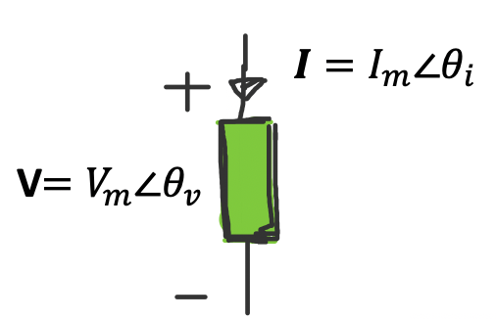
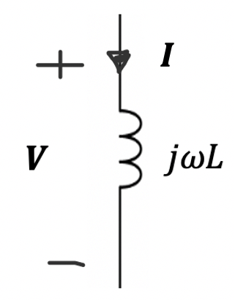
Reactive power In the inductor
Recall that the reactive power in any circuit with any sinusoidal voltage and current functions is given by,
$$Q=\frac{\left|V\right||I|}{2}\sin\left(θ_{v}−θ_{i}\right)=\frac{V_{m}I_{m}}{2}sin⁡(θ_{v}−θ_{i}\text{)}$$
For the inductor,
$$V=\left(jωL\right)I=ωL I∠{90}^{o}$$
$$(where j={∠90}^{o})$$
$$V=\left|V\right|∠θ_{v}=ωL \left(\left|I\right|∠θ_{i}\right)∠{90}^{o}=ωL I_{m}∠{(θ}_{i}+{90}^{o})$$
Since $V=\left|V\right|∠θ_{v}=V_{m}∠θ_{v}$
$$V_{m}∠θ_{v}=ωL I_{m}∠{(θ}_{i}+{90}^{o})$$
$$V_{m}∠{(θ}_{v}−θ_{i})=ωL I_{m}∠{90}^{o}$$
$$V_{m}=ωL I_{m}$$
$${(θ}_{v}−θ_{i})={90}^{o}$$
Then the Reactive Power in the inductor $Q_{L}$,
$$Q_{L}=\frac{V_{m}I_{m}}{2}sin⁡(θ_{v}−θ_{i}\text{)}=\frac{ωL {I_{m}}^{2}}{2}sin{90}^{o}=ωL\frac{{I_{m}}^{2}}{2}=ωL\frac{{|I|}^{2}}{2}$$
$$Q_{L}=ωL\frac{{I_{m}}^{2}}{2}=ωL I_{rms}^{2}$$

Slide 10
Current lags voltage by $+{90}^{o}$ in the inductor
$$Q_{L}=ωL I_{rms}^{2}$$
$$P_{ave}=0$$

Slide 11
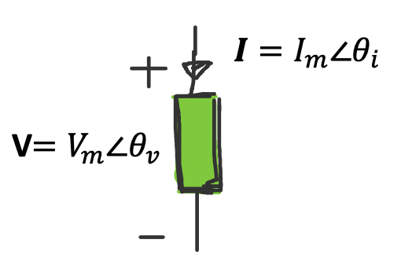
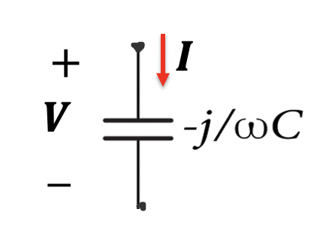
Reactive power In the inductor
Recall that the reactive power in any circuit with is given by,
$$Q=\frac{\left|V\right||I|}{2}\sin\left(θ_{v}−θ_{i}\right)=\frac{V_{m}I_{m}}{2}sin⁡(θ_{v}−θ_{i}$$
For the capacitor,
$V=\left(−j\frac{1}{ωC}\right)I$=$\frac{1}{ωC} I∠{−90}^{o}$
Then the Reactive Power in the capacitor,
$$Q_{C}=\frac{\left|V\right||I|}{2}sin{(−90}^{o})$$
Since we have,
$$|V|=\frac{1}{ωC}|I|$$
$$Q_{C}=\frac{1}{ωC}\frac{{|I|}^{2}}{2}sin{(−90}^{o})=−\frac{1}{ωC}\frac{{|I|}^{2}}{2}$$
$$Q_{C}=−\frac{1}{ωC}\frac{{I_{m}}^{2}}{2}=−\frac{1}{ωC}I_{rms}^{2}$$

Slide 12
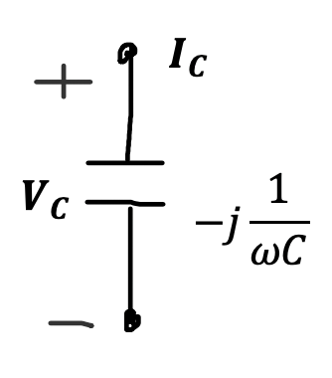
Current leads voltage by $+{90}^{o}$ in the capacitor
$$Q_{C}=−\frac{1}{ωC}I_{rms}^{2}$$
$$P_{ave}=0$$

Slide 13
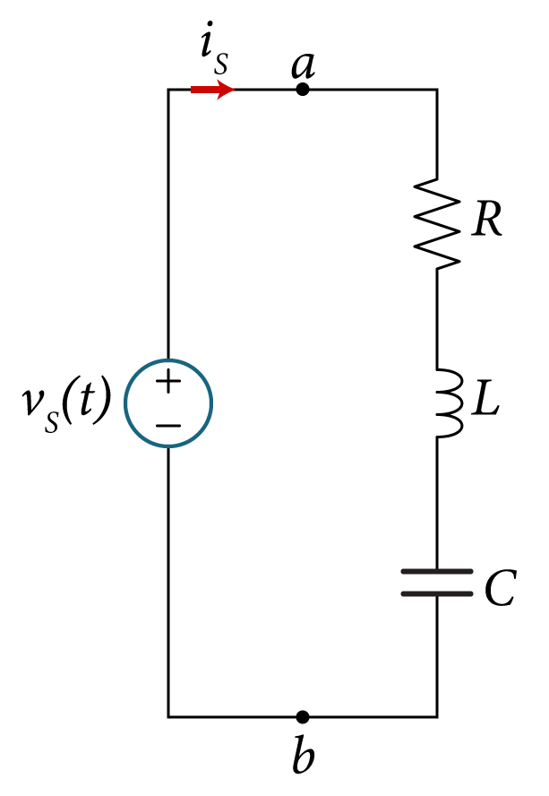
Example
(a) Determine the reactive power supplied to the load between terminals “a” and “b” for the circuit with source voltage,
(b) Determine the individual element reactive power.
(c) Show that the total VARs generated by the source are equal to the total VARs in the reactive elements.
$$v_{s}\left(t\right)=24\cos\left(2000t+{30}^{o}\right) V$$
$$R=15 Ω$$
$$L=10 mH$$
$$C=80 μF$$

Slide 14
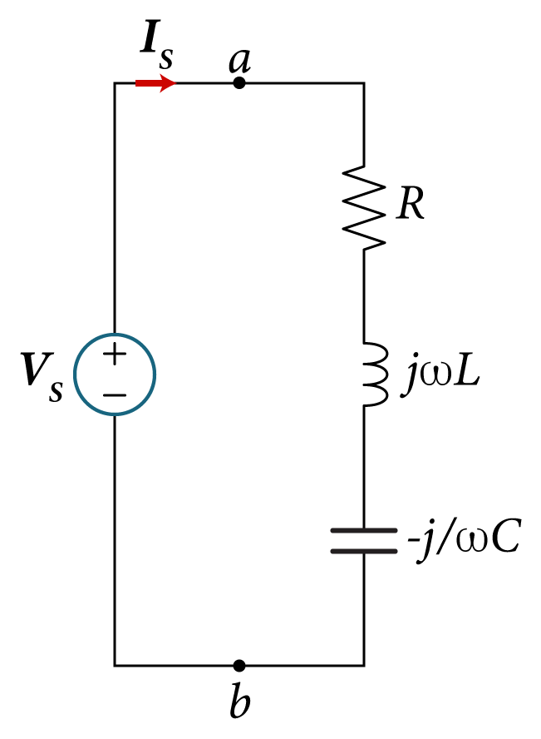
The phasor equivalent circuit is shown,
First we need to find the phasor current $I_{s}$ .
The total equivalent impedance of the circuit is given by,
$Z_{T}=R+j\left(ωL−\frac{1}{ωC}\right)$
$=\left|Z_{T}\right|∠θ_{Z_{T}}$
Where,
$\left|Z_{T}\right|=\sqrt{R^{2}+{\left(ωL−\frac{1}{ωC}\right)}^{2}}=\sqrt{{15}^{2}+{\left(2000x10x{10}^{−3}−\frac{1}{2000x80x{10}^{−6}}\right)}^{2}}=20.3 Ω$
$$θ_{Z_{T}}=\tan^{−1}\left(\frac{ω^{2}LC−1}{ωCR}\right)=\tan^{−1}\left(\frac{{2000}^{2}x10x{10}^{−3}x80x{10}^{−6}−1}{2000x80x{10}^{−6}x15}\right)={42.5}^{o}$$
$$ω=2000 rad/s$$

Slide 15
Now, the resulting phasor current drawn by the source is given by,
$$I_{s}=\frac{V_{s}}{Z_{T}}=\frac{V_{m}∠θ_{v}}{\left|Z_{T}\right|∠θ_{Z_{T}}}=\frac{24∠{30}^{o}}{20.3∠{42.5}^{o}}$$
$=\frac{24}{20.3}∠{(30}^{o}−{42.5}^{o})=1.18∠{−12.5}^{o} A$
So, $I_{s}$ is given by,
$I_{s}=\left|I_{s}\right|∠θ_{i}=1.18∠{−12.5}^{o}$ A
The corresponding time domain $i_{s}\left(t\right)$
$$i_{s}\left(t\right)=\left|I_{s}\right|\cos\left(ωt+θ_{i}\right)$$
$=1.18\cos\left(2000t{−12.5}^{o}\right)$ A

Slide 16
The reactive power at the terminals “ab” is equal to the reactive power supplied by the voltage source and it is given by,
$Q_{ SUP}=\frac{1}{2}V_{m} \left|I_{s}\right|\sin\left(θ_{v}−θ_{i}\right)$
$=\frac{1}{2}\left(24\right)\left(1.18\right)\sin\left({30}^{o}+{12.5}^{o}\right)$ VAR
$=9.5$VARs
$$Q_{ SUP}$$
The resistor in the load doesn’t absorb or generate any reactive power.
The only reactive elements in the circuit are the inductor and capacitor.
So, the 9.5 VARs are disrupted across C and L.

Slide 17
The reactive power absorbed in the inductor is given by (since $I_{s}$ is also the inductor current)
$$Q_{ L}=\frac{1}{2}{\left|I_{s}\right|}^{2}ωL$$
$$=\frac{1}{2}{1.18}^{2}x2000x10x{10}^{−3}$$
$$=13.9 VARs$$
$$Q_{ L}$$
The reactive power absorbed in the capacitor is given by,
$$Q_{ C}$$
$$Q_{ C}=−\frac{1}{2ωC}{\left|I_{s}\right|}^{2}=$$
$$=−\frac{1}{2x2000x80x{10}^{−6}}{1.18}^{2}$$
$$=−4.4 VARs$$

Slide 18
The total VARs absorbed in the load is given by,
$$Q_{ LC}=Q_{ L}+Q_{ C}$$
$$=13.9 −4.4$$
$$=9.5 VARs$$
$$Q_{ L}=+13.9$$
It can be seen that the total supplied VARs (Q_{SUP}) is equal to the absorbed VARs in both the inductor and the capacitor (Q_{LC}).
$Q_{ SUP}$=9.5
$$Q_{ C}=−4.4$$
$$Q_{LC}=Q_{ SUP}=9.5 VARs$$
The average power dissipated across R is given by,
$P_{ ave}=\frac{1}{2}{\left|I_{s}\right|}^{2}R{=\frac{1}{2}{1.18}^{2}x15{=10.44 W}}$

Slide 19
Let us check the answers from the time domain instantaneous power.
We have the following time domain voltage and current:
$$v_{s}\left(t\right)=V_{m}\cos{(ωt+θ_{v})}=24\cos\left(2000t+{30}^{o}\right) V$$
$$i_{s}\left(t\right)=I_{m}\cos\left(ωt+θ_{i}\right)=1.18\cos\left(2000t{−12.5}^{o}\right) \text{A}$$
The time domain instantaneous power is given by.
$Q_{ SUP}$=9.5
$$Q_{ L}=+13.9$$
$$p(t)=\frac{V_{m}I_{m}}{2}\cos\left(θ_{v}−θ_{i}\right)+ \frac{V_{m}I_{m}}{2}\cos\left(2ωt+θ_{v}+θ_{i}\right)$$
$$Q_{ C}=−4.4$$
$$p(t)=\frac{24x1.18}{2}\cos{({30}^{o}+{12.5}^{o})}+\frac{24x1.18}{2}\cos\left(4000t+{30}^{o}+{12.5}^{o}\right)$$
$$p(t)=14.16\cos{{42.5}^{o}}+14.16\cos\left(4000t+{42.5}^{o}\right)$$
$p\left(t\right)=10.44+14.16\cos\left(4000t+{42.5}^{o}\right)$ W
The average power dissipated across R - $P_{ave}=10.44$W

Slide 20
Another way to express the time-domain instantaneous power.
$$p\left(t\right)=P_{ave}+P_{ave}\cos{2ωt}−Q\sin{2ωt}$$
$$P_{Ave}=10.44 W$$
$$=10.44+10.44\cos{4000t}−9.4\sin{4000t}$$
$$P_{Ave}=10.44 W$$
$$Q_{ L}=+13.9$$
where,
$Q_{ SUP}$=9.5
$$Q_{ C}=−4.4$$
$The Average\left(real\right) Power$
$$P_{ave}=\frac{V_{m}I_{m}}{2}\cos\left(θ_{v}−θ_{i}\right)=\frac{24x1.18}{2}\cos\left({30}^{o}+{12.5}^{o}\right)=10.44 W$$
$$The Reactive Power$$
$$Q=\frac{V_{m}I_{m}}{2}\sin\left(θ_{v}−θ_{i}\right)=\frac{24x1.18}{2}\sin{{30}^{o}+{12.5}^{o}=9.5 VAR}$$
As obtained from the phasor analysis

Slide 21
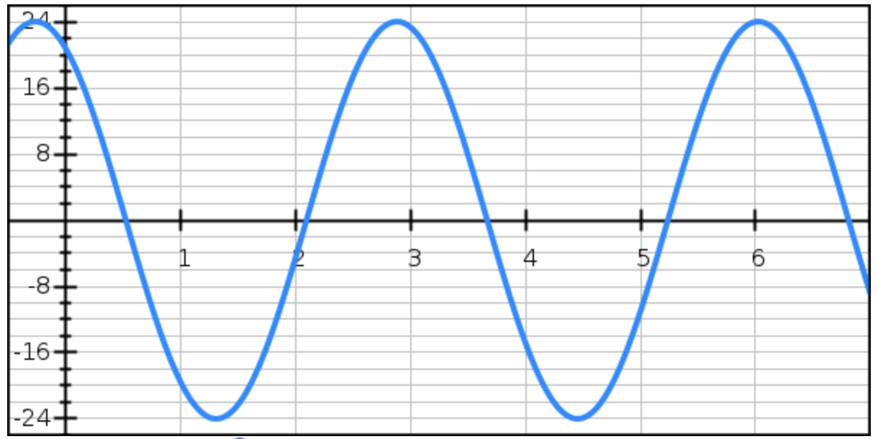
V
$$v_{s}\left(t\right)=24\cos\left(2000t+{30}^{o}\right) V$$
t(ms)
$$Δt$$
$$T=3.1 ms$$
$$T=\frac{2π}{ω }=\frac{2π}{2000 }=3.1 ms$$
$Δt=\frac{θ_{v}}{ω }$=$\frac{\frac{{30}^{o}}{{180}^{o}}π}{\text{2000} }=0.26 ms$

Slide 22
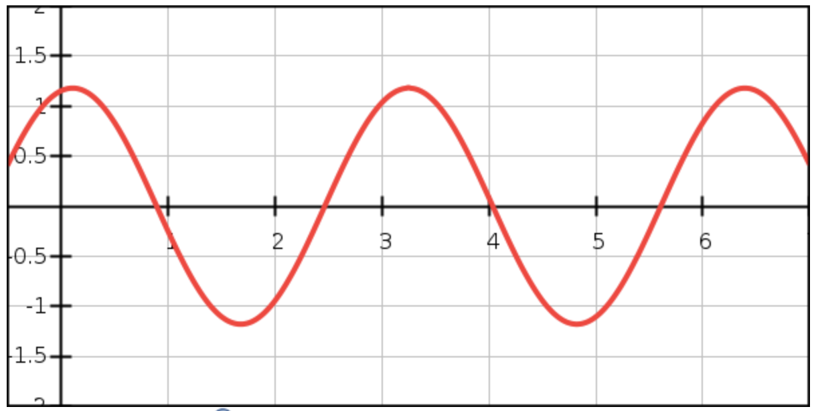
(A)
$i_{s}\left(t\right)=1.18\cos\left(2000t{−12.5}^{o}\right)$ A
t(ms)
$$Δt$$
$$T=3.1 ms$$
$$T=\frac{2π}{ω }=\frac{2π}{2000 }=3.1 ms$$
$Δt=\frac{θ_{v}}{ω }$=$\frac{\frac{{12.5}^{o}}{{180}^{o}}π}{\text{2000} }=0.11 ms$

Slide 23
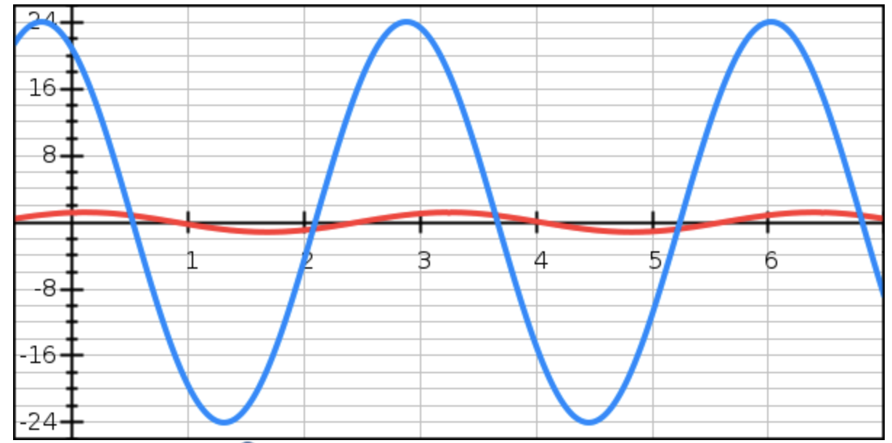
$$v_{s}\left(t\right)$$
$$i_{s}\left(t\right)$$

Slide 24
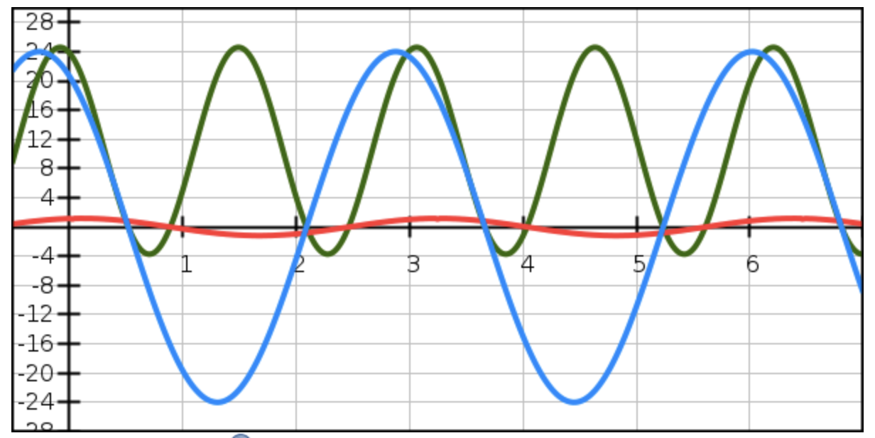
$$p\left(t\right)=10.44+10.44\cos{4000t}−9.4\sin{4000t W}$$
$$p\left(t\right)$$
$$T=1.55 ms$$
$$P_{Max}≈24 W$$
$$P_{Ave}≈10 W$$
$$i_{s}\left(t\right)$$
$$v_{s}\left(t\right)$$
$$T=3.1 ms$$

Slide 25
$$p\left(t\right)=10.44+10.44\cos{4000t}−9.4\sin{4000t W}$$
$$p\left(t\right)$$
$$T=1.55 ms$$
$$P_{Max}≈24 W$$
$$P_{Ave}≈10 W$$
$$i_{s}\left(t\right)$$
$$v_{s}\left(t\right)$$
$$T=3.1 ms$$
Negative power

Slide 26
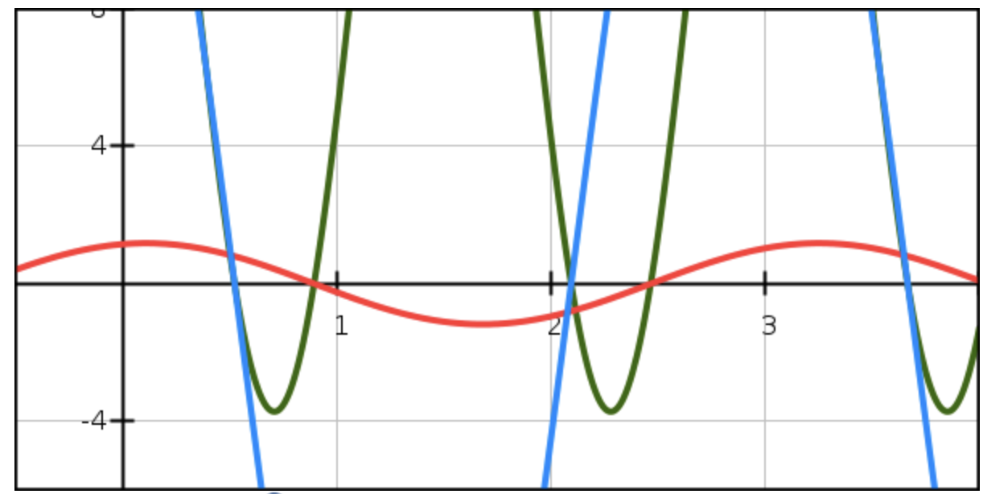
$$p\left(t\right)=10.44+10.44\cos{4000t}−9.4\sin{4000t W}$$
$$v_{s}\left(t\right)$$
$$p\left(t\right)$$
$$Δt$$
$$i_{s}\left(t\right)$$
$Δt=\frac{θ_{v}−θ_{i}}{ω }$=$\frac{\frac{{{30}^{o}+12.5}^{o}}{{180}^{o}}π}{\text{2000} }=0.37 ms$
Negative power

Slide 27
Let us find the maximum/minimum power theoretically,
$$p(t)=\frac{V_{m}I_{m}}{2}\cos\left(θ_{v}−θ_{i}\right)+ \frac{V_{m}I_{m}}{2}\cos\left(2ωt+θ_{v}+θ_{i}\right)$$
We take the 1st derivative and set it to 0 and solve for the time when this occurs.
Assume this time is $t=t_{x}$.
$$\frac{dp\left(t\right)}{dt}=−2ω\frac{V_{m}I_{m}}{2}\sin\left(2ωt_{x}+θ_{v}+θ_{i}\right)=0$$
$$t_{x}=\frac{−{(θ}_{v}+θ_{i})}{2ω}=\frac{−0.305rad}{2x2000}=−0. 076 ms$$
$2ωt_{x}+θ_{v}+θ_{i}=0^{o}$
Then the maximum is given by,
$$P_{max}\left(t_{x}\right)=10.44+\frac{24x1.18}{2}\cos\left(4000t_{x}+{30}^{o}−{12.5}^{o}\right)$$
$$P_{max}\left(t_{x}\right)=10.44+\frac{24x1.18}{2}\cos\left(−0.305+0.305\right)=10.44+14.16x1$$
$$P_{max}\left(t_{x}\right)=24.6 W$$
Then the minimum power occurs at the time of half of the power period later,
$$t_{x}=−0.076+0.775=0.699 ms$$
$$P_{min}\left(t_{x}\right)=10.44+\frac{24x1.18}{2}\cos\left(4000x0.699+0.305\right)=−3.71 W$$

Slide 28
What happens if we let the phase angle of $Z_{T}$ be zero, i.e. $θ_{Z_{T}}=0^{o}?$
This means the phase angle of $I_{s}$ is the same as the phase angle of $V_{s}$as follows,
$$I_{s}=\frac{V_{s}}{Z_{T}}=\frac{V_{m}∠θ_{v}}{\left|Z_{T}\right|∠θ_{Z_{T}}}=\frac{V_{m}∠θ_{v}}{\left|Z_{T}\right|∠0^{o}}=\frac{V_{m}}{\left|Z_{T}\right|}∠θ_{v}$$
$$I_{s}=\left|I_{s}\right|∠θ_{v}=\left|I_{s}\right|∠θ_{i}$$
This means $θ_{v}=θ_{i}$
($θ_{v}−θ_{i})=0^{o}$
This means the total Q supplied by the circuit is zero,
$Q_{ SUP}=\frac{1}{2}V_{m} \left|I_{s}\right|\sin\left(θ_{v}−θ_{i}\right)=\frac{1}{2}V_{m} \left|I_{s}\right|\sin{0^{o}=0 VAR}$
This means the circuit has only real power supplied by the source.
This means the real power (average) is at its maximum value:
$$P_{ave, max}=\frac{V_{m}I_{m}}{2}\cos\left(θ_{v}−θ_{i}\right)=\frac{V_{m}I_{m}}{2}\cos{0^{o}=\frac{V_{m}I_{m}}{2}}$$

Slide 29
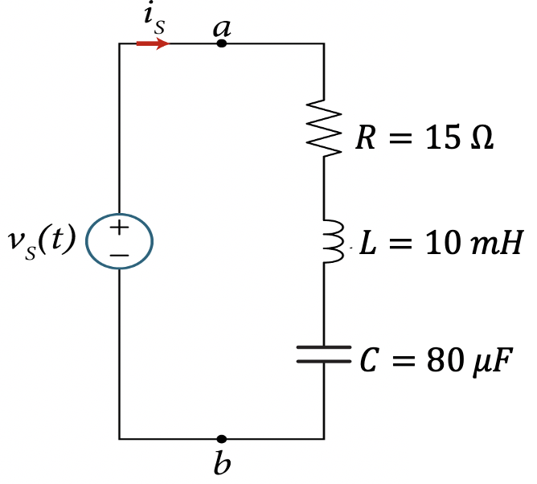
Let us re-design the values to make $θ_{Z_{T}}=0^{o}$.
Recall,
$$θ_{Z_{T}}=\tan^{−1}\left(\frac{ω^{2}LC−1}{ωCR}\right)$$
For $θ_{Z_{T}} to be 0^{o}$, we need to have,
$$ω^{2}LC−1=0$$
$$LC=\frac{1}{ω^{2}}$$
$$ω=\frac{1}{\sqrt{LC}}$$
In our case we have,
$$C=80 μF$$
$$L=10 mH$$
$$ω=2000 rad/s$$
Since $ω$is fixed we need to re-design L or C. Let us design a new value for C.
$$LC=\frac{1}{ω^{2}}=\frac{1}{{2000}^{2}}=0.25x{10}^{−6}$$
$$C=\frac{1}{{Lω}^{2}}=\frac{1}{10x{10}^{−3}({2000)}^{2}}=25x{10}^{−6}μF$$
For the redesigned $C=25 μF$,
$$θ_{Z_{T}}=\tan^{−1}\left(\frac{ω^{2}LC−1}{ωCR}\right)=\tan^{−1}\left(\frac{0}{ωCR}\right)=0^{o}$$
$$\left|Z_{T}\right|=\sqrt{R^{2}+{\left(ωL−\frac{1}{ωC}\right)}^{2}}=\sqrt{{15}^{2}+0^{2}}=15 Ω$$

Slide 30
Now, the resulting phasor current drawn by the source is given by,
$$I_{s}=\frac{V_{s}}{Z_{T}}=\frac{V_{m}∠θ_{v}}{\left|Z_{T}\right|∠θ_{Z_{T}}}=\frac{24∠{30}^{o}}{15∠0^{o}}=1.6∠{30}^{o} A$$
So, $I_{s}$ is given by,
$I_{s}=\left|I_{s}\right|∠θ_{i}=1.6∠{30}^{o}$ A
The corresponding time domain i_{S}(t),
$i_{s}\left(t\right)=1.6\cos\left(2000t{+30}^{o}\right)$ A
$Q_{ SUP}=\frac{1}{2}V_{m} \left|I_{s}\right|\sin\left(θ_{v}−θ_{i}\right)$ $=\frac{1}{2}\left(24\right)\left(1.6\right)\sin\left({30}^{o}−{30}^{o}\right)=0$ VAR
The reactive power absorbed in the inductor is given by,
$$Q_{ L}=\frac{1}{2}{\left|I_{s}\right|}^{2}ωL=\frac{1}{2}{1.6}^{2}x2000x10x{10}^{−3}=25.6 VAR$$
The reactive power absorbed in the capacitor is given by,
$$Q_{ C}=−\frac{1}{2ωC}{\left|I_{s}\right|}^{2}=−\frac{1}{2x2000x25x{10}^{−6}}{1.6}^{2}=−25.6 VAR$$
$$Q_{ L}=−Q_{ C}$$
$$p(t)=\frac{V_{m}I_{m}}{2}\cos\left(θ_{v}−θ_{i}\right)+ \frac{V_{m}I_{m}}{2}\cos\left(2ωt+θ_{v}+θ_{i}\right)$$
$$Q_{ SUP}=Q_{ L}+Q_{ C}=0$$

Slide 31
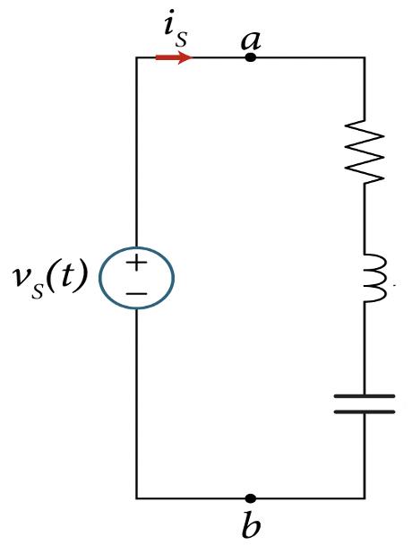
The instantaneous power is given by,
$$p(t)=\frac{V_{m}I_{m}}{2}\cos\left(θ_{v}−θ_{i}\right)+ \frac{V_{m}I_{m}}{2}\cos\left(2ωt+θ_{v}+θ_{i}\right)$$
$$p(t)=\frac{24x1.6}{2}\cos\left({30}^{o}−{30}^{o}\right)+\frac{24x1.6}{2}\cos\left(4000t+{30}^{o}+{30}^{o}\right)$$
$$p(t)=19.2+19.2\cos\left(4000t+{60}^{o}\right)$$
$$P_{Max}=38.4 W$$
$$P_{Ave}=19.2 W$$
$$R=15 Ω$$
$$P_{Ave}=19.2 W$$
$$P_{Ave}=19.2 W$$
$$Q_{ L}=+25.6$$
$$L=10 mH$$
$$P_{Min}=0 W$$
$$Q_{ SUP}=0$$
(No negative power)
$$C=25 μF$$
$$Q_{ C}=−25.6$$

Slide 32
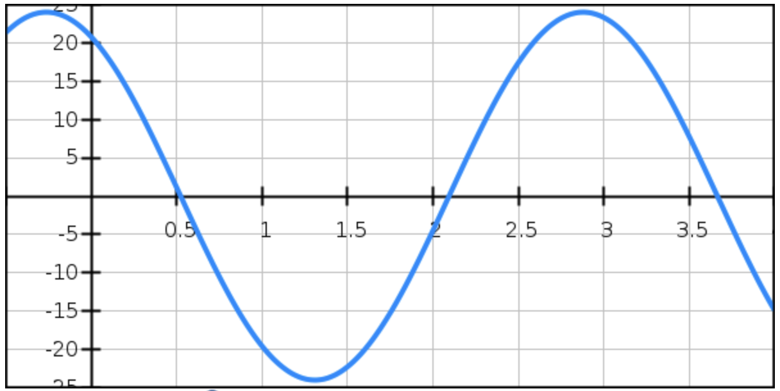
(V)
$$v_{s}\left(t\right)=24\cos\left(2000t+{30}^{o}\right) V$$
t(ms)
$$Δt$$
$$T=3.1 ms$$
$$T=\frac{2π}{ω }=\frac{2π}{2000 }=3.1 ms$$
$Δt=\frac{θ_{v}}{ω }$=$\frac{\frac{{30}^{o}}{{180}^{o}}π}{\text{2000} }=0.26 ms$

Slide 33
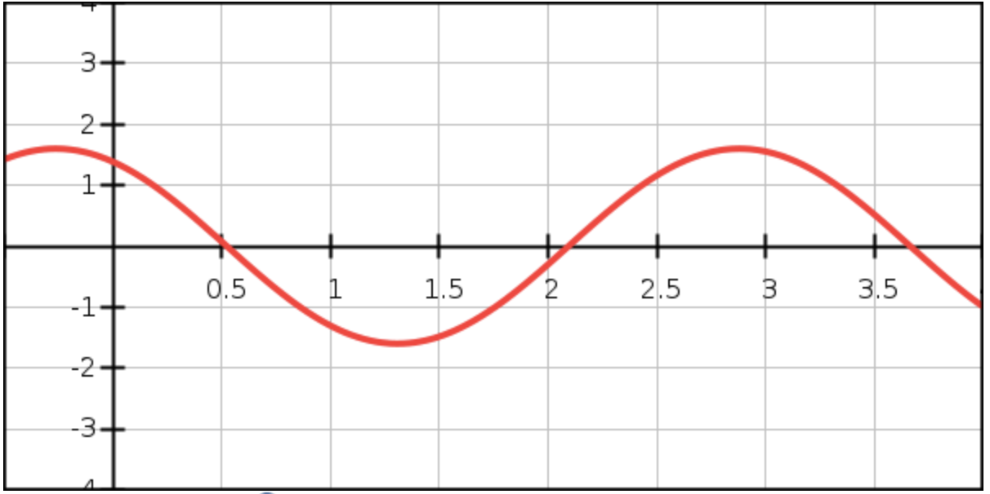
$i_{s}\left(t\right)=1.6\cos\left(2000t{+30}^{o}\right)$ A
(A)
t(ms)
$$Δt$$
$$T=3.1 ms$$
$$T=\frac{2π}{ω }=\frac{2π}{2000 }=3.1 ms$$
$Δt=\frac{θ_{v}}{ω }$=$\frac{\frac{{12.5}^{o}}{{180}^{o}}π}{\text{2000} }=0.11 ms$

Slide 34
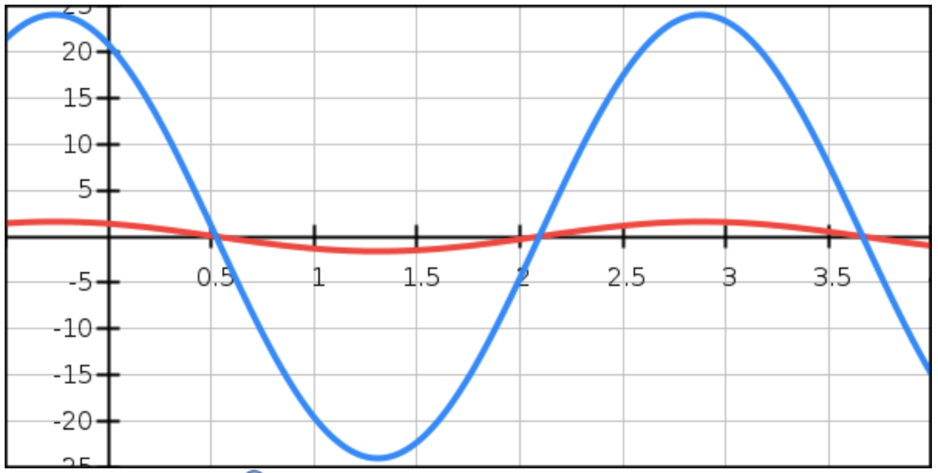
$$v_{s}\left(t\right)$$
$$i_{s}\left(t\right)$$
$The v_{s}\left(t\right)$ and current $i_{s}\left(t\right)$ are in-phase

Slide 35
$$v_{s}\left(t\right)$$
$$i_{s}\left(t\right)$$
$$θ_{v}−θ_{i}={30}^{o}+{12.5}^{o}={42.5}^{o}$$
$$θ_{Z_{T}}={42.5}^{o}$$
$$v_{s}\left(t\right)$$
$$θ_{v}−θ_{i}={30}^{o}−{30}^{o}=0$$
$$i_{s}\left(t\right)$$
$$θ_{Z_{T}}=0^{o}$$
$The v_{s}\left(t\right)$ and current $i_{s}\left(t\right)$ are in-phase

Slide 36
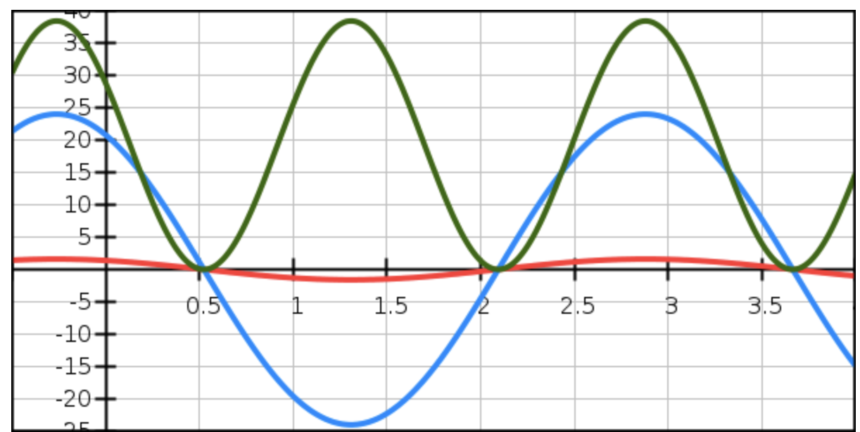
$$p\left(t\right)$$
$$T=1.55 ms$$
$$i_{s}\left(t\right)$$
$$v_{s}\left(t\right)$$
$$T/2=1.55 ms$$
$$P_{Max}=38.4 W$$
$$P_{Ave}=19.2 W$$

Slide 37
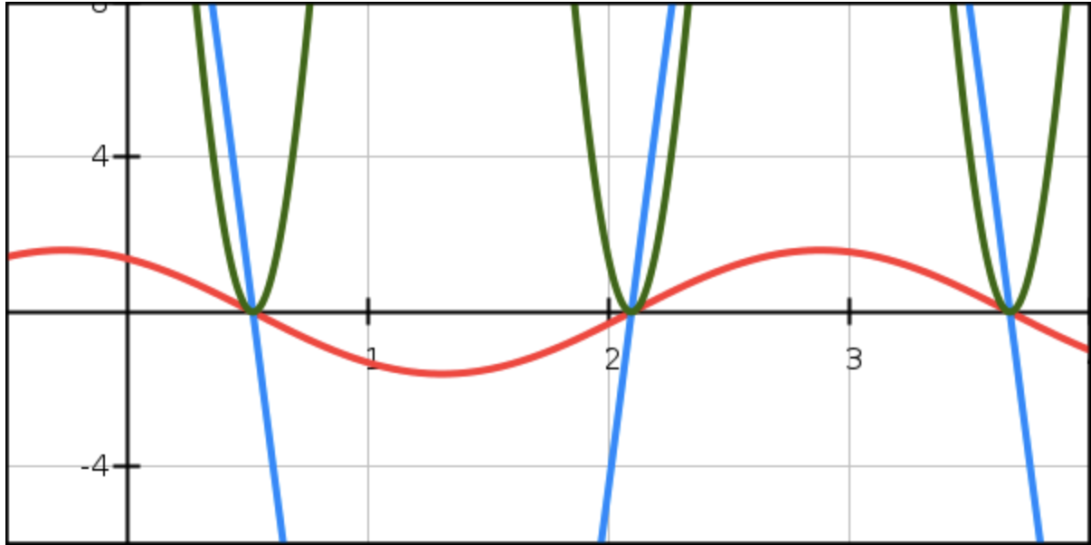
$$p\left(t\right)$$
$$Δt$$
$$i_{s}\left(t\right)$$
$$v_{s}\left(t\right)$$
NO Negative power
$$Δt=\frac{θ_{v}−θ_{i}}{ω }=\frac{{{30}^{o}−30}^{o}}{\text{2000} }=0 ms$$

Slide 38
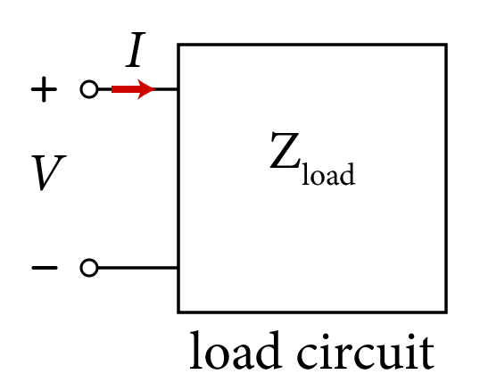
Complex Power (S)
Complex power contains all the relevant information needed to calculate power delivered to the load, denoted by S, and defined as,
The real part of S is the exactly equal to the average power, and the imaginary part of S is exactly equal to the reactive power.
Substituting for P_{ave} and Q, yields,
$$S=P_{ave}+ jQ$$
$$S=\frac{V_{m}I_{m}}{2}\cos\left(θ_{v}−θ_{i}\right)+j \frac{V_{m}I_{m}}{2}\sin\left(θ_{v}−θ_{i}\right)$$
($S, P_{ave}, Q)$

Slide 39
Complex Power (S)
Representing the voltage and current peak values by their equivalent rms values,
$$V_{rms}=\frac{V_{m}}{\sqrt{2}}$$
$$I_{rms}=\frac{I_{m}}{\sqrt{2}}$$
S is expressed as,
$$S=V_{rms}{ I}_{rms}\cos\left(θ_{v}−θ_{i}\right)+j{V_{rms}I}_{rms}\sin\left(θ_{v}−θ_{i}\right)$$
$$S=V_{rms}{ I}_{rms}e^{j\left(θ_{v}−θ_{i}\right)}$$
$$S=(V_{rms}e^{jθ_{v}}{)( I}_{rms}e^{−jθ_{i}})$$
$$S=V_{rms}{ I}_{rms}^{∗}$$
Where,
$$V_{rms}=V_{rms}∠θ_{v}$$
$$I_{rms}=I_{rms}∠θ_{i}$$
$${ I}_{rms}^{∗}=I_{rms}∠{−θ}_{i}$$
Where ${ I}_{rms}^{∗}$denotes the complex conjugate of the phases current $I_{rms}$.

Slide 40
Complex Power (S)
To distinguish between power quantities P_{ave}, Q and S, which are all products of voltage and current, the dimension for S is measured in volt-amp (VA).
$$S=V_{rms}{ I}_{rms}^{∗}=\text{|}S|∠θ_{s}$$
The magnitude of S is given by,
|$S|=\sqrt{P_{ave}^{2}+Q^{2}}$
${=V}_{rms}$ $I_{rms}$
And the phase angle of S is given by,
$$θ_{s}=\tan^{−1}\frac{P_{ave}}{Q}$$
$$=\tan^{−1}\frac{V_{rms}{ I}_{rms}cos\left(θ_{v}−θ_{i}\right)}{V_{rms}{ I}_{rms}sin\left(θ_{v}−θ_{i}\right)}$$
$$=\tan^{−1}\frac{\cos\left(θ_{v}−θ_{i}\right)}{\sin\left(θ_{v}−θ_{i}\right)}=\tan^{−1}(tanθ_{v}−θ_{i})$$
$$θ_{s}=\left(θ_{v}−θ_{i}\right)$$

Slide 41
Apparent Power
The magnitude of complex power, |S|, is referred to as apparent power measured in volt-amp (VA).
Apparent power represents the maximum average power that can be delivered to the load.
Maximum average power that equals to the apparent power can only occur when,
Which results in,
This occurs when the load is purely resistive with zero shift between voltage and current.

Slide 42
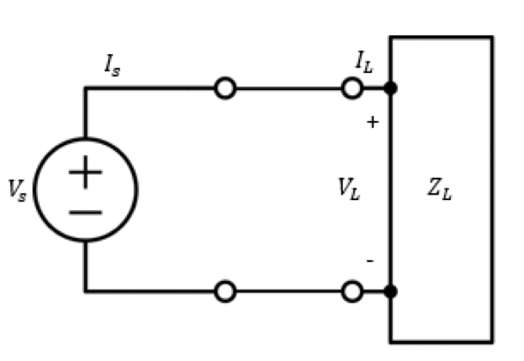
Load Impedance Point of View
Another useful relation for P_{ave}, Q and S, is to use the load $Z_{L}$representation.
If we represent the load circuit by a total impedance Z_{Load} given by,
$$Z_{L}=R+jX_{L}$$
where the real part R is the effective resistive component of the load, and the imaginary part X is the reactive component of the load.

Slide 43
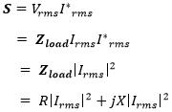
Load Impedance
P_{ave}, Q and S, can be represented using the load impedance.
Phasor rms voltage and current values are related in terms of Z_{Load} as,
Substituting into S yields,
Hence, as expected P_{ave} and Q are only dependent on resistive and inductive values, respectively,

Slide 44
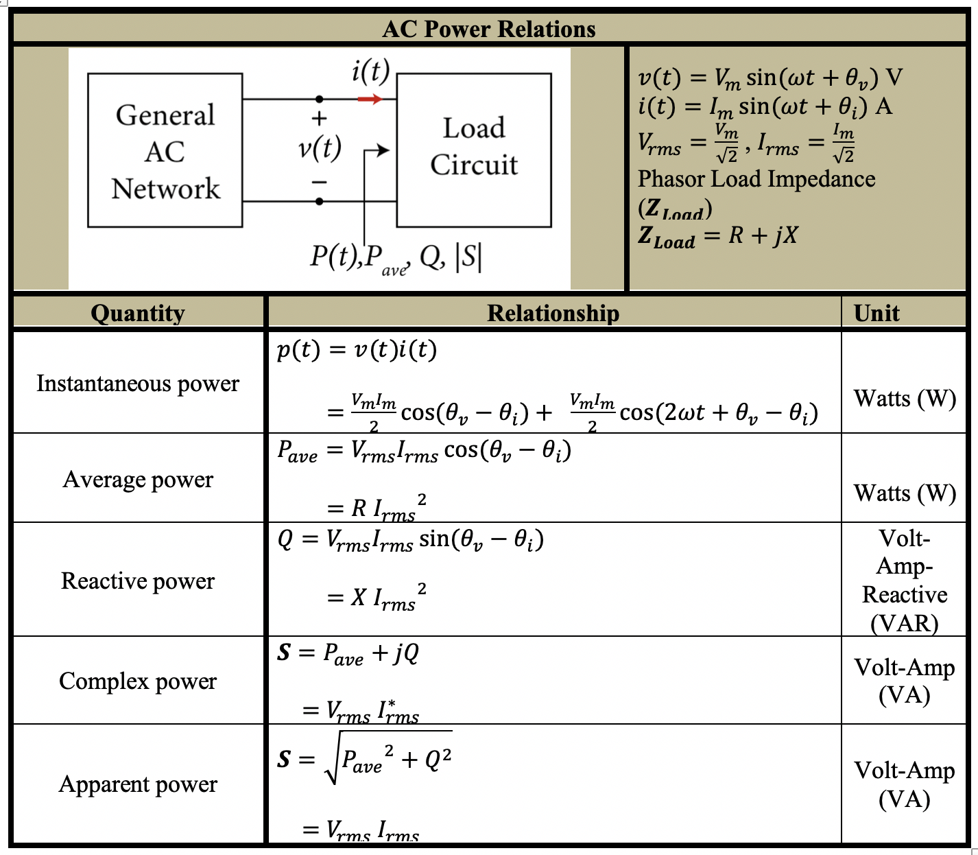

Slide 45
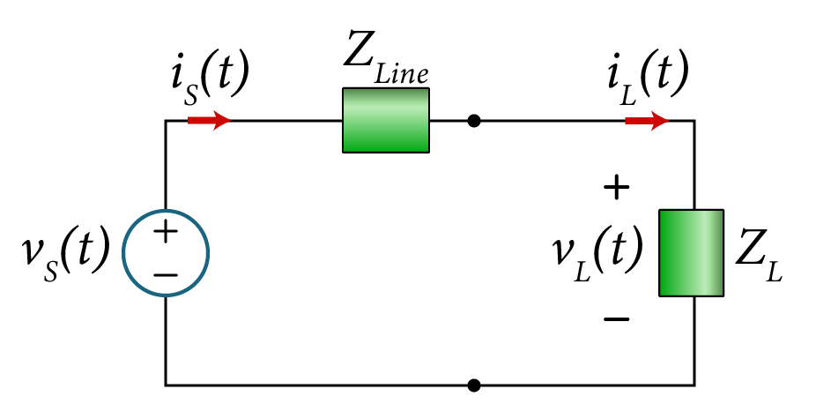
Example
Consider the circuit with a voltage source feeding a single load impedance Z_{L}.
Given the following: * The average power – P_{avg}= 5 W
* The loads phase - θ_{ZL}= $20{ᵒ}$
* The loads peak voltage -|V_{L}|=10 V
* The transmission line impedance - Z_{Line} = 0.2 + j 0.5 Ω.
Assume ω=100 rad/s
Determine:
The magnitude of the load impedance
The reactive, apparent and complex power delivered to the load,
Time-domain and phasor domain expressions for i_{S}(t) and v_{S}(t).

Slide 46
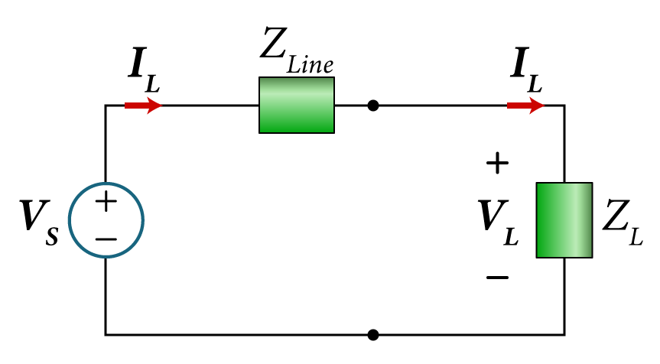
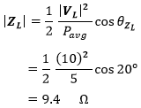
Solution:
The equivalent phasor circuit is given by,
The magnitude of the load impedance can be found as follows,

Slide 47
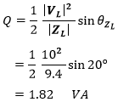
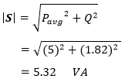
The reactive power in the load is given by,
The complex power at the load is given by,
The apparent power at the load is given by,

Slide 48
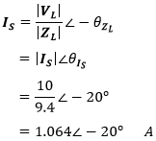
The load current IL is equal to the source current IS, and is given by,
Assuming the load voltage to be the reference (0$ᵒ$ phase),

Slide 49
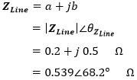
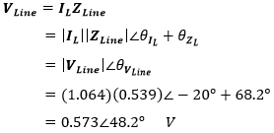
The transmission line current is also equal to the load current IL,
The transmission line impedance is given by,
Now, the transmission line voltage is given by,

Slide 50
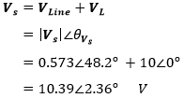
We can now obtain the source voltage by applying KVL around the loop,
After finding both V_{S} and I_{S}, their phase difference is given by,

Slide 51
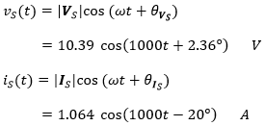
The corresponding time domain for v_{S}(t) and i_{S}(t) is given by,

Slide 52
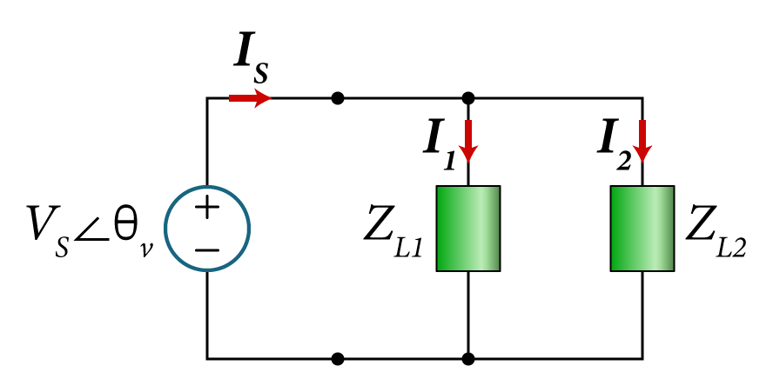
Example
For the given the two parallel impedance loads,
$Z_{L1}=\left|Z_{L1}\right|∠θ_{Z_{L1}}=10∠{40}^{o}$ Ω
$Z_{L2}=\left|Z_{L2}\right|∠θ_{Z_{L2}}=14∠{80}^{o}\text{Ω}$
Connected to a voltage source $V_{s}=V_{m}∠θ_{v}=60∠{45}^{o}$as shown.
Determine:
The average $P_{ave}$, reactive $Q$ and complex power $S$, for each passive element in addition to the source.
And show that $P_{ave}$, $Q$ and $S$ are all conserved.

Slide 53
Solution
The voltage across the parallel load is given as $V_{s}∠θ_{v}$, therefore the average power in $Z_{L1}$ is given by,
$P_{ave,1}=\frac{1}{2}\frac{{\left|V_{s}\right|}^{2}}{\left|Z_{L1}\right|}\cos{θ_{Z_{L1}}}$
$=\frac{1}{2}\frac{{(60)}^{2}}{10}\cos{40ᵒ}$
$=137.89$ W
The reactive power in $Z_{L1}$ is given by,
The complex power in $Z_{L1}$ is given by
$Q_{1}=\frac{1}{2}\frac{{\left|V_{s}\right|}^{2}}{\left|Z_{L1}\right|}\sin{θ_{Z_{L1}}}$
$=\frac{1}{2}\frac{{(60)}^{2}}{10}\sin{40ᵒ}$
$=115.7$ VAR
$S_{1}=P_{ave,1}+jQ_{1}$
$=137.89 +j 115.7$ VA
$=180∠40ᵒ$ VA

Slide 54
Similarly, we can find the average power values in $Z_{L2}$. First, the average power is given by,
$P_{ave2}=\frac{1}{2}\frac{{\left|V_{s}\right|}^{2}}{\left|Z_{L2}\right|}\cos{θ_{Z_{L2}}}$
$=\frac{1}{2}\frac{{(60)}^{2}}{14}\cos{80ᵒ}$
$=22.33$ W
The reactive power in $Z_{L2}$ is given by,
The complex power in $Z_{L2}$ is given by
$Q_{2}=\frac{1}{2}\frac{{\left|V_{s}\right|}^{2}}{\left|Z_{L2}\right|}\sin{θ_{Z_{L2}}}$
$=\frac{1}{2}\frac{{(60)}^{2}}{14}\sin{80ᵒ}$
$=126.62$ VAR
$S_{2}=P_{ave2}+jQ_{2}$
$=22.33+j 126.62$ VA
$=128.57∠80ᵒ$ VA

Slide 55
To find all the power quantities, we need to find the main current $I_{s}$.
Now, the current $I_{1}$ is given by,
The current $I_{s}$ is given by,
$I_{1}=\frac{V_{s}}{Z_{L1}}$
$=\frac{\left|V_{s}\right|}{\left|Z_{L1}\right|}∠\left(θ_{v}−θ_{ZL1}\right)$
$=\frac{60}{10}∠\left(45ᵒ−40ᵒ\right)$
$=6∠5ᵒ$ A
$I_{s}=I_{1}+I_{2}$
$$=6∠5ᵒ+4.29∠−35ᵒ$$
$$=9.49−j1.94$$
$$=9.68∠−11.55ᵒ$$
Now, the current $I_{2}$ is given by,
$$I_{s}=9.68∠−11.55ᵒ A$$
$I_{1}=\frac{V_{s}}{Z_{L2}}$
$=\frac{\left|V_{s}\right|}{\left|Z_{L2}\right|}∠\left(θ_{v}−θ_{ZL2}\right)$
$=\frac{60}{14}∠\left(45ᵒ−80ᵒ\right)$
$=4.29∠−35ᵒ$ A

Slide 56
The total average power at the source is given by,
$P_{ave,S}=\frac{1}{2}\left|V_{s}\right|\left|I_{s}\right| cos\left(θ_{v}−θ_{I_{S}}\right)$
$=\frac{1}{2}\left(60\right)\left(9.68\right)\cos\left(45ᵒ−\left(−11.53ᵒ\right)\right)$
$=290.4\cos{56.53ᵒ}$
$=160.2$ W
The total reactive power for $Z_{LT}$ is given by,
$Q_{S}=\frac{1}{2}\left|V_{s}\right|\left|I_{s}\right| sin\left(θ_{v}−θ_{I_{S}}\right)$
$=\frac{1}{2}\left(60\right)\left(9.68\right)\sin\left(45ᵒ−\left(−8.53ᵒ\right)\right)$
$=290.4\sin{56.53ᵒ}$
$=242.3$ VAR
The complex power for $Z_{LT}$ is given by
$S_{S}=P_{ave, S}+jQ_{S}$
$=160.2+j 242.3=290.49∠56.53ᵒ$ VA

Slide 57
Notice the conservation of the all the power quantities
In the load impedance $Z_{L1}$
In the load impedance $Z_{L2}$
From the main source $V_{s}$
$P_{ave,1}=137.89$ W
$P_{ave,2}=22.33$ W
$P_{ave,S}=160.2$ W
$Q_{1}=115.7$ VAR
$Q_{2}=126.62$ VAR
$Q_{S}=242.3$ VAR
$S_{1}=180∠40ᵒ$ VA
$S_{2}=128.57∠80ᵒ$ VA
$S_{Source}=290.49∠56.53ᵒ VA$
You can show that$S=S_{1}+S_{2}$
$S_{S1+S2}=S_{1}+S_{2}$
$=180∠40ᵒ+128.57∠80ᵒ$
$=290.49∠56.53ᵒ$ VA
$$S_{source }=290.49∠56.53ᵒ \text{VA}$$
$$=S_{S1+S2}$$

