Slide 1
EEL 5245 POWER ELECTRONICS I Lecture #16 Ch 4: Voltage Ripple in Non-Isolated DC-DC Converters (CCM)

Slide 2
H.W. #4: 4.1, 4.3, 4.5, 4.6, 4.10. 4.12, 4.15 (Assume CCM), 4.17, 4.21, 4.33 Solutions will be posted by this weekend

Slide 3
Objectives
Converter Analysis (CCM)
Output Voltage Ripple
Exact analysis
Charge approximation
Examples

Slide 7
Voltage Ripple Analysis
To find the output ripple, we have two approaches:
1) Using the exact expression for the capacitor voltage
2) Using the net charge Q from the capacitor current. We just need to find the area under the curve of the capacitor current.

Slide 8
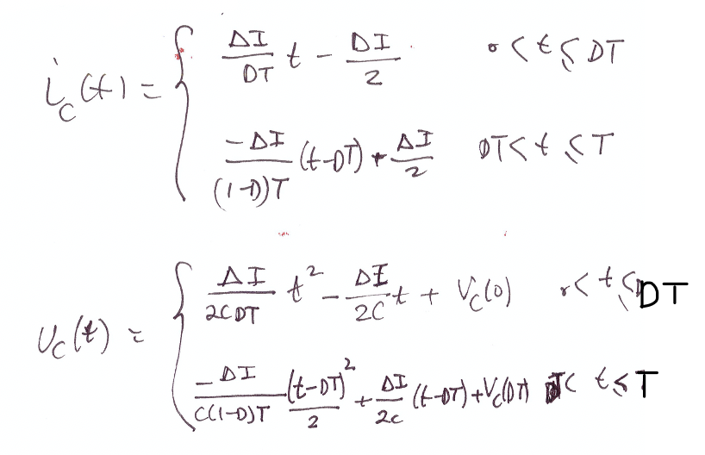
It can be shown that ic(t) and vc(t) are given by,

Slide 9
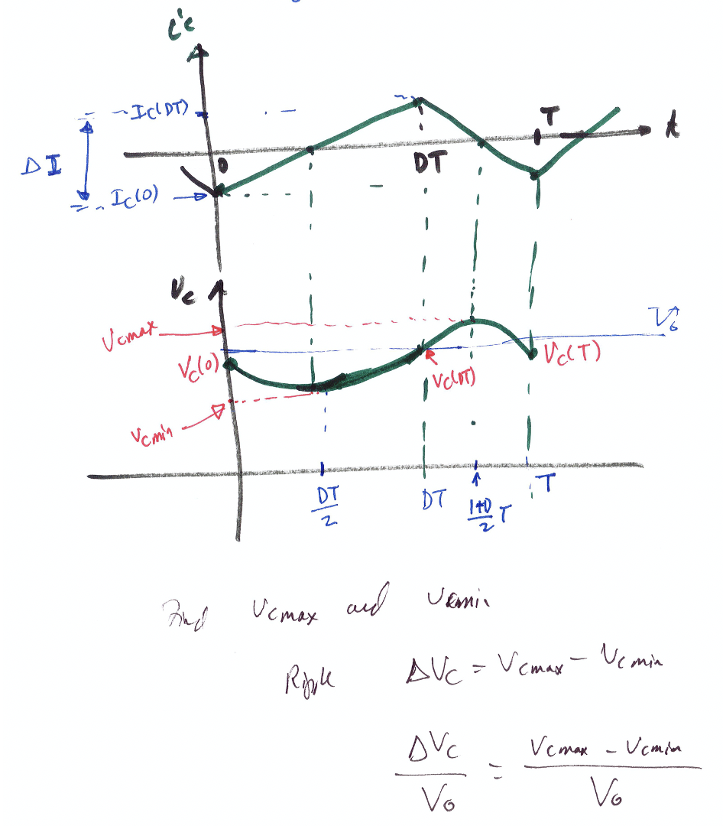
The Buck Converter
Using the exact current and voltage expressions:
Recall, the capacitor current and voltage waveforms:

Slide 10
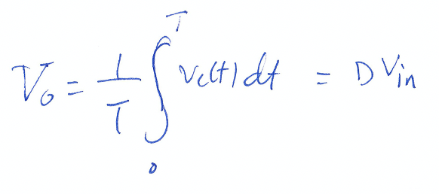
In steady-state, we have,
It can be shown that the initial value for vc(t) at t=0 is given by,
Recall, the average output voltage for the buck,
Solving for the minimum and maximum values to obtain,

Slide 12
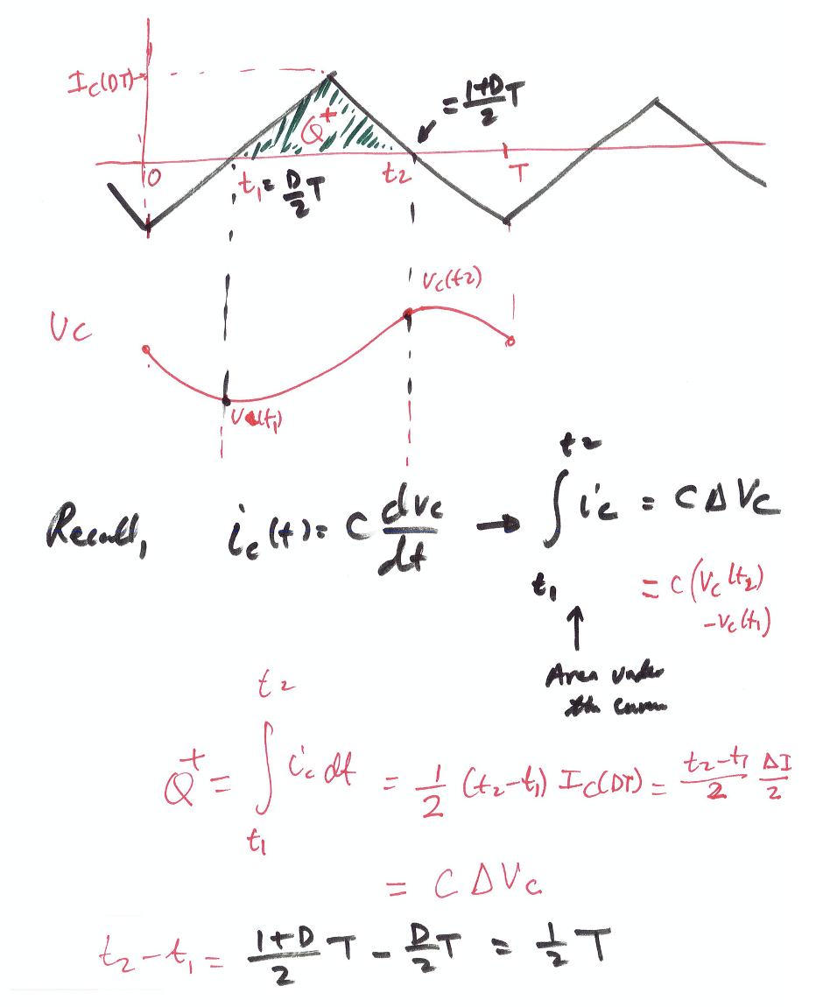
II) Using the approximation expression for Q:

Slide 16
The Boost Converter

Slide 17
The Buck-Boost Converter

Slide 20
Example 4.2 - Buck Converter Analysis

Slide 21
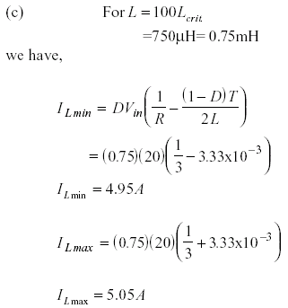
Example 4.2 - Buck Converter Analysis

Slide 22
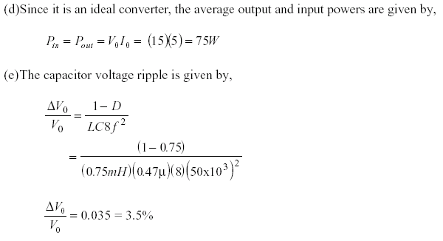
Example 4.2 - Buck Converter Analysis

Slide 23
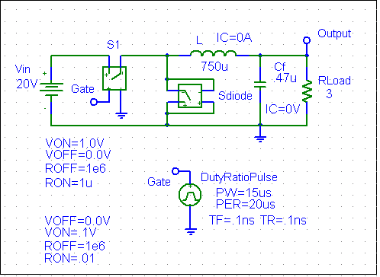
Example 4.2 - Buck Converter Analysis Simulation Results

Slide 24
Example 4.2 - Buck Converter Analysis Simulation Results
20
V_{o}= 15V
10
0
0s
0.5ms
1.0ms
1.5ms
2.0ms
I(L)
V(Gate)
V(Output)
Time

Slide 25
Example 4.2 - Buck Converter Analysis Simulation Results
10V
20mA
0V
0A
-10V
-20mA
-20V
-40mA
1.96ms
1.98ms
2.00ms
1.96ms
V(L:1,L:2)
1.98ms
2.00ms
I(Cf)
Time
Time
5.05A
5.00A
4.95A
4.90A
1.96ms
1.98ms
2.00ms
I(L)
Time

Slide 26
Example 4.2 - Buck Converter Analysis Simulation Results
15.2V
(1.9954m,15.102)
15.0V
(1.9819m,14.863)
14.8V
1.96ms
1.98ms
2.00ms
V(Output)
Time

Slide 27
Example 4.3 - Boost Converter Analysis
Sketch all waveforms for a boost converter with the following
circuit parameters: V_{in} = 50V, V_{o}= 120V and R= 20, f_{s} = 15kHz, L=1.8mH, C=147μF

Slide 28
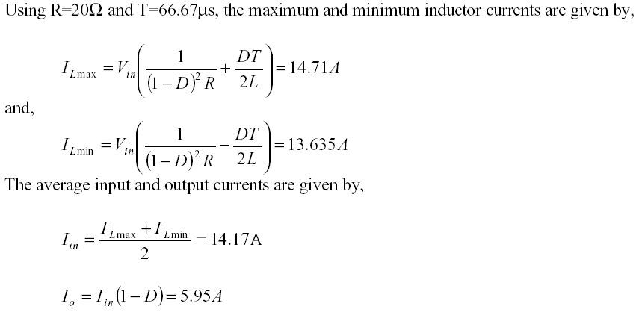
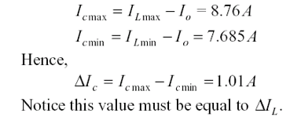
Boost Converter Analysis

Slide 29
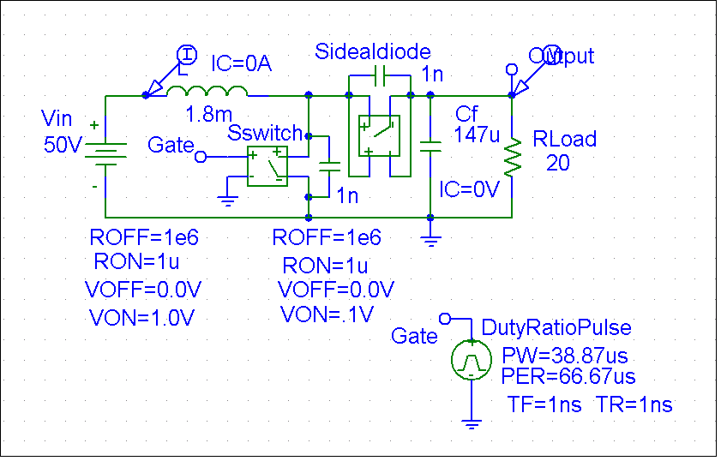
Boost Converter Analysis: Simulation Verification Example 4.4

Slide 30
Boost Converter Analysis: Simulation Verification Example 4.4
200
V_{out}=120 V
100
I_{LAve}=14.4A
0
0s
10ms
20ms
30ms
40ms
50ms
V(Output)
I(L)
Time

Slide 31
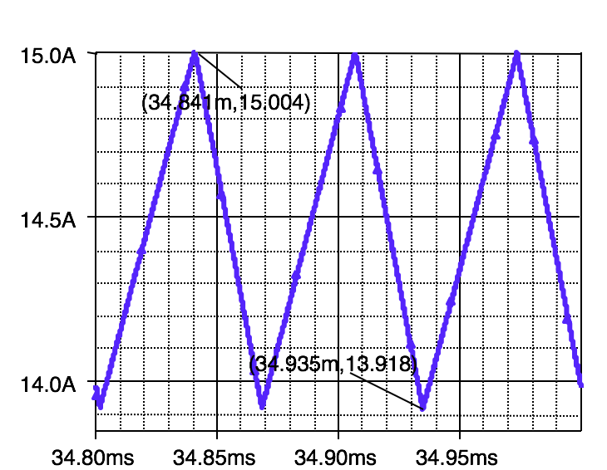
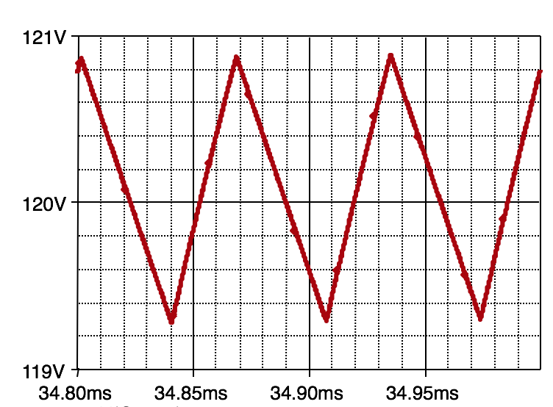
Boost Converter Analysis: Simulation Verification Example 4.4
200
V_{out}=120 V
100
I_{LAve}=14.4A
0
0s
10ms
20ms
30ms
40ms
50ms
V(Output)
I(L)
Time

Slide 32
Boost Converter Analysis: Simulation Verification Example 4.4
15.0A
50V
(34.841m,15.004)
14.5A
0V
(34.935m,13.918)
-50V
14.0A
-80V
34.80ms
34.85ms
34.90ms
34.95ms
34.80ms
V(L:1,L:2)
34.85ms
34.90ms
34.95ms
I(L)
Time
Time

Slide 33
Boost Converter Analysis: Simulation Verification Example 4.4
121V
10A
5A
(34.868m,7.8893)
(34.842m,8.9882)
120V
0A
-5A
119V
34.80ms
V(Output)
34.85ms
34.90ms
34.95ms
34.80ms
I(Cf)
34.85ms
34.90ms
34.95ms
Time
Time

