Slide 1
EEL 646 POWER ELECTRONICS II Exploring Boost ZVS Topologies
Lecture 10

Slide 2
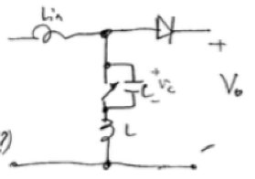
M-Type Boost ZVS Topology
v_{c}(t) resonates with L to make the voltage across the main switch reach zero.

Slide 3
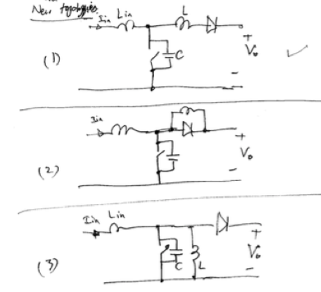
Consider the following five different possible topologies. Identify which one is the
valid L-Type ZVS Boost converter

Slide 4
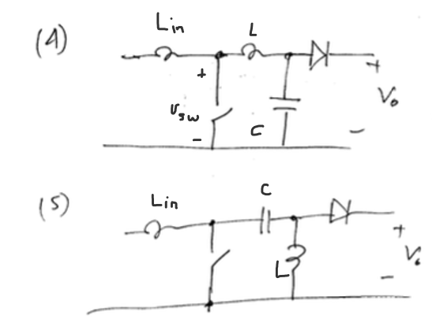

Slide 5
Achieving ZVS is not possible across the main switch given LC tank dynamic behavior

Slide 6
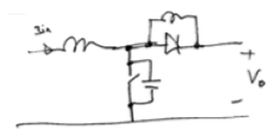
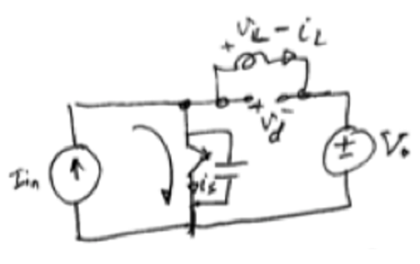
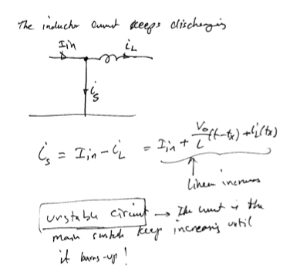
Topology 2
Assume S is closes, then D is either on or off. By inspection, D is open since v_{d}= -V_{o}.
The current i_{L} will keep decreasing since v_{L}= -V_{o.} The switch current equals I_{in}. And the circuit will not be stable

Slide 7
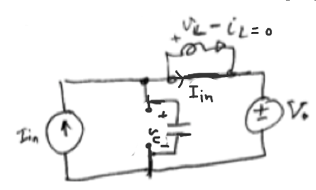
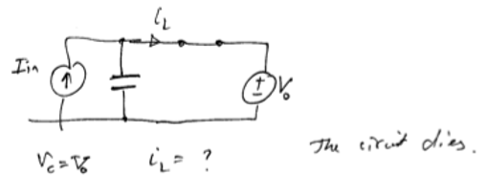
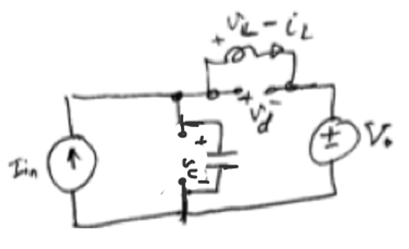
Topology 2
Depending on the value of v_{c,} the diode can be on or off.
If v_{c} > V_{o} , D is on, then v_{c}= V_{o} and v_{L}=0. The switch will never close at ZV.
If v_{c} < V_{o} , D is off, then v_{c} and i_{L} will resonate not possible to achieve ZVS before turning the main switch on.

Slide 8
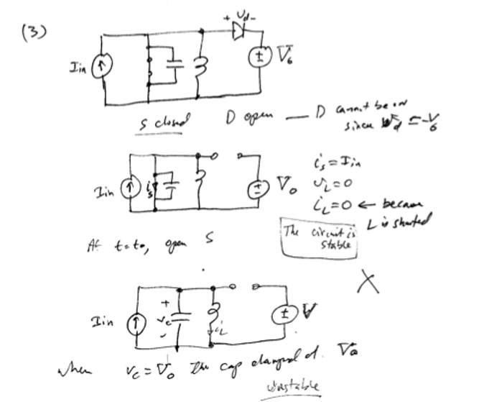
Topology 3

Slide 9
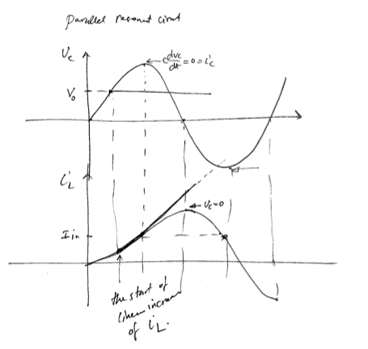

Slide 10
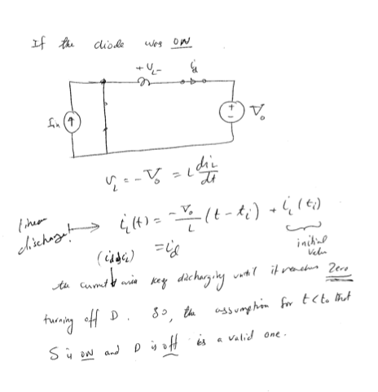

Slide 11
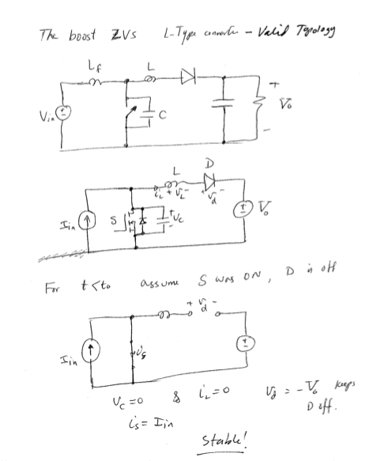
Topology 1

Slide 12
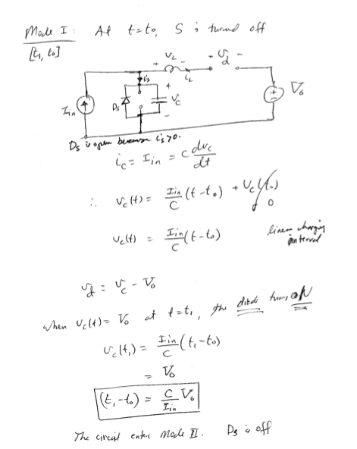
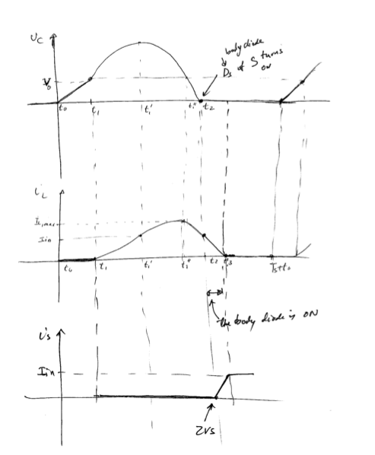

Slide 13
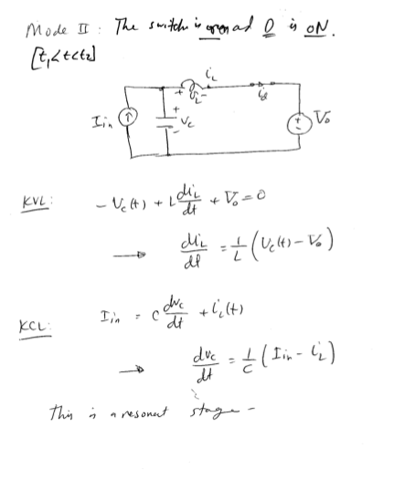

Slide 14
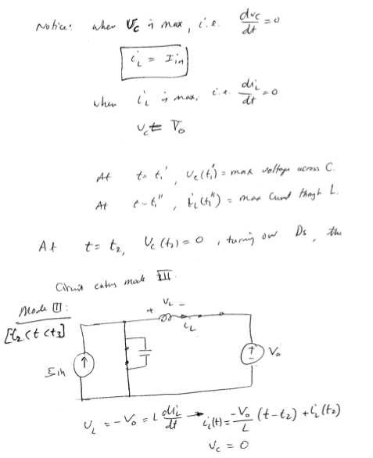

Slide 15
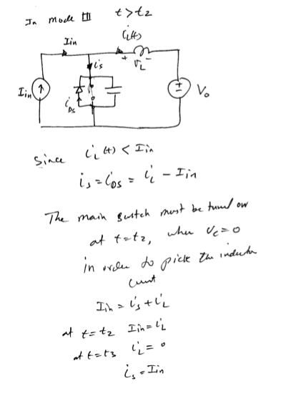

Slide 16
