Slide 1
EEL 6246 POWER ELECTRONICS II Issa Batarseh

Slide 2
Assignment 1:
Sign attendance sheet and/or email me that you saw this lecture.
Review Chapter 3, 4, 5 and workout the details analysis of all the isolated DC-DC Converters operating in CCM and DCM modes.
If you have not taken, EEL 5245, please send me an email to confirm the level of your understanding of the Chapters 1-5.

Slide 3
Agenda
About the course
Syllabus Review
Course Topics
Review of Power Electronics I
Questions

Slide 4
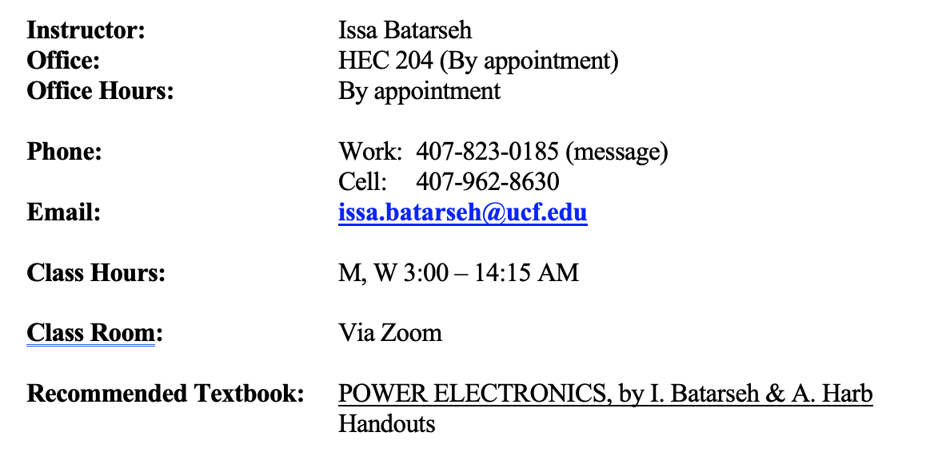
Introduction
CLASS SYLLABUS
Spring 2021
POWER ELECTRONICS II
EEL 6246

Slide 5
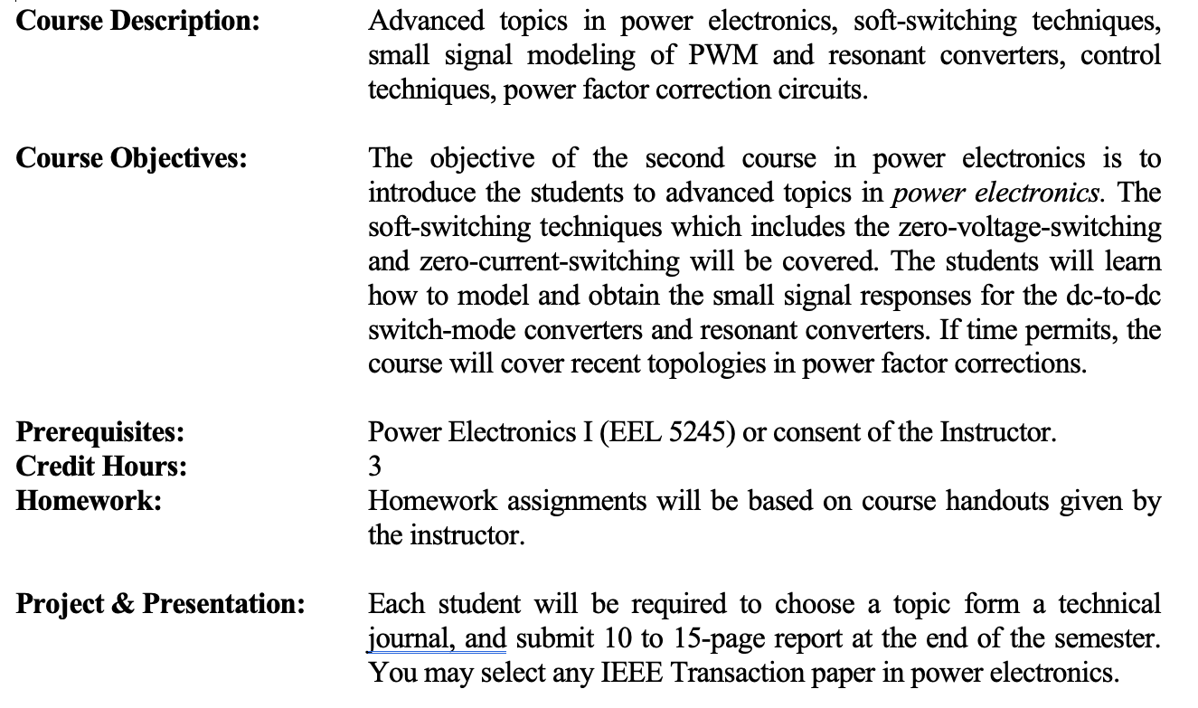
Introduction (cont’d)
All students will be required to present their project individually in class.

Slide 6
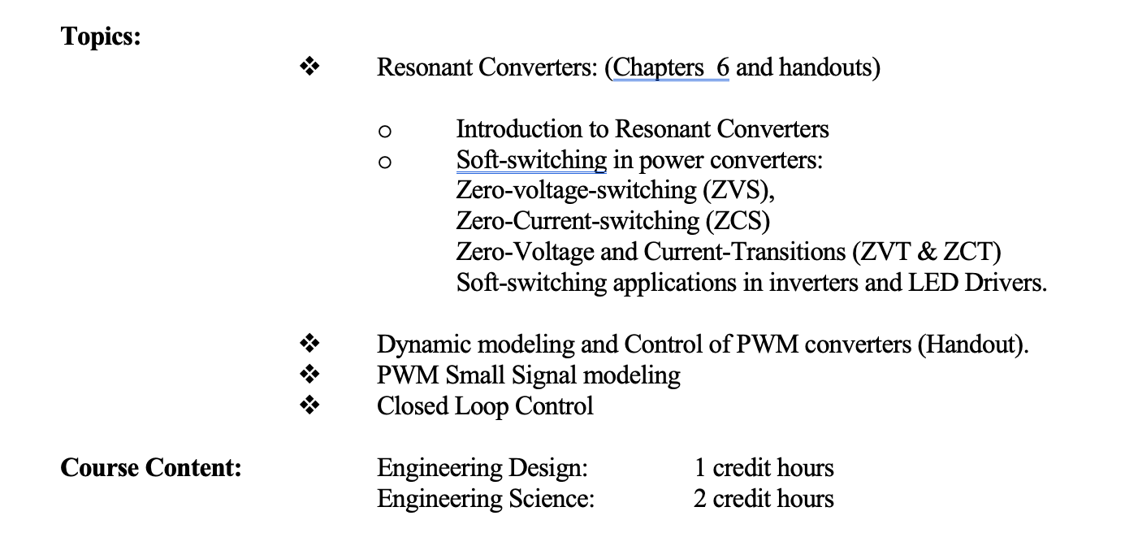
Introduction (cont’d)

Slide 7
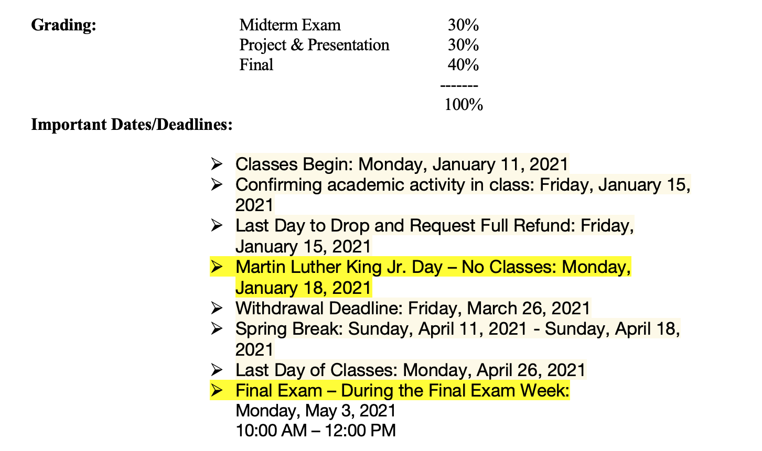
Introduction (cont’d)
Wednesday, April 28, 2021
1:00 PM – 2:00 PM

Slide 8
What is Power Electronics?
Electronics: Solid State Electronics Devices and their Driving Circuits.
Power: Static and Dynamic Requirements for Generation, Conversion and Transmission of Power.
Control: The Steady State and Dynamic Stability of the Closed Loop system.
POWER ELECTRONICS may be defined as the application of Solid State Electronics for the Control and conversion of Power.

Slide 9
Power Electronics as an Enabler Technology
Power electronics is considered as one of the most vibrant technology sectors due to ever increasing applications in renewable energy, computing, sensing and communication, IoT and because of its overlap with many other industry verticals.
From interfacing a mobile phone battery, hybrid cars wheels, power plant power generation and distribution to a nuclear reactor.
Require efficient power handling, from mW to GW!
To facilitate the transfer and conditioning of power from the source to the load.
To be achieved with less cost, high energy-efficiency, high power density, high reliability and neatly.

Slide 10
Figures of Merit for Power Electronic Converters
What is the objective?
Overall goal: To produce a converter that performs well in these areas:
Efficiency
Transient Response
Load and Line Regulation
Power Density
Input/Output Distortion (Input Power Factor)
Reliability (MTBF)
Cost
In the final analysis, the job is to process and control the flow of electric energy by supplying currents/voltages in a form most suited to both the load and energy source

Slide 11
Modern Power Electronics
Can have efficiencies approaching 100%
Uses switches in saturation mode (On of Off)
On state-resistance can be down in tenths of Ohms
Are much smaller than predecessors
High switching frequency means smaller magnetic components.
Reduced losses means smaller package size
Net effect is better efficiency, greater power density (10’sW/in^3 attainable)

Slide 12
Industrial Applications
Solar Energy Conversion (PV)
SMPS
PFC
Soft-Switching converters
LED Drivers
Uninterruptible Power Supplies
Motor Drives
EV and E2G and G2E
System Integration

Slide 13
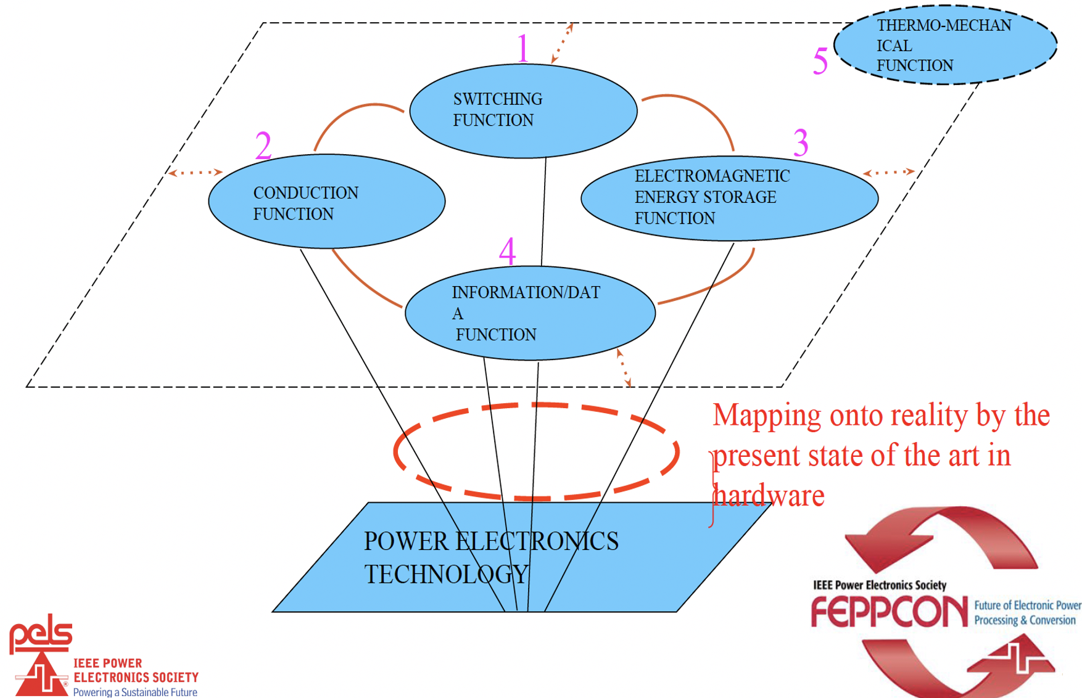
Power Electronics In terms of Fundamental Functions

Slide 14
Power Electronics as an Enabler Technology
Power electronic systems are everywhere
Projected that by 2030, 80% of electricity could flow through power electronics at generation, storage, transmission, distribution, and end use
Figure Source: Power Electronics for Renewable and Distributed Energy Systems, Eds. S. Chakraborty, M.G. Simoes, W. Kramer; Springer 2013 (Chapter 2 – Fundamentals of Power Electronics)

Slide 15
Historical Perspective
Traditional power conversion
Linear Electronics- Transistors in active mode (linear region)
Transistor acts as variable resistor for control
Terrible efficiency (50% not uncommon)
Low conversion range (greater Vd smaller efficiency)
Low power applications
Motor-Generator Sets (AC-DC or AC-AC)
Can still be found in use
Large physical size
Maintenance intensive
Low efficiency
Poor Load regulation

Slide 16
Simplified Block Diagram of a Power Electronics System

Slide 17
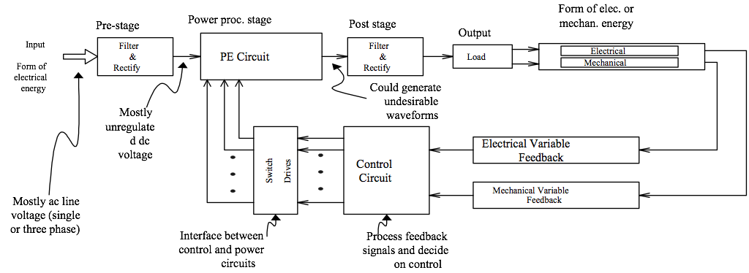
Detailed Block Diagram of Power Electronics System

Slide 18
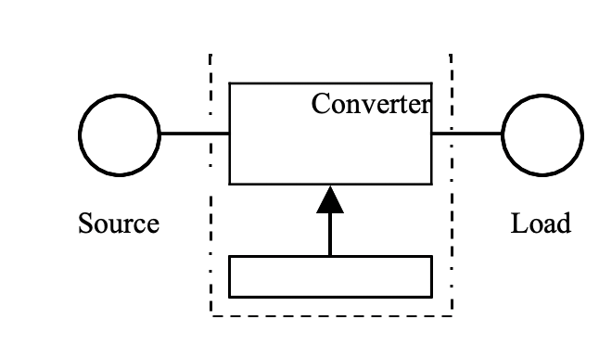
Power Electronics as an Enabler Technology
Power Electronics is the Interface for technology
Controller

Slide 19
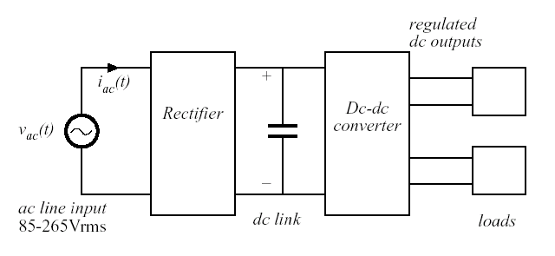
Typical PC Power Supply

Slide 20
Multidisciplinary Nature of Power Electronics
Power electronics is comprised of:
Semiconductor Devices
Analog Circuits
Control Design
Magnetics
Electric Machines
Power Systems Engineering
Circuit Simulation

Slide 21
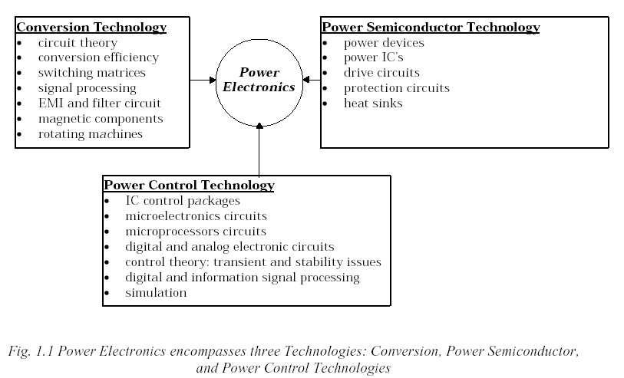
Power Electronics Focus Areas

Slide 22
Power Conversion Dictates Change in Current and/or Voltage:
Voltage/Current form ac or dc
Voltage/Current level (magnitude)
Voltage frequency (line or otherwise)
Voltage/Current waveshape (sinusoidal or nonsinusoidal such as square, triangle, sawtooth, etc.)
Voltage phase(single or three-phase).

Slide 23
Conversion Type Description
Power Electronic systems perform one or more of the following conversion functions:
a)Rectification (ac-to-dc)
b) Inversion (dc-to-ac)
c) Cycloconversion
(ac-to-ac different frequencies) or
(ac-to-ac same frequency)
d) Conversion (dc-to-dc)

Slide 24
Over All Block Diagram
Definition of Power Electronics
Industry Overview and Market Share Analysis
Multidisciplinary Nature of the Field
Block Diagrams of Power Electronic Systems
The Need for Power Electronics
Types of Power Conversion
Need for Control
Figures of Merit for Power Electronic Converters
Future Trends

Slide 25
Typical PC Power Supply

Slide 26
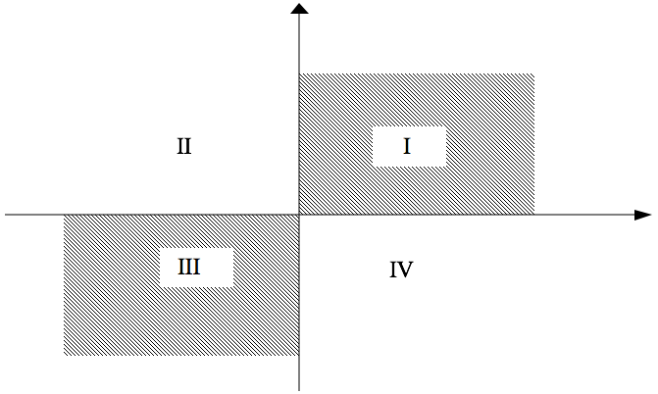
Power Flow Unidirectional: input-to-output

Slide 27
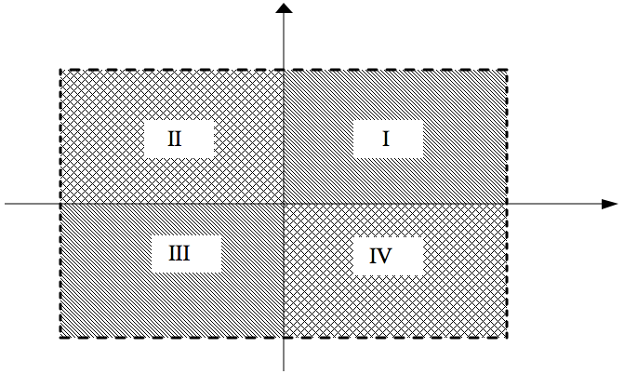
Power Flow – Bi-directional

Slide 28
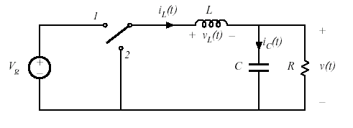
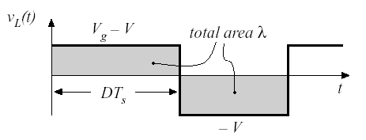
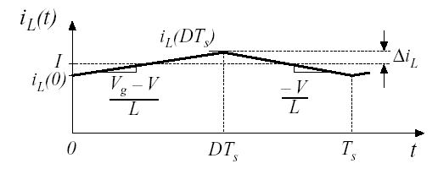
Course Content Overview: Non-isolated DC-DC Converters Continuous Conduction Mode (CCM)
Principles of Steady State Converter Analysis
Definition of Steady State
Inductor Volt-Second Balance
Capacitor Charge Balance
Small Ripple Approximation
Average Values in Steady State
Use of Power Conservation Principle in Converter Analysis
Application of Analysis Techniques to Classic Converter Topologies
Buck, Boost, and Buck Boost
Analysis of Fourth Order Converters

Slide 29
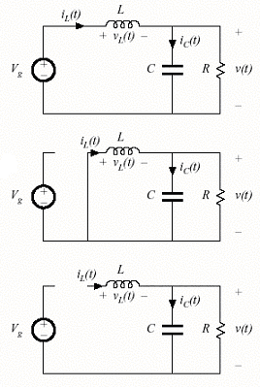
Course Content Overview: Non-isolated DC-DC Converters Discontinuous Conduction Mode (DCM)
Description of DCM
At what operating condition does DCM occur?
Application of Steady State Analysis Principles to Converters in DCM
Buck
Boost
Buck-Boost
Cuk
Properties of Converters in DCM

Slide 30
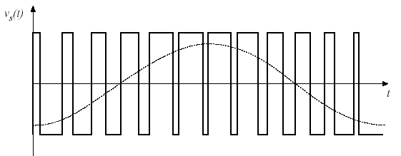
Classic Inverter Scheme

Slide 31
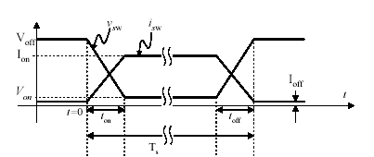
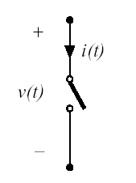
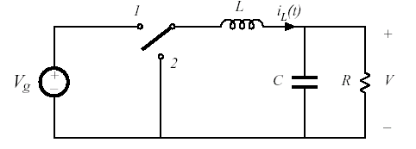
Course Content Overview: Switching Concepts
The Need for Switching in Power Electronic Circuits
Efficiency Example Comparing Power Supply Designs
Ideal Switch Discussion
Ideal Switch Types
Practical Switch Characteristics

Slide 32
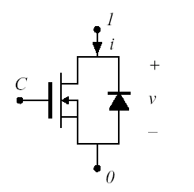
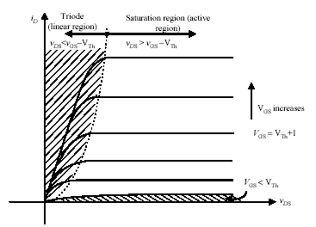
Course Content Overview: Semiconductor Device Overview
Discussion of Available Power Semiconductor Devices
Power Diode
BJT
Power MOSFET
IGBT
SCR
GTO
TRIAC
Focus on Device i-v Characteristics
Comparison of Switching Devices
Survey of Commercially Available Devices
Future Trends

Slide 33
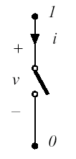
Ideal Switch Characteristics
Zero on-state resistance
No forward voltage drop when on
Infinite off-state resistance
No leakage current when off
Current limitless when on-either direction
Conduction current a function of external components only
No limit on amount of voltage across switch when off
Blocking voltage infinite (forward or reverse)
Switch can transition from on-off or off-on instantaneously when commanded to

Slide 34
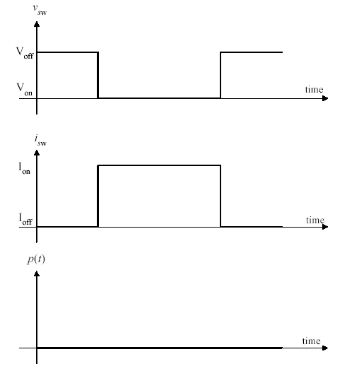
Ideal Switch i-v Characteristics (Transition)
Previous desirable conditions mean, no power loss by any mechanism (conduction, leakage, or switching)
Switch transition-No overlap
Von=0V, Ioff=0A

Slide 35
Practical Switch
Although Semiconductor Industry has produced amazing devices, the “real world” switch is not ideal
Limited conduction current when the switch on, limited blocking voltage when the switch is in the off
Both are directional in practical switch
Limited switching speed that caused by the finite turn-on and turn-off times
Real world (Semiconductor) switches are charge driven
Finite, nonzero on-state and off-state resistances
There is a I^2R loss when on and some leakage when off (very small)

Slide 36
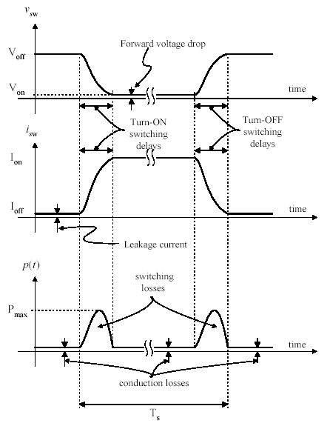
Practical Switch i-v Characteristics (Transition)
This is root cause of the single major source of loss in PE converters
Conduction- When switch is in on state (off state too, to a lesser degree)
Switching Losses- When switch is transitioning from on to off or off to on

Slide 37
Theoretical Efficiency Example
We’ll do an example to underscore why switching is the most energy efficient choice
Consider the design of a DC-DC converter as shown above
Design requires 24V step down to 12V across a 6 Ohm resistive load
Let’s investigate, some possible options

Slide 38
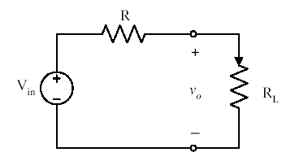
Theoretical Efficiency Example Voltage Divider
A simple voltage divider can do job
R must be set to 6 Ω
Load cannot change-R fixed so no opportunity for control
Losses are high η=50%

Slide 39
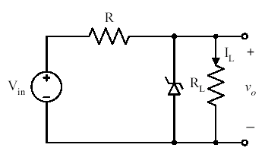
Theoretical Efficiency Example Zener Regulator
Need some control (regulation)
A Zener Regulator will allow for load variation
Assume Vz=12V, Iz@12V=.2A , Rdrop=5.5Ω
Pin=Pout+Prdrop+Pzener=24W+26.2W+2.4W=52.6W
η=46%

Slide 40
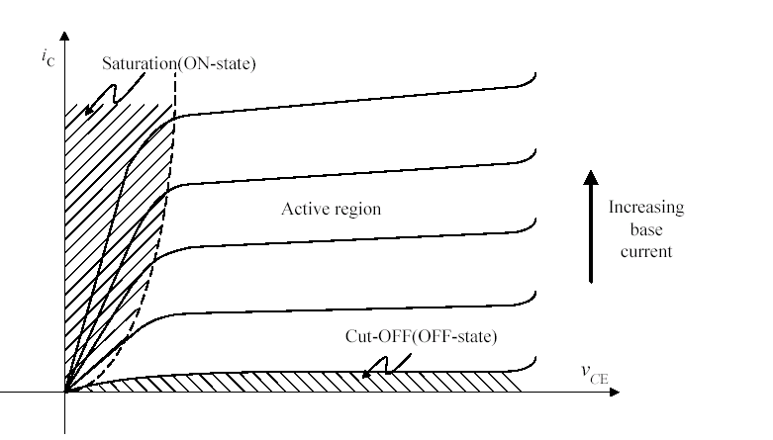
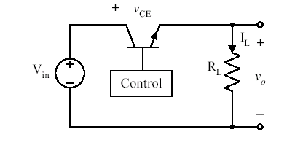
Theoretical Efficiency Example Linear Regulator
Drop resistor inefficient means
Direct source connection is preferable
Try linear regulator
(Similar to implementation 7805, LM317 etc.
Assume Vce=12V
Pin=Pout+Pnpnloss=24W+24W=50W
η=50%

Slide 41
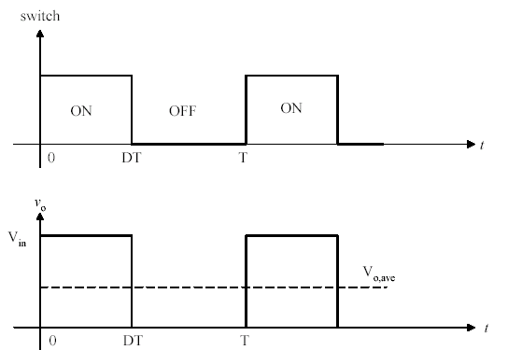
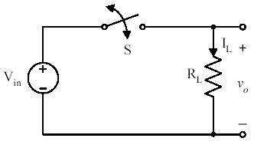
Theoretical Efficiency Example Duty Ratio Controlled Switch
Instead of operating transistor in active mode try using as switch
Low Pass filter required to extract DC
η=100%

Slide 42
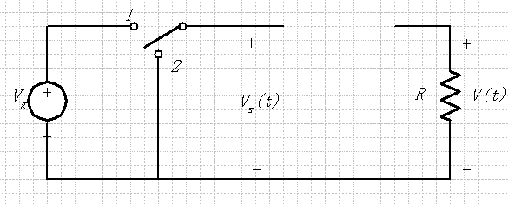
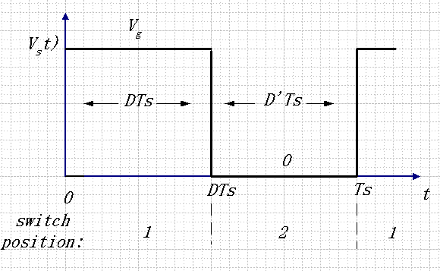
Circuit Implementation Duty Ratio Controlled Switch-SPDT

Slide 43
DC Component

Slide 44
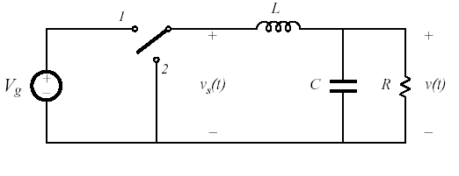
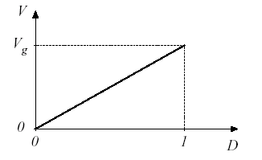
Step Down Converter-Buck
Low Pass extracts DC
Position 2 allows for current “freewheeling”
Vo can be controlled by adjusting D (Switching Period/Frequency Fixed), Vo/Vin = D
Ideally, is no switch/filter loss, η=100%
We assume an ideal switch here

Slide 45
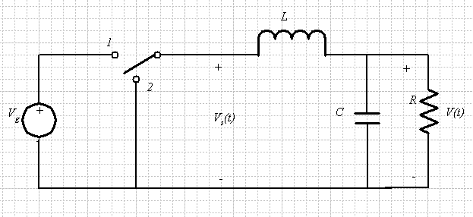
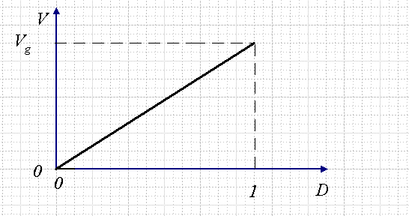
Buck Converter
Switch Position 2 for allow for uninterrupted inductor current flow
LPF for smoothing of pulse for constant DC output
Capacitor hold a DC value for the load when switch in position 1 (Inductor current charge)
2nd Order-1 L, 1 C

Slide 46
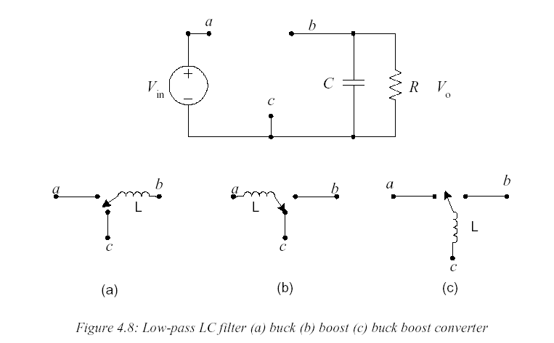
Derivation of Classic Converter Topologies (2nd Order)

Slide 47
Classic Converter Topologies

Slide 48
Analysis of Classic Converter Topologies
Analysis will assume lossless components
Exact steady state analysis would involve solution of nonlinear, 2nd Order system, we will simplify to a 1st Order System with:
Since RC>>Ts, output voltage nearly constant over switching period
Since ripple is assumed small, we assume Vo a constant during analysis (output cap not considered)
We assume analysis of converter takes place at after it has reached steady state
Since steady state, average inductor voltage equals zero over switching interval (volt-sec balance)
Since steady state, average capacitor current over one switching interval equals zero (charge balance)

Slide 49
Analysis of Classic Converter Topologies
The preceding concepts can be expressed in terms of mathematical relations.
These are tools for analysis:
P_{out}=P_{in} (Power Conservation)
i_{L}(t_{o})=i_{L}(t_{o}+T_{s}) (Steady State)
I_{cavg}=0 (Charge Balance)
V_{Lavg}=0 (volt-sec balance)

Slide 50
Converter Analysis Principle Small Ripple Approximation

Slide 51
Converter Analysis Principle Inductor Volt-Second Balance
Inductor defining relation :
Integrate over one complete switching period :
In periodic steady state, the net change in inductor current is zero :
Hence, the total area (or volt-seconds) under the inductor voltage
waveform is zero whenever the converter operates in steady state.
An equivalent form:
The average inductor voltage is zero in steady state

Slide 52
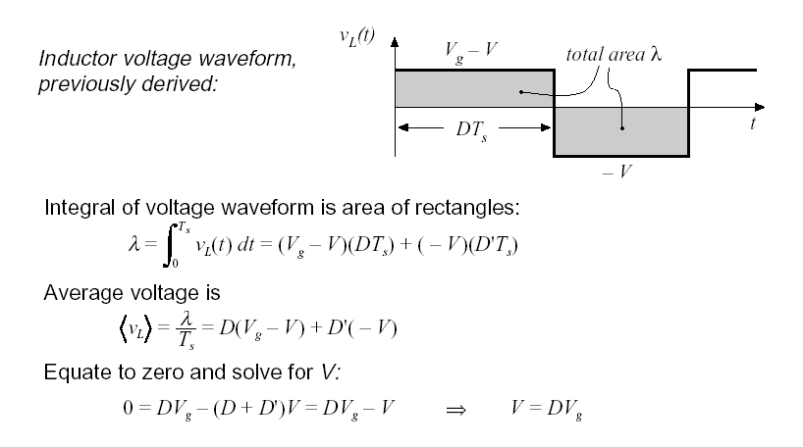
Converter Analysis Principle Volt-Second Balance gives Voltage Gain, M
Example is for Buck

Slide 53
Converter Analysis Principle Capacitor Charge Balance
Capacitor defining relation:
Integrate over one complete switching period
In periodic steady state, the net change in capacitor voltage is zero:
Hence, the area (or charge) under the capacitor current
waveform is zero whenever the converter operates in steady state.
The average capacitor current is then zero.

